Slide 1
Community for Emerging and Zoonotic Diseases
Identifying emerging risks through collective intelligence
CEZD – CAHSS Companion Animal Network Update
12 January 2024
www.cezd.ca

Slide 2
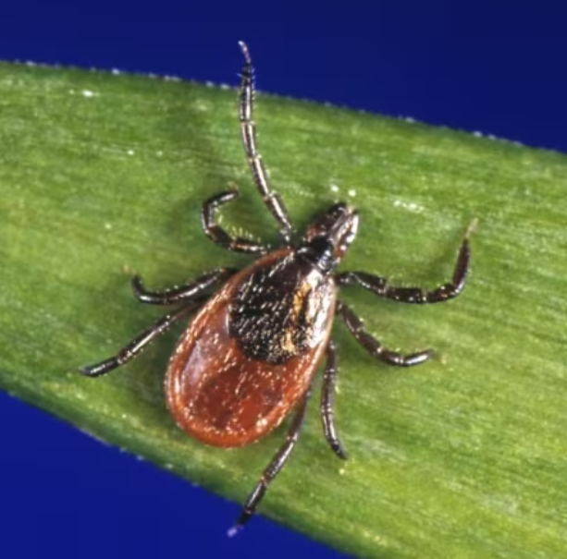
Blacklegged tick positive for B. burgdorferi in NWT
First finding of a blacklegged tick positive for Borrellia burgdorferi in the NWT
Fort Simpson Area
Adult female tick found on a dog
Dog had recently arrived from a southern province endemic for lyme disease
Unknown whether the tick and/or the bacteria was locally acquired
Notes:
Borrelia burgdorferi in blacklegged tick in Northwest Territories
Pathogen: bacteria; Transmission: vector - tick; Species affected in event: canine
○i The Northwest Territories have reported their first finding of a blacklegged tick positive for Borrelia burgdorferi. The adult female black-legged tick was found on a pet dog in the Fort Simpson area, the dog had recently arrived from an endemic southern province. It is unclear whether the tick and/or the bacteria was locally acquired.

Slide 3
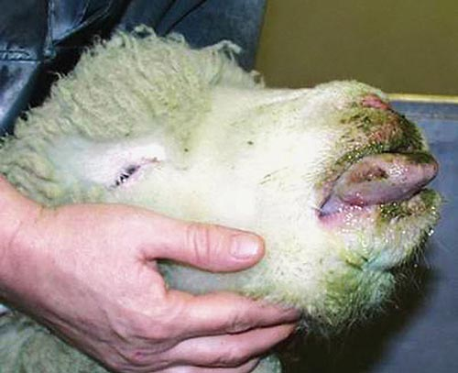
Bluetongue found in Dutch dog - WUR
3.5 year old dog
Clinical signs
  Shortness of breath
  Pulmonary edema
  Severe emaciation and lethargy
Dutch dairy farm with cattle and sheep
Large scale BTV-3 outbreak occurring in the Netherlands
Dog diagnosed before cattle and sheep diagnosed positive
https://microbewiki.kenyon.edu/index.php/File:Bluetongue.jpg

Slide 4
Bluetongue found in Dutch dog - WUR
Disease usually impacts sheep and cattle, disease in sheep is generally more severe
Experimental infection results in subclinical seroconversion
Clinical cases have been in pregnant dogs
Transmission Routes
  Transmitted by consumption of raw meat or afterbirth
  Vector borne transmission via midges
  Contaminated modified live distemper vaccines
  Iatrogenic transmission with contaminated semen extender (suspected)
Question:
Does anyone know of research in North America on canids and BTV?
Bluetongue in Domestic Dogs 2010
The clinical presentation and management of a naturally occurring Bluetongue virus infection in a pregnant Rottweiler dog (scielo.org.za)
Notes:
https://www.scielo.org.za/scielo.php?script=sci_arttext&pid=S1019-91282022000200018

Slide 5

Worms and Germs: Canine Infectious Respiratory Disease Update
Over the fall months an increased frequency of canine respiratory disease complex was seen across the US and parts of Canada
Seems to be waning
No new pathogens detected
Trend of slowly increasing cases of CIRDC over time, the higher baseline made cases more noticeable
“the usual suspects, doing their usual thing, just at higher rates.”
Question: are there any lessons learned from this event?

Slide 6
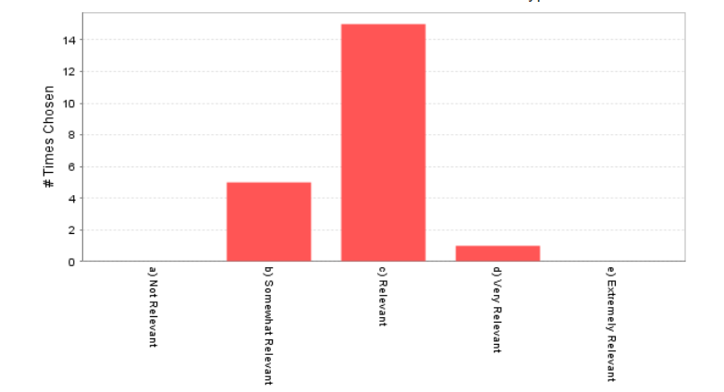
Emergence and spread of feline infection peritonitis due to a highly pathogenic canine/feline recombinant coronavirus | bioRxiv
Preprint describing the recombination between Feline Coronavirus and a hypervirulent Pantropic Canine Coronavirus
Authors suggest that it may be responsible for the outbreak of Feline Infectious Peritonitis recently described in Cypress
Spike of pCCoV replacing spike gene of FCoV1
Recombinations have been previously described and are thought not to be uncommon
Typically no major consequences of the recombinations

Slide 7




Severe inflammatory reaction around infected cells
Dry and Wet forms
FeCOV
Fecal-oral
Transmission
90% no or minimal clinical signs
Full Recovery
10% develop FIP
Fatal without treatment
Poorly transmissible cat to cat
https://urbananimalveterinary.com/event/feline-infectious-peritonitis-fip-what-every-cat-owner-should-know/
Notes:
FIP does not easily spread cat-to-cat
FeCoV spreads between cats
Cats infected with Feline Enteric Coronavirus often have no clinical signs (Diarrhea and upper respiratory signs)
Viral mutations occur 10% of the time that leads to a change in the virus and results in development of FIP

Slide 8
Emergence and spread of feline infection peritonitis due to a highly pathogenic canine/feline recombinant coronavirus | bioRxiv
Virus shows properties distinct from previous FIP detections
Authors suggest that direct transmission is possible with this strain
No biotype change required as normally occurs in FIP
Disease onset is rapid
Higher percentage of cases are neurological (28%) vs normal (14%)
High sequence identity across Cyprus as well as with UK imported case
FCoV‐23 causing FIP in a cat imported to the UK from Cyprus - Warr - 2023 - Veterinary Record - Wiley Online Library

Slide 9
FCoV‐23 causing FIP in a cat imported to the UK from Cyprus - Warr - 2023 - Veterinary Record - Wiley Online Library
9 month old female cat
Imported from Cyprus to UK August 2023
Developed fever and ascites a couple of weeks post import
Viral sequencing of Peritoneal fluid showed a recombinant feline coronavirus (FCoV-23)
Evidence shows that cat to cat transmission may be possible
Cat treated with GS-441524 and isolated indoors
Duration of potential viral shedding is unknown
https://urbananimalveterinary.com/event/feline-infectious-peritonitis-fip-what-every-cat-owner-should-know/
Notes:
GS-441524 is an analog nucleotide inhibitor against feline infectious peritonitis virus (FIPV). EC50 is 0.78 uM. GS-441524 is also a metabolite and intermediate of Remdesivir.

Slide 10
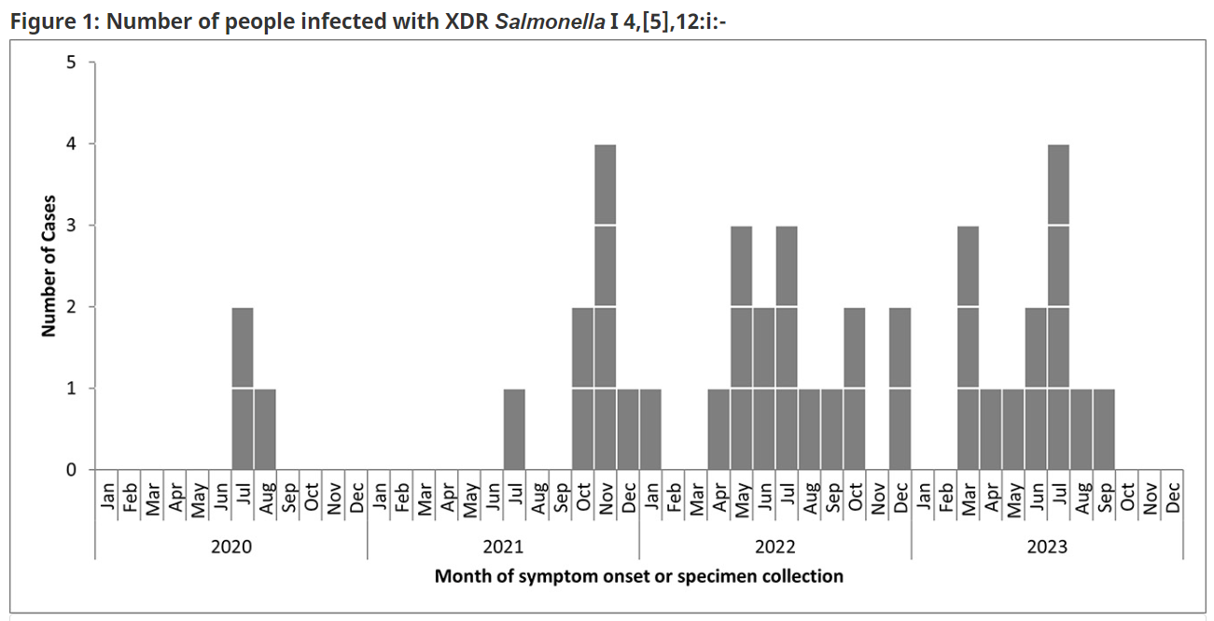
Public Health Notice: Outbreak of extensively drug-resistant Salmonella infections linked to raw pet food and contact with cattle - Canada.ca
Ongoing outbreak of infection in people with multidrug resistant salmonella in 6 Provinces
Cases go back to 2020
Linked to:
  Raw pet food diets
  Contact with dogs
  Contact with cattle
Notes:
Does anyone in the network have an update on the investigation? The website was last updated at the end of November so no current information on the investigation has been found.

Slide 11
Leishmaniasis in Germany
April to August 2023
3 unrelated cases of imported cutaneous leishmaniasis (CL) in patients exposed in southeastern Mexico
Local epidemiological data in Mexico indicates very significant increases in CL
Cases of CL in Mexico
  2021 – 136 cases
  2022 – 954 cases
  2023 – 1128 cases
Cases predominantly in men
Increases thought to be due to environmental impacts of the “Tren Maya” project.
Promed Post - ProMED-mail (promedmail.org)
Notes:
Leishmaniasis in Germany, imported from Mexico
Pathogen: parasite; Transmission: vector - sand-fly; Species affected in event: human
○i From April to August 2023, Germany diagnosed three unrelated cases of imported cutaneous leishmaniasis (CL) in patients exposed in southeastern Mexico. This is a significant increase, as prior to these findings only three cases of imported CL have been observed in Germany since 2000. This increase is likely linked to the increase in cases in Mexico due to environmental changes in the region and the construction/de forestation associated with the “Tren Maya” project. In 2022, Mexico reported its highest rates of CL since 2005. As of 2023, the accumulated number of cases for the year in Mexico stands at 1128 (with the majority, 85%, of cases reported in men)
Tren Maya project is a massive development project in Quintana Roo

Slide 12

The Train Maya: Mexico's ambitious new tourism megaproject (bbc.com)
Question: Is it reasonable to expect more cases of Leishmaniasis in rescue dogs from Mexico?
Notes:
When fully open to the public, the $28.5bn train line will span five states, 40 municipalities and 181 towns in south-eastern Mexico.

Slide 13
Scientific Publications of Interest
https://go.ucalgary.ca/rs/161-OLN-990/images/Muskrats_Echinococcus_multilocularis.pdf
Full article: Highly pathogenic avian influenza H5N1 virus infection of companion animals (tandfonline.com)
Full article: Characterization of Highly Pathogenic Avian Influenza A (H5N1) Viruses isolated from Cats in South Korea, 2023 (tandfonline.com)
New Geographic Records for Trichinella nativa and Echinococcus canadensis in Coyotes (Canis latrans) from Insular Newfoundland, Canada - PubMed (nih.gov)
Data on SARS-CoV-2 events in animals: Mind the gap! – ScienceDirect
:: JVS :: Journal of Veterinary Science (vetsci.org)
Backyard zoonoses: The roles of companion animals and peri-domestic wildlife | Science Translational Medicine
Serological exposure to influenza A in cats from an area with wild birds positive for avian influenza - Villanueva‐Saz - Zoonoses and Public Health - Wiley Online Library
American Journal of Case Reports | Look What the Cat Dragged in! Recurrent Clostridioides difficile from a Household Cat - Article abstract #940923 (amjcaserep.com)
Neurologic Effects of SARS-CoV-2 Transmitted among Dogs - Volume 29, Number 11—November 2023 - Emerging Infectious Diseases journal - CDC

