Slide 1
Community for Emerging and Zoonotic Diseases
Identifying emerging risks through collective intelligence
CEZD – CAHSS Companion Animal Network Update
07 January 2025
www.cezd.ca
Notes:
CEZD ~3 month environmental scanning update

Slide 2
HPAI H5N1 and Cats - USA
Worms & Germs Blog | Resources for Animals, Humans & Infectious Disease | University of Guelph
L.A. County Cat Cases
1st household
  8 cats fed recalled raw milk
  7 cats sick, 5 of the sick cats died
  Virus isolated exactly same as the virus from the raw milk
2nd household
  5 cats sick after eating two types of raw pet food (poultry and beef)
  2 cats euthanized respiratory distress
  2 other cats ill and 1 tested positive for H5 Influenza
USDA has confirmed a total of 62 HPAI detections among domestic cats
  Likely a gross underestimate of the number of cases
Los Angeles Public Health has issued warnings about HPAI and cats, related to raw milk consumption Dec 12, 2024, Dec 19, 2024, and raw meat consumption Dec 31, 2024
L.A. County Animal Health Alert Network Dec 20, 2024, provide more information on affected cats
FDA Outlines Ways to Reduce Risk of HPAI in Cats | FDA (Dec 18, 2024)

Slide 3
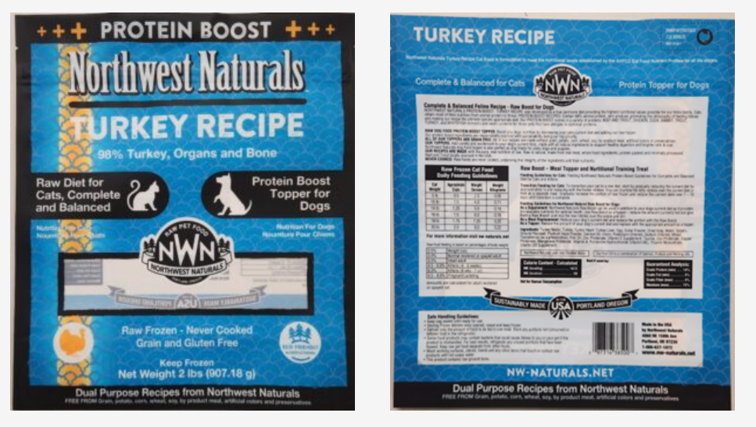
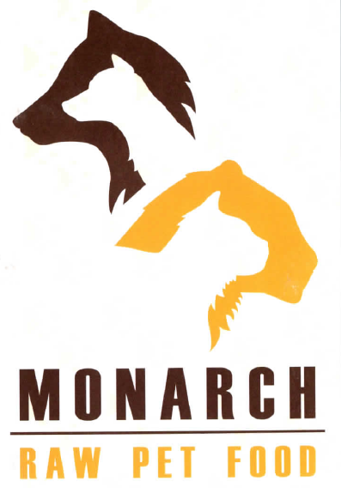
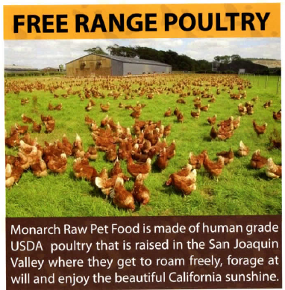
HPAI H5N1 and Cats - USA
Raw pet food recall on Dec 24,2024
  Morasch Meat Recalls Northwest Naturals Brand 2 Lb Turkey Recipe Raw & Frozen Pet Food—Tested Positive for H5N1 Strain of HPAI Virus | Oregon Veterinary Medical Association
Sold by distributors in 12 states plus British Columbia
Oregon Department of Agriculture confirmed H5N1 in a domestic cat that died
  Indoor cat
  Had been fed a raw diet (B3.13)
California household 5 cats consumed Monarch raw pet food, one confirmed positive for H5

Slide 4
Infectivity and Persistence of Influenza A Virus in Raw Milk | Environmental Science & Technology Letters
Used Influenza A H1N1 to assess the persistence of IAV in raw milk stored at 4C
Measured infectivity and RNA persistence
Raw milk collected on July 8, 2024, into sterile containers and stored at 4 °C
Milk was spiked with 10⁵−10⁶ TCID50/mL of H1N1
Stored at 4C for 57 days
Days 0, 1, 3 and 5 – withdrew 60 microlitres for tissue culture
Days 0, 1, 3, 5, 7, 21, 28, 35, and 57, withdrew 60 microliters for RNA extraction
Unspiked milk + pasteurized milk tested via TC and RNA extraction as control
2.3 days to reach 99% reduction in infectivity, viability for at least 5 days
Some viable virus present at 5 days
RNA still detectable after 57 days
Infectious dose unknown

Slide 5

Bovine H5N1 influenza virus infection is transmitted by milk causing mortality in suckling neonates | bioRxiv
Intramammary inoculation of ferrets at 2.5 weeks postpartum
10⁵ EID⁵⁰ in 3 glands
100% mortality of kits by 4 DPI and dams by 6 DPI
  Either by death or reaching humane endpoint of 20% weight loss
No virus present prior to inoculation
Ferret mammary tissue has both α2,3 and α2,6 receptors (as does human mammary tissue)
Viral RNA titers increased in milk over time and remained high
Kits developed respiratory infections from ingested milk
Passed respiratory infections to the dam
Notes:
Ferrets definitely susceptible to H5N1 B3.13 – demonstrated in previous laboratory challenges. https://www.nature.com/articles/s41586-024-08246-7.epdf?sharing_token=OaVzOtNSisb-HpBAKT_549RgN0jAjWel9jnR3ZoTv0N32Hozas4H6-hck-j6Xf6ro1eBPZ5E5rtwEAR563VCGP6NAqdb7qsB1uKeCSMla1iDUme4vk-6D9dcPWogTZXbSP6s44yF47V0tgvWfdeptfx4s-_wJdxwJtg2U1BHyKA%3D

Slide 6
Distribution of lesions and detection of influenza A(H5N1) virus, clade 2.3.4.4b, in ante- and postmortem samples from naturally infected domestic cats on U.S. dairy farms 2024
4 deceased (TX, NM) and 2 living (MN) cats from 3 dairy farms in 3 states
TX and NM cats – Postmortem sampling
  between 6 and 24 months old
  part of larger cat colonies
  Foraged on mice, rats, birds
  Fed pasteurized and unpasteurized milk and colostrum from sick cows
  3 died from disease, 1 shot
MN cats – Ante Mortem sampling
  5y and 13 years old
  Indoor cats owned by dairy workers
  13-year-old cat died 6 days post sample collection
  5-year-old presumably still alive

Slide 7
Distribution of lesions and detection of influenza A(H5N1) virus, clade 2.3.4.4b, in ante- and postmortem samples from naturally infected domestic cats on U.S. dairy farms 2024
Virus detected by IHC in all listed tissues
PCR positive:
  Brain (Ct 9.9 – 25)
  Lung (Ct 17.4 – 32.7)
  Oropharyngeal swab (Ct 28.3 – 30.5)
  Urine (Ct 30.3 – 34.4)
  Nasal swab (Ct 33.5 – 34.1)
  Fecal swabs negative
Deceased cats all showed:
  Nonsuppurative and necrotizing encephalitis
  Subtle interstitial pneumonia
Other lesions
  Myocarditis (3/4)
  Chrioretinitis (2/4)
  Sialadenitis (1/2)
Notes:
In March 2024, highly pathogenic avian influenza A(H5N1) virus, clade 2.3.4.4b, was detected in dairy cows in the United States, and at the same time in resident cats on affected farms. To help guide sample collection and diagnosis in cats, here we report the distribution of lesions and detection of H5N1 clade 2.3.4.4b influenza A virus (IAV) infection by PCR, immunohistochemistry (IHC), and serology in samples from 4 deceased and 2 living cats from 3 separate affected dairy farms. Although gross lesions were not diagnostic, histologically, all 4 deceased cats had nonsuppurative and necrotizing encephalitis and subtle interstitial pneumonia, and some also had significant myocarditis (3 of 4), chorioretinitis (2 of 4), and sialadenitis (1 of 2). The virus was detected by IHC in the aforementioned tissues, and by PCR in each brain (Ct = 9.9–25.1), lung (17.4–32.7), oropharyngeal swab (28.3–30.5), urine (30.3–34.4), and nasal swab (33.5–34.1) collected postmortem; fecal swabs were PCR-negative.

Slide 8
Distribution of lesions and detection of influenza A(H5N1) virus, clade 2.3.4.4b, in ante- and postmortem samples from naturally infected domestic cats on U.S. dairy farms 2024
Antemortem samples
  Oropharyngeal swabs (Ct 34.1 – 36.1)
  Whole blood (Ct 30.8 – 36.6)
  Serum (31.7)
  Seroconversion in one cat
Authors say these Ct values in antemortem samples are adequate for diagnosis ?
Would you consider these positives?
How are private vets testing for HPAI in companion animals?
Notes:
In the antemortem samples, the virus was detected by PCR in the oropharyngeal swabs (34.1–36.1), whole-blood samples (30.8–36.6), and one serum sample (31.7). Seroconversion was detected in one cat. Our results support histologic evaluation of brain, lung, eyes, and heart, and PCR testing of brain and lung for postmortem diagnosis, and show that oropharyngeal swabs, urine, serum, and whole blood are suitable samples for antemortem detection of IAV infection in clinically affected cats.

Slide 9
Full article: Marked neurotropism and potential adaptation of H5N1 clade 2.3.4.4.b virus in naturally infected domestic cats
Tissues from two cats from South Dakota dead with H5N1 B3.13 (lungs also found with Streptococcus canis)
  6 months + 18 months of age
  Uncertain if cattle or birds are source, plausible cattle-bird-cat transmission
Fixed Control tissues from healthy cats (Zyagen)
Lectin Histochemistry showed both α2,3 (avian type) and α2,6 (human type) receptors were found in the cats' tissues
  Brain, lung, gastrointestinal tract
Concern is that cats can function as ‘mixing vessels’ for influenza
Eurosurveillance | Highly pathogenic avian influenza (HPAI) H5 virus exposure in domestic cats and rural stray cats, the Netherlands, October 2020 to June 2023
Notes:
NL study
What did you want to address in this study and why?
Highly pathogenic avian influenza (HPAI) viruses have spread among poultry and wild birds. Avian and human influenza viruses can infect cats, and cats may function as a source of novel influenza A viruses to humans. We analysed serum samples, throat and lung samples from domestic and stray cats to investigate exposure to influenza viruses and associated factors.
What have we learnt from this study?
Of the 701 stray cats sampled, 83 had been exposed to HPAI virus, whereas only four of the 871 domestic cats. Exposure was more common in older cats and cats living in nature reserves. Some stray cats had been exposed to both avian and human influenza viruses. In contrast, 40 domestic cats were exposed to human influenza viruses.
What are the implications of your findings for public health?
We showed that cats in the Netherlands were exposed to human and/or avian influenza viruses. We recommend close monitoring of infections with influenza viruses in cats and protective measures when handling suspected cats. Further studies are needed to understand how cats become infected and whether cats can transmit highly pathogenic avian influenza virus to other animals or humans.

Slide 10

Statement from the Chief Medical Officer of Health | Ontario Newsroom - Human Rabies case in Ontario​
Brant County Health Unit received laboratory confirmation of a human case of rabies in a resident of Brantford-Brant. The illness is suspected to have been acquired from direct contact with a bat in Ontario.
Bats and Rabies in Canada, CCDR 50(12) - Canada.ca​ - Infographic from Public Health Agency
Rabies in Cats; An Emerging Public Health Issue

Slide 11
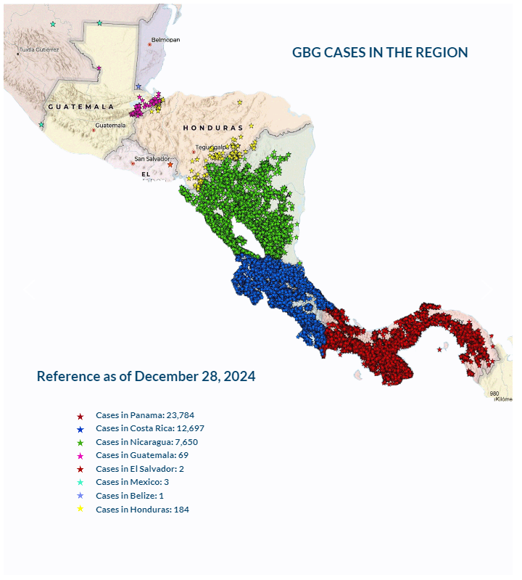
New World Screwworm in Central America
August 2023 Cases occurred in Panama; animal movements were halted. Subsequent/Concurrent with release of sterile flies.
Slow and steady march northwards
As of December 28, 2024, according to COPEG:
  Panama – 23,784 cases
  Costa Rica – 12,697 cases
  Nicaragua – 7,650 cases
  Honduras – 184
  Guatemala – 69
  El Salvador - 2
  Mexico – 3
  Belize - 1
COPEG

Slide 12
Scientific Findings
Public Health Notice: Outbreak of Salmonella Muenchen infections linked to geckos - Canada.ca
Emerging Echinococcus tapeworms: fecal PCR detection of Echinococcus multilocularis in 26 dogs from the United States and Canada (2022-2024) – PubMed
Brucella microti and Rodent-Borne Brucellosis: A Neglected Public Health Threat – PubMed
Risk factors for canine infectious respiratory disease complex and the pathogens associated with the disease – PubMed
Meta-Analysis of Seroprevalence and Prevalence of Influenza A Viruses (Subtypes H3N2, H3N8, and H1N1) in Dogs
Fatal case of imported visceral leishmaniasis in a dog caused by Leishmania infantum in French Guiana – ScienceDirect

