Slide 1
Community for Emerging and Zoonotic Diseases
Identifying emerging risks through collective intelligence
CEZD – CAHSS Companion Animal Network Update
17 April 2023
www.cezd.ca

Slide 2
Fort Good Hope dog tests positive for rabies (cabinradio.ca)
February 24, 2023
Fort Good Hope dog that had contact with a wild fox has tested positive for rabies
Rabies cases
Rabies cases | BC | AB | SK | MB | ON | QC | NB | NS | PE | NL | NU | NT | YT | Total
Arctic fox | 0 | 0 | 0 | 0 | 0 | 0 | 0 | 0 | 0 | 0 | 2 | 0 | 0 | 2
Dog | 0 | 0 | 0 | 0 | 0 | 0 | 0 | 0 | 0 | 0 | 2 | 1 | 0 | 2
Raccoon | 0 | 0 | 0 | 0 | 0 | 0 | 1 | 0 | 0 | 0 | 0 | 0 | 0 | 1
Red fox | 0 | 0 | 0 | 0 | 0 | 0 | 0 | 0 | 0 | 0 | 0 | 2 | 0 | 2
Skunk | 0 | 0 | 0 | 3 | 1 | 0 | 0 | 0 | 0 | 0 | 0 | 0 | 0 | 4
Total | 0 | 0 | 0 | 3 | 1 | 0 | 1 | 0 | 0 | 0 | 3 | 3 | 0 | 11
Rabies cases in Canada 2023 - Canadian Food Inspection Agency

Slide 3
Domestic dog tests positive for avian influenza in Canada - Canada.ca
Late March/Early April
The domestic dog was found to have been infected with avian influenza after chewing on a wild goose, and died after developing clinical signs
Pet owners are advised to:
not feed pets (e.g., dogs or cats) any raw meat from game birds or poultry
not allow pets to consume or play with dead wild birds found outside
contact their veterinarian if they have questions about their pet's health

Slide 4
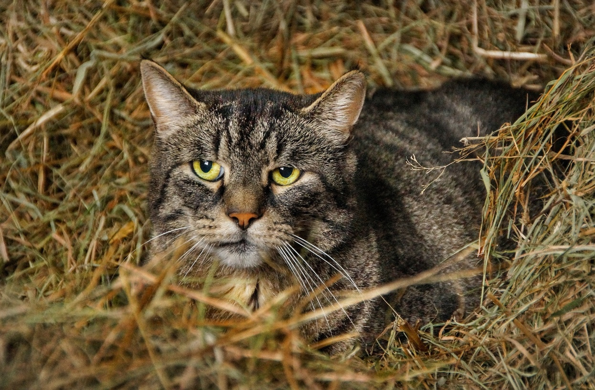
Avian Flu Diary: Nebraska Veterinary Diagnostic Center (NVDC) Report: 2 Domestic Cats Infected With HPAI H5N1 (afludiary.blogspot.com)
Wyoming:
  Barn cat likely infected by eating meat from infected waterfowl (dates not provided)
Nebraska
4 outdoor cats in 1 household
2/4 positive for HPAI H5N1
https://vbms.unl.edu/VDC/documents/HPAI_Cats.pdf

Slide 5
Nebraska Cat #1 – Acute Presentation
Clinical signs
  Anorexia
  Recumbency
  Pyrexia
  Anisocoria
  Seizures
  Tremors
  Nystagmus
  Loss of proprioception, and
  Hyperesthesia
Rapid decline and death
Gross Lesions: mild
pulmonary congestion and edema
mild pericardial effusion (transudate)
subtle darkening of areas of the cerebrocortical grey matter

Slide 6
Nebraska Cat #1 – Acute Presentation
Histopathology
necrotizing lesions
  kidney, liver, adrenal gland, and pancreas;
encephalitis
  patches of extensive neuronal degeneration and necrosis, particularly in the cerebral cortex;
Lung and epicardium
  edema, vessel congestion, and mild inflammation
Ct value of 12 for AI in brain tissue
H5N1 confirmed at National Vet Services Laboratory

Slide 7
Nebraska Cat #2 – Chronic presentation
Histopathology
  extensive loss of neurons
  with severe vacuolation and collapse of the supporting parenchyma,
  reactive changes including astrogliosis and lymphocytic perivascular cuffs.
Ct value on brain tissue for AI was 30
Tested positive for H5N1 at NVSL
Clinical Signs
  Somnolence
  Circling
  ~ 10 day duration
  Recumbent with continual tremors
  Euthanized
Gross Lesions
  Brain only
  excessive bloody cerebrospinal fluid from the subarachnoid space
  areas of malacia and hemorrhage in the cerebral cortex

Slide 8
Increased public health threat of avian-origin H3N2 influenza virus caused by its evolution in dogs | eLife (elifesciences.org)
H3N2 CIV first detected in Guangdong Province in China in 2006, most similar to AIVs from aquatic birds in Korea
Examined the biological characteristics of H3N2 CIV isolated worldwide over 10 years.
H3N2 avian influenza viruses transmitted to dogs around 2006 and have formed stable lineages
Changes seen make them more likely to be transmissible to humans
Human populations lack immunity to H3N2 CIVs
Canine Flu Vaccine Shortage Issues | Worms & Germs Blog (wormsandgermsblog.com)
Notes:
Become able to recognize the human-like SAα2,6-Gal receptor
HA functions at more acidic pH after 2019
Ability to replicate in human respiratory epithelial cells
Efficient airborne transmission in ferret model after 2016

Slide 9
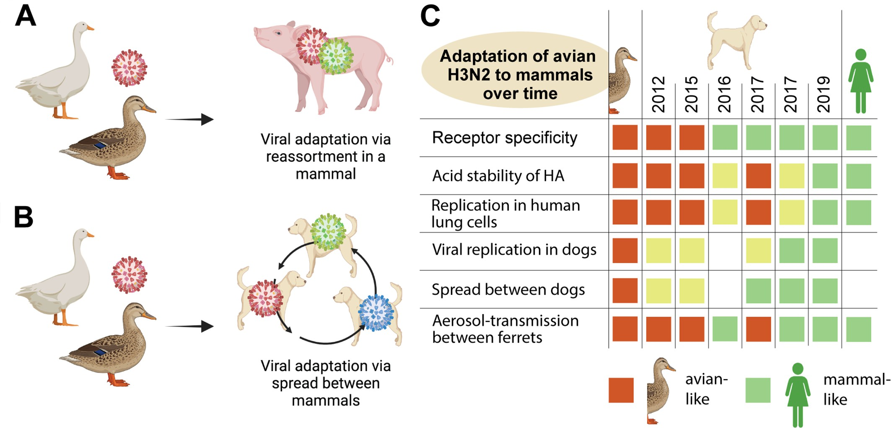
Viruses: How avian influenza viruses spill over to mammals | eLife (elifesciences.org)

Slide 10
Trends in Reported Babesiosis Cases — United States, 2011–2019 | MMWR (cdc.gov)
The CDC Morbidity and Mortality Weekly Report reported a significant increase in the incidence of babesiosis from 2011-2019 across the United States
Connecticut, Maine, Massachusetts, New Hampshire, New Jersey, New York, Rhode Island, and Vermont
Largest increases reported in Vermont (1,602%, from two to 34 cases), Maine (1,422%, from nine to 138), New Hampshire (372%, from 13 to 78), and Connecticut (338%, from 74 to 328)
Also seems to be spreading in Canada
VBD network call indicated an increasing number of detections of B. odocoilei
Notes:
From CBC article: In Canada, babesiosis became a provincially reportable disease in Manitoba in 2015.
Babesiosis has typically been spread in North America by two parasite species: Babesia microti (the tick-borne disease spreading in the U.S.) and Babesia duncani (an emerging tick-borne pathogen that is mainly on the Pacific coast).
Links to climate change
Babesia microti acquired in Canada Paper: Babesia microti acquired in Canada | CMAJ (2021):
The range of I. scapularis has expanded into Canada. Tick-borne diseases, including babesiosis, should be included in the differential diagnosis in Canada, and empiric treatment should be considered.

Slide 11
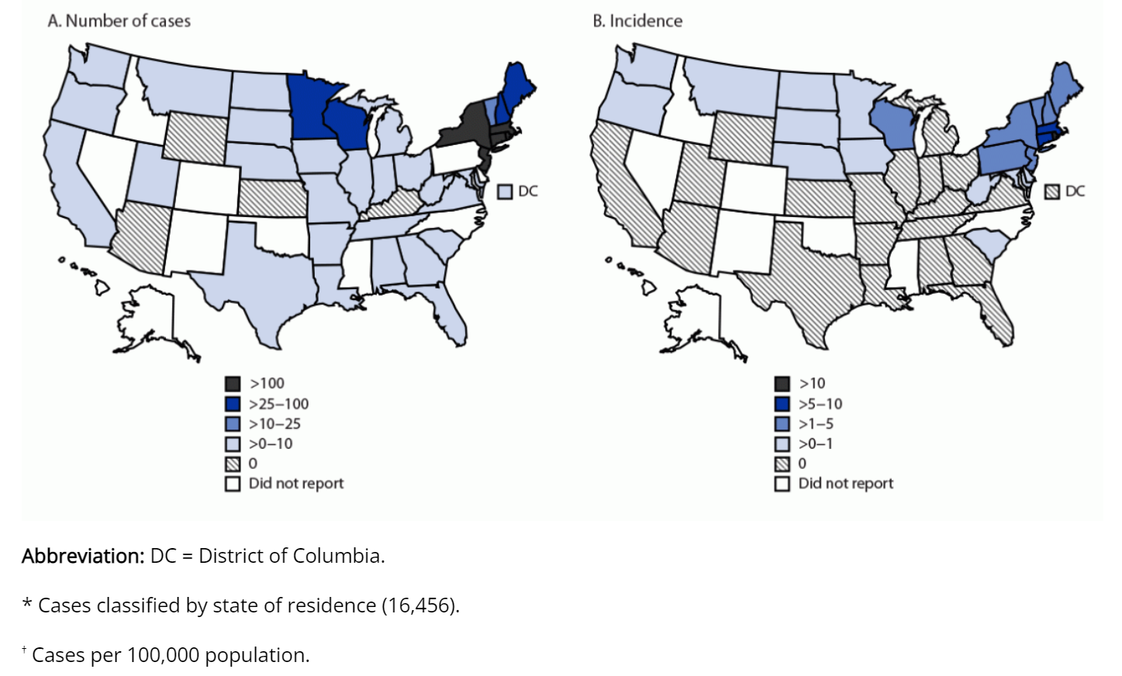

Slide 12
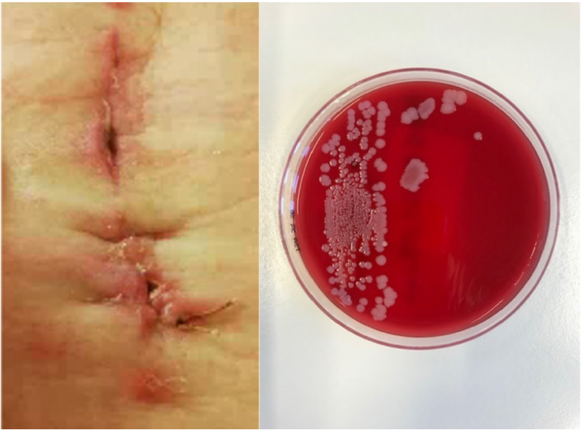
Evidence of cat-to-human transmission of Staphylococcus felis | Microbiology Society (microbiologyresearch.org)
First documented case of S. felis from cat to human
58 year old woman with a surgical site infection
S. felis cultured
3 cats in the household
  All positive for S. felis
  Each cat had a distinct genotype
Patient’s isolate clustered with isolates from one cat
Coagulase-negative Staphylococcus
Common commensal in cats; opportunistic pathogen
Notes:
Abstract
Introduction. Staphylococcus felis is a coagulase-negative staphylococcal species that is commonly isolated from healthy cats. Like other commensal staphylococci, S. felis can cause opportunistic infections, e.g. otitis externa, skin and urinary tract infections, in cats.
Gap Statement. Several studies have reported within-household transmission between humans and pets and human infections caused by coagulase-positive staphylococci. However, human infections with coagulase-negative staphylococci of zoonotic origin are relatively rare.
Methodology. Culture of a surgical site infection in a 58-year-old woman who underwent a laminectomy revealed dominant growth of S. felis. The three cats owned by the patient were sampled to investigate potential within-household transmission. S. felis isolates were sequenced to investigate the relatedness of the isolates and to look for virulence factors and host specific genes.
Results. All cats were colonized with S. felis. Comparative genomics of the isolates showed that each cat was colonized with a distinct genotype. The patient’s isolate clustered with isolates of one of the cats. Sequence analysis of the studied isolates together with 29 publicly available S. felis genomes detected putative virulence factors that can be crucial in potential interspecies transmission.
Conclusion The current case is the first reported human infection caused by S. felis and highlights the zoonotic potential of this bacterial species. Evidence of cat-to- human transmission was shown by comparative genomics of isolates from the patient with isolates of her cats.

Slide 13
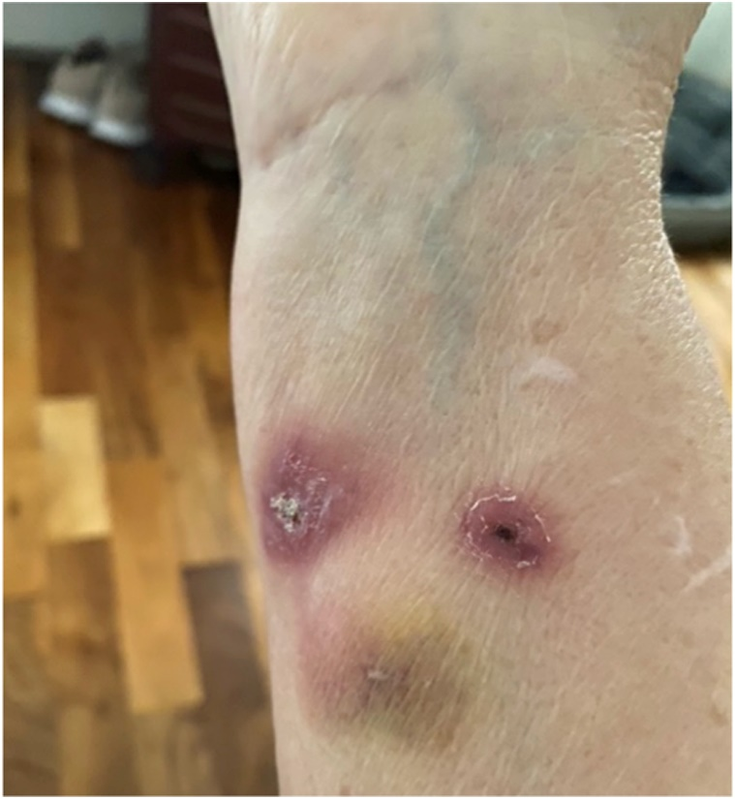
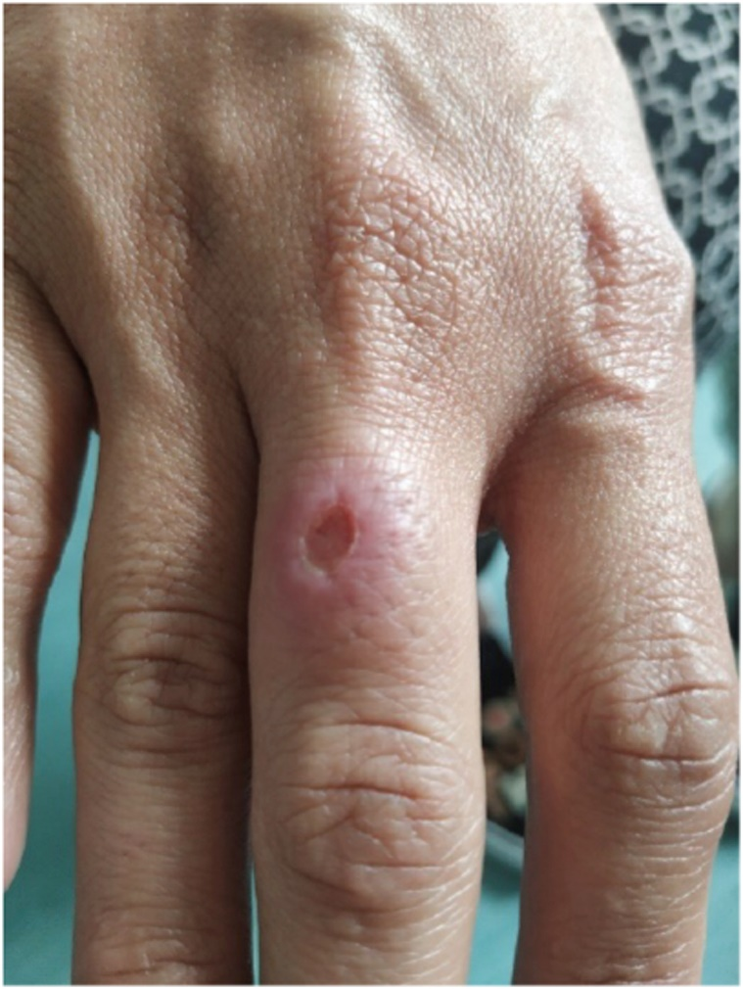
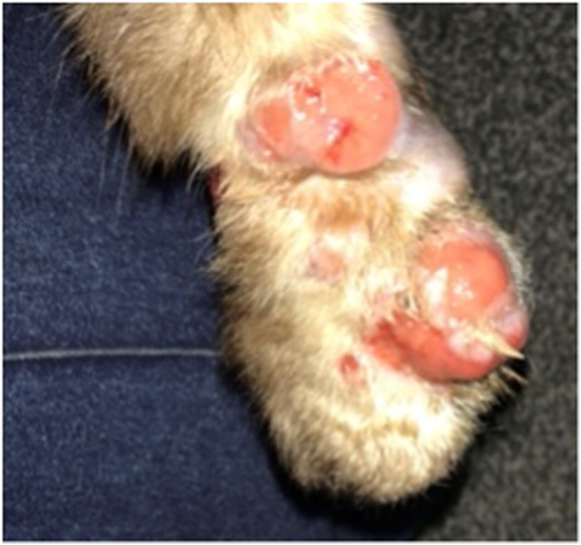
The first three reported cases of Sporothrix brasiliensis cat-transmitted sporotrichosis outside South America - ScienceDirect
Sporotrichosis has been considered an emerging public health threat in Brazil (1990s)
3 cases occurred outside of Brazil
Family emigrated to the UK and brought their cat with them 3 years prior onset of illness
Woman, her adult daughter and the attending vet were scratched by the cat
Humans successfully treated with itraconazole (6 months)

Slide 14
Scientific Publications of Interest
It's a small world for parasites: evidence supporting the North American invasion of European Echinococcus multilocularis | Proceedings of the Royal Society B: Biological Sciences (royalsocietypublishing.org)
Full article: Cross-species transmission of coronaviruses with a focus on severe acute respiratory syndrome coronavirus 2 infection in animals: a review for the veterinary practitioner (tandfonline.com)
Experimental Infection and Transmission of SARS-CoV-2 Delta and Omicron Variants among Beagle Dogs - Volume 29, Number 4—April 2023 - Emerging Infectious Diseases journal - CDC

