Slide 1
Community for Emerging and Zoonotic Diseases
Identifying emerging risks through collective intelligence
CEZD – CAHSS Companion Animal Network Update
17 July 2023
www.cezd.ca

Slide 2
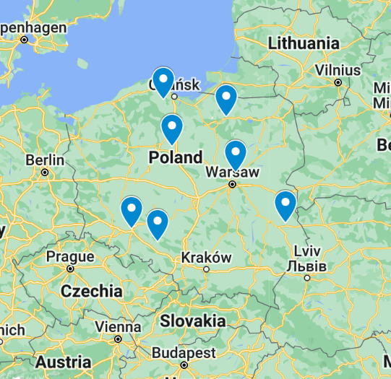
Polish Cats Infected with HPAI H5N1
June 19 2023 - Polish Veterinary Authority begins to receive notifications from across country
70 suspected cases
  Respiratory and neurological signs
  Multiple mortalities
June 22 2023 – lab tests reveal Influenza A H5N1

Slide 3
Polish Cats Infected with HPAI H5N1
July 2023
  Genotyping shows that viruses are closely related and were predominant at the peak of the 2022/23 AI outbreak in Poland
  Most recent case of this genotype was in a white stork
  2 mutations that are favorable to mammalian adaptation
All strains appear to originate from a common source
ECDC Report + OFFLU Report
Cat-to-Cat and Bird-to-Cat is not considered the mode of transmission
5 July 2023
  45 samples from sick or dead cats were tested
  24 were positive for influenza A(H5N1) virus.
  13 cats were fed with raw poultry meat
Survival of Highly Pathogenic Avian Influenza H5N1 Virus in Tissues Derived from Experimentally Infected Chickens - PMC (nih.gov)
Notes:
Positive tests to July 12 (estimate)
28 positive cats
1 positive caracal

Slide 4
Polish Cats Infected with HPAI H5N1
ECDC risk assessment (July 8, 2023):
  Low risk to general public, moderate risk to those exposed to infected cats
Guidance on human health issues related to avian influenza in Canada - Canada.ca
Pets and H5N1 highly pathogenic avian influenza (HPAI) - Canadian Food Inspection Agency (canada.ca)
  Don't allow your dog or cat to eat or play with dead wild birds
  Don't feed dogs or cats any raw meat from poultry, wild or game birds
  Contact your veterinarian if you have questions about your pet's health
Updated WHO Information on cats and H5N1 – July 16 2023

Slide 5


Italy – Domestic Dogs and Cat Seropositive for H5N1
H5N1 detected in a backyard farm with domestic birds
5 dogs and 1 cat found serologically positive for H5N1 on May 22, 2023
All the animals were asymptomatic
Question: how reliable is serosurveillance in dogs and cats?

Slide 6




Efficient Direct and Limited Environmental Transmission of SARS-CoV-2 Lineage B.1.22 in Domestic Cats | Microbiology Spectrum (asm.org)
4 replicate groups
4 cats each
Swap cages
Day 6 post intranasal
inoculation
Cat 1 intranasal
inoculation
Cat 3+4 Separate cage
Nasal and rectal swabs taken 15X throughout the study.
Blood, oropharyngeal and nasal swabs collected D0, D8, D15, and upon euthanasia.
Cat 2 cohoused 1 DPI

Slide 7

Efficient Direct and Limited Environmental Transmission of SARS-CoV-2 Lineage B.1.22 in Domestic Cats | Microbiology Spectrum (asm.org)
All 4 inoculated cats became infected
sgPCR Positive results from all cats
All seroconverted
2/4 demonstrated mild serous nasal discharge
¾ Direct Contact Cats became infected
¾ sgPCR positive results from all cats
2/4 seroconverted
No clinical signs
1/8 Environmental contact cats became infected
1 cat sgPCR positive
All seronegative
No clinical signs
Notes:
Cats considered infectious either based on positive sgPCR or on seroconversion.
No attempts to isolate virus were made.

Slide 8
Results on Environmental Surfaces
Efficient Direct and Limited Environmental Transmission of SARS-CoV-2 Lineage B.1.22 in Domestic Cats | Microbiology Spectrum (asm.org)
Conclusions
  Direct contact is an efficient transmission mechanism
  Indirect contact is less efficient but cannot be ruled out
Monitored virus on floor, litterbox, food dish, toy and wall
Viral decay and inactivation after 8.8 hours (95% confidence interval 1.5 – 31.2 hours)

Slide 9
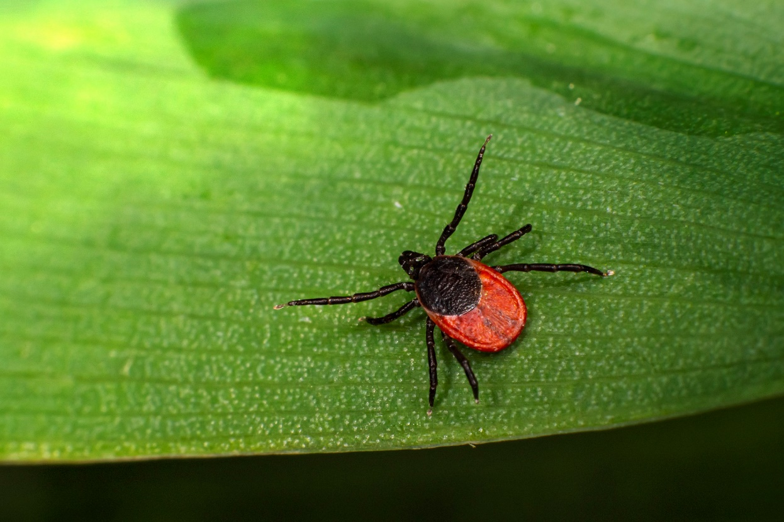
Reports of increasing VBDs in Maine and Michigan
Anaplasmosis
Lyme Disease
Ehrlichiosis
Babesiosis
Can no longer access due to ProMed limited searches
Companion Animal Parasite Council | 2023 Annual Pet Parasite Forecasts (capcvet.org)

Slide 10
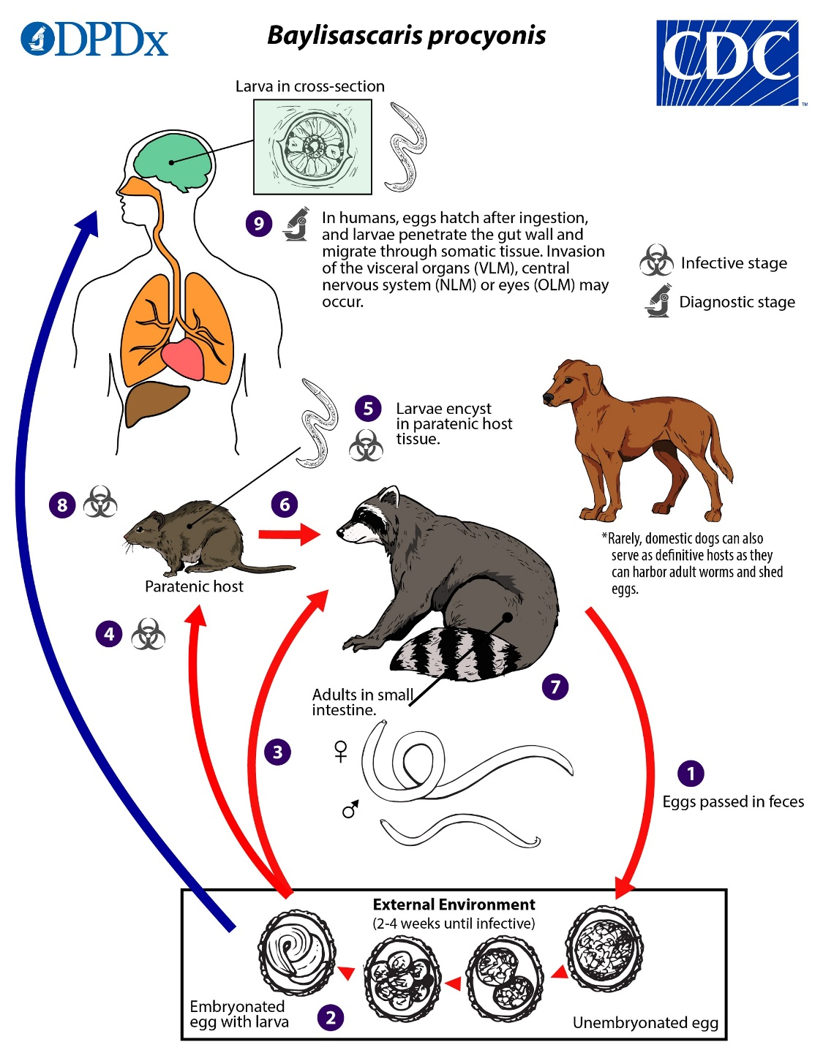
Baylisascaris procyonis Roundworm Infection in Child with Autism Spectrum Disorder, Washington, USA, 2022 - Volume 29, Number 6—June 2023 - Emerging Infectious Diseases journal - CDC
Child with autism and exhibiting pica
Developed eosinophilic meningitis
Environmental assessment found that there was a raccoon latrine near the patient’s house

Slide 11
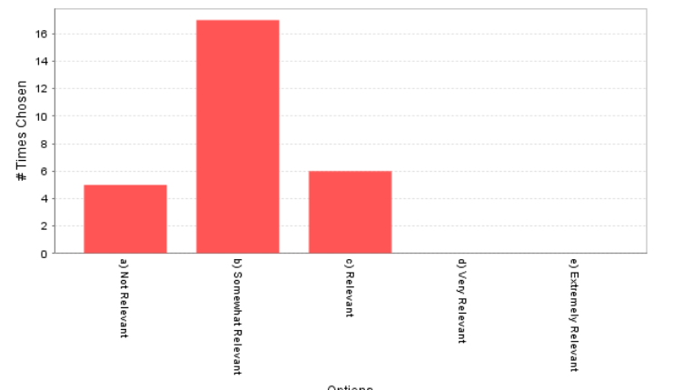
Angiostrongylus vasorum in UK
Canine angiostrongylosis: the French heartworm: an emerging threat in North America - PubMed (nih.gov)
“Parasite has now established on mainland Canada (NS) and it will likely establish anywhere terrestrial slugs and snails are present as intermediate hosts.”
Moxidectin/Imidacloprid is approved for prevention of Angiostrongylus vasorum in dogs in Canada
Ontario survey published in 2021 found no evidence of the parasite
Metastrongyloid lungworms - Canadian Parasitology Expert Panel Guidelines | CPEP - University of Saskatchewan (usask.ca)
Investigation of the occurrence of Angiostrongylus vasorum in coyotes in southern Ontario, Canada

Slide 12
Scientific Publications of Interest
Intestinal infection with Echinococcus multilocularis in a dog - PubMed (nih.gov)
Novel molecular diagnostic (PCR) diagnosis and outcome of intestinal Echinococcus multilocularis in a dog from western Canada in: Journal of the American Veterinary Medical Association - Ahead of print (avma.org)
Emergence of canine hookworm treatment resistance: Novel detection of Ancylostoma caninum anthelmintic resistance markers by fecal PCR in 11 dogs from Canada in: American Journal of Veterinary Research - Ahead of print (avma.org)
Rising Incidence of Sporothrix brasiliensis Infections, Curitiba, Brazil, 2011–2022 - Volume 29, Number 7—July 2023 - Emerging Infectious Diseases journal – CDC
Early Release - Highly Pathogenic Avian Influenza A(H5N1) Clade 2.3.4.4b Virus in Domestic Cat, France, 2022 - Volume 29, Number 8—August 2023 - Emerging Infectious Diseases journal – CDC
Frontiers | Emergence of a novel reassortant H3N6 canine influenza virus (frontiersin.org)

Slide 13
Scientific Publications of Interest
Clinical investigation and management of Brucella suis seropositive dogs: A longitudinal case series - PubMed (nih.gov)
First molecular confirmation of multiple zoonotic vector-borne diseases in pet dogs and cats of Hong Kong SAR - PubMed (nih.gov)
SARS-CoV-2 Seroprevalence and Cross-Variant Antibody Neutralization in Cats, United Kingdom - Volume 29, Number 6—June 2023 - Emerging Infectious Diseases journal – CDC
SARS-CoV-2 Seroprevalence Studies in Pets, Spain - PubMed (nih.gov)

