Slide 1
Community for Emerging and Zoonotic Diseases
Identifying emerging risks through collective intelligence
CEZD – CAHSS Equine Network Update
8 March 2023
www.cezd.ca

Slide 2
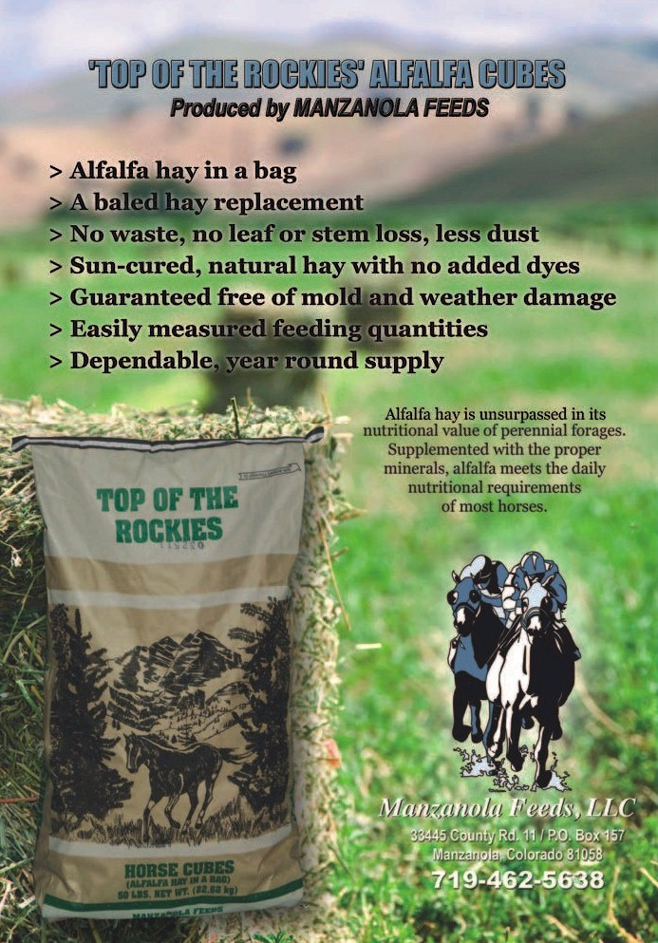
FDA Cautions Horse Owners Not to Feed Recalled Lots of Top of the Rockies Alfalfa Cubes due to Reports of Illness and Death | FDA
Louisiana, Colorado, New Mexico, and Texas
98 horses showed neurological symptoms
Deaths of at least 52 horses attributed to Clostridium botulinum Toxin C
Top of the Rockies alfalfa cubes found to contain rodent carcasses

Slide 3









Pathogens | Free Full-Text | Getah Virus (Alphavirus): An Emerging, Spreading Zoonotic Virus (mdpi.com)
Togaviridae, Alphaviridae
  32 Alphaviruses known
  Western and Eastern Equine Encephalitis are also in this family
1st isolated in 1955 in Malaysia
Spread from 0° North (Malaysia) to 60° North (Russia)
Found in 17 mosquito species, and one midge
# of disease outbreaks is increasing
Notes:
Togaviridae, Alphaviridae
32 Alphaviruses known
Western and Eastern Equine Encephalitis are also in this family
1st isolated in 1955 in Malaysia
Spread from 0 North (Malaysia) to 60 North (Russia)
Found in 17 mosquito species, and one midge
# of disease outbreaks is increasing
Since its original detection, different studies have found that GETV can be amplified in mosquitoes, transmitted to animals through bites, and virus-infected animals serve as a reservoir from which uninfected mosquitoes can acquire the virus. Thus, GETV undergoes a mosquito–vertebrate host–mosquito cycle in nature.
GETV infection causes disease in livestock with symptoms including fever, rash, edema of the limbs and lymphadenopathy in horses and abortion in pigs.
Humans can be seropositive but no evidence of clinical disease or viral detection has been found to date.
Very low levels of seroconversion have been found in ducks and chickens.

Slide 4
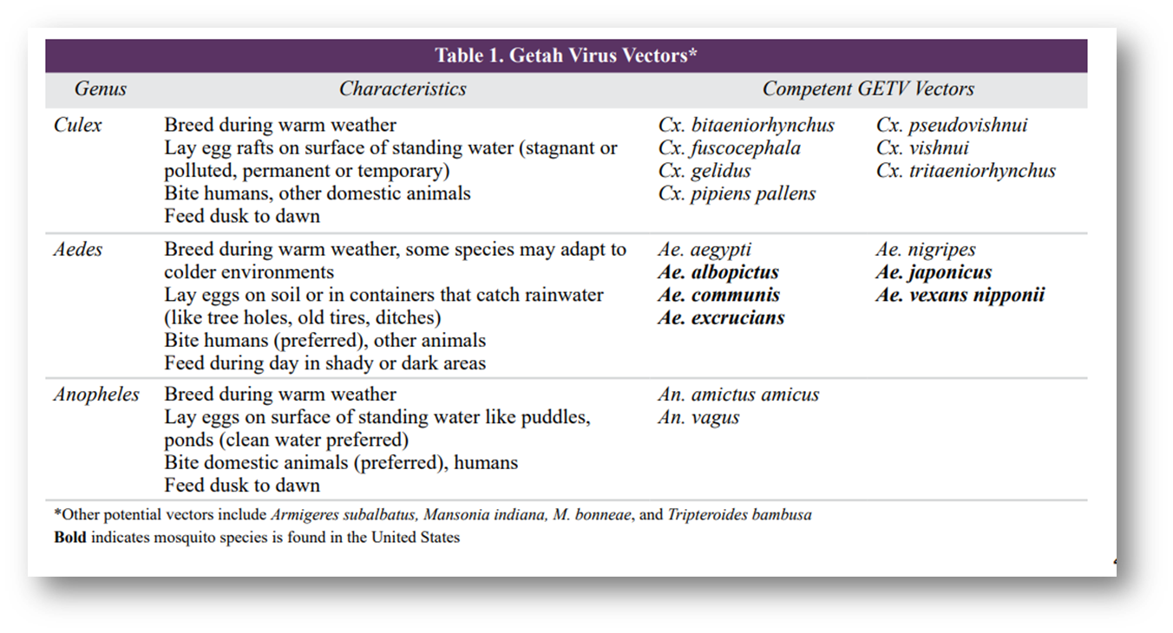
Getah Virus Vectors
SHIC-Getah-Virus-Fact-Sheet.pdf (swinehealth.org)

Slide 5
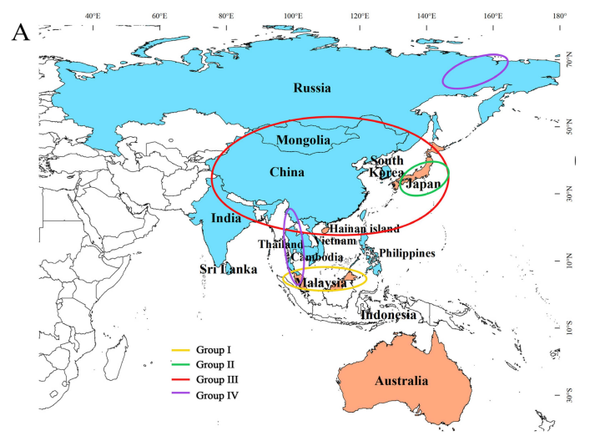
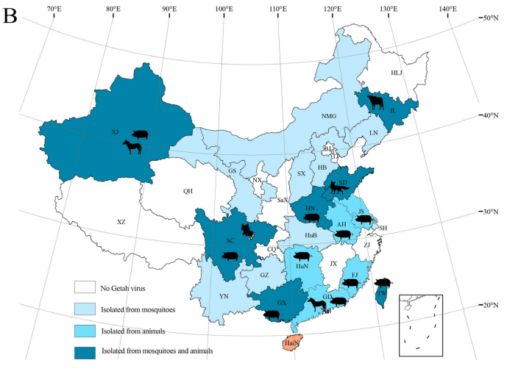
Pathogens | Free Full-Text | Getah Virus (Alphavirus): An Emerging, Spreading Zoonotic Virus (mdpi.com)
Notes:
Image A. Orange colored areas are where the virus was found from 1955 to 65.
Pale blue is current distribution. GETV group III has been emerging and spreading with a large host and vector range.
Image B. Shows the distribution and specific hosts and vectors affected in China
The transmission and migration routes of GETV in continental Asia are similar to those of Japanese Encephalitis virus that is widely distributed in natural hosts in the region.

Slide 6
Getah virus in horses
Outbreaks in race horses in Japan (5 outbreaks between 1978 and 2015) and thoroughbred breeding farms in India (1990)
Managed with vaccination and vector controls
Further outbreaks limited to young horses that had not completed vaccine series
Clinical signs
  Fever, skin rash, edema on the legs
  Nasal discharge in experimentally infected horses (not naturally infected)
Generally a self limiting infection that responds to supportive care

Slide 7
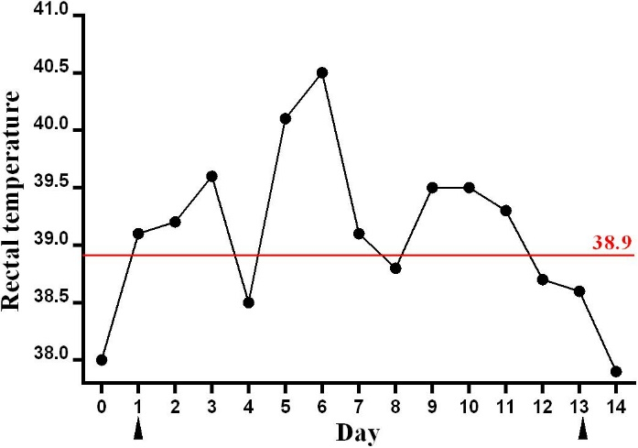
Frontiers | Emergence of Getah Virus Infection in Horse With Fever in China, 2018 (frontiersin.org)
Sudden onset fever in a 17 year old warmblood in China
Uneventful recovery
Whole genome sequencing indicates the virus isolated was most closely related to strains circulating within China in pigs

Slide 8
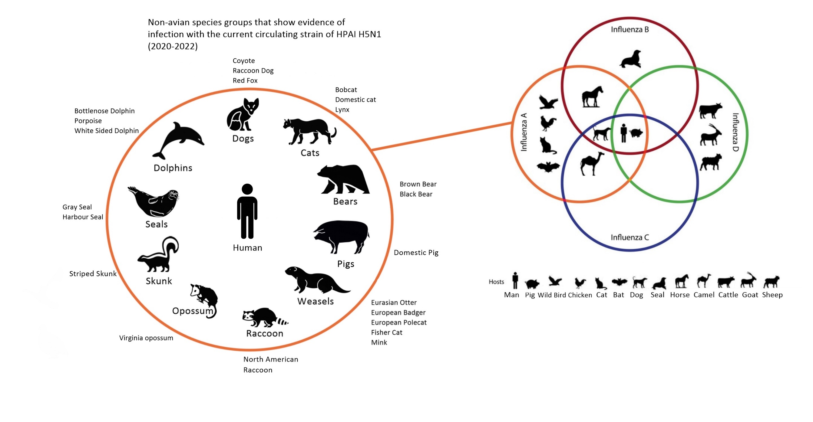
Statement on avian influenza and mammals - World Organization for Animal Health (woah.org)
The continual threat of influenza virus infections at the human–animal interface - PMC (nih.gov)
Notes:
Ongoing detections of HPAI in mammals
Including events that indicate mammal to mammal spread
Mink farm in Spain
Sealion mass mortality event in Peru

