Slide 1
Community for Emerging and Zoonotic Diseases
Identifying emerging risks through collective intelligence
CEZD – CAHSS Bovine Network Update
15 January 2025
www.cezd.ca

Slide 2
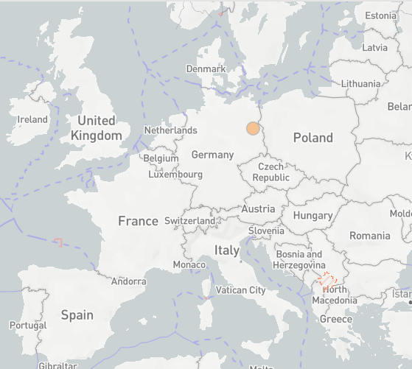
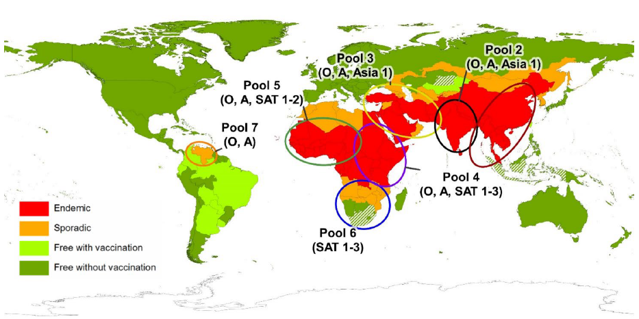
Foot and Mouth Disease
Germany has reported cases of FMD in water buffalo in Brandenburg
  First occurrence since 1988 (lower saxony)
  Three buffalo have died and the rest of the herd (11) have been culled
  Identified as serotype O – vaccines available in German FMD antigen bank
  Source of infection is still unknown
DEFRA FMD Outbreak Assessment
  All susceptible livestock within a 1km radius would be culled as a precaution
  Sampling of all establishments within the 10km Restriction Zone is ongoing, so far results have been negative, hunting ban in place
  Berlins zoo’s have closed
  Netherlands ban on veal calves (>3,600 transported from Brandenburg since December 1)
Global Distribution of FMD – Merck Veterinary Manual
Notes:
Germany reported an outbreak of FMD in water buffalo in Honow, outskirts of Berlin, this past Friday (Jan 10th).
This is the first report of FMD in the country since 1988 (which occurred in lower saxony). And the last outbreak in Europe was reported in Bulgaria in 2011. FMD remains endemic in Turkey, the Middle East, Africa, parts of Asia and South America.
In this event - three water buffalo in Honow have died and the entire herd (remaining 11 buffalo) were culled as a precautionary measure. You can see on the map on the top right where this is in Germany.
The serotype has been identified as O – which is closely related FMD viruses are found in the Middle East and Asia, - You can see from the bottom right image the different pools for FMD worldwide and serotype O is present in all of them except for pool 6 which is in southern Africa. But the closest in proximity to Europe would be those circulating in the middle eat (pool 3)
The exact origin and route of entry is still unknown, and it is interesting that it was detected in water buffalo and its listed as a backyard farm – so it may not be a regular production site and biosecurity may be very different
But it also shows that the risk of introduction of this virus into a susceptible population can happen anytime.
DEFRA has also released a preliminary outbreak assessment – some notable information there includes
- all susceptible livestock within a 1km radius would be culled as a precaution and this includes a pigs farm with ~ 200 pigs in Ahrensfelde, near where the outbreak was detected.
- Additionally, 55 sheep and goats and 3 cattle from a farm in OderSpree are to be slaughtered on 13 January as the farm had obtained hay from the farm in Hönow where the outbreak occurred but none of the animals have shown signs of infection. The sampling of all establishments within the 10km Restriction Zone (RZ) is ongoing, but so far results have been negative. There is also a hunting ban in place in the restriction zone and berlins two zoo’s have closed.
- Netherlands have implemented a national ban on the movement of veal calves (unless they are going to slaughter) and a ban on visitors to veal farms because there have been more than 3,600 calves transported from Brandenburg to the Netherlands since 1 December. These calves are located on more than 125 veal calf farms spread across the Netherlands.
Re-testing of samples which tested negative for bluetongue for FMD as bluetongue can be a differential diagnosis for FMD

Slide 3
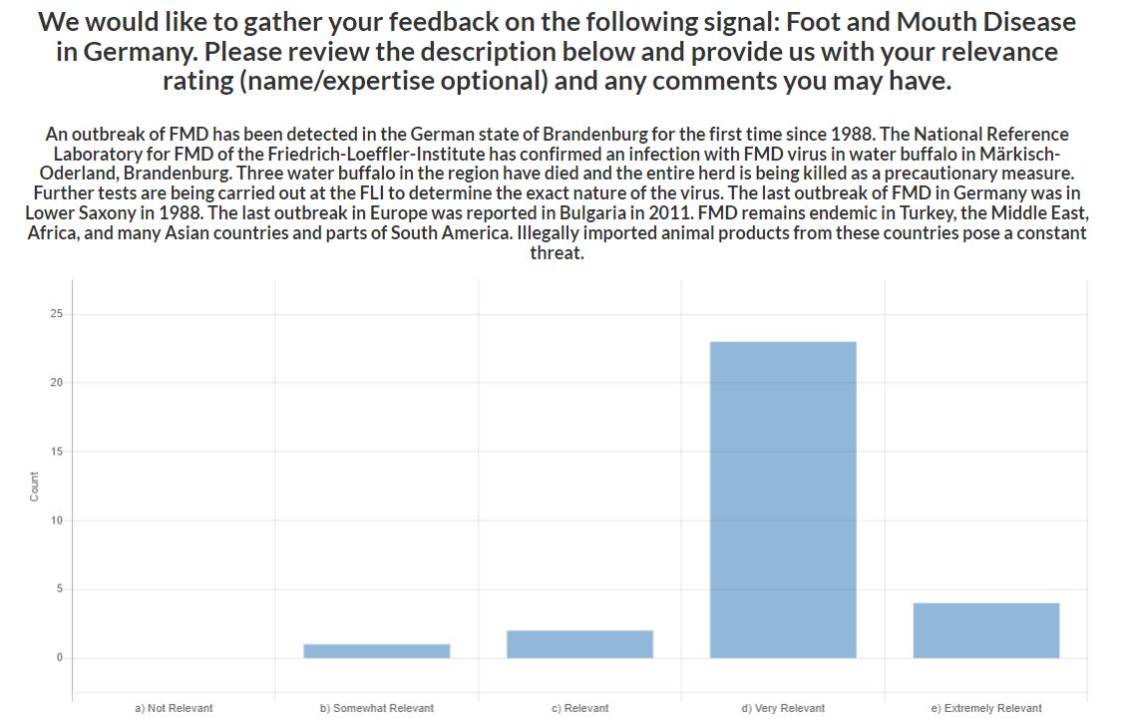
Foot and Mouth Disease
CEZD Ping Results
CFIA has issued import restrictions for commodities/products from Germany
Canada – FMD last reported in 1951 in Saskatchewan
  introduction thought to have been by an immigrant through his clothes as well as by sausage
  The epidemic of foot-and-mouth disease in Saskatchewan, Canada, 1951-1952 - PMC
Notes:
Sent out a ping to the CEZD community early Friday morning and to date we’ve had 31 responses. With an average rating of very relevant. The CFIA has also issued import restriction on commodities/products from Germany – Gen will provide those details.

Slide 4
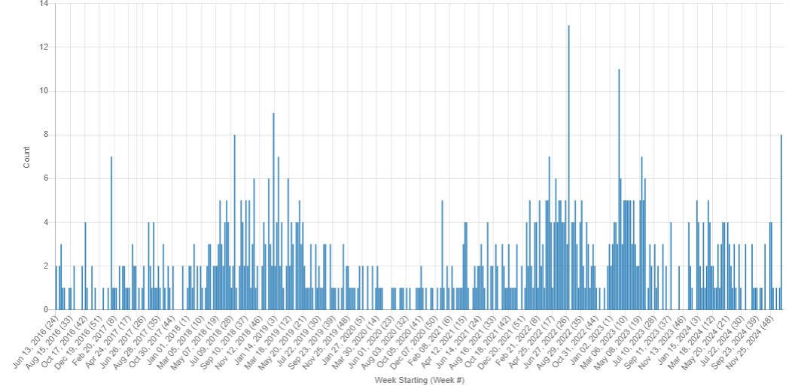
Foot and Mouth Disease
Other countries reporting FMD outbreaks: Palestine(O), Israel, Algeria (SAT-2), Libya(O), China(O), Indonesia, South Africa (SAT – 2)
FMD Indonesia
SAT – 2 Middle East
COVID
KIWI FMD Signals June 2016 - January 2025
Notes:
A few other countries have reported outbreaks of FMD over the past few months: Palestine, Israel, Algeria, Libya, China, Indonesia South Africa

Slide 5
Bovine Tuberculosis in Canada and the USA
Canada
  Bovine TB was confirmed in a Saskatchewan cow
  Animal was slaughtered in Alberta, where tests confirmed the disease
  The six-year-old cow tested PCR positive on November 29, 2024, leading to the tracing back to a farm in Saskatchewan
  The farm is under quarantine and additional testing and tracing is underway
United States
  Bovine TB was confirmed in South Dakota cattle for the first time since 2021
  The infected steer was identified in late October by meat inspectors during a routine inspection at a Wisconsin packing plant
  Records linked the steer to a Hamlin County, South Dakota, feedlot that had marketed the animal
  The infection was confirmed by the NVSL on December 6, 2024
Notes:
Since 1923, Canada has worked to eradicate bovine TB and had been infection-free from cattle since 2006.

Slide 6
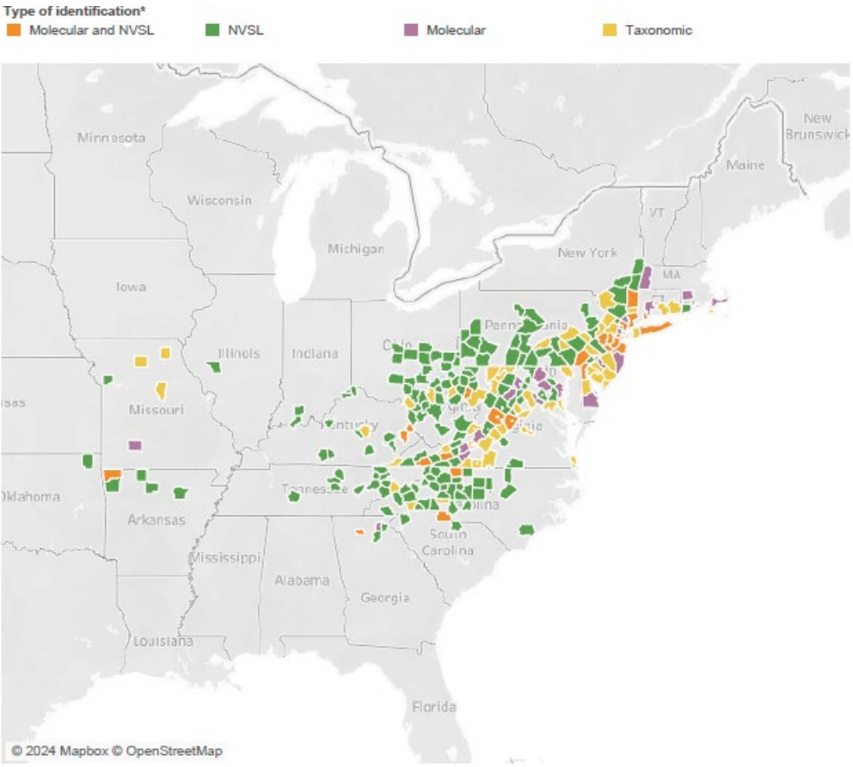
Longhorn Tick and Theileriosis in the USA
No changes or recently activity regarding the ALHT
Kansas has reported Theileria orientalis Ikeda
  Affected calves were purchased and imported to Kansas from the east
  No ALHT in Kansas yet
USDA Haemaphysalis longicornis (Asian longhorned tick) Situation Report

Slide 7
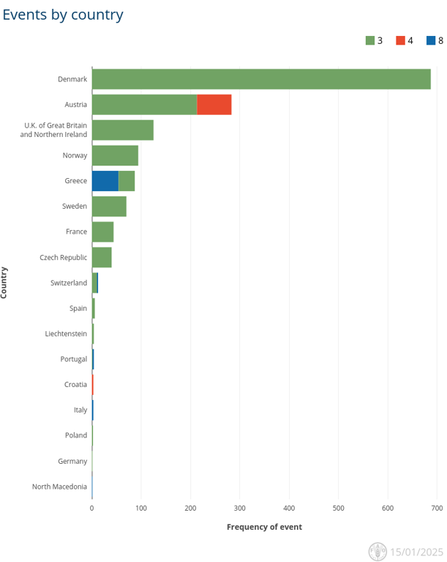
Bluetongue virus in Europe
Multiple different serotypes of BTV have been circulating in Europe
From September 1, 2024 – January 15, 2025 serotypes 3, 4, 8, and 12 were reported
  Majority of cases being BTV-3
17* different countries reporting cases in EMPRES-i
  + Netherlands and Belgium
  Not a complete list of countries/events
EMPRES-i
Notes:
We’ve been reporting on BTV for the past year and a bit with BTV-3 spreading increasingly throughout Europe in 2024 – first identified in the Netherlands on Sept 5, 2023.
Currently Europe is reporting multiple different circulating serotypes of BTV.

Slide 8
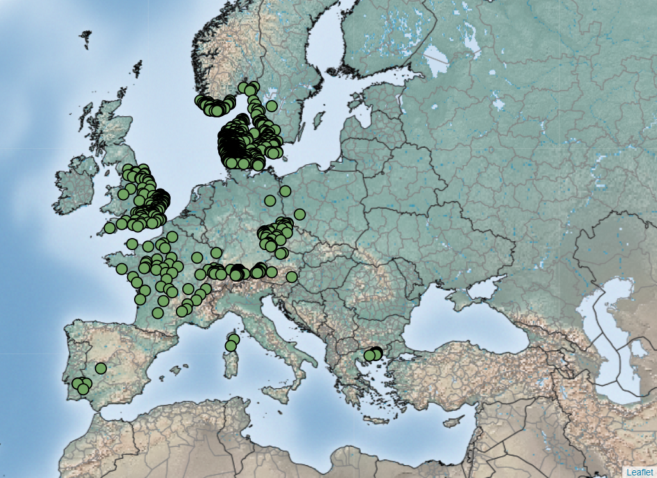
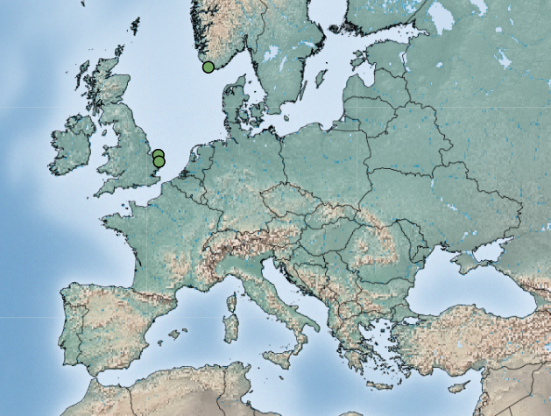
Bluetongue virus (BTV-3) in Europe
September 1, 2024 – January 15, 2025
1322 events
BTV-3 continues to spread across Europe
As of our last update, the following countries had reported cases of BTV-3:
  the Netherlands, Belgium, Germany, the UK, France, Luxemburg, Switzerland, Denmark, Norway, Sweden, Czech Republic, Austria, Portugal, Spain, and Greece
From September 1, 2024 – January 15, 2025, 1322 BTV-3 events were reported in EMPRES-i
  Greece, Denmark, Sweden, Norway, Spain, Portugal, France, UK, Czech Republic
Liechtenstein and Poland have also reported their first cases of BTV-3 recently
Cases in January reported from UK and Norway
January 1 – January 15, 2025
4 events
Notes:
Liechtenstein reported its first outbreak of BTV-3 on October 7, 2024 in sheep. To date they have reported 6 total outbreak affecting both cattle and sheep.
Poland reported its first case of BTV-3 on Dec 10 – but with a start date of Nov 15. Three cases were reported in cattle in Dolnośląskie in the west of the country, towards borders with Germany/Czech Republic
Then also within the last two weeks Norway and the UK reported cases which is fairly late for midge activity.

Slide 9
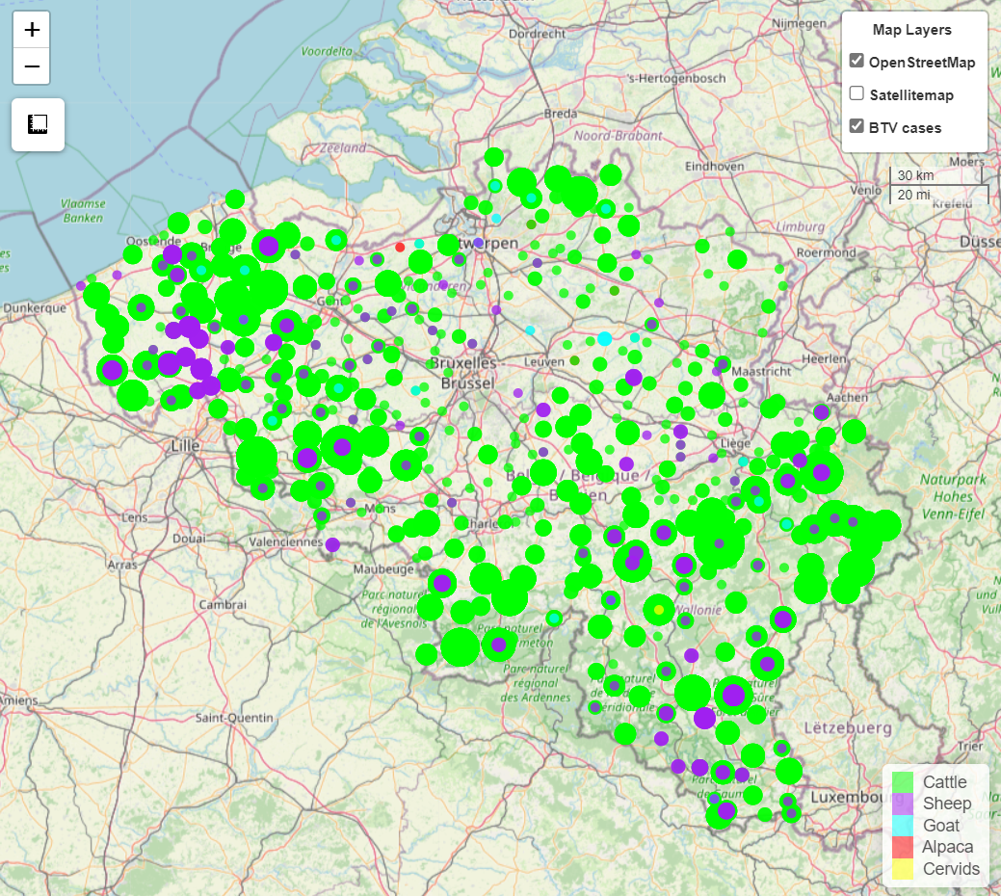
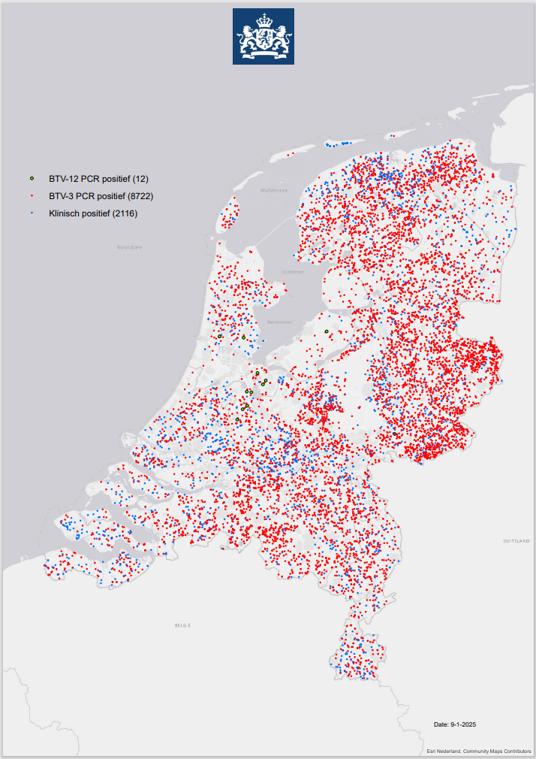
Bluetongue virus (BTV-3) in Europe
Some countries aren’t reporting regularly to WOAH/EMPRES-i
Belgium – events from September 1, 2024- January 15, 2025
  Shows continued spread across the entire country
Netherlands most recent update:
  PCR BTV-3 positives – 8722
  Clinically positive - 2116
  Spread through entire country, all 12 provinces
Notes:
Belgium not regularly reporting to WOAH, but their dashboard shows cases across the entire country – affected mainly cattle, then sheep, and some goats, alpaca and cervids are also mentioned.
Similarly, Netherlands does not have any recent data in Empres-I but looking at the regulatory authority's website, the most recent update shows cases across all 12 provinces, and they have also reported finding a new strain BTV-12.

Slide 10
Bluetongue virus (BTV-12) in Netherlands
The Netherlands reported their first cases of BTV-12 on October 10, 2024, in a sheep on a farm in Kockengen and in a cow and her calf on a farm in Harmelen
First report in Europe, serotype previously reported in Israel(2010) and Australia(2015)
Article mentioned a retrospective analysis of ~1,400 samples will be examined for the new serotype
As of January 9, 2025 there have been 12 PCR positive cases of BTV-12
No vaccine available for serotype 12
Notes:
On October 10, 2024, BTV-12 was reported in a sheep on a farm in Kockengen and in a cow and her calf on a farm in Harmelen.
This serotype has never before occurred in the Netherlands, but it is prevalent in other countries outside Europe, specifically Israel(2010) and Australia(2015).
The article mentioned that approximately 1,400 previously submitted samples will be retrospectively examined for the new serotype and a distribution map will be created- right now it seems that they are adding it to the BTV-3 map.
Unclear how these different serotypes keep being identified in the Netherlands [BTV-3 (2023), now BTV-12 (2024), and previously BTV-6 (in 2008)]. Is their diagnostics capacity better and its just going undetected in certain countries, or is it another transmission pathway directly into the Netherlands?

Slide 11
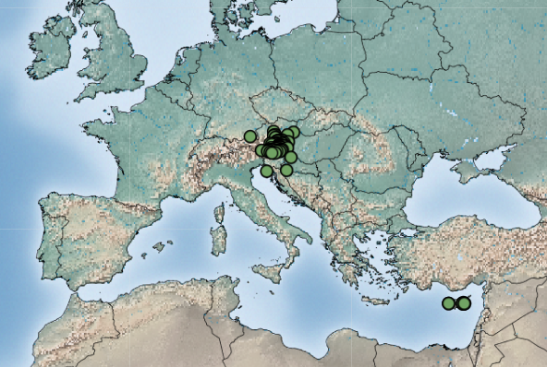
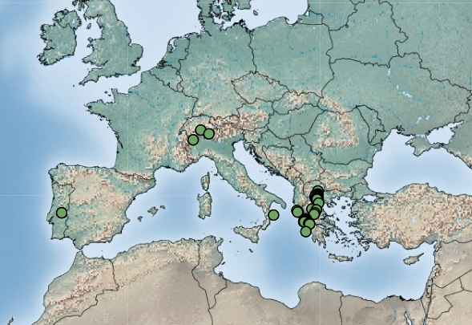
Bluetongue virus (BTV-4, BTV-8) in Europe
BTV-4 September 1, 2024 - January 15, 2025
BTV-4
84 events, from: Cyprus, Croatia, Austria
+ France (not in Empres-i)
BTV-8
61 events, from: Italy, Portugal, Switzerland, North Macedonia and Greece
North Macedonia and Portugal reported their first outbreaks during this period
Greece reported a recurrence (last detected in 2009)
+ France (not in EMPRES-i) in cattle in Savoie
BTV-8 September 1, 2024 – January 15, 2025
Notes:
North Macedonia has reported its first outbreak of BTV-8 in a mixed sheep/goat herd in Demir Kapija. Still only one report in WAHIS.
Greece reported a recurrence of BTV-8, previously reported in early 2009. Cases were identified in sheep on the Ionian Islands. As of December 5, Greece has reported 51 total outbreaks throughout most of the country
France has also reported cases of BTV-4 and 8, but these are not in WAHIS/Empres-I, but BTV-8 was recently reported in cattle in Savoie and the article stated that: serotypes 4 and 8 have been present in France for many years without clinical signs, except in rare cases.

Slide 12
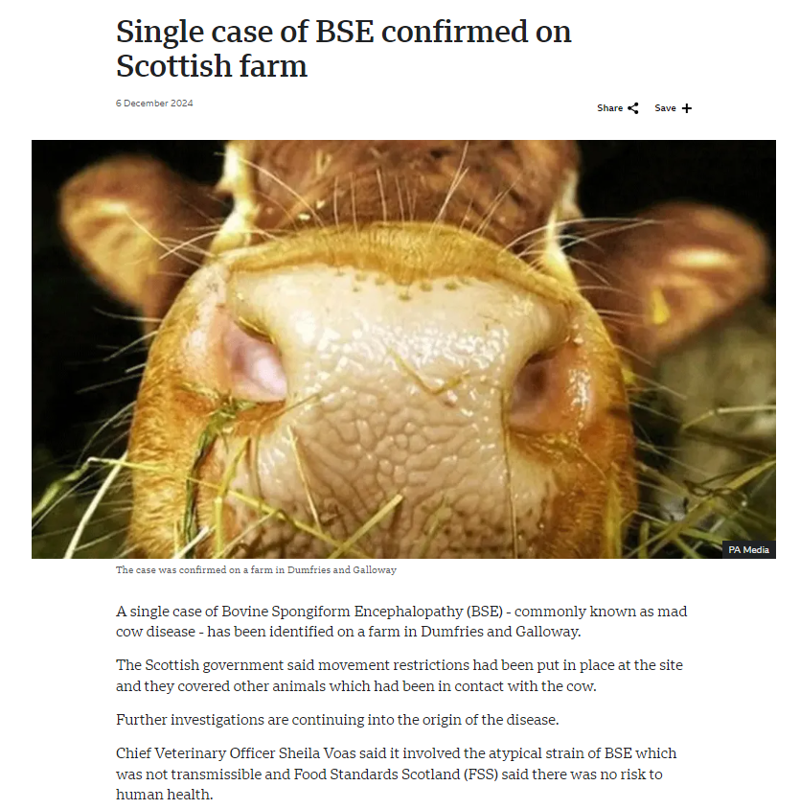
Bovine Spongiform Encephalopathy in Scotland
A single case of atypical BSE was reported on a farm in Dumfries and Galloway
Identified during routine surveillance
Movement restrictions and movement tracing were put in place
Further investigations are continuing into the origin of the disease

Slide 13
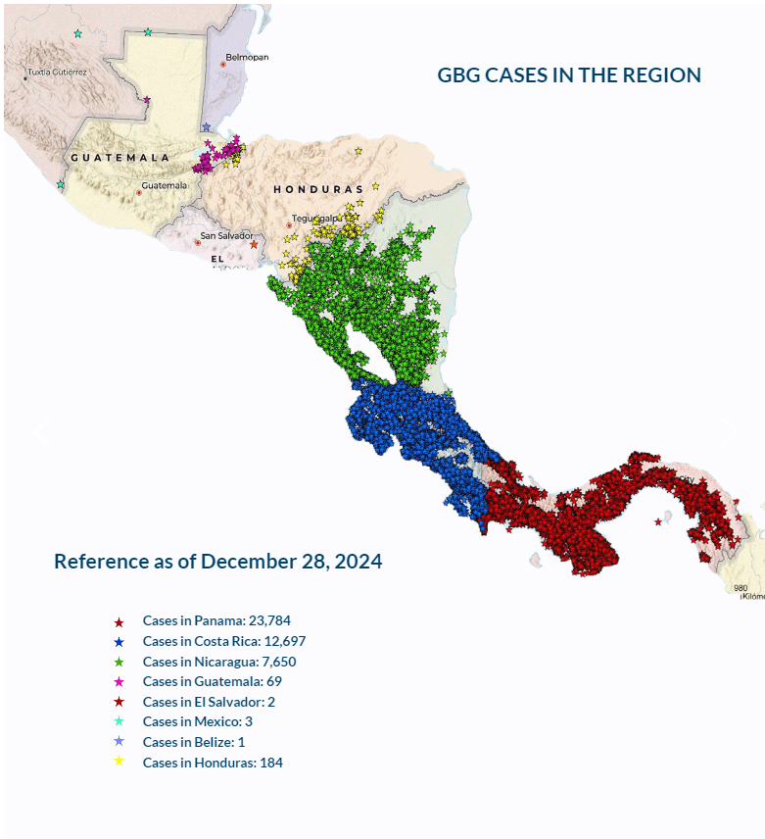
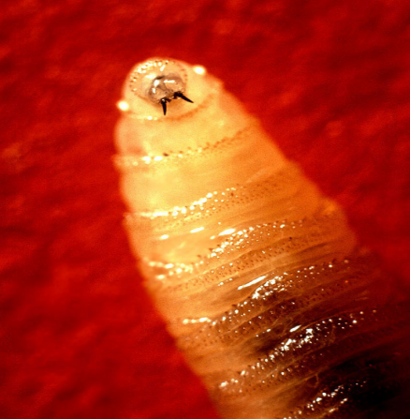
New World Screwworm in Central & North America
Parasitic fly larva - Cochliomyia hominivorax causing wound myiasis
Steady northward movement over the last year
Cases as of December 28, 2024, according to COPEG:
  Panama - 23,784
  Costa Rica - 12,697
  Nicaragua - 7,650
  Honduras – 184 (242* news report)
  * Guatemala - 69
  * Mexico - 3
  * El Salvador - 2
  * Belize – 1 (second case recently reported)
Human cases: Costa Rica, Panama, Nicaragua
Increase in cases may be due to more aggressive fly as well as increased rainfall
Impacts on wildlife unclear, spread may be also be linked to illegal cattle trafficking
COPEG
Notes:
Resurgence may also be somewhat driven by illegal cattle trafficking. As major screwworm outbreak hotspots closely mirror cattle smuggling routes identified in InSight Crime's 2022 report, “Cash Cows – The Inner Workings of Cattle Trafficking from Central America to Mexico.”

Slide 14
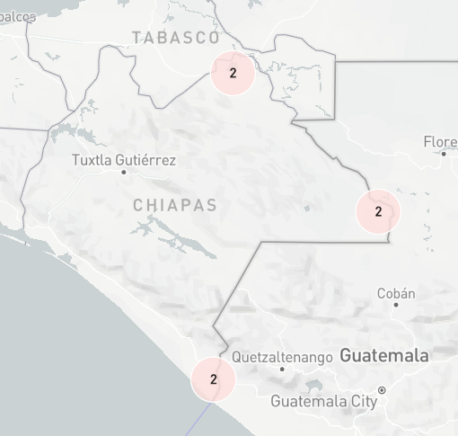
Mexico Notifies United States of New World Screwworm Detection | Animal and Plant Health Inspection Service
The NWS was found in a cow in the southern Mexico state of Chiapas, at an inspection checkpoint close to the border with Guatemala.
1/100 cows had an ear lesion
Trade restrictions issued
Trade in cattle stopped between Mexico and US (normally >1 million animals per year)
Dogs and horses being inspected at US border; other species are not approved for movement from Mexico to the US (pigs, sheep, goats, cervids, camelids)
Six outbreaks in Chiapas, one in Campeche
Enhanced Surveillance
Ongoing Sterile Fly Releases
Notes:
Some more information on the cases of NWS in Mexico

Slide 15
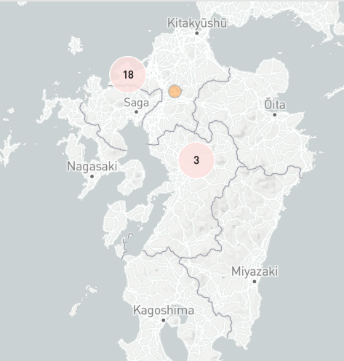
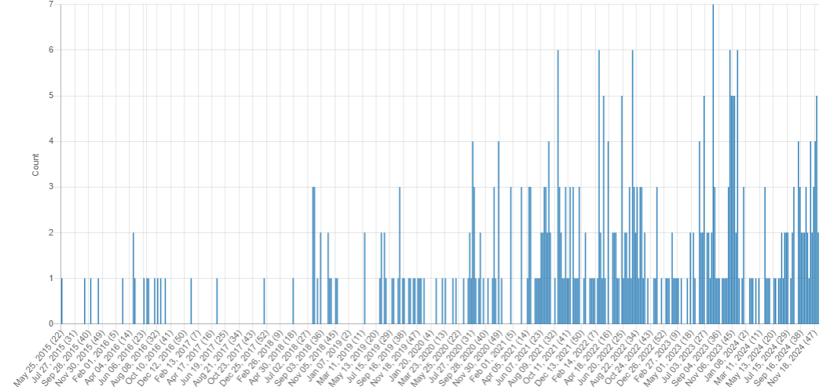
Lumpy Skin Disease
Japan has reported LSD for the first time
  Initial case reports occurred in cattle in Itoshima city, Fukuoka prefecture
  22 total outbreaks reported as of January 13, 2025
Other countries reporting LSD outbreaks: South Korea, Algeria, Tunisia, China
LSD Signals: May 2015 – December 2024
Notes:
In early November 2024, Lumpy skin disease was reported for the first time in Japan. Initial case reports occurred in cattle in Itoshima city, Fukuoka prefecture. Three cases were then found in Ozu Town, Kumomoto prefecture, which are epidemiologically linked to the Itoshima city outbreak. Movement restrictions of all cattle, and movement restrictions and disposal of raw milk derived from cattle with clinical signs have been implemented. The source of the introduction is unknown, however Fukuoka prefecture is close to South Korea which has been recently reporting outbreaks of lumpy skin disease.

Slide 16
Scientific Findings
Identification and characterization of two atypical strains of bluetongue virus in sheep, Tunisia
Potential mechanisms underlying bluetongue virus emergence and spread
The European Union summary report on surveillance for the presence of transmissible spongiform encephalopathies (TSE) in 2023

