Slide 1
Community for Emerging and Zoonotic Diseases
Identifying emerging risks through collective intelligence
CEZD – CAHSS Bovine Network Update
10 October 2025
www.cezd.ca
Notes:
~3-4 Environmental Scanning update on bovine related signals

Slide 2


Asian Longhorn Tick and Theileriosis in the USA
ALHT calls have been taken over by the University of Tennessee
Since the last CAHSS call – three additional states have reported first detections
24 states + Washing D.C. now affected
Mid-June, Michigan reported ALHT nymphs were found in Berrin County, found by routine tick surveillance
Mid-June, Iowa confirmed case of Theileria orientalis Ikeda, and the presence of the ALHT, in cattle in Van Buren County
  As of mid-July, Iowa has reported additional cases (4 confirmed, 1 suspected) of Theileriosis in cattle in the southeast corner of the state, along with findings of the ALHT
Mid-August, Maine confirmed its first finding of the ALHT in Cumberland County
Asian Longhorned Tick Situation Report - The Tick App

Slide 3


New World Screwworm in Central America and Mexico
USA - Mexico border remains closed (cattle, bison, horses)
*Recent detection in Nuevo León (~125 km from border)
Mexico has reported 52 human cases (mostly in Chiapas), including 3 deaths linked to underlying conditions
Situation in other Central American countries: Honduras (160 human cases, >2,496 animal cases), Nicaragua (124 human cases), Guatemala (16 human cases), El Salvador (5 human cases), Belize (2 human cases), and Costa Rica (56 human cases in 2025, triple the 2024 count)
The USDA is investing $29.5 million in sterile fly production and dispersal facilities in Mexico and Texas
Mexico has launched an interactive dashboard for tracking NWS in animals
The USA is deploying Swormlure-5, a synthetic bait with insecticide, and has authorized emergency use of animal drugs for NWS control
July 2025
COPEG
Notes:
The positive New World Screwworm (NWS) case in Nuevo León, Mexico, was confirmed in Sabinas Hidalgo on September 21, 2025. The affected animal was an 8-month-old cow that had recently been moved to a certified feedlot in Nuevo León from a region in southern Mexico known to have active NWS cases.
Food and Drug Administration conditionally approved Dectomax-CA1 (doramectin injection) injectable solution for the prevention and treatment of New World screwworm larval infestations, and prevention of NWS reinfestation for 21 days. Dectomax-CA1 is conditionally approved for use only in cattle.

Slide 4
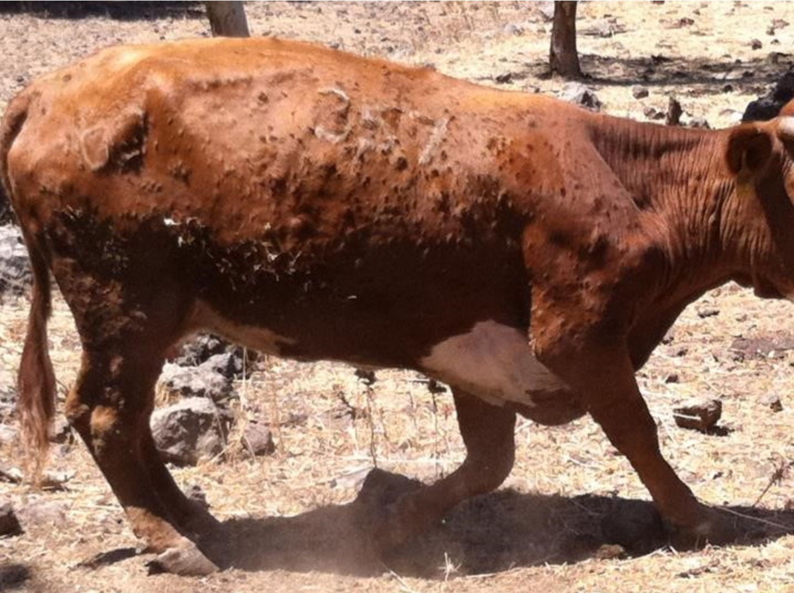
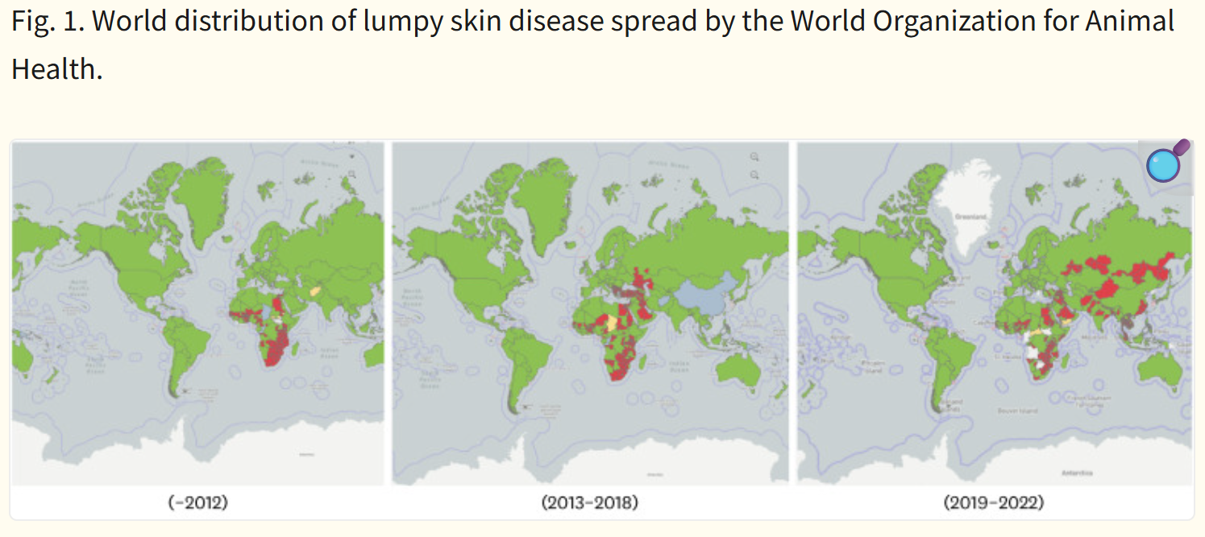
Lumpy Skin Disease
Lumpy Skin Disease | Department of Natural Resources and Environment Tasmania
Lumpy skin disease is highly contagious viral disease that affects cattle
Spread by flies and mosquitos
Clinical signs: fever, skin nodules, nasal/eye discharge, lameness and reduced milk production
Closely related to sheep and goat pox, from which it cannot be distinguished by routine diagnostic tests
Economic losses – decreased milk yield, culling, trade restrictions, damage to hides, and reproductive issues
LSD is endemic in most African countries - since 2013, it has spread rapidly through the Middle East, some parts of Europe and throughout Asia
Lumpy skin disease as an emerging infectious disease - PMC
Notes:
LSD in a viral disease that affects cattle and water buffalo, its spread by flies and mosquitos.
Clinical signs include fever, skin nodules, nasal/eye discharge, lameness, and reduced milk production.
It was first identified in Zambia in 1929 and is found throughout Africa.
It is closely related to SGP
. LSD causes significant economic losses due to:
Decreased milk yield (up to 30%)
Trade restrictions
Culling of infected animals
Damage to hides and reproductive issues

Slide 5
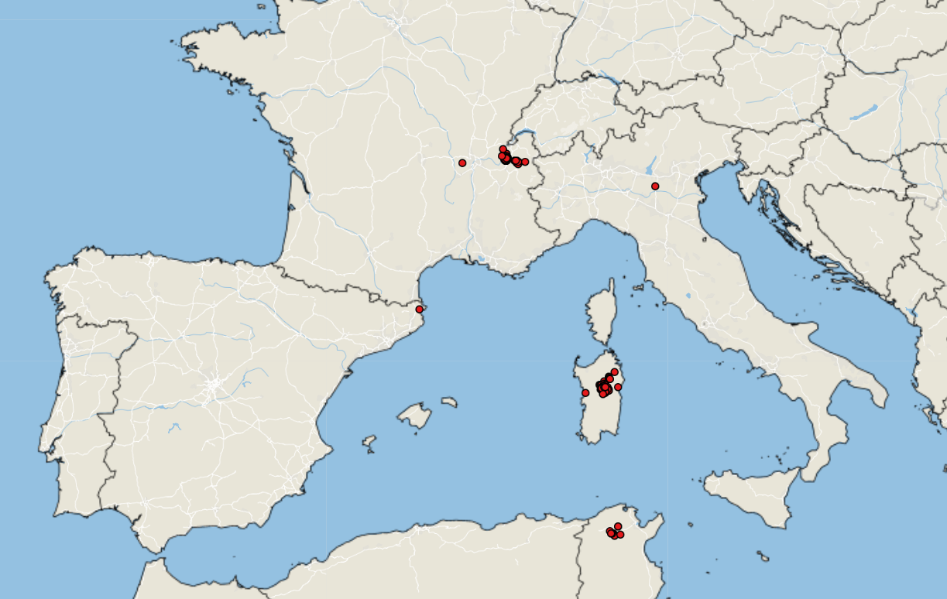
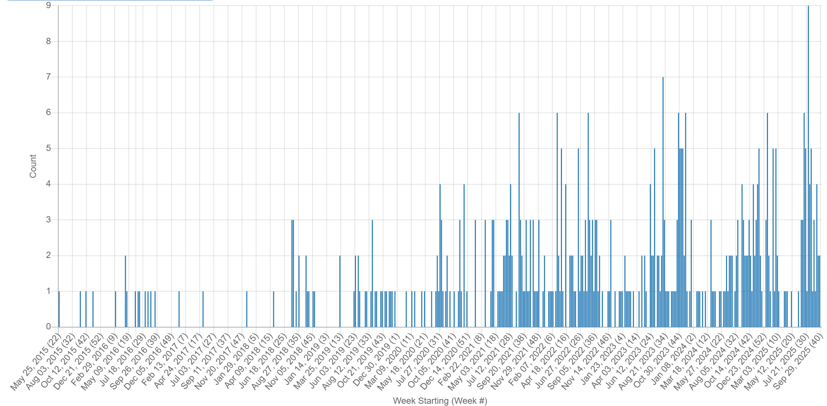
Lumpy Skin Disease in Europe
Empres-i +
LSD Case: June 2025 – October 2025
Italy reported its first cases of LSD in Sardinia
  Potential source of the outbreak listed as vector movement from northern Africa
  Genotyping showed that the virus circulating in Italy is closely related to cluster 1.2, which includes strains isolated in Nigeria and South Africa
France reported its first cases of LSD in Savoie, close to its borders with Switzerland and Italy
France: 79 outbreaks, mainly in Savoie(32), Haute-Savoie(44), Ain(2), and Rhône(1)
Italy: 68 outbreaks, concentrated in Sardinia, with one cases in Lombardy (linked to animal movement from Sardinia
Protection zone established, depopulation, and emergency vaccinations campaigns
October 4th - Spain reported its first cases of LSD in Girona, close to French border
LSD Signals: May 2015 – October 2025
Notes:
In late June 2025 the First outbreaks of LSD in Europe were reported in Italy and then France.
Italy reported its first cases of LSD in Sardinia. Seven cases of LSD were reported in domestic cattle in Orani. The WAHIS report identifies the potential source of the outbreak as vector movement from northern Africa, where LSD has recently been reported (Tunisia and Algeria).
Recent genotyping showed that the virus circulating in Italy is closely related to cluster 1.2, which includes strains isolated in Nigeria and South Africa
Shortly thereafter, France has reported its first cases of LSD in Savoie (southeastern France), close to its borders with Switzerland and Italy; fifteen cases were initially reported.
As of early October 2025, France: 79 outbreaks, mainly in Savoie, Haute-Savoie, and Ain, with a recent spread to Rhône.
Italy: 68 outbreaks, concentrated in Sardinia, with isolated cases in Lombardy (linked to animal movement from Sardinia)
Protection zones (20 km radius) and surveillance zones (50 km radius) have been established around outbreak sites. Animal movement restrictions are in place within and between affected regions. Depopulation (culling) of infected herds is being used to contain spread.
Emergency vaccination campaigns are underway in both countries.

Slide 6
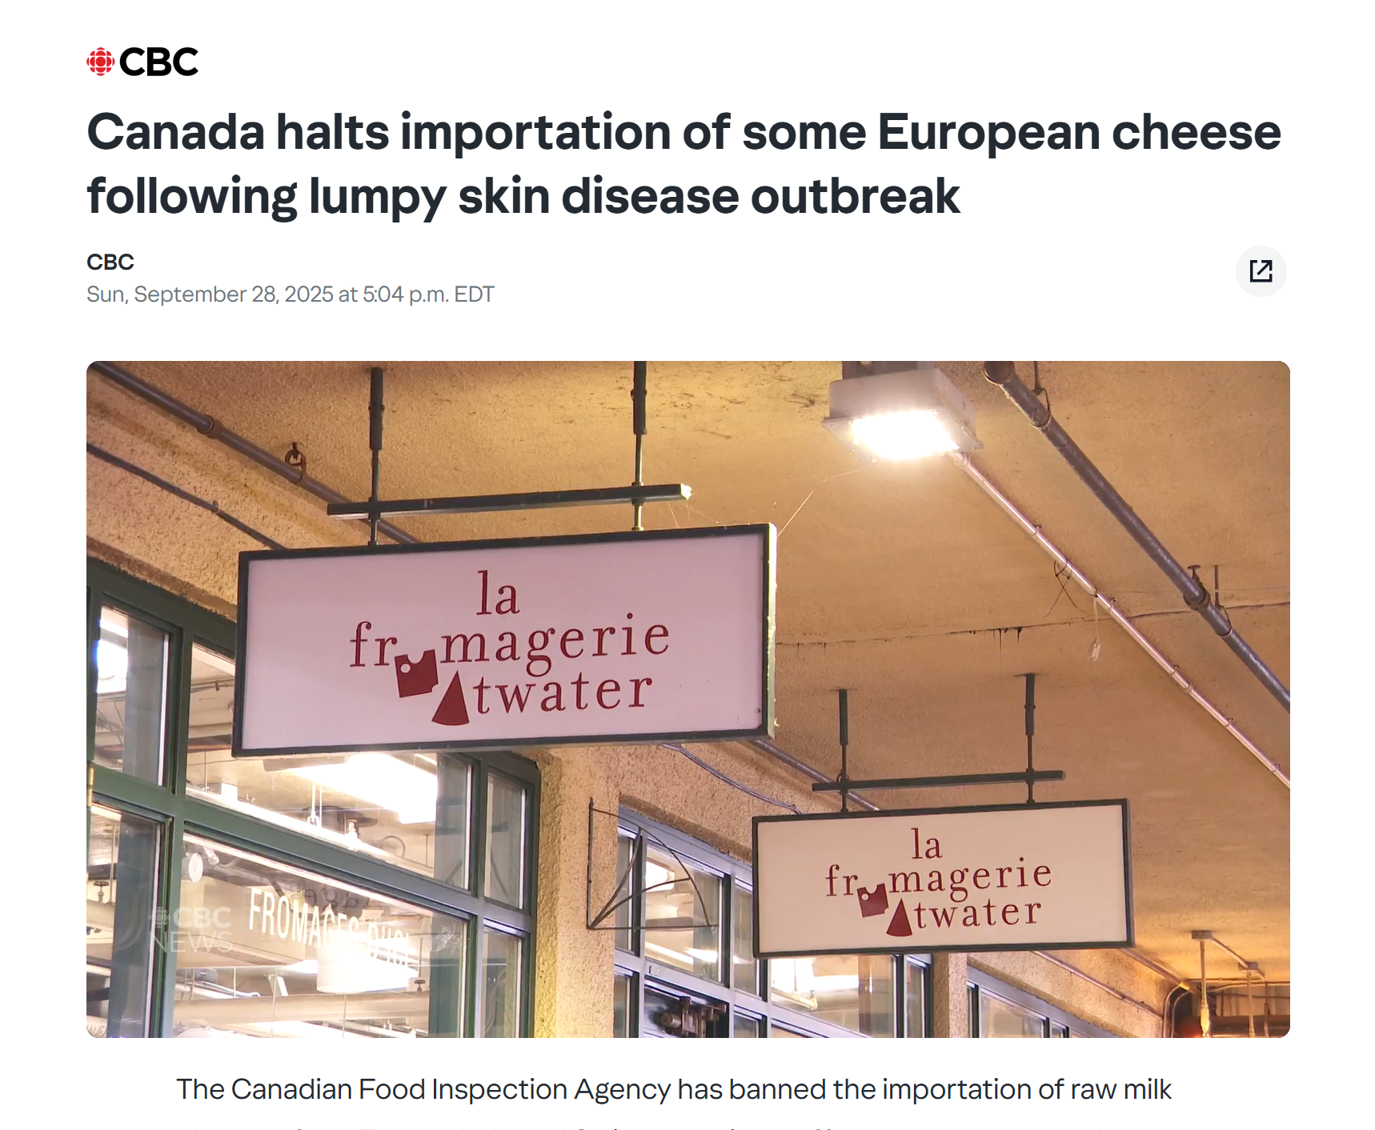
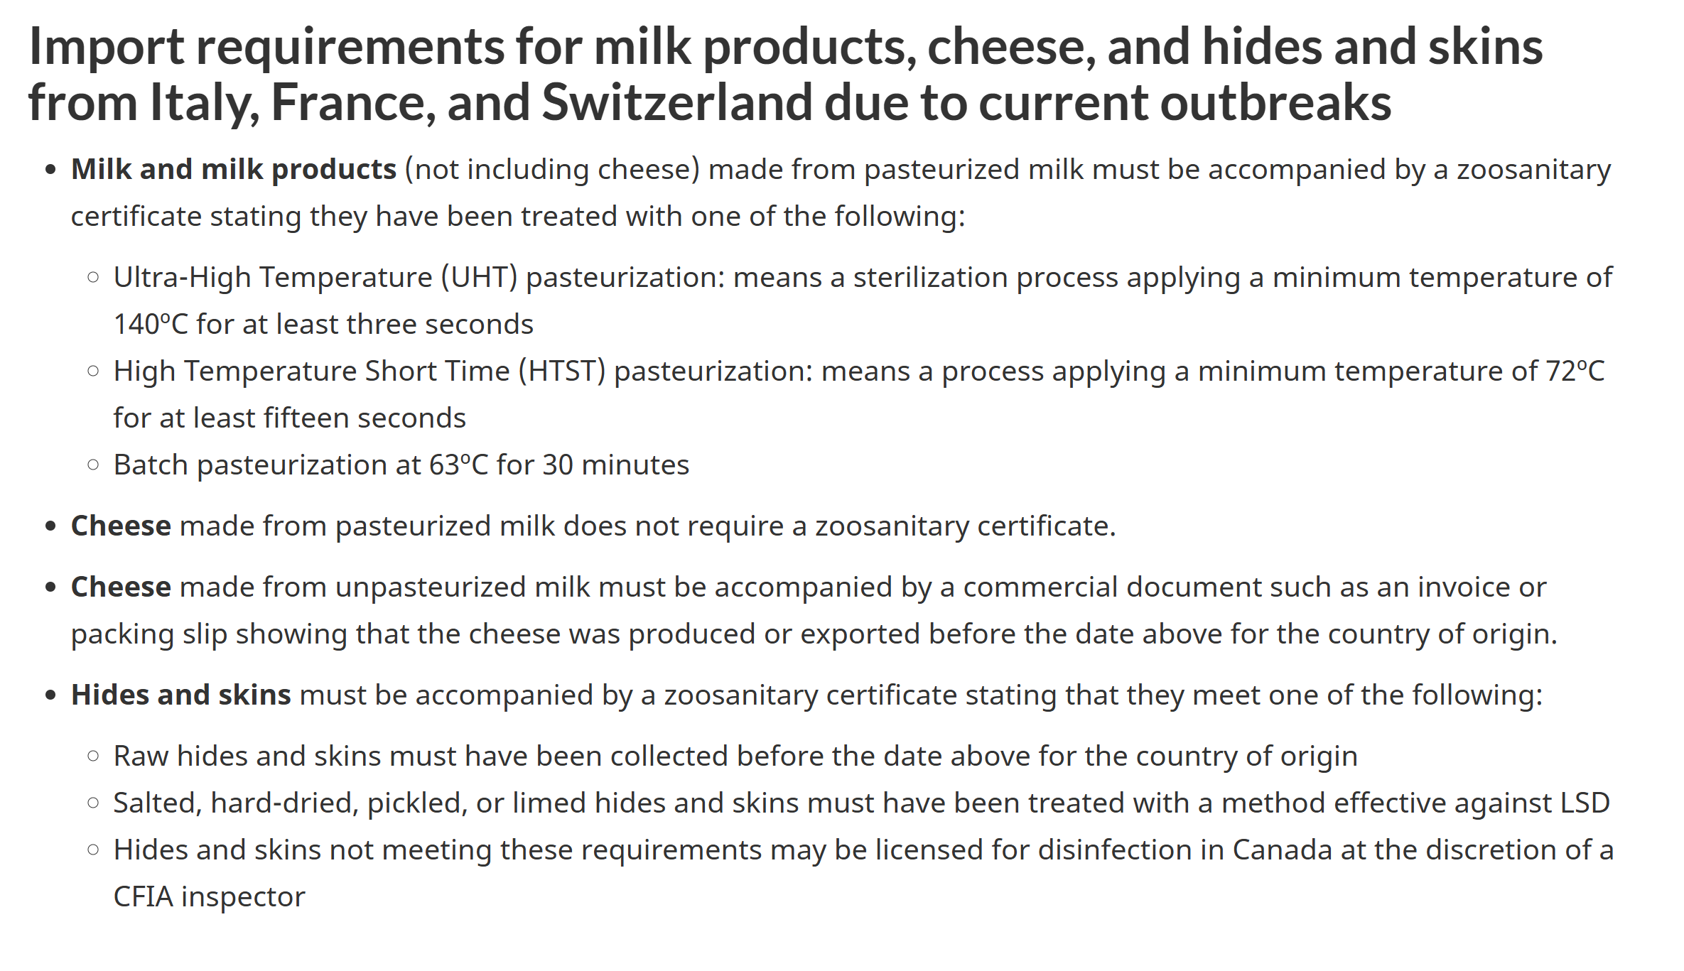
Lumpy Skin Disease in Europe
CFIA import requirements
Canada halts importation of some European cheese following lumpy skin disease outbreak
Lumpy skin disease - Countries that Canada recognizes as being free from the disease - inspection.canada.ca
Notes:
Canada has suspended imports of certain bovine products (e.g., raw milk cheeses and hides/skins) from France, Italy, and Switzerland.

Slide 7
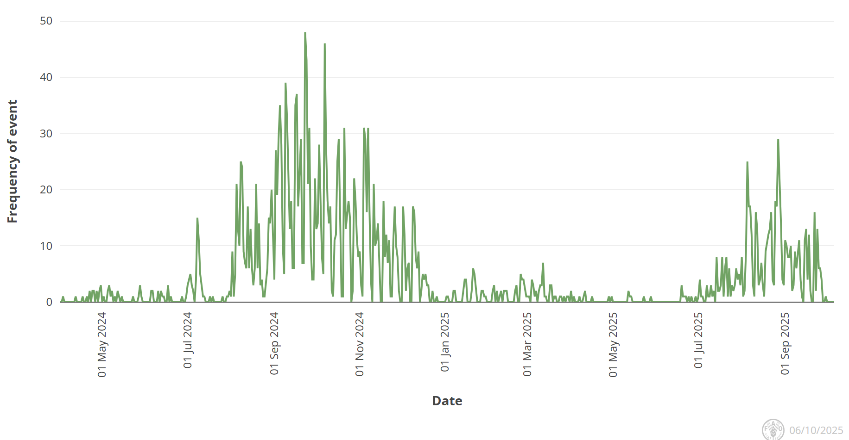
Bluetongue virus in Europe
Europe still reporting cases of BTV (serotypes 3, 8, and recently 5), but less than the previous year
BTV-3 Cases
  UK, Poland, Norway, Czech Republic, Romania (1st report), Hungary (1st since 2015)
  In Africa, Morocco recently reported its first cases of BTV-3
BTV-8 Cases
  UK, Slovenia, Italy, Greece, North Macedonia, Croatia, Serbia, Bosnia
BTV-5
  Italy
Unspecified BTV Serotype
  Kosovo
Empres-Plus
Notes:
The total number of BTV-3 cases in Great Britain for the 2025 to 2026 vector season (since July 2025) is 91. There have been: 87 cases in England 4 cases in Wales The total number of BTV-8 cases in Great Britain for the 2025 to 2026 vector season (since July 2025) is one. This case was in England.
Italy recently reported BTV-5 in sheep in Sardinia

Slide 8
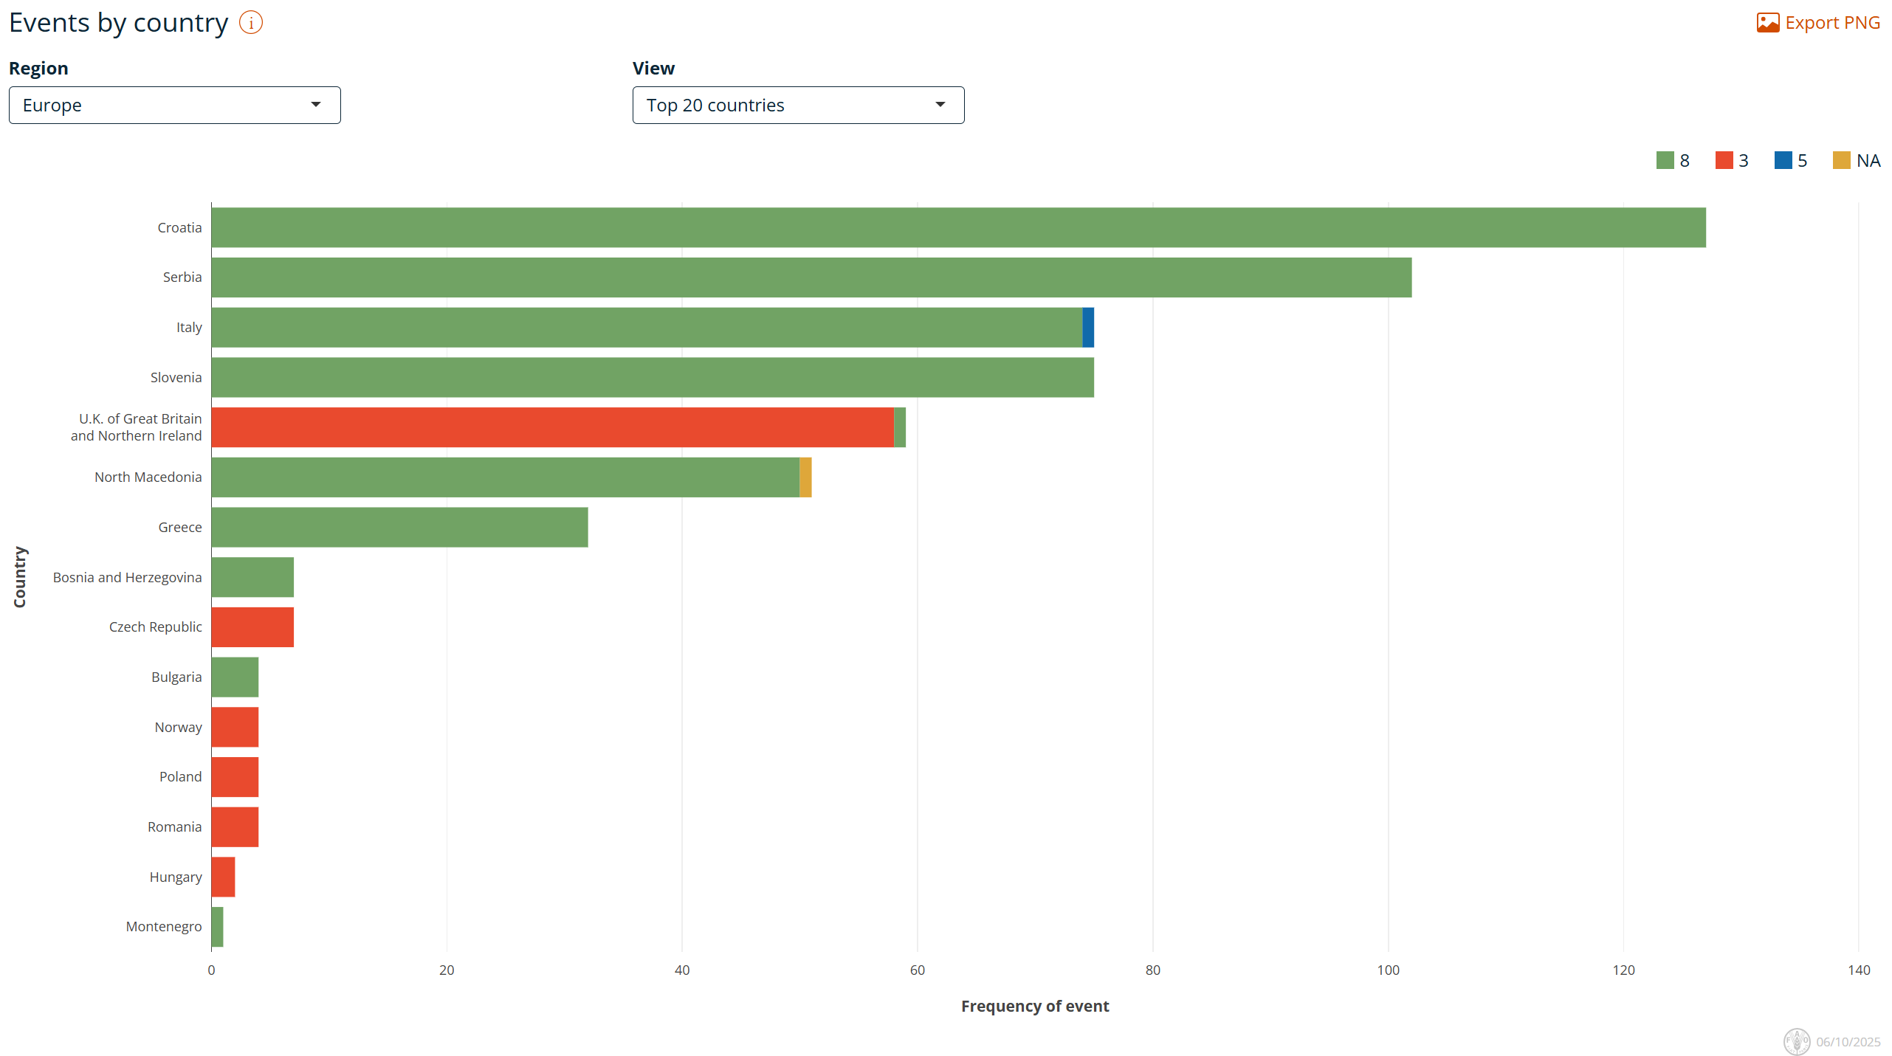
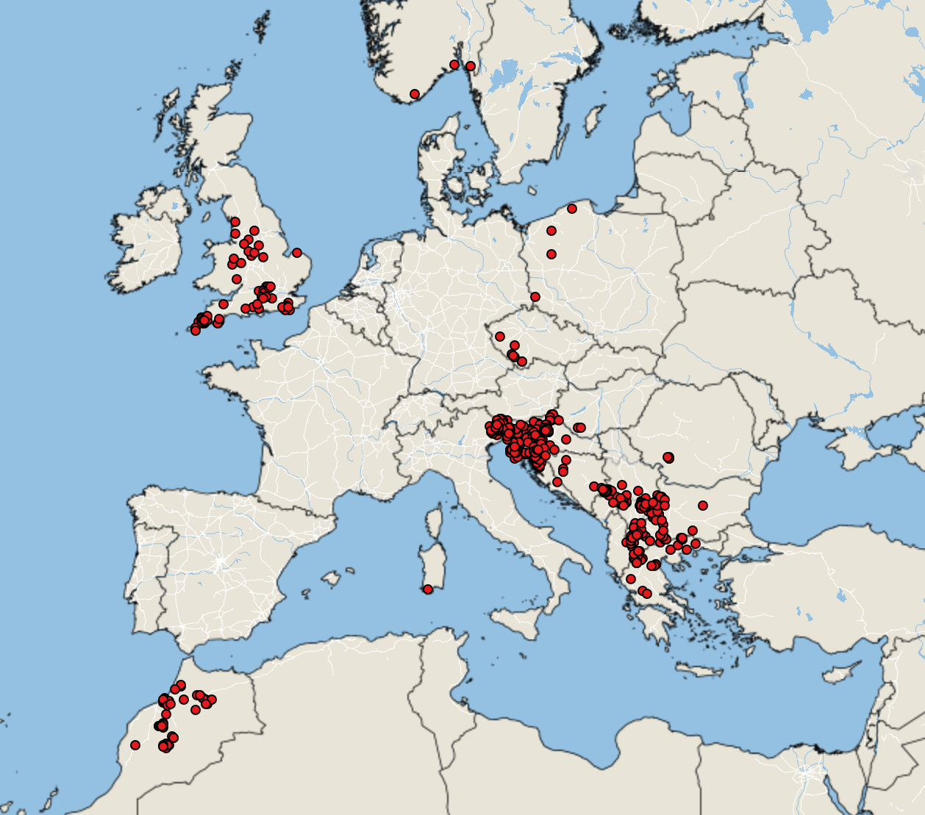
Bluetongue virus in Europe
Empres-Plus
BTV cases June 1, 2025 – October 5, 2025

Slide 9
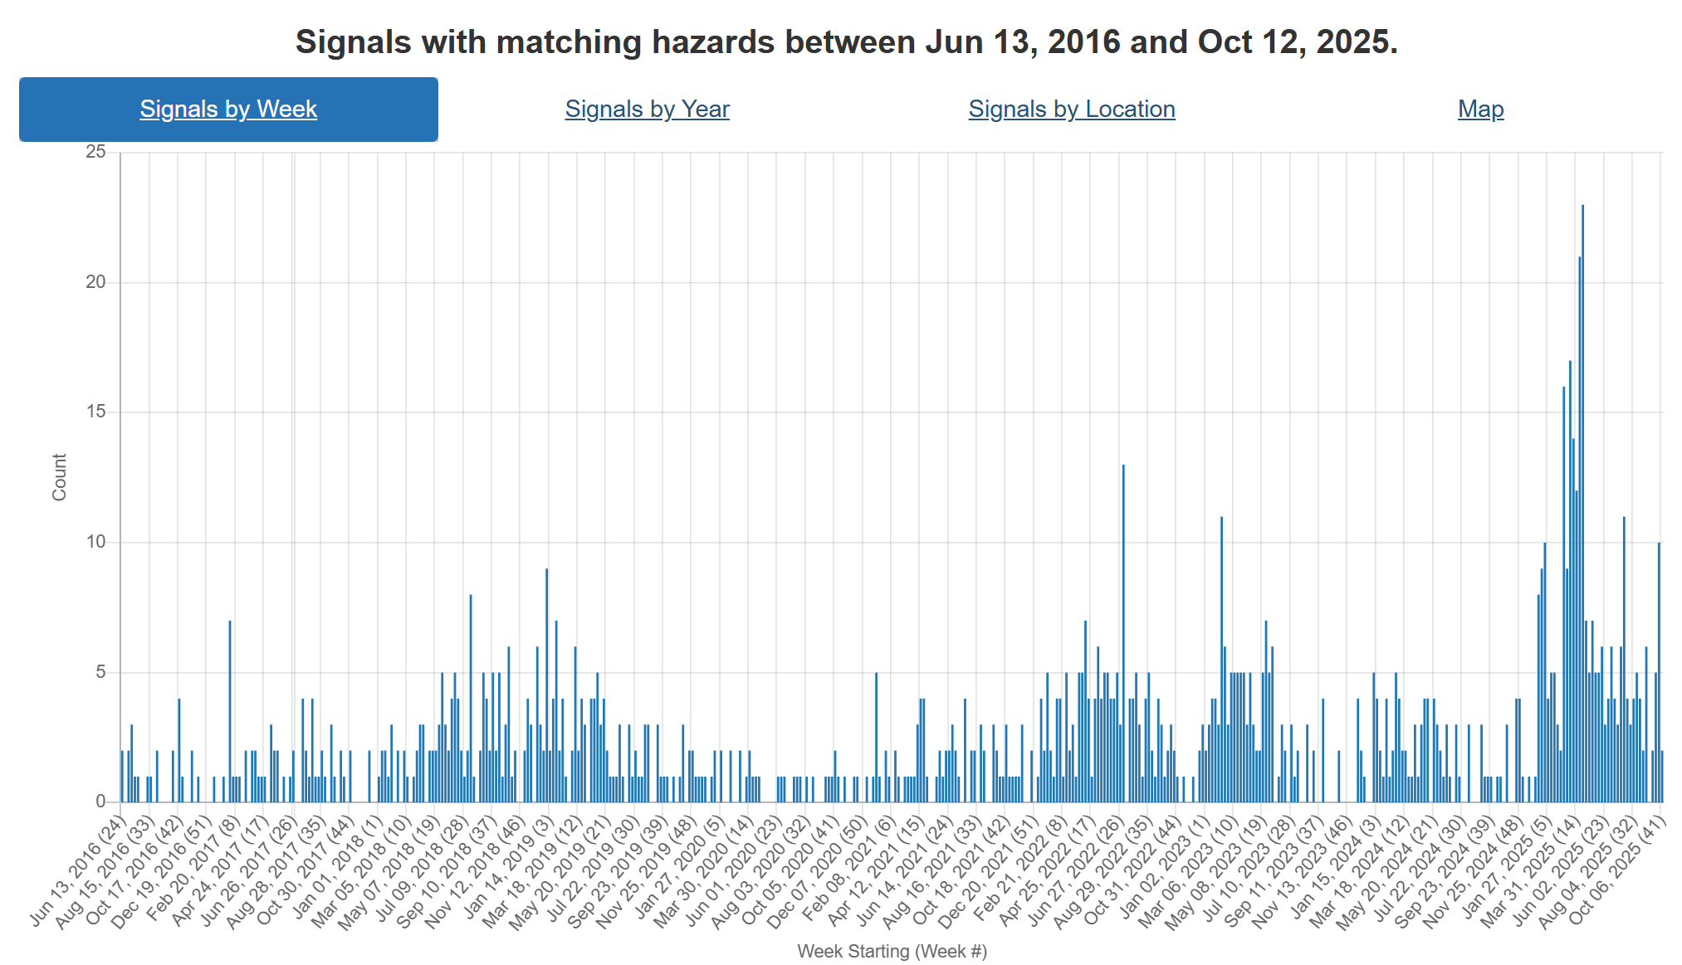
Foot and Mouth Disease – Hazard Trend
Slovakia
COVID
Indonesia
SAT-2
Middle East
Hungary
Germany
SAT-1
Middle East, Turikye, Egypt
Notes:
FMD trends over the last ~9 years. Can see increasing activity in recent years starting with its spread to Indonesia, than emergence of SAT-2 in the Middle East. This year Europe reporting cases in Germany, then Hungary and Slovakia. In addition there has been emergence of serotype SAT-1 in the middle East and Türkiye as well.

Slide 10
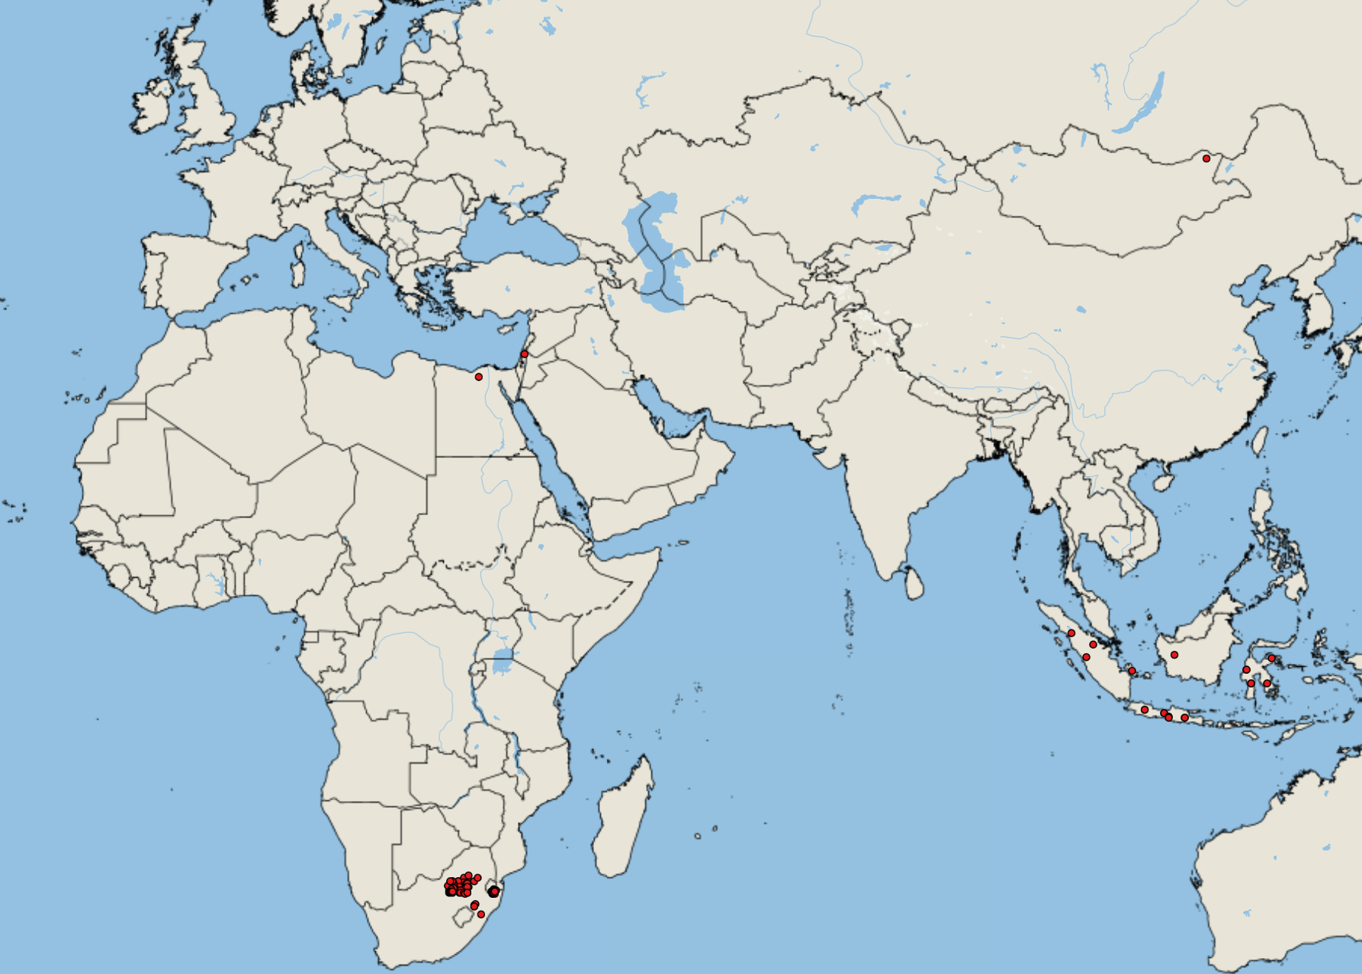
FMD cases Africa & Asia (since last meeting July 11, 2025)
Europe
  No additional cases
Asia
  Türkiye ~900 (SAT-1, SAT-2, O, A, untyped)*
  Iran 1 (suspected SAT-1)*
  Mongolia 1 (O)
  Israel 1 (unspecified)
  Indonesia 19 (O)
  India 1(O)*
Africa
  Egypt 1 (SAT-1)
  Swaziland 20 (SAT-2)
  South Africa 96 (SAT-2)
https://empres-i.apps.fao.org/general
Notes:
Since the beginning of the year (but mostly concentrated in Sept) Turkiye has reported 487 outbreaks of FMD SAT-1, 223 type O, 92 SAT-2, 85 untyped, and 4 outbreaks of type A
Turkish authorities are warning about the spread of FMD in the country, particularly in the Thrace region which acts as a critical point in preventing disease entry into Europe; outbreaks appear to be spreading westward and close monitoring is required as even vaccinated animals are showing mild signs of the virus (multiple different FMD serotypes circulate in Türkiye: O, A, SAT-1, SAT-2
SAT-2 continues to spread in southern Africa
India has reported FMD serotype O in chital/spotted deer at a zoo in Pune in July 2025

Slide 11
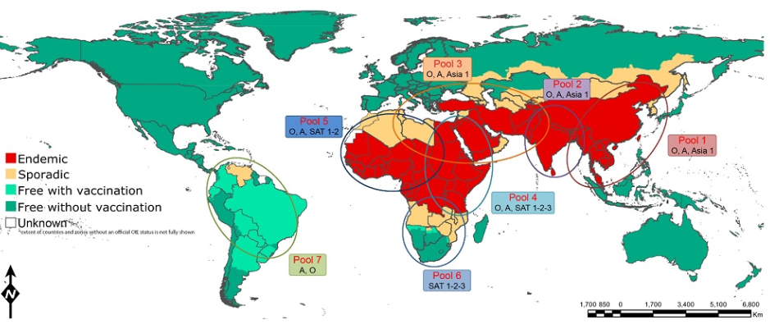
FMD SAT-1 in the Middle East, Türkiye & Egypt
Since January 2025, FMD serotype SAT-1 has been reported in the Middle East (Iraq, Bahrain, Kuwait, Iran), Egypt, and Türkiye.
Genome sequencing identified these viruses as SAT1/I topotype most closely related to FMD viruses that circulate in East Africa (pool 4)
Bahrain: 7 FMD SAT-1 outbreaks reported
Iraq: January 2025, FMD SAT-1 outbreaks reported in cattle and buffalo across the country. This is the first time SAT-1 has been reported in Iraq since 1962. 7 outbreaks reported in WAHIS
Kuwait: FMD SAT-1 reported in April 2025, 32 total outbreaks in WAHIS. These are the first outbreaks of FMD SAT1 since 1969/70 and the first FMD outbreaks since 2016.
Türkiye: 483 outbreaks of FMD SAT-1 reported. This is the first time SAT-1 has been reported in Türkiye since 1965.
Qatar had previously reported FMD SAT-1 in 2023
Egypt: July 2025, cases of FMD SAT-1 were reported in cattle and buffalo in Al Buhayrah
Iran: suspected FMD SAT-1 in western province
DEFRA Outbreak Assessment on SAT-1
Foot-and-Mouth Disease in Animals - Infectious Diseases - Merck Veterinary Manual
Notes:
Since January 2025, FMD serotype SAT-1 has been reported in the Middle East (Iraq, Bahrain, Kuwait) and Türkiye.
Genome sequencing identified these viruses as SAT1/I topotype most closely related to FMD viruses that circulate in East Africa (pool 4)
Bahrain: From January 2025, at least 7 FMD SAT-1 outbreaks have been reported in the country.
Iraq: Beginning in January 2025, FMD SAT-1 outbreaks have been reported in cattle and buffalo across the country. This is the first time SAT1 has been reported in Iraq since 1962; other serotypes (O and SAT2) have been reported in recent years.
Kuwait: On April 6, 2025 FMD SAT-1 was identified in Sulaibiya, in Al Jahra Governorate. These are the first FMD SAT1 outbreaks ever reported in the country after 1969/70 and the first FMD outbreaks since 2016. Since then, 31 outbreaks have been reported in WAHIS.
Turkiye: 9 outbreaks of FMD SAT-1 have been reported in Hakkari and Van division. This is the first time SAT1 is reported in Turkiye since 1965. Outbreaks were initially reported in the southeast of the country close to the border with Iraq. Wind borne spread may be the source of introduction
Qatar had also previously reported FMD SAT-1 in 2023
Turkiye has reported more FMD cases recently (although they have not been confirmed as SAT-1) due to animal movements that occurred during Eid.

Slide 12
Bovine Tuberculosis in Canada
Investigation status as of 2025-09-18
Manitoba (June 9, 2025):
The CFIA reported bovine TB in a 7-year-old dairy cow originating from the Pembina Valley Region, Manitoba that was slaughtered at a federally registered abattoir in Manitoba
1 Infected herd - depopulation completed, lab testing ongoing
Strain found in the infected herd is not a close match to any strain previously reported in livestock or wildlife in North America
29 trace-out herds identified with 6 herds released from quarantine or no quarantine required
CFIA continues to identify lifeline, trace-out, and contact herds and prepare for testing
Saskatchewan (November 29, 2024):
The CFIA reported bovine TB in a 6-year-old cow originating from Saskatchewan that was slaughtered at a federally registered abattoir in Alberta
1 Infected herd - humanely depopulated with 27 cases of bovine TB to date, cleaning/disinfection underway
Strain found in the infected herd is not a close match to any strain previously reported in livestock or wildlife in North America
7 lifeline herds identified with 5 herds released from quarantine
108 trace-out herds identified with 55 herds released from quarantine or no quarantine required
CFIA continues to identify trace-in and contact herds and prepare for testing
Bovine tuberculosis investigations - inspection.canada.ca
Notes:
Manitoba Case (June 9, 2025):
A 7-year-old dairy cow from the Pembina Valley Region tested positive for bovine TB at a federally registered abattoir. Depopulation of the infected herd is ongoing. The strain is genetically distinct from any previously reported in North America. The CFIA is actively tracing and preparing to test related herds.
Saskatchewan Case (November 29, 2024):
A 6-year-old cow from Saskatchewan was confirmed with bovine TB at an Alberta abattoir. One infected herd has been depopulated with 25 confirmed cases. The strain is also genetically unique. The CFIA has identified 7 lifeline and 46 trace-out herds, with several already released from quarantine.

Slide 13
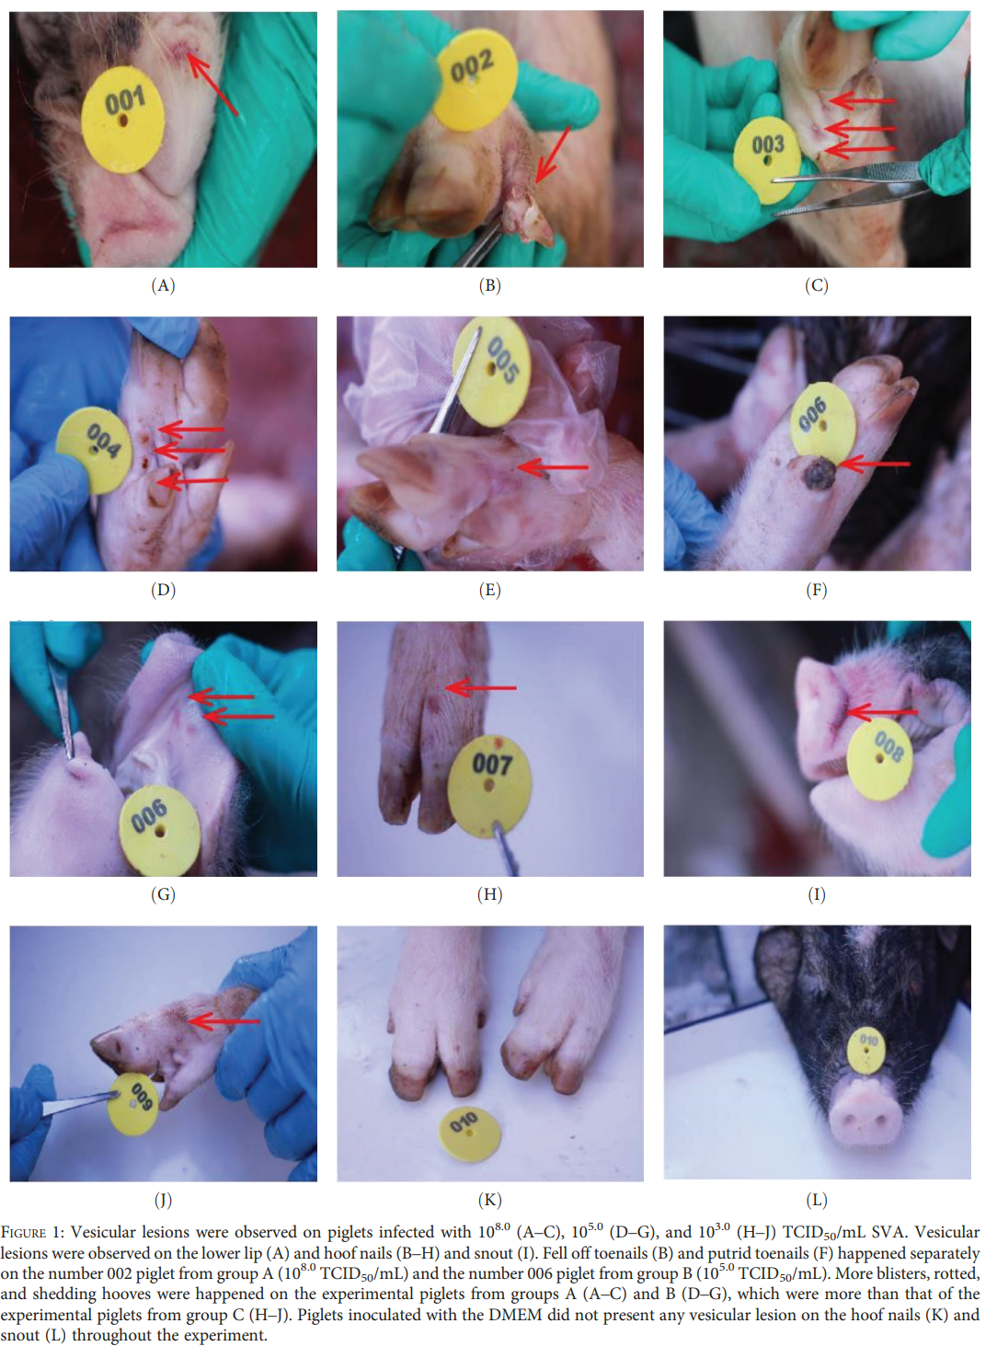
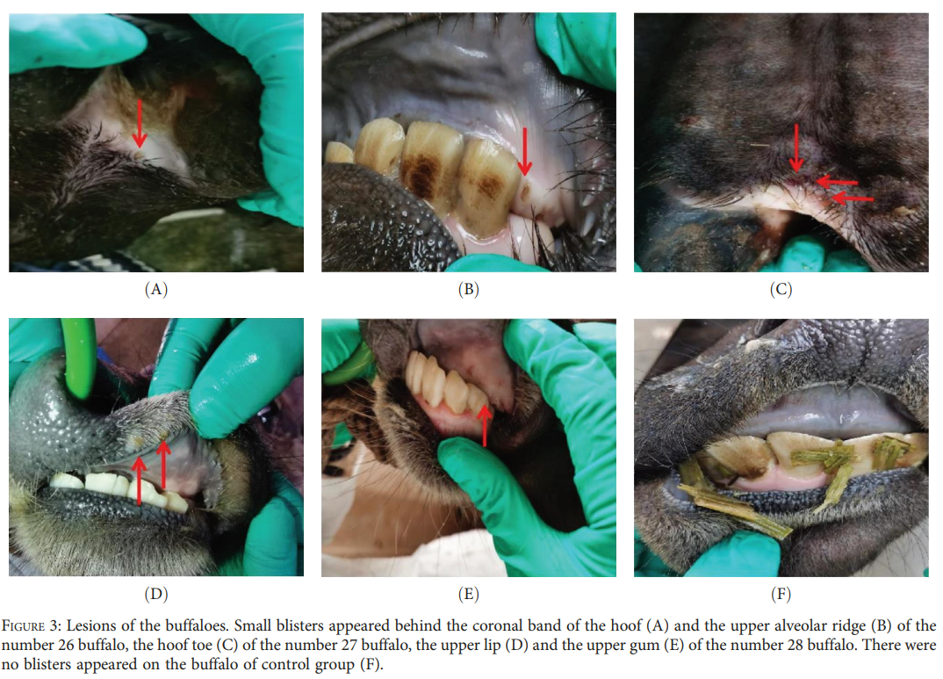
Pathogenicity of the First Buffalo-origin Senecavirus A in Conventional Piglets and Buffaloe
Study compared the outcome of piglets and buffaloes artificially infected by the different viral dose of the buffalo-origin SVA strain (SVA/GD/China/2018)
Clinical symptoms were observed in the piglets and buffaloes with the inoculation of 105.0 50% tissue culture infective dose (TCID50/mL)
The SVA antigen expression was also detected in the lung tissue, chin blister lesion tissue, nasolabial tissue of the piglets, and the upper lip blister tissue of the buffaloes
Notes:
Senecavirus A (SVA) is a non-enveloped RNA virus, clinically similar to foot-and-mouth disease virus. With the transmission routes are not fully understood, howver both direct and indirect pathways are believed to contribute to its spread.
SVA is traditionally associated with vesicular disease in swine. However, neutralizing antibodies have been detected in small populations of cattle and wild mice in the United States, suggesting possible exposure without overt clinical signs.
In 2018, SVA was identified in a buffalo in Guangdong Province, China — the first confirmed detection in this species. The buffalo-origin strain, SVA/GD/China/2018, was isolated from an animal with mouth ulcers and shares over 99% genetic similarity with a wild boar-origin strain.
This study compared the outcomes of piglets and buffaloes artificially infected with the boffola-origin strain.
And they observed clinical signs in piglets and buffalos inoculated with a medium does as well as Viral antigens were found in lung tissue, nasolabial regions, and blister lesions.

Slide 14
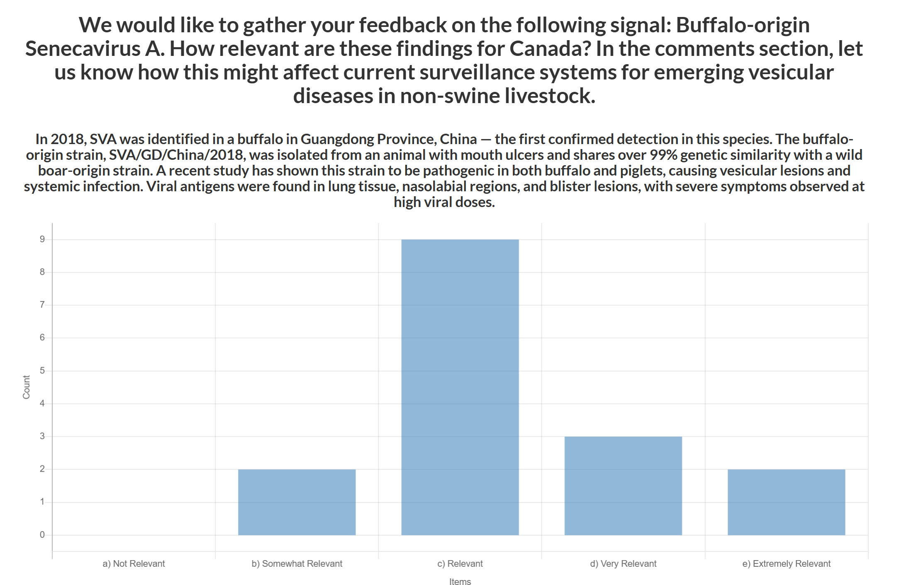
Pathogenicity of the First Buffalo-origin Senecavirus A in Conventional Piglets and Buffaloe - Ping
September 15, 2025
N = 16
Average = 3.31
Comments – trade impacts, surveillance, cross species concerns, gaps, research and reporting
Concern over potential infection of cattle, even subclinically - could complicate epidemiology and control
Vesicular diseases that mimic FMD can impact trade, causing delays and economic losses, differentiation requires laboratory testing
Normalization of vesicular lesions in swine could delay FMD detection
Cross-species spillover risk is heightened in multi-species farming systems, especially in China
Notes:
These findings raise important questions about cross-species transmission and biosecurity in mixed-species operations.
How relevant are these findings for Canada?
In the comments section, let us know how this might affect current surveillance systems for emerging vesicular diseases in non-swine livestock.
Trade Implications
Canada’s livestock exports depend on freedom from FMD and similar vesicular diseases.
SVA mimics FMD, risking trade disruptions and costly investigations.
Surveillance Needs
Enhanced SVA surveillance is needed to detect new strains and support export certification.
SVA should remain a differential diagnosis for vesicular lesions.
Emerging Risks
A new SVA strain in China shows higher pathogenicity and possible cross-species transmission.
Potential cattle infection would significantly raise concern.
Epidemiological Gaps
Unknowns remain about SVA’s transmission and wildlife reservoirs (e.g., wild boar).
Cross-species spillover risk is heightened in multi-species farming systems.
Preparedness and Vigilance
Normalizing vesicular signs in pigs could delay FMD detection.
Continued vigilance and diagnostic capacity are critical to protect trade and animal health.

Slide 15
Scientific Findings
FMD Quarterly Report April – June 2025
Epidemiology and economics of foot-and-mouth disease: current understanding and knowledge gaps
Progress of Foot-and-Mouth Disease Eradication in the Americas Since 1951
Interferon-stimulated gene MCL1 inhibits foot-and-mouth disease virus replication by modulating mitochondrial dynamics and autophagy
Molecular epidemiology of foot and mouth disease virus in Iran during 2019 and 2023
Predicted foot and mouth disease virus and African swine fever virus inactivation within carcasses undergoing field decomposition in three Australian climate zones
Spatiotemporal Dynamics of Emerging Foot-and-Mouth Disease, Bluetongue, and Peste Des Petits Ruminants in Algeria
Epidemiologic consequences of preclinical transmission of foot-and-mouth disease virus in cattle
Opportunities for machine learning to predict cross-neutralization in FMDV serotype O
Monitoring of Schmallenberg virus, bluetongue virus and epizootic haemorrhagic disease virus in biting midges in Germany 2019-2023
Replication and Virulence in Cattle of the First Lumpy Skin Disease Virus Isolated in Xinjiang, China (2019)
Genomic evolution of Salmonella Dublin in cattle and humans in the United States
Retrospective study of bovine besnoitiosis in the Auvergne Rhône-Alpes region in France
First isolation and characterization of caprine parainfluenza virus type 3 from cattle in China
Permissiveness of American bison to infection with severe acute respiratory syndrome coronavirus-2
First identification of Tusavirus in calf intestinal tissue suggests interspecies transmission and genomic variation

