Slide 1
Community for Emerging and Zoonotic Diseases
Identifying emerging risks through collective intelligence
CEZD – CAHSS Bovine Network Update
9 January 2026
www.cezd.ca
Notes:
~3-4 Environmental Scanning update on bovine related signals

Slide 2

Bovine Theileriosis in Canada
Bovine theileriosis is caused by Theileria protozoa
Infects cattle, sheep, water buffalo, yak, and other bovids
Several types of T. orientalis are found in the USA, but only T. orientalis Ikeda has been shown to cause severe illness
T. orientalis is transmitted by ticks, primarily the ALHT, but may also occur through re-use of needles, or during transfusions
The CFIA confirmed Canada’s first case of T. orientalis Ikeda in Kawartha Lakes, Ontario in October
    The cow was imported from the USA on July 15, 2025
    No control measures are undertaken to control the disease
2
Notes:
On October 8, 2025, the CFIA was notified of a suspicion of Theileriosis in a dairy cow with regenerative anemia located in Kawartha Lakes, Ontario. The cow was imported from the USA on July 15, 2025. The NCFAD then confirmed the sample to be positive for Theileria orientalis Ikeda through metagenomic sequencing and genotype identification. This is the first detection of Theileriosis in Canada. No control measures are undertaken to control the disease.
Bovine theileriosis is caused by a blood parasite (protozoa) from the Theileria genus that infects red and white blood cells. It is primarily spread by ticks, especially the Asian longhorned tick, but can also spread via contaminated needles or blood transfusions. However, other insects such as flies, mosquitoes and lice may also spread the disease but their role is not yet clear.
Susceptible species include cattle, sheep, water buffalo and other bovids.
There are several types of Thelieria orientallis in the USA (including Chitose, buffeli and Ikeda) but only Ikeda has been shown to cause severe illness.
Clinical signs in infected cattle often appear as:
fever
swollen lymph nodes (lymphadenopathy)
loss of appetite and weight loss
nasal discharge
diarrhea
decreased milk production
anaemia, jaundice, and bloody urine
How sick the animal gets depends on the type of theileria parasite and the susceptibility of the animal host. In some cases, animals may get sick or die, especially if they've never had the disease before.
2

Slide 3


Asian Longhorn Tick and Theileriosis in the USA
Since the last CAHSS call – Kansas has reported its first detection in October 2025
  Found on a dog in Franklin County
25 states + Washing D.C. now affected
Kansas has also recently report theileriosis in cattle that were brought into the state (unclear from where)
Theileria is tick-borne, but flies, mosquitos, and lice may also play a role
Detection and response to Haemaphysalis longicornis and Theileria orientalis Ikeda on a cow-calf farm in Tennessee (USA)
Emergence of multidrug-resistant Haemaphysalis longicornis populations in China
Asian Longhorned Tick Situation Report - The Tick App
Notes:
Also a recent study from China has identified ALHT resistance to acaricides (cyhalothrin, cypermethrin, deltamethrin, amitraz, and fipronil), resistance levels to the different acaricides ranged from susceptible (S) to level IV. Level IV resistance was observed for fipronil and amitraz.
This study documents our first response to a T. orientalis Ikeda-positive herd in Maury County, Tennessee (USA). Before our arrival and detection of H. longicornis on the property, we advised the producer to maintain a closed herd, use on-animal chemical control, and reduce overgrown vegetation. Upon arrival, we identified sampling areas where cattle primarily resided or previously had been and targeted these areas using timed tick dragging methods, checking the drag for ticks every 10 meters for a mean of 352 min per visit (~6 h). Collections occurred once in July 2022 and every other week in 2023 (June–November). In total, 166 H. longicornis larvae and 45 nymphs were collected. Nymphs were screened for T. orientalis, and 4.5% (2/44) were positive for T. orientalis Ikeda a year after the herd was initially confirmed positive
3

Slide 4
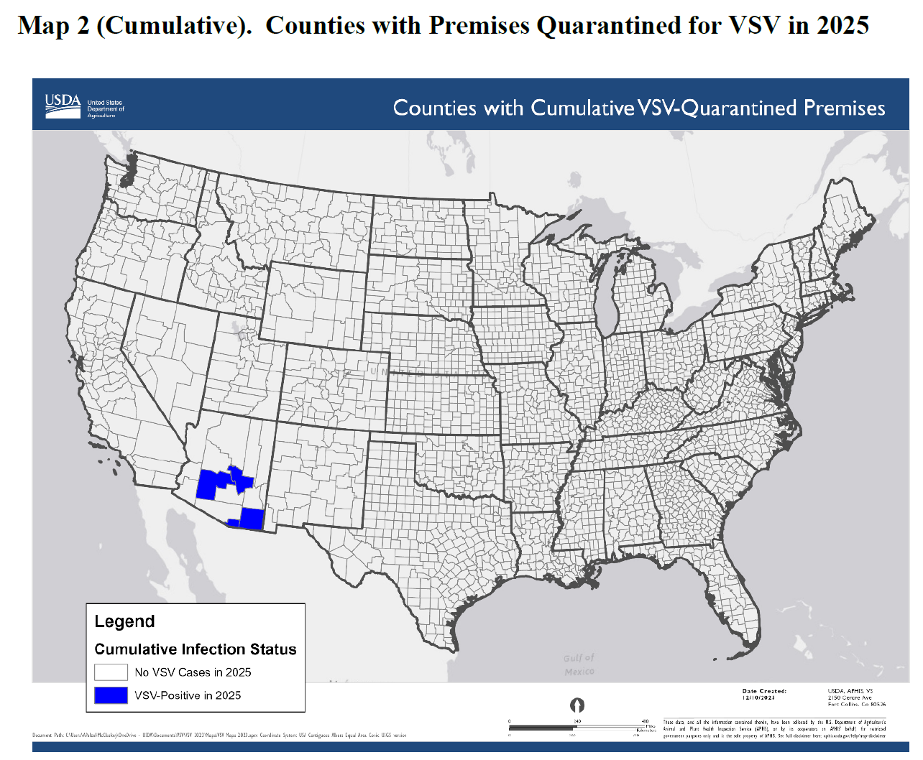
Vesicular Stomatitis in Arizona
USDA VSV Situation Report (January 5, 2026)
Most recent incursion is in Arizona (October 2025)
New Jersey Strain virus
7 premises affected in 4 counties
  Cochise County (2 initial cases - released)
  Gila County (1 case – released)
  Santa Cruz County (2 case – 1 released, 1 quarantine)
  Maricopa County (2 cases, wild horse – 2 quarantine)
No recent livestock movements onto the index premises
Suspect that vector movements across the border are the source of the outbreaks
The 2023/24 outbreaks in California, Nevada and Texas are also thought to have originated from vector movements across the border with Mexico
4
Notes:
Vesicular stomatitis primarily affects horses but can also affect other farm animals such as cows, sheep, and goats, as well as humans.
It circulates annually in livestock and insect vectors in southern Mexico and results in occasional incursions in the U.S. when climate and ecological factors support northward movement.
Most recent incursion to the southern US is in Arizona with the New Jersey Strain virus.
On October 31, 2025, the USA confirmed two cases of vesicular stomatitis New Jersey virus (VSNJV) in horses on two separate premises in Cochise County, Arizona.
There had been no recent livestock movements related to the index case, so, it is suspected that vector movements across the border are the source of the outbreaks.
As of this week there have been 7 affected premises reported across 4 counties, with 3 currently still in quarantine.
4

Slide 5
Bovine Tuberculosis in Canada
Investigation status as of 2025-12-30
Manitoba (June 9, 2025):
The CFIA reported bovine TB in a 7-year-old dairy cow originating from the Pembina Valley Region, Manitoba
1 Infected herd - depopulation completed, lab testing ongoing
Strain found in the infected herd is not a close match to any strain previously reported in livestock or wildlife in North America
44 trace-out herds identified with 36 herds released from quarantine or no quarantine required; 5 trace-in herds identified and released from quarantine or no quarantine required; 7 proximity herds identified with 1 herd released from quarantine or no quarantine require
CFIA continues to identify lifeline, trace-out, and contact herds and prepare for testing
Saskatchewan (November 29, 2024):
The CFIA reported bovine TB in a 6-year-old cow originating from Saskatchewan that was slaughtered at a federally registered abattoir in Alberta
1 Infected herd - humanely depopulated with 27 cases of bovine TB to date, cleaning/disinfection underway
Strain found in the infected herd is not a close match to any strain previously reported in livestock or wildlife in North America
7 lifeline herds identified with 6 herds released from quarantine; 125 trace-out herds identified with 115 herds released from quarantine or no quarantine required; 11 trace-in herds identified with 8 herds released from quarantine or no quarantine required; 1 contact herd identified and released from quarantine or no quarantine required; 13 proximity herds identified with 3 herds released from quarantine or no quarantine required
CFIA continues to identify contact herds and prepare for testing
Bovine tuberculosis investigations - inspection.canada.ca
Notes:
Manitoba Case (June 9, 2025):
A 7-year-old dairy cow from the Pembina Valley Region tested positive for bovine TB at a federally registered abattoir. Depopulation of the infected herd is ongoing. The strain is genetically distinct from any previously reported in North America. The CFIA is actively tracing and preparing to test related herds.
Saskatchewan Case (November 29, 2024):
A 6-year-old cow from Saskatchewan was confirmed with bovine TB at an Alberta abattoir. One infected herd has been depopulated with 25 confirmed cases. The strain is also genetically unique. The CFIA has identified 7 lifeline and 46 trace-out herds, with several already released from quarantine.

Slide 6
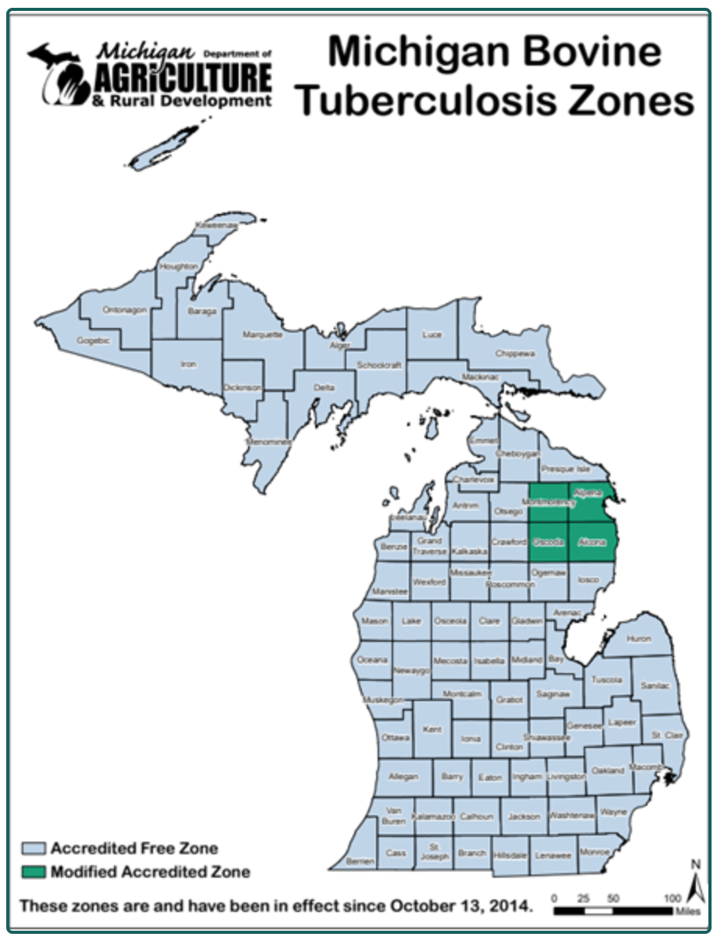
Bovine Tuberculosis in the United States
Michigan reported a case of bTB in a beef herd from Presque Isle County
  Located north of Michigan's Modified Accredited Zone
  Detected via routine annual herd surveillance
  84th infected herd detected in Michigan since 1998
MDARD - Bovine Tuberculosis
Notes:
November 2025

Slide 7
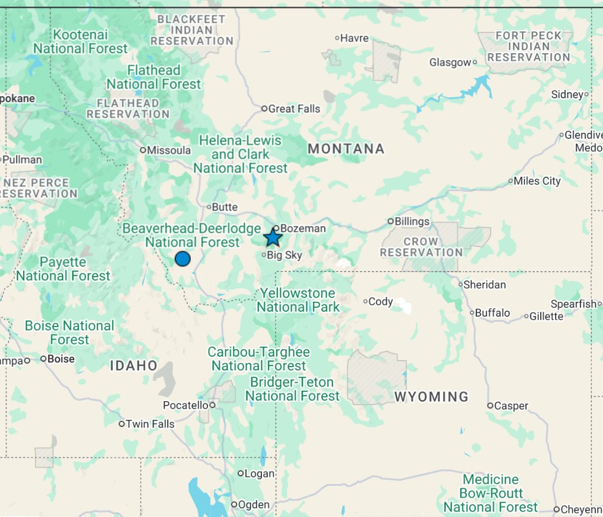
Brucellosis in the United States
Montana has confirmed a case of brucellosis in Gallatin County, within Montana’s Designated Surveillance Area
  2nd case in 2025, result of annual surveillance testing
  Infected animal was euthanized, herd in under quarantine, investigation in ongoing
  Earlier case this year was in Beaverhead County
  15th brucellosis affected herd confirmed in Montana since the implementation of the DSA in 2010
  All previous herds infections were related to wild elk
Notes:
marking Montana’s second case in 2025
Brucellosis is a bacterial disease primarily of cattle. It can also affect wildlife, particularly elk and bison. And it’s also a zoonotic disease — so it’s capable of causing infections in people. Concern for people who consume raw milk.
The recent Gallatin County case was identified through Montana’s Department of Livestock surveillance program, which has been in place since 2010. On average, the state has identified roughly one affected herd per year since the program began.
Montana’s DSA exists due to the risk of disease spillover from infected wildlife in the Greater Yellowstone Area
Montana’s DSA exists due to the risk of disease spillover from infected wildlife in the Greater Yellowstone Area (GYA). Brucellosis causes reproductive issues in livestock including abortions, still births, and neonatal mortalities.

Slide 8
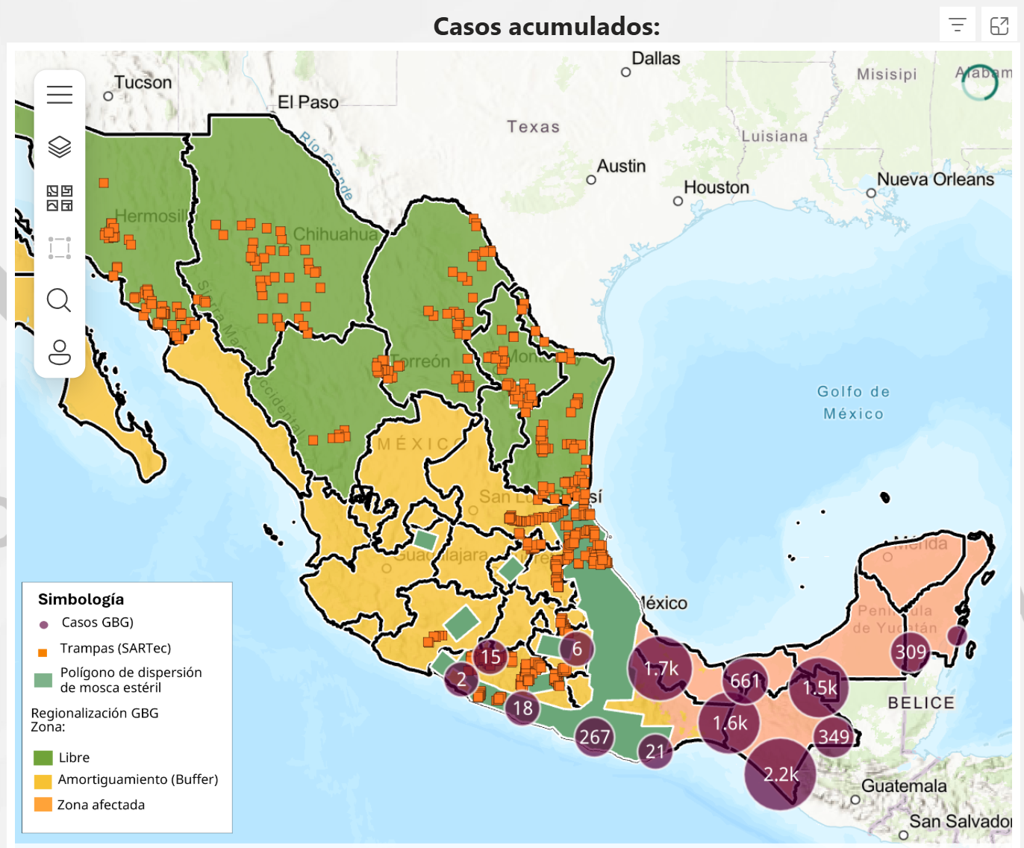
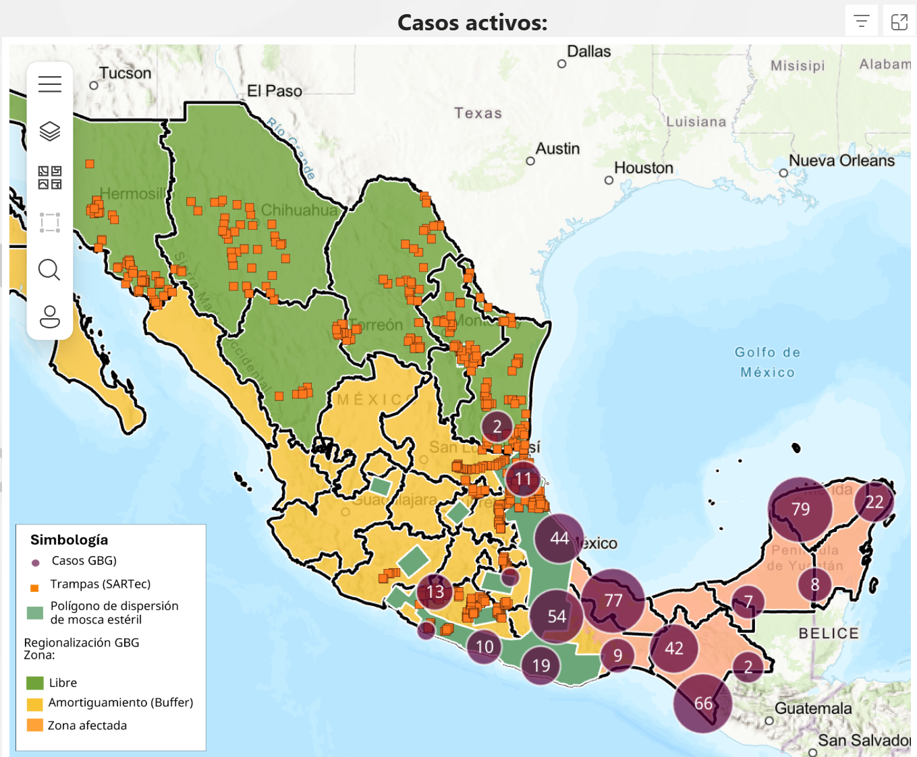
New World Screwworm
Mexico has reported two cases of NWS in Tamaulipas (317km from Texas border) - same region where the new sterile fly dispersal facility was opened
Mexico has reported its first case of NWS in Michoacán, a case in the State of Mexico (bordering Mexico city), and a 3rd case of NWS in Nuevo Leon in a bovine imported from Veracruz
Continued increase in cases in animals and humans
Mexico’s interactive dashboard displays 492 active cases of NWS in animals (13,355 cumulative)
Mexico – 1862 (~13.9%) cases in dogs, 32 cases in cats
Alternate management strategy being piloted in Yucatan to decrease total fly numbers before release of sterile flies
“For sterile flies to be effective, there must be 10 of them for each fertile fly”
8
Notes:
Mexico has reported its first case of NWS in Tamaulipas - in a 6 day old calf (no reports of it being imported from another region) - Today they also reported a case in Altimira in a horse – which could mean the fly has reached the region.
This is also the same region where the new sterile fly dispersal facility was opened (Tampico, Mexico); which aims to increase the range and number of sterile flies being released and allow for a greater ability to push the pest south.
Mexico has reported a third case of NWS infestation in Nuevo Leon, again in a bovine imported from a southern affected region (Veracruz)
Mexico's dashboard shows 671 active cases with 13,106 cumulative cases in animals. A recent report also mentioned the impact of pets, with ~1602 cases reported in dogs and 32 cases in cats
Mexico has also reported additional human cases of NWS infestation, bringing the total number to 106 as of Dec 13 (Chiapas = 86, Campeche = 4, Tabasco = 2, Yucatan = 8, Oaxaca = 2, and QuintanaRoo = 4)
8

Slide 9

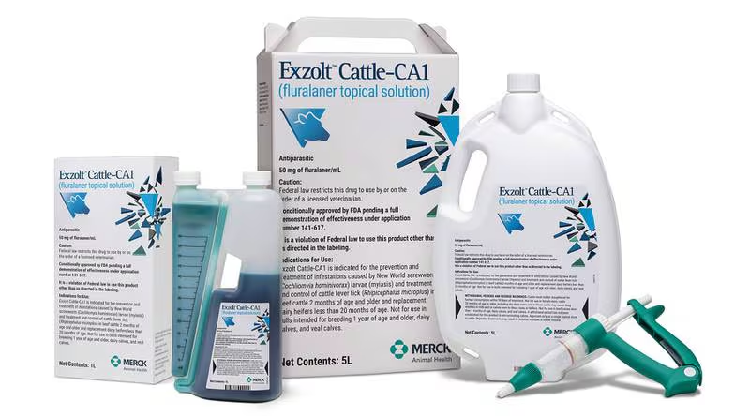
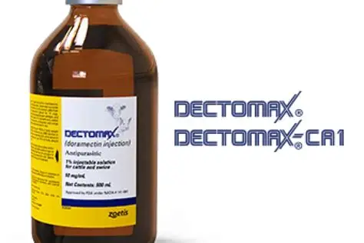
New World Screwworm
Emergency Use Authorizations
  Credelio Cat
  Credelio Dog
Efficacy of lotilaner against myiasis caused by Cochliomyia hominivorax (Diptera: Calliphoridae) in naturally infested dogs | Parasites & Vectors
US FDA Conditionally Approved Treatments
  Credelio Quattro-CA1 (Elanco) chewable tablets for dogs
  Exzolt Cattle-CA1 (Merck) fluralaner topical solution for beef cattle (>2 months of age) and replacement dairy heifers (<20 months of age)
  Dectomax-CA1 (Zoetis) injectable for cattle, 35 day withdrawal for cattle, not for use in dairy >20 months of age
9
Notes:
Washington, D.C., December 17, 2025—Today, the U.S. Food and Drug Administration conditionally approved Credelio Quattro-CA1 (lotilaner, moxidectin, praziquantel, pyrantel) chewable tablets for the treatment of infestations caused by New World screwworm (NWS) larvae (myiasis) in dogs and puppies at least eight weeks of age and weighing at least 3.3 pounds.
Washington, D.C., December 4, 2025—Today, the U.S. Food and Drug Administration conditionally approved Exzolt Cattle-CA1 (fluralaner) topical solution for the prevention and treatment of New World screwworm (NWS) larval infestations, and the treatment and control of cattle fever tick in beef cattle 2 months of age and older and replacement dairy heifers less than 20 months of age.
9

Slide 10
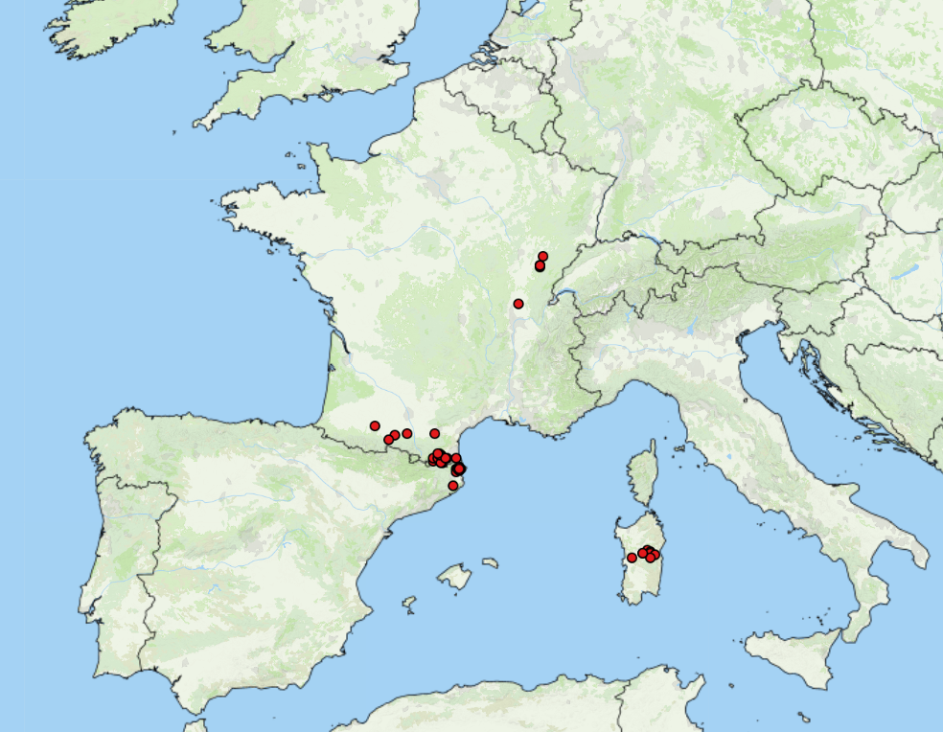
Lumpy Skin Disease in Europe
LSD Cases: October 2025 – December 2025
Empress +
France: 117 outbreaks, Savoie (32), Haute-Savoie (44), Ain (3), Rhône (1), Jura (7), Pyrénées-Orientales (22), Doubs (1), Ariège (3) and Hautes-Pyrénées (1), Haute-Garonne (2), Aude (1)
Italy: 80 outbreaks, concentrated in Sardinia, with one cases in Lombardy (linked to animal movement from Sardinia), no new outbreaks reported since early November 2025
Spain: cases in Girona, close to French border, as of October 27 has reported 17 outbreaks
DEFRA LSD Outbreak Assessment: Phylogenetic analysis indicates that the outbreaks in France and Italy are clade 1.2 strain - same clade that circulating in Europe in 2015 - 2017
French farmers have been protesting the culling measures used to control LSD
10
Notes:
In late June 2025 the First outbreaks of LSD in Europe were reported in Italy, followed shortly by France and then Spain.
As of January 9, 2025
France has experienced 117 outbreaks, Savoie (32), Haute-Savoie (44), Ain (3), Rhône (1), Jura (7), Pyrénées-Orientales (22), Doubs (1), Ariège (3) and Hautes-Pyrénées (1), Haute-Garonne (2), Aude (1) - still reporting new outbreaks, with french farmers protesting the culling measures used in an effort to control the disease.
Italy up to 80 outbreaks, still concentrated on Sardinia, no new outbreaks since early Nov 2025
Spain has reported 17 outbreaks all still within Girona (close to the french border) with the last one on October 27, 2025
Info included in a recent DEFRA outbreak assessment indicates from phylogenetic analysis that the LSD outbreaks in France and Italy and clase 1.2, the same one that circulated in Europe in 2015-2017.
10

Slide 11
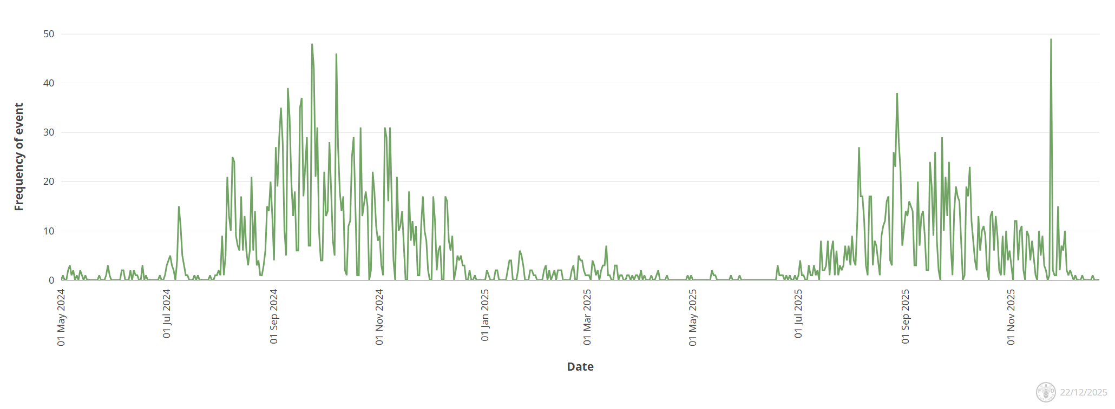
Bluetongue virus in Europe
Europe still reporting cases of BTV (serotypes 3, 8, 5, and 4)
BTV – 3
  The UK (including Northern Ireland now), Romania, Serbia, Greece, Poland, Hungary, Bulgaria, Lithuania, Croatia
BTV – 8
  Germany (re-emergence), Greece, Serbia, Bosnia, Slovenia, Hungary, Bulgaria
BTV - 4
  Bulgaria, Romania, Italy, Greece
BTV – 5
  Italy, Tunisia*
Empres-Plus
Notes:
With regards to Bluetongue we are still seeing cases across Europe with a recent peak, with cases of BTV-3 being reported from Northern Ireland now as well.. Most cases/activity has been related to BTV-3, followed by BTV-8 (which has just recently been reported again in Germany and a re-emergence). BTV-4 has been reported in a few countries (Bulgaria, romania, Italy and a little in Greece) and then BTV-5 reported in Italy.
11

Slide 12
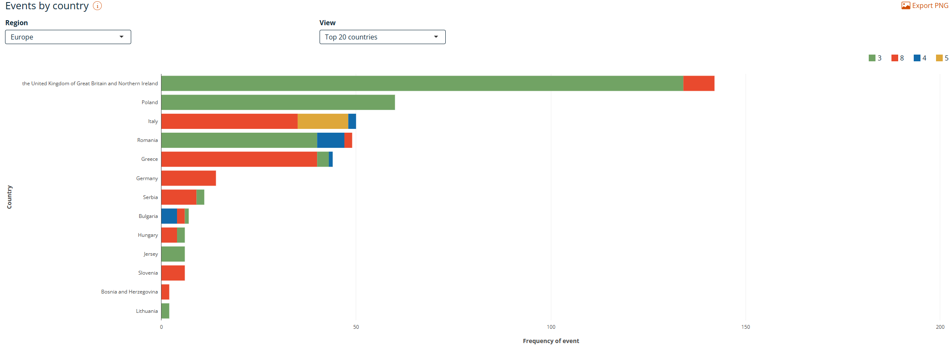
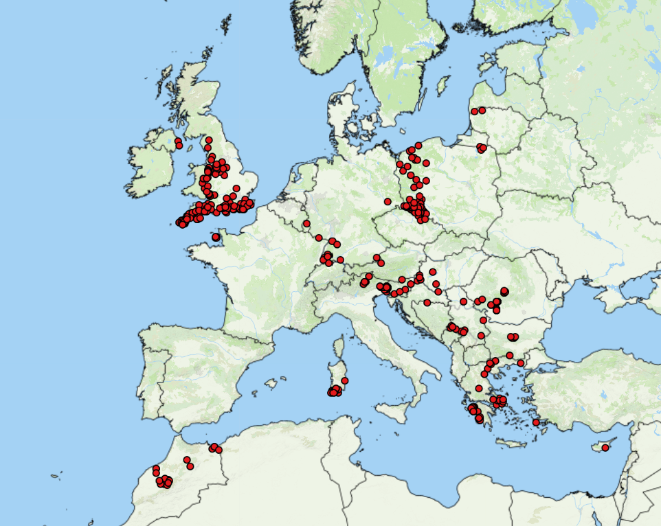
Bluetongue virus in Europe
Empres-Plus
BTV cases October 15, 2025 – January 6, 2026

Slide 13
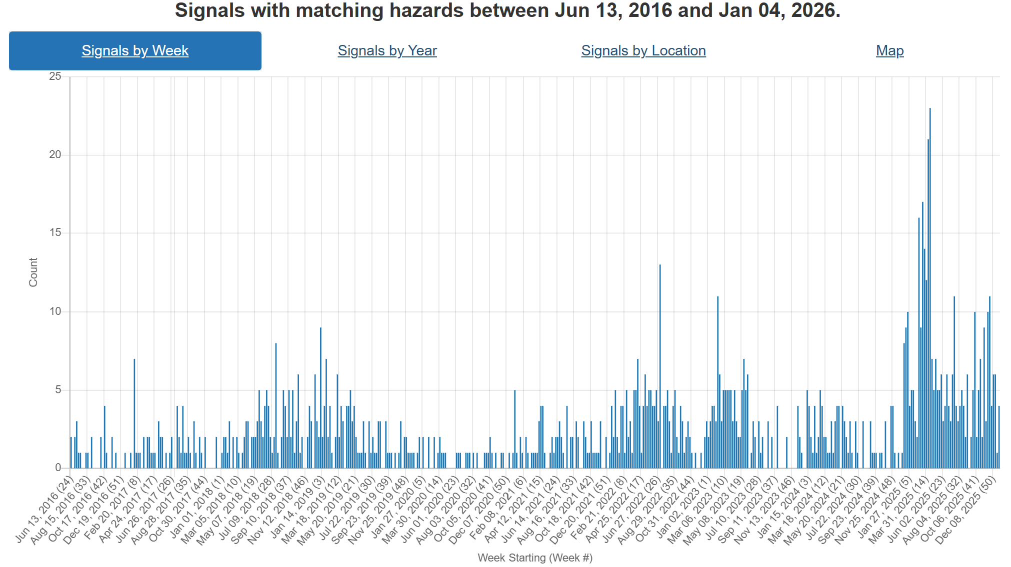
Foot and Mouth Disease – Hazard Trend
Slovakia
COVID
Indonesia
SAT-2
Middle East
Hungary
Germany
SAT-1
Middle East
Notes:
FMD trends over the last ~9 years. Can see increasing activity in recent years starting with its spread to Indonesia, than emergence of SAT-2 in the Middle East. Early 2025 we saw Europe reporting cases in Germany, then Hungary and Slovakia. In addition there has been emergence of serotype SAT-1 in the Middle East and Türkiye as well.

Slide 14
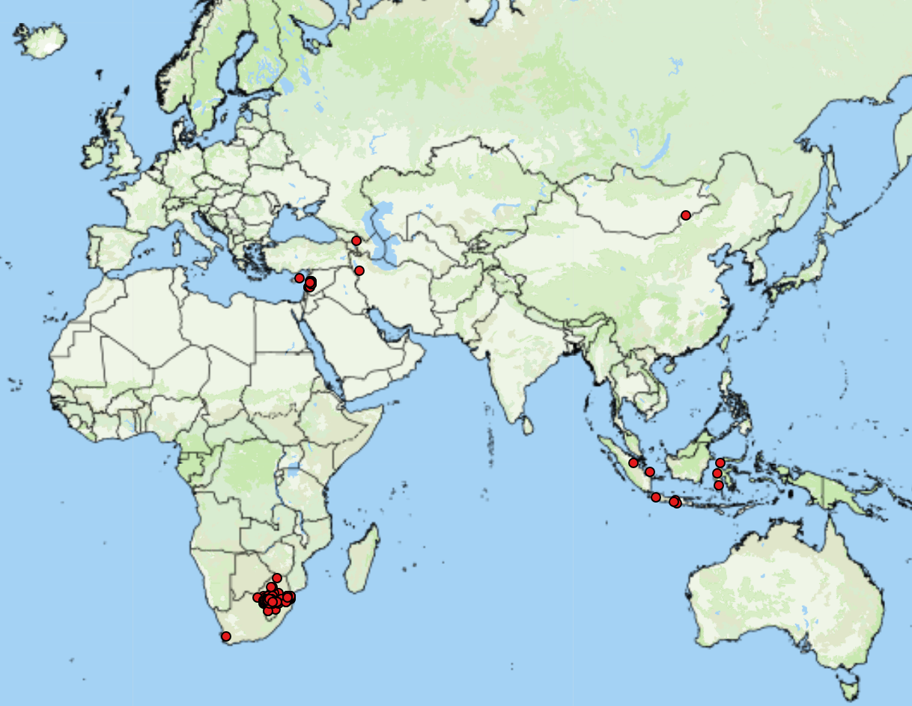
FMD cases reported by FAO Empres-i (since October 15, 2025)
Asia (underestimates)
Azerbaijan* (1 SAT-1)
Cyprus* (1 SAT-1)
Indonesia (9 no serotype)
Iran* (1 SAT-1)
Lebanon* (53 no serotype)
Mongolia (1 O)
Africa
Swaziland (38 SAT-1, 4 SAT-2)
South Africa (182 SAT-2)
Mozambique* (1 SAT-1)
Egypt (SAT-1)
53
https://empres-i.apps.fao.org/general
Notes:
* Indicate first reports
Two separate outbreaks of FMD have been confirmed in Turkish-controlled Northern Cyprus. These are the first FMD outbreaks in Cyprus since 2007. One outbreak was detected in Ayios Sergios, and four cases were reported in cattle at a farm in Lapithos, ~75 kms to the north-west of Ayios Sergios. Laboratory testing by the Turkish Foot and Mouth Research Institute in Ankara identified the SAT1 serotype as the causative agent. Approximately 13,000 animals, including cattle, sheep, and goats, are being vaccinated by 35 teams across Northern Cyprus. The spread of FMD into Cyprus, and several other countries, was considered as "likely” by a recent FAO risk assessment
Azerbaijan has reported its first cases of FMD SAT-1. Two cases were reported in cattle in a farm in Ganja-Qazakh that kept both cattle and small ruminants. Control measures (zoning, monitoring, movement restrictions, culling, and disinfection) have been implemented, however no vaccination has been carried out as the vaccine for this serotype is currently unavailable.
Iran has confirmed the detection of FMD SAT-1 topotype 3 (with reported rapid spread in Tehran province), and has begun work on developing a vaccine for the serotype
Lebanon has reported two outbreaks of FMD (serotype pending) in Bekaa. Lebanon last reported FMD in 2008. Two outbreaks were reported, one in a large cattle farm in West Bekaa and the other in a small farm in Zahleh.
Egypt has reported increasing cases of FMD in livestock, specifically in Lower Egypt and the Delta, along with low vaccine uptake from farmers

Slide 15
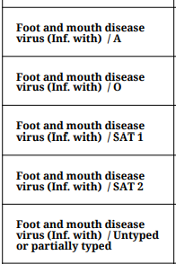



Foot and mouth disease in North Africa and the Middle East - GOV.UK
Türkiye
Lebanon
  WAHIS – 53 total outbreaks as of Jan 7
Cyprus
  No official reports to WOAH
  News reports indicate SAT-1 outbreak
  Ministry of Agriculture: Foot-and-mouth disease outbreak confirmed, emergency action plan in force - Kıbrıs Newspaper - Kıbrıs News, TRNC Breaking and Agenda News
Assessment of Foot‐and‐Mouth Disease Trends in Türkiye Between 2005 and 2025 - Pedro Mil-Homens - 2025 - Transboundary and Emerging Diseases - Wiley Online Library
ADIS Notification - TRACES NT – 2025 Summary Report
ADIS outbreaks-current-year-report – updated weekly
Notes:
Turkiye trends between Nov 2005-Mar 2025 (although 2025 data was not fully included) indicate a peak of FMD between 2010 and 2016 with serotype O dominating, however it does not include recent 2025 data, in which from the ADIS system shows surpassing SAT-1 outbreaks/

Slide 16
FAO - Rapid risk assessment: FMD SAT-1
Country | Likelihood/Uncertainty | Impact/Uncertainty
Afghanistan | Likely/High | Severe/Moderate
Armenia | Likely/Moderate | Low/Moderate
Bulgaria | Unlikely/Low | Low/Low
Cyprus | Likely/Moderate | Low/Moderate
Georgia | Very Likely/Moderate | Moderate/Moderate
Greece | Likely/Moderate | Low/Low
Israel | Likely/Moderate | Low/Moderate
Jordan | Likely/High | Moderate/High
Lebanon | Likely/High | Moderate/High
Libya | Very Likely/High | Severe/High
Country | Likelihood/Uncertainty | Impact/Uncertainty
Oman | Likely/Moderate | Low/Moderate
Pakistan | Likely/Moderate | Severe/Moderate
Qatar | Likely/Low | Low/Low
Russian Federation | Likely/High | Moderate/Moderate
Saudi Arabia | Likely/High | Moderate/Moderate
Syrian Arab Republic | Very Likely/High | Severe/High
Turkmenistan | Likely/High | Moderate/High
United Arab Emirates | Unlikely/Moderate | Low/Low
West Bank & Gaza Strip | Likely/High | Moderate/High
Yemen | Very Likely/High | Severe/High
Likelihood – Border sharing, trade networks, veterinary services, SAT-1 vaccination, historical entry of FMD/other diseases
Notes:
Afghanistan – likelihood – borders with Iran, has low veterinary coverage, populations naïve to SAT-1, no vaccination
Armenia – Likelihood – bordered by countries reported FMD SAT-1 (Azerbaijan, Iran, Turikye) Livestock pop = 1.4 million cattle/ruminants/pigs, launched vaccination against SAT-1 in Sept 2025
Bulgaria- borders Turikye (trade is informal/limited), Thrace is still FMD-free, no SAT-1 vaccination,
Cyprus – Turkiye animal exports to the island, proximity/connections to Anatolia enhance likelihood
Georgia- outbreak in Azerbaijan near border, also proximity to Turkiye, is mobilizing SAT-1 vaccination, trade in animals/products are potential pathways
Greece – Borders Turkiye, LSD also spread from Turkiye previously, no vaccination, small trade volume of dairy/meat from Bahrain 2021/Turkiye 2023/ cheese from Egypt 2023
Israel – consistently reporting FMD outbreaks, trade related exposure from Turkiye, land border with Egypt, historical entry from neighbouring countries
Jordan – historical entry from neighbouring countries (SAT-2 in 2023, LSD in 2013), FMD SAT-1 vaccination is available and used., informal movements from Iraq/workers from Egypt
Lebanon – historical entry from neighbouring countries. Porous border from Syria, human mobility from Iraq/Turkiye, low vet capacity
Libya – strong cross border links with Egypt, live cattle imports, porous border. Large ruminant population, limited surveillance.
Oman – imports live cattle from affected countries (Bahrain/Iran/Turkiye), SAT-1 vaccination is applied,
Pakistan - large susceptible population, no SAT-1 vaccination, FMD endemic (multiple serotypes), animal trade is limited, small volume, however informal border movement occurs with Iran
Qatar – imported live sheep from affected countries (Turkiye), had surveillance/control capacity, Susceptible species, SAT-1 vaccination is applied
Russia – has reported previous FMD outbreaks, trade related pathways exist with Azerbaijan/Egypt/turkiye, cross border movement of people in the regions as well
Saudi Arabia – No recent imports from affected countries, SAT-1 vaccination not widely used, large national and informal trade with Bahrain/Kuwait/Yemen (with people and vehicle as well)
Syrian Arab Republic – borders with affected countries/Turkiye (porous/uncontrolled), no SAT-1 vaccination, susceptible species, vet capacity is weak, unregulated livestock movements
Turkmenistan – Trade risk from Turkiye and Iran, vet capacity is weak, FMD O is endemic
United Arab Emirates – do not import animals from currently affected countries. SAT-1 vaccination not applied, strong border controls, strong vet services, likestock trade limited, but informal movements may occur
West Bank/Gaza Strip – Susceptible livestock common, FMD O reported in 2024, vet services are fragile, no SAT-1 vaccination
Yemen – historically imported live cattle from Egypt, susceptible species common, no SAT-1 vaccination, fragile vet service, uncontrolled borders.

Slide 17
Scientific Findings
DEFRA Outbreak Assessment - FMD SAT1 in the Middle East and North Africa #2
DEFRA Outbreak Assessment – FMD in the Middle East and Cyprus #4
FAO Rapid risk assessment: foot-and-mouth disease (FMD) virus serotype SAT1
Foot-and-mouth disease virus variability and recombination on dairy farms in Pakistan
Assessment of Foot‐and‐Mouth Disease Trends in Türkiye Between 2005 and 2025-
FAO alerts countries in North Africa, West Asia and Caucasus to enhance preparedness for foot-and-mouth disease SAT1
Rabies Cluster Among Steers on a Dairy Farm - Minnesota, 2024
Two outbreaks of Varicellovirus bovine alpha (herpesvirus)-5 meningoencephalitis in Argentinian calves
Global vaccination coverage and disease incidence in cattle, pigs, and poultry
Prevalence of bluetongue serotype 3 following the 2023 epidemic and associated risk factors in Dutch dairy cattle
First detection of Crimean Congo Hemorrhagic Fever antibodies in cattle and wildlife of southern continental France: Investigation of explanatory factors
Implications of a fatal anaphylactic reaction occurring 4 hours after eating beef in a young man with IgE antibodies to galactose-α-1,3-galactose
DEFRA Outbreak Assessment #5 - Lumpy Skin Disease in Europe
Long-Term Residual Infection as a Source of Bovine Tuberculosis Reemergence: A Phylogenetic and Epidemiological Investigation of Recurrent Outbreak

