Slide 1
Community for Emerging and Zoonotic Diseases
Identifying emerging risks through collective intelligence
CEZD – CAHSS Companion Animal Network Update
01 October 2024
www.cezd.ca
Notes:
CEZD ~3 month environmental scanning update

Slide 2
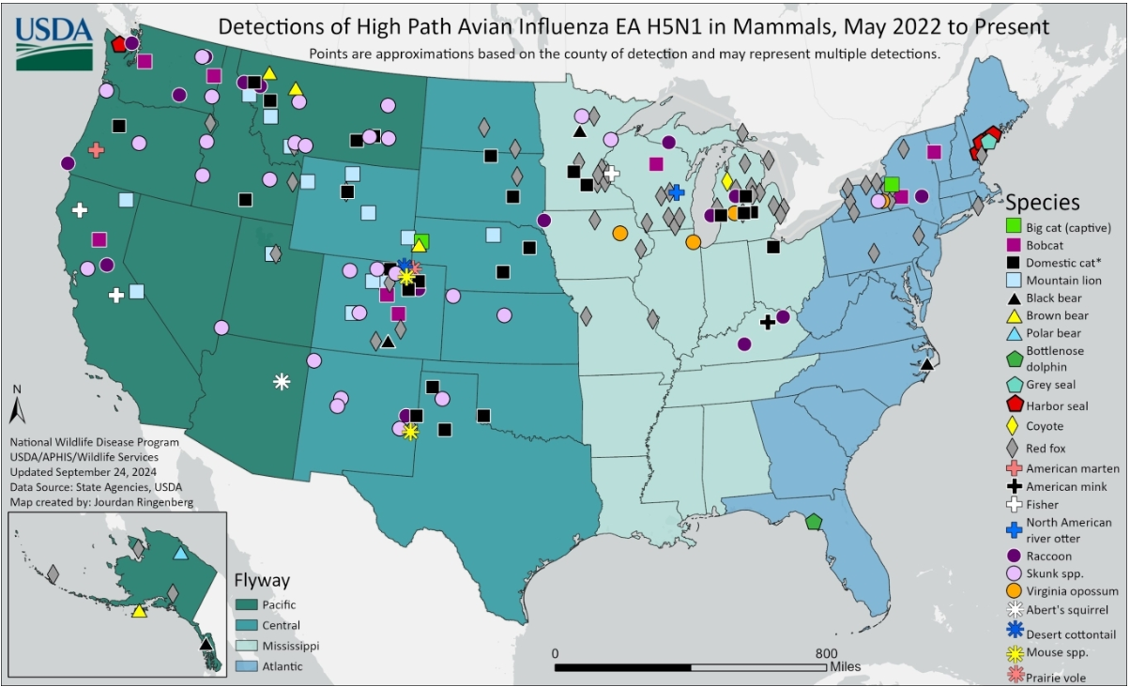
HPAI H5N1 and Cats - USA
August 9 - Colorado released details on six domestic cats diagnosed with HPAI H5N1 in the state in 2024:
One cat was directly linked to a dairy farm
Two were indoor only cats (no known direct exposures to the virus)
Three were indoor/outdoor cats (hunted mice and/or small birds)
Five of the six presented with respiratory symptoms and neurological impairment
USDA has confirmed a total of 53 HPAI detections among domestic cats
mammals page now includes positive detections of HPAI H5N1 in cat species prior to March 1, 2024
HPAI Detections in Mammals (usda.gov)
Highly Pathogenic Avian Influenza (HPAI) & Cats FAQ
Pathogenicity of Highly Pathogenic Avian Influenza A(H5N1) Viruses Isolated from Cats in Mice and Ferrets, South Korea, 2023
Notes:
We’ve talked about cats and HPAI before – last year with the reports in Poland and South Korea, and then various ongoing reports for the US and some for Canada as well.
On August 9 - Colorado released details regarding six domestic cats diagnosed with HPAI H5N1 in the state in 2024
One cat was directly linked to a dairy farm
Two were indoor only cats (no known direct exposures to the virus)
Three were indoor/outdoor cats (hunted mice and/or small birds)
Five of the six cats presented with respiratory symptoms and neurological impairment
Interesting note about the indoor cats with no direct exposure (in South Korea it was linked to pet food, I don’t think Poland ever identified a source for their outbreak)
To date - the USDA has confirmed a total of 53 HPAI detections among domestic cats (All the black squares on the USDA map)
some of them were associated with outbreaks in dairy cows and some were detected among cats in other states. Just note the mammals page now includes positive detections of HPAI H5N1 in cat species prior to March 1, 2024
Also Michigan released a FAQ sheet on HPAI in cats
And then a scientific finding from South Korea -
During 2023, outbreaks of HPAI H5N1 virus infections were reported in cats in South Korea. The H5N1 clade 2.3.4.4b viruses isolated from 2 cats harbored mutations in the polymerase basic protein 2 gene encoding single amino acid substitutions E627K or D701N, which are associated with virus adaptation in mammals. Researchers analyzed the pathogenicity and transmission of the cat-derived H5N1 viruses in other mammals. Both isolates caused fatal infections in mice and ferrets. Contact infections were observed between ferrets, confirming the viruses had high pathogenicity and transmission in mammals.

Slide 3
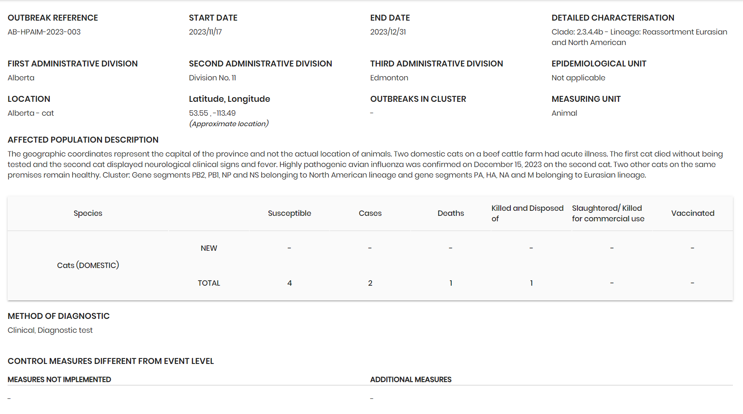
HPAI H5N1 and Cats - Canada
No recent case reports from cats in Canada
Last year, 2 cats from Alberta identified November 17, 2023
HPAI confirmed December 15, 2023
  Clade 2.3.4.4b Eurasian and North America Reassortment
From a beef cattle farm
1st cat died without being tested
2nd cat displayed neurological signs
Any updates on the Ontario feral cat testing?
WAHIS (woah.org)
CAHSS Risk Communication Document – HPAI H5N1 and cats
Animals susceptible to H5N1 highly pathogenic avian influenza (HPAI) - inspection.canada.ca
Notes:
Wrt to Canada there have been no recent case reports from cats in Canada
Last year, 2 cats from Alberta were identified November 17, 2023
HPAI was confirmed on December 15, 2024
As Clade 2.3.4.4b Eurasian and North America Reassortment
The two cats were from a beef cattle farm
1st cat died without being tested
2nd cat displayed neurological signs and was tested
interesting that the cats were from a beef cattle farm (something we wouldn’t have really thought much of back in Nov 2023) but still most likely had contact with wild birds
Links are posted here to the risk communication document that was created by CAHSS on HPAI and cats and then also the CFIA HPAI animals webpage
Question to the group - have there been any updates/news regarding the Ontario feral cat testing?

Slide 4
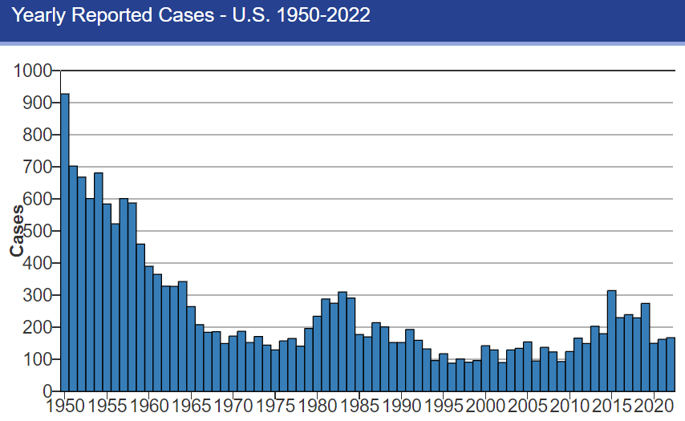
Tularemia
Ping – Tularemia reports in the USA
Has there been any increases in cases of tularemia in humans or animals within your jurisdiction in Canada over the last few months?
Laboratory testing of animals for Francisella tularensis is made more challenging due to it requiring biocontainment level 3, and being Category A bioterrorism agent. Do any veterinary labs in Canada test animal samples for this agent?
SUMMARY
Canadian information
  Accessibility of reports varies among provinces and cases reported nationally are not summarized well
  Tularemia reported in wildlife in Canada, but no cases reported in domestic species
Questions
  Reporting bias as emerging diseases being focused upon more?
  How are awareness/availability of non-confirmatory diagnostic testing in the US influencing observed increase in cases?
  Is it possible to do a survey of availability/awareness across Canadian non-biocontainment 3 labs of non-confirmatory test offerings?
First human case detected in Colorado in July 2024
20 rabbits confirmed positive in Indiana since April 2024
Tularemia Data and Statistics | Tularemia | CDC
Notes:
On the last CAHSS Companion Animal call a Tularemia infection surge in US prompted warning, especially for cat owners
Updates since then:
In July, the first human case was detected in Colorado.
Also, the Indiana Department of Natural Resources also reported more than 20 rabbits found dead since April in Tippecanoe County.
We asked if any increases in Canada had been noticed at the last CAHSS Companion Animal call? And after this meeting a Ping was sent out to the CEZD Community on July 4, 2024
We asked this same question if there have been any increases in cases of tularemia in humans or animals within your jurisdiction in Canada over the last few months?
Additionally, the Ping asked if any veterinary labs in Canada test animal samples for this agent, since laboratory testing of animals for Francisella tularensis is made more challenging due to it requiring biocontainment level 3, and being Category A bioterrorism agent.
To summarize the responses:
It’s challenging to get current information on occurrences throughout Canada
Accessibility of reports varies among provinces and cases reported nationally are not summarized well
- Tularemia is reported in wildlife in Canada, but no cases reported in domestic species
Majority of cases in Canada may be due to direct contact with infected animals
Alberta typically diagnoses 0 to 2 human cases per year. Zero cases in 2023 or 2024 to date.
Manitoba previously reported cases of Tularemia in rodents (hamsters) in 2005/2006.
CWHC data suggests there hasn't been an increase in wildlife cases (UNABLE TO FIND THIS ONLINE)
Might there be reporting bias as emerging diseases are being focused upon more?
Related to this it would be interesting to know in the US how awareness and availability of non-confirmatory diagnostic testing (i.e. serology done outside of biocontainment level 3 labs?) is influencing observed increase in cases.
Similarly, is it possible to do a survey of availability (awareness?) across Canadian non-biocontainment 3 labs of non-confirmatory test offerings (i.e serology, +/- PCR?)?
Extra info below for interest --------------------------------
Caused by the bacterium Francisella tularensis and is commonly found in wildlife animals
Most frequently in rodents, rabbits, and hares, but also found in insects like ticks and deer flies.
Cases of the disease have been reported in dogs, cats, pigs, and horses. However, sheep are most commonly infected
Transmission to humans can occur through bites of infected insects, skin contact with infected animals, drinking or eating contaminated water or food, or by inhaling airborne bacteria through contaminated aerosols or agricultural and landscaping dust

Slide 5
Leishmaniasis
Leishmaniasis is a neglected tropical disease caused by the protozoan parasite Leishmania and transmitted by sand flies
Scientific Findings
Ecological determinants of leishmaniasis vector, Lutzomyia spp.: A scoping review - PubMed (nih.gov)
  Review summarized current state of literature on ecological factors associated with the survival, activity and reproduction of Lutzomyia spp. (phlebotomine sand flies)
  Some consensus regarding some ecological requirements (e.g., seasonality, temperature and habitat features)
A climatic suitability indicator to support Leishmania infantum surveillance in Europe: a modelling study - PubMed (nih.gov)
  Aim of study - To develop an indicator that tracks climatic suitability for L. infantum transmission at subnational level
  An increase in the number of climatically suitable regions for leishmaniasis was detected, especially in southern and eastern countries, coupled with a northward expansion towards central Europe
Feline leishmaniosis in the Mediterranean Basin: a multicenter study - PubMed (nih.gov)
  Cats recognized as competent hosts for Leishmania infantum and a blood source for sand fly vectors
  L. infantum circulates within domestic feline populations living in countries of the Mediterranean Basin, where canine leishmaniosis is endemic
Emerging Leishmania donovani Lineages Associated with Cutaneous Leishmaniasis, Himachal Pradesh, India, 2023 - Volume 30, Number 9—September 2024 - Emerging Infectious Diseases journal – CDC
  Recent emergence of novel Leishmania lineages has caused atypical pathologies
  Isolated and characterized two new Leishmania donovani parasites causing cutaneous leishmaniasis in Himachal Pradesh, India
Notes:
We had presented previously on leishmaniasis, there have not been any animal events reported in the system but a few journal articles have come in. They are summarized here.
Ecological determinants of leishmaniasis vector, Lutzomyia spp.: A scoping review
Review summarized current state of literature on ecological factors associated with the survival, activity and reproduction of Lutzomyia spp. (phlebotomine sand flies)
Some consensus in the literature regarding some ecological requirements (such as seasonality, temperature and habitat features)
For example, Lutzomyia spp. activity was found to be higher during the rainy season, and peak when temperatures were between 20 and 25°C.
Lutzomyia spp. were also found to preferentially reside in tropical or subtropical forests, which are characterised by their lack of a distinct dry season and high precipitation.
Overall, there is a lack of published research in this topic. This poses a significant challenge for future studies, which aim to predict the future distribution of Lutzomyia spp. in the context of climate and land use changes.
A climatic suitability indicator to support Leishmania infantum surveillance in Europe: a modelling study
Aim of the modelling study was to develop an indicator that tracks climatic suitability for Leishmania infantum transmission in Europe at the subnational level.
Evidence is clear that climate is a major determinant of L. infantum distribution in Europe, and that the proposed indicator may be used to assess current and future risk at a subnational level, assisting in the development of well-planned surveillance programs.
An increase in the number of climatically suitable regions for leishmaniasis was detected, especially in southern and eastern countries, coupled with a northward expansion towards central Europe.
The suitability predictions were positively associated with human leishmaniasis incidence and canine seroprevalence for Leishmania.
Feline leishmaniosis in the Mediterranean Basin: a multicenter study
Dogs, the main reservoirs of this protozoan parasite, but cats are also recognized as competent hosts for Leishmania infantum and a blood source for sand fly vectors
This is a large-scale epidemiological survey on feline leishmaniosis and its clinical presentation, revealing that L. infantum circulates among domestic cats, especially shelter/free-roaming and feline immunodeficiency virus-infected animals, living in canine leishmaniosis endemic countries of the Mediterranean Basin.
Emerging Leishmania donovani Lineages Associated with Cutaneous Leishmaniasis, Himachal Pradesh, India, 2023
Historically, Leishmania donovani and Leishmania infantum cause visceral leishmaniasis, and species such as Leishmania tropica and Leishmania major cause cutaneous leishmaniasis (CL). But in recent years the existence of interspecies and intraspecies hybrids has emerged.
Study data and other reports could support the theory that atypical L. donovani parasites are being increasingly encountered as a cause of cutaneous leishmaniasis in the Indian subcontinent. The clade includes both hybrid and nonhybrid parasites able to cause both visceral and cutaneous leishmaniasis.

Slide 6
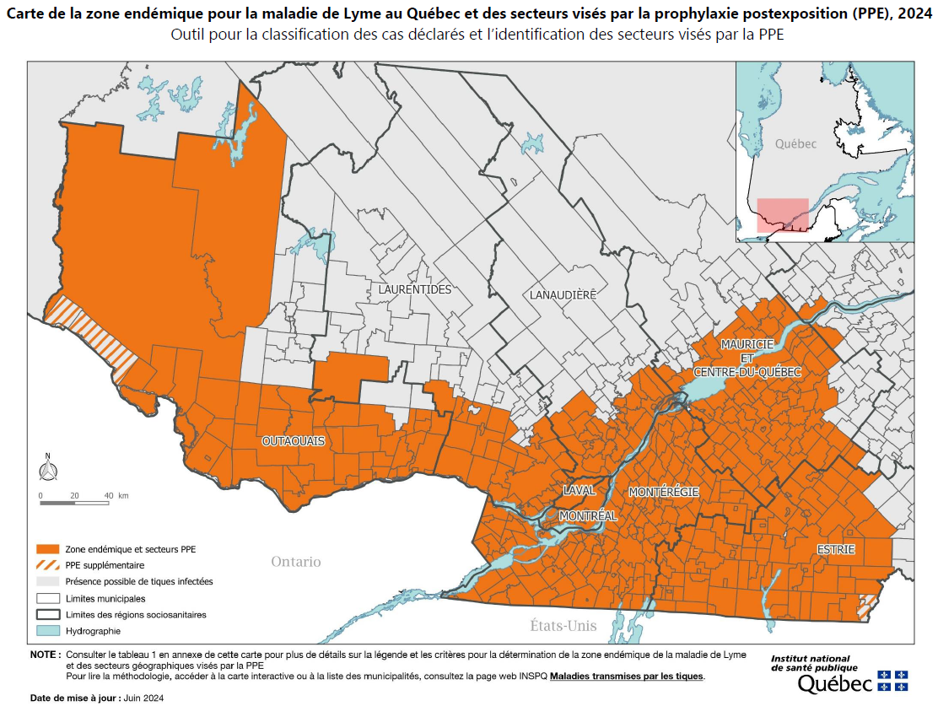
Lyme Disease
527 confirmed human cases in Quebec (1 January to 14 September 2024):
433 acquired in Quebec
29 acquired outside of Quebec
65 unknown place of acquisition
Scientific Reports
Epidemiology of Lyme Disease Diagnoses among Older Adults, United States, 2016–2019
Rapid Increase in Seroprevalence of Borrelia burgdorferi Antibodies among Dogs, Northwestern North Carolina, USA, 2017–2021
https://www.inspq.qc.ca/sites/default/files/2024-06/carte_risque_acquisition_lyme2024.pdf
Notes:
Number of reported cases of Lyme disease in Quebec between 1 January and 14 September 2024, by health region (HSR) of residence and place of acquisition, Province of Quebec
Overall total is 527, with 433 acquired in Quebec, 29 outside of Quebec, and 65 Unknown place of acquisition.
The map shows endemic area of Lyme disease in Quebec and areas covered by post-exposure prophylaxis (PEP), 2024 (updated June 2024)
Data sources: Surveillance of confirmed and probable human cases of Lyme disease acquired in Quebec and reported to public health (2004-2023); active acarological surveillance (2010-2023); passive acarological surveillance (2009-2023).
Two scientific findings:
Epidemiology of Lyme Disease Diagnoses among Older Adults, United States, 2016–2019
- In total, 88,485 Medicare enrollees were diagnosed as having LD from 2016 to 2019, with an average incidence of 123.5 cases per 100,000 person-years, 7.4 times higher than the 34,183 cases picked up by surveillance during the same period (average rate, 16.6 cases/100,000 persons).
- Most diagnoses occurred among residents of high-incidence states, in summer, and among men. Incidence of diagnoses was substantially higher than that reported through public health surveillance.
Rapid Increase in Seroprevalence of Borrelia burgdorferi Antibodies among Dogs, Northwestern North Carolina, USA, 2017–2021
The percentage of incident seropositivity increased from 2.1% (45/2,130) in 2017 to 7.6% (231/3,033) in 2021.

Slide 7
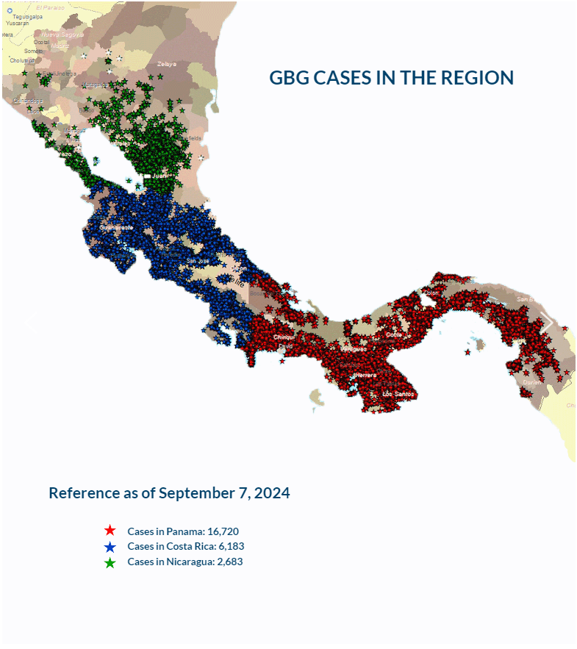
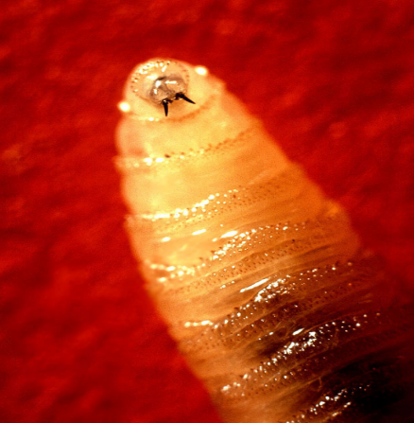
New World Screwworm in Central America
Parasitic fly larva - Cochliomyia hominivorax causing wound myiasis
February 2024 – Costa Rica declared a sanitary emergency
March 2024 – Costa Rica reported 1st human case
As of Sept 7, 2024, according to COPEG:
  Panama – 16,720 cases
  Costa Rica – 6,183 cases
  Nicaragua – 2,683 cases
Honduras reported 3 cases in illegally imported equines
July 29, 2024 – Costa Rica reported 22 human cases
July 29, 2024 – Panama reported 49 human cases
Sept 9, 2024 – Nicaragua reported at least 2 human cases
Increase in cases may be due to more aggressive fly as well as increased rainfall
COPEG
Notes:
Now for the New world Screwworm, it has been spreading through central America, moving north from Panama to Costa Rica to Niaragua, and most recent reoccurrence in Honduras
In Feb 2024 – Costa Rica declared a sanitary emergency due the presence of the screwworm, and then in March 2024 they reported their first human case.
As of September 7, 2024:
Panama has reported 16,720 cases
Costa Rica – 6,183 cases
Nicaragua – 2,683 cases
Note Copeg cases – unsure if this include human cases along with the animal cases or just the animal cases.
As of July 29, 2024 Costa Rica has reported 22 human cases and Panama has reported 49 human cases (age range from 1 year to 95 years).
Nicaragua, as of Sept 9, reported its first two human cases of the Screwworm.
Honduras reported 3 cases in illegally imported equines (unclear of specific species), very close to the border of Nicaragua.
The increase in cases in Costa Rica may be due to a more aggressive strain of fly, that moves faster and prefers to mate with field flies (as opposed to sterile flies), which has reduced the effectiveness of the sterile fly control program.
Increased rainfall has also been implicated as it may lead to may parasitic activity.
There is also concern for wildlife (deer, wild boar, coyotes…) in these countries, but due to their habitats its hard to determine the exact number of animals affected

Slide 8
Scientific Findings
Prevalence and geographic distribution of Echinococcus genus in wild canids in southern Québec, Canada
Detections of Rabbit Hemorrhagic Disease Virus 2 (RHDV2) Following the 2020 Outbreak in Wild Lagomorphs across the Western United States
Rabbit Hemorrhagic Disease Virus in Mexico in 2020–2021: Risk Areas and Climatic Distribution
Circulation of influenza viruses in the dog population in Kazakhstan (2023-2024)
Identification and characterization of a novel canine circovirus with truncated replicate protein in Sichuan, China
Domestic dogs as reservoirs for African trypanosomiasis in Mambwe district, eastern Zambia
The comparison of pathogenicity among SARS-CoV-2 variants in domestic cats

