Slide 1
Community for Emerging and Zoonotic Diseases
Identifying emerging risks through collective intelligence
CEZD – CAHSS Companion Animal Network Update
14 July 2025
www.cezd.ca
Notes:
CEZD ~3 month environmental scanning update

Slide 2
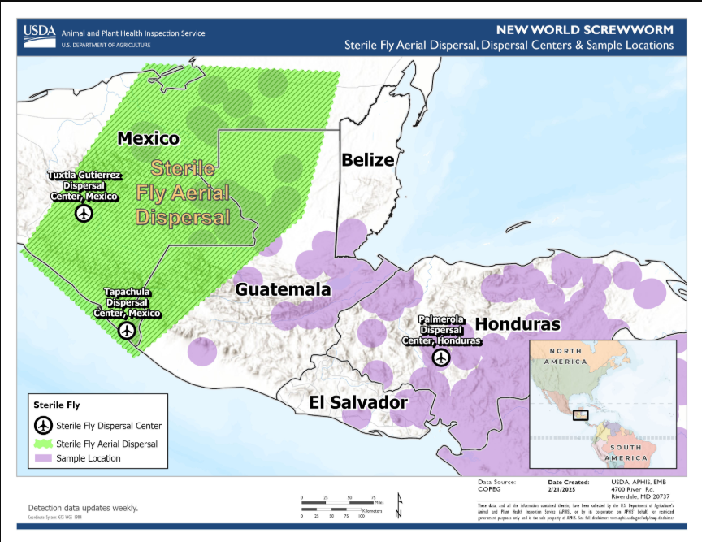
New World Screwworm in Central America and Mexico
New World Screwworm continues to spread northward, beyond the sterile fly release area
July 10th border between Mexico and US closed once again
All warm-blooded animals are susceptible to this parasite
History of travel to Mexico, Central and South America important to request for cases of myiasis
Question: Treatments available in Canada?

Slide 3
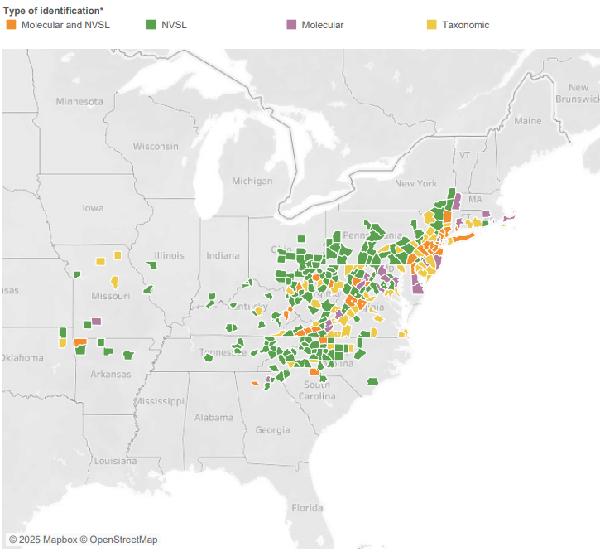
Longhorn Tick in the USA
USDA ALHT update calls have been cancelled
Map is dated – last data from April 2025 (no longer reflects current situation)
~59% of affected counties are established
Michigan reported its first detection of the ALHT in the state
  Two ALHT nymphs confirmed in Berrien County on June 11, 2025
  ~400km from Canadian border
Iowa has confirmed two cases of Theileria orientalis Ikeda in cattle
  Both located in southeast Iowa (1st in Van Buren County)
  Modelling suggests most of Iowa is not suitable habitat for the tick, would mostly affect southeast of the state
https://scwds.shinyapps.io/haemaphysalis/
USDA Haemaphysalis longicornis (Asian longhorned tick) Situation Report – April 2025
Ehrlichia chaffeensis DNA in Haemaphysalis longicornis Ticks, Connecticut, USA
One ALHT nymph tested positive for E. chaffeensis in Stratford county, Connecticut from a sample collected in May 2021
Notes:
Due to limited resources and competing priorities, surveillance calls have been suspended until another organization can take over. The current distribution map is outdated (last updated April 2025), and no longer reflects the evolving situation. Approximately 59% of affected counties are now considered established (at least six individual ticks, or 2 of 3 life stages collected in single collection period (one year))
Michigan confirmed its first ALHT detection on June 11, 2025, with two nymphs found in Berrien County—just ~400 km from the Canadian border. Meanwhile, Iowa reported two cases of Theileria orientalis Ikeda in cattle in the southeast, including Van Buren County. Habitat modeling suggests most of Iowa is unsuitable for the tick, with risk concentrated in the southeast.
A recent publication also reported Ehrlichia chaffeensis DNA in an ALHT in Connecticut. E. chaffeensis is the primary agent of human monocytic ehrlichiosis (HME), typically transmitted by the lone star tick.
Researchers also found Borrelia burgdorferi DNA in two other ALHT, however, lab studies have found that the ALHT does not transmit Lyme disease. Unclear if it can also transmit Ehrlichia.

Slide 4
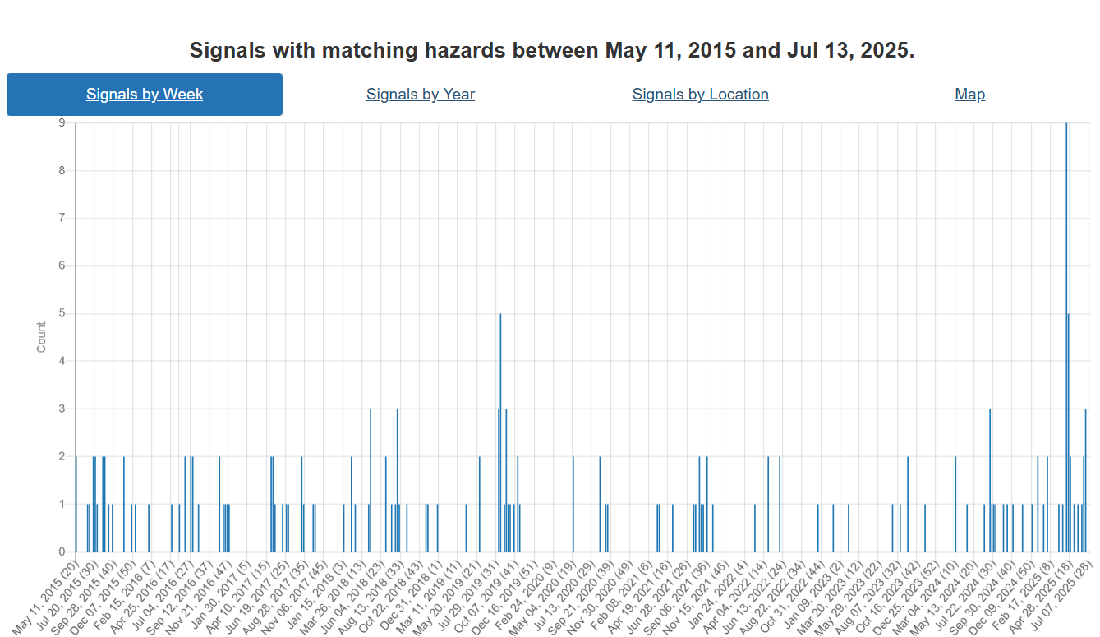
Tularemia
Increase in news reports since last meeting
Europe (11):
United States (6):
Time of year when cases normally rise due to increased:
  vector abundance
  outdoor activity
  Wildlife behaviour and population dynamics
  Environmental conditions
Francisella tularensis Subspecies holarctica in Stranded Beluga Whales, Cook Inlet, Alaska, USA - Volume 31, Number 6—June 2025 - Emerging Infectious Diseases journal - CDC
Notes:
Increase in news reports, however, no reliable sources of solid epi information on cases. EU dashboard only goes to 2022, CDC only human cases.

Slide 5
Bluetongue’s New Frontier—Are Dogs at Risk?
Primarily a disease of domestic and wild ruminants
Recent cases reported in pregnant dogs in Portugal, South Africa, Netherlands
Transmission mechanisms:
  Ruminants: Vector borne (primarily Culicoides midges, some evidence for hard ticks)
  Carnivores: Ingestion of raw infected meat, placental tissues, aborted fetuses, also likely vector borne transmission
Most carnivores remain sub-clinical with rare severe hemorrhagic disease
Thrombocytopenia, coagulopathy, multisystemic vascular injury
Acute respiratory distress
Evidence of transplacental transmission
Likely underdiagnosed due to:
  Non-specific clinical signs
  Lack of diagnostic protocols
  Lack of awareness of practitioners

Slide 6
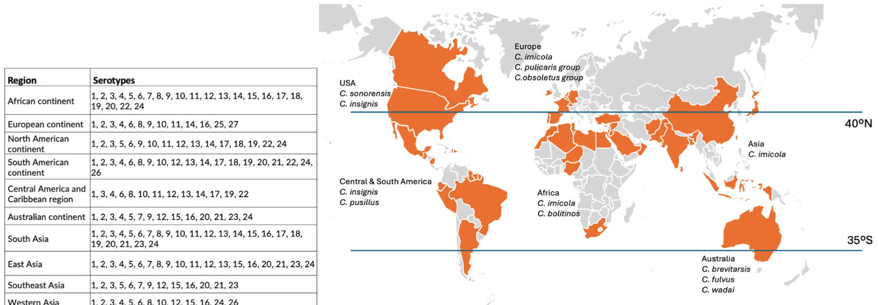
Worldwide distribution of Bluetongue Disease and representative competent vector species
Bluetongue’s New Frontier—Are Dogs at Risk?

Slide 7

Knowledge Gaps for BTV in Carnivores
Clinical spectrum of disease in carnivores
Risk factors
Transmission mechanisms
Role in epidemiology of bluetongue
  Dead end vs reservoir hosts

Slide 8
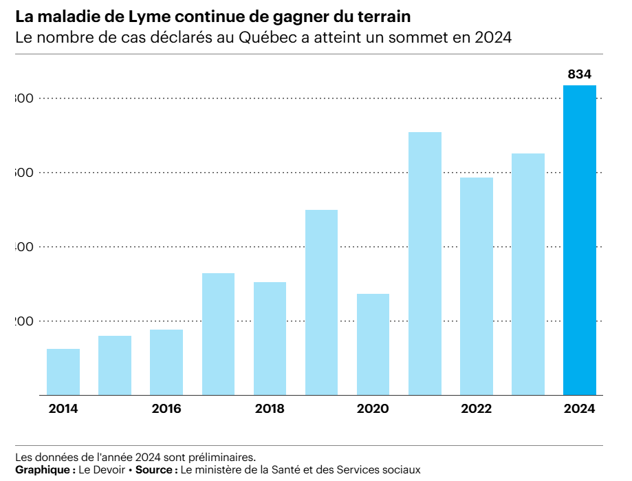
Increasing reports of vector borne diseases
Lyme disease human cases
Lyme disease continues to gain ground in Quebec | Le Devoir
  61 cases reported between January 1 and mid May 2025
Lyme disease increases by 165% in Michigan, according to MDHHS | News, Sports, Jobs - The Alpena News

Slide 9
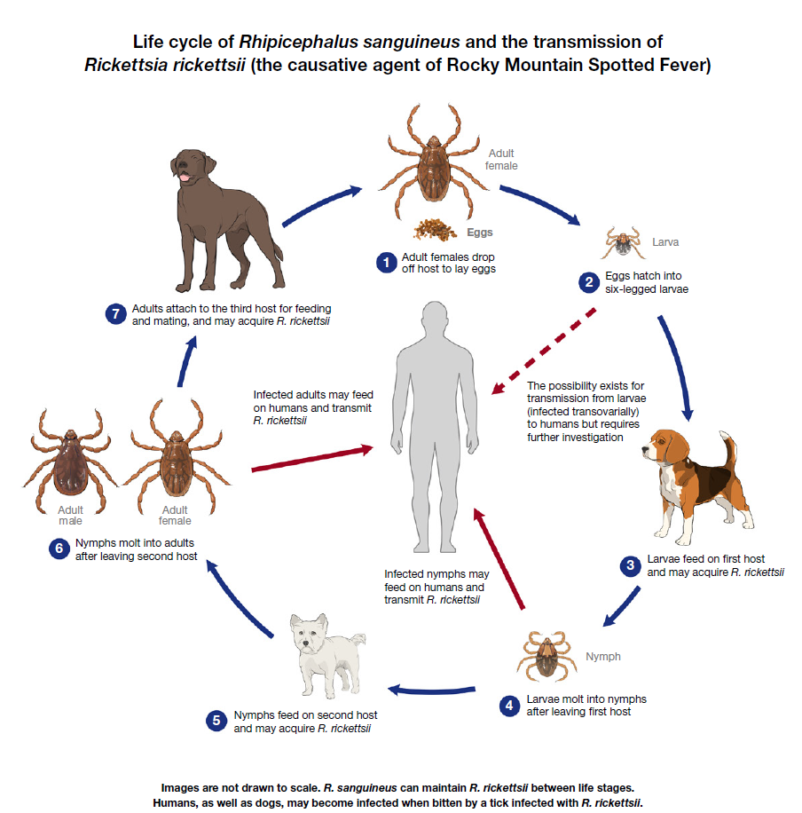
Increasing reports of vector borne diseases
5 cases of RMSF in dogs in Ontario
4/5 at had been at Long Point
Rocky Mountain Spotted Fever, Ontario | Worms & Germs Blog
Update: Rocky Mountain Spotted Fever, Ontario | Worms & Germs Blog
A new spotted fever group Rickettsia genotype in Haemaphysalis leporispalustris from Maine, USA – ScienceDirect
US CDC

Slide 10
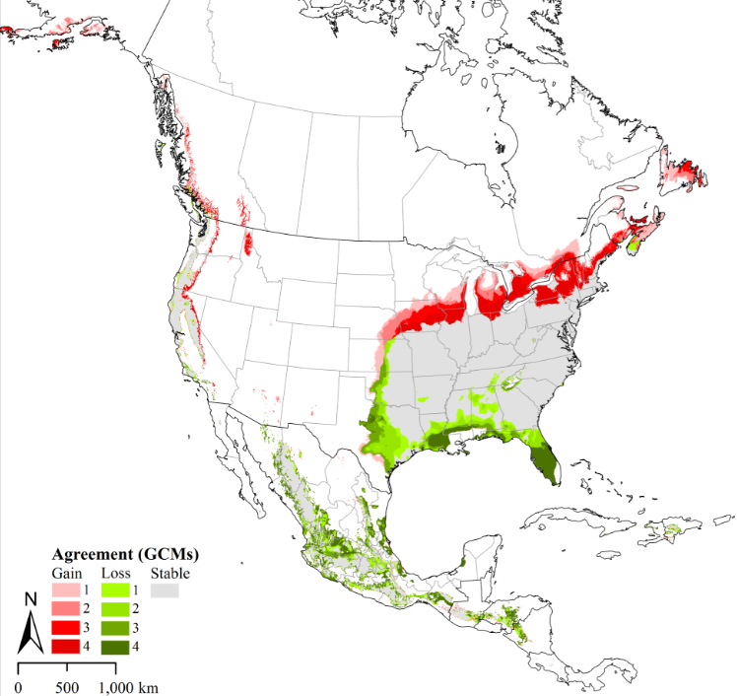
Increasing reports of vector borne diseases
Cytauxzoon felis
Apicomplexan parasite
Spread by Lonestar tick
Reported increase in Lonestar tick occurrence in NorthEast US, recent cases in Massachusetts
Bobcat Fever: Confirmed case of the deadly feline disease in the Tennessee Valley
Current and Future Distribution of the Lone Star Tick, Amblyomma americanum (L.) (Acari: Ixodidae) in North America | PLOS One
Notes:
Cytauxzoonosis is a life-threatening infectious disease of domestic cats in the southcentral and southeastern United States caused by infection with Cytauxzoon felis, which is transmitted by the lone star tick, Amblyomma americanum.
Infected cats often present with depression, lethargy, anorexia, and fever as high as 106°F (41°C). Additional findings may include icterus, lymphadenopathy, hepatosplenomegaly, and dyspnea.
Diagnosis is by identification of Cytauxzoon piroplasms in a peripheral blood smear or schizonts in cytology of infected tissues and by PCR.
Recommended treatment includes a combination of atovaquone and azithromycin, heparin therapy, and supportive care with minimal stress/handling.
Two acaracidal products, have provided promising preliminary results in preventing transmission of C felis; however, additional studies are needed.

Slide 11
Scientific Findings
Avian Influenza
Avian Influenza Virus Infections in Felines: A Systematic Review of Two Decades of Literature | Open Forum Infectious Diseases | Oxford Academic
The Seroprevalence of Influenza A Virus Infections in Polish Cats During a Feline H5N1 Influenza Outbreak in 2023
SARS-CoV2
Infectious potential and circulation of SARS-CoV-2 in wild rats | PLOS One
Molecular and Serological Survey of SARS‐CoV‐2 in Murid Rodents From Central Chile - Grisolia - Zoonoses and Public Health - Wiley Online Library
Evidence of SARS‐CoV‐2 Exposure in Cats and Dogs From Households in Romania and Long‐Term Specific Seroconversion in Cats - Oslobanu - 2025 - Veterinary Medicine and Science - Wiley Online Library

Slide 12
Scientific Findings
Babesiosis
Emerging babesiosis in the mid-Atlantic: autochthonous human babesiosis cases and Babesia microti (Piroplasmida: Babesiidae) in Ixodes scapularis (Acari: Ixodidae) and Ixodes keiransi (Acari: Ixodidae) ticks from Delaware, Maryland, Virginia, West Virginia, and the District of Columbia, 2009 to 2024 | Journal of Medical Entomology | Oxford Academic
Three Cases of Human Babesiosis, Italy, 2017–2020 - Volume 31, Number 6—June 2025 - Emerging Infectious Diseases journal – CDC
Echinococcus
A new intermediate host of Echinococcus shiquicus in Qinghai-Tibet Plateau, China – PubMed
Comprehensive Survival Analysis of Alveolar Echinococcosis Patients, University Hospital Zurich, Zurich, Switzerland, 1973–2022 - Volume 31, Number 5—May 2025 - Emerging Infectious Diseases journal – CDC

Slide 13
Scientific Findings
Coccidiodomycosis
Estimated Burden of Coccidioidomycosis | Infectious Diseases | JAMA Network Open | JAMA Network
Use of Dog Serologic Data for Improved Understanding of Coccidioidomycosis: A One Health Approach | The Journal of Infectious Diseases | Oxford Academic
Porcine Deltacoronavirus
Susceptibility of Ferret and Cat to Porcine Deltacoronavirus: Evidence of Infection in Ferrets But Not Cats – PubMed

