Slide 1
Community for Emerging and Zoonotic Diseases
Identifying emerging risks through collective intelligence
CEZD – CAHSS Companion Animal Network Update
14 October 2025
www.cezd.ca
Notes:
CEZD ~3 month environmental scanning update

Slide 2


Asian Longhorn Tick in the USA
ALHT calls have been taken over by the University of Tennessee
Since the last CAHSS call – three additional states have reported first detections
24 states + Washing D.C. now affected
Mid-June, Michigan reported ALHT nymphs were found in Berrin County, found by routine tick surveillance
Mid-August, Maine confirmed its first finding of the ALHT in Cumberland County
Asian Longhorned Tick Situation Report - The Tick App

Slide 3


New World Screwworm in Central America and Mexico
USA - Mexico border remains closed (cattle, bison, horses)
Recent detection in Nuevo León (~125 km from border)
Mexico has reported 52 human cases (mostly in Chiapas), including 3 deaths linked to underlying conditions
Situation in other Central American countries: Honduras (64+ human cases, >2,496 animal cases), Nicaragua (124 human cases), Guatemala (16 human cases), El Salvador (5 human cases), Belize (2 human cases), and Costa Rica (56 human cases in 2025, triple the 2024 count)
The USDA is investing $29.5 million in sterile fly production and dispersal facilities in Mexico and Texas
Mexico has launched an interactive dashboard for tracking NWS in animals
The USA is deploying Swormlure-5, a synthetic bait with insecticide, and has authorized emergency use of animal drugs for NWS control
July 2025
COPEG
Notes:
The positive New World Screwworm (NWS) case in Nuevo León, Mexico, was confirmed in Sabinas Hidalgo on September 21, 2025. The affected animal was an 8-month-old cow that had recently been moved to a certified feedlot in Nuevo León from a region in southern Mexico known to have active NWS cases.
Food and Drug Administration conditionally approved Dectomax-CA1 (doramectin injection) injectable solution for the prevention and treatment of New World screwworm larval infestations, and prevention of NWS reinfestation for 21 days. Dectomax-CA1 is conditionally approved for use only in cattle.

Slide 4
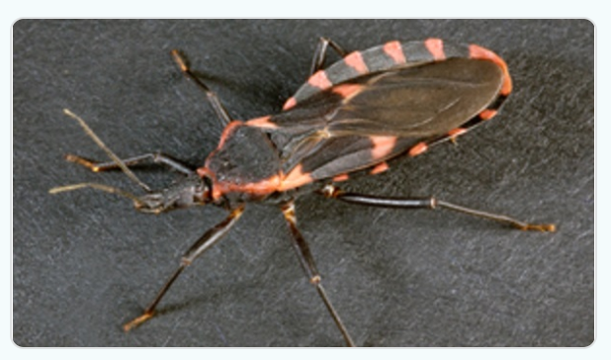
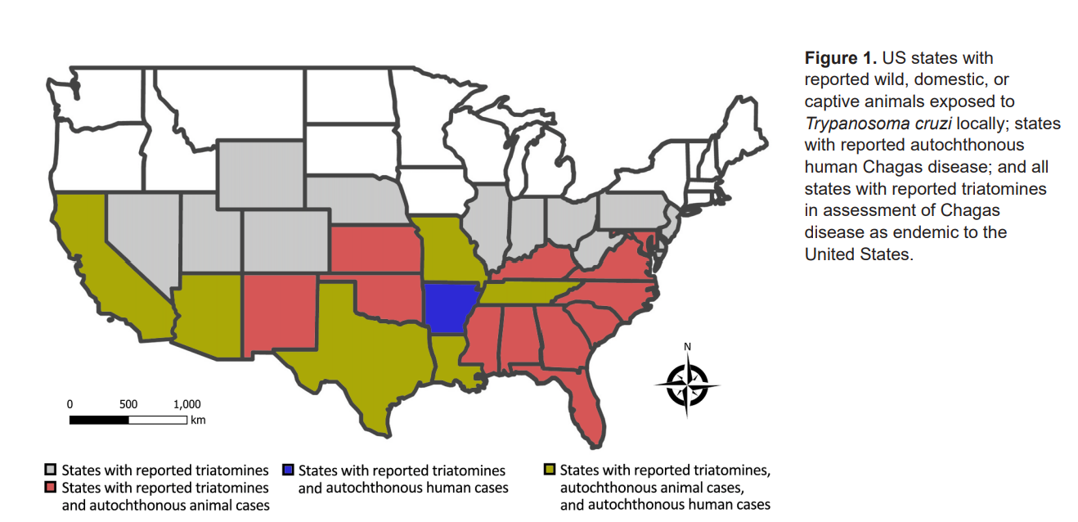
Chagas Disease, an Endemic Disease in the United States - Volume 31, Number 9—September 2025 - Emerging Infectious Diseases journal - CDC
32 states have reported triatomines
9/11 species present found to be infected
Infection prevalence ranges from 30 – 50%

Slide 5
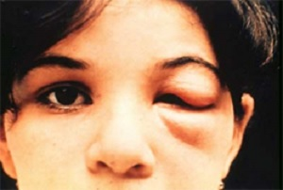
Chagas Disease, an Endemic Disease in the United States - Volume 31, Number 9—September 2025 - Emerging Infectious Diseases journal - CDC
Peridomestic animal hosts
  Woodrat
  Opossum
  Raccoon
  Armadillo
  Striped skunk
Prevalence of T. cruzi in some populations reach >50%
Sufficient levels to serve as reservoir hosts
Domestic Animals
  Evidence of exposure of dogs to T. cruzi found in 23 states
Texas
  Studies on large dog kennels show prevalence of ~10% to >50% of the dogs are infected
Zoonotic

Slide 6
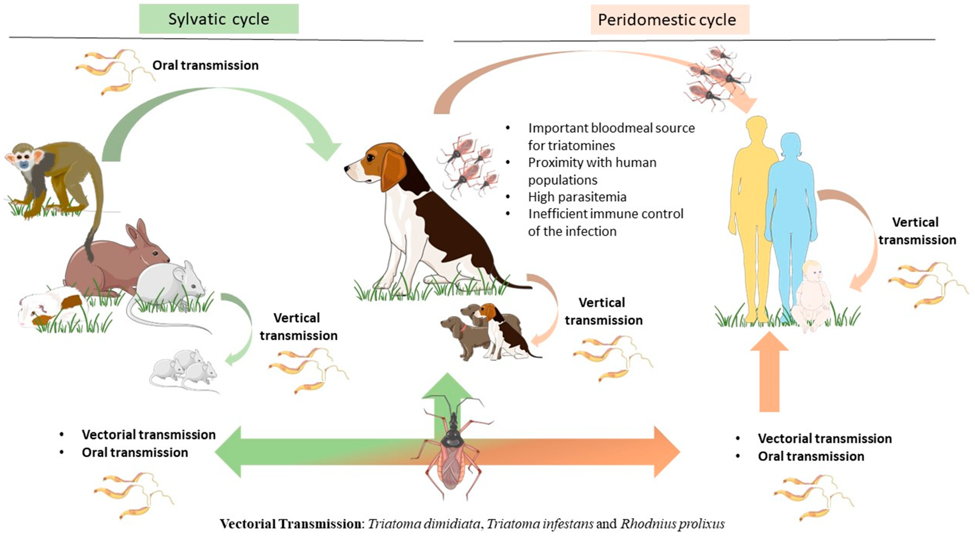
Transmission mechanisms in dogs
Vector borne
Fecal oral (insect to dog)
Ingestion of infected insects or rodents
Vertically transmitted to puppies
Iatrogenic – blood transfusions
Chagas Disease: A Silent Threat for Dogs and Humans

Slide 7
Clinical Signs
Latent
  Asymptomatic
  Sudden Death
Chronic
  Heart failure, Arrhythmias
  Coughing
  Exercise intolerance
  Lymphadenopathy
  Fever, Lethargy
  Pale gums
  Enlarged spleen/liver
  Abdominal distension
Variable and non-specific
Acute
  No signs
  Lymphadenopathy
  Enlarged spleen
  Pale gums
  Decreased appetite
  Lethargy
  Sudden death
Triatomines not present in Canada. Travel history important for dogs and cats that may have been in the Southern US, Mexico or Central/South America

Slide 8
H5N1 Flu in Cats Fed Raw Pet Food… Again | Worms & Germs Blog
Multiple articles on hazards in raw food diets, H5N1 present once again
Raw Food Contamination: Deflection and Denial | Worms & Germs Blog
Detection of H9N2 Avian Influenza Virus in Commercial Raw Meat-based Diets for Dogs and Cats in South Korea – ScienceDirect
Analysis of the microbiota of raw commercial feline diets to prioritize food safety investigations | Communications Biology
Mycobacterium bovis infected domestic cats in an officially bovine tuberculosis free country resulting in human infection – ScienceDirect

Slide 9
Brucella suis in a dog
Austria has been reporting B. suis in wild European hares (not unusual)
Biovar 2 circulates in wild boar in Europe, hares are reservoir hosts
July 2025 a case was reported in a dog WAHIS
Unusual host species, with no information on clinical signs provided
Similar clinical signs to B. canis but transmitted via ingestion of infected tissues and contact with wildlife
Biovar 4 B. suis is present in Arctic regions of North America but has never been reported in dogs (strong host preference for cervids)
Over 100 dogs diagnosed with brucellosis at breeding farm: Ministry
Species of Brucella not provided in article from South Korea

Slide 10
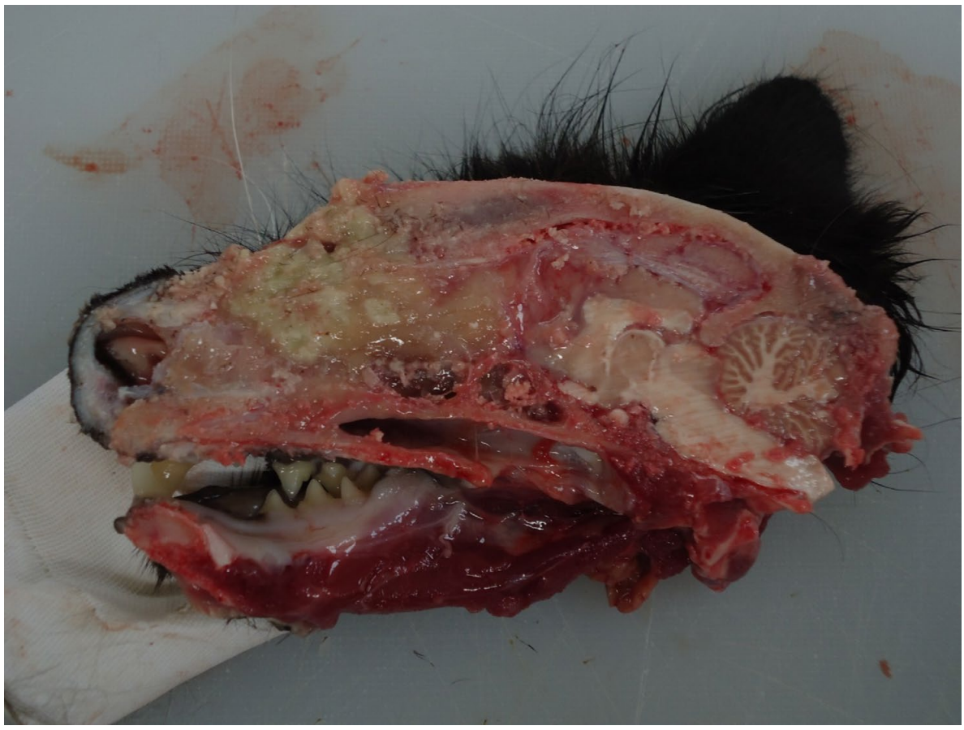
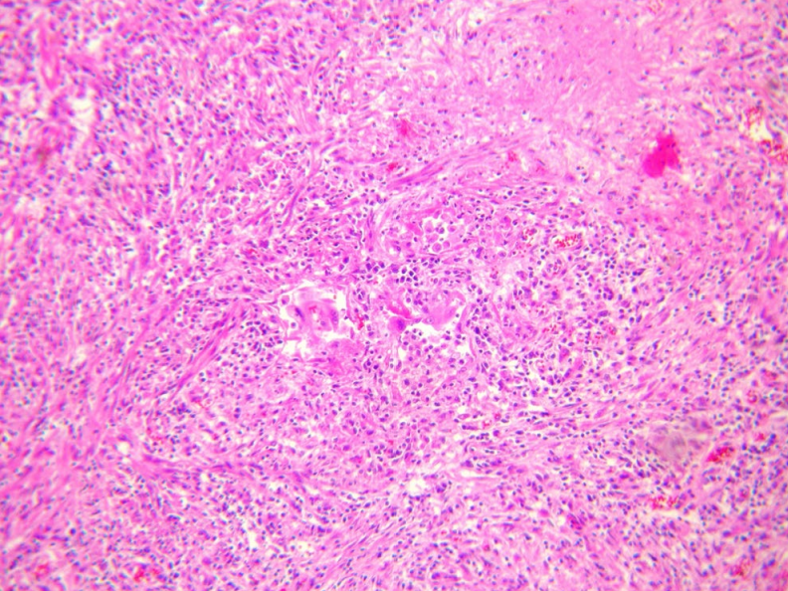
Mycobacterium bovis Infection in Cats: Zoonotic Transmission – PubMed
Cats present with:
  Skin lesions
  Respiratory distress
  Lymphadenopathy
  Gastrointestinal disorders
This case cat 1 had a nasal deformity and no skin lesions
Nodules on the neck and near the thyroid
Sneezing and weight loss had occurred
Cat 1 introduced to the household as a young cat from a neighboring cat colony
Notes:
Granulomatous mass in the nasal cavity, chronic granulomatous rhinitis, lymphadenitis, and bronchopneumonia

Slide 11
Mycobacterium bovis Infection in Cats: Zoonotic Transmission – PubMed
Owner (28 M) hospitalized with pulmonary TB (M. bovis)
Veterinarian who had performed the fine needle aspirate had a puncture wound during the procedure
  Developed a suppurative, non healing finger mass
Cat 2
  Outdoor cat from same colony as cat 1 originated
  Occasionally visited the home and sporadically interacted with the owners
  Found dead in the backyard
  Necropsy found lesions on neck and lung lymph nodes
  Diagnosed as M. bovis

Slide 12
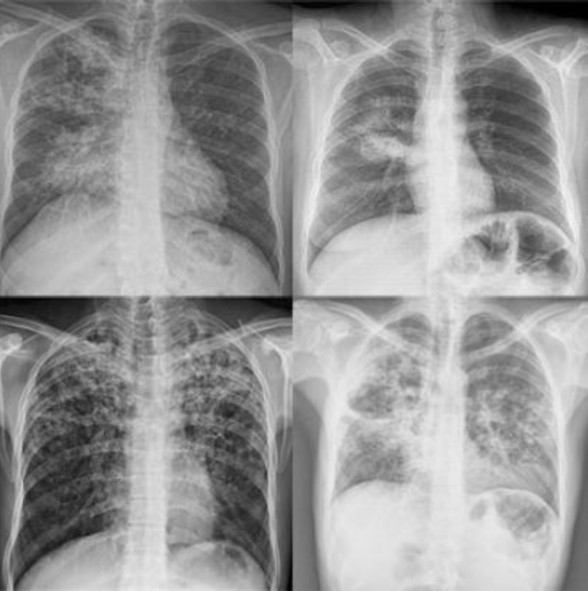
Mycobacterium bovis Infection in Cats: Zoonotic Transmission – PubMed
Owner was vegetarian and lactose intolerant and reported no contact with cattle
Suspect respiratory transmission from cat to human
No information on severity of disease
Treatment for 9 months with antibiotics (Ethambutol, Rifampin, Isoniazid)
Identification of Mycobacterium bovis in patients diagnosed with pulmonary and extrapulmonary tuberculosis

Slide 13
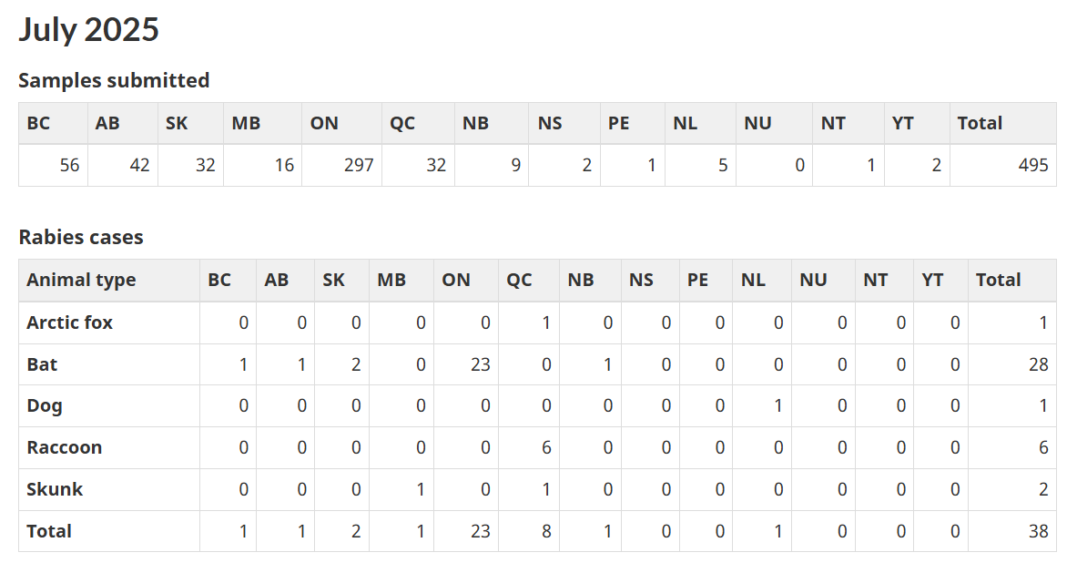
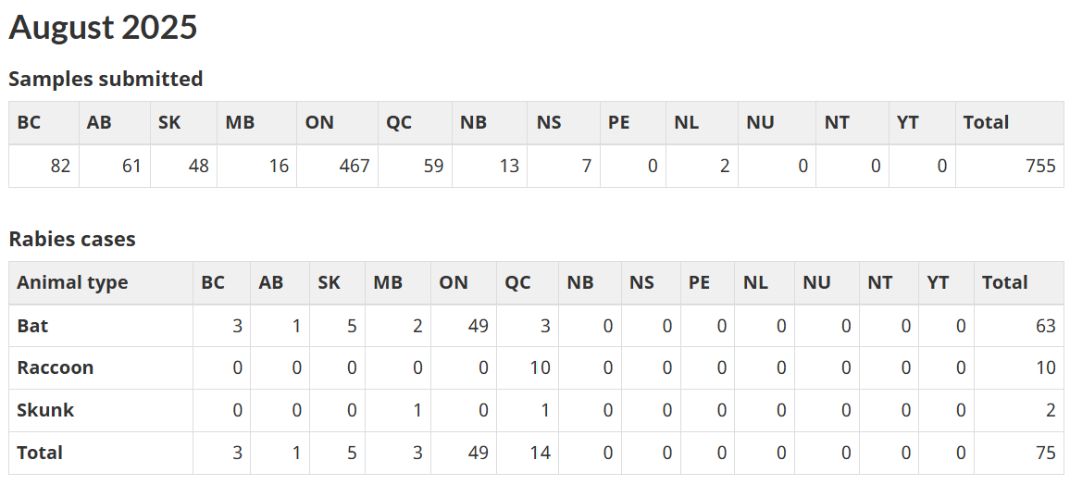







Rabies
Notes:
Plenty of Rabies cases across the Prairies, Ontario and Quebec and single cases in a bat in New Brunswick and in a dog in Newfoundland

Slide 14
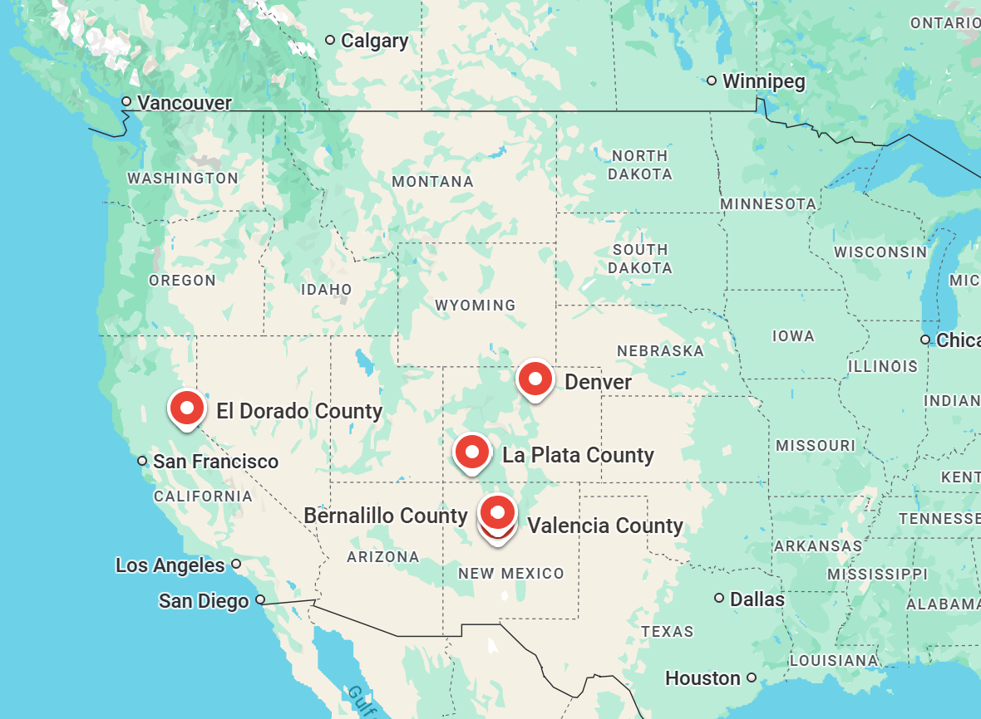
Plague
Colorado
  Denver – Cat
  La Plata County – Prairie Dog Die Off
New Mexico
  Valencia County – Human
  Bernalillo County - Human
California
  El Dorado County - Human
Notes:
Multiple cases reported in the United States in last few months.
Cat, wildlife (Prairie dogs) and Humans

Slide 15
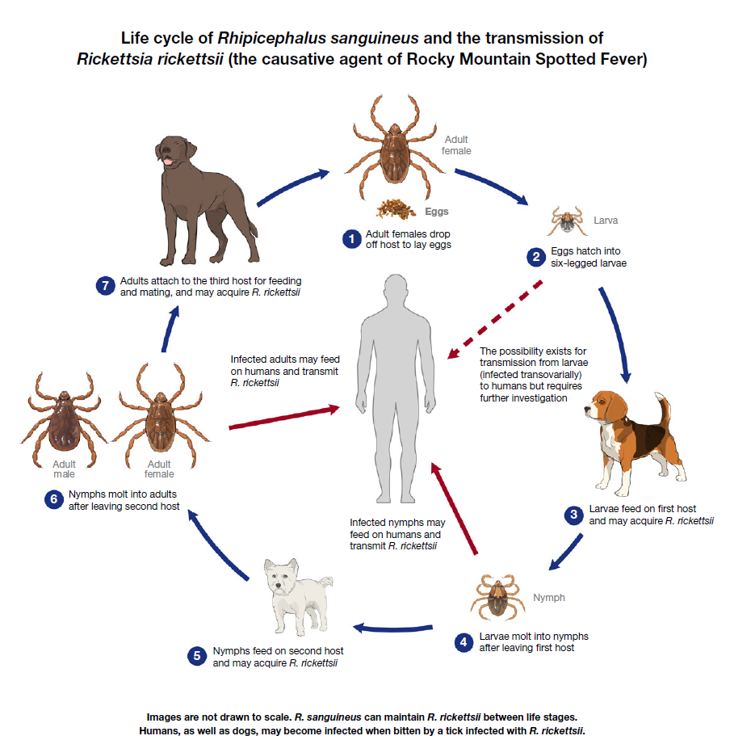
Increasing reports of vector borne diseases
Rocky Mountain Spotted Fever, Ontario | Worms & Germs Blog
Update: Rocky Mountain Spotted Fever, Ontario | Worms & Germs Blog
A new spotted fever group Rickettsia genotype in Haemaphysalis leporispalustris from Maine, USA – ScienceDirect
Reports in humans in Ontario, Quebec and Saskatchewan
5 cases of RMSF in dogs in Ontario
4/5 at had been at Long Point
US CDC

Slide 16
Scientific Findings
Influenza
Influenza D Virus in Domestic and Stray Cats, Northern China, 2024 - Volume 31, Number 8—August 2025 - Emerging Infectious Diseases journal – CDC
H5N1 Influenza A is now promiscuous in host range and has improved replication in mammals | bioRxiv
Rabies
Rabies Outbreak in an Urban, Unmanaged Cat Colony — Maryland, August 2024 | MMWR
Plague
Notes from the Field: Early-Season Human Plague Transmitted from an Infected Cat — Oregon, January 2024 | MMWR

Slide 17
Scientific Findings
Baylisascariasis
Baylisascariasis (Raccoon Roundworm Infection) in Two Unrelated Children — Los Angeles County, California, 2024 | MMWR
Human infections with the raccoon roundworm, Baylisascaris procyonis: A scoping review - PubMed
Echinococcus
An update on the prevalence of Echinococcus multilocularis in red foxes (Vulpes vulpes) in a Central European focus: Northern and northeastern Poland (2022–2024) - ScienceDirect

Slide 18
Scientific Findings
VBDs
High prevalence of vector-borne pathogens in the blood of clinically healthy dogs in Hong Kong | Parasites & Vectors | Full Text
Canine Spotted Fever Group Rickettsial Seroprevalence as an Indicator for Human Rocky Mountain Spotted Fever Case Rates in Arizona, USA - Oliva - Zoonoses and Public Health - Wiley Online Library
Severe Fever with Thrombocytopenia Syndrome Acquired through Dog Bite, South Korea - Volume 31, Number 8—August 2025 - Emerging Infectious Diseases journal - CDC

