Slide 1
Community for Emerging and Zoonotic Diseases
Identifying emerging risks through collective intelligence
CEZD – CAHSS Companion Animal Network Update
13 January 2026
www.cezd.ca
Notes:
CEZD ~3 month environmental scanning update

Slide 2
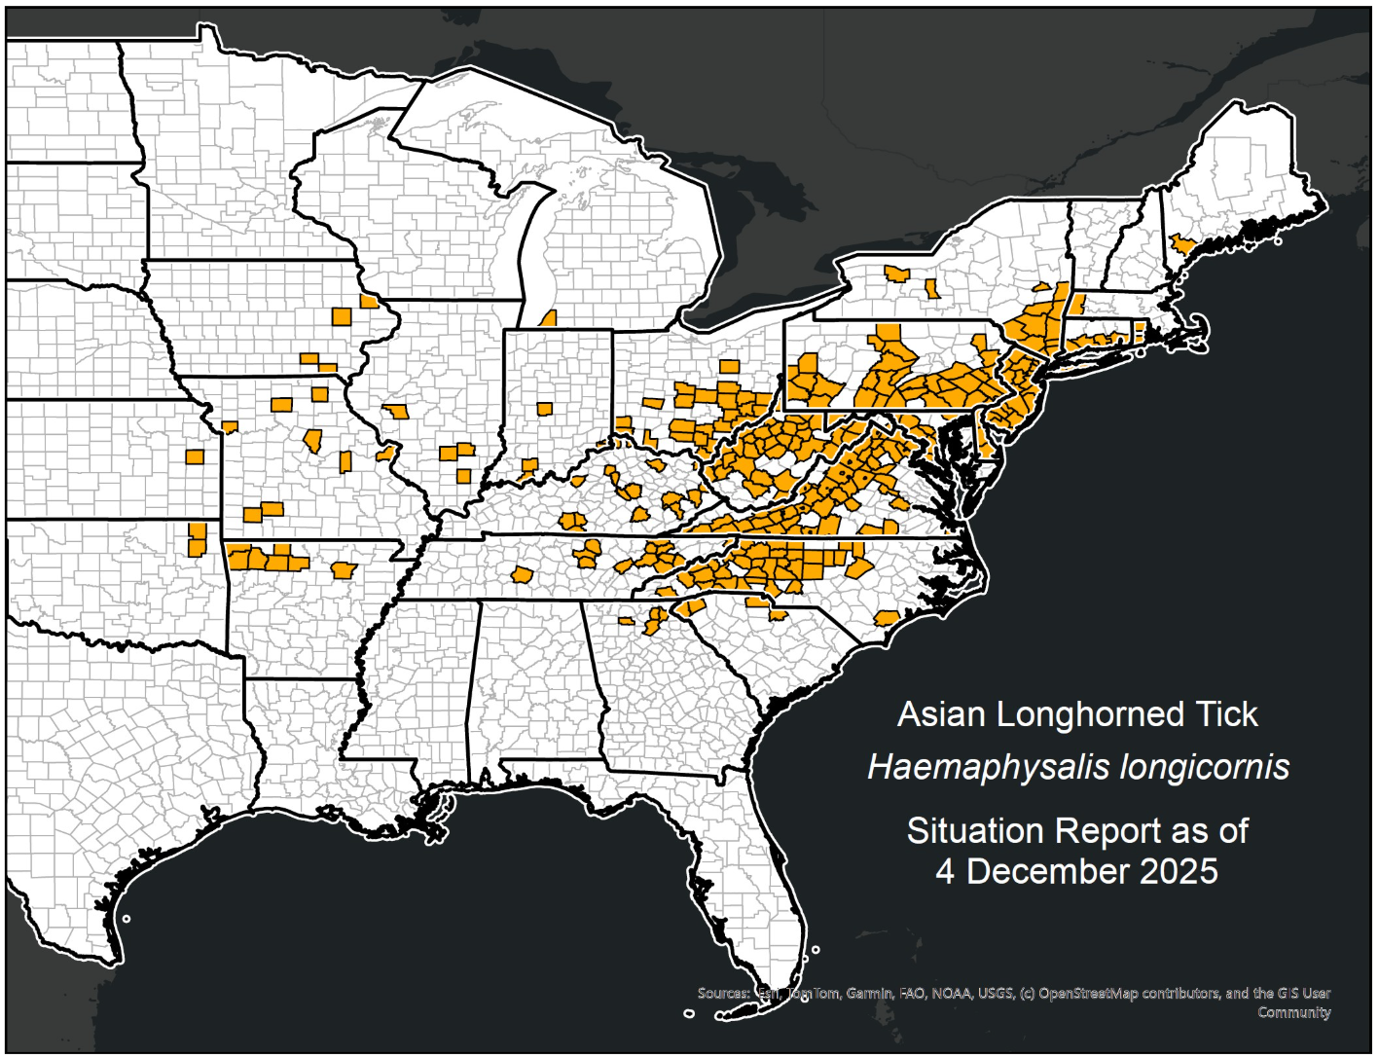
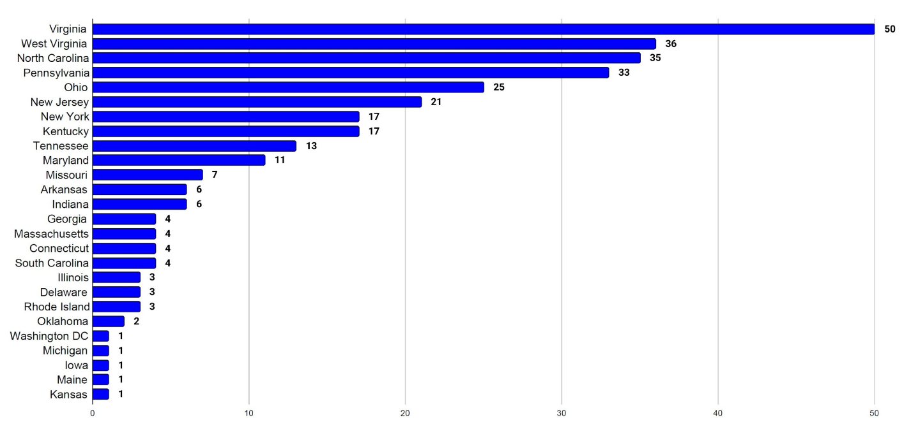
Asian Longhorn Tick in the USA
Since the last CAHSS call – Kansas has reported its first detection in October 2025
  Found on a dog in Franklin County
25 states + Washington D.C. now affected
Emergence of multidrug-resistant Haemaphysalis longicornis populations in China – PubMed
Studies available so far in N. America indicate no resistance yet here
  Baseline susceptibility of Haemaphysalis longicornis to organophosphate, carbamate, and pyrethroid acaricides - Bickerton - 2023 - Pest Management Science - Wiley Online Library
  Spray and Pour-On Acaricides Killed Tennessee (United States) Field-Collected Haemaphysalis longicornis Nymphs (Acari: Ixodidae) in Laboratory Bioassays 2021
Asian Longhorned Tick Situation Report - The Tick App

Slide 3
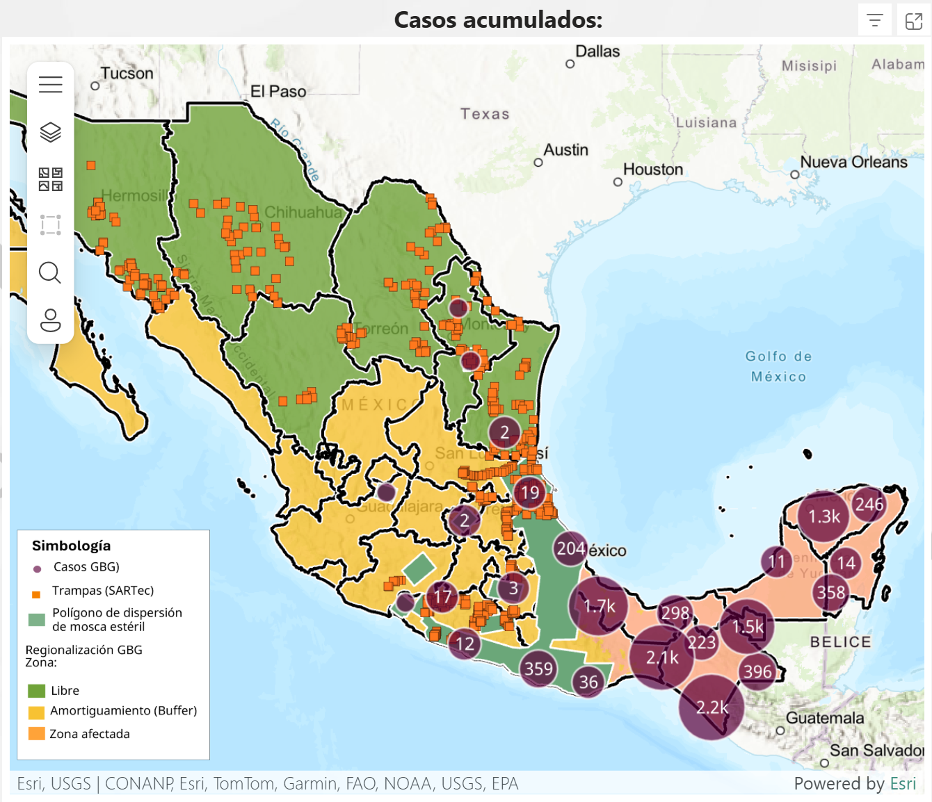
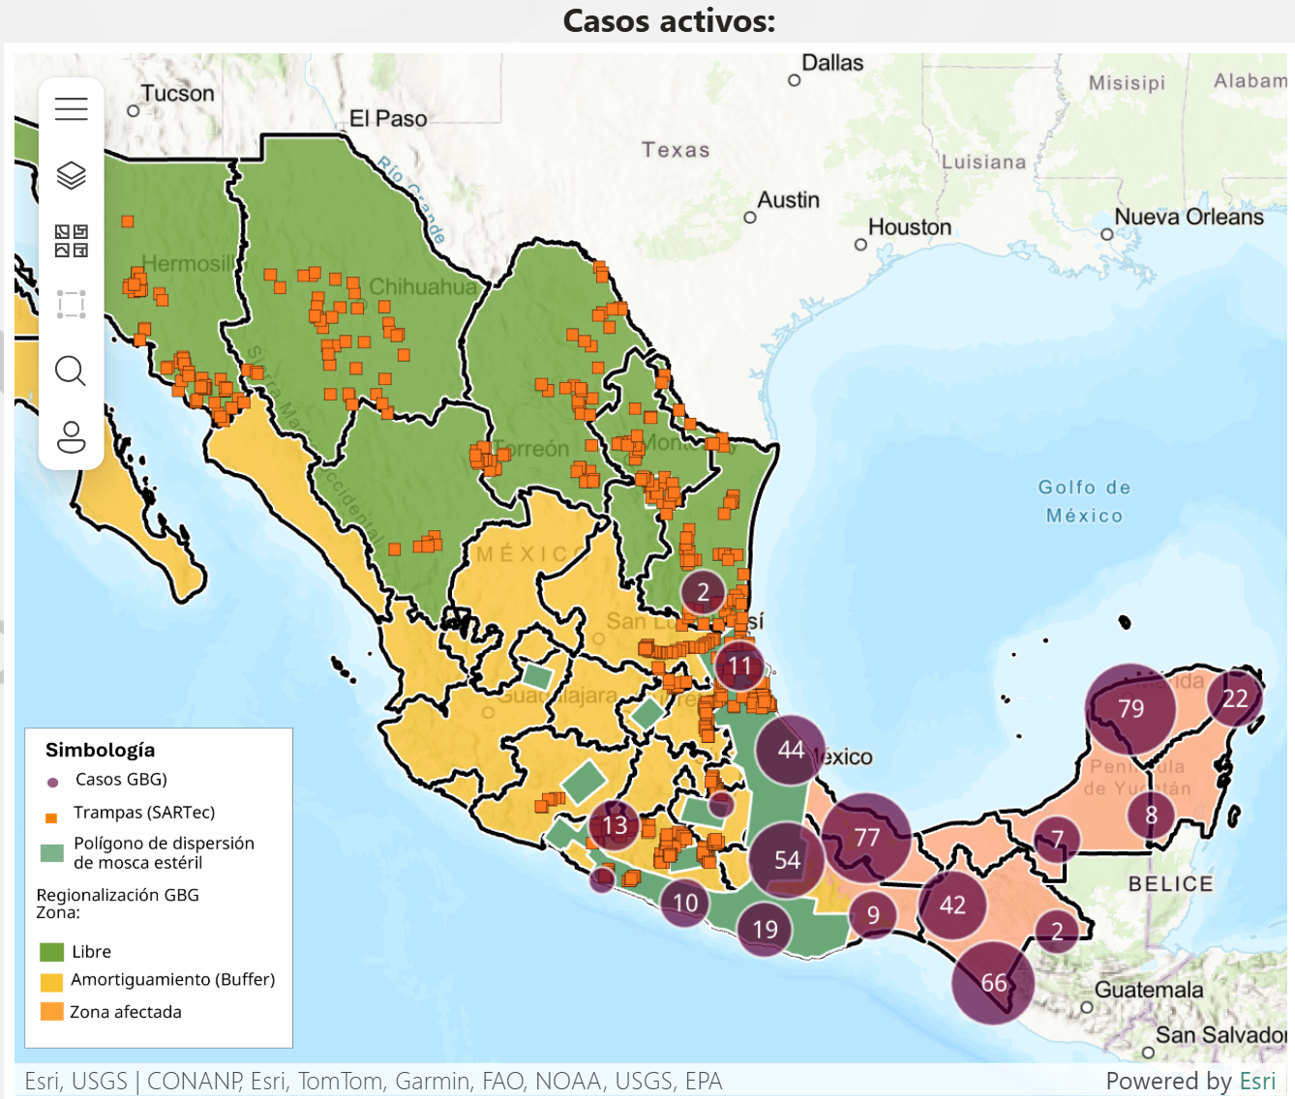
New World Screwworm
Mexico has reported two cases of NWS in Tamaulipas (bordering US) the first detections in this state
3rd case of NWS in Nuevo Leon (bordering US) a bovine imported from Veracruz, 1 case in Michoacán
Continued increase in cases in animals and humans
Alternate management strategy being piloted in Yucatan to decrease total fly numbers before release of sterile flies
“For sterile flies to be effective, there must be 10 of them for each fertile fly”
Mexico’s interactive dashboard displays 492 active cases of NWS in animals (13,335 cumulative) as of January 12th
Mexico – 1862 (~14%) cases in dogs, 38 cases in cats
Vets should be aware of possibility of NWS in imported animals (rescues and travellers)
Notes:
Mexico reported its first case of NWS in Tamaulipas - in a 6 day old calf (no reports of it being imported from another region) - they also reported a case in Altimira in a horse – which could mean the fly has reached the region.
This is also the same region where the new sterile fly dispersal facility was opened (Tampico, Mexico); which aims to increase the range and number of sterile flies being released and allow for a greater ability to push the pest south.
Mexico has reported a third case of NWS infestation in Nuevo Leon, again in a bovine imported from a southern affected region (Veracruz)
Mexico's dashboard shows 492 active cases with 13,335 cumulative cases in animals. A recent report also mentioned the impact of pets, with ~1862 cases reported in dogs and 38 cases in cats
This will be very important for Canadian vets to be aware of in case of animals coming in via Rescues or travelling companions.

Slide 4
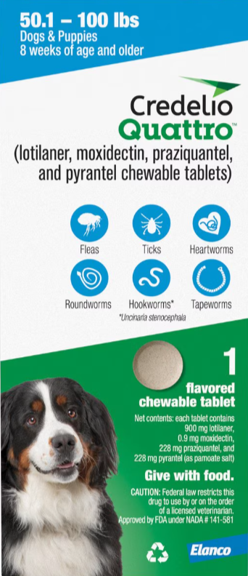
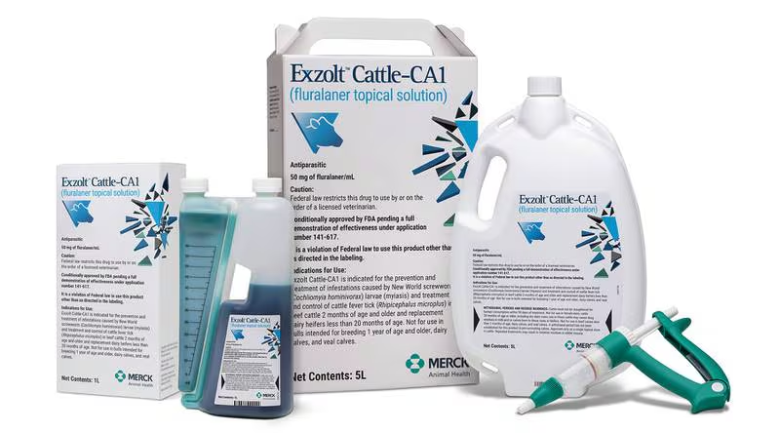
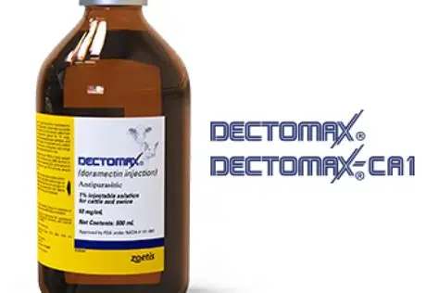
New World Screwworm
USA Emergency Use Authorizations
  Credelio Cat
  Credelio Dog
Efficacy of lotilaner against myiasis caused by Cochliomyia hominivorax (Diptera: Calliphoridae) in naturally infested dogs | Parasites & Vectors
US FDA Conditionally Approved Treatments
  Credelio Quattro-CA1 (Elanco) chewable tablets for dogs
  Exzolt Cattle-CA1 (Merck) fluralaner topical solution for beef cattle (>2 months of age) and replacement dairy heifers (<20 months of age)
  Dectomax-CA1 (Zoetis) injectable for cattle, 35-day withdrawal for cattle, not for use in dairy >20 months of age
Notes:
Washington, D.C., December 17, 2025—Today, the U.S. Food and Drug Administration conditionally approved Credelio Quattro-CA1 (lotilaner, moxidectin, praziquantel, pyrantel) chewable tablets for the treatment of infestations caused by New World screwworm (NWS) larvae (myiasis) in dogs and puppies at least eight weeks of age and weighing at least 3.3 pounds.
Washington, D.C., December 4, 2025—Today, the U.S. Food and Drug Administration conditionally approved Exzolt Cattle-CA1 (fluralaner) topical solution for the prevention and treatment of New World screwworm (NWS) larval infestations, and the treatment and control of cattle fever tick in beef cattle 2 months of age and older and replacement dairy heifers less than 20 months of age.

Slide 5

Fatal H5N1 Influenza in a Dog: Alberta, Canada | Worms & Germs Blog
10-year-old golden doodle
Being treated for an immune mediated disease
Exposed to a snow goose
Subsequently died
Tragic but not surprizing ☹

Slide 6
Full article: Cats are more susceptible to the prevalent H3 subtype influenza viruses than dogs
H3N2 avian influenza virus (AIV), H3N8 avian influenza virus, and H3N2 swine influenza virus (SIV)
Exposed dogs and cats and tested at 7, 14 and 21 days post exposure
Dogs (20, 9-11 week old beagles)
  Seroconversion evident throughout sampling period
  No clinical signs
  No viral shedding
  No evidence viral replication in organs
Cats (20, 9-12 week old DSH)
  Seroconversion evident throughout sampling period
  No clinical signs
  Nasal viral shedding for approximately one week
  Demonstrated viral replication in their lungs, trachea, and nasal turbinate.
Author’s Conclusion: Cats are more susceptible to H3 avian and swine influenza viruses than dogs
Notes:
Study from China looking at impacts of Avian Influenza Virus and Swine Influenza virus on cats and dogs.

Slide 7
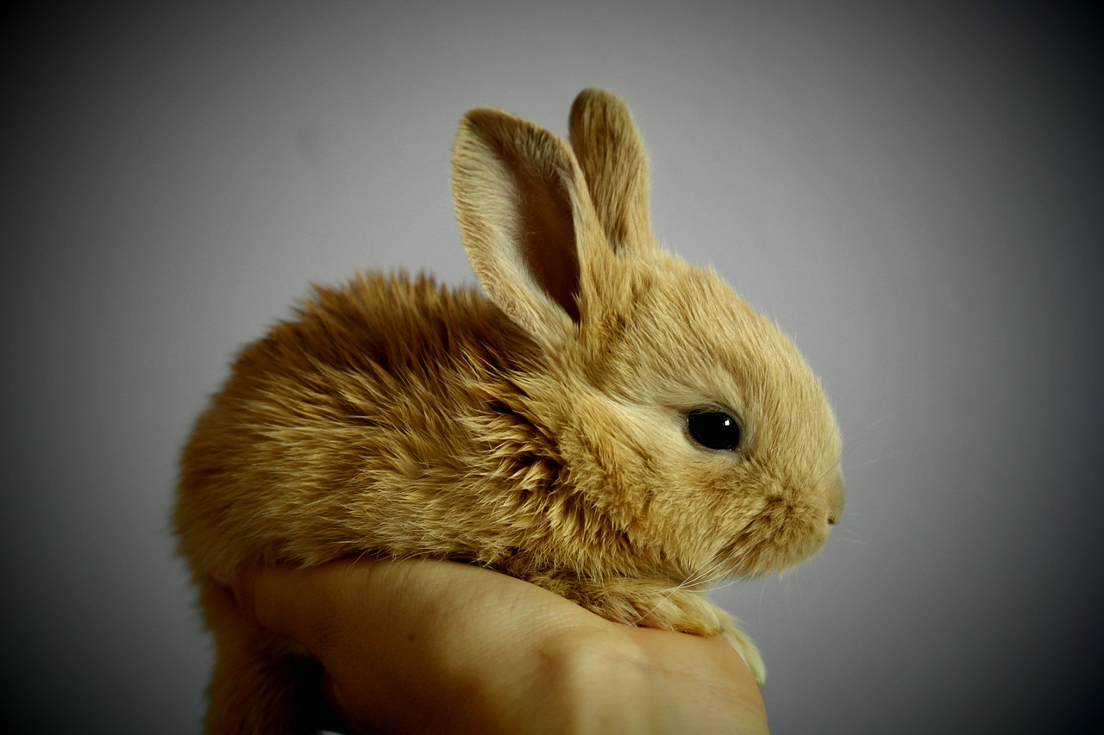
RHD on Vancouver Island
End of October animals showing clinical signs of disease found in Cedar BC
BC Gov News release
Does anyone know if this was confirmed?

Slide 8
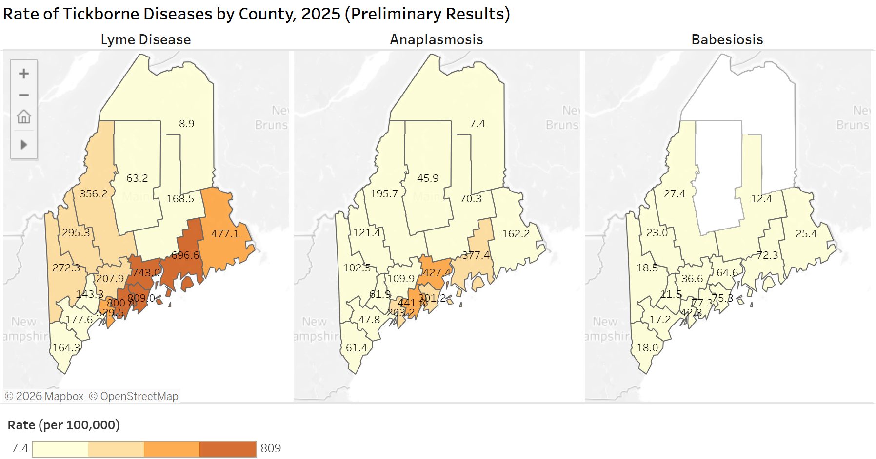
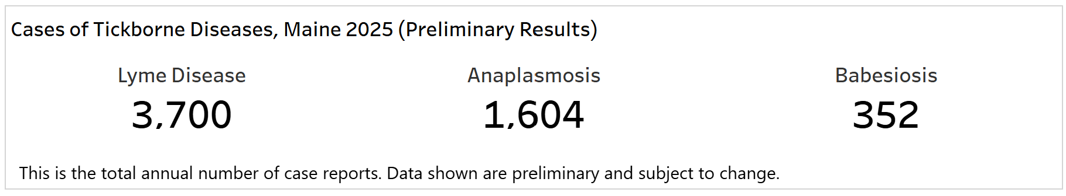
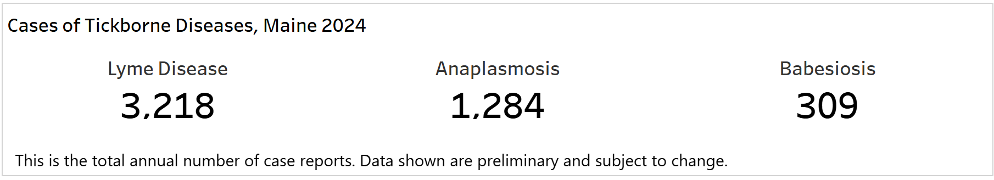
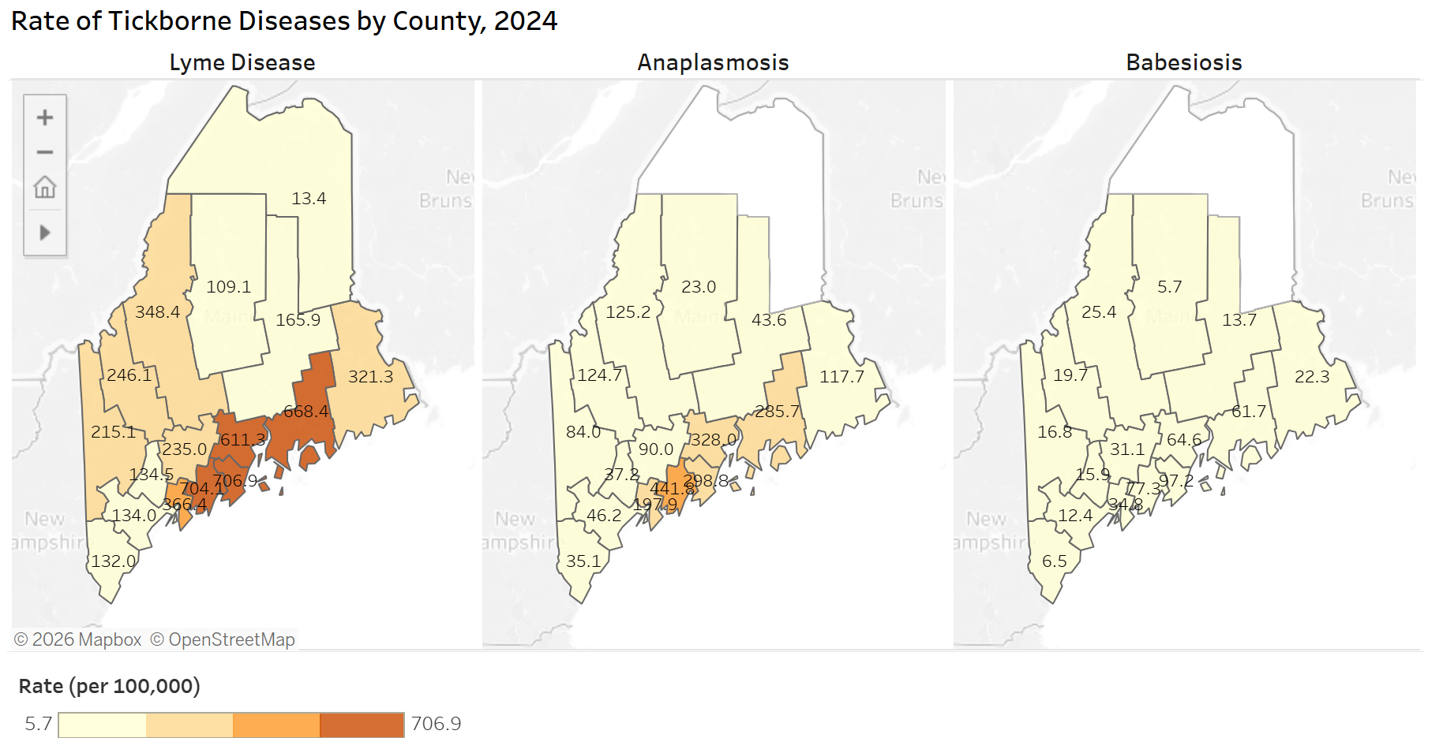
Maine sets new record in tick borne diseases 2025
https://data.mainepublichealth.gov/tracking/tickborne

Slide 9
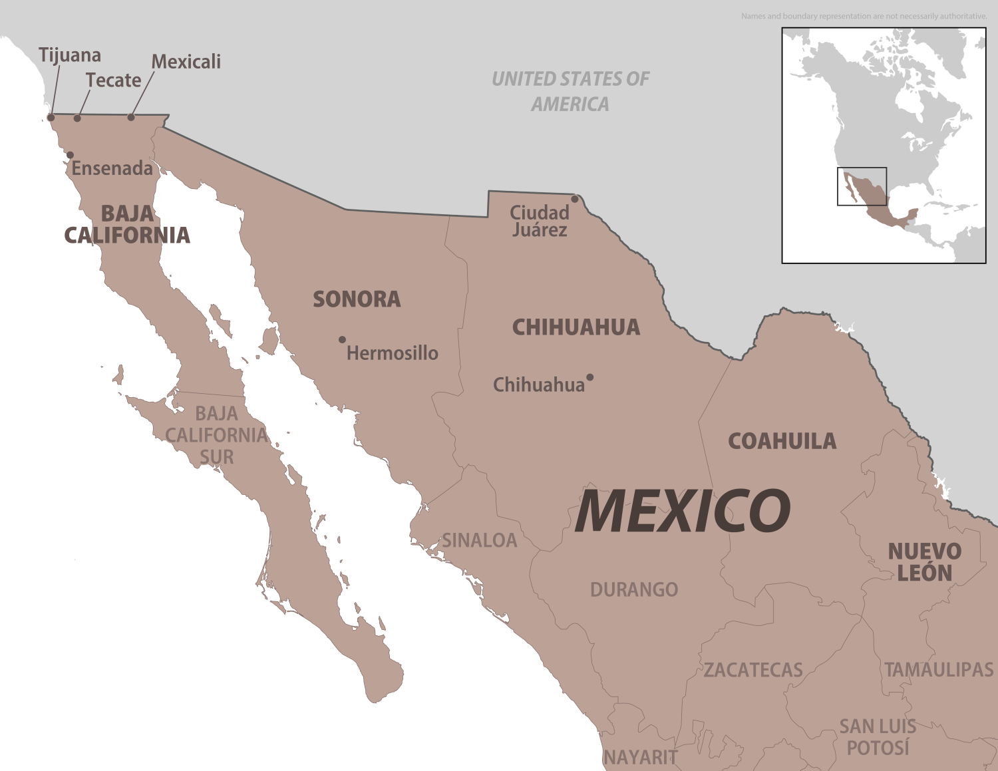
Rocky Mountain Spotted Fever in Mexico
Multiple cases of RMSF in Mexico reported in News
Rickettsia deaths soar to 53 in Chihuahua
34-year-old man dies of spotted fever in SP; it is the 4th death in the region | G1
Code 13 News » The death toll from rickettsia in the state rises to 41
Ministry of Health confirms 48 cases and 15 deaths from rickettsia in Sinaloa during 2025 - El Sol de Sinaloa | Local News, Police, about Mexico, Sinaloa and the World
Mexico: Baja California reports large increase in rickettsiosis
Mexico: Chihuahua reports 89 confirmed rickettsiosis cases, 43 deaths
Salto confirms fourth death from spotted fever | G1
Travel advice and advisories for Mexico
Rocky Mountain Spotted Fever in Mexico - Level 1 - Practice Usual Precautions - Travel Health Notices | Travelers' Health | CDC

Slide 10
Scientific Findings
Influenza
Fatal infection of a novel canine/human reassortant H3N2 influenza A virus in the zoo-housed golden monkeys – ScienceDirect
Multisystemic manifestations of highly pathogenic avian influenza (H5N1) in a young domestic shorthair cat - Kyle L Granger, Chase Gross, Chad Frank, Michael R Lappin, 2025
Tularemia
Case of Congenital Tularemia with Neuroinvasive Disease, Utah, USA - Volume 31, Number 12—December 2025 - Emerging Infectious Diseases journal – CDC

Slide 11
Scientific Findings
Vector Borne Diseases
Full article: Bluetongue virus in carnivores: expanding the host range and implications for disease ecology
Beyond Rocky Mountain spotted fever: investigation of the presence and diversity of spotted fever Rickettsia species in ticks submitted from forestry workers
Human infection with Candidatus Rickettsia jingxinensis: First identification and clinical characteristics | PLOS Neglected Tropical Diseases
Isolation and Characterization of Rickettsia finnyi, Novel Pathogenic Spotted Fever Group Rickettsia in Dogs, United States - Volume 31, Number 11—November 2025 - Emerging Infectious Diseases journal – CDC
Survey of Coyotes (Canis latrans) for Vector-Borne and Bacterial Pathogens in South Carolina and Tennessee, USA – PubMed
Seroprevalence of selected vector-borne agents in pet cats using the SNAP® 4Dx® PLUS, United States, 2022–2025 - ScienceDirect

