Slide 1
Community for Emerging and Zoonotic Diseases
Identifying emerging risks through collective intelligence
CEZD – CAHSS Companion Animal Network Update
14 April 2026
www.cezd.ca
Notes:
CEZD ~3 month environmental scanning update

Slide 2
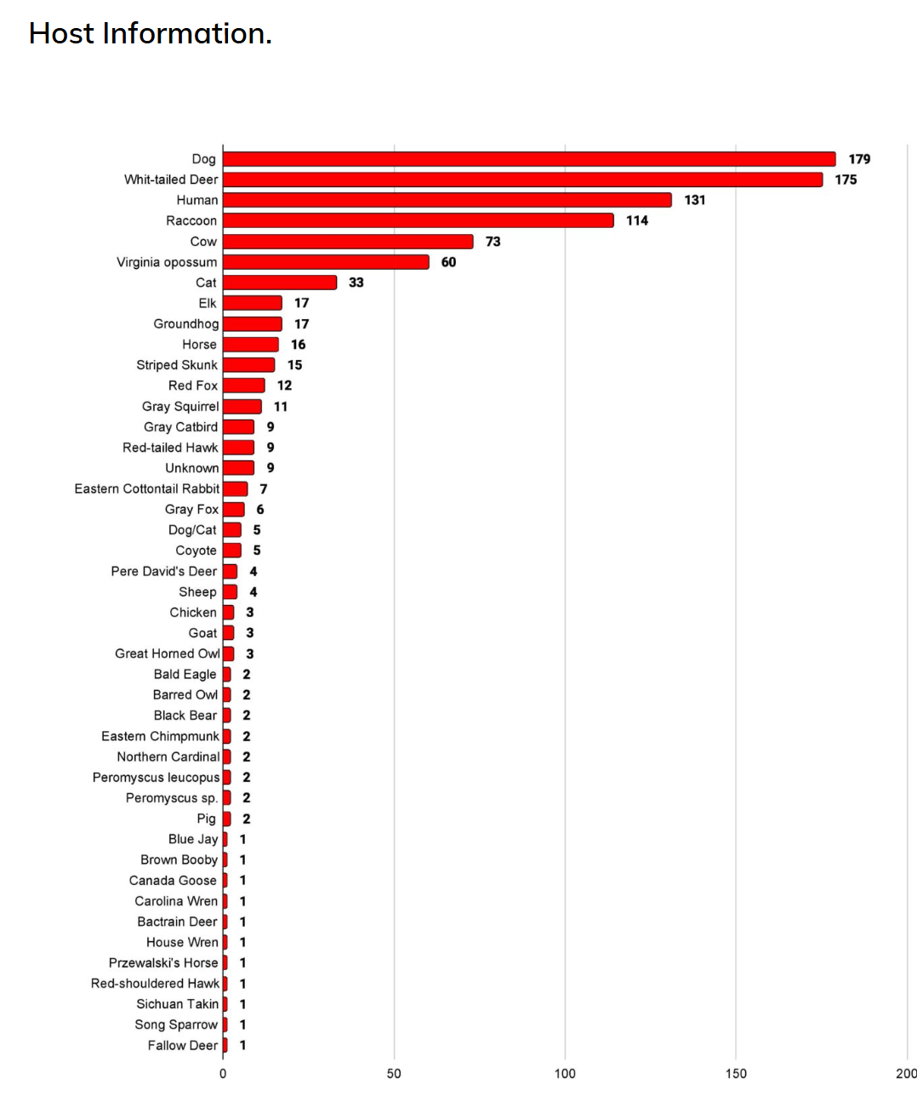
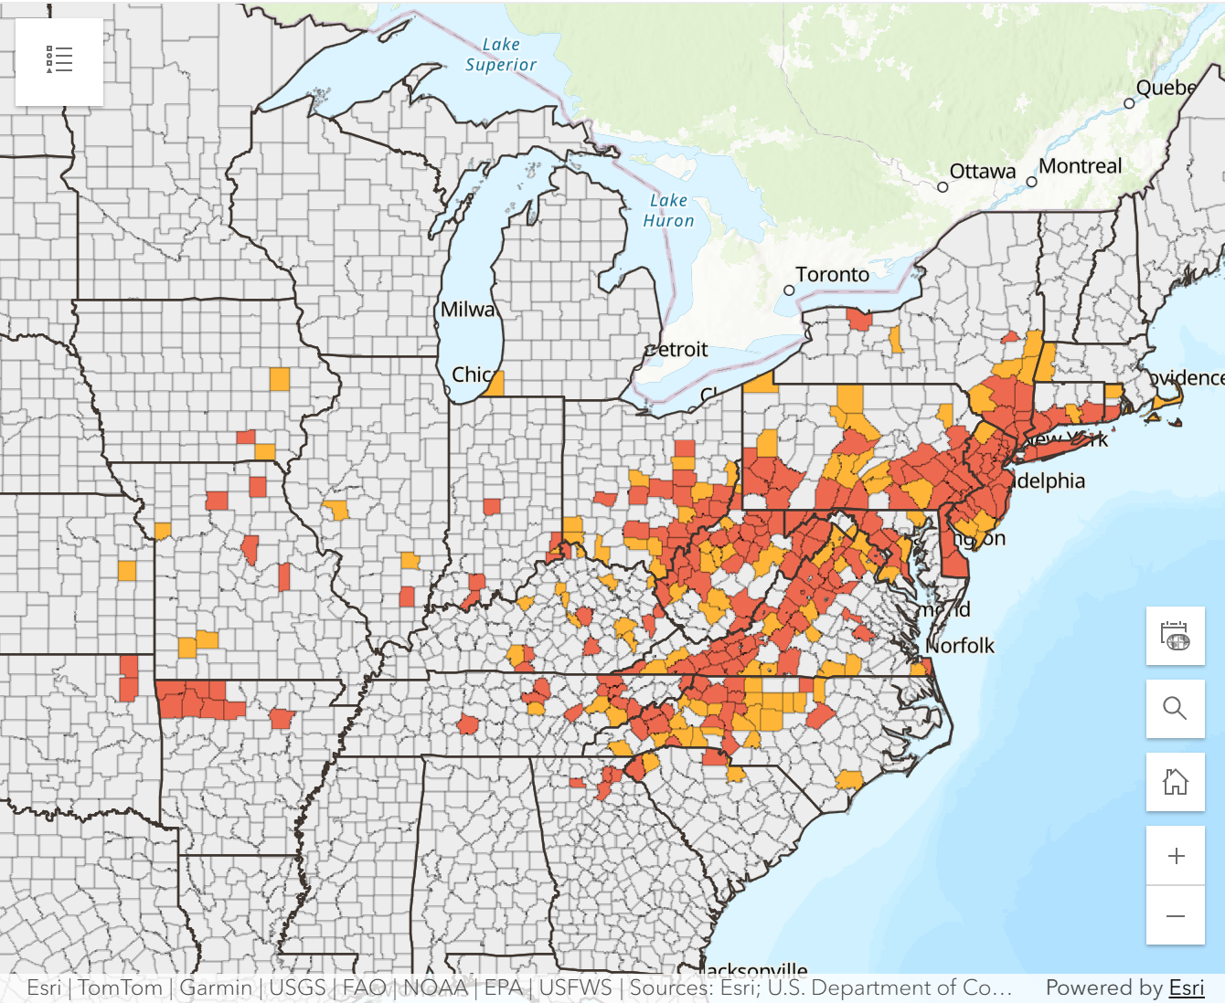
Asian Longhorn Tick in the USA
Since the last CAHSS meeting – one additional state (New Hampshire – reported a detection from last June 2025)
26 states + Washington D.C. affected
Asian Longhorned Tick Situation Report - The Tick App
Haemaphysalis longicornis and Theileria | Exotic and Invasive Vector and Vector-borne Disease
Notes:
Dogs and Cats

Slide 3
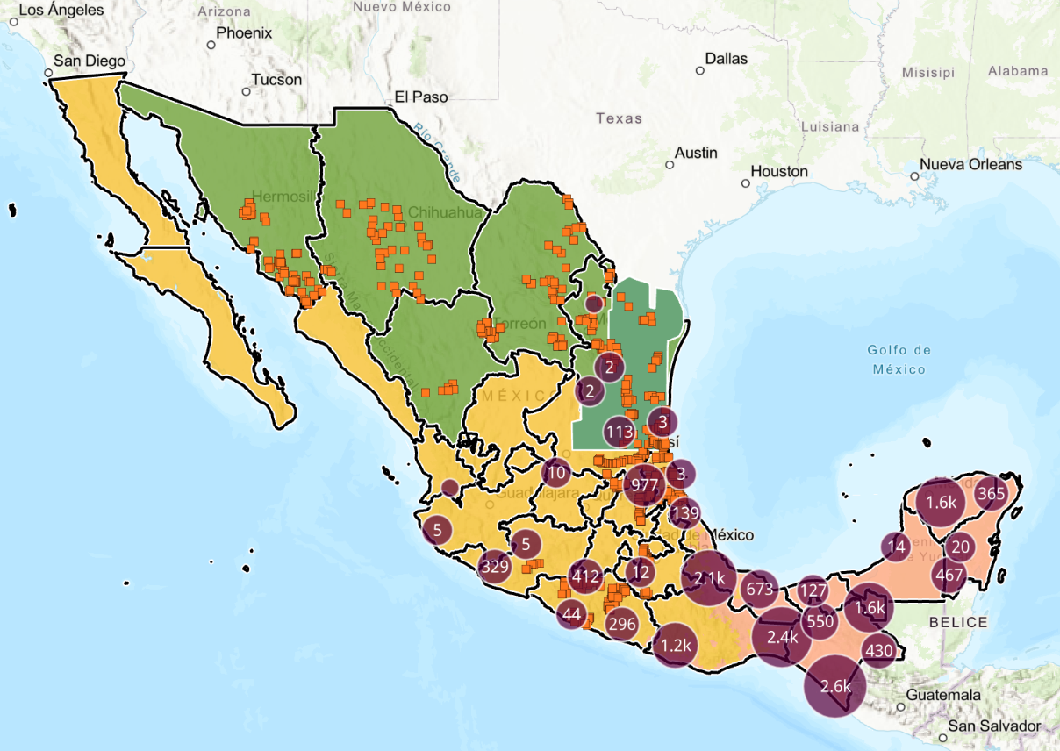
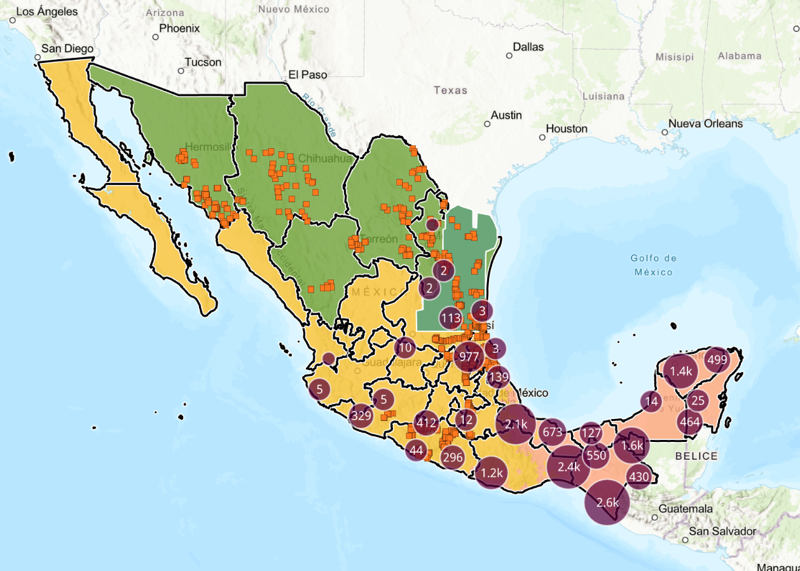
New World Screwworm
Continuing to see cases in Humans and Animals, recently 3 dogs in Nuevo Leon infested with fly larvae and cases are considered endemic
Mexico’s interactive dashboard displays 1,188 active cases of NWS in animals (20,444 cumulative) as of April 13th (~17% dogs, <0.5% cats)
Ongoing risk of imported companion animals being infested with the new world screwworm. Expect increasing cases in Mexico and incursion into the southern US as temperatures rise.
Active Cases
Accumulated Cases

Slide 4
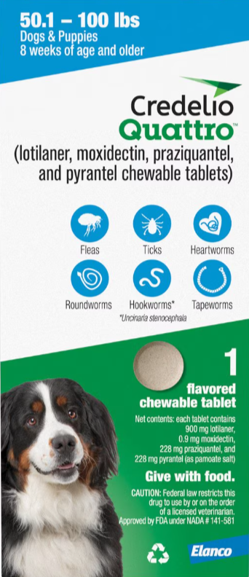
New World Screwworm
US FDA Emergency Use Authorizations
  Fact Sheet – Credelio Cat
  Fact Sheet – Credelio Dog
  Fact Sheet – NexGard Dogs
  Fact Sheet – NexGard Combo - Cats
US FDA conditionally approved
  Credelio Quattro-CA1 Receives FDA Conditional Approval for NWS in Dogs
Last Meeting Discussion:
“Mainstay of treatment is to get the maggots out”
“Capstar effective at killing larvae”
“No approved drugs in Canada for NWS”
CVM Updates | FDA

Slide 5
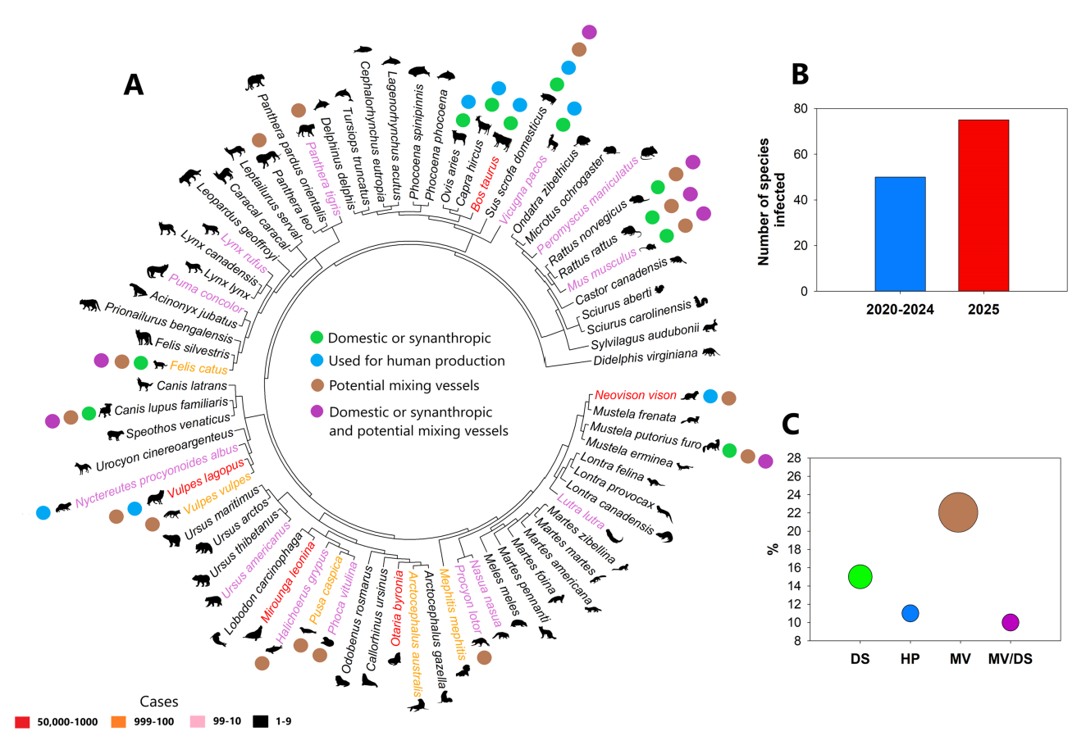
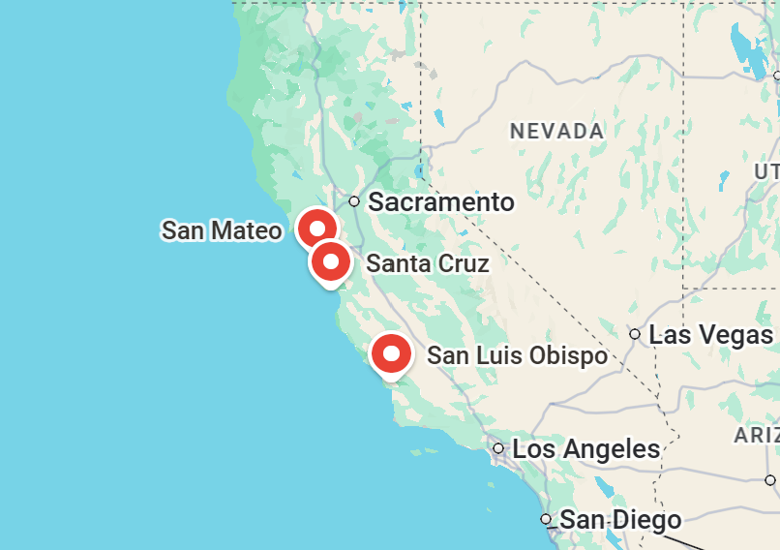
H5N1
H5 Influenza A Outbreak in Marine Mammals | Institute for Pandemic Insights
Update on H5N1 Panzootic: Infected Mammal Species Increase by Almost 50% in Just Over a Year - Plaza - 2025 - Influenza and Other Respiratory Viruses - Wiley Online Library
San Mateo
  Northern Elephant Seal
  California Sea Lion
  Southern Sea Otter
Santa Cruz
  Northern Elephant Seal
San Luis Obispo
  California Sea Lion
HPAI Confirmed Cases in Livestock | APHIS
5 new cases in Dairy Cattle in Idaho April 13, 2026

Slide 6
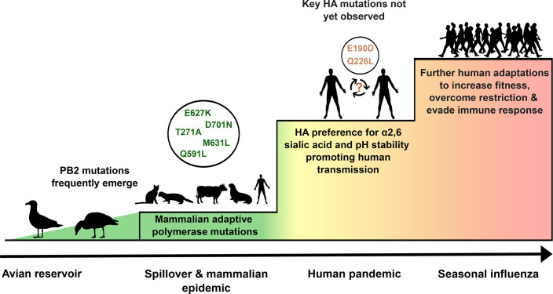
Analyses of receptor binding specificity of highly pathogenic avian influenza A (H5N1) viruses isolated from felines in South Korea, 2023 - PMC
Two clusters of H5N1 2.3.4.4b in cat shelters in 2023
Highly pathogenic and spread by direct contact
Analyses of viruses showed that they retained α2-3 receptor specificity
No detectable binding to α2-6 receptors
H5N1 2.3.4.4b: a review of mammalian adaptations and risk of pandemic emergence - PMC

Slide 7
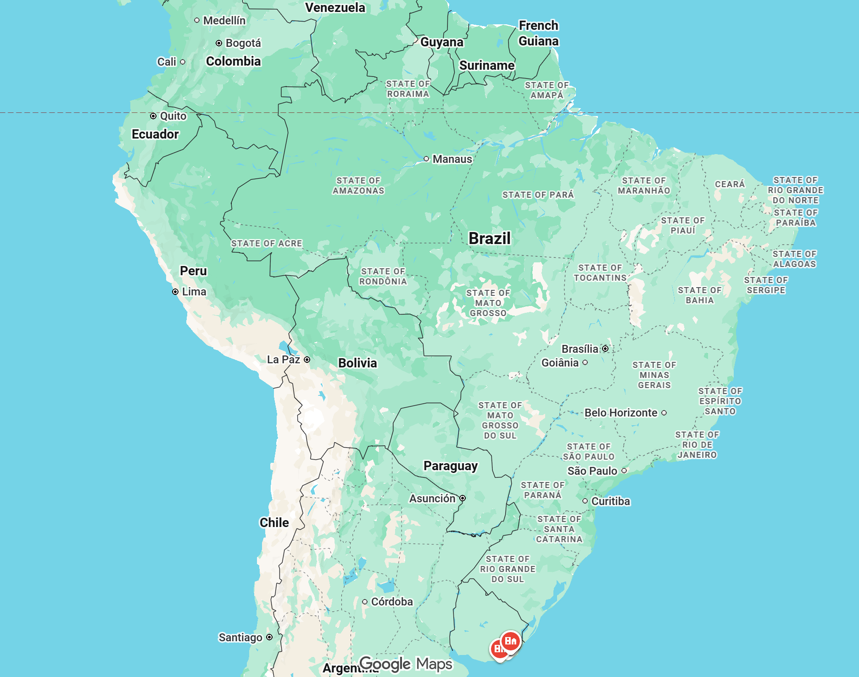
A fungus of Brazilian origin transmitted from cats to humans detected in Uruguay - Infobae
Sporothrix brasiliensis
First local detection of this pathogen of Brazilian origin
Owner adopted a puppy in Brazil, developed ulcers on snout and ears after arrival
Infected owners and cats in the household
Additional cases reported with no epi links to the index case
Cases reported rising in Brazil 2011 - 2023

Slide 8

Feline chaphamaparvovirus (feline fechavirus) in different cat populations - PubMed
Potentially emerging virus associated with diarrhea and vomiting in cats
  Shelter A (no GI disease) – 8/65 - 12%
  Shelter B – 1/9 – 11%
  Shelter C – 2/9 – 25%
  Shelter D – 7/8 – 88%
  Research Colony – 12/46 – 26%
Virus found in both healthy and diarrheic cats
Role of virus in outbreaks of diarrheic disease is unclear

Slide 9
Scientific Findings
Avian Influenza
Beyond poultry: Rethinking monitoring and control of HPAI H5Nx anticipating spillover risks for mammals – offlu
Lack of respiratory droplet transmission of two recent human influenza A(H5N1) viruses in female ferrets – ScienceDirect
Hematogenous neuroinvasion and genotype-dependent transmission of influenza A H5N1 viruses in the cat host | bioRxiv
Advancing A(H5N1) influenza risk assessment in ferrets through comparative evaluation of airborne virus shedding patterns | Nature Communications
Viral protein mutations enabling mammalian adaptation in Avian Influenza A viruses: Strategies for zoonotic risk mitigation and future perspectives – ScienceDirect
Salpingitis and multiorgan lesions caused by highly pathogenic avian influenza A(H5N1) virus in a cat associated with consumption of recalled raw milk in California – PubMed
Oseltamivir and baloxavir monotherapy and combination therapy efficacy against clade 2.3.4.4b A(H5N1) influenza virus infection in ferrets | Communications Biology
Novel recombinant H5-based vaccine provides effective protection against H5N1 influenza virus in cats | npj Vaccines

Slide 10
Scientific Findings
Coronavirus
Will animal reservoirs give us the next SARS-CoV-2 variant? | PLOS Pathogens
Blastomycosis
Emerging Endemic Area for Blastomycosis, New York, USA, 2000–2024 - Volume 32, Number 3—March 2026 - Emerging Infectious Diseases journal – CDC
Parasites
Human Intestinal Infection with the Dog Hookworm, Ancylostoma caninum, in Western Australia in: The American Journal of Tropical Medicine and Hygiene Volume 114 Issue 4 (2026)
Autochthonous Rat Lungworm Angiostrongylus cantonensis Infections in Accidental and Definitive Hosts, San Diego, California, USA - Volume 32, Number 2—February 2026 - Emerging Infectious Diseases journal – CDC
Analysis of Echinococcus multilocularis complete mitogenomes: evidence for the historical spread from Central Asia to the Northern Hemisphere - PubMed

Slide 11
Scientific Findings
Vector Borne Diseases
Clinical characteristics of two companion canines with severe fever with thrombocytopenia syndrome virus (Bandavirus dabieense) in Seoul, Republic of Korea - PubMed
Frontiers | Emergence of autochthonous Leishmania infantum infection in dogs from Costa Rica confirmed by multimodal diagnostics: a case series
Unravelling the genomic landscape of Canadian Borrelia burgdorferi: a comparison across global strains – PubMed
Tularemia in New York, USA, 1993–2023 - Volume 32, Number 1—January 2026 - Emerging Infectious Diseases journal – CDC
Simultaneous serological assessment of four zoonotic rickettsiae among dogs near the United States-Mexico border - PMC
Psitaccosis
Frontiers | Online parrot trade as a source of psittacosis caused by a novel Chlamydia psittaci ST388

