Slide 1
Community for Emerging and Zoonotic Diseases
Identifying emerging risks through collective intelligence
CEZD – CAHSS Equine Network Update
14 March 2024
www.cezd.ca

Slide 2
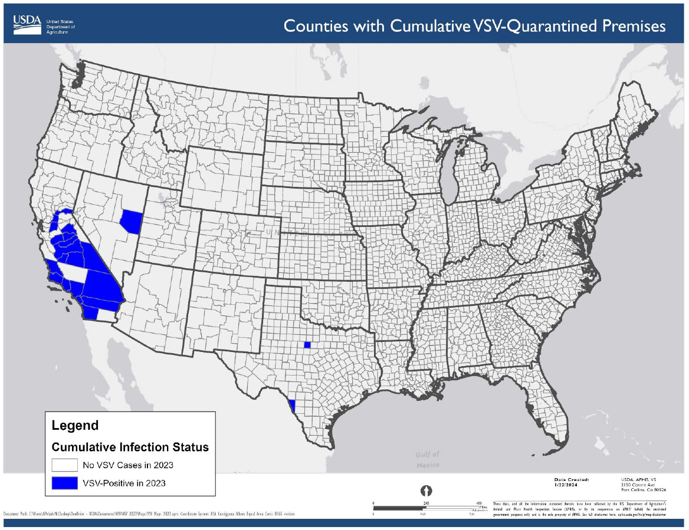
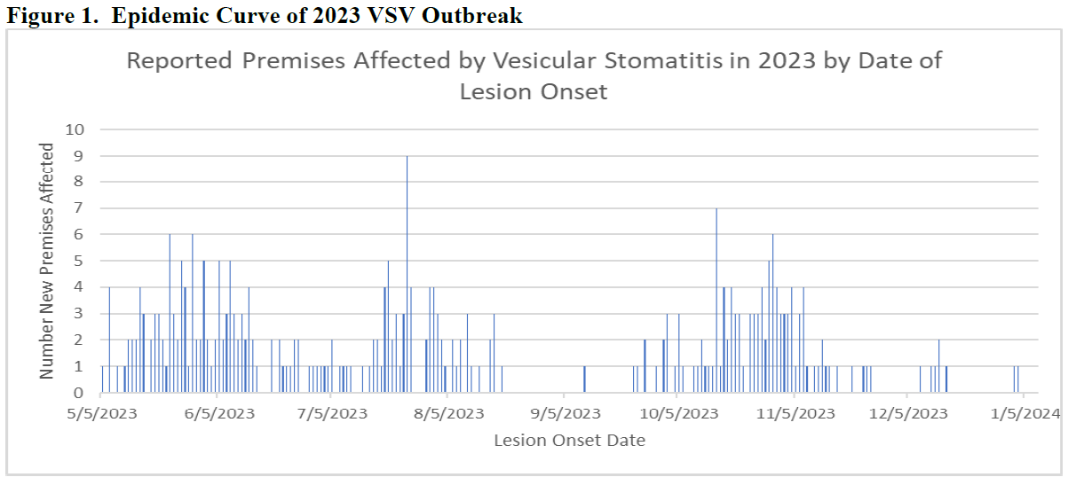
USDA APHIS | Vesicular Stomatitis
Since last meeting the cases of VSV have declined
Currently no active quarantines in place
Last quarantine released 18 Jan 2024
Images from Situation Report from 22 January 2024
Notes:
There have been no recent cases of Vesicular stomatitis in the US.
The last quarantine was released on Jan 18th.
The map on the right shows the locations of all the affected counties in California, Nevada and Texas.

Slide 3
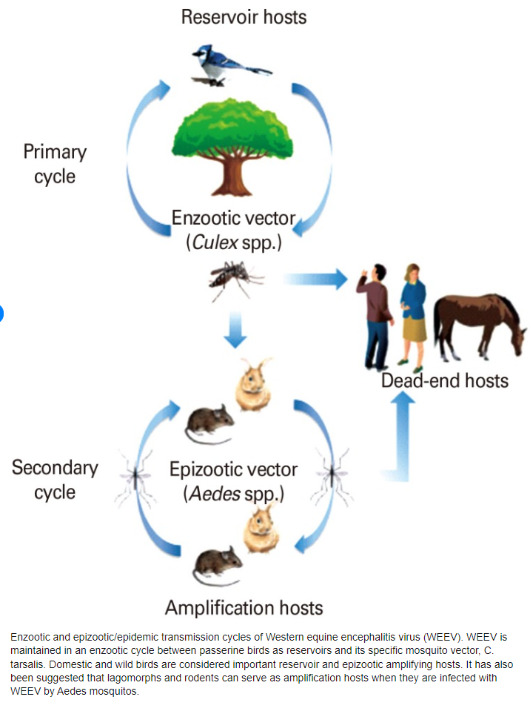
Western Equine Encephalitis in South America
Alphavirus of the Togaviridae family (EEE, VEE)
Primary vector – culex tarsalis
  Species of Aedes (melanimon, dorsalis, and campestris) have also been implicated
Reservoir: Birds – passerines
  Rodents, rabbits, and bats may play a role as reservoirs of the virus
Horses and humans are dead end hosts, are not contagious
WEE virus has been identified in opossums (US), and in garter snakes and leopard frogs (Saskatchewan)
Zoonotic encephalitides caused by arboviruses: Transmission and epidemiology of alphaviruses and flaviviruses
Notes:
WEE has been recently spreading in South America – but before we get into those details I’ll go over a bit about WEE
Western Equine Encephalitis Virus was first isolated in 1930, from a horse brain in the Central Valley of California
It is an Alphavirus of the Togaviridae family (same as EEE, VEE)
The primary vector of WEE in culex tarsalis, however other species of Aedes (melanimon, dorsalis, and campestris) have also been implicated in its spread
Birds – passerines primarily are the reservoirs for the virus – that are shown here in its primary cycle, and then Rodents, rabbits, and possible bats may play a role as reservoirs in the secondary cycle. Horses and humans are dead end hosts, are not contagious
WEE virus has also been identified in opossums (US), and in garter snakes and leopard frogs (Canada)
WEE virus causes asymptomatic or mild infections in humans, with non-specific symptoms (fever, headache, nausea, vomiting, anorexia, and malaise).
In horses WEE can occur without clinical signs, or result in fever and depression, anorexia, weakness and lethargy, incoordination and staggering gait….

Slide 4
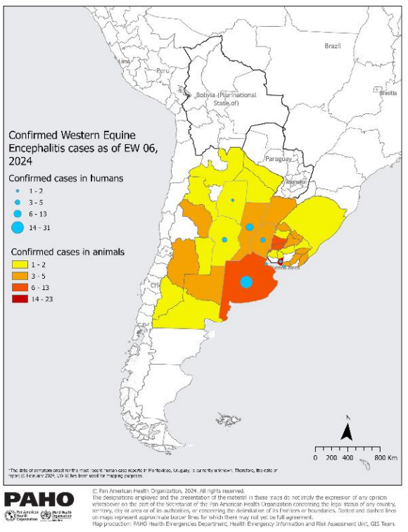
Western Equine Encephalitis in South America
Late November 2023, cases of WEE reported in equine in Argentina
December 20, 2023 initial human cases of WEE in Argentina
Since then, additional cases of WEE have been reported in equine in Argentina, Uruguay, and Brazil, and in humans in Argentina and Uruguay
Argentina has also reported a case of WEE in a four-month old female sheep
Paraguay has also analyzed some suspected cases of WEE, but has reported any confirmations
Notes:
In late Nov 2023, cases of WEE were reported in horses in Argentina – PAHO shortly thereafter released a warning notification for potential human cases in the region
On December 20th, Argentina reported a rare human case of WEE, the country’s first in more than two decades. The last reported human cases in Argentina occurred in 1982/1983 and 1996
Since then, additional cases of WEE have been reported in horses in Argentina, Uruguay, and Brazil, and in humans in Argentina and Uruguay
Argentina also reported a cases of WEE in a four month old female sheep
Paraguay has done some analysis of suspected human samples of WEE but has not reported any confirmations

Slide 5
Western Equine Encephalitis in South America
As of 14 February 2024
  2,464 outbreaks in animals (1,445 in 16 provinces of Argentina, 1,018 in 16 departments of Uruguay, and one case in a Brazilian state)
  73 confirmed cases in humans (69 in Argentina and four in Uruguay)
  distribution of human cases coincides with areas with a higher number of suspected and confirmed equine cases
The outbreaks in Argentina and Uruguay coincide with the summer season in these countries (December to March)
There is no data available suggesting that there is an increased density of the vector
Epidemiological update - Western Equine Encephalitis in the Region of the Americas - 8 February 2024
Public health risk assessment related to Western Equine Encephalitis (WEE) virus in the Region of the Americas - 23 February 2024
Notes:
From the PAHO Public Health Risk assessment that was recently released
As of 14 February 2024:
There have been 2,464 outbreaks in animals (1,445 in 16 provinces of Argentina, 1,018 in 16 departments of Uruguay, and one case in a Brazilian state)
73 confirmed cases in humans (69 in Argentina and four in Uruguay)
distribution of human cases coincides with areas with a higher number of suspected and confirmed equine cases
There have been 7 fatal cases in Argentina, all reported a history of having lived, worked, or visited a rural or semi-rural area and 86% (n=6) reported a history of previous illness or underlying condition (diabetes, oncological disease, arterial hypertension, among others)
We were wondering what may be driving this outbreak this year – but its unclear whether there is something there - the outbreaks in Argentina and Uruguay coincide with the summer season in these countries (December to March)
There is no data available suggesting that there is an increased density of the vector – now I’m not sure if this means there is no data on vector density or that the data they have does not suggest an increased density.

Slide 6
Western Equine Encephalitis in North America
United States
  Most cases of WEE are reported during summer, in western and central states
  Cases have been reported in the past from a variety of US states: Utah, Colorado, California, Texas, Oklahoma (emus), Nevada (chickens), Florida (human serology, bears), North Dakota (birds)
  Decrease in reported cases since the early 2000’s
Canada
  Outbreak in 1941 (1094 human cases) from Manitoba and Saskatchewan
    highest incidence in these provinces
  From 1952-1987 additional outbreaks reported in humans and horses in Manitoba, Saskatchewan, and Alberta
  1987 – Manitoba equine outbreak
Notes:
What is our risk to North America?
WEE has been reported in the USA and in Canada - WEE occurrence in Canada is less common than EEE. WEE cases have not been reported in Canada since the late 1980’s I believe.
In the USA, most cases of WEE are reported during summer, in western and central states
Cases have been reported in the past from a variety of US states: Utah, Colorado, California, Texas, Oklahoma (emus), Nevada (chickens), Florida (human serology, bears), North Dakota (birds)
Decrease in reported cases since the early 2000’s
In Canada - Outbreak in 1941 (1094 human cases) from Manitoba and Saskatchewan
up until the late 1980’s the highest incidence was reported in these provinces
From 1952-1987 additional outbreaks reported in humans and horses in Manitoba, Saskatchewan, and Alberta
1987 – Manitoba equine outbreak

Slide 7
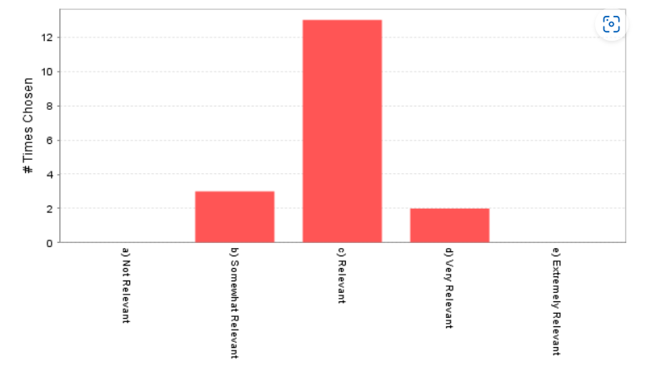
Ping - WEE Re-emergence in Canada?
Present in USA wildlife
Northward incursion from USA/South America is possible
Migrating birds could re-introduce it
Competent vectors are present
West Nile has displaced WEE in our ecosystem
What is the state of equine WEE/EEE vaccinations in Canada?
  Impact of climate on western equine encephalitis in Manitoba, Minnesota and North Dakota, 1980-1983
  1988 study looking at wind trajectories before initial outbreaks
  During these years the timing and location of WEE outbreaks in horses and man, seroconversion in chickens, the maximum Culex tarsalis counts at Winnipeg and first isolation of WEE virus from C. tarsalis could be correlated with trajectories of winds from states further south within acceptable intervals
  Suggested that C. tarsalis mosquitoes infected with WEE virus are carried on the wind from Texas on the Gulf of Mexico, where they continue to breed during the northern winter months, to northern Texas and Oklahoma in the spring
Question: What are your thoughts on this? Are we at increased risk for WEE now?
Notes:
As a result of the South America situation and the fact that North America has had cases in the past with competent vectors - we sent out a ping asking members about potential WEE re-emergence in Canada
We received 18 responses – with the majority of members identifying it as a relevant issue and lots of good comments – which I’ve quickly summarized:
Present in USA wildlife, Canada has had outbreaks in the past, northward incursion from USA/South America is possible
Migrating birds could re-introduce it
Competent vectors are present
Someone stated that west nile has displaced WEE in our ecosystem – how might that be?
And then a question as to what is the state of equine WEE/EEE vaccinations in Canada?
One individual told us that it was more important to look at what has happened in Canada/Manitoba in the past than what is going on in South America today- and there’s a study looking at the impact of climate on WEE in Manitoba

Slide 8
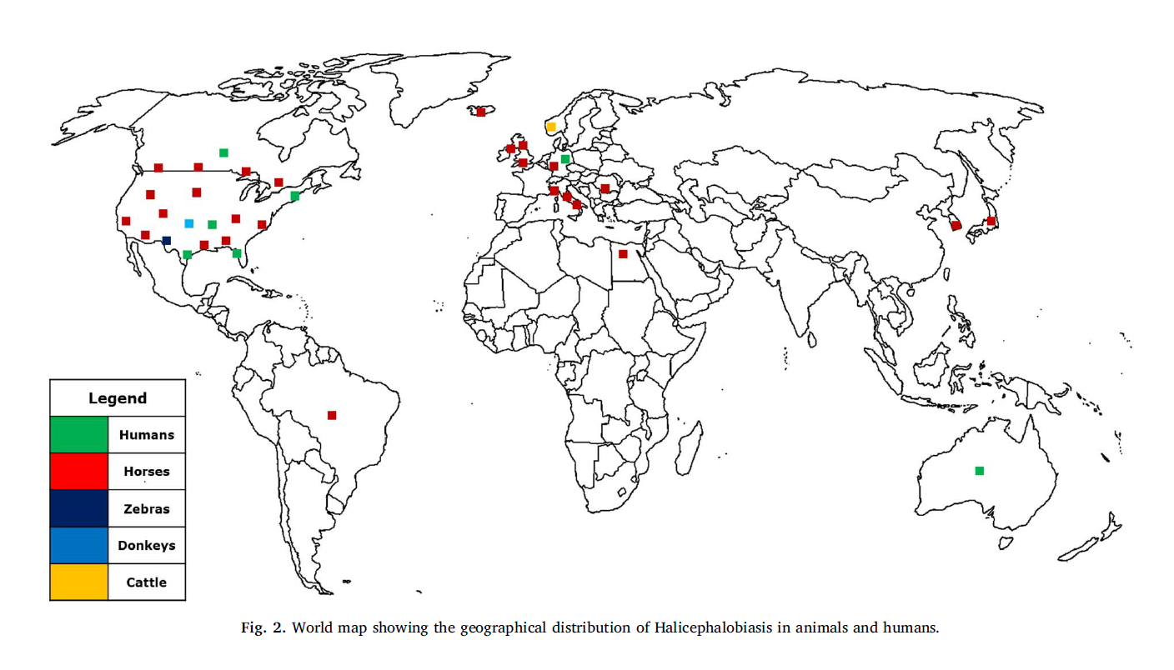
Icelandic Gelding in Quebec Positive for Halicephalobus – The Horse
Gelding imported from Iceland last summer
Colic in the fall and severe neurological signs in January
Euthanized
Histopathology indicated Halicephalobolus gingivalis
Parasitic and zoonotic meningoencephalitis in humans and equids: Current knowledge and the role of Halicephalobus gingivalis - ScienceDirect
Notes:
Dr Martin Rondeau (MAPAQ) reported a case of Halicephalobolus gingivalis in a horse in Estrie, Quebec.
The gelding was imported from Iceland last summer, and presented with colic in the fall, and severe neurological signs in January. The animal was euthanized and histopathology indicated infection with Halicephalobolus gingivalis. It was not possible to do PCR testing.
The nematode is a very rare cause of meningoencephalitis in horses, humans and ruminants. The map above shows the global distribution of cases (published in 2018). Humans in green, horses in red.

Slide 9
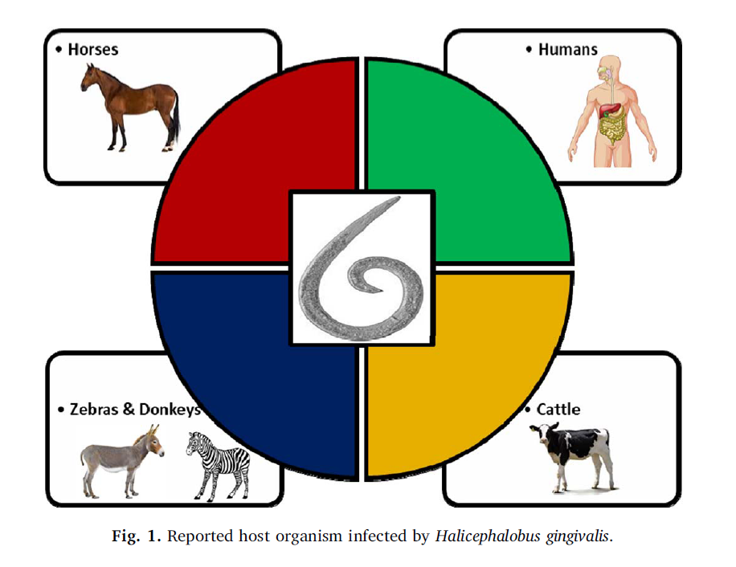
Parasitic and zoonotic meningoencephalitis in humans and equids: Current knowledge and the role of Halicephalobus gingivalis - PMC (nih.gov)
Free living saprophytic nematode
Generally feeds on rotting matter in compost and manure piles
Rare cause of disease in humans, horses, zebras, donkeys and cattle
Nematode is parthenogenetic
  Only female adult worms, larvae and eggs have been found in parasitized hosts
Notes:
The nematode is free living and and a rare cause of meningoencephalitis in humans, horses and ruminants.
Only female worms, larvae and eggs have been found in hosts to date, the worm is parthenogenetic so does not require a male to reproduce.

Slide 10
Mode of infection is speculative
  Suspected migration through wounds in skin and oral mucosa
  Inhalation into nasal cavities
  Ingestion of contaminated food
  Trans mammary infection has been reported
  Larvae found in urine samples and semen
  Flies proposed as carriers of larvae
Unknown if vertical transmission can occur
Notes:
The transmission mechanism is currently speculative, and the epidemiology is poorly understood.
It’s currently thought that the worm migrates through wounds in the skin or oral mucosa of the host, or is inhaled into the nasal cavity or consumed with contaminated food.
Trans mammary infection has been reported, and larvae have been found in urine and semen samples. Flies have also been proposed as carriers of larvae.
It is unknown if vertical transmission can occur.

Slide 11
Parasitic and zoonotic meningoencephalitis in humans and equids: Current knowledge and the role of Halicephalobus gingivalis - PMC (nih.gov)
Brain is most commonly affected other sites include
  Kidney
  Oral and nasal cavities
  Lymph nodes
  Spinal cord
  Adrenal glands
  Heart, stomach, liver, lung, testes, mammary gland, ganglia and bone also reported
Prognosis: poor when parasite spreads within host
Hematogenous spread to other body locations
Clinical signs can vary, depends on the location of the parasite larvae in the body
Always closely associated with vasculature of affected organs
Incubation period can be weeks to months and dependent on site of infection and health status of the host
Notes:
Once in the host, the worm travels via hematogenous spread to other body locations and the clinical signs vary based upon the location of the parasite, it is always closely associated with the vasculature of affected organs.
The incubation period is variable from weeks to months.
Brain is the most commonly affected organ, but many other sites can also be infected.
The prognosis is poor once the parasite has spread within the host. Mortality rate is 100% for horses with clinical signs.

Slide 12
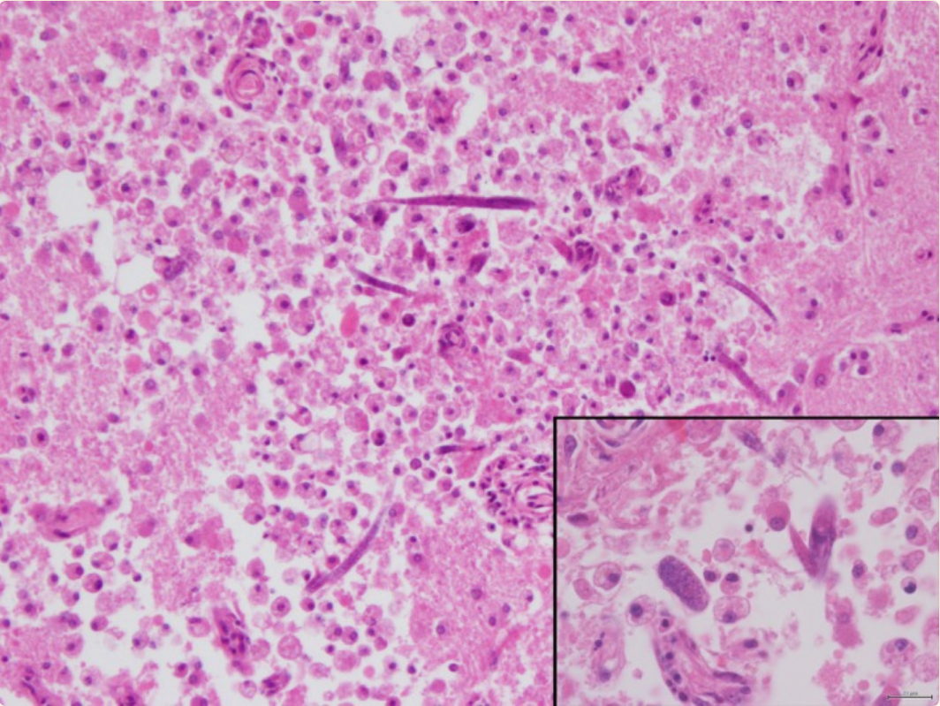
Parasitic and zoonotic meningoencephalitis in humans and equids: Current knowledge and the role of Halicephalobus gingivalis - PMC (nih.gov)
Diagnosis
  Difficult, no good ante mortem tests
  Fecal samples may yield very low levels of H. gingivalis
  Histopathology and PCR on tissues at post mortem
Treatment:
  Poor efficacy of anthelminthics
    Difficulty crossing blood-brain barrier
    Intrinsic resistance to ivermectin/thiabendazole
First description of a fatal equine infection with Halicephalobus gingivalis in Portugal. Relevance for public health - PMC (nih.gov)
Notes:
The diagnosis is very difficult as there are no good ante mortem tests. Diagnosis typically occurs on postmortem with histopathology of affected organs and PCR for diagnosis.
Treatment with anthelminthics, if used, has poor efficacy both due to poor ability to cross blood brain barrier, as well as some intrinsic resistance to ivermectin/thiabendazole.

Slide 13
Management Measures
Environmental Management
Biosecurity Measures
  Good hygiene
  Pasture management, remove stagnant water if possible
  Fly control
  Management of manure and urine
Do not use manure from infected animals for fertilizer for forage crops or human food production
Fully compost manure before use
Humans
Clean and protect skin wounds
Wash hands frequently, wear gloves when handling waste products
Leave equipment on site, clean and disinfect regularly
Get dewormed!
Notes:
Management measures are about having good biosecurity in place. Good hygiene in the barn, fly control and management of pastures, manure and urine.
Manure from infected animals should not be used as fertilizer for forage crops or human food. If manure is used, it should be fully composted and aged before use.
Those working with horses should clean and protect skin wounds, wash their hands frequently and wear gloves. Equipment used on an infected farm should stay there and be cleaned and disinfected regularly
Humans can consider routine deworming.

Slide 14

Management Measures
Horses
Fecal tests of horses and manure
If an affected horse is found on farm
  Separate from other horses
  Avoid transporting to other sites
  Watch for skin wounds on other animals
  Use separate pasture
Necropsy on suspicious deaths
Questions for Martin on Quebec Case?
Notes:
Fecal floats for horses and manure can be conducted to understand the parasite burden in the environment.
If an affected horse is found on farm, separate it from the others and avoid moving that animal off site. Monitor other animals for skin wounds and keep on separate pastures if possible.
Any suspicious deaths should be necropsied if possible.

Slide 15



Survey of Network Groups
Are CEZD quarterly reports providing value?
Anything we can do better?
Anything we should stop doing?
Notes:
We’re asking all of our network groups for feedback on whether what is being done for the network is providing value. So just a thumbs up/thumbs down survey. No thumbs down in the ‘reactions’ so just use surprized face if the reports have no value for you.
If you have any feedback on what we could do better, or should stop doing that would be valuable – now or later. Given our limited resources, we don’t want to put effort into things that don’t have value.

