Slide 1
Community for Emerging and Zoonotic Diseases
Identifying emerging risks through collective intelligence
CEZD – CAHSS Equine Network Update
13 June 2024
www.cezd.ca

Slide 2
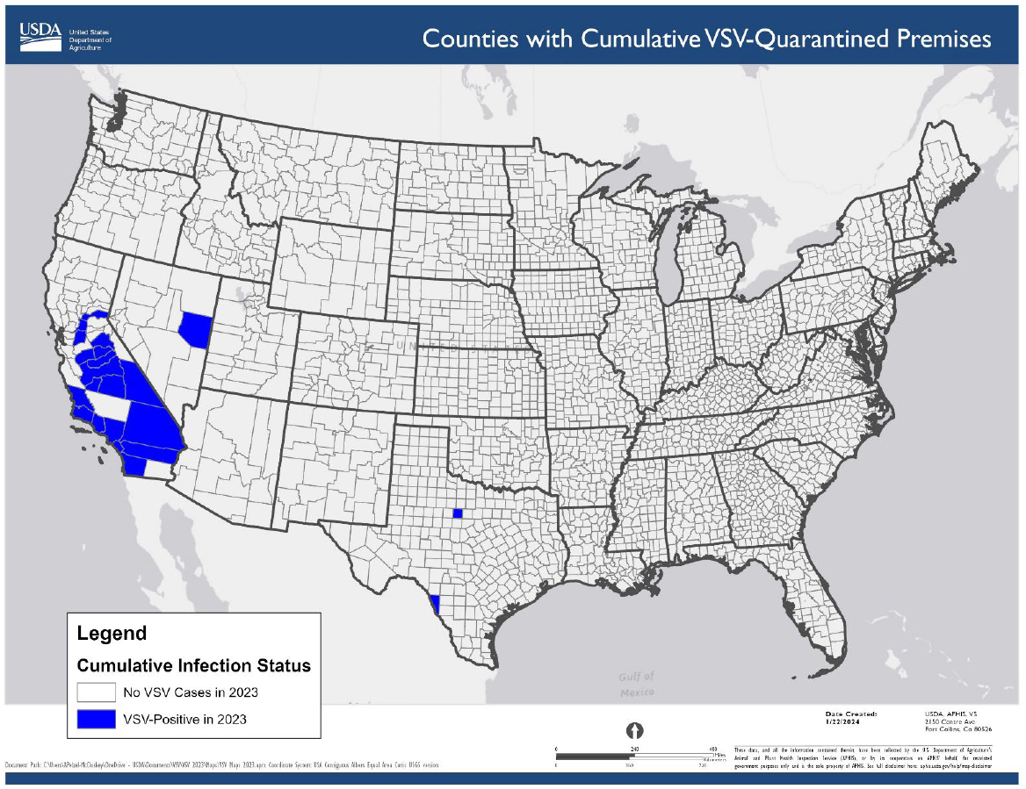
USDA APHIS | Vesicular Stomatitis
Since last meeting no new cases of VSV reported
Website last updated April 6, 2024
Last situation report 22 January 2024

Slide 3
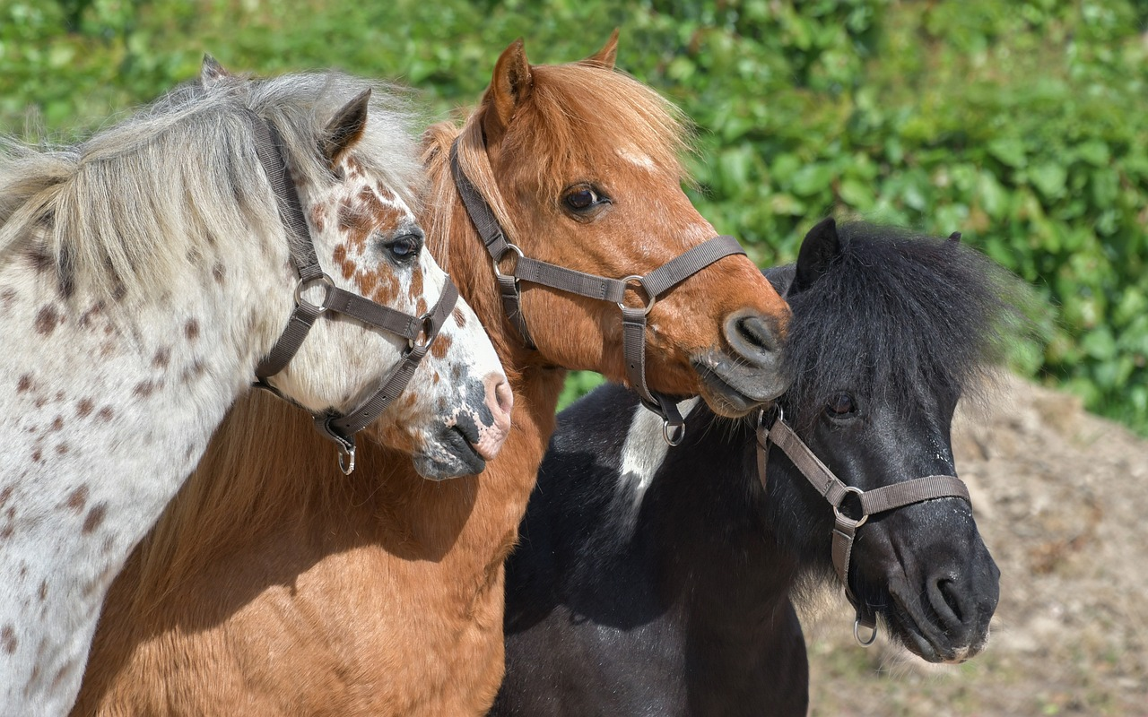
Contagious Equine Metritis in Florida
USDA Reports of CEM in Florida
CEM is detected sporadically in the United States, the last time it was detected was 2013
3 animals have been confirmed positive for CEM in central Florida
  2 pony stallions and 1 pony mare

Slide 4
WNV early detections
California - First West Nile Virus Positive Dead Bird of 2024 Found in Contra Costa County (April )
West Nile Virus in Illinois – Surveillance Mosquitos/Birds (April)
West Nile Virus Makes an Early Appearance in Wild Birds in Ontario this Year - Healthy Wildlife
Ontario (May)
  Peterborough (crow)
  North Bay (crow)
Notes:
• In early April 2024, dead birds tested positive for WNV across several counties in California; it is early in the season for the first detections of WNV
• Illinois has also reported its first bird to test positive for WNV for 2024 in Douglas County; the specimen was collected on April 2, 2024, again, very early in the season

Slide 5
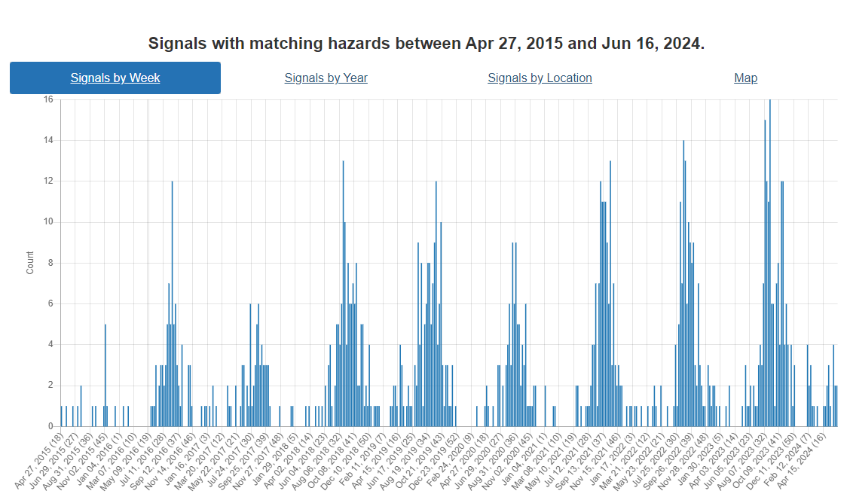
West Nile Virus Hazard Trend
Notes:
In April a small bump is visible this year, this is earlier than normally detected.

Slide 6
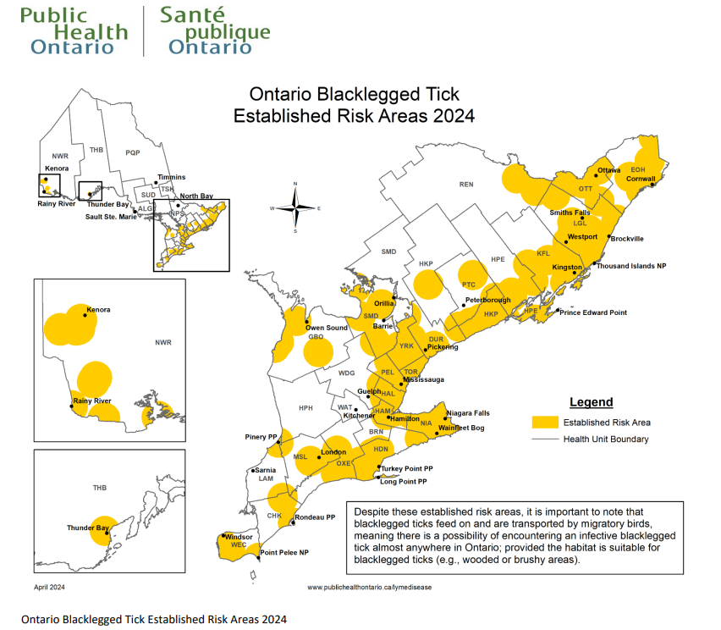
Lyme Disease
21 confirmed cases of Lyme disease in May: Public Health Ontario (chch.com)
60 human cases so far in 2024
Signals from New England (CT, NY) also showing increases

Slide 7
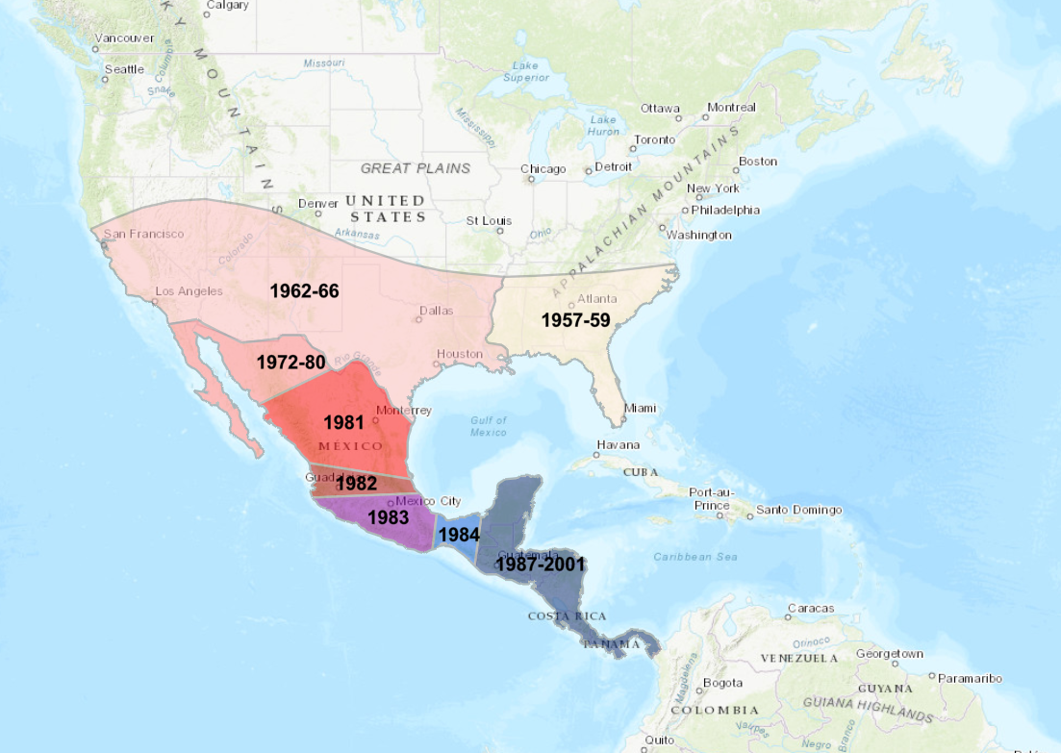
New World Screwworm in Central America
Parasitic fly larva - Cochliomyia hominivorax causing wound myiasis
Had been eradicated from the United States and Central America between 1957 – 2001 using sterile male flies
Re-emergence in Florida Keys in 2016 but that has been controlled
Normally, Panama is the control point with millions of sterile flies released to control northward movement
History and Current Situation of the New World Screwworm in the Americas | IAEA

Slide 8
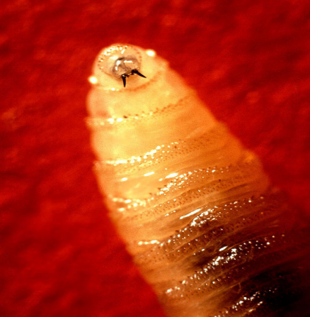
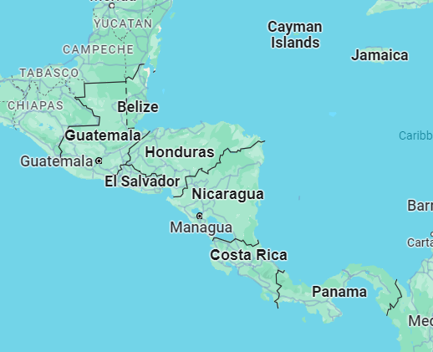
Northward movement in Central America
August 2023 Cases occurred in Panama, animal movements were halted. Subsequent/Concurrent with release of sterile flies.
Costa Rica (Feb 2024) declared a sanitary emergency due to the presence and spread of new world screwworm; Cases in cattle, horses, pigs, sheep, goats and dogs
March 2024 First Human case
Panama >4,700 cases in cattle (April 12)

Slide 9
Nicaragua
Canada?
Nicaragua (April 2024) – issued a health alert due to presence of screwworm in livestock
Reporting delayed
Cases in pigs, dogs, horses, cattle
Environmental requirements for survival make it improbable they could establish here
Susceptible to freezing/near freezing
Need 25-30C and relative humidity of 30-70%
https://www.cfsph.iastate.edu/Factsheets/pdfs/screwworm_myiasis.pdf
Notes:
Screwworms are very susceptible to freezing temperatures or long periods of near–freezing temperatures. These organisms are seasonal in some areas, and can spread into colder climates during the summer. The ideal environmental conditions for survival and activity are temperatures of 25-30°C and relative humidity of 30-70%.

Slide 10
Identification of equine mares as reservoir hosts for pathogenic species of Leptospira - PubMed (nih.gov)
37 mares in study, urine tested
  PCR
  Culture
  Serology
35/37 were seropositive for Leptospirosis
1 mare aborted during the study and was seropositive for L. interrogans serogroup Pomona serovar Pomona
3 mares PCR positive for lipL32, a gene specific for pathogenic species of Leptospira
  DNA enrichment found shedding of:
    1 L. kirschneri serogroup Australis
    1 L. interrogans serogroup Icterohaemorrhagiae
1 mare culture positive L. kirschneri serogroup Australis serovar Rushan
Notes:
In this study, PCR and culture were used to assess urinary shedding of pathogenic Leptospira from 37 asymptomatic mares.
Three asymptomatic mares, designated as H2, H8, and H9, were PCR-positive for lipL32, a gene specific for pathogenic species of Leptospira. One asymptomatic mare, H9, was culture-positive, and the recovered isolate was classified as L. kirschneri serogroup Australis serovar Rushan.
Our results demonstrate that horses in the US can act as reservoir hosts of leptospirosis and shed diverse pathogenic Leptospira species via urine. This report also details the detection of L. kirschneri serogroup Australis serovar Rushan, a species and serotype of Leptospira, not previously reported in the US.

Slide 11

Question
Why haven’t horses been reported with HPAI H5N1?
Receptors are present in the Upper Respiratory Tract (α2-3 and α2-6 sialoreceptors)
Distribution of Influenza Virus Sialoreceptors on Upper and Lower Respiratory Tract in Horses and Dogs

