Slide 1
Community for Emerging and Zoonotic Diseases
Identifying emerging risks through collective intelligence
CEZD – CAHSS Equine Network Update
12 December 2024
www.cezd.ca

Slide 2

Contagious Equine Metritis in USA (ongoing)
CEM is detected sporadically in the United States, the last time it was detected was 2013
Case count as of 05 November 2024
  48 animals (+9)
    17 domestic ponies (2 stallions, 1 mare, and 14 geldings)
    17 riding horses (all geldings), and
    15 draft horses (all geldings)
  41 on Index Farm
  8 trace outs are geldings in Florida, Iowa, Maine, Maryland, North Carolina
  Trace back has not revealed source of infection

Slide 3
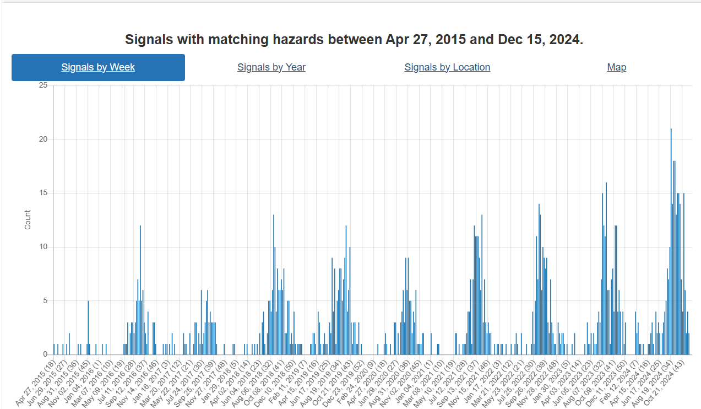
West Nile Virus
Number of reports of WNV has returned to baseline

Slide 4
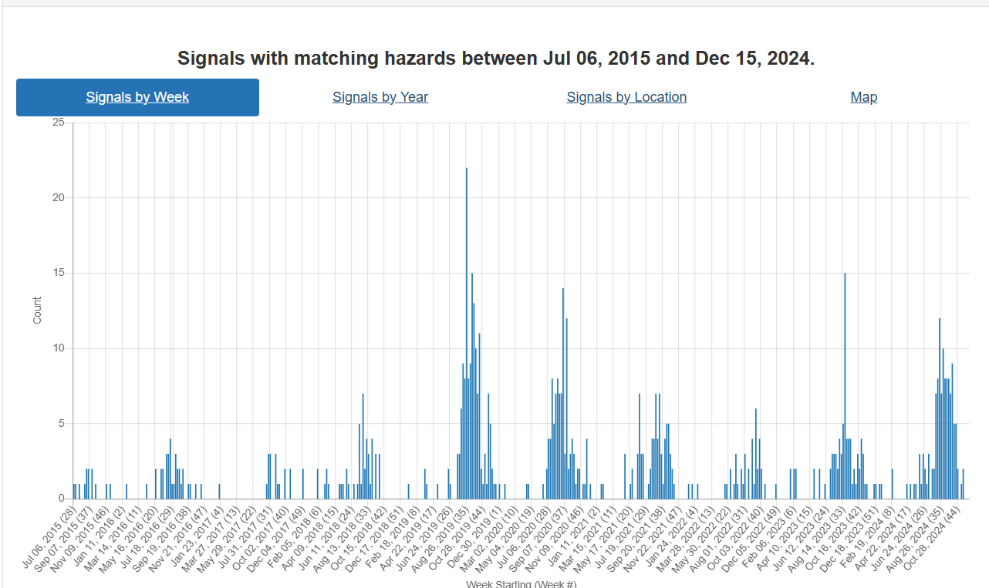
Eastern Equine Encephalitis
Number of reports of EEE has returned to baseline
Ottawa Public Health reports first human case of eastern equine encephalitis in Ottawa | CTV News
Notes:
Right after the last meeting there was a report of a human death from EEE in Ottawa.

Slide 5
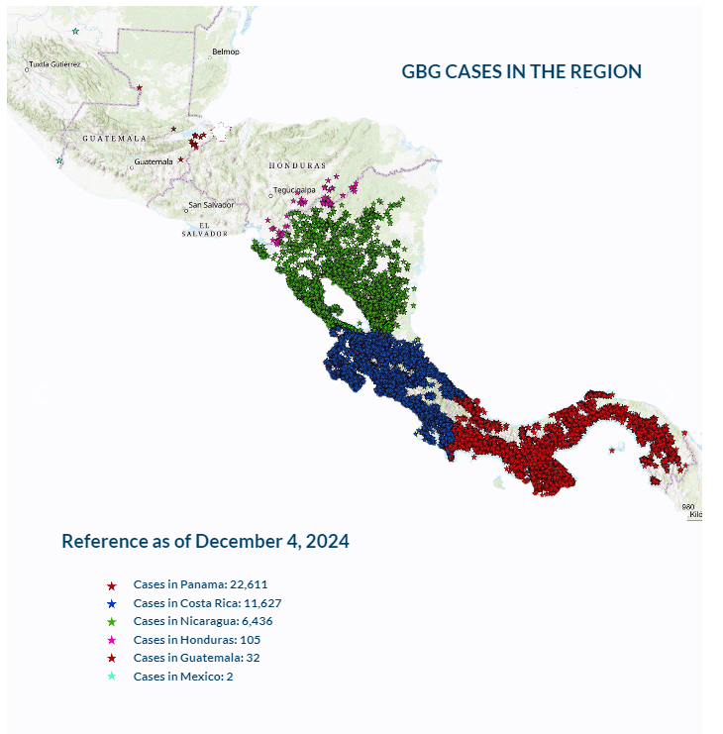
New World Screwworm in Central America
August 2023 Cases occurred in Panama; animal movements were halted. Subsequent/Concurrent with release of sterile flies.
Slow and steady march northwards
As of December 4, 2024, according to COPEG:
  Panama – 22,611 cases
  Costa Rica – 11,627 cases
  Nicaragua – 6,436 cases
  Honduras – 105
  Guatemala – 32
  Mexico – 2
Human cases in Costa Rica, Panama and Nicaragua
Potentially linked to illegal cattle smuggling
Risks for wildlife are undefined
COPEG
Notes:
In statements to Prensa Latina, Carlos Moreno, of the Panama-United States Commission for the Eradication of Screwworm (Copeg) said that the increase in the pest in mid-2023 was due to the lack of vigilance of both citizens and authorities during the Covid-19 pandemic.
Now for the New world Screwworm, it has been spreading through central America, moving north from Panama to Costa Rica to Niaragua, Honduras and Guatemala
The increase in cases in Costa Rica may be due to a more aggressive strain of fly, that moves faster and prefers to mate with field flies (as opposed to sterile flies), which has reduced the effectiveness of the sterile fly control program.
Increased rainfall has also been implicated as it may lead to may parasitic activity.
There is also concern for wildlife (deer, wild boar, coyotes…) in these countries, but due to their habitats its hard to determine the exact number of animals affected. Recently Costa rica reported an infestation in a sloth.
Mexico is providing Central American nations with over 90,000 packets of larvicides and wound-healing powders to support containment efforts. SENASICA is also working with local producers to ensure timely treatment of livestock wounds and monitor animal movement from Mexico’s southern border.

Slide 6
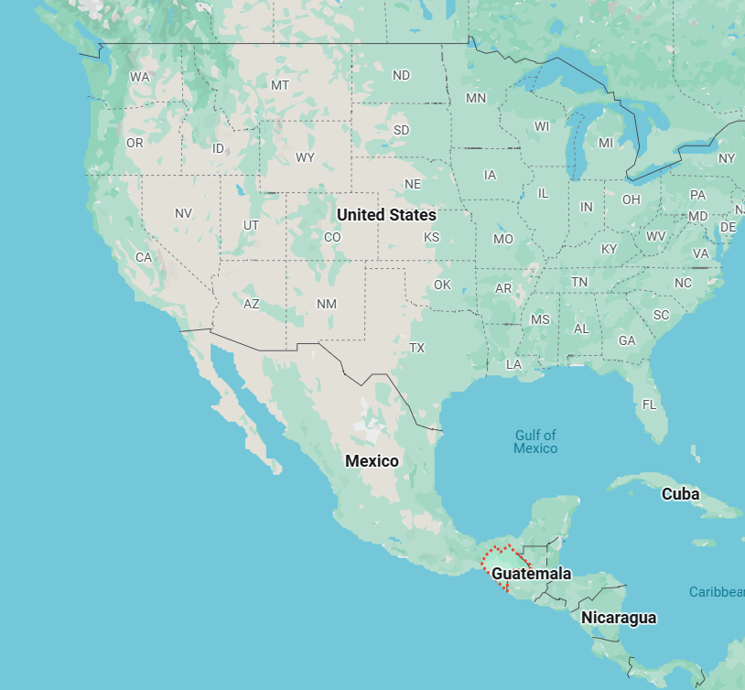
Mexico Notifies United States of New World Screwworm Detection | Animal and Plant Health Inspection Service
The NWS was found in a cow in the southern Mexico state of Chiapas, at an inspection checkpoint close to the border with Guatemala.
1/100 cows had an ear lesion
Trade in cattle stopped between Mexico and US (normally >1 million animals per year) USDA APHIS
Dogs and horses being inspected at US border
Other species are not approved for movement from Mexico to the US (pigs, sheep, goats, cervids, camelids)
Enhanced Surveillance
Ongoing Sterile Fly Releases
WAHIS
Notes:
Following the interception of a batch of cattle originating from outside of Mexico at a federal control and inspection point before movement, official personnel identified the presence of myiasis in one of the animals and collected samples for diagnosis. The affected animal was treated with larvicidal powder (Negasunt: coumaphos and propoxur) on the wound. The entire batch (including the affected animal) was bathed with ivermectin 1% injectable and sprays (cypermethrin and chlorpyrifos), according to the control and inspection points' Operational Manual to prevent the entry of affected animals. The trailer and truck were sprayed with larvicidal liquid (cypermethrin and chlorpyrifos). The lot is being held in federal quarantine and under official supervision, with the support of the Mexican Armed Forces.

Slide 7
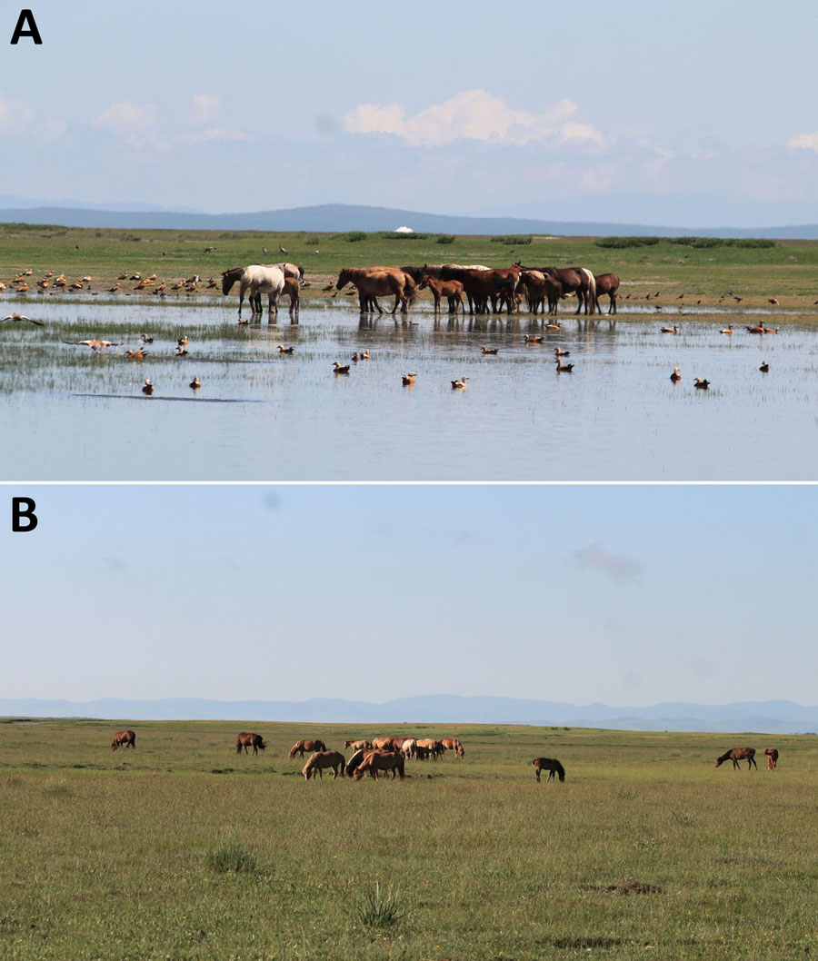
Evidence of Influenza A(H5N1) Spillover Infections in Horses, Mongolia
July 2021 – October 2023
2 Provinces in Mongolia, 1 wetland, 1 dry area
24 herds, 10 horses per herd tested 3 x per year
Horses unvaccinated and clinically healthy
No history of respiratory disease
997 samples tested with H5 ELISA
  9 positive
  8 doubtful
  980 negative
2 positive horses on serum neutralization one from each area
Notes:
Typical ecosystems of sampling sites for study of influenza A(H5N1) spillover infections in horses, Mongolia. A) Arkangai Province, characterized by large wetlands. B) Bulgan Province, characterized by dry areas.
9 samples were positive, 8 doubtful, and 980 negative
To confirm the H5 ELISA results, we tested all doubtful and positive samples (n = 17) in virus neutralization assays using live virus A/chicken/England/053052/2021, clade 2.3.4.4b (Appendix). Two samples derived from working horses sampled in October 2021 in the Bulgan area, and in October 2022 in Arkangai were positive, with a titer of 1:20. Serum samples from horses experimentally infected with EIV were negative in neutralization assays.

Slide 8
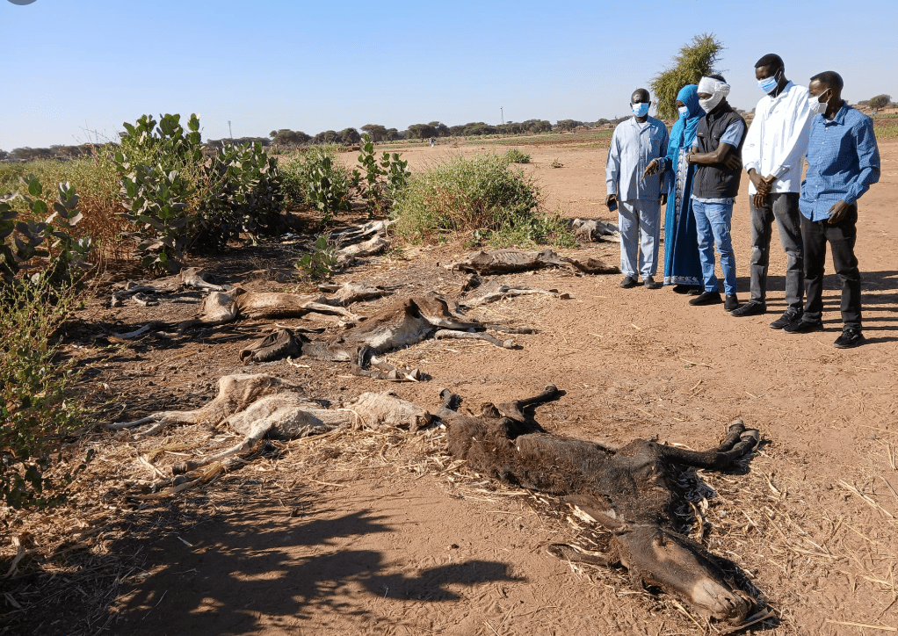
A mysterious epidemic kills animals in South Darfur state - Al-Rakoba newspaper
800 donkeys recently died across western Sudan
Lethargy, poor appetite nasal discharge that turns yellow in a day or two
Diagnosis was Trypanosomiasis, species not identified
Spread by biting flies
Interference in response due to war
Immediately notifiable in Canada

Slide 9
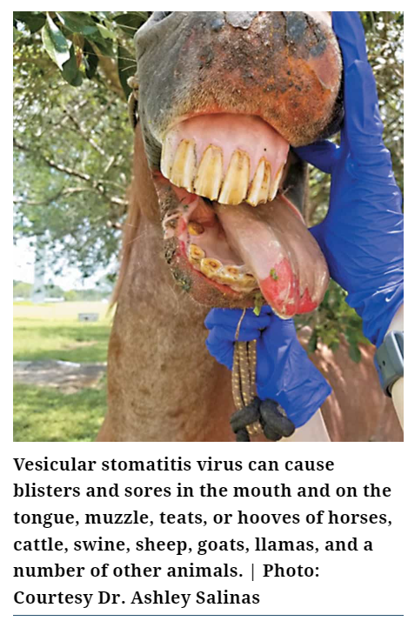
Vesicular Stomatitis Virus Detected in Biting Midges and Black Flies during the 2023 Outbreak in Southern California
2023 was first VSV outbreak that California experienced not related to animal movements
VSV is endemic in Mexico and Central America and sporadic introductions have occurred in US
Last outbreak in California had been 1982

Slide 10
Vesicular Stomatitis Virus Detected in Biting Midges and Black Flies during the 2023 Outbreak in Southern California
Surveillance of biting midges (Culicoides spp) and biting flies (Simulium spp) in San Diego County
CO2 baited traps set from mid-May to Mid-August 2023
  2357 biting midges
  1215 biting flies
PCR testing:
9 positive pools of Culicoides
16 positive pools of Simulium
Viral Isolation
96 percent of positive pools had virus isolated

Slide 11
Species Captured and Species Positive
Culicoides bergi (5.6%)
Culicoides crepuscularis
Culicoides freeborni (1.4%)
Culicoides occidentalis (1.7%)
Simulium argus (5.6%)
Simulium donovani
Simulium hippovorum (17.6%)
Simulium tescorum (3.9%)
Simulium vittatum complex (21.4%)
Only S. vittatum complex had been detected positive in previous outbreaks in the US
6 new species found positive for VSV RNA
Does not imply vector competence, further study needed

Slide 12
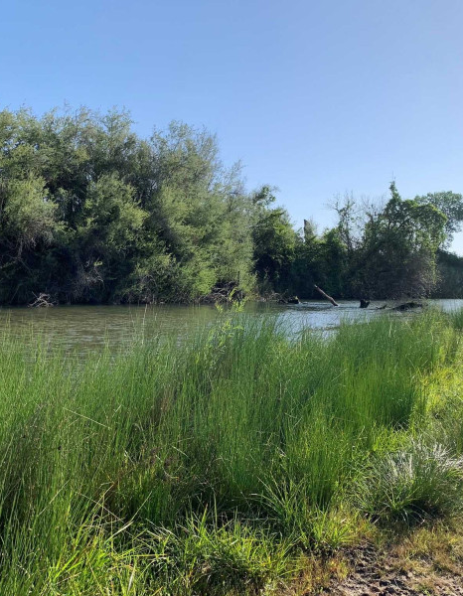
Vesicular Stomatitis Virus Detected in Biting Midges and Black Flies during the 2023 Outbreak in Southern California
Environmental conditions favourable to the outbreak
Increased vegetation greenness at onset of outbreak and ~ 6 months prior
Max temperatures were anomalously low 1 month prior to onset
Rainfall was high 4 months prior to onset
  Standing water as well as higher water flows

