Slide 1
Community for Emerging and Zoonotic Diseases
Identifying emerging risks through collective intelligence
CEZD – CAHSS Equine Network Update
01 April 2025
www.cezd.ca

Slide 2

Contagious Equine Metritis in USA (ongoing)
CEM is detected sporadically in the United States, the last time it was detected was 2013
Case count as of 10 March 2025
  52 animals (+4)
    18 domestic ponies (2 stallions, 1 mare, and 15 geldings)
    18 riding horses (all geldings), and
    16 draft horses (all geldings)
  41 on Index Farm
  11 trace outs are geldings in Florida, Iowa, Maine, Maryland, North Carolina + South Carolina
Notes:
The case counts have increased by 4 animals since the last presentation in December
Genomic sequencing indicates the isolates show close correlation between the infected horses and the index farm in Florida.
The isolates do not match the strains from previous outbreaks in the United States. Current isolates fall in the same clade as two previously obtained international isolates but they are not closely related.

Slide 3
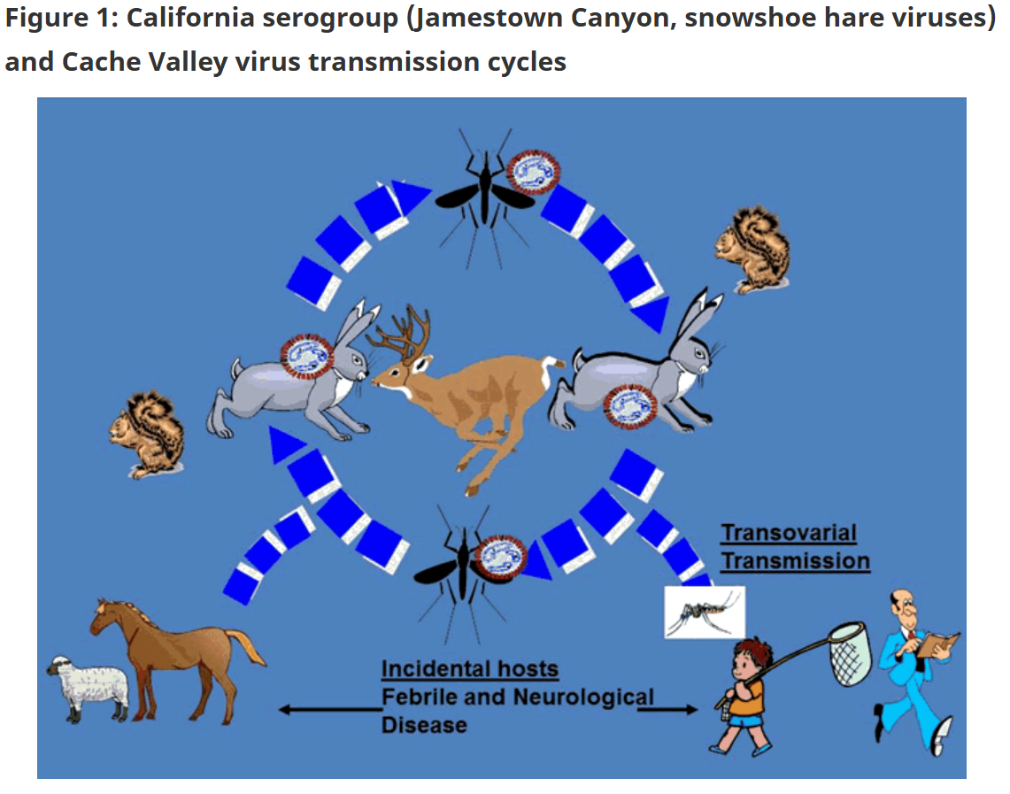
Understanding Jamestown Canyon Virus in Horses
Jamestown Canyon virus discovered in a horse in Pennsylvania with neurological disease (Oct 2024)
Not a new virus and not cause for alarm
Orthobunyavirus in the California serogroup
Normal lifecycle between deer and mosquitos, horses and humans are incidental hosts
https://www.canada.ca/en/public-health/services/reports-publications/canada-communicable-disease-report-ccdr/monthly-issue/2015-41/ccdr-volume-41-06-june-4-2015/ccdr-volume-41-06-june-4-2015.html

Slide 4
Jamestown Canyon Virus in Horses
Seroprevalence studies in Canada show JCV exposure in horses in:
  Newfoundland and Labrador (64%)
  New Brunswick (3.2%)
Viruses found throughout the country
Mosquito vectors:
  non-Culex mosquitoes such as Aedes, Culiseta and Anopheles species
Case reports of clinical disease in horses very limited
  Horse with vesicular lesions on coronary band and mouth in Colorado in 1997
  Neurological horse at New Bolton Centre in Pennsylvania 2024
California Serogroup Viruses in a Changing Canadian Arctic: A Review

Slide 5
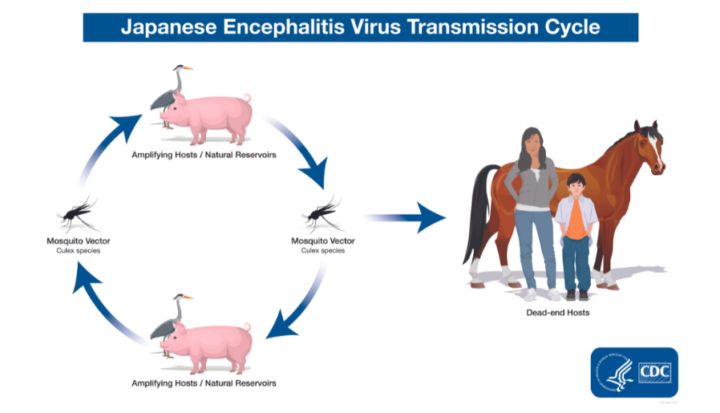
Japanese Encephalitis in Australia
Flavivirus causing encephalitis in humans, neurological disease in pigs and horses
Spread by Culex species mosquitos
Pigs can act as amplifying hosts
Emerged in Australia in 2022 affecting humans and pigs
2025 - Two human deaths reported in Australia
  Other human cases in Victoria, New South Wales, and Queensland
2025 – Two piggeries in Queensland, feral swine?
SHIC JE Factsheet – June 2024
Notes:
Japanese encephalitis virus (JEV) is a flavivirus that causes encephalitis in humans mainly in Asia and the western Pacific. The virus also produces neurological disease in pigs and horses and reproductive failure in pigs.
JE virus is transmitted to humans through the bites of infected Culex species mosquitoes, particularly Culex tritaeniorhynchus.
In areas of Asia, JE virus transmission is seasonal. Human disease usually peaks in the summer and fall.
JEV emergence in the United States (and other areas outside of Asia) is a concern due to the presence of competent mosquito vectors and susceptible hosts.
First cases in pigs since 2022.. And some report of JE in feral pigs and fears that they may further amplify and spread the virus.

Slide 6
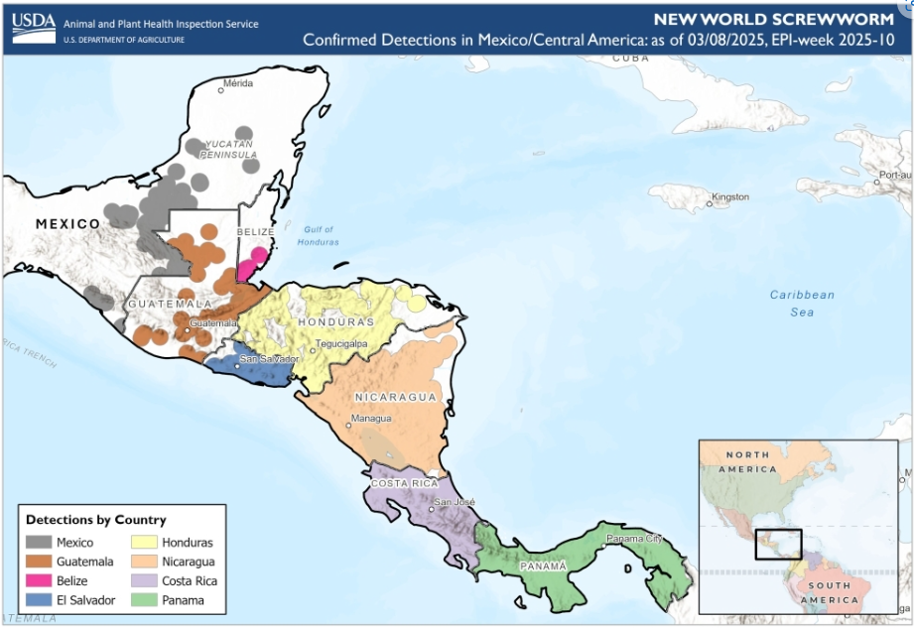
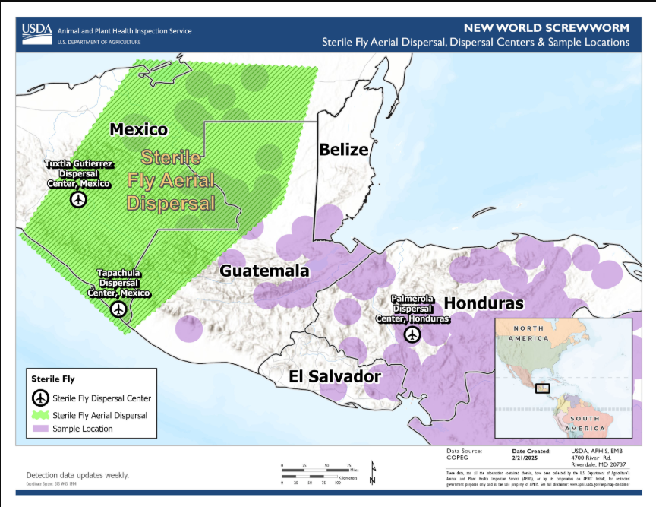
New World Screwworm in Central America and Mexico
NWS has now been found as far north as the Yucatan peninsula
COPEG maps not being updated
Sterile fly release moved to Mexico to try and prevent further northward movement
USDA states that the eradication of NWS in Central America with re-establishment of controls at the Darian gap are the aim of the program
Case in a human in Mexico city?
COPEG

Slide 7
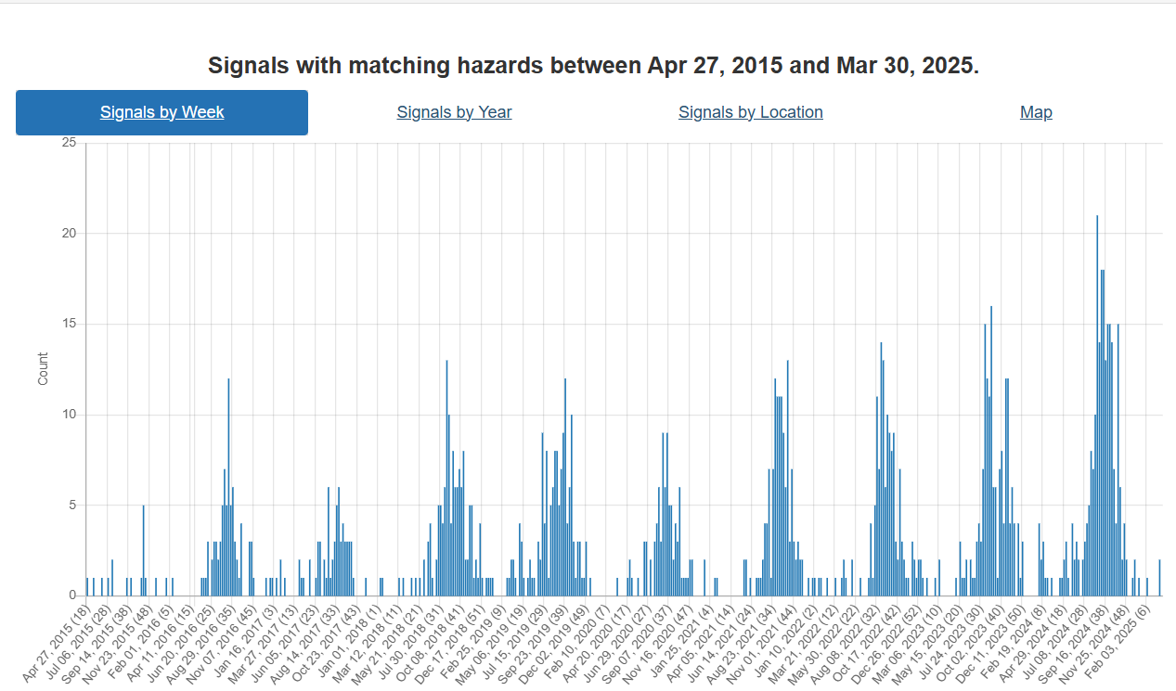
West Nile Virus Hazard Trend
Notes:
The handful of recent signals have been in Europe. Last North American signals last November.
General increase in signals year over year – is this real? Do you think there is increasing WNV in Canada?

Slide 8
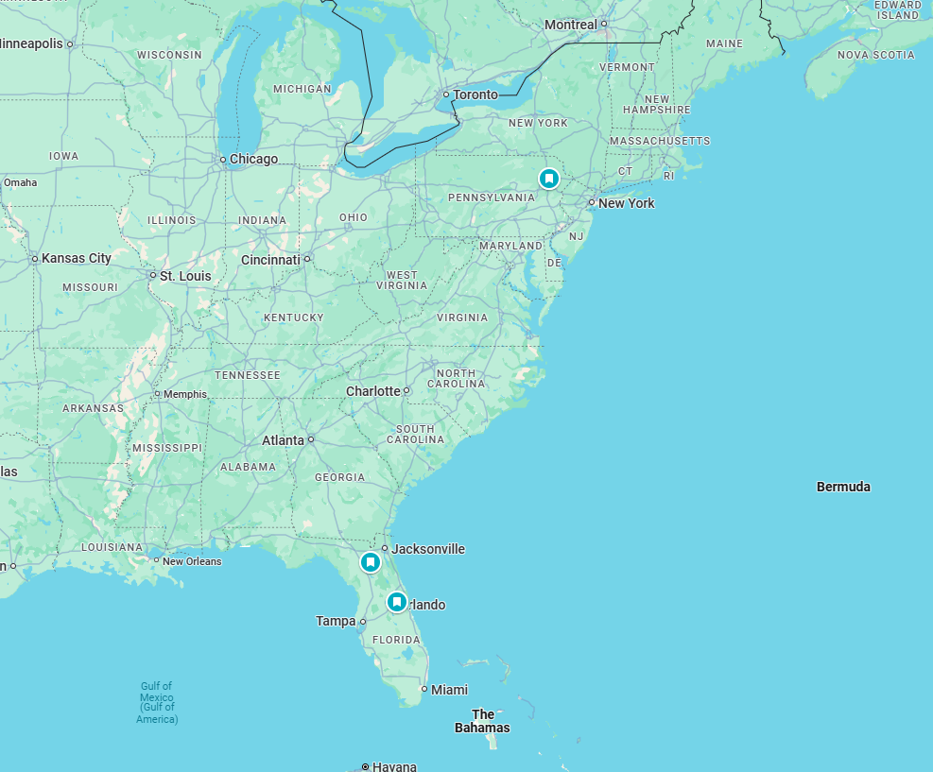
Eastern Equine Encephalitis
First Cases in 2025
Pennsylvania
Two in Florida
  Bradford County
  Seminole County

Slide 9
Scientific Findings
Equine Encephalomyelitis Outbreak, Uruguay, 2023–2024 - Volume 31, Number 1—January 2025 - Emerging Infectious Diseases journal – CDC
Neuropathology, pathomechanism, and transmission in zoonotic Borna disease virus 1 infection: a systematic review - ScienceDirect

