Slide 1
Community for Emerging and Zoonotic Diseases
Identifying emerging risks through collective intelligence
CEZD – CAHSS Equine Network Update
21 October 2025
www.cezd.ca

Slide 2
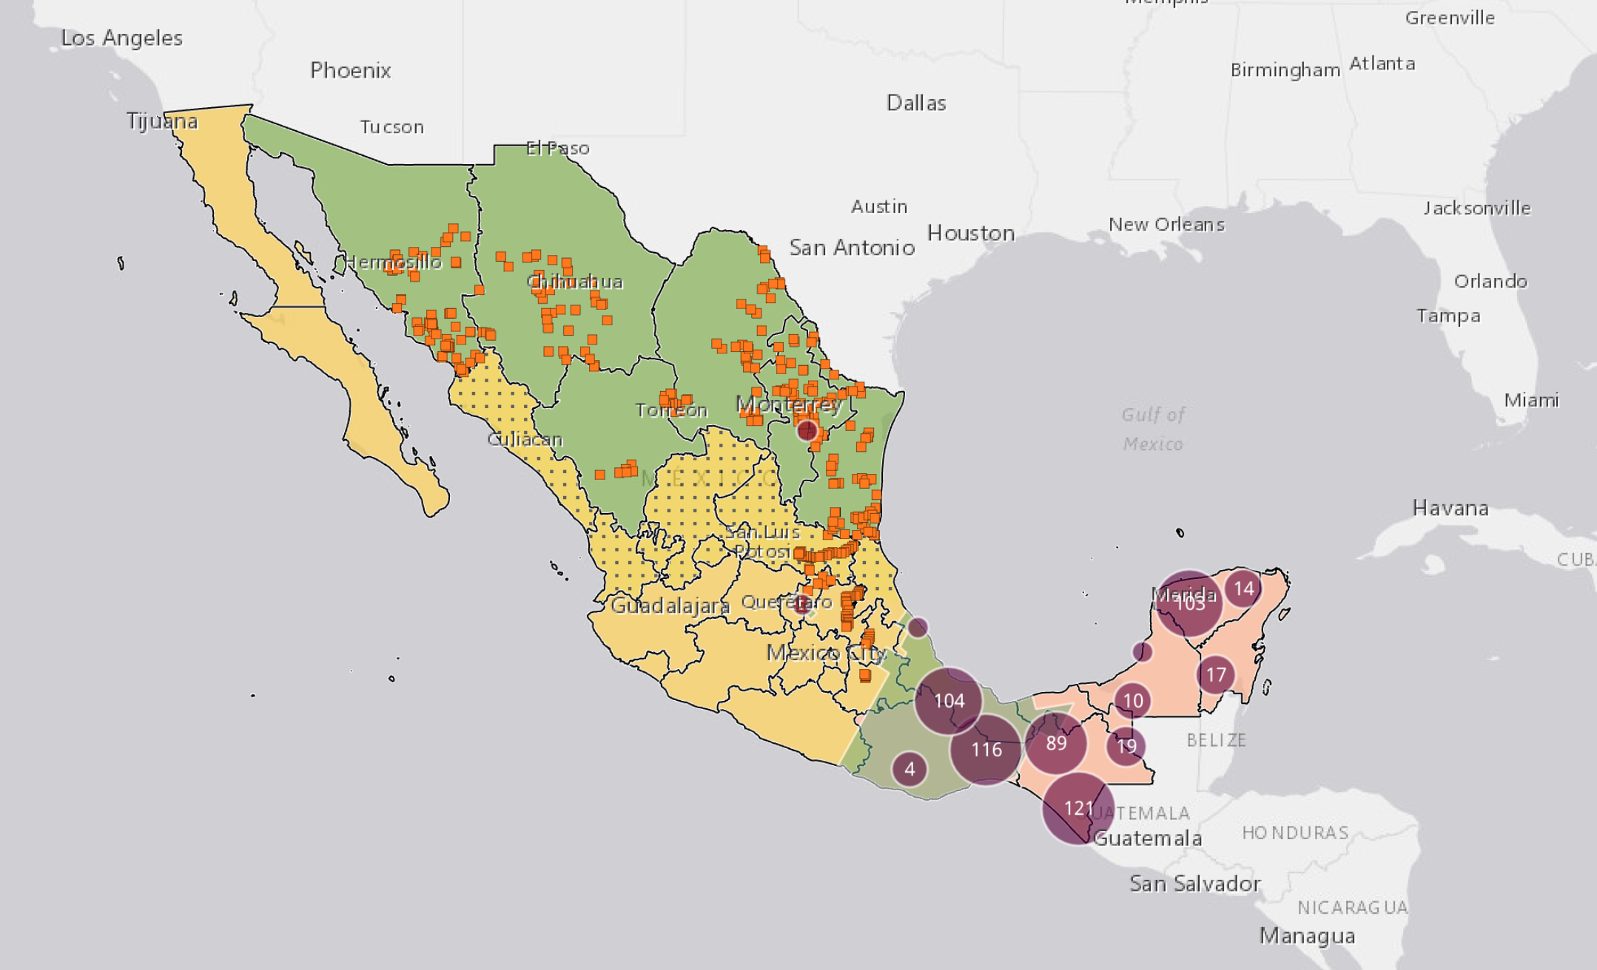
New World Screwworm in Mexico
Cases northward related to animal movements
Mexico’s dashboard reports 30 cases in horses
First FDA-Approved Solution Targets New World Screwworm in Cattle Herds
Microsoft Power BI
Notes:
Orange dots are fly trap sites
Green area in south central Mexico is the site of sterile fly releases
Yellow area is a buffer zone, with the spotted yellow requiring inspection prior to animal movements
Northern green area is “free”

Slide 3
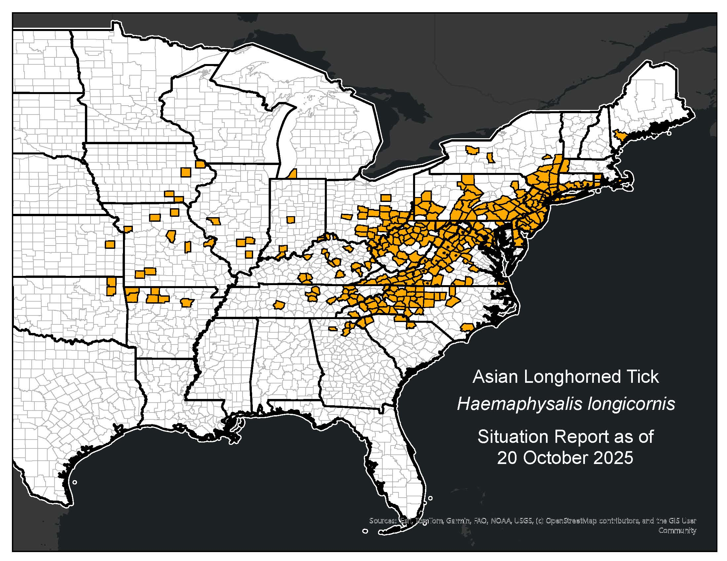
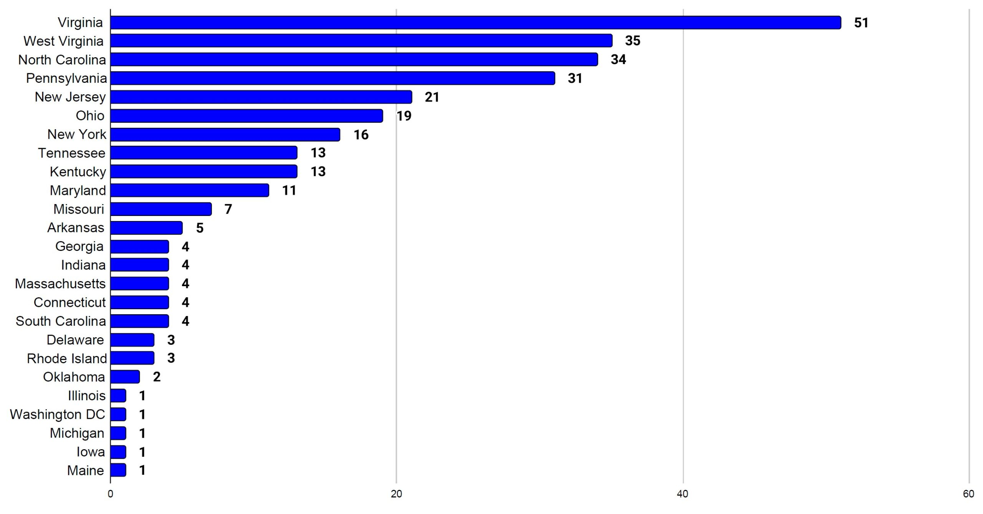
Asian Longhorn Tick in the USA
ALHT calls have been taken over by the University of Tennessee
Ongoing new states with detections, Kansas most recently
25 states + Washing D.C. now affected
Mid-June, Michigan reported ALHT nymphs were found in Berrin County, found by routine tick surveillance
Mid-August, Maine confirmed its first finding of the ALHT in Cumberland County
Mid October, Kansas confirmed it’s first finding
Asian Longhorned Tick Situation Report - The Tick App

Slide 4
First finding of Rickettsia rickettsii in Haemaphysalis longicornis (Acari: Ixodidae) in North America | Journal of Medical Entomology | Oxford Academic
Mixed information on susceptibility of horses to RMSF
A Suspected Case of Rocky Mountain Spotted Fever in an Adult Horse in the Southeastern United States
Experimental infection of horses with Rickettsia rickettsii | Parasites & Vectors | Full Text
Prevalence of zoonotic and non-zoonotic Rickettsia in horses: A systematic review and meta-analysis - PMC
With RMSF cases in humans and dogs in Canada in recent months something to be aware of
Only a single case report located (non-specific clinical signs)
Experimental studies indicate horses are not susceptible
Serosurveys show a high seroprevalence

Slide 5
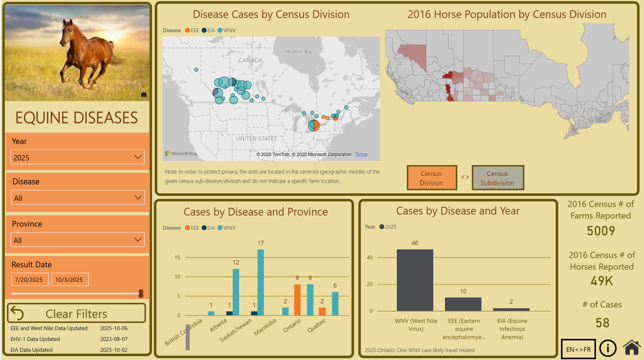
WNV, EEE and EIA since last meeting
CAHSS Equine Dashboard

Slide 6
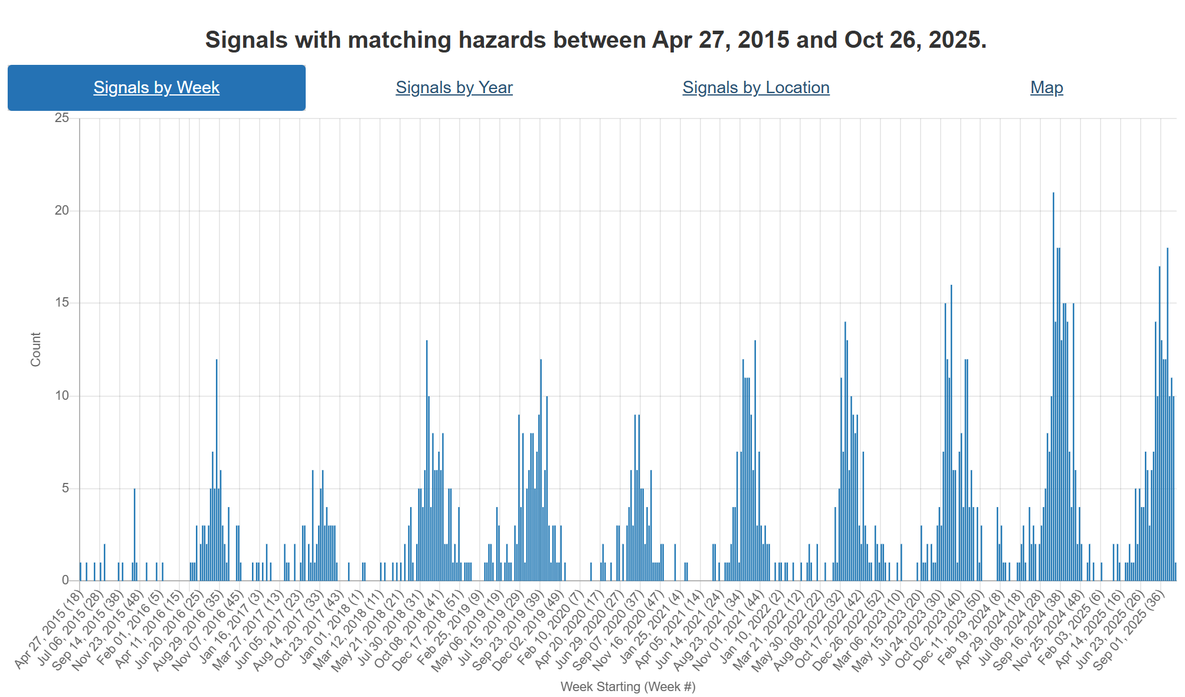
West Nile Virus Hazard Trend
Large number of cases since last meeting
On the downward side of the trend line now

Slide 7
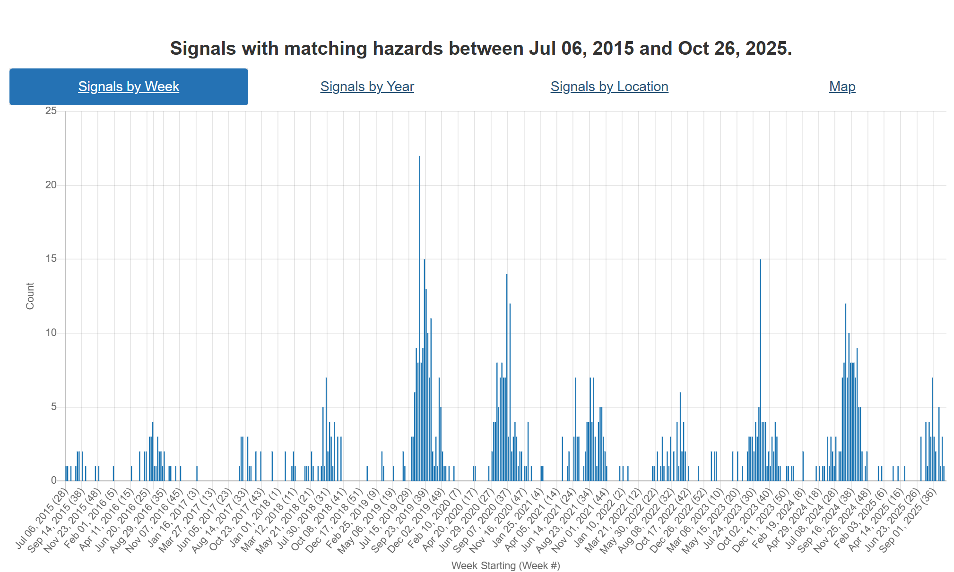
Eastern Equine Encephalitis Hazard Trend
Number of reports are down, however under-reporting likely occurring
Question: do EEE, EIA and WNV interact with each other?
WNV appears to be dominant this fall? Is that real?

Slide 8



Getah virus in China
Evidence of a strain of increased virulence in pigs in China (GIII variant)
Horses are considered an amplifying host of the disease
No evidence yet of GIII presence in horses or impact on the species
Getah virus in the Canadian Context
Full article: Outbreak and epidemic of Getah virus infection in swine by virulence-enhanced GIII variant in Henan, central China in 2024
Frontiers | Genomic characterization and evolutionary analysis of a Getah virus variant from piglets in central China
Getah virus as an equine pathogen - PubMed

Slide 9
Scientific Findings
Influenza D Virus Circulation Among Bovines, Swine, Equines, and Wild Boars in Italy: A Sero-Epidemiological Study
Venezuelan Equine Encephalitis Virus, Amazonas, Brazil, 2025 | medRxiv

