Slide 1
Community for Emerging and Zoonotic Diseases
Identifying emerging risks through collective intelligence
CEZD – CAHSS Equine Network Update
21 April 2026
www.cezd.ca

Slide 2
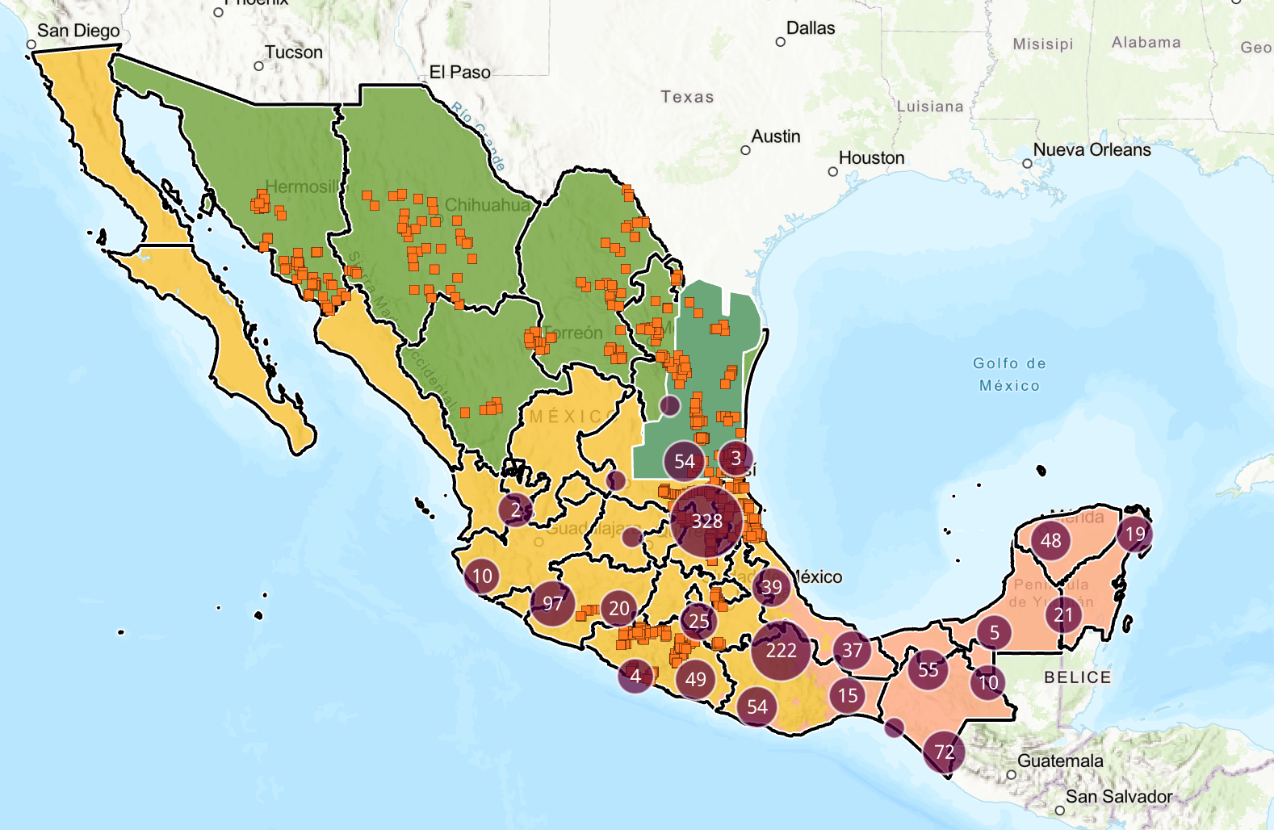
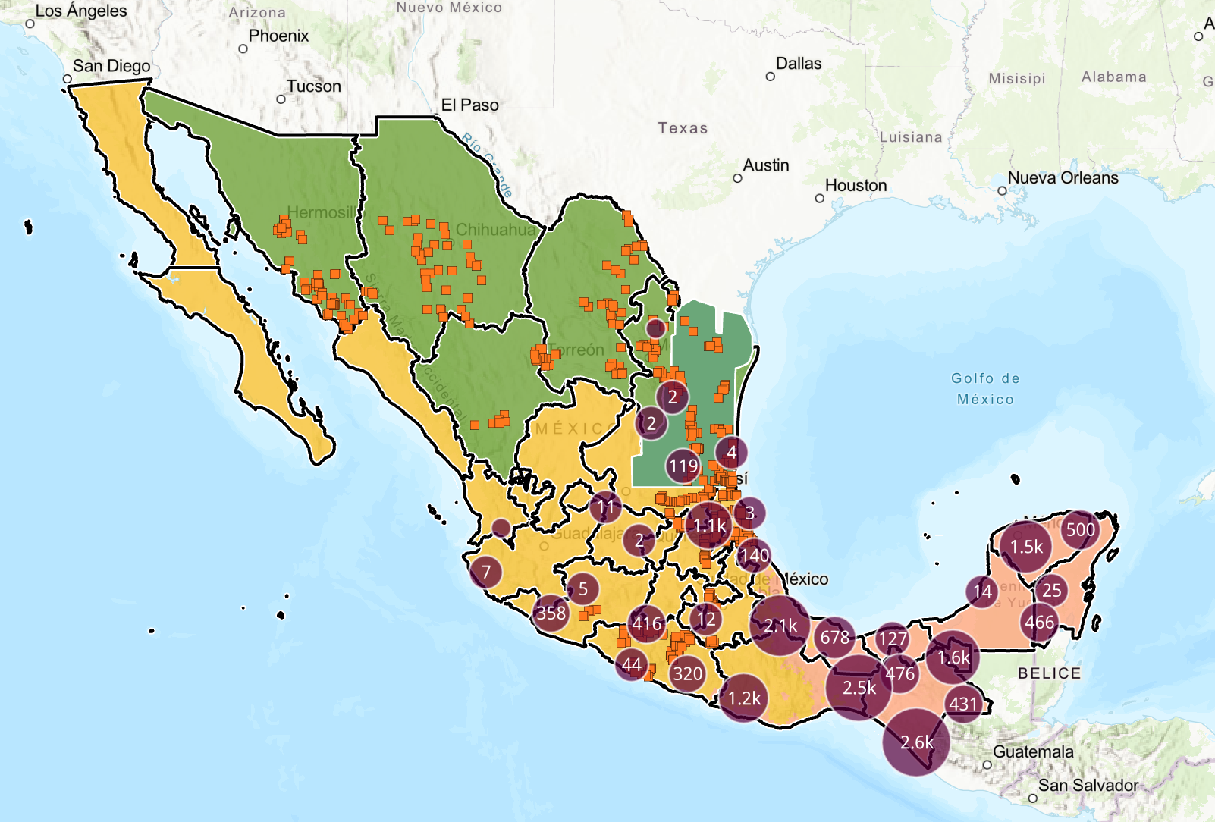
New World Screwworm
Mexico’s interactive dashboard displays 1,310 active cases of NWS in animals (21,131 cumulative) (April 20, 2026)
NWS continues to spread northwest throughout the country, recent cases in Nuevo Leon in dogs show it has become endemic close to the US border
Mexico – 1,043 cases in horses so far (~5%) 73 active
Cases also reported in wildlife (red deer, howler monkey)
Mexico human cases now 204 (primarily in Chiapas)
Honduras reported 76 NWS human cases for 2026
USA - Florida reported NWS in a horse imported from Argentina
February - Sterile fly dispersal facility completed in Texas, dispersal shifted northwards
USA/Mexico border remains closed – recent discussions about limited “reopening strategy”
USDA Released new Response Playbook Emergency Response NWS| Animal and Plant Health Inspection Service
How glow-in-the-dark sterile flies are being used to combat New World screwworm | TPR
Active Cases
Accumulated Cases
2
Notes:
NWS continue to spread northwards and westwards in Mexico, during this time period initial cases were reported in Michoacan, Colima, Guanajuato, Tlaxcala.
There have been 1,043 horses reported infested so far, at our last meeting it was 695.
Red deer in Yucatan reinforcing concerns about its impact on wildlife
The USDA is shifting sterile fly dispersal northwards to include areas of southern Texas, along its shared border with Tamaulipas, Mexico
The USDA also reported that a horse recently imported from Argentina was found to have a NWS infestation upon presentation at an import quarantine facility in Florida
The US Mexico remains closed, however there have been recent discussions about a reopening strategy. At the same time the US has now released it’s new Response Playbook.
Iridescent dust so can differentiate them from wild flies in traps. USDA APHIS traps - seeing dispersal of flies and seeing if we have any wild flies. Traps in New Mexico, Arizona, California, Texas
2

Slide 3
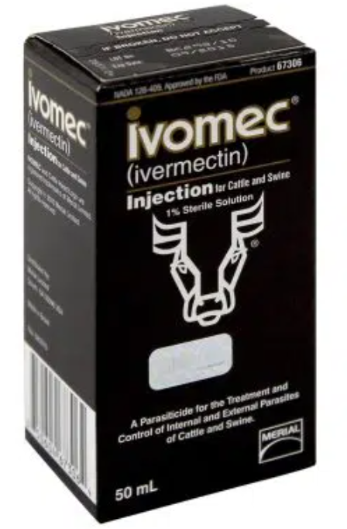
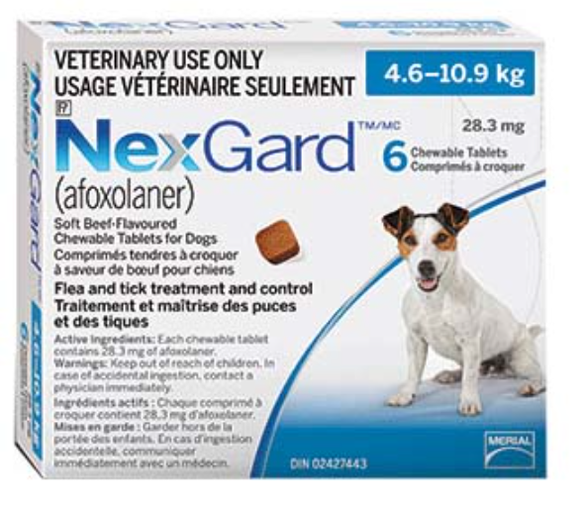
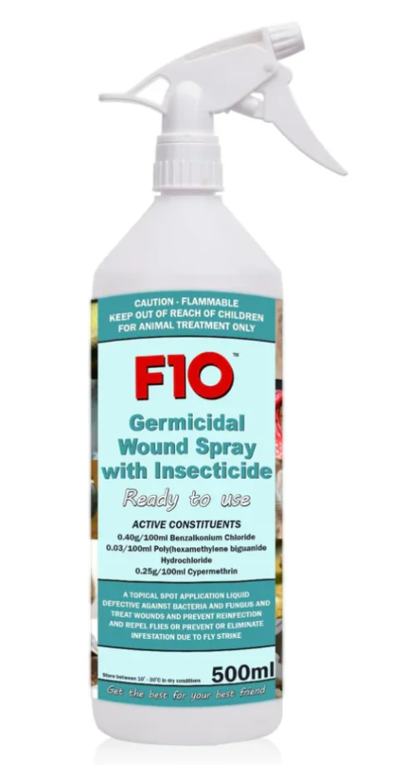
New World Screwworm
Previously - FDA Conditionally Approved Treatments
  Credelio Quattro-CA1 (Elanco) chewable tablets for dogs
  Exzolt Cattle-CA1 (Merck) fluralaner topical solution for beef cattle
  Dectomax-CA1 (Zoetis) injectable for cattle
Recent - FDA Emergency Use Authorizations
Ivomec (10 mg/mL of ivermectin) injectable solution for cattle (excluding female dairy cows)
NexGard (afoxolaner) chewable tablets for the treatment of NWS in dogs & NexGard COMBO (esafoxolaner, eprinomectin, and praziquantel topical solution) for NWS in cats
F10 Antiseptic Wound Spray with Insecticide (benzalkonium chloride, polyhexanide, and cypermethrin topical solution) for the prevention and treatment of NWS
Companion Animal Meeting Discussion:
“Mainstay of treatment is to get the maggots out”
“No approved drugs in Canada for NWS”
3
Notes:
In the USA, the FDA has issued an emergency use authorization for Ivomec (ivermectin) injectable solution against NWS - in cattle when administered within 24 hours of birth, at the time of castration, or when a wound appears, and the known and potential benefits of the product outweigh its known and potential risks. Except for female dairy cattle producing milk for human consumption and calves that will be processed for veal.. The slaughter withdrawal period for cattle is 35 days.
The FDA has issued two Emergency Use Authorizations for drugs to treat NWS in pets – one for NexGard (afoxolaner) chewable tablets for the treatment of NWS in dogs, and the second for NexGard COMBO (esafoxolaner, eprinomectin, and praziquantel topical solution) for the treatment of NWS myiasis in cats
The FDA has issued an Emergency Use Authorization for F10 Antiseptic Wound Spray with Insecticide (benzalkonium chloride, polyhexanide, and cypermethrin topical solution) for the prevention and treatment of NWS infestations. prevention and treatment of NWS myiasis in cattle, horses, minor species of hoof stock (e.g., sheep, goats, deer), raptors and other wild birds, pet birds, and captive wild, exotic, and zoo mammals, and the known and potential benefits of the product outweigh its known and potential risks. F10 Antiseptic Wound Spray with Insecticide may not be used in domestic dogs and cats.
3

Slide 4
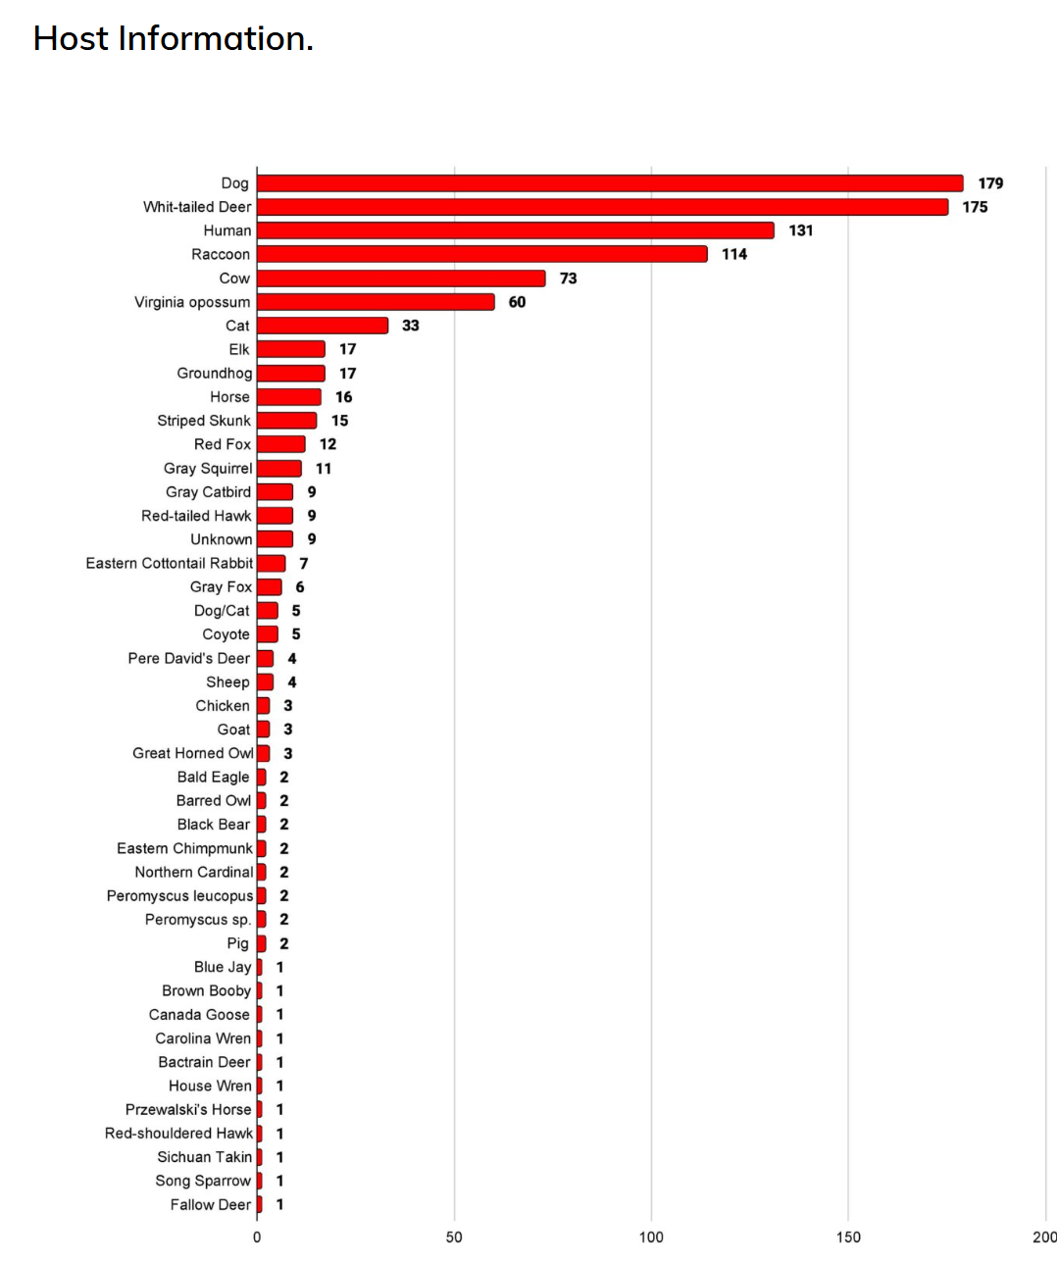
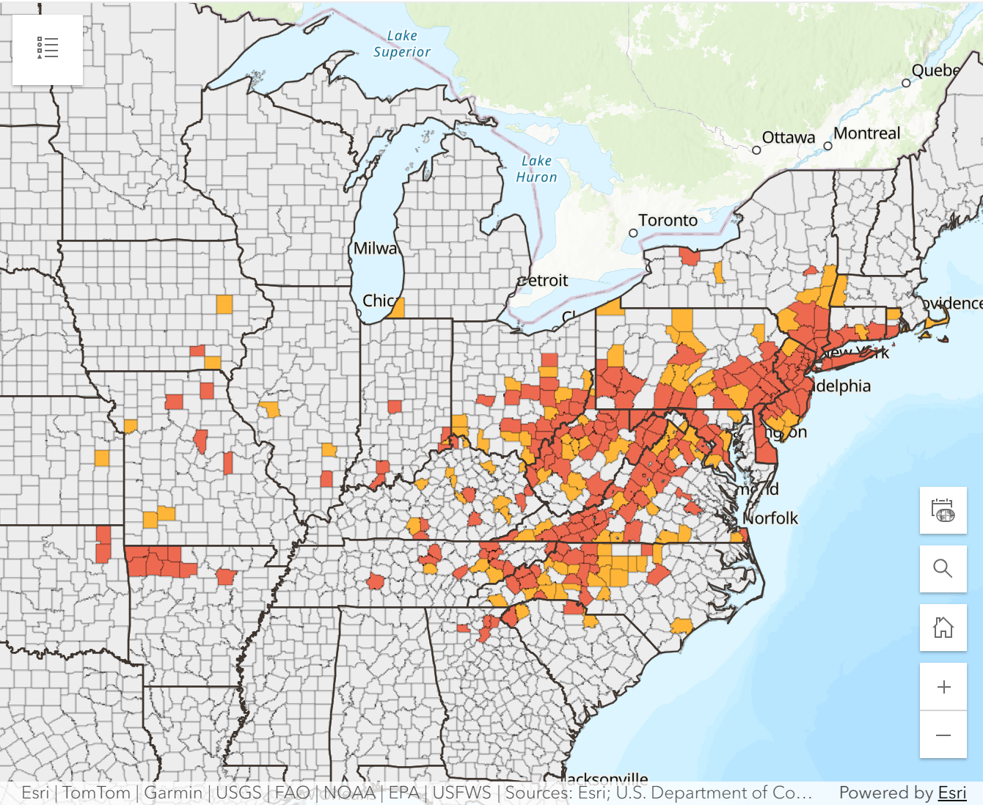
Asian Longhorn Tick in the USA
Since the last CAHSS meeting – one additional state (New Hampshire – reported a detection from last June 2025)
26 states + Washington D.C. affected
Asian Longhorned Tick Situation Report - The Tick App
Haemaphysalis longicornis and Theileria | Exotic and Invasive Vector and Vector-borne Disease
Notes:
Dogs and Cats

Slide 5
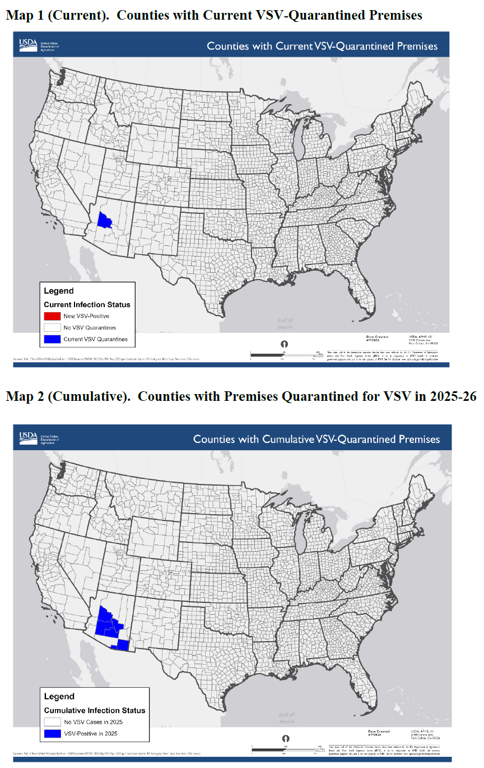
Vesicular Stomatitis in Arizona
Most recent incursion is in Arizona – October 2025
New Jersey Strain virus
15 premises affected in 6 counties, includes one case in a wild horse. 2 most recent cases in Yavapai county.
13 premises released from Quarantine
No recent livestock movements onto the index premises
Suspect that vector movements across the border are the source of the outbreaks
The 2023/24 outbreaks in California, Nevada and Texas are also thought to have originated from vector movements across the border with Mexico
Canadians travelling with their horses should be aware of import restrictions
Notes:
Most recent incursion to the southern US is in Arizona with the New Jersey Strain virus
There had been no recent livestock movements related to the index case, so, it is suspected that vector movements across the border are the source of the outbreaks.
The outbreaks in California, Nevada and Texas in 2023 and 2024 are also thought to have originated from vector movements across the border with Mexico without any associated animal movements.
Given the impacts of climate change it would not be surprizing to see more frequent incursions of vesicular stomatitis into the southern United States.

Slide 6
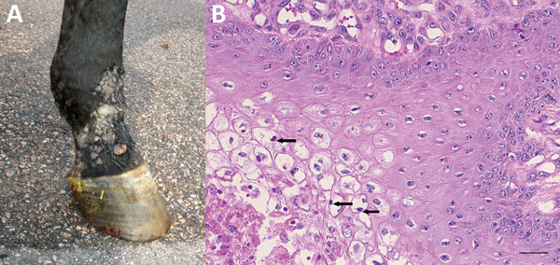
Equine Parapox Virus in Sweden
First detections in Sweden
  Aug 2025 Warmblood
  Dec 2025 Standardbred
Same strain as emerged in Finland in 2021-22
Pastern dermatitis - small blisters rupture into ulcers
Retrospective testing of 80 horses with similar skin lesions found no additional cases
Figure 1 - Infection with Possible Novel Parapoxvirus in Horse, Finland, 2013 - Volume 22, Number 7—July 2016 - Emerging Infectious Diseases journal - CDC
Notes:
On 24 February 2026, SVA reported that equine parapox virus has been detected in Sweden for the first time, with confirmed cases in a Warmblood in Jönköping County (August 2025) and Standard racing horse in Norrbotten County (December 2025). DNA analysis by the Swedish Veterinary Institute (SVA) confirms the strain is the same as one that emerged in Finland in 2021. Clinical signs for parapox virus include: small blisters that burst into round ulcers. The SVA have analysed 80 past samples from horses with skin issues all of which were negative. It was noted that this is a new infection that has likely not yet established a significant presence in Sweden. It should also be noted that the disease is zoonotic.

Slide 7
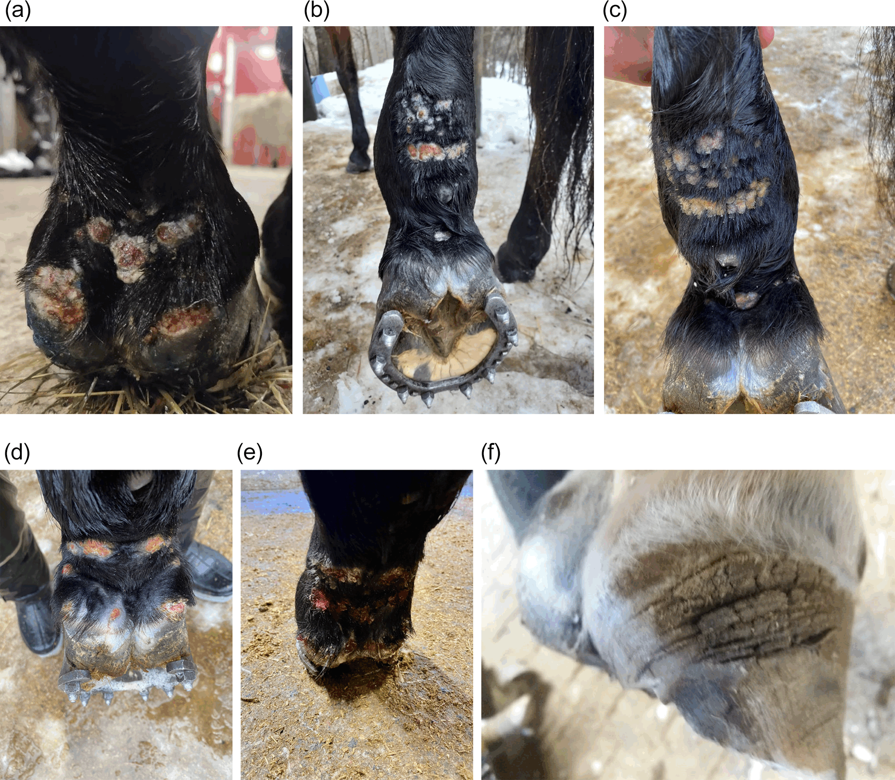
Equine Parapox Finland 2021-22
Equine dermatitis outbreak associated with parapoxvirus | Microbiology Society
Large Scale outbreak of suppurative and ulcerative pastern dermatitis in racehorses in Finland 2021-22
1/3 of horses at affected stables developed severe skin lesions
Skin lesions occasionally reported in humans
Attendance at racing events prior to disease occurrence
Zoonotic
Notes:
Previously detected in Finland 2013
In Humans in the United States

Slide 8
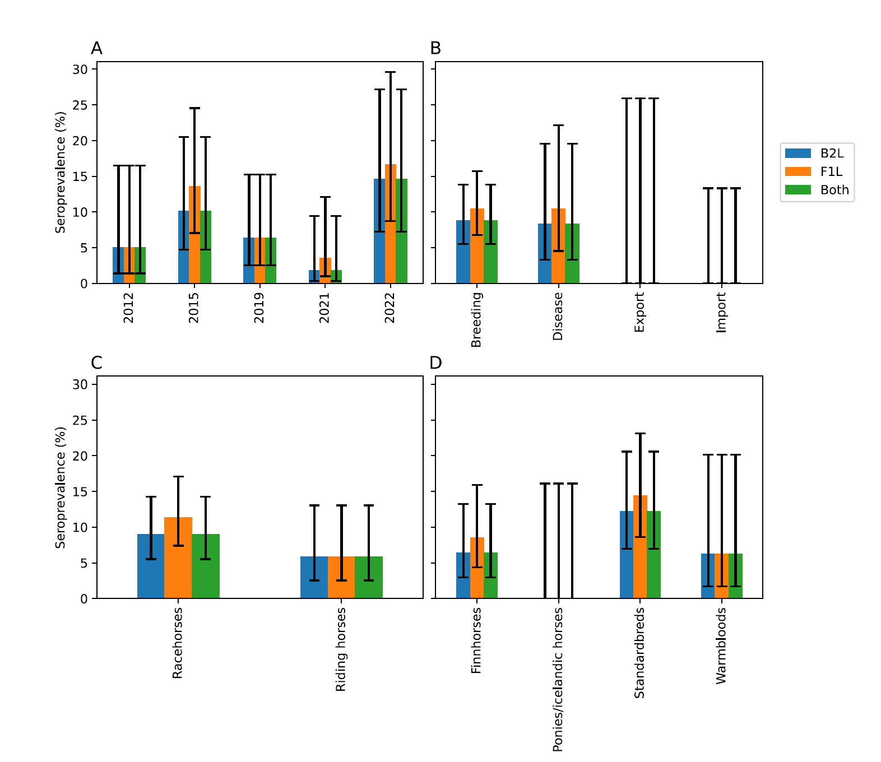
Is Equine Parapox Emerging/Re-emerging?
Antibody responses to equine parapoxvirus reveal a re-emerging pattern | BMC Veterinary Research | Springer Nature Link
Field reports from Finland suggests outbreaks may have occurred in 2015 and 2019
Retrospective serological study
The results suggest that EqPPV is a re-emerging pathogen that has a potential to cause large epidemics
Notes:
Two components to this study – 266 archived samples from the Finnish Food Authority for the retrospective study, and 26 horses from 11 stables during the outbreak December 2021 – March 2022.
This first serological study on EqPPV shows that the virus causes a fast immune response that can be detected with IFA for at least a year. It also shows that the virus has been circulating in Finland at least since 2012 and supports reports that EqPPV can cause reoccurring epidemics. In the future, screening of larger sample panels is needed to confirm connection between EqPPV and earlier epidemics as well as to understand the global distribution of the virus.

Slide 9
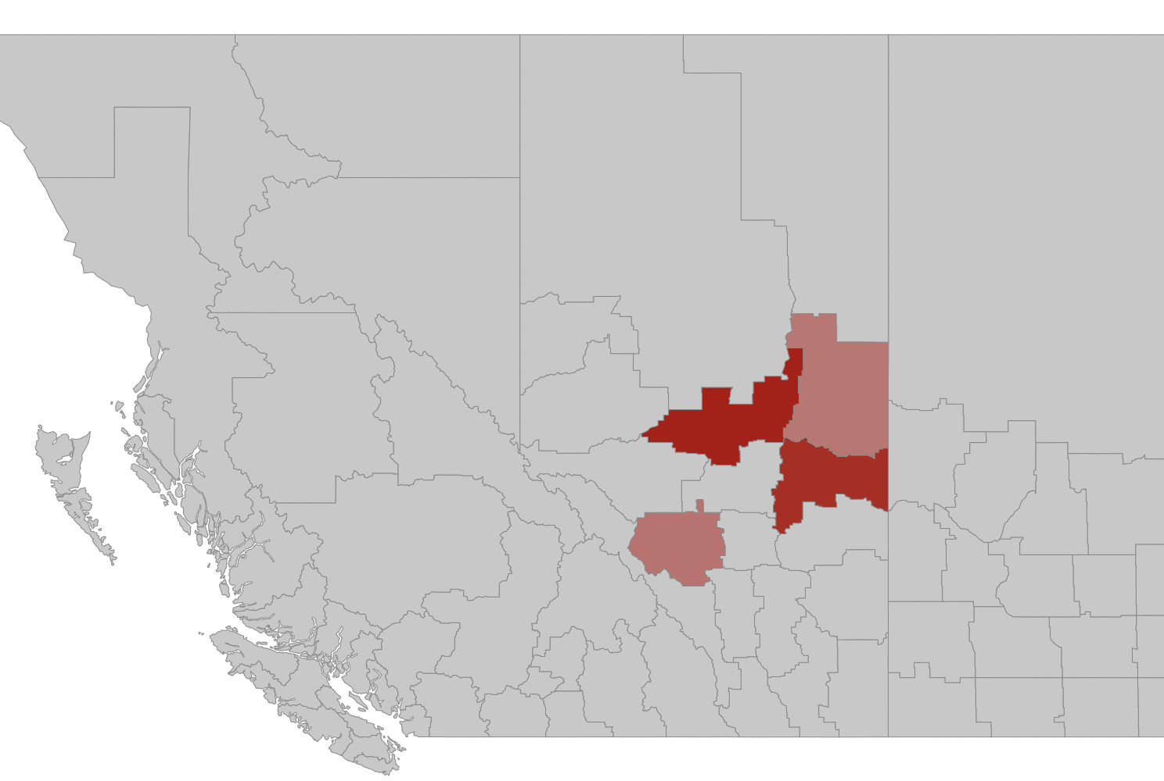
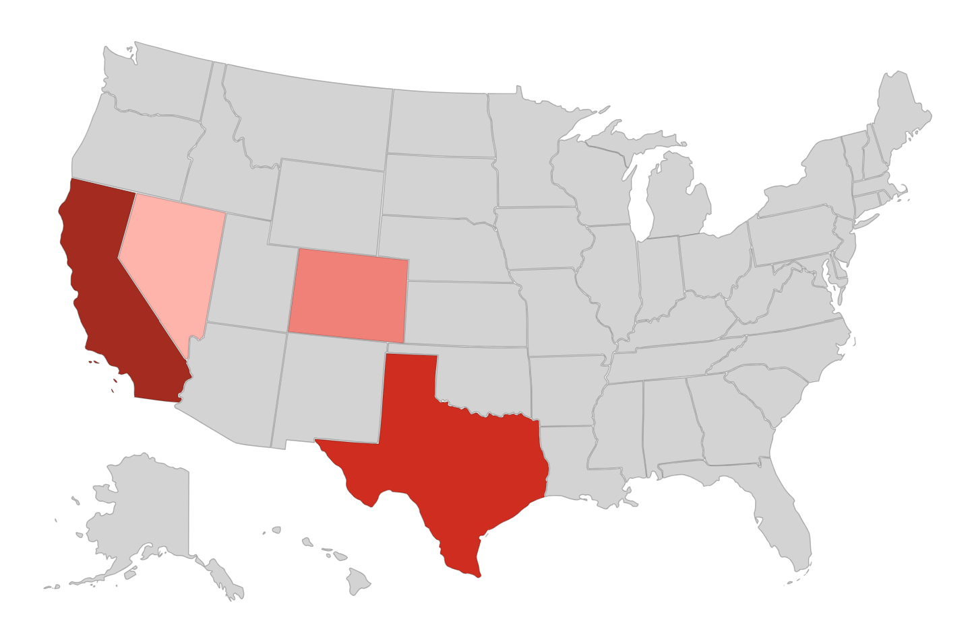
Equine Infectious Anemia
Equine Dashboard
Since January 1, 2026 all Canadian cases have been in Alberta (36 cases, # premises?)
US Cases
  California (7 premises, 22 confirmed cases)
  Texas (7 premises, 9 confirmed cases)
  Nevada (2 premises, 2 confirmed cases)
  Colorado (3 premises, 8 confirmed cases)
Outbreaks | Equine Disease Communication Center

Slide 10
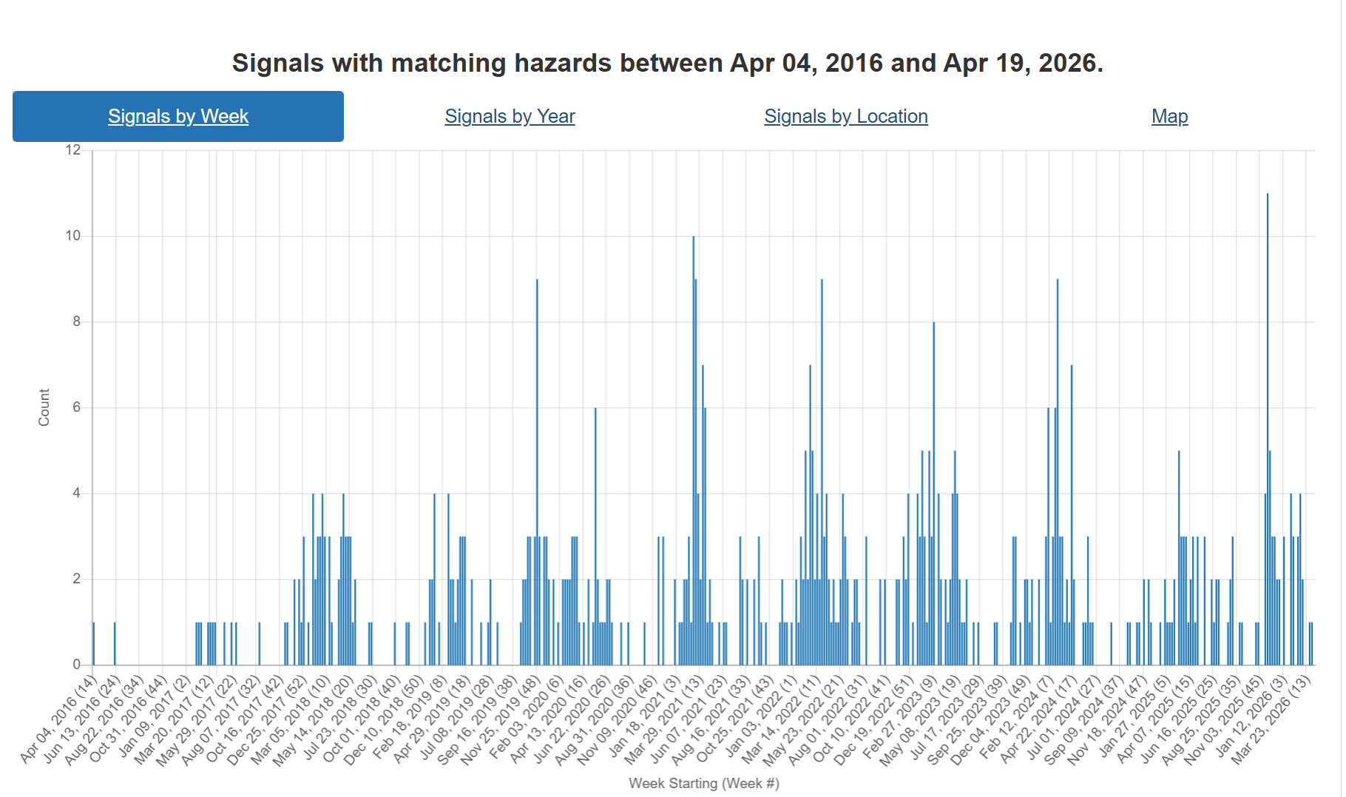
60 equine herpesvirus cases confirmed in multistate outbreak | American Veterinary Medical Association
Notes:
Last time we discussed the cases of equine herpes from the multistate outbreak in the US associated with the Waco Texas Women’s Professional Rodeo Association and Elite Barrel Race in November 2025. The hazard trend for EHV shows a periodic pattern, What happens in reality?

Slide 11
Scientific Findings
Probable Japanese Encephalitis Virus Transmission through Organ Transplantation | New England Journal of Medicine
Frontiers | Isolation and characterization of Japanese encephalitis virus genotype I from pig provides evidence for the presence of the virus in nasal secretion and co-circulation of JEV genotypes in Assam, India
Rocio virus sustained circulation in Brazil: first infection case in a horse highlights the need for enhanced arbovirus surveillance | Archives of Virology | Springer Nature Link
County-level surveillance for the American dog tick (Dermacentor variabilis) and Rickettsia species in Kentucky | Scientific Reports
Eurosurveillance | First detection of West Nile virus in Belgium through wild bird surveillance, Belgium, 2025

