Slide 1
Community for Emerging and Zoonotic Diseases
Identifying emerging risks through collective intelligence
CEZD – CAHSS Poultry Update
01 March 2024
www.cezd.ca

Slide 2
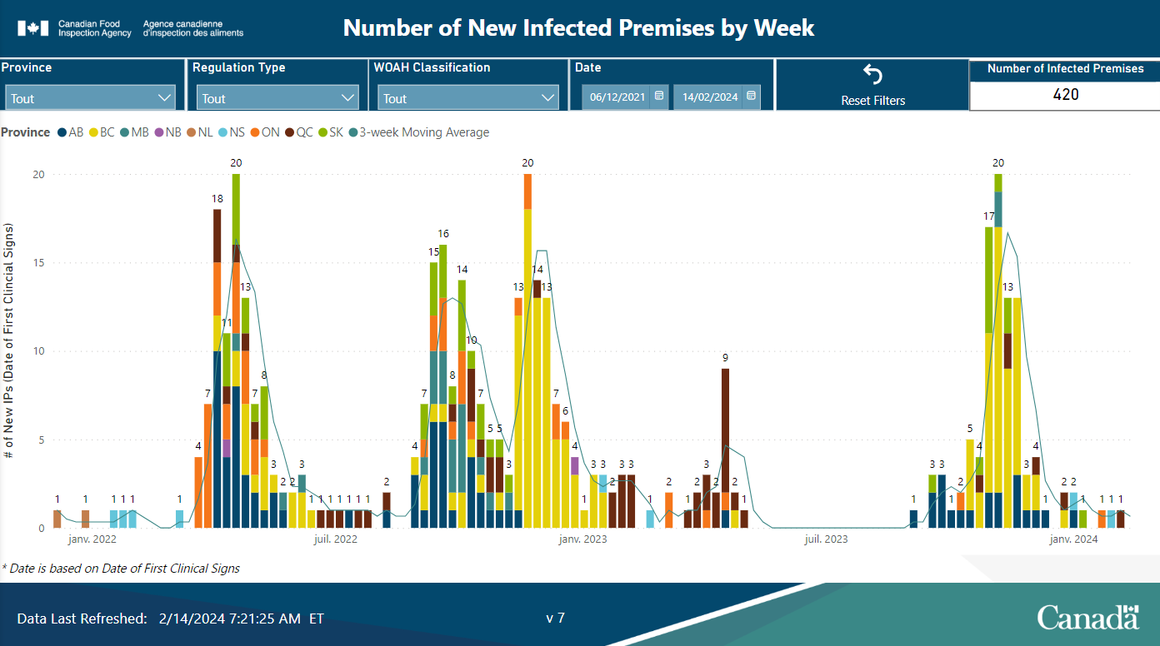
HPAI in Domestic Birds in Canada
2021: 2 IP
2022: 281 IP
2023: 131 IP
2024: 8 IP
Notes:
For domestic birds in Canada we have had greater than 50% decline in cases in 2023 compared to 2022. Most of that difference was in the spring and summer, with a steep rise in cases at the end of 2023.
In the spring of 2023 Quebec (in brown bars on the graph) was affected the most, whereas in Fall of 2023 BC, Alberta and Saskatchewan were most affected and the fall peak is just as high as it was the previous two years.
We have had 8 cases of HPAI so far in 2024 so it is still actively circulating even though it is not a peak migration time.

Slide 3
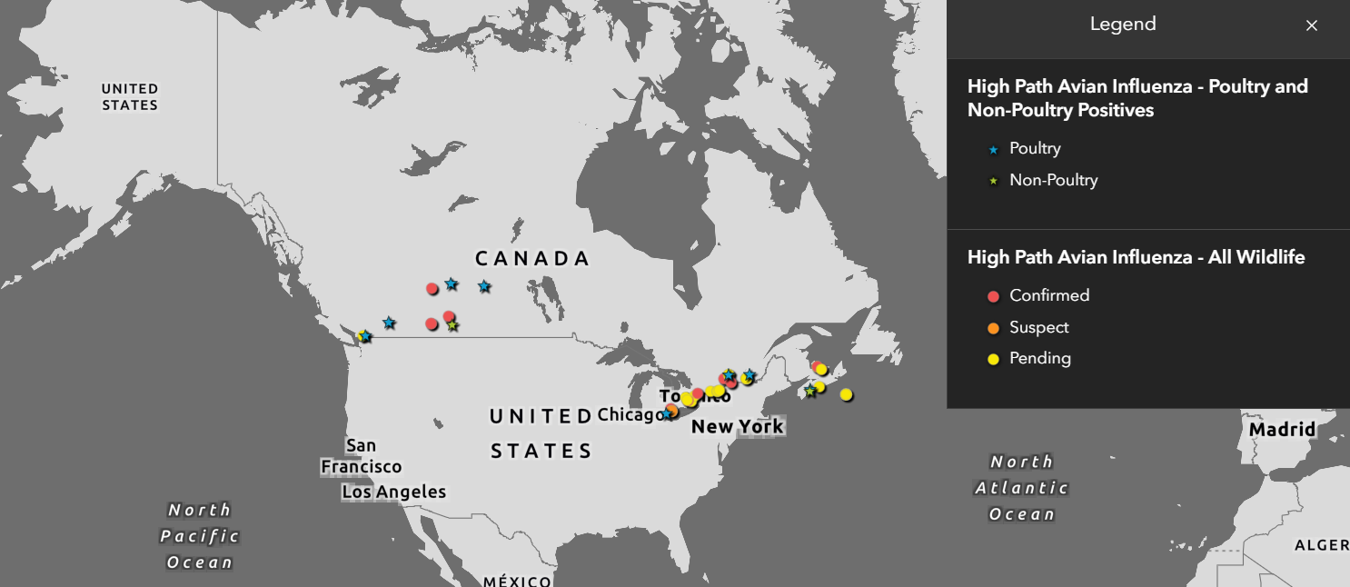
Wildlife H5N1 Avian Influenza
Dashboard Filtered from Dec 8 2023 – Feb 27, 2024
45 cases (11 confirmed)
Of those confirmed:
  Striped skunk
  Canada goose
  American Goshawk
  Great Horned Owl
  American Crow
H5N1
  Fully Eurasian (2)
  Reassortant EA/NM (9)
Avian flu likely behind influx of sick, dead Canadian geese in Kingston: expert - Kingston | Globalnews.ca
CWHC
Wild Bird Dashboard
Notes:
These are the wildlife detections since our last meeting. There are no new species affected but detections are ongoing,
The total numbers of detections in wildlife declined substantially in 2023 compared to 2022.

Slide 4
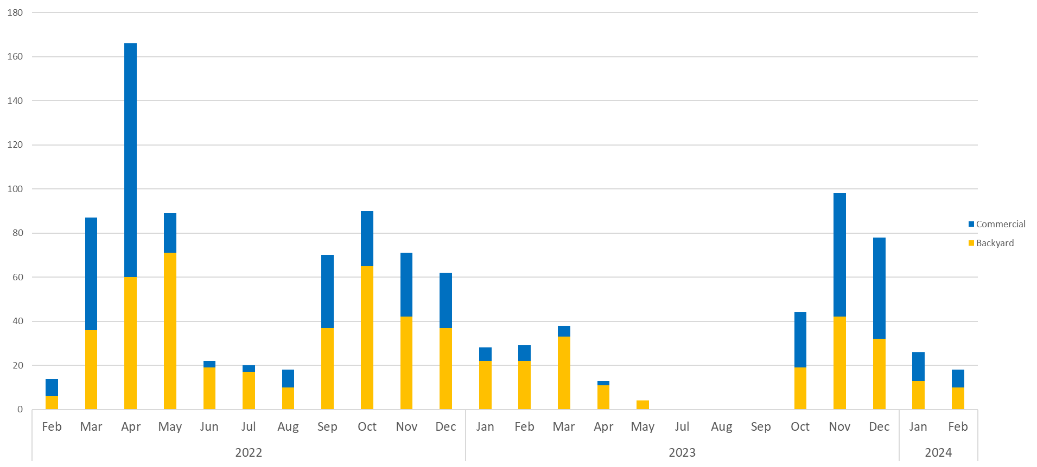
US Domestic Detections H5N1 Over Time
Notes:
This is a graph of the number of detections of HPAI in the US over time. Just like us, they had a steep rise in cases at the end of 2023, and they continue to have cases (3 new cases in backyard poultry were reported yesterday)

Slide 5
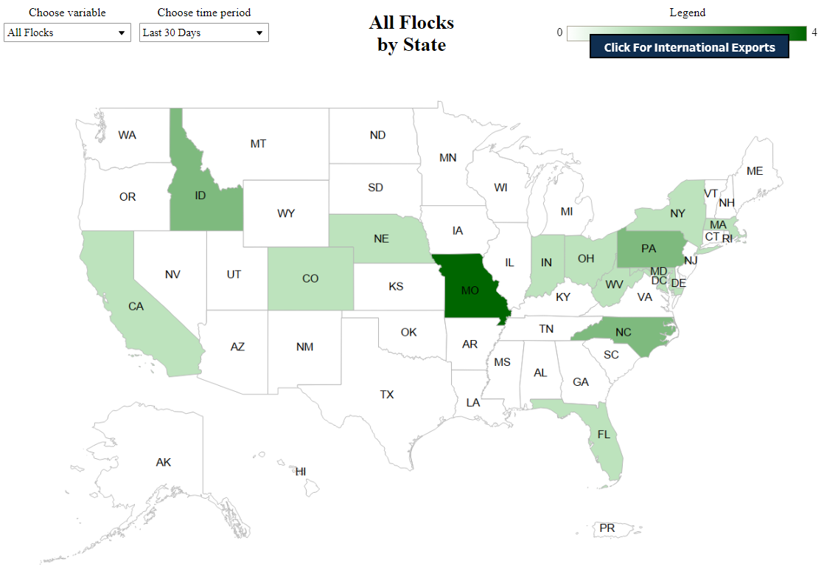
United States – HPAI Domestic Bird Detections
Last 30 days
16 states have had outbreaks in the last 30 days
23 flocks
  7 commercial
  16 backyard
Notes:
There have been a slow and steady number of cases over the last month.
It’s relatively quiet as the spring migration hasn’t had a big impact yet. Ongoing cases are showing that the virus is present across the country in all flyways.

Slide 6
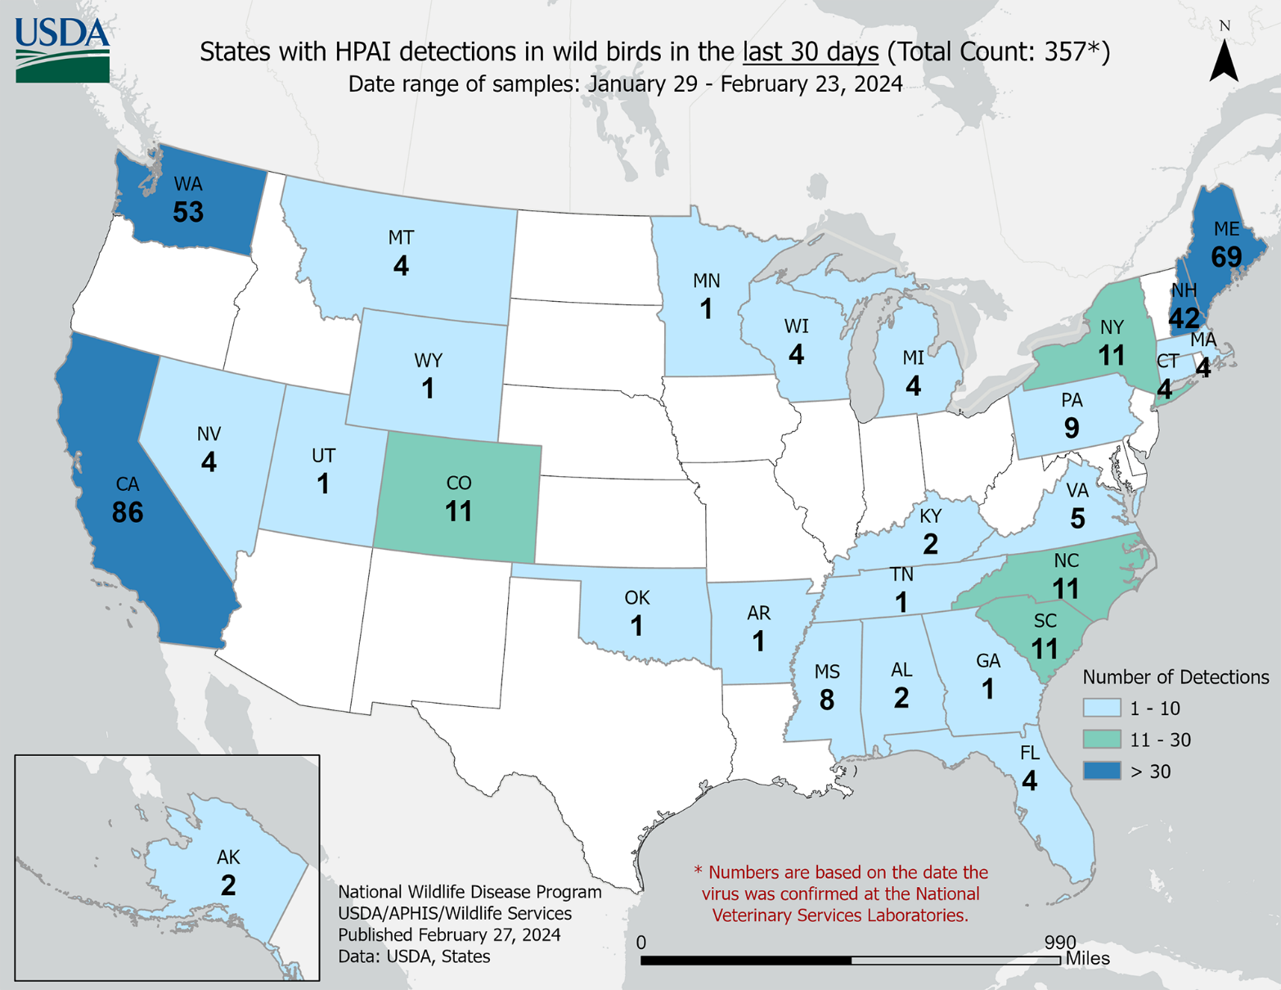
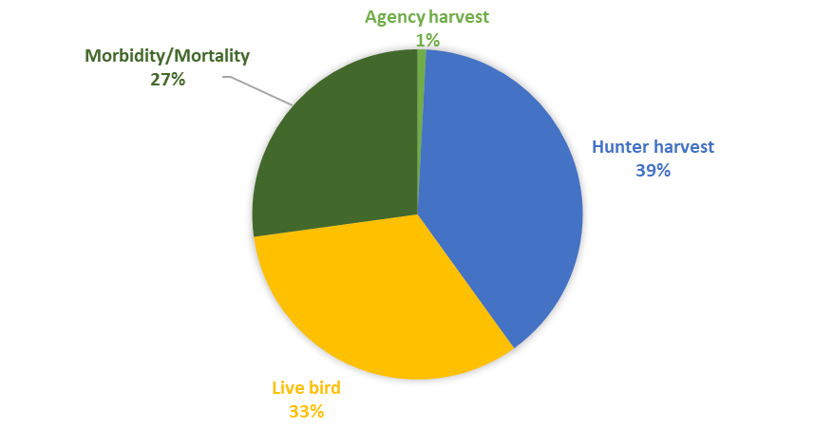
US Wild Bird Detections Jan 29 – Feb 23, 2024
Notes:
This is an image from USDA for the wild bird detections over approximately the last 30 days. Again, showing that virus is present in all flyways.
The detections come from multiple sampling sources – morbidity/mortality, hunter harvest and live bird sampling.

Slide 7
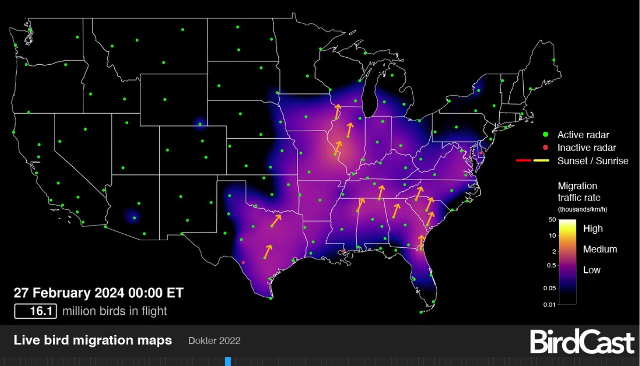
Wild Bird Migration
Notes:
There are a low number of birds in flight at night currently, it is expected that the spring migration will become more visible over the coming weeks.

Slide 8
Vaccination in France
Large scale vaccination program for ducks in 2023
64 million birds to be vaccinated twice
12 million birds vaccinated by January 8, 2024
Media reports indicate a third dose is being given in Foie Gras birds
Two vaccinated barns on one farm detected with HPAI in early 2024
Vaccine efficacy? Or reduced infection pressure?
Dramatic decline in cases in France in fall of 2023
Question: Does anyone have any updates on this situation?
Notes:
Last time we had discussed vaccination of ducks in France.
France implemented a large scale vaccination program for ducks in 2023. The vaccination plan was for 64 million ducks to be vaccinated twice, however media report indicate that in adapting to the results seen, foie gras birds were being given a 3rd dose. 12 million birds had been vaccinated by January 8th, 2024, this is a much smaller number than anticipated.
Despite incredible infrastructure in France to undertake this effort, they were unable to achieve their targets.
Two vaccinated barns on a single farm were detected with HPAI at the beginning of 2024 and were subject to depopulation and other control measures. This is not surprizing as the vaccine was not expected to provide sterile immunity.
The epidemiological analysis of the affected farms is still underway, so we don’t know much more about this yet.
There was a dramatic decline in both domestic and wild birds in France in the fall of 2023 compared to the previous years, so we cannot be sure if the low number of cases is due to decreased infection pressure or vaccine efficacy.

Slide 9
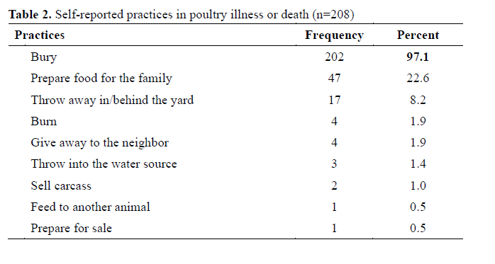
Human cases of H5N1 Clade 2.3.2.1c in Cambodia
Knowledge, Attitudes, and Practices Related to Avian Influenza (H5N1) After the Outbreak in Rural, Cambodia | medRxiv
Jump in cases in recent weeks
11 cases in last 12 months
So far those genotyped have been Clade 2.3.2.1c
All cases had direct contact with poultry
No indication of human to human transmission
Notes:
The jump in human cases of H5N1 2.3.2.1c in recent weeks in Cambodia needs to be monitored.
There have been 11 human cases in the last 12 months, all have been Clade 2.3.2.1c so far (last couple not genotyped yet). All cases had direct close contact with poultry.
Exposure to poultry is much more common in Cambodian culture and likely across much of Southeast Asia compared to what happens in Canada. ~23% of survey respondents from Rural Cambodia reported preparing food for their families with sick or dead poultry. Other responses include giving carcasses to the neighbor, selling them, throwing them into water or feeding to other animals.

Slide 10
Other HPAI’s to watch
H5N5 in Northern Europe has changed distribution
H5N6 detections in Asia have increased
Notably in South Korea there have been 38 cases since October 2023
  1 case was mixed infection with H5N1 and H5N6 on a duck farm
Japan reported H5N6 for the first time in 6 years
Notes:
In South Korea, and more recently Japan, the detection of H5N6 has increased. Because this is along the East Asian-Australasian flyway that overlaps with the Pacific Flyway in the Arctic there is a possibility of intercontinental introduction with H5N6, however time will tell if it’s significant.
The map on the right shows the change in location of H5N5 in Northern Europe, the dark blue stars are detections of H5N5 to mid January.
In previous years, H5N5 had largely only appeared in Norway, it has now spread westward to the UK and Iceland, eastward to Sweden and Finland, and southward to Germany. Some of these aren’t represented on the map as they are very recent.
H5N5 in Europe has not resulted in any outbreaks on farm, these are all wild bird cases, however they are on the migratory path of seabirds and fully Eurasian H5N5s have been identified in Atlantic Canada in wild birds, again with no domestic introductions resulting.

Slide 11
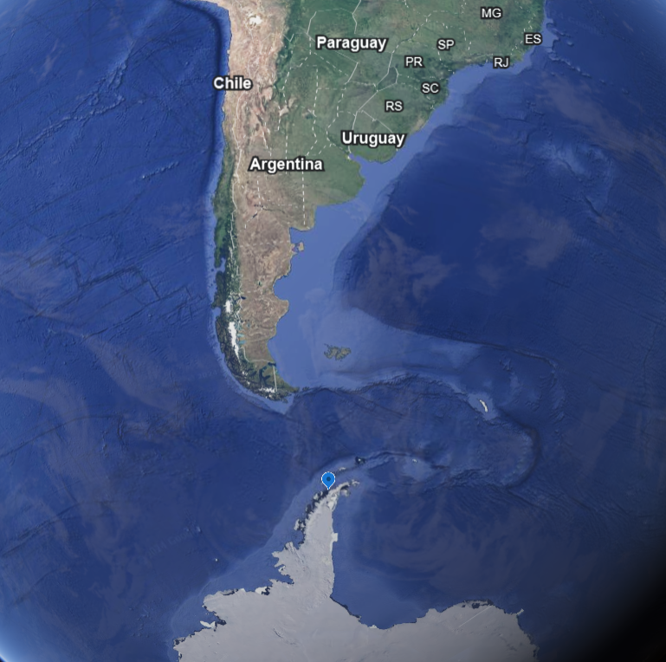
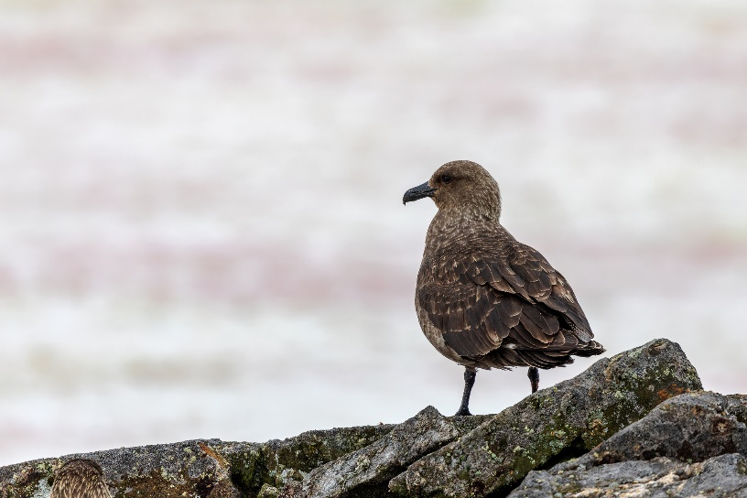
Scientists from the Severo Ochoa Center for Molecular Biology of the CSIC confirm the presence of the Highly Pathogenic Avian Influenza virus for the first time in Antarctica | Spanish National Research Council (CSIC)
HPAI found in two samples of dead Skuas
Found by Argentine scientists near the Argentine Antarctic base Primavera
Notes:
H5N1 has made it to mainland Antarctica, found in two dead Skuas at the Primavera Antarctic base (the blue marker on the map), not all that far from the tip of South America and previous detections in the sub-Antarctic islands.

Slide 12
Scientific Findings
Protection conferred by an H5 DNA vaccine against highly pathogenic avian influenza in chickens: The effect of vaccination schedules – ScienceDirect
Recent Changes in Patterns of Mammal Infection with Highly Pathogenic Avian Influenza A(H5N1) Virus Worldwide - Volume 30, Number 3—March 2024 - Emerging Infectious Diseases journal – CDC
A systematic review of influenza virus in water environments across human, poultry, and wild bird habitats – ScienceDirect
UK flockdown: A survey of smallscale poultry keepers and their understanding of governmental guidance on highly pathogenic avian influenza (HPAI) – ScienceDirect
Veterinarians' knowledge and experience of avian influenza and perspectives on control measures in the UK - PubMed (nih.gov)
Targeted genomic sequencing of avian influenza viruses in wetland sediment from wild bird habitats | Applied and Environmental Microbiology (asm.org)
Synchrony of Bird Migration with Global Dispersal of Avian Influenza Reveals Exposed Bird Orders | Nature Communications
Notes:
A few relevant articles that popped up that might be of interest.

Slide 13



Survey of Network Groups
Are CEZD quarterly reports providing value?
Anything we can do better?
Anything we should stop doing?
Notes:
We’re asking all of our network groups for feedback on whether what is being done for the network is providing value. So just a thumbs up/thumbs down survey.
If you have any feedback on what we could do better, or should stop doing that would be valuable – now or later. Given our limited resources, we don’t want to put effort into things that don’t have value.

