Slide 1
Community for Emerging and Zoonotic Diseases
Identifying emerging risks through collective intelligence
CEZD – CAHSS Poultry Update
06 December 2024
www.cezd.ca

Slide 2
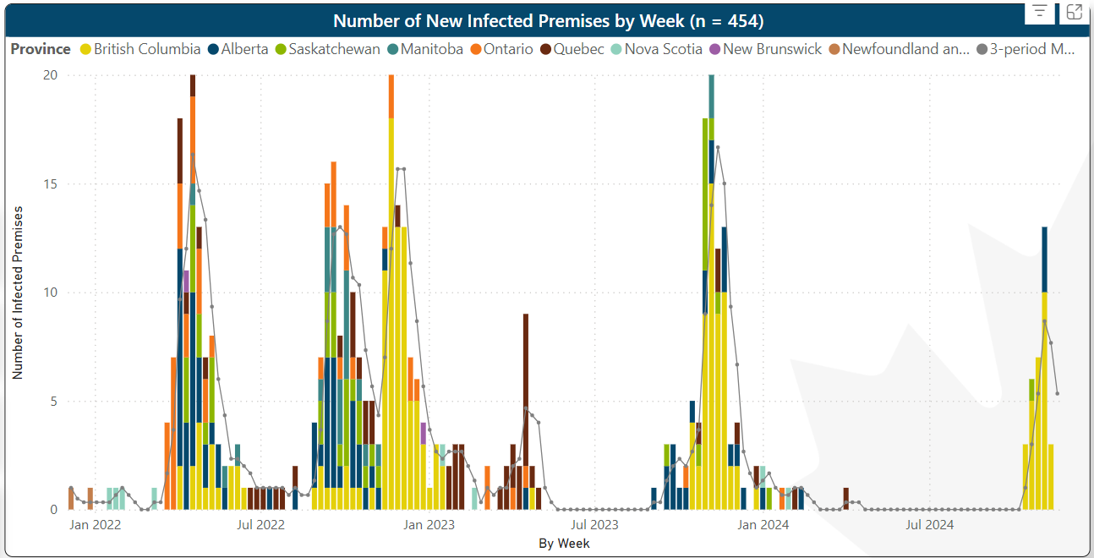
HPAI in Domestic Birds in Canada
After a break with no cases in spring and summer we are being hit hard by new cases this fall
Microsoft Power BI
Last updated Nov 20
Notes:
Spring and Summer were free of domestic cases of HPAI. New cases started to be reported on Oct 21st in BC.

Slide 3
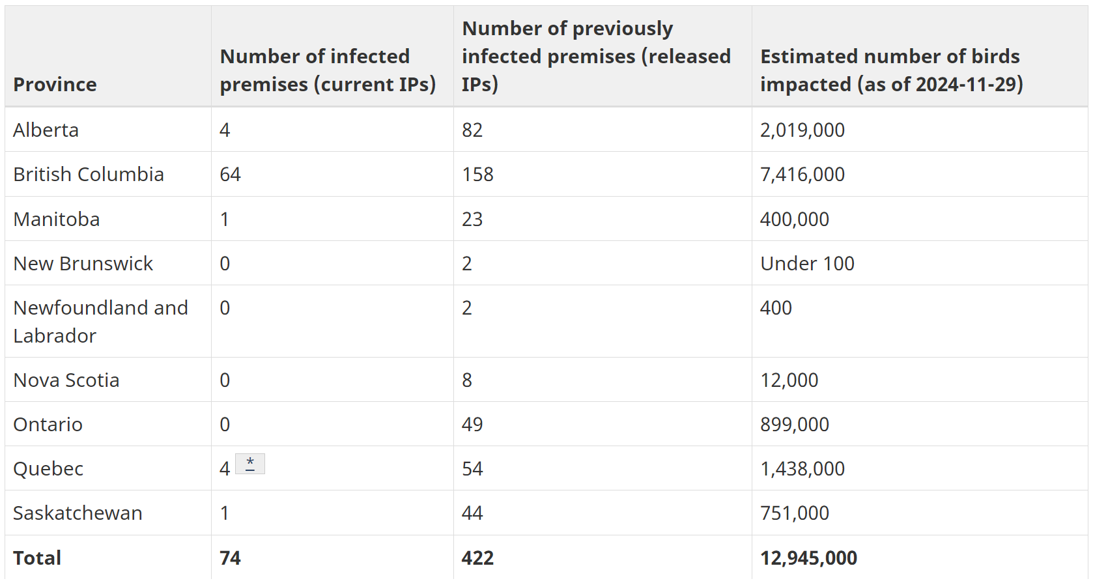
Status of ongoing avian influenza response by province - inspection.canada.ca
British Columbia is being particularly hard hit this fall by HPAI
5 Provinces have had infected premises since October 21st
LPAI H5N2 detected on 4 Quebec farms

Slide 4
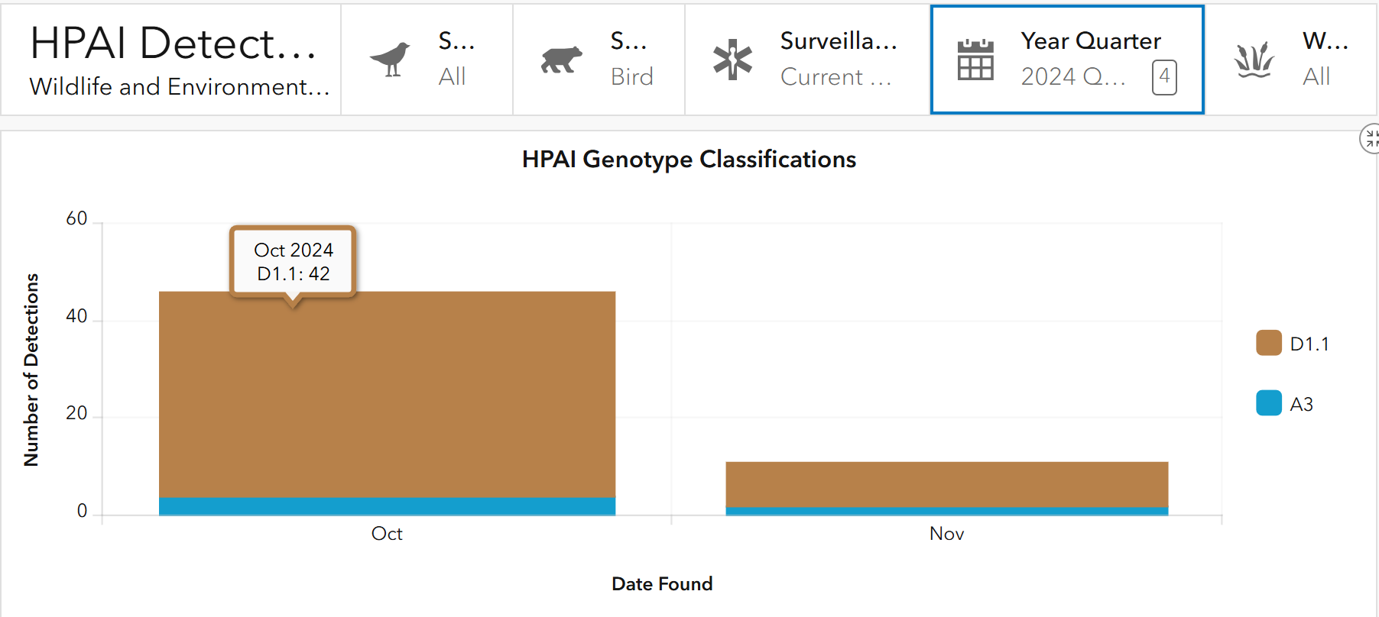
H5N1 Dominant Variant in Western Canada so far this Fall
H5N1 2.3.4.4b D1.1
Eurasian virus (HA) that arrived via the Pacific Flyway
Reassorted with a North American LPAI
BC Dashboard
accessed December 4

Slide 5
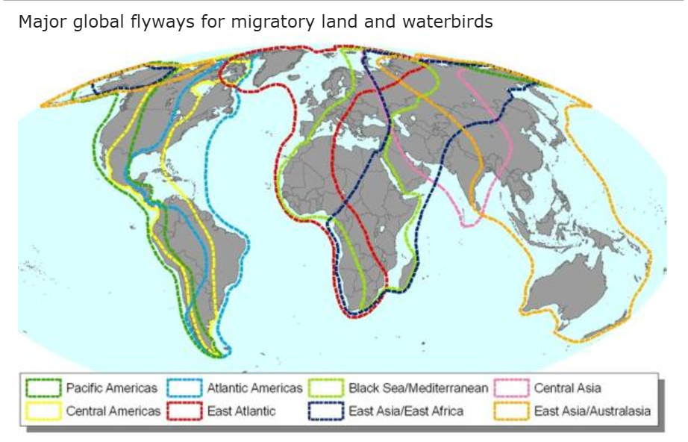
Why is fall worse than spring?
Birds from all flyways have range overlaps in the Arctic
Viral reassortment occurs on the summer breeding grounds
Fall migration includes the young of the year
Large number of birds
Uncertain immune status
May be stressed
What are your thoughts?
Pattern previously seen in N. America and Europe of more cases in fall

Slide 6
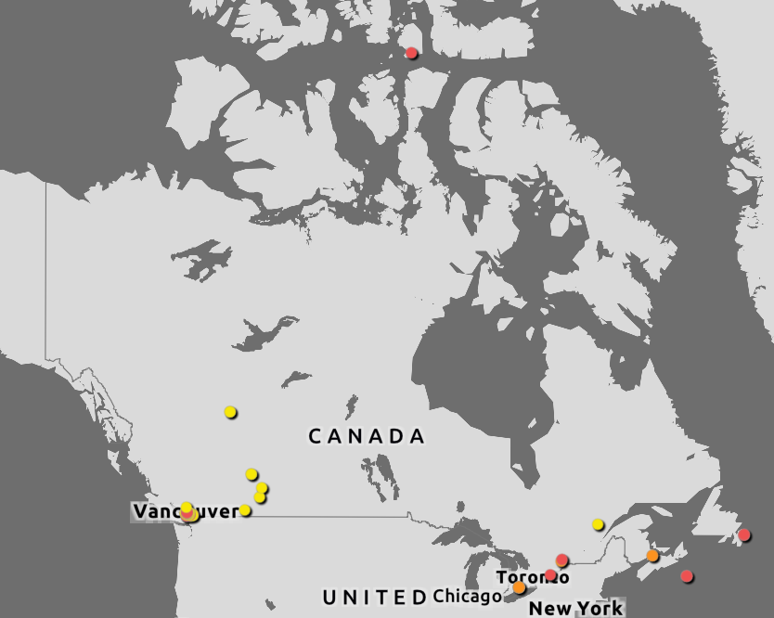
Wildlife HPAI
Dashboard Filtered from Sept 1 – Dec 5
65 new cases
17 confirmed
39 suspect or pending
H5N5 (fully Eurasian)
Nunavut 1 N. Fulmar
NL 2 Herring Gulls, 1 black backed gull
NS 1 Herring Gull, 2 black backed gull
ON 1 Turkey Vulture
Pending
Suspect (H5)
Confirmed (H5Nx)
CWHC
Wild Bird Dashboard

Slide 7
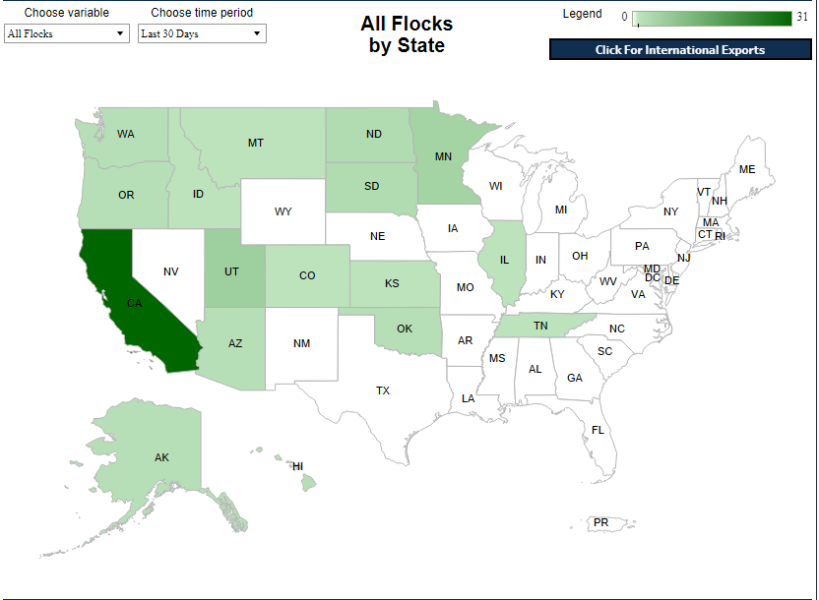
United States – HPAI Domestic Bird Detections
Last 30 days
40 Commercial
26 Backyard Flocks
>7 million birds
Confirmations of Highly Pathogenic Avian Influenza in Commercial and Backyard Flocks | Animal and Plant Health Inspection Service (usda.gov)
USDA Confirms Highly Pathogenic Avian Influenza in Backyard Non-Poultry Flock in Hawaii | Animal and Plant Health Inspection Service

Slide 8
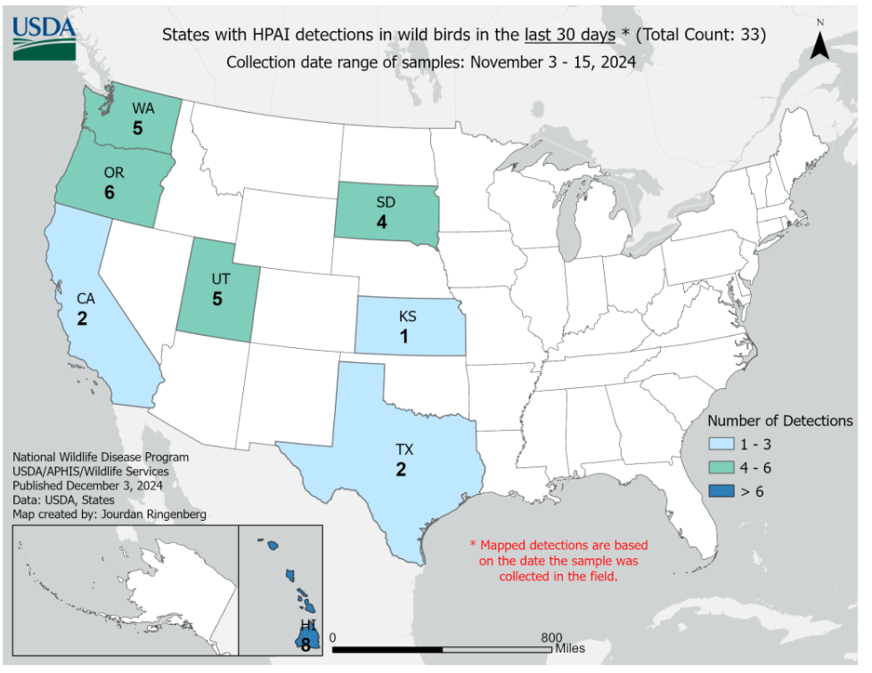
US Wild Bird HPAI Detections, Oct 26-Nov 26 2024
33 wild bird detections of HPAI in the last 30 days
Detections of B3.13 associated have only been associated with Peri-domestic birds since the cattle was detected
No migratory birds have been found with genotype 3.13 (yet)
HPAI Detections in Wild Birds (usda.gov)

Slide 9
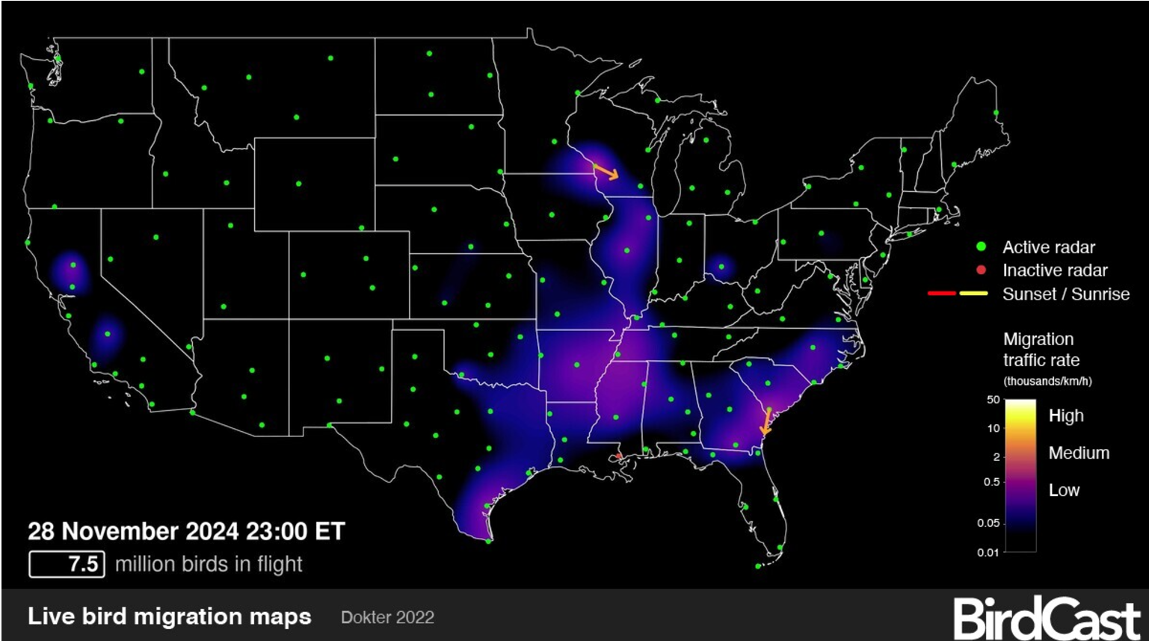
Wild Bird Migration
Wild bird migration has slowed drastically
Notes:
Wild bird migration is well underway with 500 million + birds in flight at different times this week. Overlapping all flyways

Slide 10
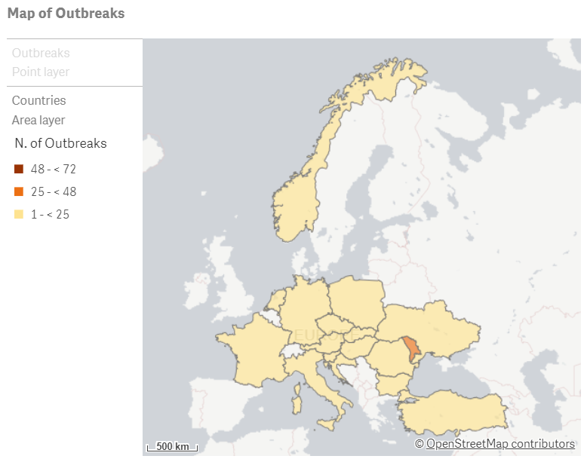
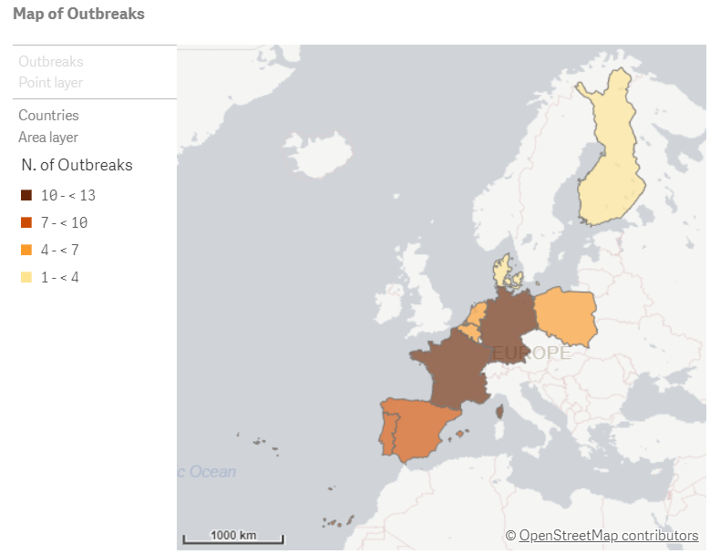
Europe – Farmed Birds
Europe – Wild Birds
143 outbreaks in 18 countries (since last meeting)
  270 outbreaks in 21 countries (since last meeting)
There has been a resurgence of HPAI virus among seabirds along European coastlines.
EURL Avian Flu Data Portal
Notes:
Much worse in Europe this fall than last spring

Slide 11
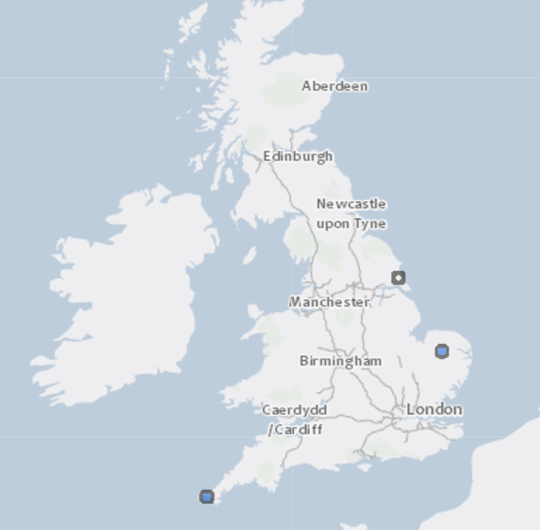
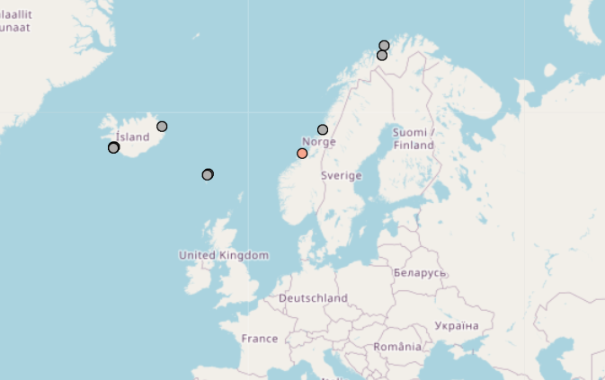
H5N5
Iceland, Faroes and Norway have H5N5 cases in wild birds (10)
Norway has had a single case in a hobby farm
UK has more H5N5 (97) in wild birds than H5N1 (16)
UK Single case of H5N5 in large free range outdoor flock
Domestic case in UK
H5N5
APHA Interactive Avian Influenza Disease Map
AI/ND EURL Data Portal
Notes:
H5N5 has continued to be detected in Europe and the UK.

Slide 12
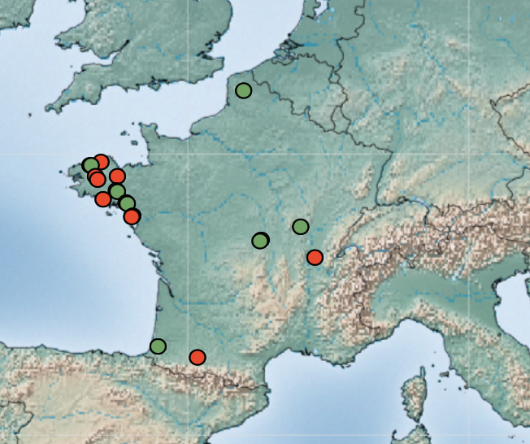
HPAI France
HPAI Detected on routine testing of two vaccinated duck rearing premises in Bretagne
  No clinical disease
The Vaccination campaign continues for this year and models indicate 95% fewer cases in 2023-24 than expected due to vaccination
  Promising effects of duck vaccination against highly pathogenic avian influenza, France 2023-24 | bioRxiv
Wild
Domestic
https://empres-i.apps.fao.org/diseases
  Between September 1 and Dec 6 2024, France has had 12 outbreaks of HPAI, 9 in Bretagne
Notes:
9 domestic premises infected in Bretagne
2 in Nouvelle-Aquitaine
1 in Auvergne-Rhône-Alpes

Slide 13

Ongoing Cases of HPAI in domestic and wild birds
Australia
Victoria , New South Wales – Capital territory no further cases since June
New Zealand
H7N6 in Free range poultry
Asia
S. Korea domestic and wild birds, + new strain H5N3
Japan domestic and wild birds
Israel domestic and wild birds
Taiwan domestic and wild birds
INDIA Four villages in Cuttack district declared bird flu-infected zones
Bhutan - domestic birds
South America
EU report criticises Brazil's avian flu controls – Euractiv EN
PERU – domestic birds
The Falkland Islands wild birds
Africa
South Africa Domestic birds H7N6
Nigeria – domestic birds
HPAI is everywhere, this is not a complete list of cases!

Slide 14

Human Cases Continue to be Reported
Epidemiological Alert Human Cases of Avian Influenza A(H5N1) in the Americas Region - 3 December 2024 - PAHO/WHO | Pan American Health Organization
58 human cases in 2024 in the Americas
  74% of cases in last 2 months
  Canada – 1 (<18yrs)
  United States 57 (1<18 yrs, 56>18 yrs)
  34 exposed to infected dairy cattle
  21 exposed to infected poultry
  2 exposure pathway not determined
GHANA H9N2
China H9N2
Cambodia H5N1
Australia – child that had travelled to India
  Reassortant 2.3.2.1a + 2.3.4.4b + LPAI
Expect human cases to continue to emerge given high viral load globally

Slide 15
Protocol for enhanced human surveillance of avian influenza A(H5N1) on farms in Canada - Canada.ca
Not routine, only under specific circumstances:
Positive laboratory-confirmed detections in humans on farms with infected animals
Laboratory-confirmed detection (PCR) in a new livestock species in Canada where there is a strong likelihood of animal-to-human contact.
Unusual, laboratory-confirmed, infection in livestock where there is a strong likelihood of animal-to-human contact
A genetic mutation is identified in an H5 strain linked to a farm animal infection in Canada that suggests increased risk to humans

Slide 16




Susceptibility of Synanthropic Rodents (Mus musculus, Rattus norvegicus and Rattus rattus) to H5N1 Subtype High Pathogenicity Avian Influenza Viruses
Study from Japan
Looking at rodent susceptibility to HPAI Clade 2.2 and 2.3.2.1 via intranasal innoculation
Rodents showed no clinical signs of disease after exposure
Virus detected in oral swabs for several days after exposure
Post Mortem samples show live virus in respiratory system, not in rectal swabs or feces
Mice (Mus musculus)
Brown rats (Rattus norvegicus)
Black rats (Rattus rattus)
Rodents may provide another transmission pathway for HPAI

Slide 17
Susceptibilities and viral shedding of peridomestic wildlife infected with clade 2.3.4.4b highly pathogenic avian influenza virus (H5N1) - ScienceDirect
Assessed six peri-domestic wildlife species to replicate HPAI H5N1 clade 2.3.4.4b (2022 isolate)
All tested species replicated and shed virus, at least to some degree
Range of species that can be infected with H5N1 has drastically increased, and biosecurity measures may need amendments
House sparrow (Passer domesticus)
European starlings (Sturnus vulgaris)
Feral pigeons (Columba livia)
Cottontail rabbits (Didelphis virginiana)
Striped Skunks (Mephitis mephitis)
Virginia opossums (Sylvilagus sp.)
Notes:
House sparrows could be infected and seroconverted but did not spread the virus to in contact control birds.
All directly inoculated and contact control starlings tested in this study had virus detected in their oral cavities, though not at very high levels, especially in the case of contact control birds, the control birds did not seroconvert.
Pigeons could be infected and some shed low levels of virus, 6/8 seroconverted including in contact controls. The individual heterogeneity in viral shedding in this species suggests that certain individual birds may have the capacity to transmit these viruses on rare occasions. Nonetheless, considering contact birds shed virus only 1 day at low levels, the ability of pigeons to efficiently transmit HP AIVs to conspecifics is still in question.
Rabbits could be infected and seroconverted viral shedding at low levels.
Skunks showed clinical disease, particularly neurological signs, only one survived to the end of the experiment. No virus was isolated from the lung tissues of these animals.
Opossums were infected and seroconverted, no clinical signs of disease

Slide 18
Avian Metapneumovirus
Frontiers | Introduction of Avian metapneumovirus subtype A to the United States: molecular insights and implications
AMPV-A in US is most closely related to Mexican strains
Transboundary spread, unknown whether via wild or domestic birds
Avian metapneumovirus challenges US turkey industry | WATTPoultry.com
AMPV is estimated to be present in 60-80% of U.S. turkey flocks
>1,500 detections since February 2024
seen in every poultry producing state in the U.S. and is the likely cause of low U.S. inventories of turkey eggs in incubators

Slide 19
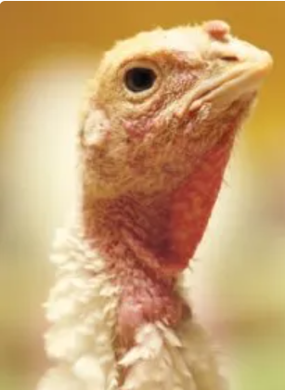
Avian Metapneumovirus in Canada
In Canada
Cases now being included in 6 monthly reports to WOAH
FBCC November report includes 6 new cases of AMPV in Ontario
Can anyone share updates on what is being seen?

Slide 20
Scientific Findings
Avian influenza virus circulation and immunity in a wild urban duck population prior to and during a highly pathogenic H5N1 outbreak
Influenza A Virus Antibodies in Ducks and Introduction of Highly Pathogenic Influenza A(H5N1) Virus, Tennessee, USA - Volume 30, Number 12—December 2024 - Emerging Infectious Diseases journal – CDC
https://www.mdpi.com/1999-4915/16/11/1661
https://www.tandfonline.com/doi/full/10.1080/22221751.2024.2432364
Full article: Novel reassortant H2N2 low pathogenic avian influenza virus in live bird markets in the Northeastern United States, 2019-2023
Avian raptors are indicator species and victims of high pathogenicity avian influenza virus HPAIV H5N1 (clade 2.3.4.4b) in Germany – PubMed
Genetic and pathogenic potential of highly pathogenic avian influenza H5N8 viruses from live bird markets in Egypt in avian and mammalian models | PLOS ONE
Sequencing-Based Detection of Avian Influenza A(H5N1) Virus in Wastewater in Ten Cities | New England Journal of Medicine
Detection and spread of high pathogenicity avian influenza virus H5N1 in the Antarctic Region | Nature Communications

Slide 21
Scientific Findings
Unexpected Delayed Incursion of Highly Pathogenic Avian Influenza H5N1 (Clade 2.3.4.4b) Into the Antarctic Region - Lisovski - 2024 - Influenza and Other Respiratory Viruses - Wiley Online Library
Eurosurveillance | Highly pathogenic avian influenza management policy in domestic poultry: from reacting to preventing
Avian influenza overview June–September 2024
Detection and Monitoring of Highly Pathogenic Influenza A Virus 2.3.4.4b Outbreak in Dairy Cattle in the United States
The global H5N1 influenza panzootic in mammals | Nature
Experimental infection of Clades 2.2.1.2 (H5N1) and 2.3.4.4b (H5N8) of highly pathogenic avian influenza virus infection in commercial broilers – ScienceDirect
Evolution and mutational landscape of highly pathogenic avian influenza strain A(H5N1) in the current outbreak in the USA and global landscape – ScienceDirect
Full article: Genomic characterization of highly pathogenic H5 avian influenza viruses from Alaska during 2022 provides evidence for genotype-specific trends of spatiotemporal and interspecies dissemination
A New Variant of Avian Encephalomyelitis Virus Associated with Neurologic Signs in Turkey Poults

