Slide 1
Community for Emerging and Zoonotic Diseases
Identifying emerging risks through collective intelligence
CEZD – CAHSS Small Ruminant Network Update
13 December 2023
www.cezd.ca

Slide 2
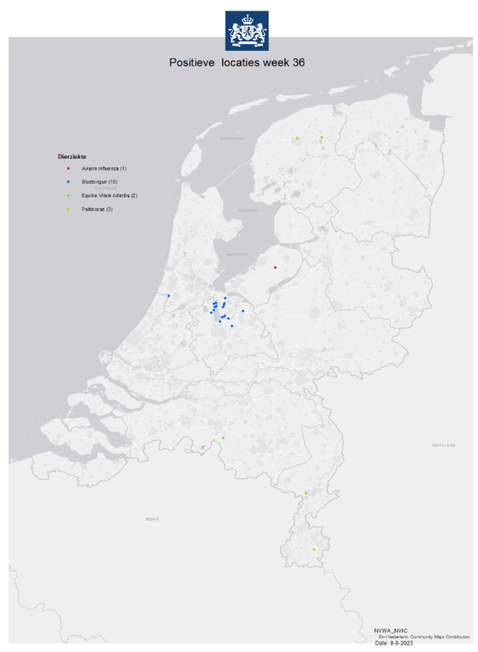
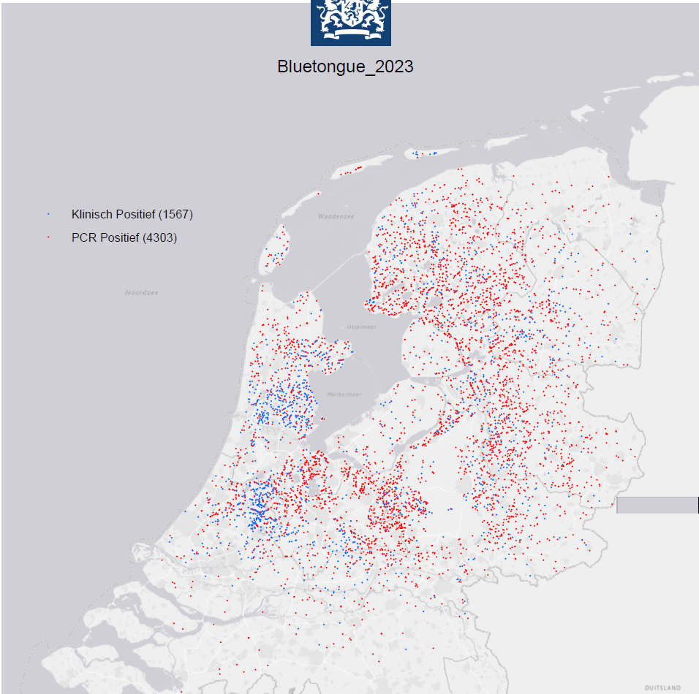
Bluetongue virus in Europe
Netherlands
Initial cases reported end of Sept 2023
  BTV was last reported in the Netherlands in 2009
Identified as serotype 3 (new strain)
Most recent reports
  PCR positives - 4303
  Clinically positive - 1564 (no PCR)
Cases in cattle and sheep
Source of introduction (hypothesis)
  Midges in household waste transported from Rome to Amsterdam via train
  Weekly transport, 36% organic
Notes:
Image as of Dec 8, 2023
Total ~4303 PCR positives, 1564 clinical signs cases
apart from Italy, the virus could only appear in the Netherlands – while all intermediate and surrounding countries were left untouched – the experts have so far no explanation.
The Netherlands have reported 18 outbreaks of BTV on sheep farms in Noord-Holland and Utrecht. BTV was last reported in the Netherlands in 2009. The Netherlands will now lose its EU disease-free status, meaning sheep will have to be vaccinated before they can be exported.
The bluetongue virus found on sheep farms in the Netherlands has been confirmed as serotype 3, the most recently reported serotype in Europe, and presumably entered from Tunisia to Italy; the source of infection with this serotype in the Netherlands is unknown
(~Oct 20) The Netherlands have now reported BTV in its southern most province of Limburg; across the country, a total of 2,428 farms have reported cases of the virus, of which 873 have noted clinical signs
As of October 31, 2023, the Netherlands have reported a total of 3,914 cases of BTV, of which 1,372 have noted clinical signs
The source of introduction of BTV serotype 3 into the Netherlands is thought to be related to midges present in household waste that was transported via train from Rome to Amsterdam
seems to have traveled along with the train wagons full of household waste from Rome, which are delivered weekly to waste processor AEB in Amsterdam.

Slide 3
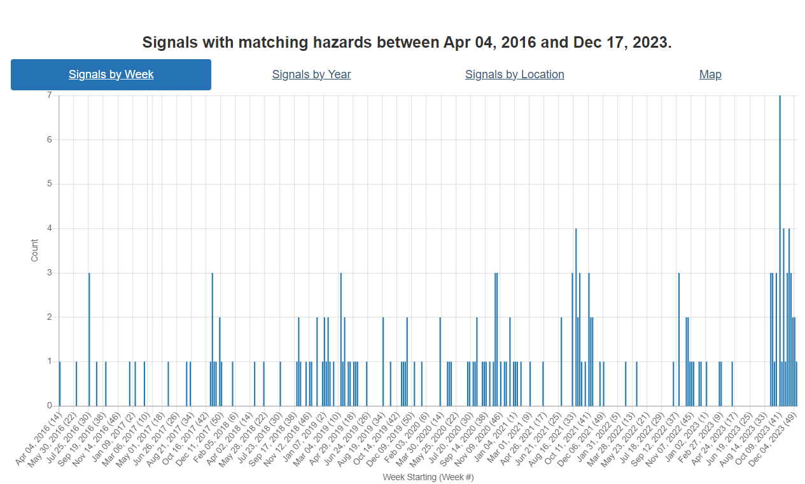
Bluetongue virus in Europe
UK
Early Nov, 1st cases of BTV serotype 3 in cattle in Kent
To Dec 8th, 11 cases on 6 premises
APHA Interactive Bluetongue Virus Map (arcgis.com)
Belgium
End of Sept, 1st case of BTV serotype 3 in sheep in Merksplas
Close to border with Netherlands
Germany
Early Oct, 1st cases of BTV serotype 3 in Kleve
Close to border with Netherlands
Additional cases continue to be reported in cattle and sheep in NW Germany
BTV Signals: April 2016 – Present day

Slide 4
Epizootic Hemorrhagic Disease in Europe
France
End of Sept, first reports of EHD in cattle
Near border with Spain
Spread by culicoides, similar clinical signs as bluetongue
May be circulating in Morocco (not directly from Tunisia to Spain)
Switzerland
First reported case in calf in Bern
Portugal
First cases in July/Aug in northern regions
More spread/reports in Sept
Recent drought reported
Notes:
on cattle in 3 farms located in the Pyrénées-Atlantiques and Hautes-Pyrénées.
Previous reports of EHD in Europe were in Italy (Sardinia, Sicily), Portugal, and Spain
2021- Tunisia. Serotype 8 in deer,
2022 October – Italy EHD-8
Europe is considering this an emerging disease as its rapidly spreading, vectors in place, climate compatibility – they are looking to see if the Culicoides can survive the winter, other countries should implement monitoring systems.
France has confirmed the presence of the Epizootic Haemorrhagic Disease (EHD) virus on cattle in three farms located in the Pyrénées-Atlantiques and Hautes-Pyrénées. Movement controls have been implemented across several departments. EHD causes clinical signs very similar to those of bluetongue, including fever, weight loss, oral lesions and difficulty breathing. In Europe, it has previously been reported in Italy, Spain, and Portugal.
Switzerland has confirmed its first case of epizootic hemorrhagic disease (EHD), in a calf on a farm in the canton of Bern. As Switzerland is no longer considered EHD-free there have been international trade restrictions on farm animals and their semen.
Portugal has reported 33 cases of EHD in cattle in Trás-os-Montes. The first cases of the disease were detected in the northern territories in July and early August 2023. Case reports have been more frequent since the beginning of September.

Slide 5
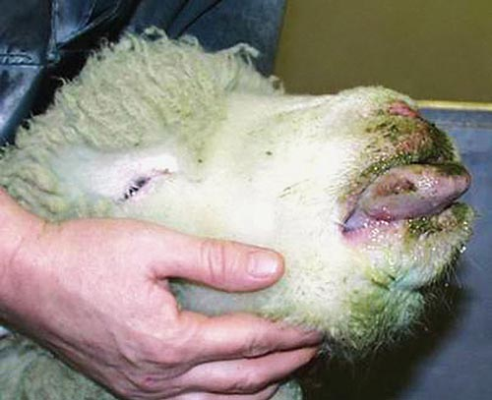
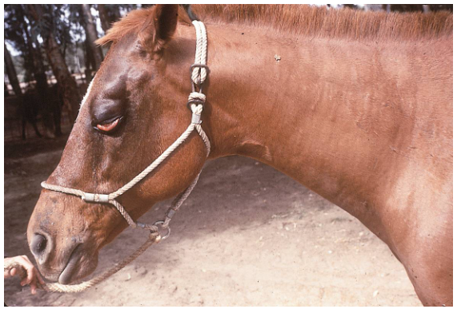
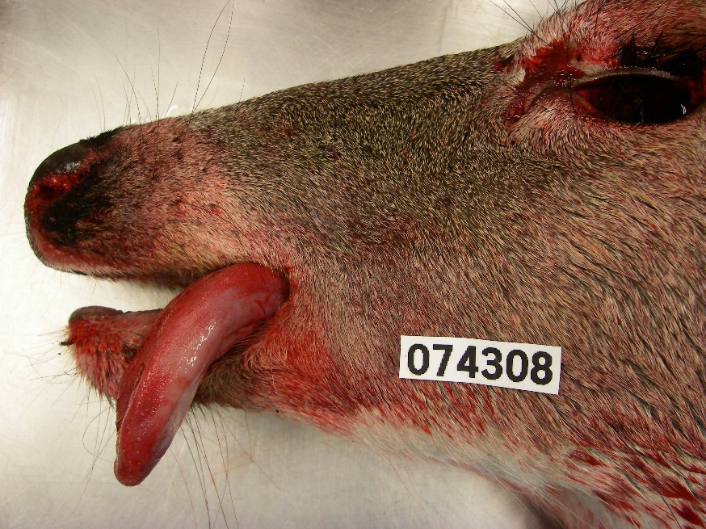
SF: Culicoides-borne Orbivirus epidemiology in a changing climate
https://microbewiki.kenyon.edu/index.php/File:Bluetongue.jpg
Orbiviruses transmitted by biting midges (Culicoides):
  Bluetongue virus
  Epizootic Hemorrhagic Disease
  African horse sickness
https://cwhl.vet.cornell.edu/disease/hemorrhagic-disease-deer#collapse21
https://thehorse.com/199024/african-horse-sickness-update/

Slide 6
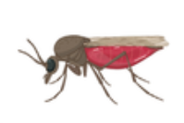
Culicoides-borne Orbivirus epidemiology in a changing climate
Two competent Culicoides species in North America
  C. sonorensis (BTV, EHD + AHSV in the lab)
  C. insignis (BTV)
C. sonorensis is distributed in sub-tropical to temperate Western US
  Sporadically in the East US
  Survives to -20C and eggs resistant to dessication
C. insignis in tropical and sub-tropical zones
  Southern US, Central and South America

Slide 7
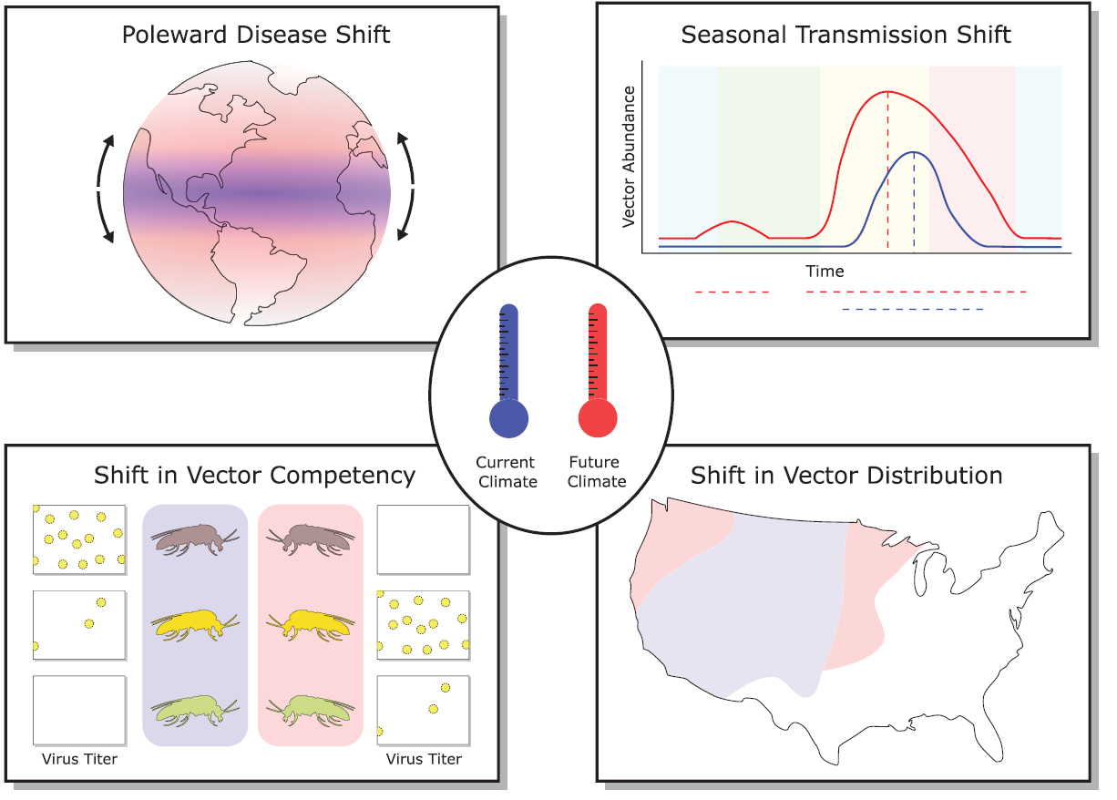
Increased transmission
period duration
Earlier in spring +
Later in fall
Global north and
southward shifts
in vector distribution
Increased virogenesis
Shortened EIPs
Higher virus receptor
binding efficiency
Increased reassortments
C. insignis moving
north and west
C. sonorensis sporadic
incursions into
southern Canada
Notes:
Climate change is expected to alter the established orbivirus epidemiology
Range expansion of midge species
In the US C. insignis showing north- and west-ward expansion
Local and long distance wind dispersal dynamics
Can range from less than 30 km to over 700 km
Increased transmission period duration (earlier spring, later fall)
Possible expansion of less common orbiviruses: Peruvian horse sickness virus, Yunnan virus, Palyam virus, and equine encephalosis virus
EIP = extrinsic incubation period

Slide 8
Scientific Findings
Cache Valley virus: an emerging arbovirus of public and veterinary health importance | Journal of Medical Entomology | Oxford Academic (oup.com)

