Slide 1
Community for Emerging and Zoonotic Diseases
Identifying emerging risks through collective intelligence
CEZD – CAHSS Small Ruminant Network Update
18 December 2024
www.cezd.ca

Slide 2
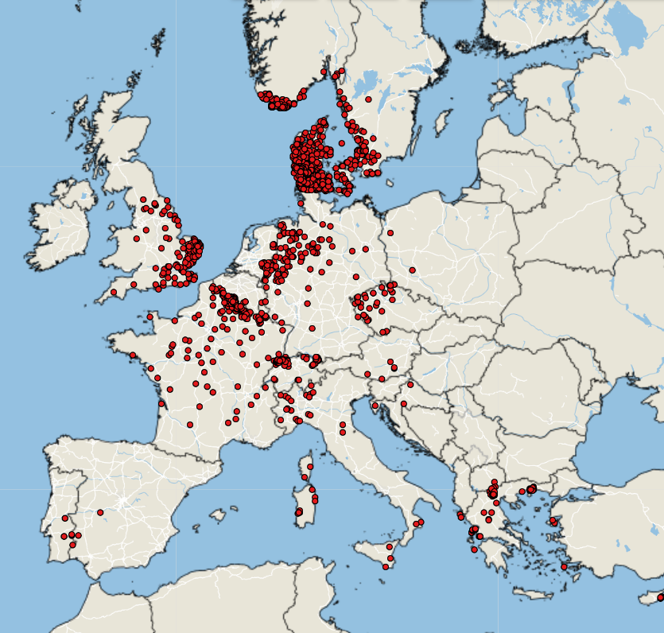
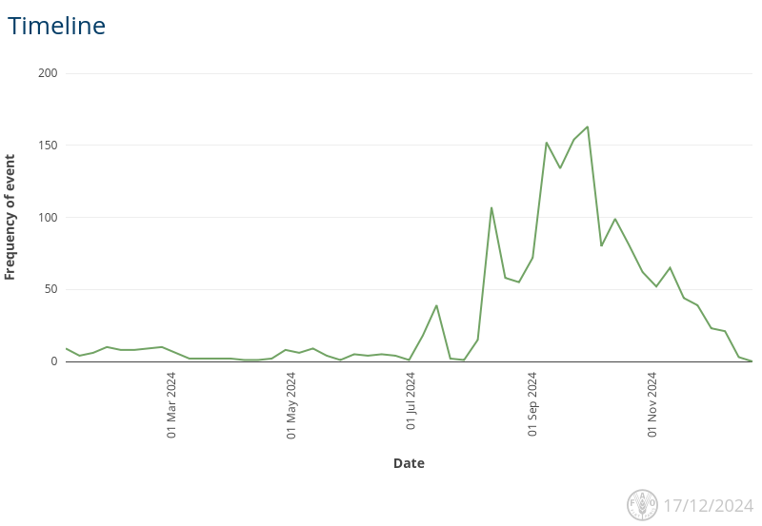
Bluetongue virus (BTV-3) in Europe
First reported Sept 5, 2023 in the Netherlands
Source of infection has never been identified
Has spread rapidly across Europe in 2024
Empres-Plus

Slide 3
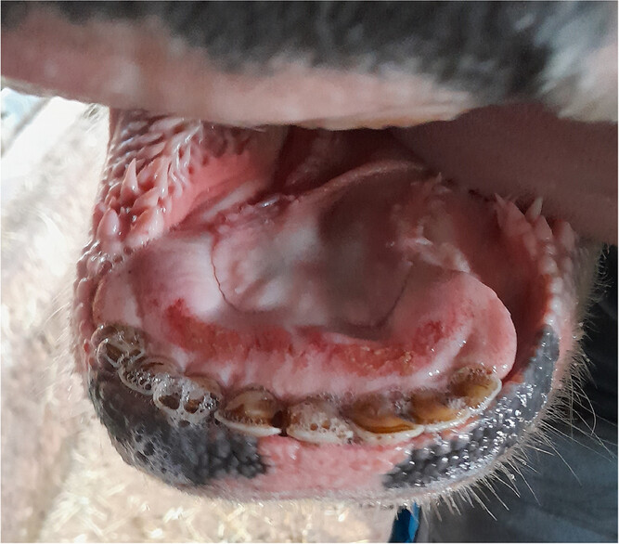
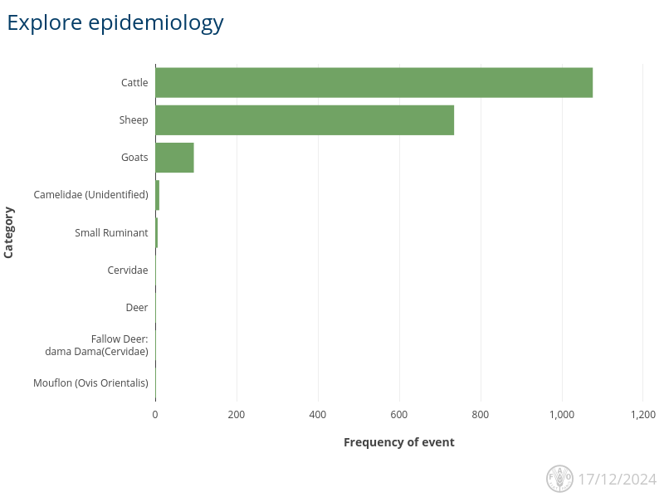
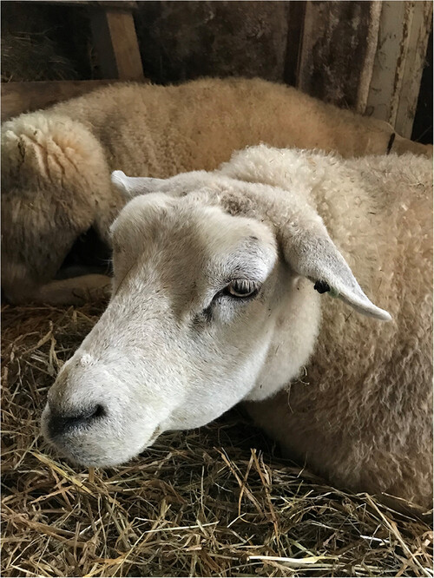
Species most affected
https://bvajournals.onlinelibrary.wiley.com/doi/10.1002/vetr.4533
Empres-Plus

Slide 4
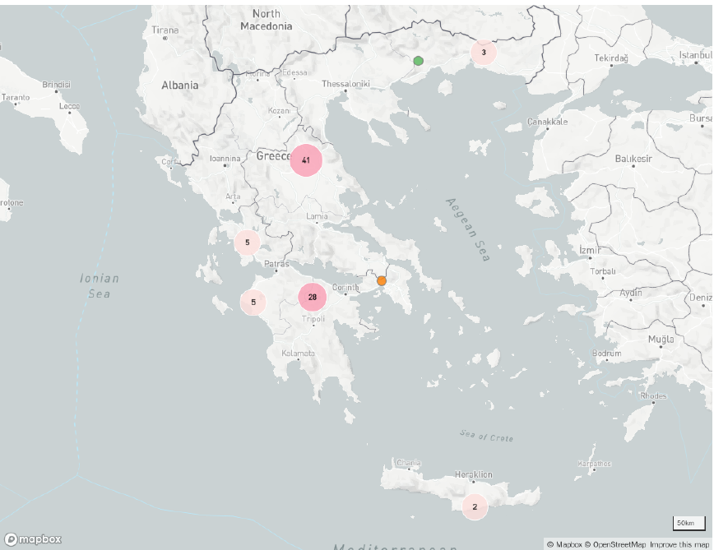
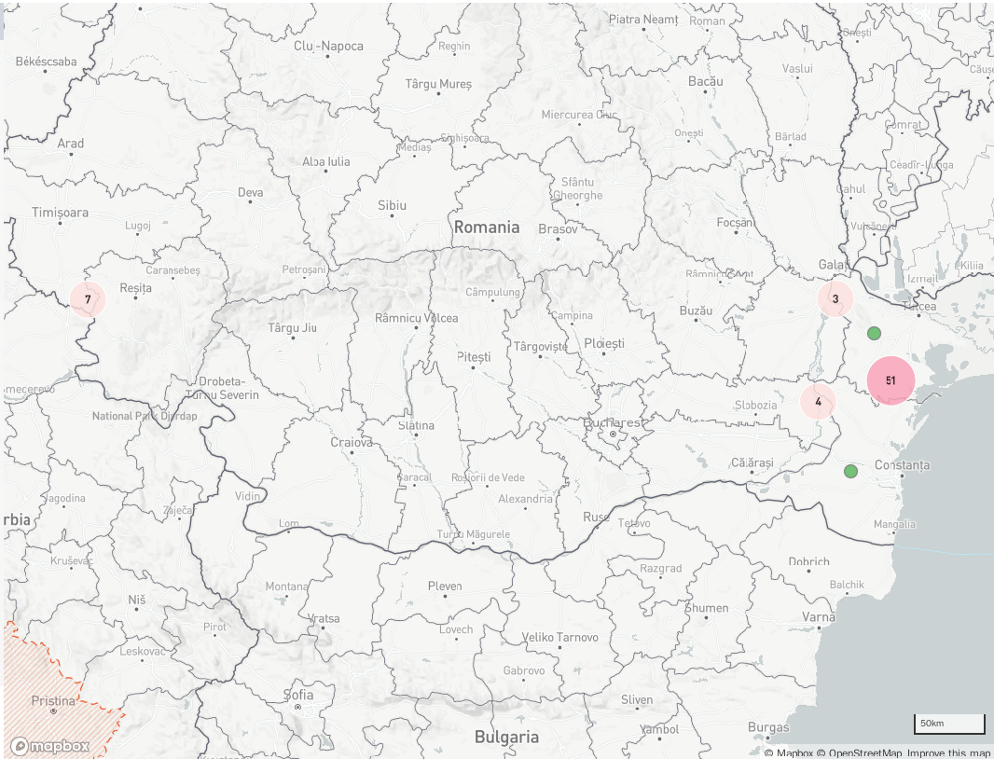
Peste des petits ruminants - Europe
Romania
First case detected on July 15, 2024
As of December 17, 2024 – 67(0) outbreaks reported
Majority of outbreaks located in the east of the country, some on the west near border with Serbia
« Resolved » on WOAH report
Greece
First case detected on July 8, 2024
As of December 17, 2024 – 86 (+17) outbreaks reported across the country
No official word on source of outbreaks
Molecular typing of the isolates would give us more information

Slide 5
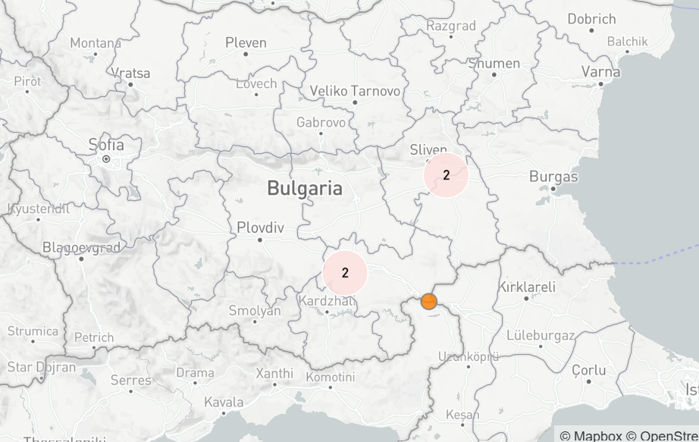
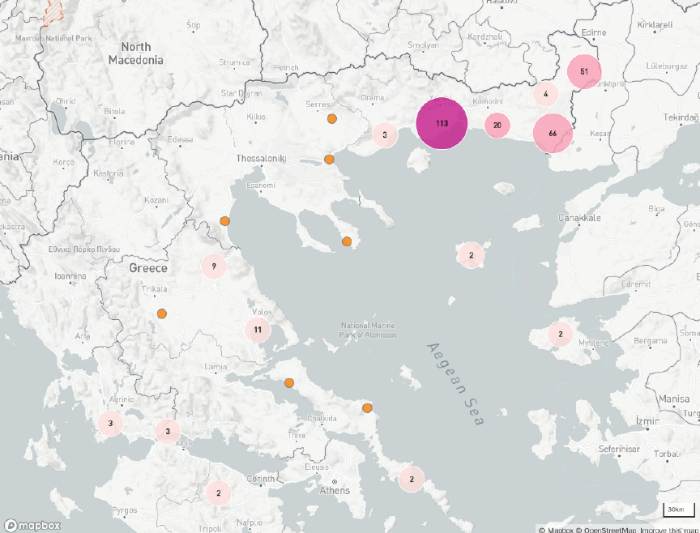
Sheep and Goat Pox
Greece
Continues to report cases, now up to 298 cases
Bulgaria
First confirmation (4 Sep 2024)
5 cases

Slide 6
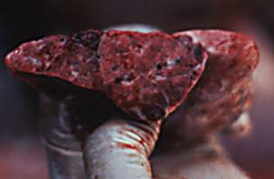
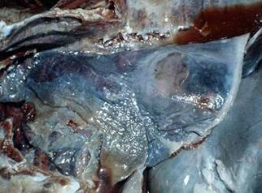
Contagious Caprine Pleuropneumonia in Mongolia
Mycoplasma capricolum subsp. capripneumoniae
Reported for first time in 70 years (?) WOAH Report
Broad global distribution in Africa, Asia and the Middle East
Immediately Notifiable Disease in Canada
Never been detected in North America
Severe serofibrinous pleuropneumonia, very high morbidity (∼100%), and mortality (80–100%).
Per acute, Acute or Chronic Presentations

Slide 7
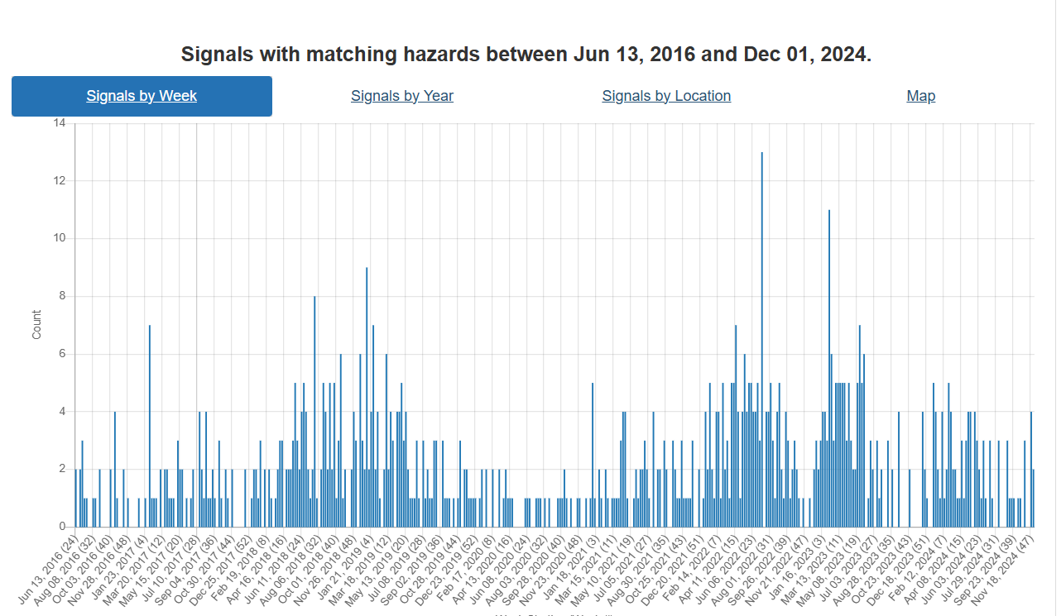
Foot and Mouth Disease – Hazard Trend
SAT-2 in middle east
Hazard trend line has returned to baseline after spike due to SAT-2 in the middle east last year
COVID
FMD Indonesia
Notes:
Hazard trend line has gone back to baseline from last year when we were sharing information on SAT-2 in the middle east.

Slide 8
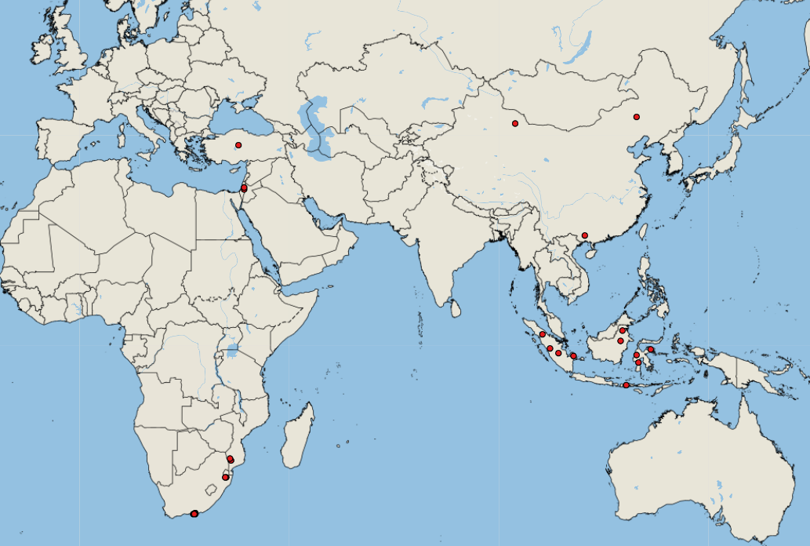
FMD Cases Q3 and Q4
20 cases in Q3
  17 Africa
    S. Africa SAT-3
    Mozambique SAT-1 + unidentified
  3 Asia
    China O + unidentified
    Turkey A
17 so far in Q4
  3 Africa SAT-2
  14 Asia
    10 Indonesia unidentified
    1 China O
    3 Palestine O
Notes:
20 outbreaks in Q3
17 in Africa
South Africa SAT3
Mozambique SAT1 + unidentified
3 in Asia
China O and unidentified
Turkey A
~10 so far in Q4
Indonesia unidentified type
China just reported type O in swine at the slaughterhouse

Slide 9
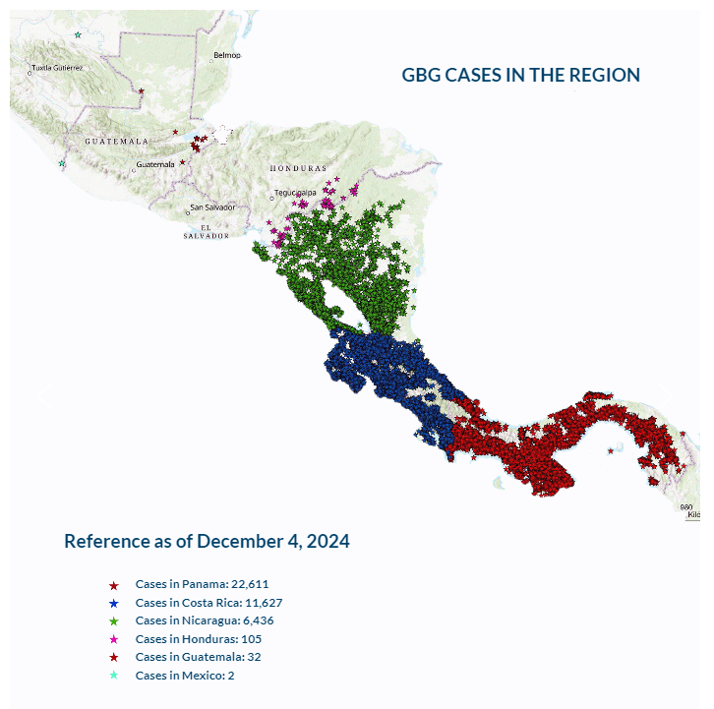
New World Screwworm in Central America
August 2023 Cases occurred in Panama; animal movements were halted. Subsequent/Concurrent with release of sterile flies.
Slow and steady march northwards
As of December 4, 2024, according to COPEG:
  Panama – 22,611 cases
  Costa Rica – 11,627 cases
  Nicaragua – 6,436 cases
  Honduras – 105
  Guatemala – 32
  Mexico - 2
COPEG

Slide 10
Scientific Findings
Identification and characterization of two atypical strains of bluetongue virus in sheep, Tunisia – ScienceDirect
The European Union summary report on surveillance for the presence of transmissible spongiform encephalopathies (TSE) in 2023 - - 2024 - EFSA Journal - Wiley Online Library
Frontiers | Potential mechanisms underlying bluetongue virus emergence and spread

