Slide 1
Community for Emerging and Zoonotic Diseases
Identifying emerging risks through collective intelligence
CEZD – CAHSS Small Ruminant Network Update
16 October 2025
www.cezd.ca

Slide 2
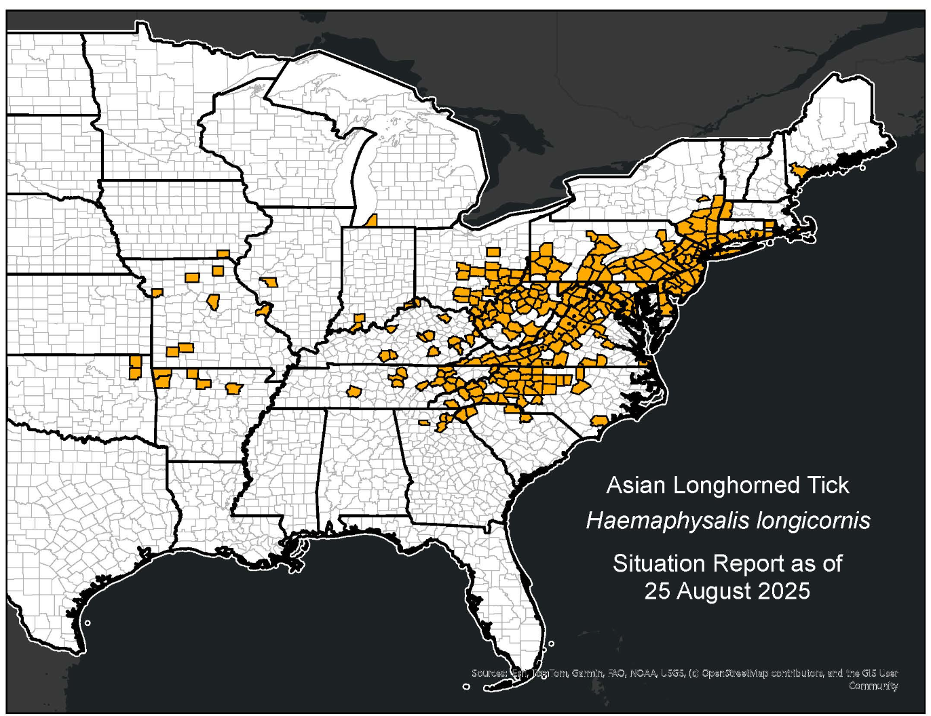
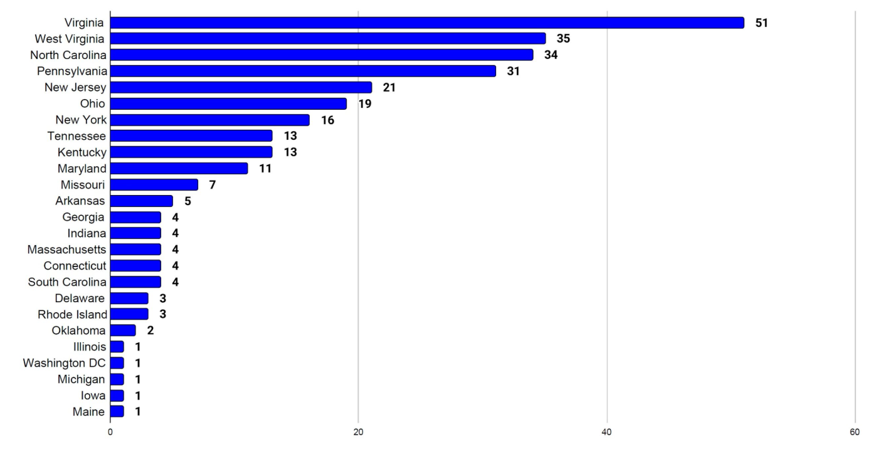
Asian Longhorn Tick in the USA
ALHT calls have been taken over by the University of Tennessee
Since the last CAHSS call – three additional states have reported first detections
24 states + Washington D.C. now affected
Mid-June, Michigan reported ALHT nymphs were found in Berrin County, found by routine tick surveillance
Mid-August, Maine confirmed its first finding of the ALHT in Cumberland County
Asian Longhorned Tick Situation Report - The Tick App

Slide 3
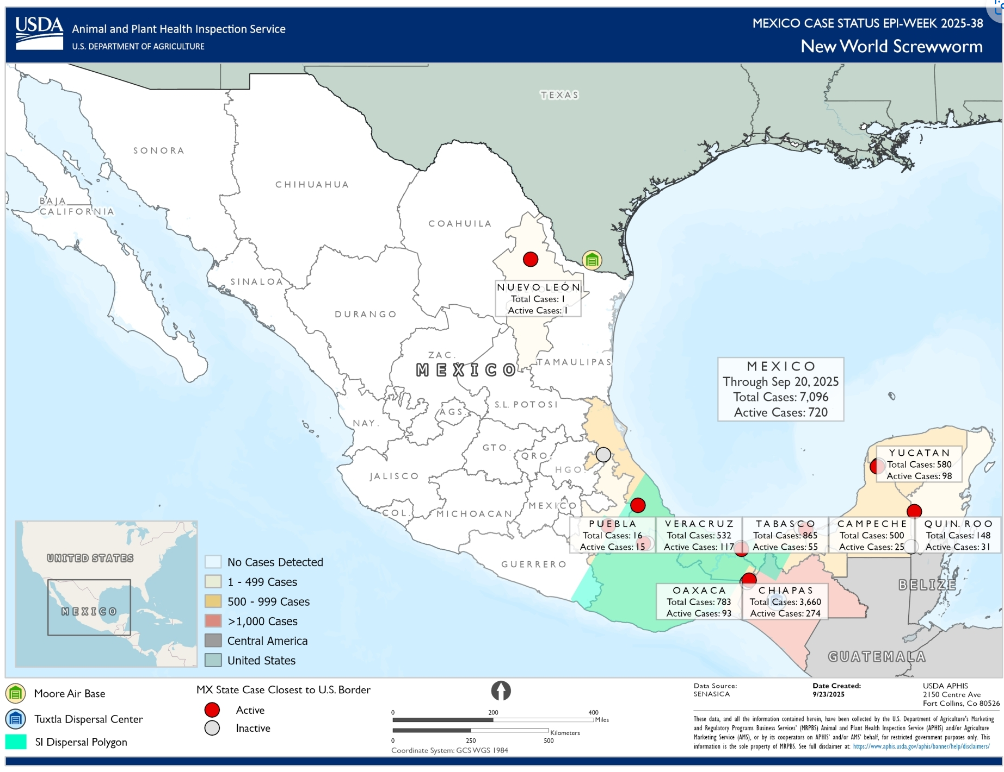
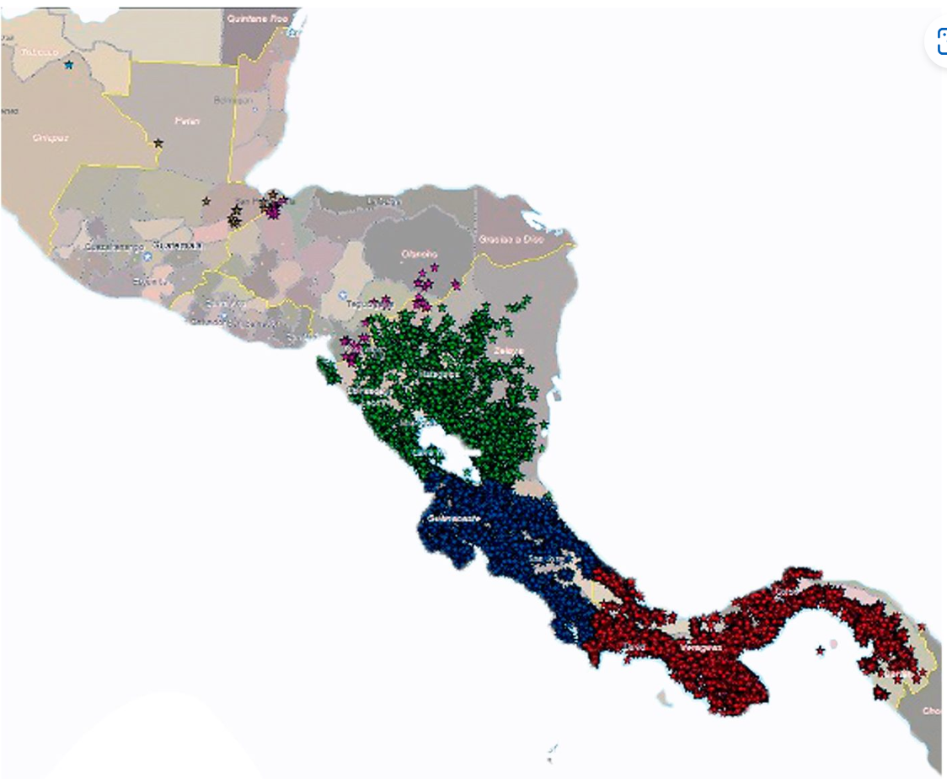
New World Screwworm in Central America and Mexico
USA - Mexico border remains closed (cattle, bison, horses)
Recent detection in Nuevo León (~125 km from border)
Mexico has reported 52 human cases (mostly in Chiapas), including 3 deaths linked to underlying conditions
Situation in other Central American countries: Honduras (64+ human cases, >2,496 animal cases), Nicaragua (124 human cases), Guatemala (16 human cases), El Salvador (5 human cases), Belize (2 human cases), and Costa Rica (56 human cases in 2025, triple the 2024 count)
The USDA is investing $29.5 million in sterile fly production and dispersal facilities in Mexico and Texas
Mexico has launched an interactive dashboard for tracking NWS in animals
The USA is deploying Swormlure-5, a synthetic bait with insecticide, and has authorized emergency use of animal drugs for NWS control
July 2025
COPEG
Notes:
The positive New World Screwworm (NWS) case in Nuevo León, Mexico, was confirmed in Sabinas Hidalgo on September 21, 2025. The affected animal was an 8-month-old cow that had recently been moved to a certified feedlot in Nuevo León from a region in southern Mexico known to have active NWS cases.
Food and Drug Administration conditionally approved Dectomax-CA1 (doramectin injection) injectable solution for the prevention and treatment of New World screwworm larval infestations, and prevention of NWS reinfestation for 21 days. Dectomax-CA1 is conditionally approved for use only in cattle.

Slide 4
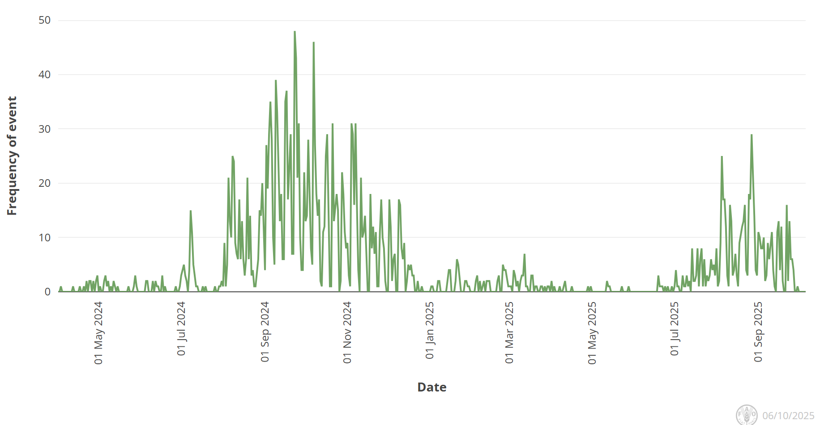
Bluetongue virus in Europe
Europe still reporting cases of BTV (serotypes 3, 8, and recently 5), but less than the previous year
BTV-3 Cases
  UK, Poland, Norway, Czech Republic, Romania (1st report), Hungary (1st since 2015)
  In Africa, Morocco recently reported its first cases of BTV-3
BTV-8 Cases
  UK, Slovenia, Italy, Greece, North Macedonia, Croatia, Serbia, Bosnia
BTV-5
  Italy
  First occurrence in Europe
Unspecified BTV Serotype
  Kosovo
Empres-Plus
Notes:
The total number of BTV-3 cases in Great Britain for the 2025 to 2026 vector season (since July 2025) is 91. There have been: 87 cases in England 4 cases in Wales The total number of BTV-8 cases in Great Britain for the 2025 to 2026 vector season (since July 2025) is one. This case was in England.
Italy recently reported BTV-5 in sheep in Sardinia, the first recorded occurrence of BTV-5 in Europe

Slide 5
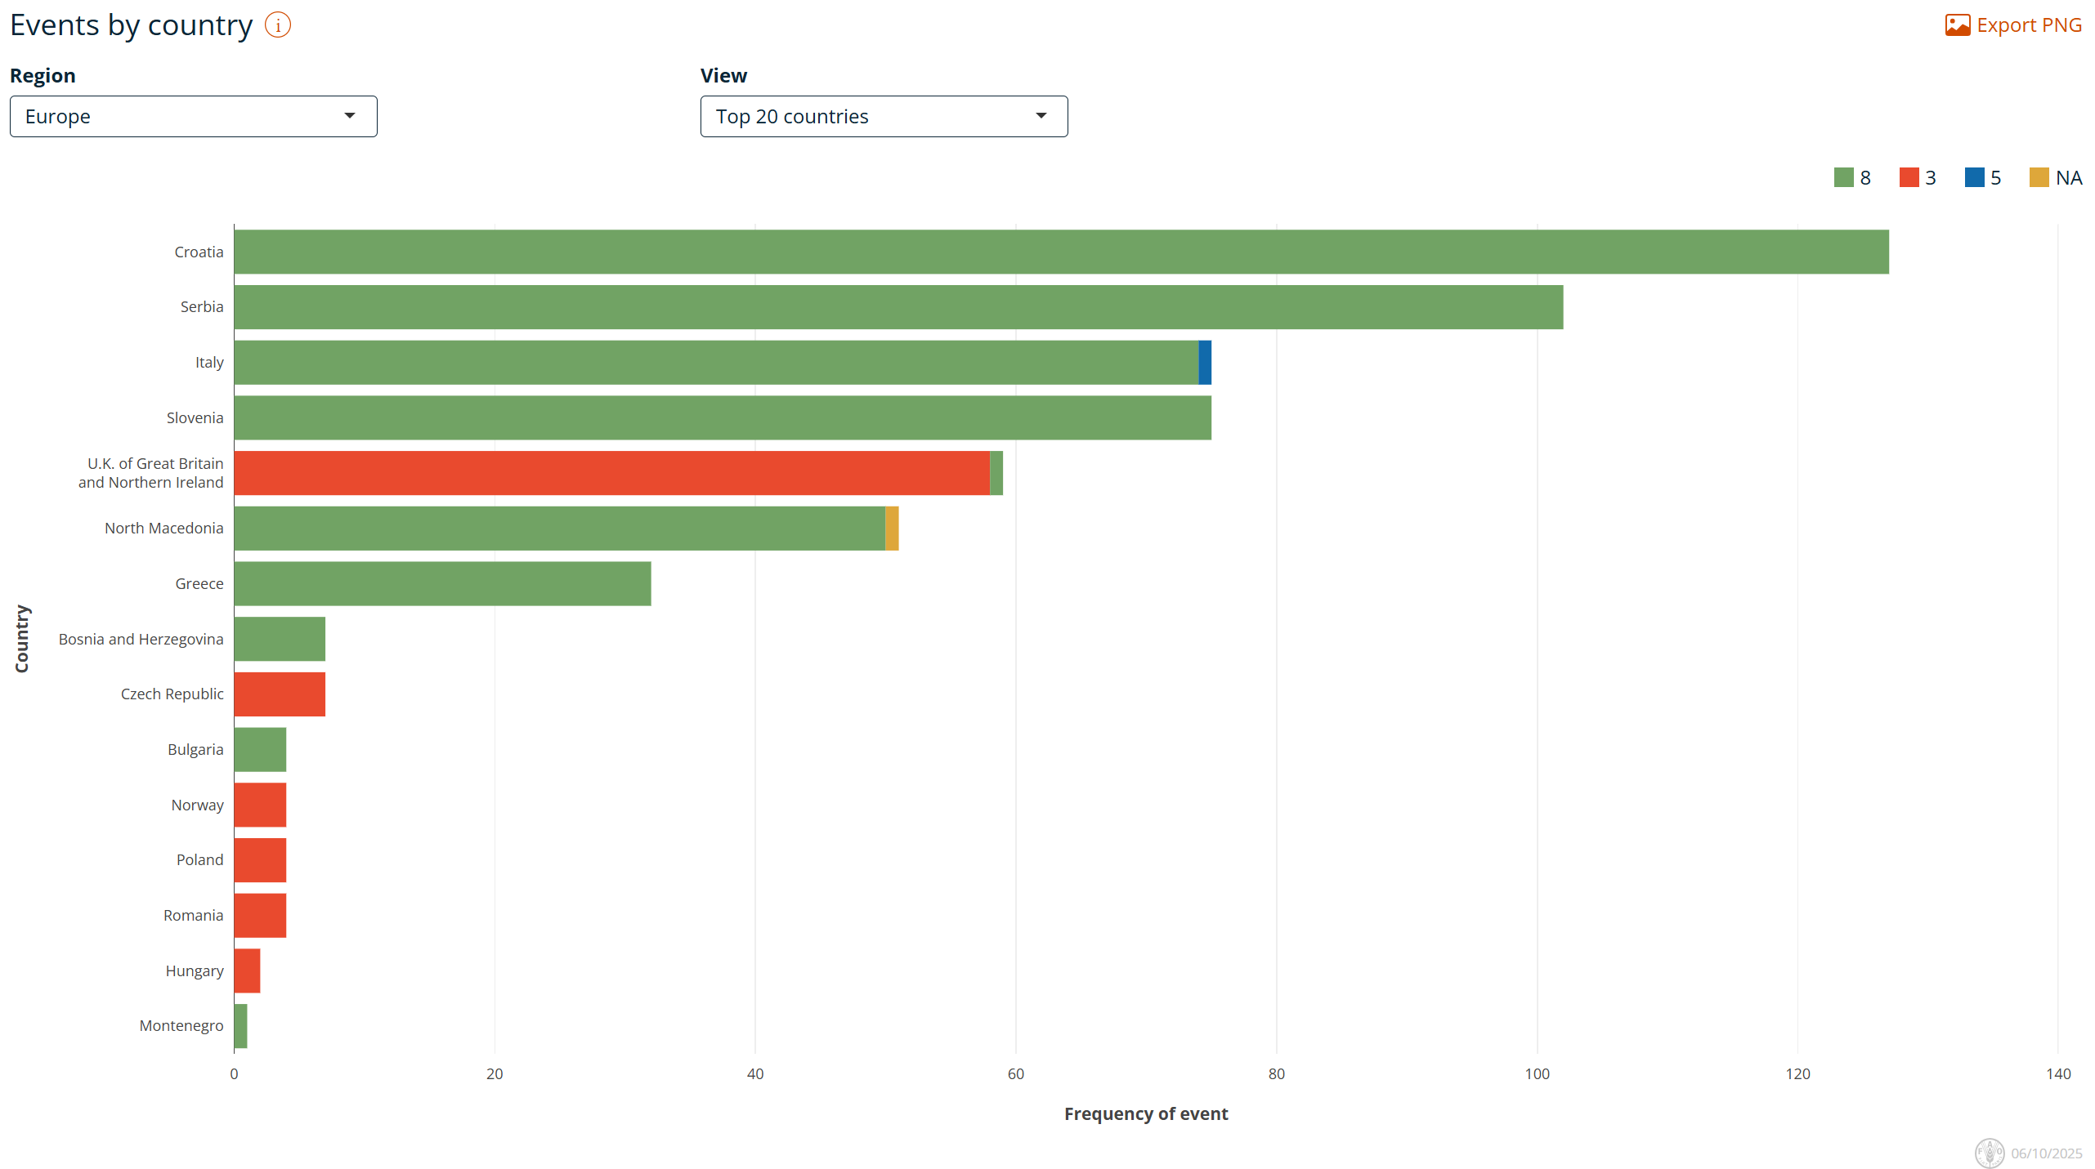
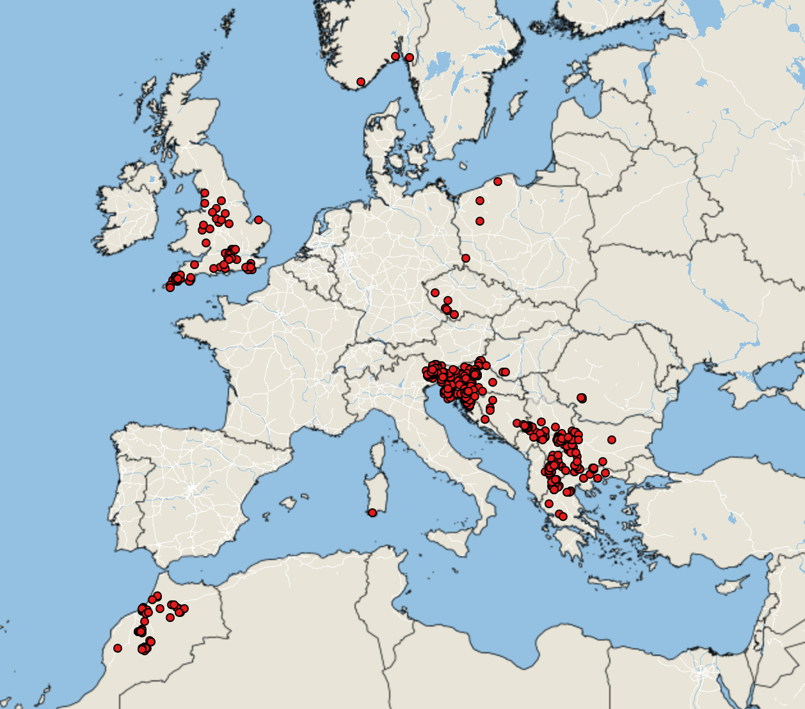
Bluetongue virus in Europe
Empres-Plus
BTV cases June 1, 2025 – October 5, 2025

Slide 6
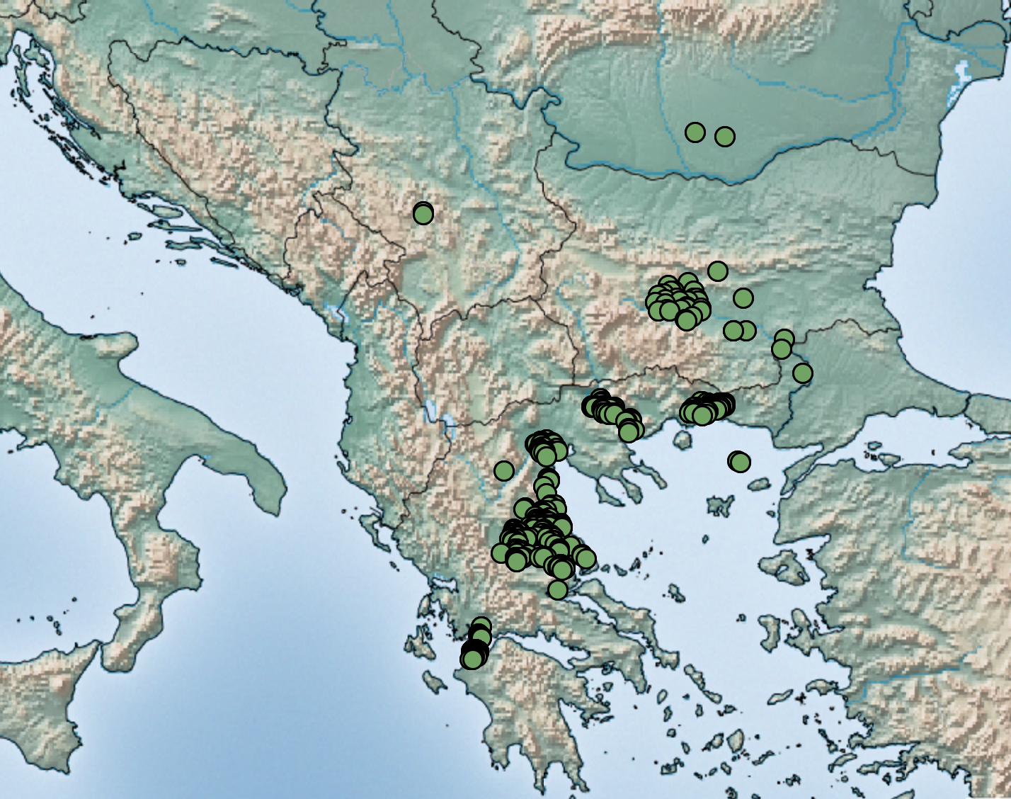
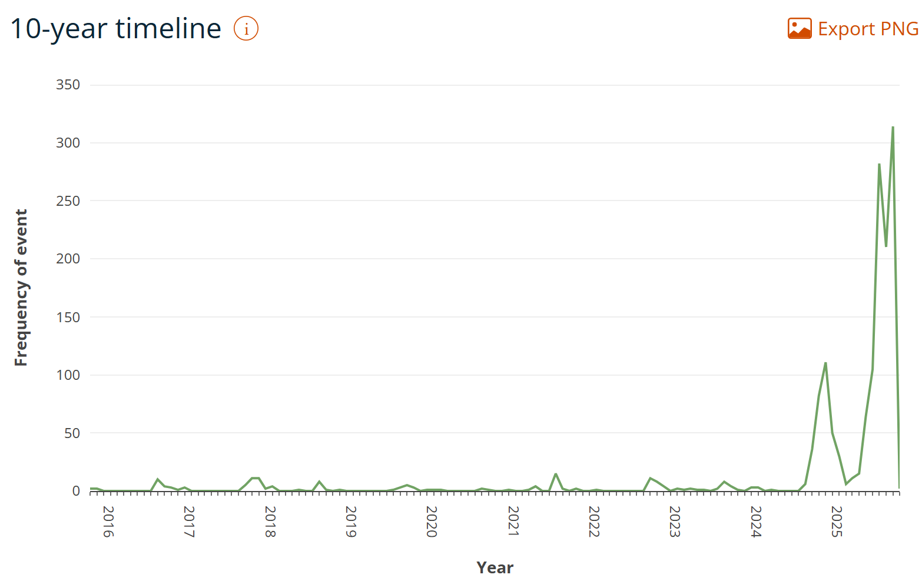
Sheep Pox and Goat Pox in Europe
Outbreaks ongoing in Greece, Bulgaria, Romania and Serbia
727 Events reported since last meeting

Slide 7
Epizootic Hemorrhagic Disease in the United States
Epizootic Hemorrhagic Disease reports in United States have been very significant this year
Reports of hundreds to thousands of white-tailed deer impacted
  Ohio
  Indiana
  Kentucky
  Michigan
  Montana
Serologic evidence of EHD in sheep and goats recent study from Türkiye suggests they may play some role in EHD epidemiology
Sheep are susceptible via experimental infection but rarely develop clinical signs
Goats do not seem to be susceptible (WOAH)
The same environmental conditions that favour EHD also favour BTV

Slide 8
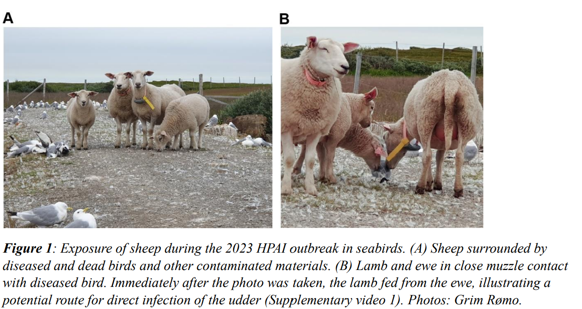
Detection of antibodies specific to H5 avian influenza virus in a sheep in Norway, June 2024, eleven months after an outbreak of highly pathogenic avian influenza in a nearby seabird colony | bioRxiv
July 2023 outbreak caused mass mortality events in seabirds (~15,000)
Sheep had close contact with the birds
Samples taken 11 months post exposure
Retrospective Serology:
  1/220 sheep seropositive
Antibody persistence?

Slide 9
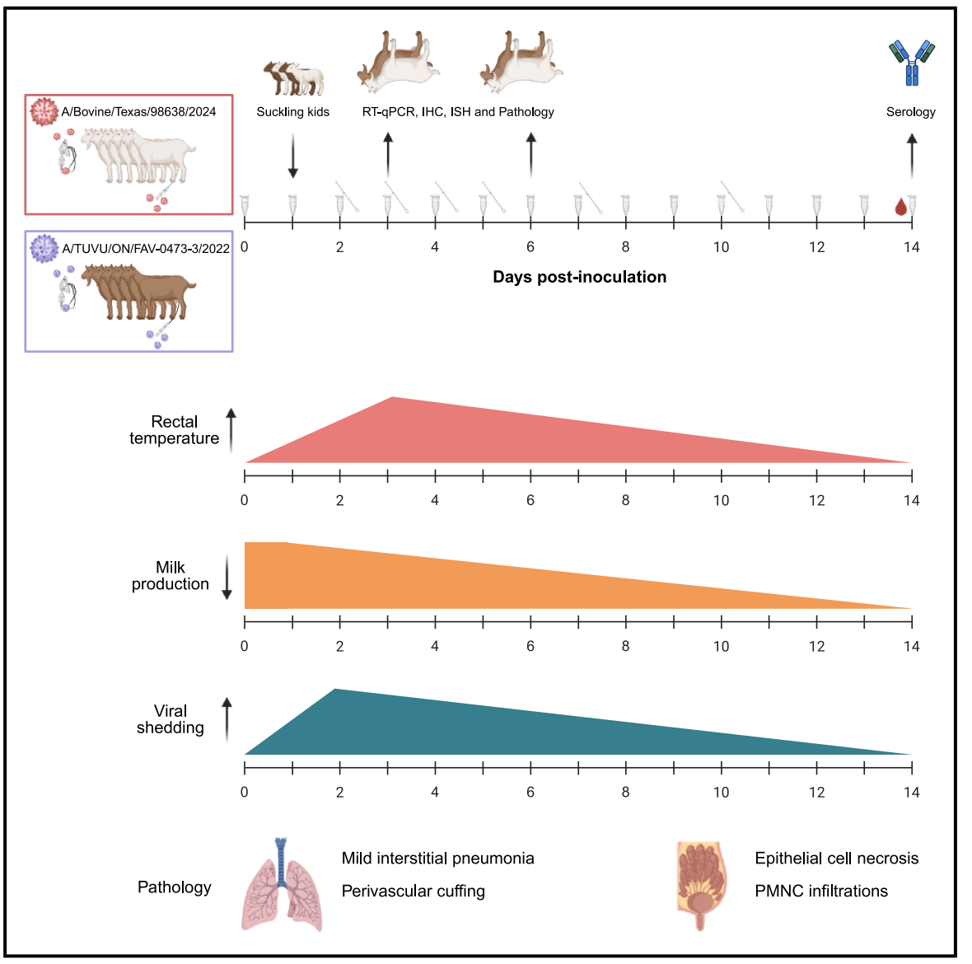
Dairy cow- and avian-origin clade 2.3.4.4b H5N1 induce severe mastitis in lactating goats and transmission to suckling goats: Cell Reports
Cow- and avian-origin A(H5N1) caused severe mastitis in goats
Infected goats shed viruses in milk, transmitting A(H5N1) to suckling kids
Both viruses infected goat respiratory and mammary cells, which express sialic acid receptors
Notes:
The emergence of highly pathogenic avian influenza (HPAI) H5N1 clade 2.3.4.4b has led to unprecedented spillover and spread among US dairy cows, raising concerns about transmission to other ruminants. We inoculated two groups of lactating goats via intramammary and respiratory routes with Cow-H5N1 (genotype B3.13) or avian-H5N1 (genotype B1.2) virus. Both groups developed severe clinical mastitis and shed viruses in milk, resulting in transmission to suckling kids. Viral RNA was detected in nasal and oral swabs and various tissues, and virus-neutralizing antibodies were present in serum, milk, and bronchoalveolar lavage fluid. In vitro, both viruses replicated efficiently in goat respiratory and mammary epithelial cells. Mammary tissue expresses both α2,3- and α2,6-linked sialic acid receptors. These findings demonstrate that goats are highly susceptible to H5N1 infection, with mammary tropism facilitating transmission to offspring

Slide 10
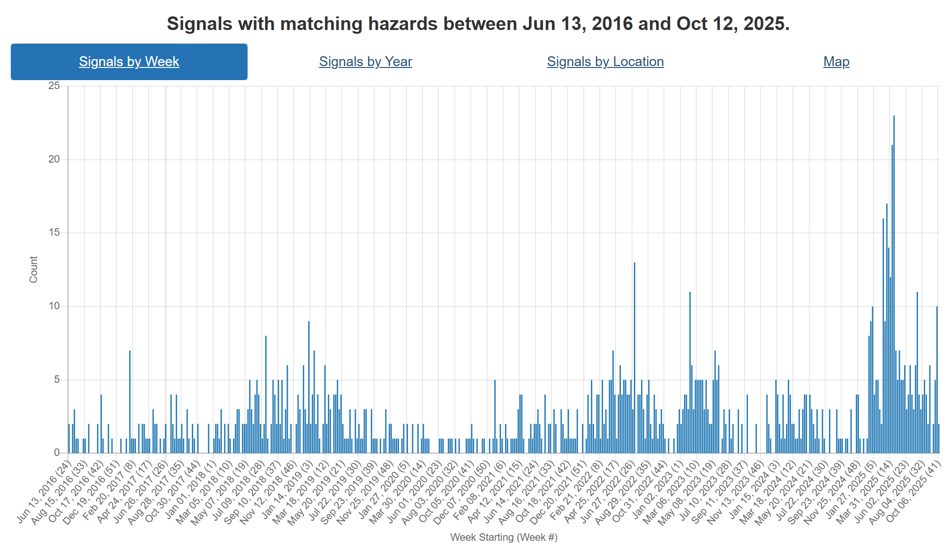
Foot and Mouth Disease – Hazard Trend
Slovakia
COVID
Indonesia
SAT-2
Middle East
Hungary
Germany
SAT-1
Middle East, Turikye, Egypt, Iran
Notes:
FMD trends over the last ~9 years. Can see increasing activity in recent years starting with its spread to Indonesia, than emergence of SAT-2 in the Middle East. This year Europe reporting cases in Germany, then Hungary and Slovakia. In addition there has been emergence of serotype SAT-1 in the middle East and Türkiye as well.

Slide 11
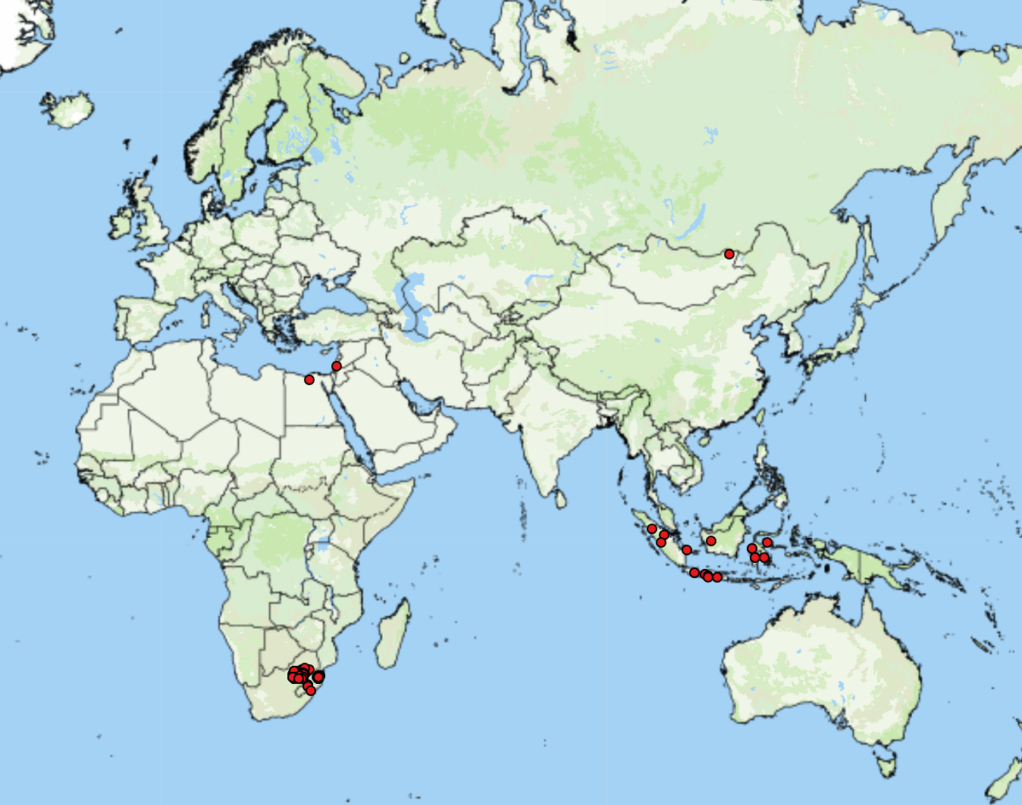
FMD cases globally (since July 14)
Asia
Indonesia (20)
Mongolia (1 O)
Israel (1)
Africa
Egypt (1 SAT-1)
Swaziland (21 SAT-2)
South Africa (97 SAT-2)
https://empres-i.apps.fao.org/general

Slide 12
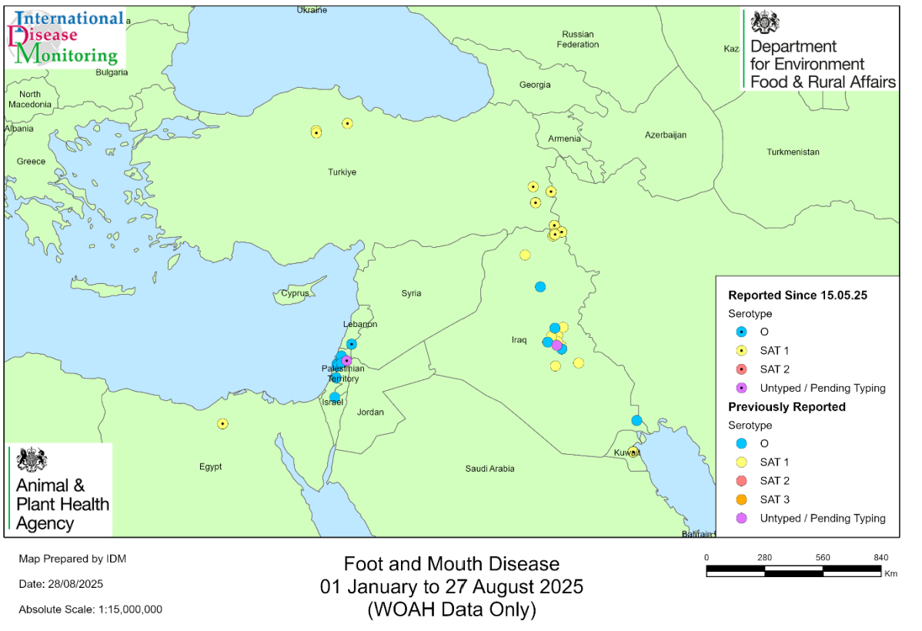
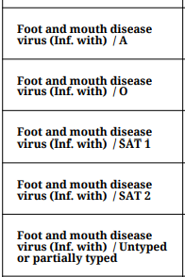



FMD in Türkiye
ADIS outbreaks-current-year-report
FMD_in_the_Middle_East_and_North_Africa_POA.pdf

Slide 13
Scientific Findings
Spatiotemporal Dynamics of Emerging Foot-and-Mouth Disease, Bluetongue, and Peste Des Petits Ruminants in Algeria – PubMed
First isolation and characterization of caprine parainfluenza virus type 3 from cattle in China – PubMed
Evidence of Crimean–Congo hemorrhagic fever virus in livestock and wildlife in Northeastern Portugal | Scientific Reports

