Slide 1
Community for Emerging and Zoonotic Diseases
Identifying emerging risks through collective intelligence
CEZD – CAHSS Small Ruminant Network Update
14 January 2026
www.cezd.ca

Slide 2


Asian Longhorn Tick in the USA
Kansas reported its first detection in October 2025
  Found on a dog in Franklin County
25 states + Washington D.C. now affected
Emergence of multidrug-resistant Haemaphysalis longicornis populations in China – PubMed
Studies available so far in N. America indicate no resistance yet here
  Baseline susceptibility of Haemaphysalis longicornis to organophosphate, carbamate, and pyrethroid acaricides - Bickerton - 2023 - Pest Management Science - Wiley Online Library
  Spray and Pour-On Acaricides Killed Tennessee (United States) Field-Collected Haemaphysalis longicornis Nymphs (Acari: Ixodidae) in Laboratory Bioassays 2021
Asian Longhorned Tick Situation Report - The Tick App

Slide 3
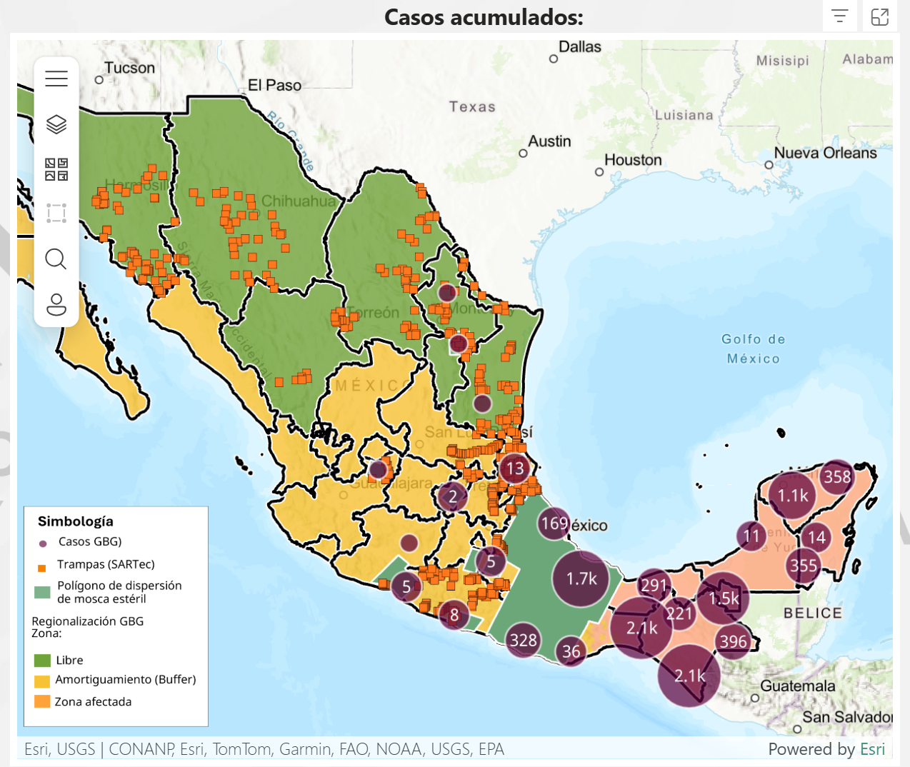
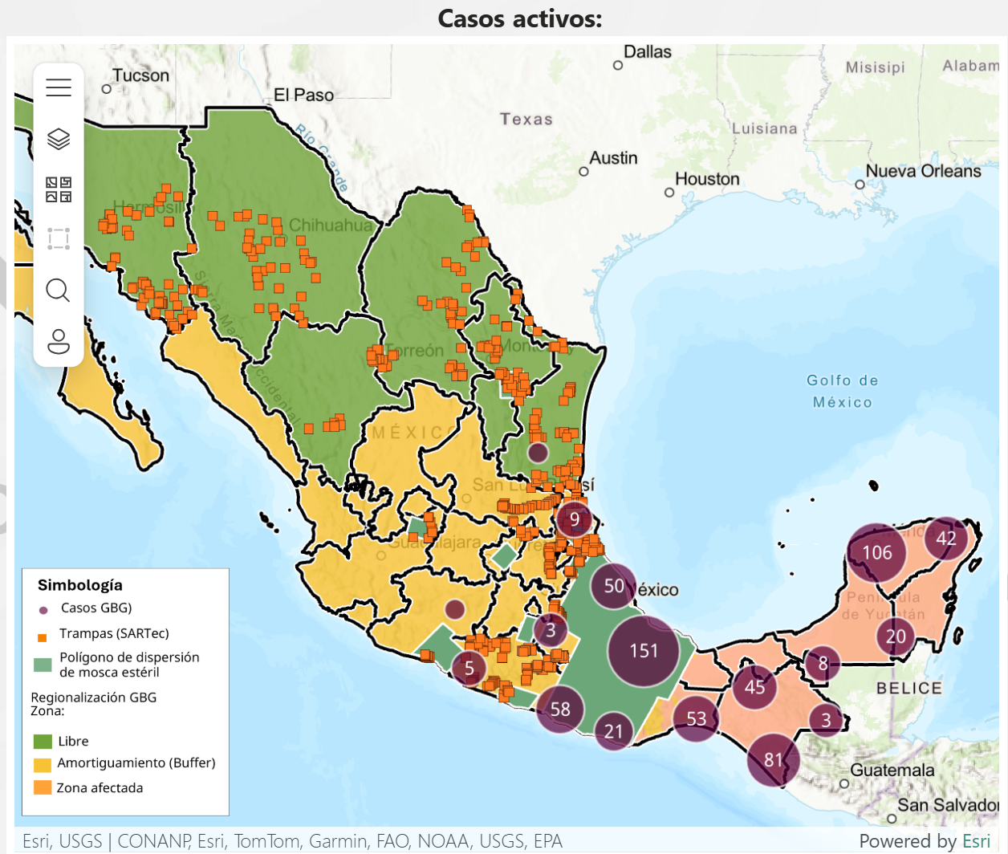
New World Screwworm
Mexico has reported two cases of NWS in Tamaulipas (bordering US) the first detections in this state
3rd case of NWS in Nuevo Leon (bordering US) a bovine imported from Veracruz, 1st case in Michoacán
Continued increase in cases in animals and humans
Alternate management strategy being piloted in Yucatan to decrease total fly numbers before release of sterile flies
“For sterile flies to be effective, there must be 10 of them for each fertile fly”
Mexico’s interactive dashboard displays 492 active cases of NWS in animals (13,335 cumulative) as of Jan 12
Mexico – 360 cases in sheep, 68 cases in goats
Notes:
Mexico reported its first case of NWS in Tamaulipas - in a 6-day old calf (no reports of it being imported from another region) - they also reported a case in Altimira in a horse – which could mean the fly has reached the region.
This is also the same region where the new sterile fly dispersal facility was opened (Tampico, Mexico); which aims to increase the range and number of sterile flies being released and allow for a greater ability to push the pest south.
Mexico has reported a third case of NWS infestation in Nuevo Leon, again in a bovine imported from a southern affected region (Veracruz)
Mexico's dashboard shows 692 active cases with 13,217 cumulative cases in animals. A recent report also mentioned the impact of pets, with ~1602 cases reported in dogs and 32 cases in cats
This will be very important for Canadian vets to be aware of in case of animals coming in via Rescues or travelling companions.
Mexico has also reported additional human cases of NWS infestation, bringing the total number to 106 as of Dec 13 (Chiapas = 86, Campeche = 4, Tabasco = 2, Yucatan = 8, Oaxaca = 2, and QuintanaRoo = 4)

Slide 4


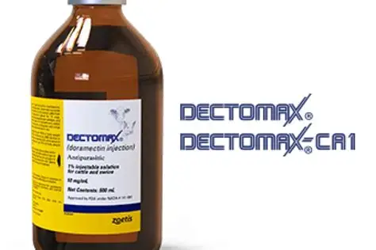
New World Screwworm
USA Emergency Use Authorizations
  Credelio Cat
  Credelio Dog
Efficacy of lotilaner against myiasis caused by Cochliomyia hominivorax (Diptera: Calliphoridae) in naturally infested dogs | Parasites & Vectors
US FDA Conditionally Approved Treatments
  Credelio Quattro-CA1 (Elanco) chewable tablets for dogs
  Exzolt Cattle-CA1 (Merck) fluralaner topical solution for beef cattle (>2 months of age) and replacement dairy heifers (<20 months of age)
  Dectomax-CA1 (Zoetis) injectable for cattle, 35-day withdrawal for cattle, not for use in dairy >20 months of age
Notes:
Washington, D.C., December 17, 2025—Today, the U.S. Food and Drug Administration conditionally approved Credelio Quattro-CA1 (lotilaner, moxidectin, praziquantel, pyrantel) chewable tablets for the treatment of infestations caused by New World screwworm (NWS) larvae (myiasis) in dogs and puppies at least eight weeks of age and weighing at least 3.3 pounds.
Washington, D.C., December 4, 2025—Today, the U.S. Food and Drug Administration conditionally approved Exzolt Cattle-CA1 (fluralaner) topical solution for the prevention and treatment of New World screwworm (NWS) larval infestations, and the treatment and control of cattle fever tick in beef cattle 2 months of age and older and replacement dairy heifers less than 20 months of age.

Slide 5
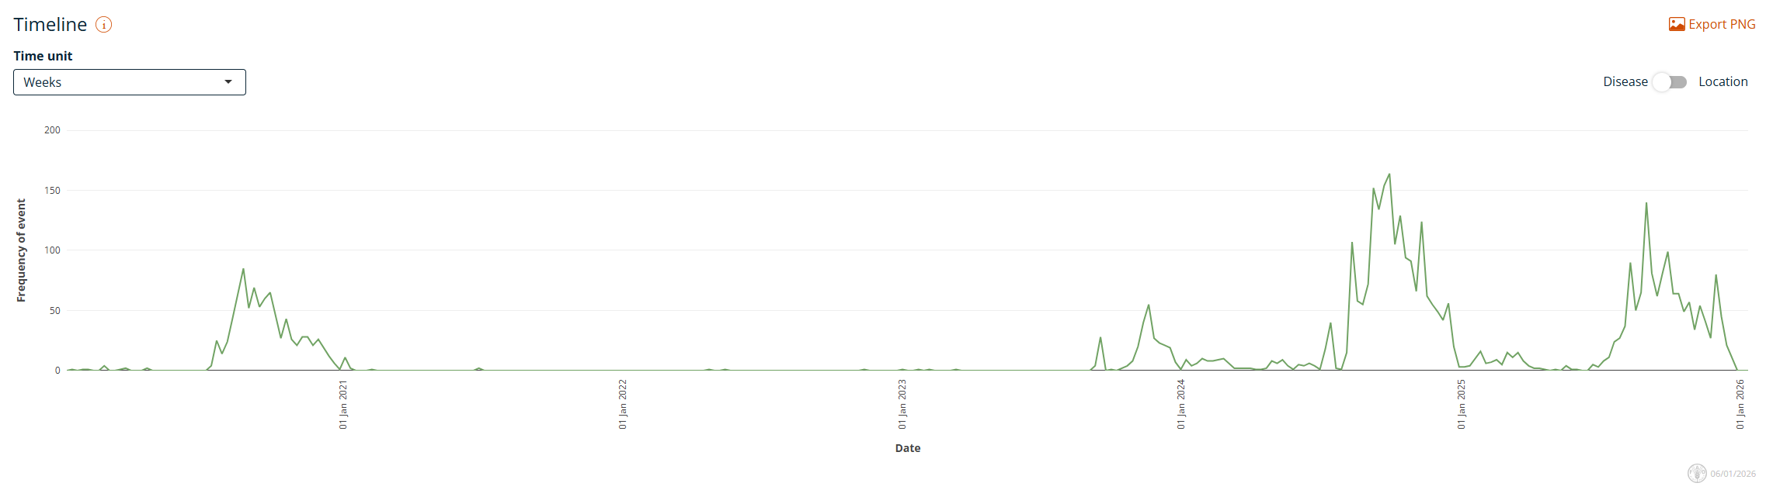
Bluetongue virus in Europe
Europe still reporting cases of BTV (serotypes 3, 4, 5, and 8)
Including ongoing case reports in the winter in UK of BTV-3, previous cases in cattle hadn’t had clinical signs
Empres-Plus
Notes:
The total number of BTV-3 cases in Great Britain for the 2025 to 2026 vector season (since July 2025) is 91. There have been: 87 cases in England 4 cases in Wales The total number of BTV-8 cases in Great Britain for the 2025 to 2026 vector season (since July 2025) is one. This case was in England.
Italy recently reported BTV-5 in sheep in Sardinia, the first recorded occurrence of BTV-5 in Europe

Slide 6
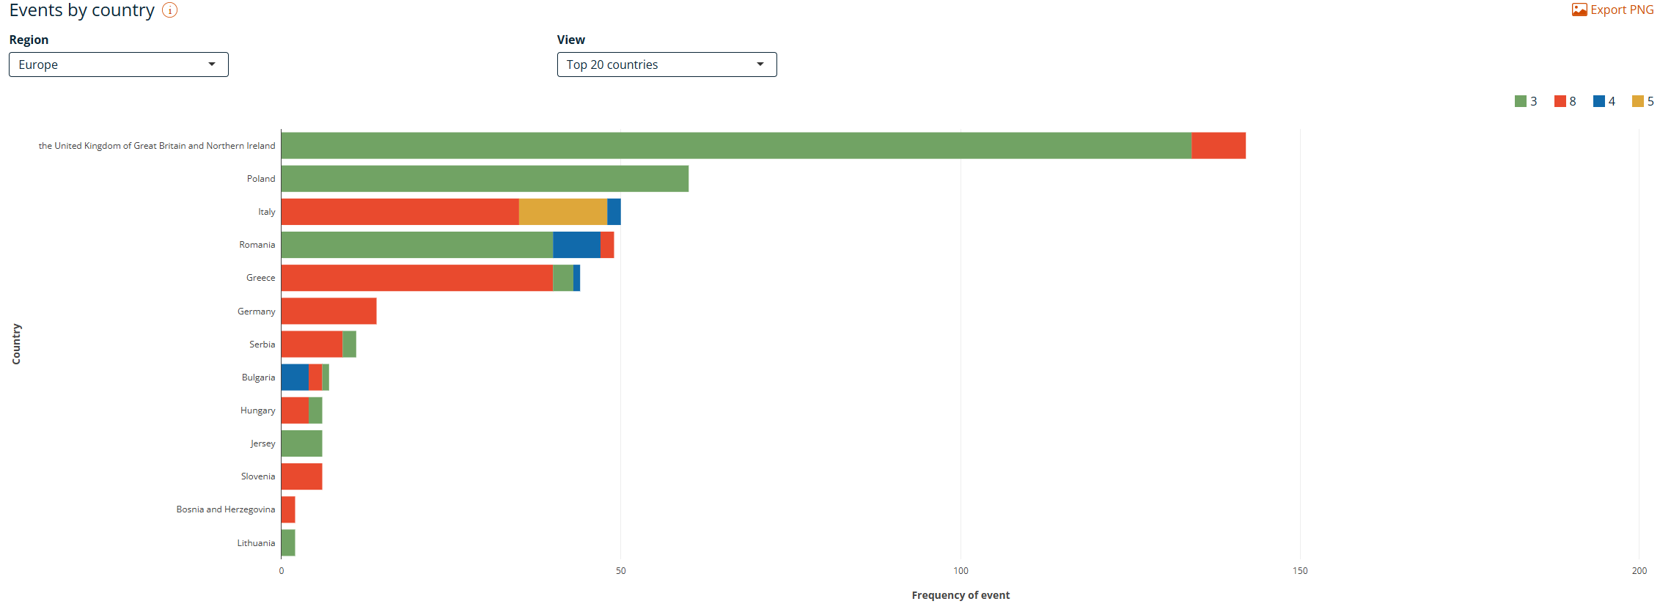
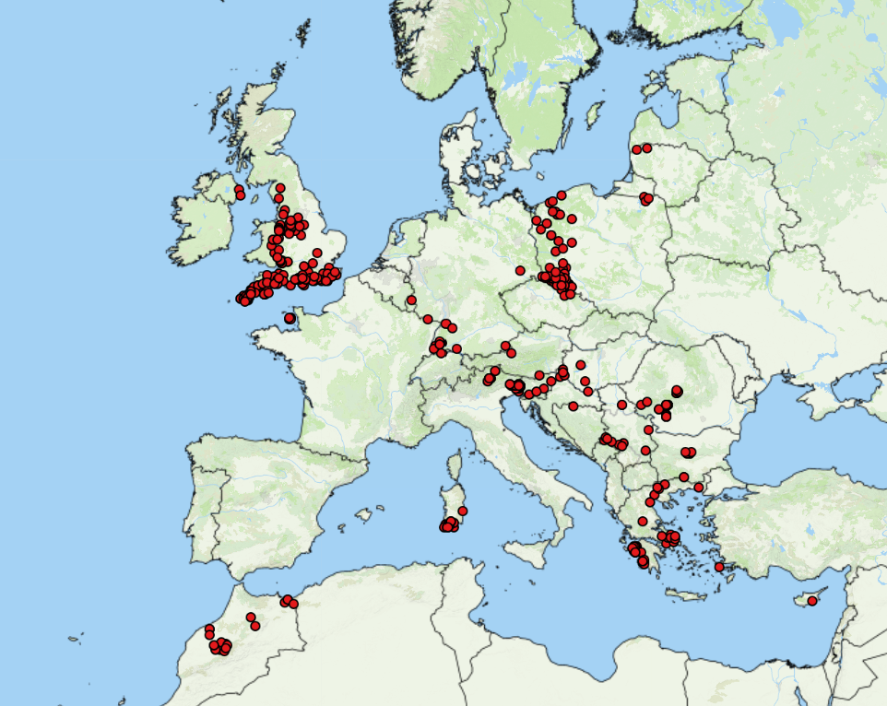
Bluetongue virus in Europe
Empres-Plus
BTV cases October 15, 2025 – January 6, 2026

Slide 7
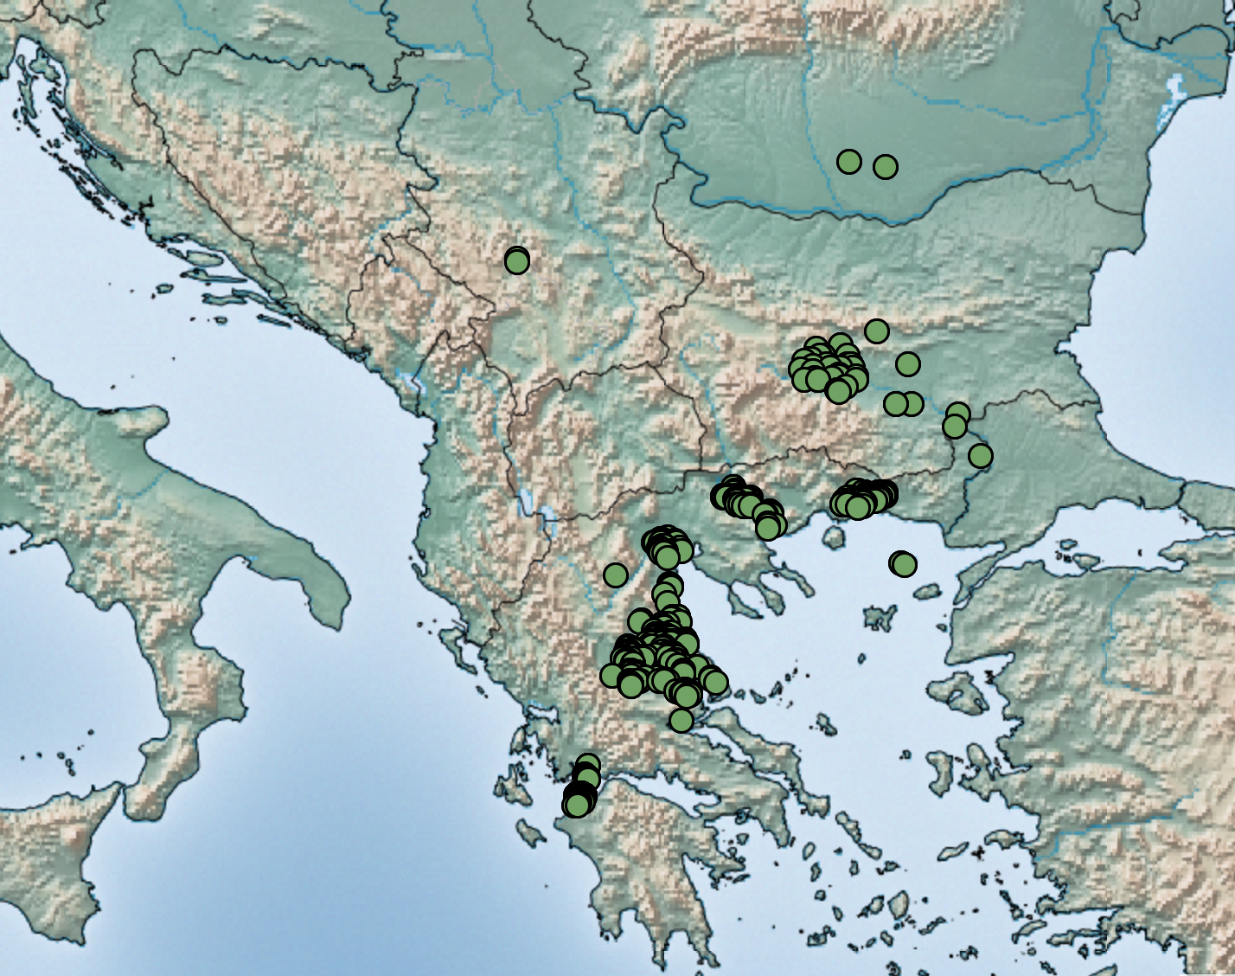
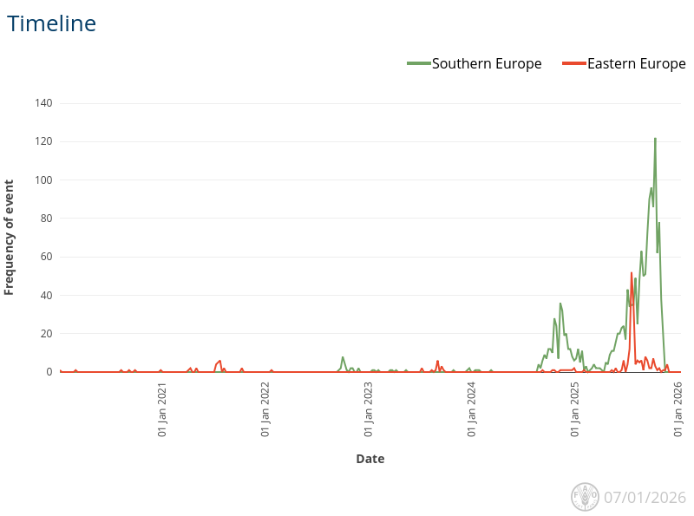

Sheep Pox and Goat Pox in Europe
Greece continues to report cases of SGP, with almost 500,000 sheep and goats culled, potentially affecting the global supply of feta cheese
Bulgaria has ongoing cases
Serbia 3 cases in October, now listed as resolved
Romania has also recently reported cases of SGP, appears to be under control
Risk assessment: sheep pox and goat pox to Great Britain from EU and EFTA member states - GOV.UK

Slide 8
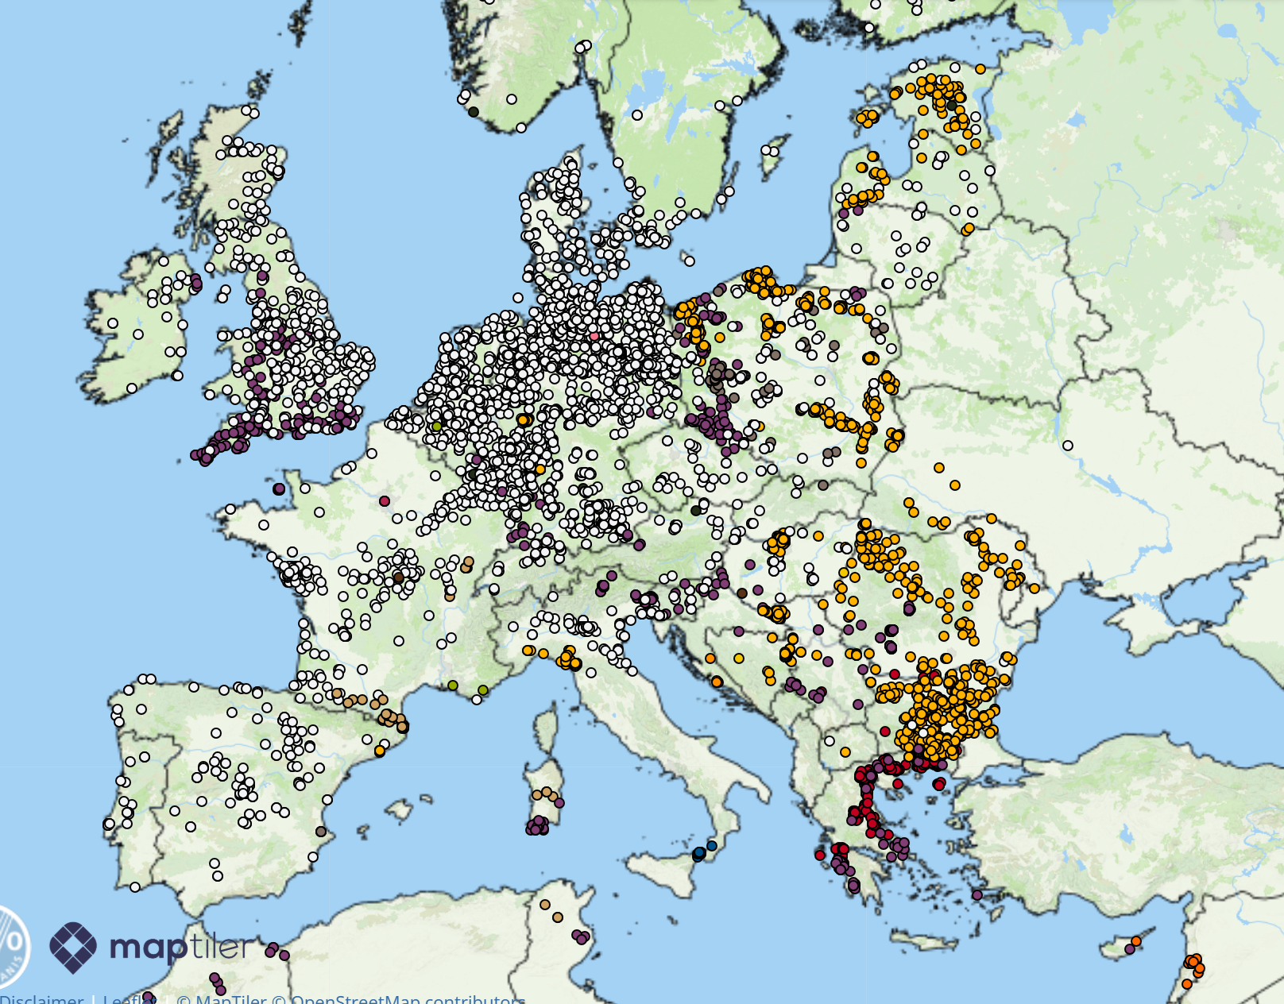
High consequence diseases in Europe
Since October 13th
Sheep Pox and Goat Pox
Bluetongue
African Swine Fever
Highly Pathogenic Avian influenza
Lumpy Skin Disease
West Nile Virus
Foot and Mouth Disease
Newcastle Disease
Empres-i +

Slide 9
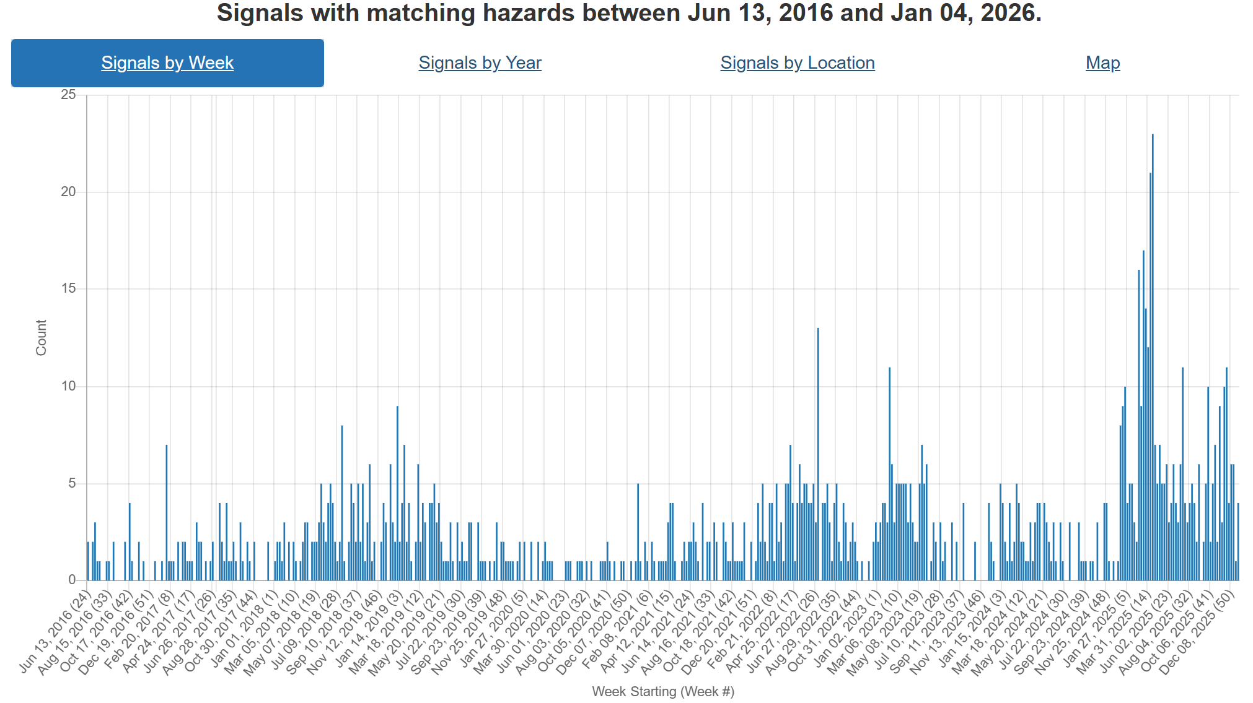
Foot and Mouth Disease – Hazard Trend
Slovakia
COVID
Indonesia
SAT-2
Middle East
Hungary
Germany
SAT-1
Middle East
Notes:
FMD trends over the last ~9 years. Can see increasing activity in recent years starting with its spread to Indonesia, than emergence of SAT-2 in the Middle East. This year Europe reporting cases in Germany, then Hungary and Slovakia. In addition there has been emergence of serotype SAT-1 in the middle East and Türkiye as well.

Slide 10
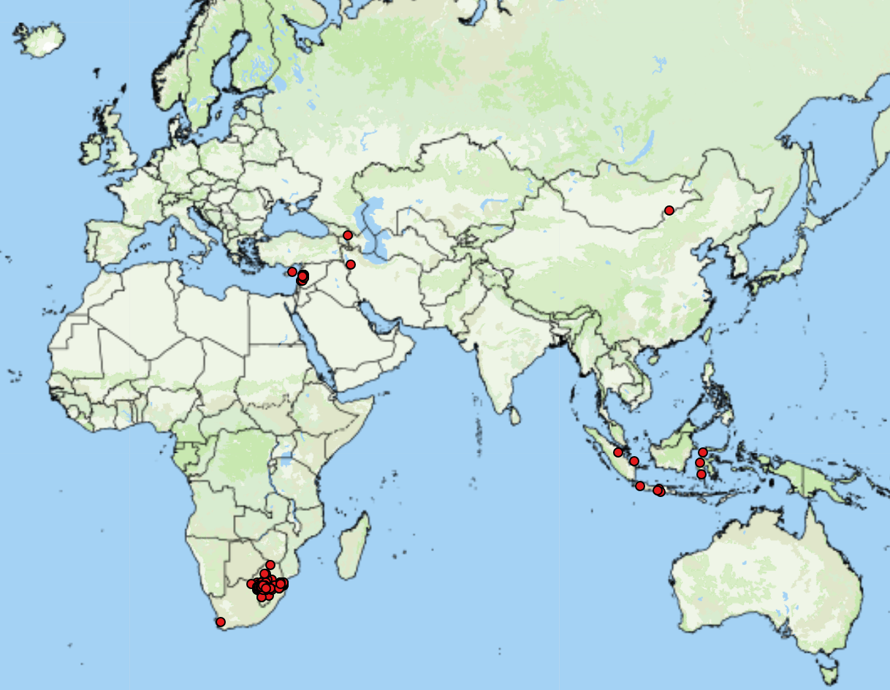
FMD cases reported by FAO Empres-i (since October 15, 2025)
Asia (underestimates)
Azerbaijan* (1 SAT-1)
Cyprus* (1 SAT-1)
Indonesia (9 no serotype)
Iran* (1 SAT-1)
Lebanon* (53 no serotype)
Mongolia (1 O)
Africa
Swaziland (38 SAT-1, 4 SAT-2)
South Africa (182 SAT-2)
Mozambique* (1 SAT-1)
Egypt (SAT-1)
53
https://empres-i.apps.fao.org/general
Notes:
* Indicate first reports
Two separate outbreaks of FMD have been confirmed in Turkish-controlled Northern Cyprus. These are the first FMD outbreaks in Cyprus since 2007. One outbreak was detected in Ayios Sergios, and four cases were reported in cattle at a farm in Lapithos, ~75 kms to the north-west of Ayios Sergios. Laboratory testing by the Turkish Foot and Mouth Research Institute in Ankara identified the SAT1 serotype as the causative agent. Approximately 13,000 animals, including cattle, sheep, and goats, are being vaccinated by 35 teams across Northern Cyprus. The spread of FMD into Cyprus, and several other countries, was considered as "likely” by a recent FAO risk assessment
Azerbaijan has reported its first cases of FMD SAT-1. Two cases were reported in cattle in a farm in Ganja-Qazakh that kept both cattle and small ruminants. Control measures (zoning, monitoring, movement restrictions, culling, and disinfection) have been implemented, however no vaccination has been carried out as the vaccine for this serotype is currently unavailable.
Iran has confirmed the detection of FMD SAT-1 topotype 3 (with reported rapid spread in Tehran province), and has begun work on developing a vaccine for the serotype
Lebanon has reported two outbreaks of FMD (serotype pending) in Bekaa. Lebanon last reported FMD in 2008. Two outbreaks were reported, one in a large cattle farm in West Bekaa and the other in a small farm in Zahleh.
Egypt has reported increasing cases of FMD in livestock, specifically in Lower Egypt and the Delta, along with low vaccine uptake from farmers

Slide 11
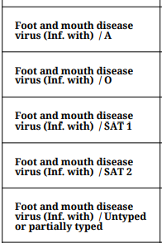



Foot and mouth disease in North Africa and the Middle East - GOV.UK
Türkiye
Lebanon
  WAHIS – 53 total outbreaks as of December 30th
Cyprus
  No official reports to WOAH or ADIS
  News reports indicate SAT-1 outbreak
  Ministry of Agriculture: Foot-and-mouth disease outbreak confirmed, emergency action plan in force - Kıbrıs Newspaper - Kıbrıs News, TRNC Breaking and Agenda News
Assessment of Foot‐and‐Mouth Disease Trends in Türkiye Between 2005 and 2025 - Pedro Mil-Homens - 2025 - Transboundary and Emerging Diseases - Wiley Online Library
ADIS Notification - TRACES NT – 2025 Summary Report
ADIS outbreaks-current-year-report – updated weekly

Slide 12
FAO - Rapid risk assessment: FMD SAT-1
Country | Likelihood/Uncertainty | Impact/Uncertainty
Afghanistan | Likely/High | Severe/Moderate
Armenia | Likely/Moderate | Low/Moderate
Bulgaria | Unlikely/Low | Low/Low
Cyprus | Likely/Moderate | Low/Moderate
Georgia | Very Likely/Moderate | Moderate/Moderate
Greece | Likely/Moderate | Low/Low
Israel | Likely/Moderate | Low/Moderate
Jordan | Likely/High | Moderate/High
Lebanon | Likely/High | Moderate/High
Libya | Very Likely/High | Severe/High
Country | Likelihood/Uncertainty | Impact/Uncertainty
Oman | Likely/Moderate | Low/Moderate
Pakistan | Likely/Moderate | Severe/Moderate
Qatar | Likely/Low | Low/Low
Russian Federation | Likely/High | Moderate/Moderate
Saudi Arabia | Likely/High | Moderate/Moderate
Syrian Arab Republic | Very Likely/High | Severe/High
Turkmenistan | Likely/High | Moderate/High
United Arab Emirates | Unlikely/Moderate | Low/Low
West Bank & Gaza Strip | Likely/High | Moderate/High
Yemen | Very Likely/High | Severe/High
Notes:
Afghanistan – likelihood – borders with Iran, has low veterinary coverage, populations naïve to SAT-1, no vaccination
Armenia – Likelihood – bordered by countries reported FMD SAT-1 (Azerbaijan, Iran, Turikye) Livestock pop = 1.4 million cattle/ruminants/pigs, launched vaccination against SAT-1 in Sept 2025
Bulgaria- borders Turkikye (trade is informal/limited), Thrace is still FMD-free, no SAT-1 vaccination,
Cyprus – Turkiye animal exports to the island, proximity/connections to Anatolia enhance likelihood
Georgia- outbreak in Azerbaijan near border, also proximity to Turkiye, is mobilizing SAT-1 vaccination, trade in animals/products are potential pathways
Greece – Borders Turkiye, LSD also spread from Turkiye previously, no vaccination, small trade volume of dairy/meat from Bahrain 2021/Turkiye 2023/ cheese from Egypt 2023
Israel – consistently reporting FMD outbreaks, trade related exposure from Turkiye, land border with Egypt, historical entry from neighbouring countries
Jordan – historical entry from neighbouring countries (SAT-2 in 2023, LSD in 2013), FMD SAT-1 vaccination is available and used., informal movements from Iraq/workers from Egypt
Lebanon – historical entry from neighbouring countries. Porous border from Syria, human mobility from Iraq/Turkiye, low vet capacity
Libya – strong cross border links with Egypt, live cattle imports, porous border. Large ruminant population, limited surveillance.
Oman – imports live cattle from affected countries (Bahrain/Iran/Turkiye), SAT-1 vaccination is applied,
Pakistan - large susceptible population, no SAT-1 vaccination, FMD endemic (multiple serotypes), animal trade is limited, small volume, however informal border movement occurs with Iran
Qatar – imported live sheep from affected countries (Turkiye), had surveillance/control capacity, Susceptible species, SAT-1 vaccination is applied
Russia – has reported previous FMD outbreaks, trade related pathways exist with Azerbaijan/Egypt/turkiye, cross border movement of people in the regions as well
Saudi Arabia – No recent imports from affected countries, SAT-1 vaccination not widely used, large national and informal trade with Bahrain/Kuwait/Yemen (with people and vehicle as well)
Syrian Arab Republic – borders with affected countries/Turkiye (porous/uncontrolled), no SAT-1 vaccination, susceptible species, vet capacity is weak, unregulated livestock movements
Turkmenistan – Trade risk from Turkiye and Iran, vet capacity is weak, FMD O is endemic
United Arab Emirates – do not import animals from currently affected countries. SAT-1 vaccination not applied, strong border controls, strong vet services, likestock trade limited, but informal movements may occur
West Bank/Gaza Strip – Susceptible livestock common, FMD O reported in 2024, vet services are fragile, no SAT-1 vaccination
Yemen – historically imported live cattle from Egypt, susceptible species common, no SAT-1 vaccination, fragile vet service, uncontrolled borders.

Slide 13
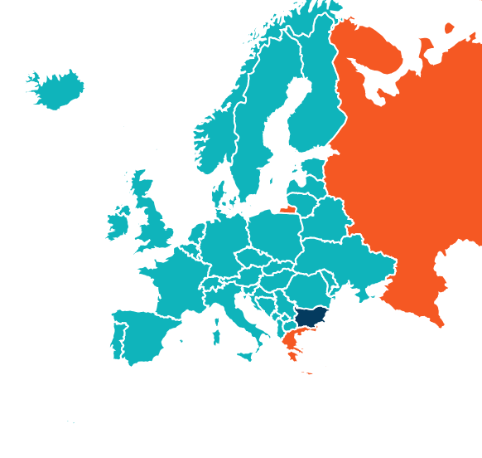
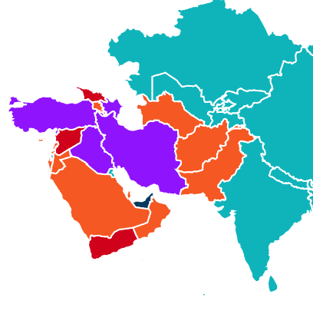

Slide 14
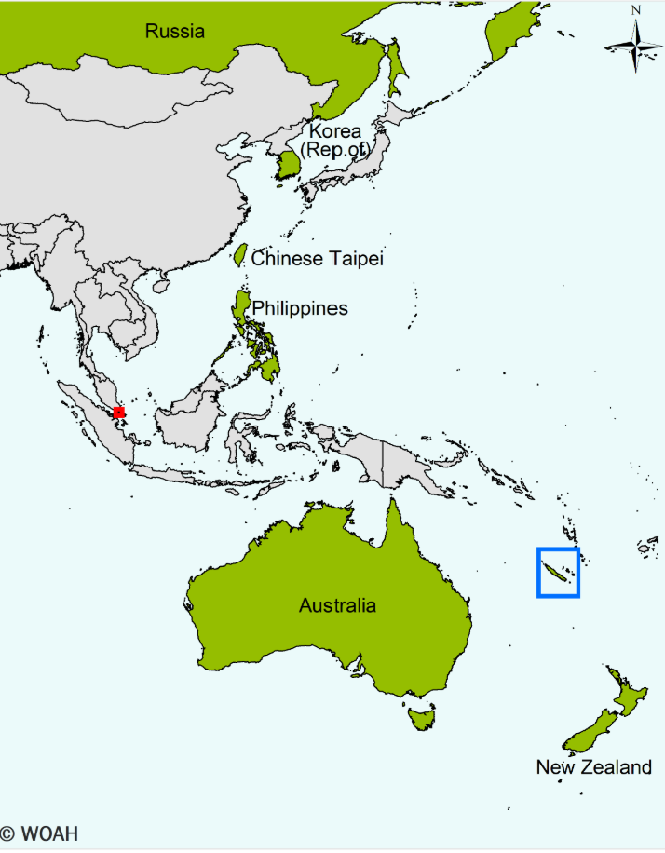
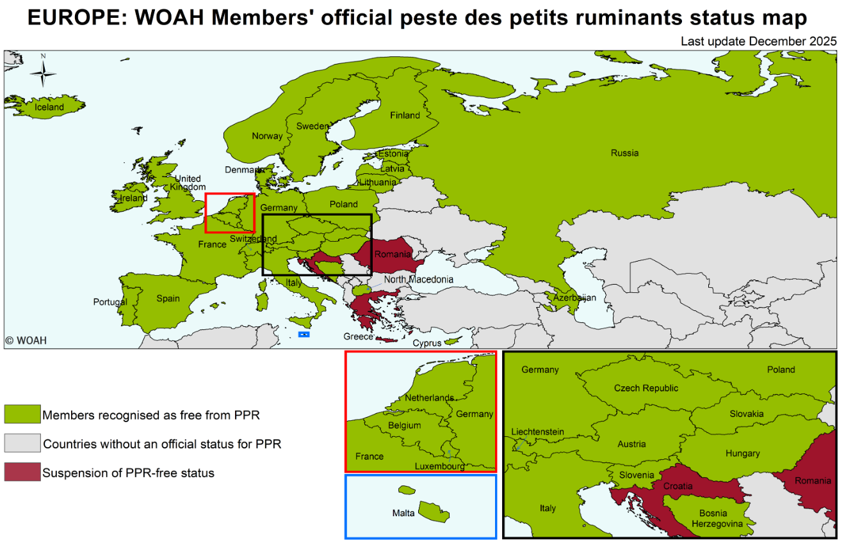
Peste des Petits Ruminants
WAHIS Vietnam
  Reported first cases in Vietnam, however it is surrounded by countries without official disease status
Croatia has reported its first cases of PPR
  “The information established so far about illegal activities points to a possible way for the virus to enter the facility”
Romania and Greece still affected
Peste des petits ruminants - WOAH - World Organisation for Animal Health
Notes:
Croatia has reported its first outbreak of PPR in the country. Fourteen cases of PPR were reported in sheep after reports of abortions. All susceptible animals on the establishment have been culled and preliminary cleaning and disinfection have been completed. An investigation to determine the source of introduction is underway.

Slide 15
Scientific Findings
Exploring influenza A virus receptor distribution in the lactating mammary gland of domesticated livestock and in human breast tissue - Journal of Dairy Science
Spatio-temporal dataset (2009–2012) of Culicoides spp., vectors of livestock viruses, in France | Scientific Data
Assessment of Foot‐and‐Mouth Disease Trends in Türkiye Between 2005 and 2025 - Pedro Mil-Homens - 2025 - Transboundary and Emerging Diseases - Wiley Online Library
Foot-and-mouth disease virus variability and recombination on dairy farms in Pakistan – ScienceDirect
Full article: Bluetongue virus in carnivores: expanding the host range and implications for disease ecology
Comparative metagenomic profiling of microbial pathogen diversity in Haemaphysalis longicornis and Hyalomma dromedarii ticks – ScienceDirect

Slide 16
Scientific Findings
Improving the sex-specificity of a conditional female lethal system for genetic biocontrol of the New World screwworm, Cochliomyia hominivorax | Scientific Reports
Epidemiology and Risk Factors of Ovine Toxoplasmosis: Evidence from a Cross-Sectional Study in Iraq | Acta Parasitologica
Enterovirus E infections in goats with respiratory disease | BMC Veterinary Research
Combination of serology and PCR analysis of environmental samples to assess Coxiella burnetii infection status in small ruminant farms – PubMed
Prevalence of bluetongue serotype 3 following the 2023 epidemic and associated risk factors in Dutch dairy cattle – ScienceDirect
Preparation for a potential outbreak of bluetongue virus in Ireland: surveillance design to estimate local prevalence after an initial case detection - PMC

