Slide 1
Community for Emerging and Zoonotic Diseases
Identifying emerging risks through collective intelligence
CEZD – CAHSS Small Ruminant Network Update
15 April 2026
www.cezd.ca

Slide 2
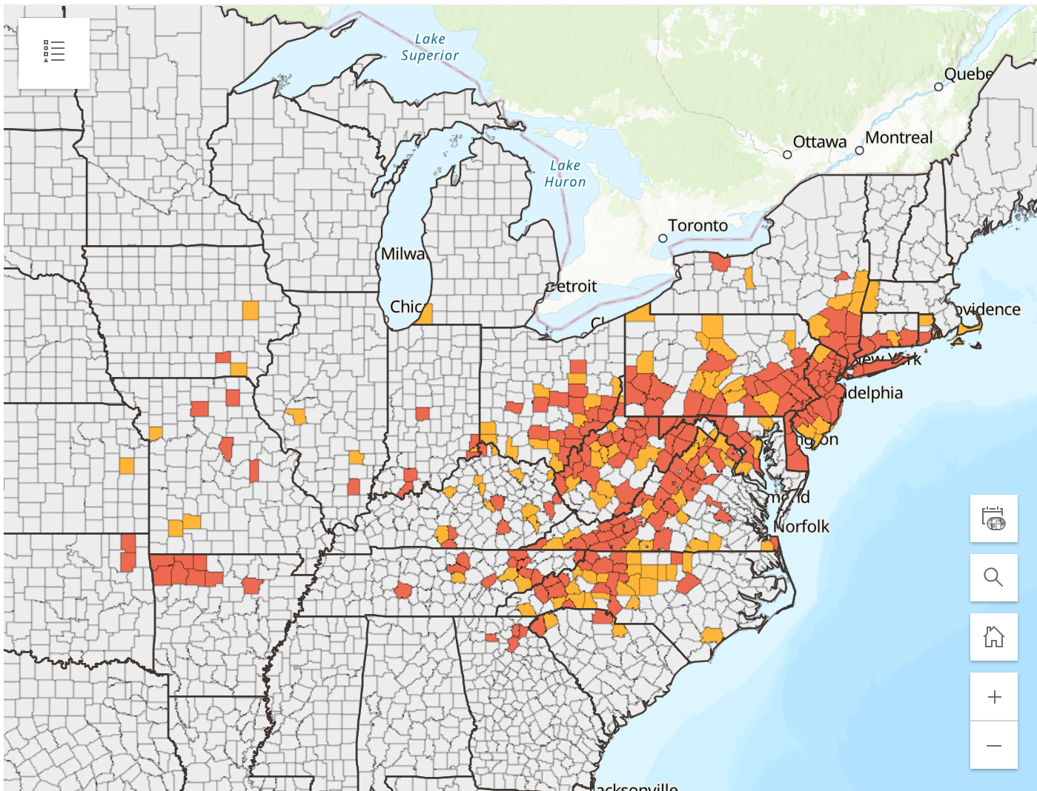
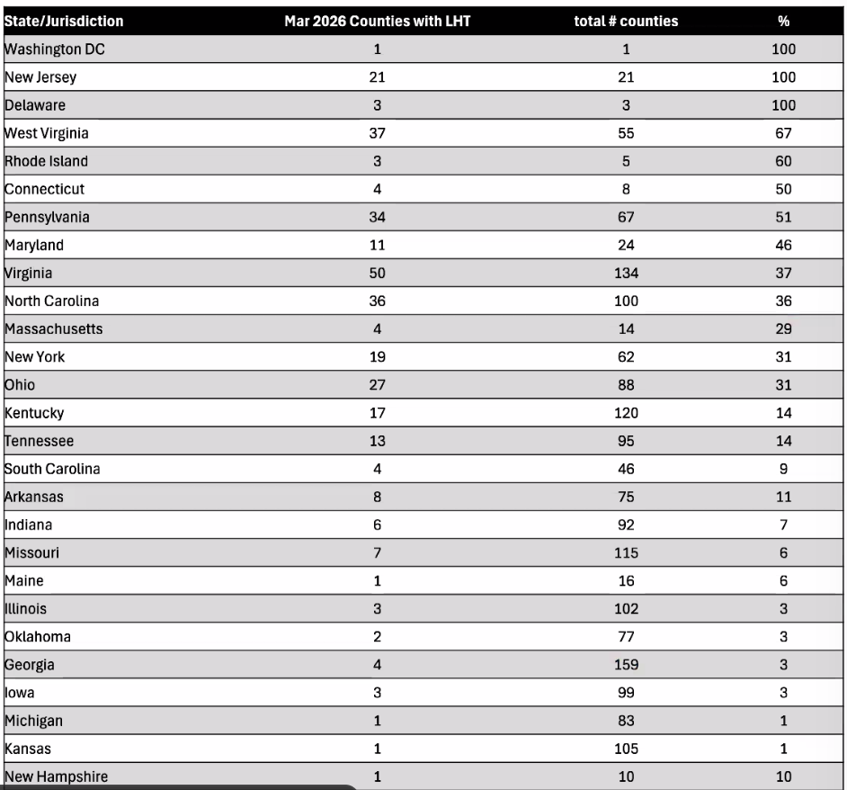
Asian Longhorn Tick in the USA
Since the last CAHSS call, New Hampshire has reported its first ALHT finding
  Collected in June 2025, eastern state border
26 states + Washington D.C. now affected
Haemaphysalis longicornis ticks as a competent vector for ‘Candidatus Mycoplasma haemobos’ in experimental transmission studies
  First experimental proof that H. longicornis transmits ‘Ca. M. haemobos’
  ‘Ca. M. haemobos’ is maintained transovarially and transstadially in ticks
  Sheep and Goats are Susceptible Molecular investigation of “Candidatus Mycoplasma haemobos” in goats and sheep in central China
New Website Now Live:
Red = established
Orange = reported
Haemaphysalis longicornis and Theileria | Exotic and Invasive Vector and Vector-borne Disease
Notes:
Haemaphysalis longicornis is a proven competent vector for ‘Candidatus Mycoplasma haemobos’, able to acquire, maintain, replicate, and transmit the pathogen across all life stages under experimental conditions, with high transmission efficiency to mammalian hosts.
Both transovarial and transstadial transmission occur, allowing the pathogen to persist through the tick’s entire life cycle, highlighting H. longicornis as an important reservoir and vector with significant implications for cattle disease control in endemic regions.
Ca. M. haemobos’ is associated with hemolytic anemia, reduced weight gain, decreased milk production, reproductive losses, and increased susceptibility to co-infections.
Ca. M. haemobos is found in East Asia, Europe and South America.
2

Slide 3
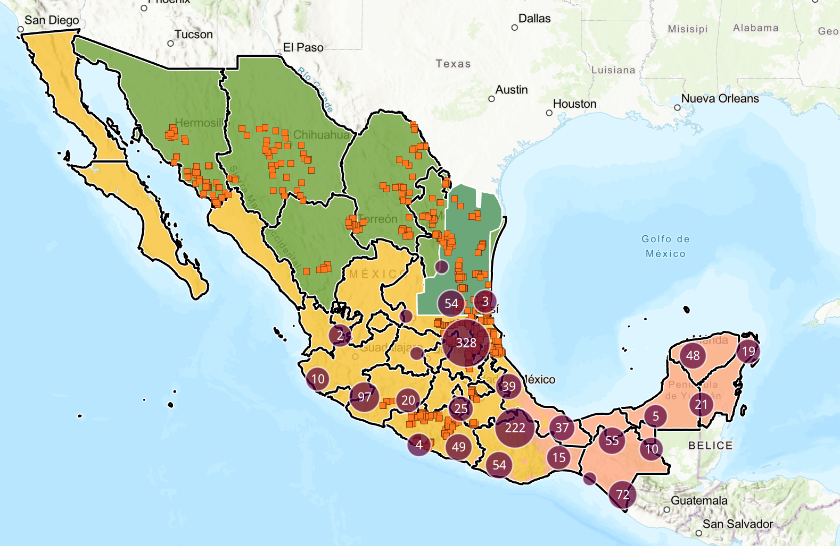
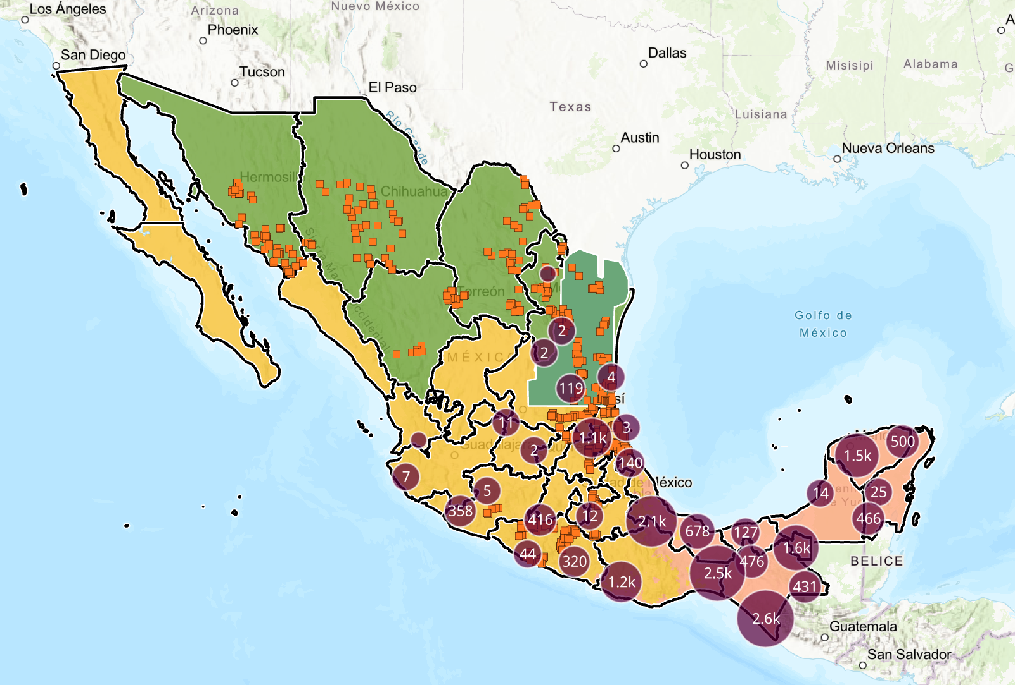
New World Screwworm
Mexico’s interactive dashboard displays 1,188 active cases of NWS in animals (20,444 cumulative)
NWS continues to spread northwest throughout the country, recent cases in Nuevo Leon in dogs show it has become endemic close to the US border
Mexico – 532 cases in sheep, 160 cases in goats
Cases also reported in wildlife (red deer, howler monkey)
Mexico human cases now 204 (primarily in Chiapas)
Honduras reported 76 NWS human cases for 2026
USA - Florida reported NWS in a horse imported from Argentina
February - Sterile fly dispersal facility completed in Texas, dispersal shifted northwards
USA/Mexico border remains closed – recent discussions about limited “reopening strategy”
USDA Released new Response Playbook Emergency Response NWS| Animal and Plant Health Inspection Service
How glow-in-the-dark sterile flies are being used to combat New World screwworm | TPR
Active Cases
Accumulated Cases
3
Notes:
NWS continue to spread northwards and westwards in Mexico, during this time period initial cases were reported in Michoacan, Colima, Guanajuato, Tlaxcala
Red deer in Yucatan reinforcing concerns about its impact on wildlife
The USDA is shifting sterile fly dispersal northwards to include areas of southern Texas, along its shared border with Tamaulipas, Mexico
The USDA also reported that a horse recently imported from Argentina was found to have a NWS infestation upon presentation at an import quarantine facility in Florida
Iridescent dust so can differentiate them from wild flies in traps. USDA APHIS traps - seeing dispersal of flies and seeing if we have any wild flies. Traps in New Mexico, Arizona, California, Texas
3

Slide 4
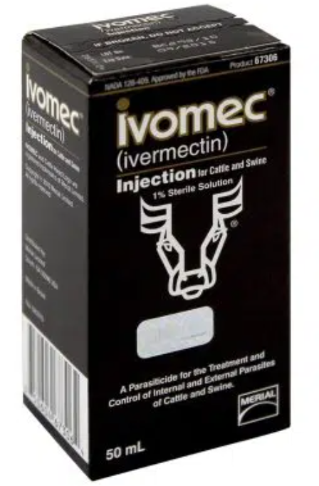
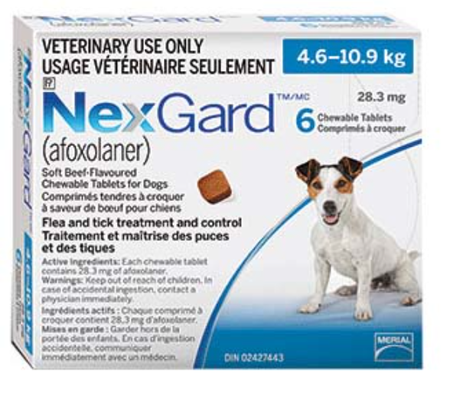
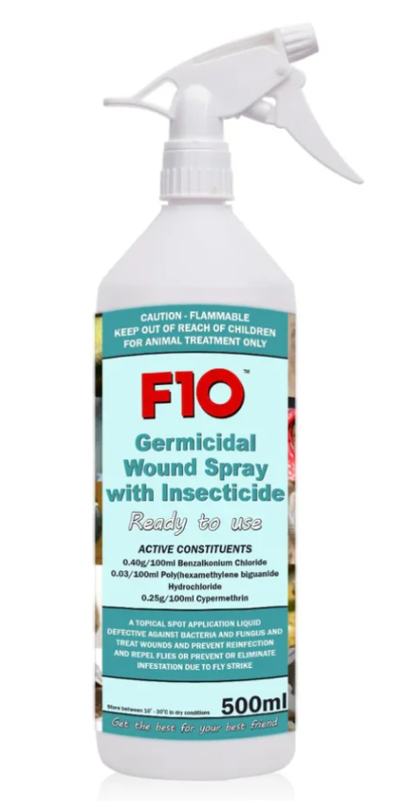
New World Screwworm
Previously - FDA Conditionally Approved Treatments
  Credelio Quattro-CA1 (Elanco) chewable tablets for dogs
  Exzolt Cattle-CA1 (Merck) fluralaner topical solution for beef cattle
  Dectomax-CA1 (Zoetis) injectable for cattle
Recent - FDA Emergency Use Authorizations
Ivomec (10 mg/mL of ivermectin) injectable solution for cattle (excluding female dairy cows)
NexGard (afoxolaner) chewable tablets for the treatment of NWS in dogs & NexGard COMBO (esafoxolaner, eprinomectin, and praziquantel topical solution) for NWS in cats
F10 Antiseptic Wound Spray with Insecticide (benzalkonium chloride, polyhexanide, and cypermethrin topical solution) for the prevention and treatment of NWS
4
Notes:
In the USA, the FDA has issued an emergency use authorization for Ivomec (ivermectin) injectable solution against NWS - in cattle when administered within 24 hours of birth, at the time of castration, or when a wound appears, and the known and potential benefits of the product outweigh its known and potential risks.
except for female dairy cattle producing milk for human consumption and calves that will be processed for veal.. The slaughter withdrawal period for cattle is 35 days.
The FDA has issued two Emergency Use Authorizations for drugs to treat NWS in pets – one for NexGard (afoxolaner) chewable tablets for the treatment of NWS in dogs, and the second for NexGard COMBO (esafoxolaner, eprinomectin, and praziquantel topical solution) for the treatment of NWS myiasis in cats
The FDA has issued an Emergency Use Authorization for F10 Antiseptic Wound Spray with Insecticide (benzalkonium chloride, polyhexanide, and cypermethrin topical solution) for the prevention and treatment of NWS infestations
. prevention and treatment of NWS myiasis in cattle, horses, minor species of hoof stock (e.g., sheep, goats, deer), raptors and other wild birds, pet birds, and captive wild, exotic, and zoo mammals, and the known and potential benefits of the product outweigh its known and potential risks. F10 Antiseptic Wound Spray with Insecticide may not be used in domestic dogs and cats.
4

Slide 5
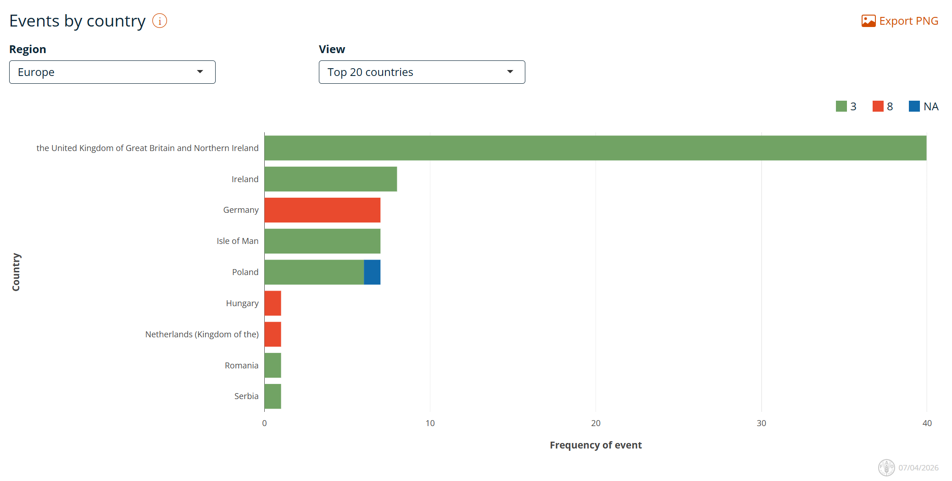
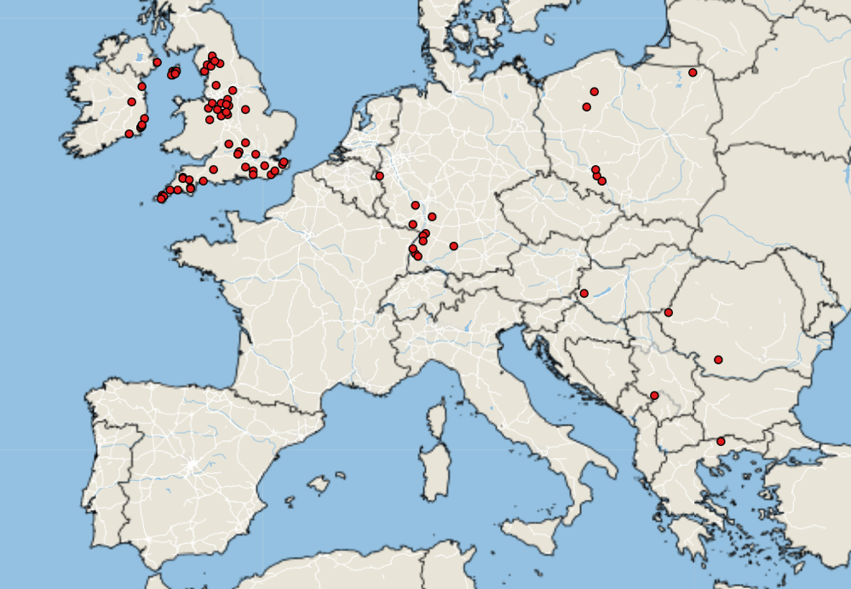
Bluetongue virus in Europe
Empres-Plus
BTV cases January 1, 2026 – April 7, 2026
Notes:
Reduced BTV activity over winter but some countries still reports cases, mostly in cattle but some sheep/goats affected as well. BTV-3 remains the most prominent, with some cases of BTV-8 reported in Germany, Hungary, and the Netherlands. Ireland and the UK have continued to reports cases of BTV-3 over the winter.
5

Slide 6
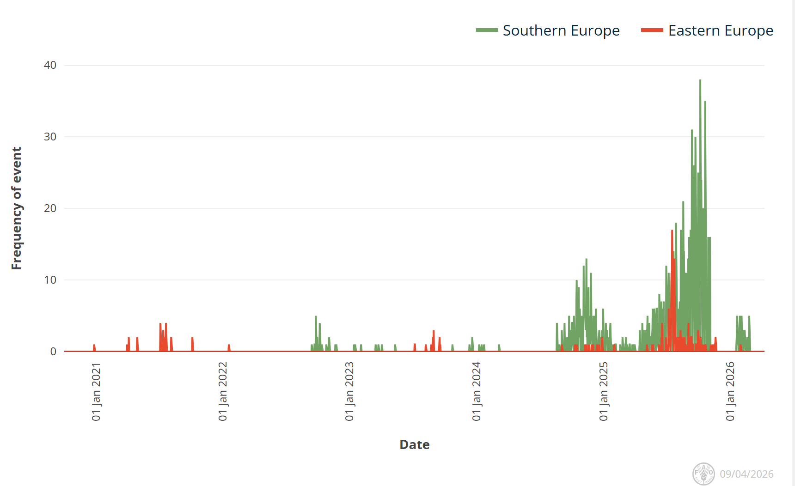
Sheep Pox and Goat Pox in Europe
Cases have declined significantly this winter
Greece continues to report cases of SGP, 117 since January 1, 2026
Bulgaria has had one additional case
North Macedonia reporting their first case close to the Serbian Border

Slide 7
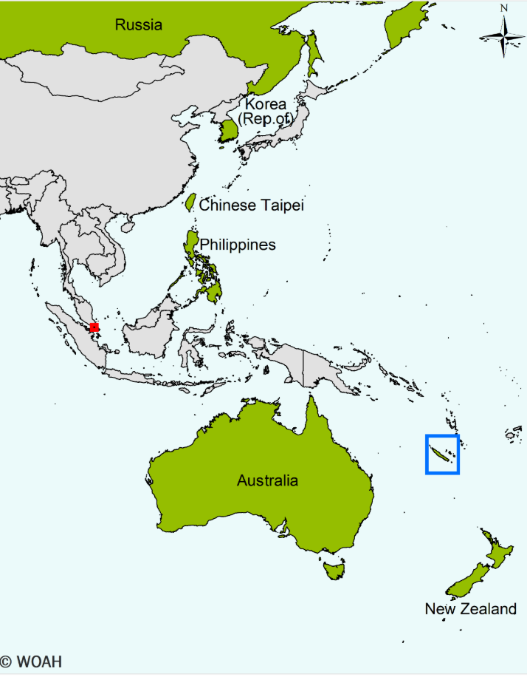
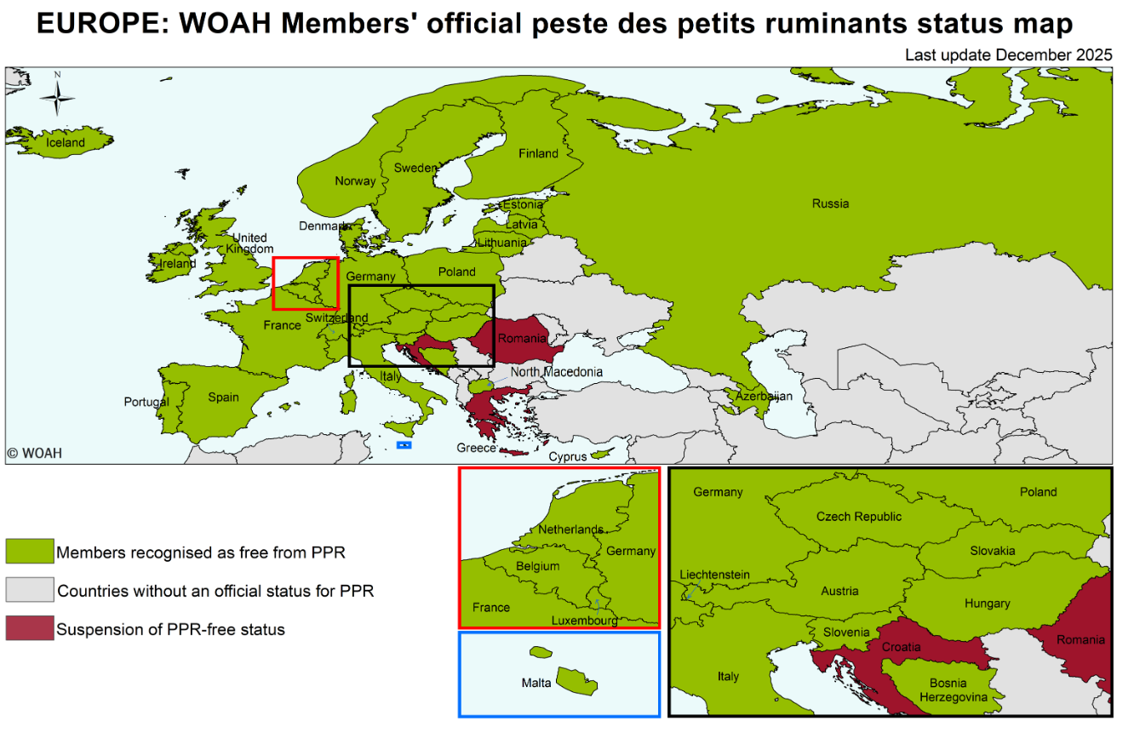
Peste des Petits Ruminants
WAHIS Vietnam
  Reported first cases in Vietnam, however it is surrounded by countries without official disease status
Croatia has reported its first cases of PPR
  “The information established so far about illegal activities points to a possible way for the virus to enter the facility”
Romania and Greece still affected
Peste des petits ruminants - WOAH - World Organisation for Animal Health
Notes:
This is the slide from last time showing Croatia, Romania and Greece with loss of PPR free status.
Croatia has reported its first outbreak of PPR in the country. Fourteen cases of PPR were reported in sheep after reports of abortions. All susceptible animals on the establishment have been culled and preliminary cleaning and disinfection have been completed. An investigation to determine the source of introduction is underway.

Slide 8
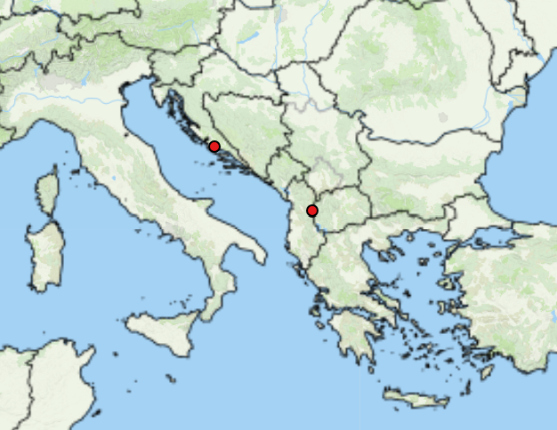
Peste des Petits Ruminants
Two new outbreaks in Europe since Jan 1st
  Croatia (1)
  Albania (1)
Global situation
  Africa – endemic
  Middle East – endemic
  Asia – large areas endemic
WOAH Control and Eradication Strategy

Slide 9
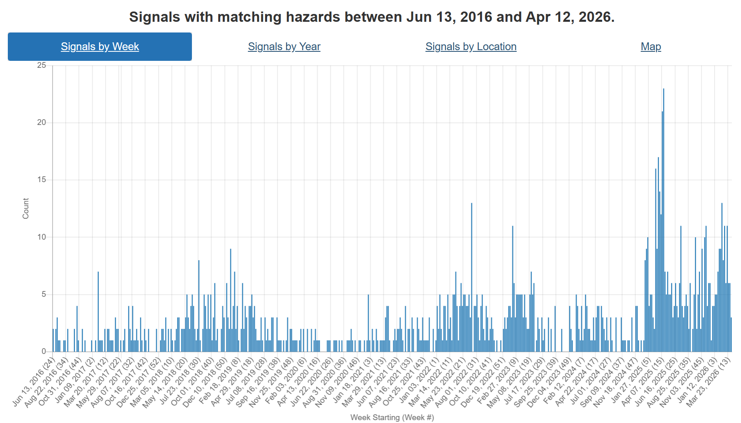
Foot and Mouth Disease – Hazard Trend
Slovakia
COVID
Indonesia
SAT-2
Middle East
Hungary
SAT-1
Middle East, Europe, China
Germany
Notes:
FMD trends over the last ~10 years. Can see increasing activity in recent years starting with its spread to Indonesia, than emergence of SAT-2 in the Middle East. Early 2025 we saw Europe reporting cases in Germany, then Hungary and Slovakia. In addition there has been emergence of serotype SAT-1 in the Middle East and Türkiye, followed be Eastern Europe and now most recently China.

Slide 10
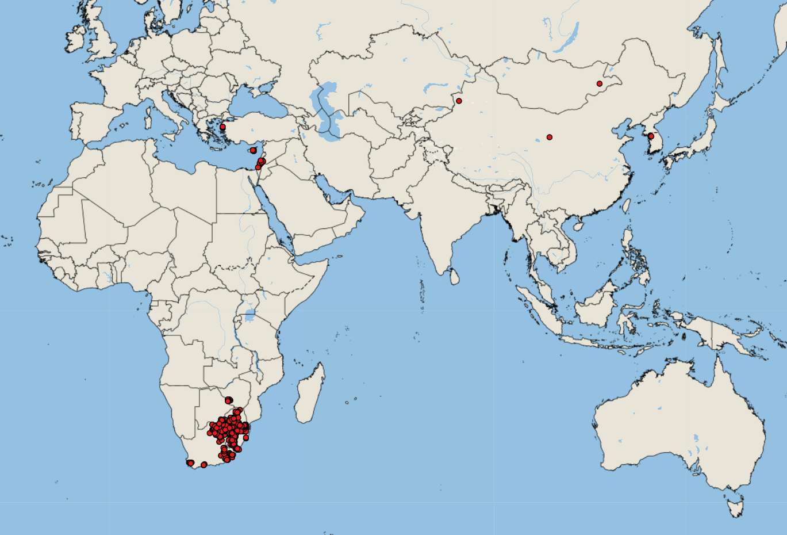
FMD cases reported by FAO Empres-i (since January 1, 2026)
Asia (underestimates)
Cyprus (33 SAT-1 Topotype III) - 66 outbreaks*
China (SAT-1) - 2 outbreaks*
Israel (5 SAT-1)
Palestine (SAT-1)* - 1 outbreak
South Korea (3 O)
Mongolia (1 O)
Iraq* (Topotype III)
Africa
Swaziland (40 SAT-1, 3 SAT-2, 4 N/A)
South Africa (318 SAT-2)
Botswana (5 SAT-1, 1 N/A)
Lesotho (6 N/A)
Zimbabwe (2 SAT-1)
53
https://empres-i.apps.fao.org/general
Notes:
*Indicate not reported in EMPRES-I or different outbreak counts
Lesotho has reported its first outbreak of FMD (untyped) in the country. Six cases of FMD were confirmed in cattle in Butha-Buthe. These case are not unexpected as South Africa is currently experiencing its worst-ever FMD outbreak, with cases reported in nearly all provinces and mass vaccination underway.
South Korea reported a reoccurrence of FMD, after nine months without any outbreaks, with three outbreak of FMD type O

Slide 11
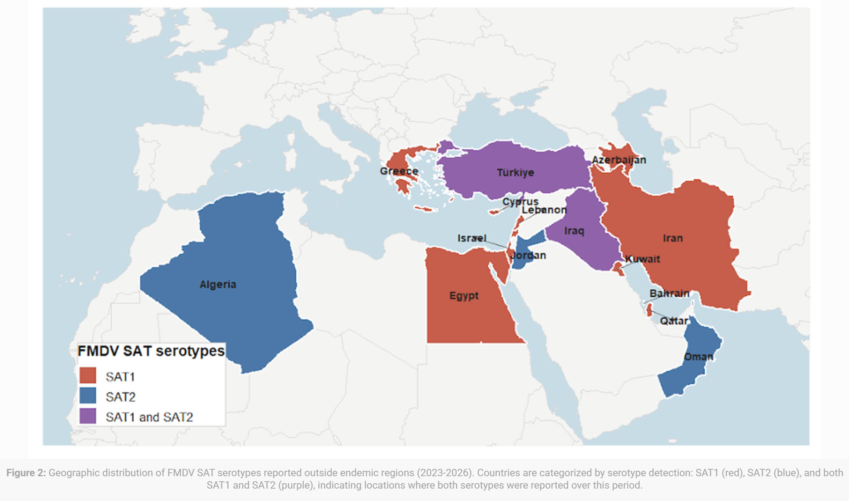
FMD SAT-1 Spread
Emergence and Global Expansion of Foot-and-Mouth Disease Virus Serotype SAT1 – Swine Health Information Center
Since 2025, SAT-1 has expanded beyond its traditional range in sub–Saharan African, with confirmed detections in Western Asia, Middle East, and Europe - a significant shift in global FMD epidemiology
Two co‑circulating SAT-1 topotypes (SAT-1/I and SAT-1/III) have been identified in newly affected regions, suggesting multiple introductions or rapid regional spread
This expanding geographic range increases the risk of transboundary spread, including potential incursions into South‑East Europe and other previously unaffected region
Topotype I
Topotype III
Reference Laboratory Reports | World Reference Laboratory for Foot-and-Mouth Disease
Notes:
Türkiye – reported 50 outbreaks of SAT-1 so far this year (ADIS data).

Slide 12
FMD SAT-1 in Europe (Cyprus and Greece)
Cyprus
  On December 13 2025, FMD SAT-1, was reported for the first time on a cattle farm in Lapetos, in Northern Cyprus (Turkish region – no official reports)
  On February 21, 2026, FMD SAT-1 outbreaks were reported in Larnaca spread via contaminated hay (EU control – official reports)
  No impacts on Halloumi cheese imports
  EU - Total number of outbreaks now 70 across two regions (Larnaca and Nicosia)
  Second phase of vaccination 67% cattle, 44% sheep/goats, 84% swine in infected zones
  SAT-1 Topotype III
Greece
  On March 16 2026, FMD SAT-1 was reported on Lesvos Island
  First FMD outbreak since after 1994, 32 years ago
  Total number of outbreaks now 22
  Source of introduction – unknown but similar to Cyprus, the island of Lesvos is very close to Türkiye (4km)
  No vaccination, focus on culling and biosecurity measures in order to keep disease free status for international trade
Notes:
Unclear if more outbreaks in Turkish regions
Cyprus - The second phase of vaccinations has reached 67 per cent of cattle, while coverage among sheep and goats stands at 44 per cent.
In pig farms located within infected zones, vaccination has reached 84 per cent of units.
Cyprus must follow the EU‑mandated mass culling rules for FMD, despite farmers’ calls for exemptions, as any deviation could jeopardize the country’s access to the EU Single Market
Scientists in Cyprus are warning that the island’s small, unique native cattle breed is at serious risk from FMD, urging authorities to prioritise vaccination and avoid mass culling that could cause irreversible genetic loss and threaten the breed’s survival
presence of antibodies before clinical detection indicates silent virus circulation for several weeks, enabling undetected transmission and spread across multiple farms. This delay in detection, along with the high contagiousness of foot and mouth disease virus (FMDV), enabled rapid transmission within the densely farmed regions of northern Lesvos
Greece’s control strategy depends on eradicating entire affected flocks, implementing strict movement restrictions, establishing protection and surveillance zones, thoroughly disinfecting premises and equipment, and ensuring full traceability of animal movements. It also maintains a ban on vaccination to keep its disease-free status for international trade. This approach relies entirely on culling and biosecurity measures, leaving the livestock population without immunological protection and vulnerable to infection.

Slide 13
FMD SAT-1 in Asia (Israel, Palestine, and China)
China
  News reports from April 2, 2026
  Not officially reported to WOAH
  219 cases of FMD SAT-1 were reported across two cattle herds in Gansu Province and Xinjiang Uyghur Autonomous Region
  Current domestic vaccines (O & A) offer no cross-protection, urgent development of SAT-1 vaccines
  Most recent news reports indicate at least 12 Provinces affected
Israel
  Official initial report on January 29, 2026
  Feedlot calves from free ranging beef cattle – vaccinated against serotype O
  As of April 9, 26 outbreaks have been reported
  Spillover of FMD reported in wildlife as well – in mountain gazelles in Nahal Tavor and Yissachar nature reserves
Palestine
  Initial WOAH report April 5, 2026 – 1 case of FMD SAT-1 reported in cattle in West Bank start date March 2
Notes:
China has confirmed 219 cases of FMD SAT-1 across two cattle herds, holding 6,229 cattle, in Gansu Province and Xinjiang Uyghur Autonomous Region. This is the first time serotype SAT-1 has been reported in China and current domestic vaccines offer no ⁠cross-protection against this strain.
Palestine has reported its first case of FMD SAT-1 in the country early April. One case was reported in a group of four cattle in the West Bank, on the border with Israel.
Israel reported its first occurrence of FMD SAT-1 in the country in late January. The outbreak was reported in feedlot calves originating from free ranging beef cattle. Prior to the outbreak, the herd had been vaccinated against serotype O and has now also been vaccinated against SAT-1. On 29 January 2026, three FMD outbreaks, serotype SAT1, have been reported for the first time in cattle and goats in Golan Heights area.
On 05 Mar 2026, 20 infected cattle were found near the Nahal Tavor and Yissachar nature reserves in the Lower Galilee, with evidence of spillover into wildlife, including two deaths among mountain gazelles

Slide 14
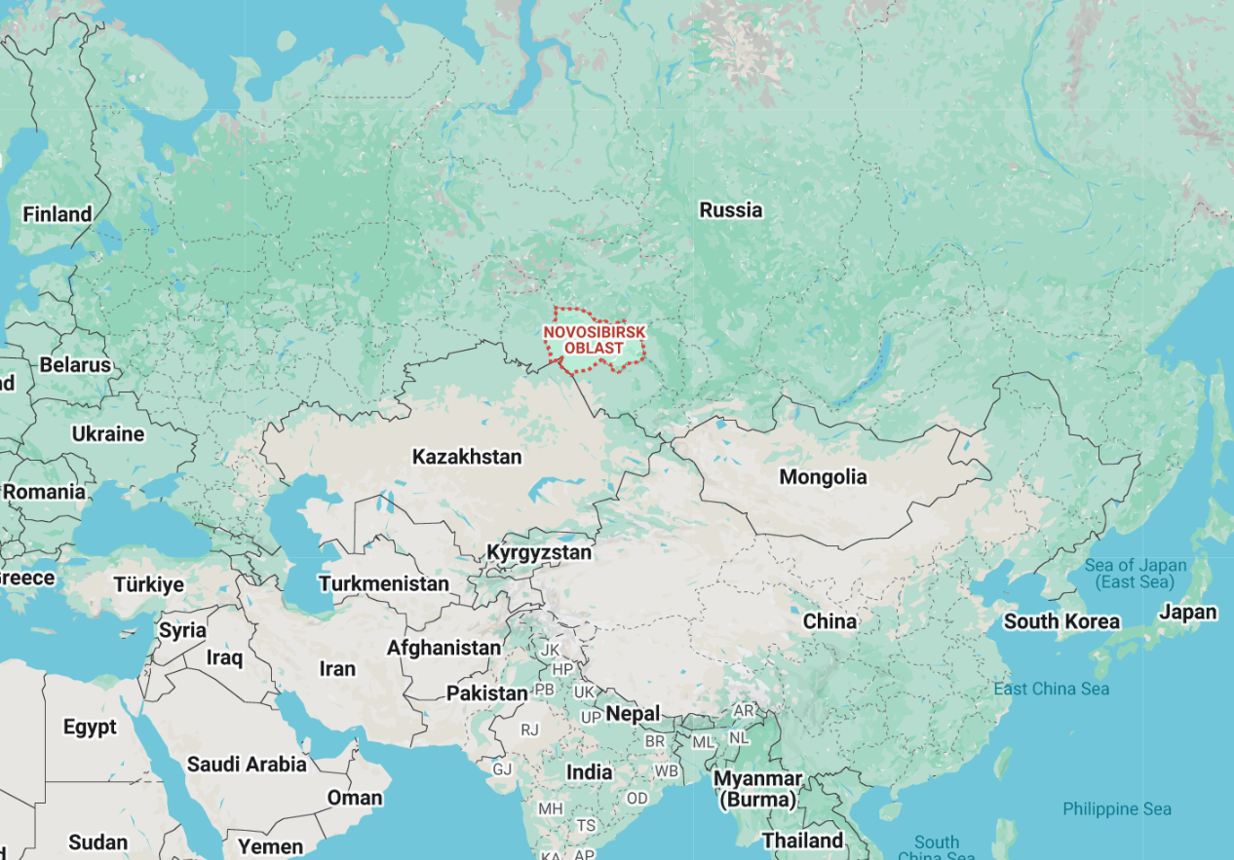
Suspected FMD in Russia and Turkmenistan
Mid March, Russian veterinary authorities declared a state of emergency in response to a cattle disease outbreak (officially attributed to pasteurellosis) in Siberia, with a particular focus on Novosibirsk Oblast
Reports that 15-18 regions of the country are affected
Scale and response appear atypical for pasteurellosis
  Mass seizure and culling of livestock (cattle, small ruminants, and pigs)
  Movement restrictions across multiple regions
Kazakhstan has imposed restrictions on Russian livestock products/ animal feed
Putin has signed a decree overhauling Russia’s animal vaccine industry, consolidating state producers into a single entity
Turkmenistan also recently reported cattle mortalities, mostly likely suspected to be FMD
Notes:
President Putin signed a decree overhauling Russia’s animal vaccine industry, consolidating state producers into a single entity following disease outbreaks in cattle, mass culling, and farmer unrest
Kazakhstan has banned imports of animal feed wheat from Russia after an outbreak of cattle diseases in several Russian regions bordering Kazakhstan led to mass culling of livestock
On 01 April 2026, media reported cattle mortalities in two districts of Mary Province, in Turkmenkala and Yoleten (see red dotted area on Map 2b).
The most likely candidate is reported to FMD. The second likely diagnosis is pasteurellosis (hemorrhagic septicemia).
The use of antibiotics by Turkmen veterinarians also suggests a bacterial origin or, at the very least, an attempt to suppress secondary infections.

Slide 15
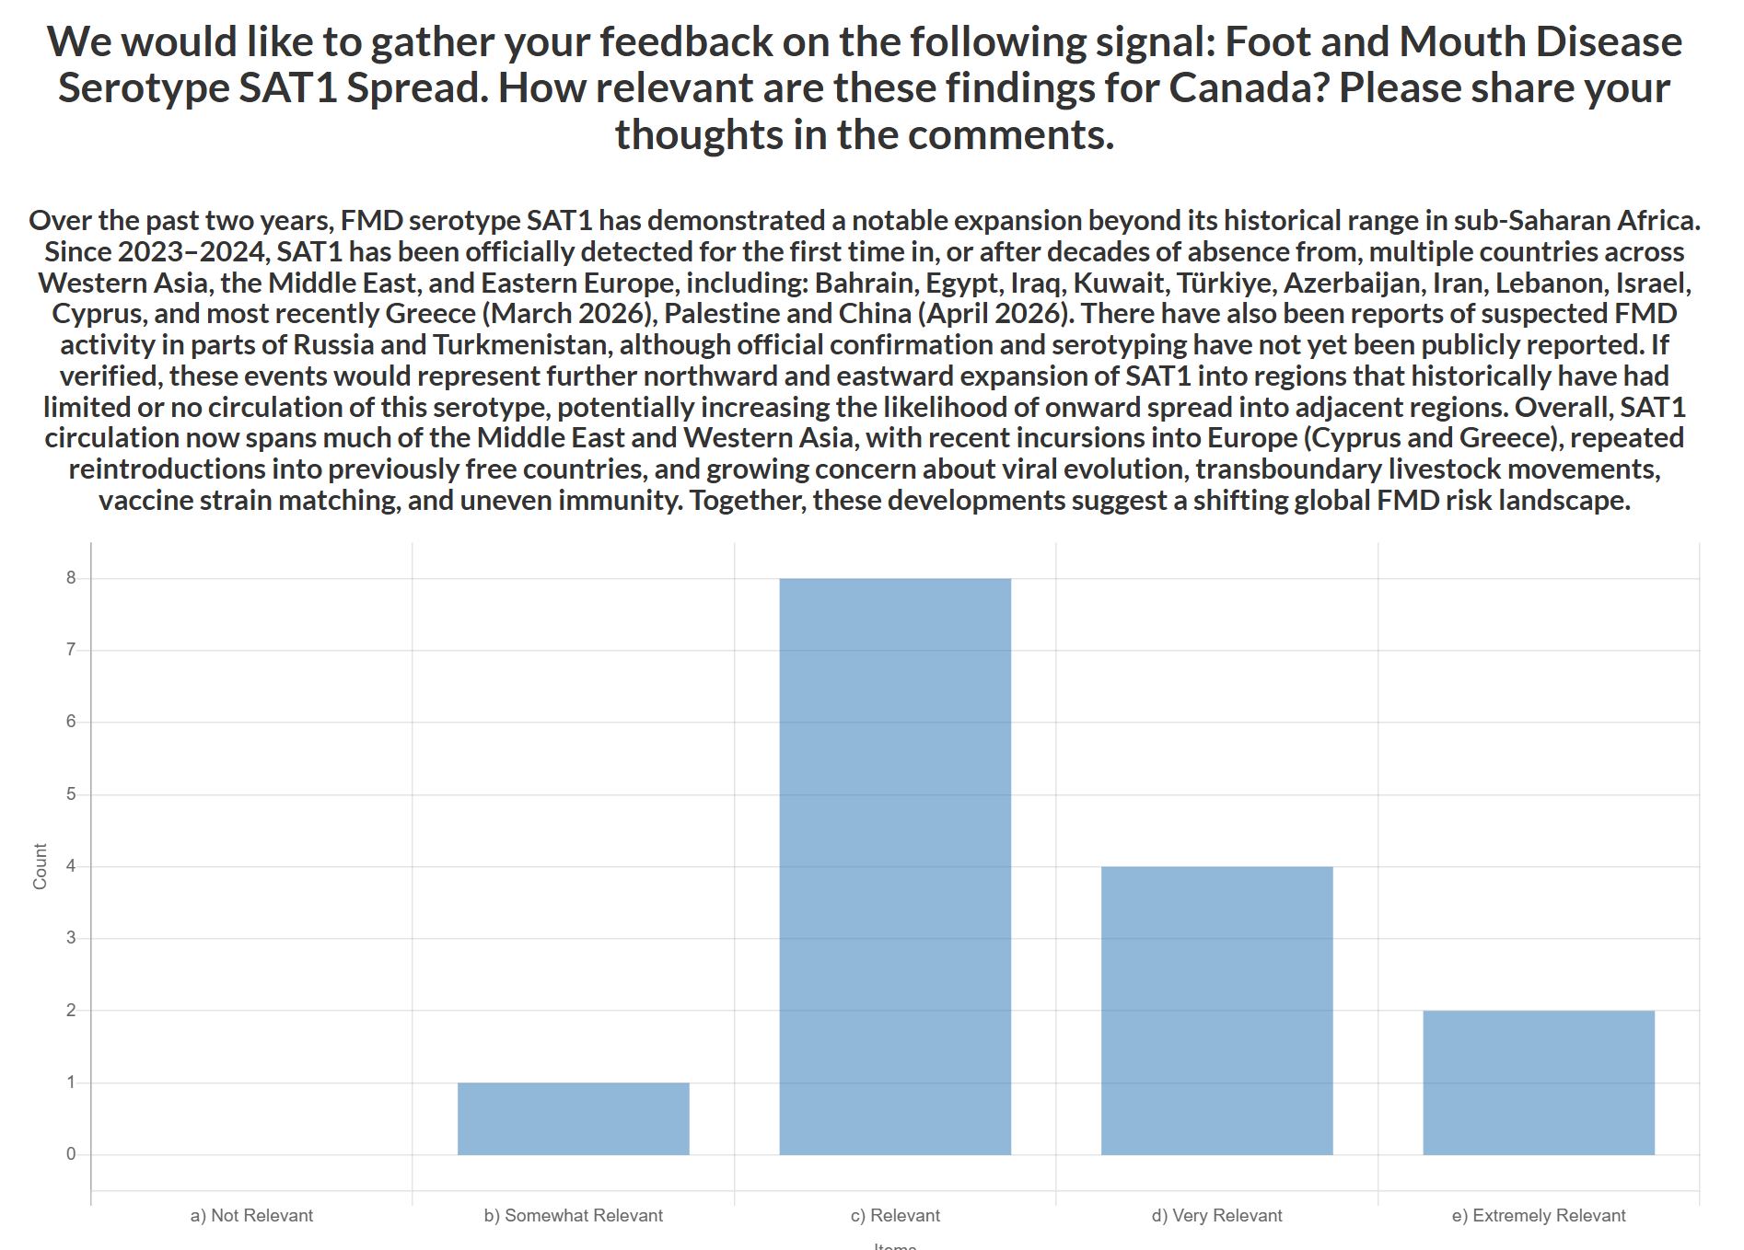
CEZD Ping: FMD SAT-1 Spread
Considering the emergence and spread of FMD SAT1 across the Middle East, Western Asia, and Europe, how relevant is the current global SAT1 situation to Canada?
N = 15 Avg = 3.5
Comments:
  Emergence and spread in China significantly amplifies concern due to scale and connectivity
  Pattern is reminiscent of ASF’s global expansion in the late 2010s
  Overall likelihood of SAT‑1 introduction into Canada remains low
  Risk is not immediate but is increasing due to global trends and cumulative exposure
  Spread into tourist destinations elevates risk due to high travel volumes
Notes:
Considering the emergence and spread of FMD SAT1 across the Middle East, Western Asia, and Europe, how relevant is the current global SAT1 situation to Canada?
In the comments, please share your perspectives on the factors most important to consider for Canada such as potential entry pathways (e.g., travellers, fomites, e-commerce), implications of increased global viral burden, vaccine strain availability and preparedness, laboratory and surveillance capacity, wildlife susceptibility, etc..

Slide 16
FAO - Rapid risk assessment: FMD SAT-1
Country | Likelihood/Uncertainty | Impact/Uncertainty
Afghanistan | Likely/High | Severe/Moderate
Armenia | Likely/Moderate | Low/Moderate
Bulgaria | Unlikely/Low | Low/Low
Cyprus | Likely/Moderate | Low/Moderate
Georgia | Very Likely/Moderate | Moderate/Moderate
Greece | Likely/Moderate | Low/Low
Israel | Likely/Moderate | Low/Moderate
Jordan | Likely/High | Moderate/High
Lebanon | Likely/High | Moderate/High
Libya | Very Likely/High | Severe/High
Country | Likelihood/Uncertainty | Impact/Uncertainty
Oman | Likely/Moderate | Low/Moderate
Pakistan | Likely/Moderate | Severe/Moderate
Qatar | Likely/Low | Low/Low
Russian Federation | Likely/High | Moderate/Moderate
Saudi Arabia | Likely/High | Moderate/Moderate
Syrian Arab Republic | Very Likely/High | Severe/High
Turkmenistan | Likely/High | Moderate/High
United Arab Emirates | Unlikely/Moderate | Low/Low
West Bank & Gaza Strip | Likely/High | Moderate/High
Yemen | Very Likely/High | Severe/High
Likelihood – Border sharing, trade networks, veterinary services, SAT-1 vaccination, historical entry of FMD/other diseases
Notes:
FAO projections indicate that SAT1 spread is very likely over the next three months, particularly through informal movements of small ruminants, which may be sub-clinically infected yet capable of shedding the virus.
Afghanistan – likelihood – borders with Iran, has low veterinary coverage, populations naïve to SAT-1, no vaccination
Armenia – Likelihood – bordered by countries reported FMD SAT-1 (Azerbaijan, Iran, Turikye) Livestock pop = 1.4 million cattle/ruminants/pigs, launched vaccination against SAT-1 in Sept 2025
Bulgaria- borders Turikye (trade is informal/limited), Thrace is still FMD-free, no SAT-1 vaccination,
Cyprus – Turkiye animal exports to the island, proximity/connections to Anatolia enhance likelihood
Georgia- outbreak in Azerbaijan near border, also proximity to Turkiye, is mobilizing SAT-1 vaccination, trade in animals/products are potential pathways
Greece – Borders Turkiye, LSD also spread from Turkiye previously, no vaccination, small trade volume of dairy/meat from Bahrain 2021/Turkiye 2023/ cheese from Egypt 2023
Israel – consistently reporting FMD outbreaks, trade related exposure from Turkiye, land border with Egypt, historical entry from neighbouring countries
Jordan – historical entry from neighbouring countries (SAT-2 in 2023, LSD in 2013), FMD SAT-1 vaccination is available and used., informal movements from Iraq/workers from Egypt
Lebanon – historical entry from neighbouring countries. Porous border from Syria, human mobility from Iraq/Turkiye, low vet capacity
Libya – strong cross border links with Egypt, live cattle imports, porous border. Large ruminant population, limited surveillance.
Oman – imports live cattle from affected countries (Bahrain/Iran/Turkiye), SAT-1 vaccination is applied,
Pakistan - large susceptible population, no SAT-1 vaccination, FMD endemic (multiple serotypes), animal trade is limited, small volume, however informal border movement occurs with Iran
Qatar – imported live sheep from affected countries (Turkiye), had surveillance/control capacity, Susceptible species, SAT-1 vaccination is applied
Russia – has reported previous FMD outbreaks, trade related pathways exist with Azerbaijan/Egypt/turkiye, cross border movement of people in the regions as well
Saudi Arabia – No recent imports from affected countries, SAT-1 vaccination not widely used, large national and informal trade with Bahrain/Kuwait/Yemen (with people and vehicle as well)
Syrian Arab Republic – borders with affected countries/Turkiye (porous/uncontrolled), no SAT-1 vaccination, susceptible species, vet capacity is weak, unregulated livestock movements
Turkmenistan – Trade risk from Turkiye and Iran, vet capacity is weak, FMD O is endemic
United Arab Emirates – do not import animals from currently affected countries. SAT-1 vaccination not applied, strong border controls, strong vet services, likestock trade limited, but informal movements may occur
West Bank/Gaza Strip – Susceptible livestock common, FMD O reported in 2024, vet services are fragile, no SAT-1 vaccination
Yemen – historically imported live cattle from Egypt, susceptible species common, no SAT-1 vaccination, fragile vet service, uncontrolled borders.

Slide 17
Scientific Findings
Sero‐Epidemiology and Molecular Detection of Bluetongue Virus in Goats in Bangladesh - Rahman - 2026 - Veterinary Medicine and Science - Wiley Online Library
Beyond poultry: Rethinking monitoring and control of HPAI H5Nx anticipating spillover risks for mammals – offlu
Bluetongue in China: Current Status of Viruses, Vectors, Detection Methods, and Vaccines - Xin - 2026 - Transboundary and Emerging Diseases - Wiley Online Library
Oestrus ovis Nasal Myiasis with Pupation in Human Host, Greece, October 2025 - Volume 32, Number 3—March 2026 - Emerging Infectious Diseases journal – CDC
Sheep and goat pox: vaccines and vaccination scenarios to control the epidemics in Greece and Bulgaria in 2025 – PubMed
DEFRA - Preliminary Outbreak Assessment Foot and Mouth Disease (FMD) in Cyprus
Global Seroprevalence of bluetongue virus in camels: a first systematic review and meta-analysis | Tropical Animal Health and Production | Springer Nature Link

Slide 18
Scientific Findings
Crimean-congo hemorrhagic fever in Iraq, 2021–2024: epidemiological and clinical data analysis with proposed severity indicators for resource-constrained settings | BMC Infectious Diseases | Springer Nature Link
Seroprevalence of rift valley fever virus and associated risk factors in small ruminants at human-livestock-wildlife interface within Uganda’s conservation areas | BMC Veterinary Research | Springer Nature Link
Seroprevalence and risk factors of epizootic hemorrhagic disease and bluetongue in Northwestern Tunisia: a comprehensive seroepidemiological study | BMC Veterinary Research | Springer Nature Link
Genomic analysis of Brucella Ovis in Italy reveals high genetic diversity and a novel lineage – PubMed
Haemaphysalis longicornis ticks as a competent vector for ‘Candidatus Mycoplasma haemobos’ in experimental transmission studies - ScienceDirect

