Slide 1

Community for Emerging and Zoonotic Diseases
Signals of Interest for CSHIN Q2
Dr Andrea Osborn
28 August 2023
www.cezd.ca

Slide 2
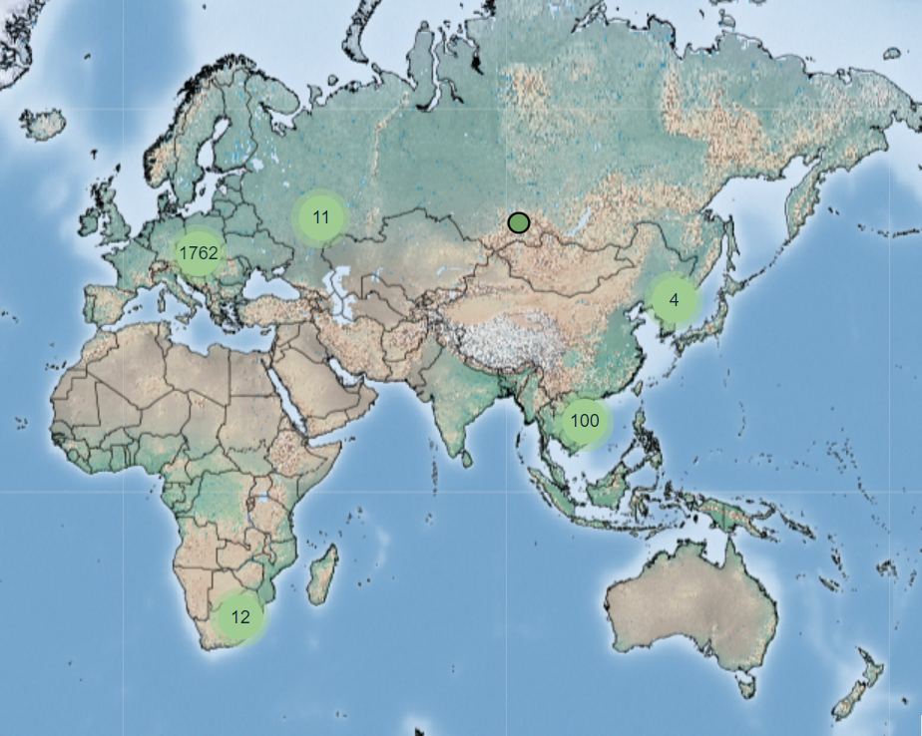
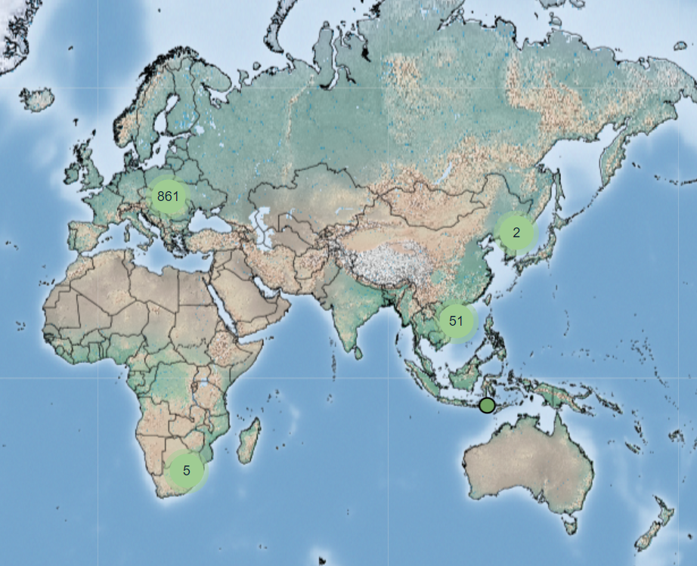
ASF spread – Q2 > 1890 events reported (Empress i) in Q3 so far - 920
Notes:
No major change in distribution, new countries affected in the Balkans, but they were surrounded by countries that already had the disease

Slide 3
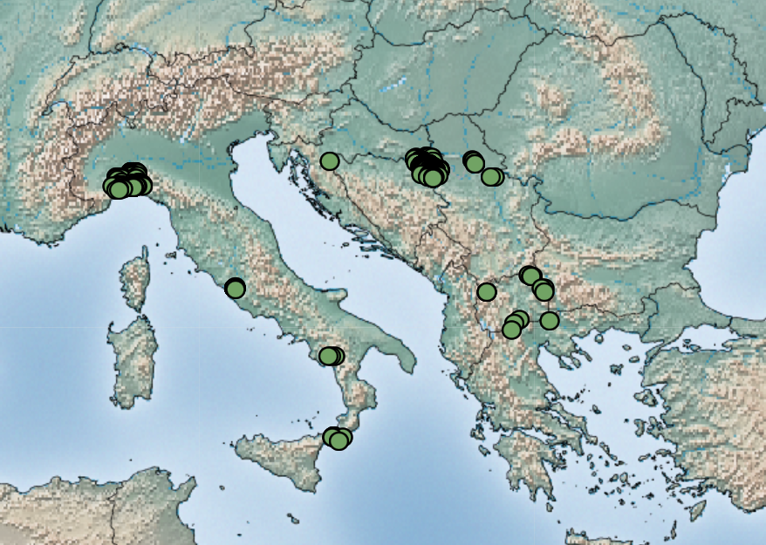
All cases in Southern Europe April 1 – August 25
Notes:
This slide provides context for the new cases in the Balkans

Slide 4
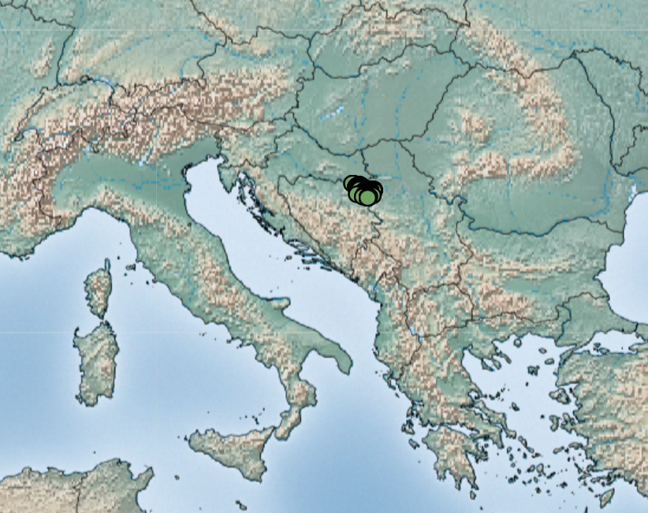
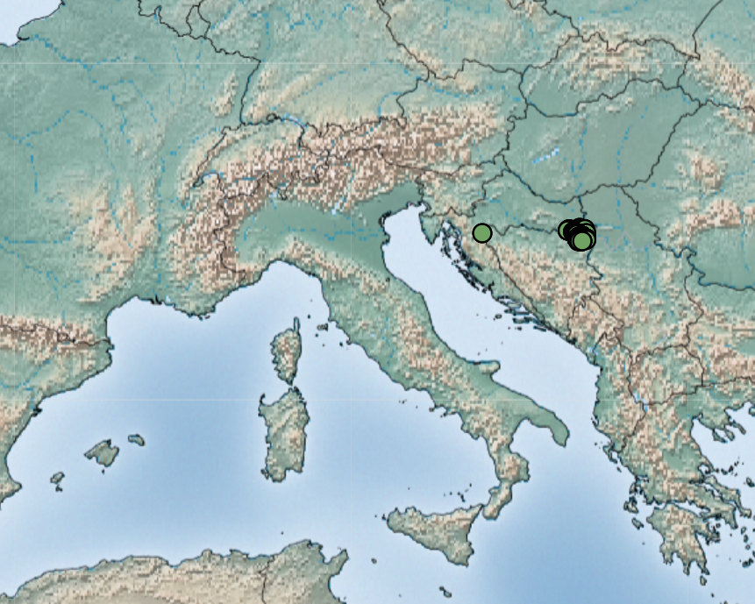
ASF Outbreaks in the Balkans
Bosnia-Herzegovina
Croatia
Kosovo – African swine fever also comes to Kosovo, the first case is confirmed - KosovaPress
Notes:
Empress I shows ~ 270 cases in BH and 111 in Croatia, but WOAH has much higher case counts.
News report shows positive cases in Kosovo, but Kosovo is not a country included in WOAH reporting.

Slide 5
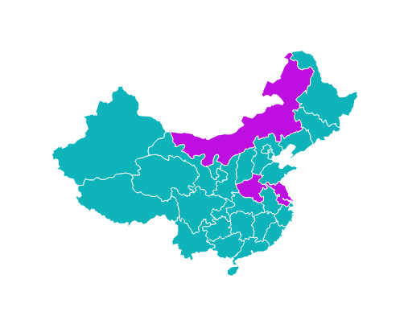
Highly lethal genotype I and II recombinant African swine fever viruses detected in pigs | Nature Communications
Chinese researchers have identified 3 naturally occurring recombinant ASF strains
Overall genetic makeup:
  43.5% Genotype I
  56.5% Genotype II
Recombinants found in 3 provinces but genetically from a single source
Notes:
Researchers in China identified three naturally occurring recombinant strains of African swine fever virus in pigs. These three ASF strains are a result of genetic material from two different types of ASFV, genotype I and genotype II, combined together. The newly discovered ASFV strains are mostly like one type (genotype I), when the B646L gene is used to determine their identity, but they contain pieces from another type (genotype II). About 56% of their genetic makeup comes from genotype II (specifically, a virus similar to ASFV Georgia 2007), while the remaining 43% is from genotype I (a virus similar to ASFV NH/P68).
Although the three recombinant viruses were found in pigs from Jiangsu province, Henan province, and Inner Mongolia, their similar genetic structures suggest that they originated from one place and then spread, rather than independently emerging in each province. It is, however, not known which exact province these virus strains originated.
In animal studies done by the same authors, these recombinant viruses were highly virulent and transmissible in pigs under experimental settings. Moreover, the study presents preliminary evidence that the live attenuated vaccine based on genotype II ASFV (Georgia07-like genotype II virus-based live attenuated vaccine), does not provide protection against challenge with the recombinant virus.
How to interpret these findings?
● Currently, there are 24 different types of ASF. One of these types, called genotype II, was introduced from Africa into Georgia in 2007, a country in Eastern Europe and West Asia. The Georgia-07-like genotype II ASFV of high virulence has been prevalent in China since 2018.
● In 2021, researchers in China reported the emergence of genotype I - the isolates recovered from two farms in different provinces showed a low virulence.
● Recombination occurs when at least two viral genomes co-infect the same host cell and exchange genetic segments. In the context of ASF, the occurrence of recombination between different genotype viruses in nature has been a topic with limited evidence until now. Further research is needed to understand the mechanisms and drivers behind these events.
● This information arises at a critical moment when the global community is focusing its attention and hopes on assessing promising vaccine candidates in several endemic countries. In this context, the emergence of a new ASF variant outside Africa, for which the current vaccine candidates (based on Georgia-07-like genotype II variant) in the pipeline may not present cross protection, has the potential to hamper local and regional efforts to control the disease.
● Furthermore, the risk of spread of this new variant to other regions should be assessed based on these findings. Unfortunately, the current absence of a systematic approach to molecular surveillance for monitoring the prevailing variants circulating across different regions further compounds the challenge at hand.
In this study, we isolated three high lethal recombinant ASFVs with mosaic genomes composed of 56.5% Georgia07-like genotype II virus and 43.5% NH/P68-like genotype I virus. The recombinant virus is highly lethal and transmissible in pigs, and completely evades the immunity induced by vaccination with a Georgia07-like genotype II virus-based live attenuated vaccine.

Slide 6
Highly lethal genotype I and II recombinant African swine fever viruses detected in pigs | Nature Communications
Vaccine Approval in VietNam
2 vaccines now approved:
NAVET-ASFVAC – US Vietnam collaboration
AVAC ASF LIVE - Vietnam
Philippines making progress on swine fever vaccine trials, president says | Reuters
Dominican Republic begins to apply Vietnamese vaccine against African Swine Fever (dominicantoday.com)
The recombinant virus is highly lethal and transmissible in pigs
Completely evades the immunity induced by vaccination with a Georgia07-like genotype II virus-based live attenuated vaccine

Slide 7
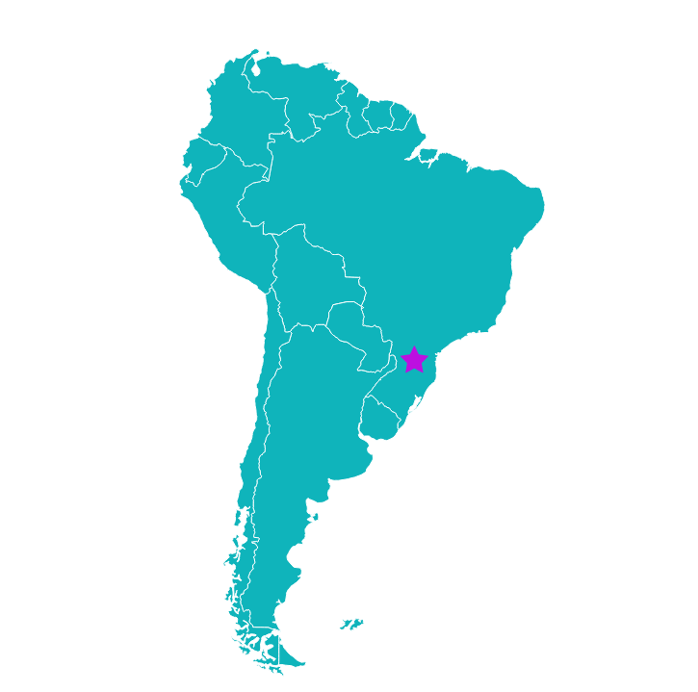
Brazil Human H1N1v Mortality Event
42 year old woman
Underlying medical conditions
Lived near a swine farm but had no direct contact with pigs
2 close contacts worked at the swine farm but tested negative and had no illness
  May 1 - Fever, Headache, Sore Throat
  May 3 - Hospitalized
  May 5 - Passed away
WHO has not changed assessment of risk – still low

Slide 8
Study finds wild pigs infected with BVDV in several US states (dvm360.com)
High seroprevalence of BVDV in wild pigs
1129 wild pigs in 17 US states
  32 positive – BVDV 2a
  39 positive – BVDV 1b
Primary source of infection for wild pigs uncertain
Infected cattle are primary source of infection for pigs on farms
Pigs do not necessarily have clinical signs
Can pass the virus back to cattle and other ruminants

Slide 9
Increase in Hepatitis E signals
Associated with consumption of undercooked pork
Had been seeing increasing signals from Europe
  UK
  Czech Republic
Canadian Context:
  Frontiers | High occurrence of hepatitis E virus in raw pork liver and pork liver pâté produced in the Canadian province of Quebec (frontiersin.org)
Also publications indicating rats as source of Hep E in humans
  Rat Hepatitis E Virus in Norway Rats, Ontario, Canada, 2018–2021 - Volume 29, Number 9—September 2023 - Emerging Infectious Diseases journal – CDC
  First Detection of Hepatitis E Virus ( Rocahepevirus ratti Genotype C1) in Synanthropic Norway Rats ( Rattus norvegicus) in Romania - PubMed (nih.gov)
Notes:
We’ve recently noticed an increase in Hepatitis E signals coming from some European countries. Hepatitis E genotypes 1 and 2 cause outbreaks mostly from contaminated water/food, however genotypes 3 – 7 are zoonotic. Genotype 3 is primarily spread from swine and can cause chronic infection in immunosuppressed individuals.
The UK (England, Wales, Jersey) and the Czech Republic have reported an increase in Hepatitis E infections, linked to the consumption of undercooked pork products. However, in the UK, the Hepatitis E G3-2 phylotype has not been detected in domestic pigs, suggesting the human infections may be due to the of consumption of pork products originating outside the UK. In Belgium supermarkets, Hepatitis E RNA was found in 17/54 pork products tested (in 65% of pâtés, 15% of raw dried hams, and none in raw dried sausages).

Slide 10


Getah Virus Infosheet
Getah Virus in the Canadian Context
Distribution of known competent vectors in Canada
Known information on species susceptibility
Intended to supplement the information provided by SHIC updated in 2021

Slide 11
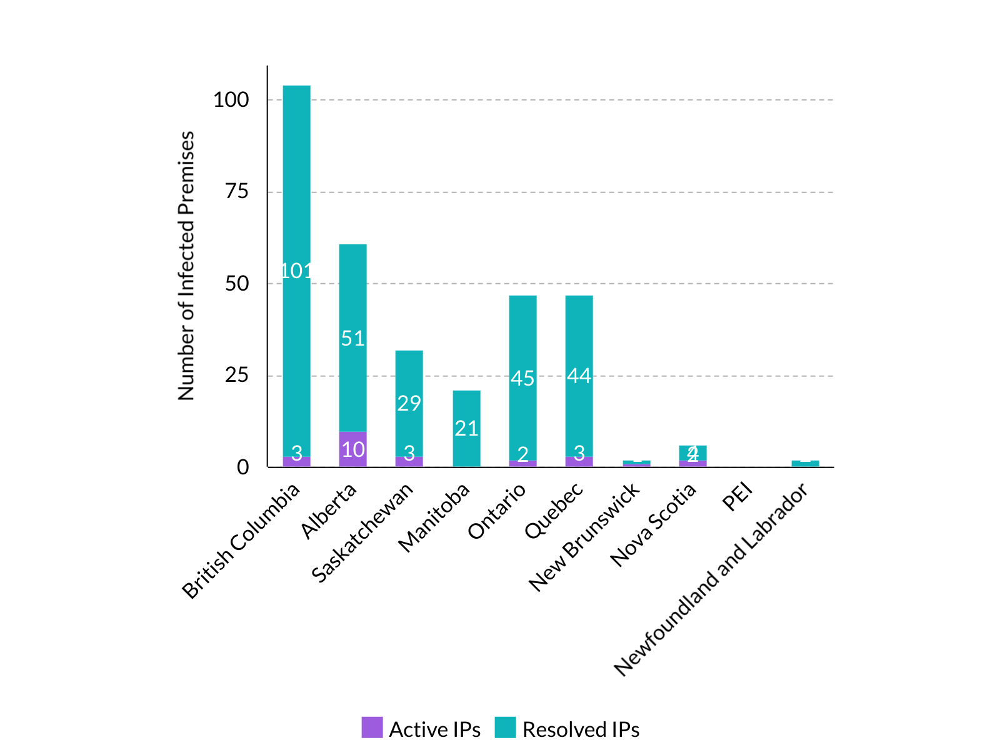
HPAI in Canada Update
As of July 28, 2023:
Total of 322 infected premises
24 currently active IPs
>7.6 million birds
National Emergency Operations Centre Demobilized

Slide 12
Scientific Findings
Influenza
Low Susceptibility of Pigs against Experimental Infection with HPAI Virus H5N1 Clade 2.3.4.4b - Volume 29, Number 7—July 2023 - Emerging Infectious Diseases journal - CDC
Microorganisms | Free Full-Text | Seroconversion of a Swine Herd in a Free-Range Rural Multi-Species Farm against HPAI H5N1 2.3.4.4b Clade Virus (mdpi.com)
Microorganisms | Free Full-Text | First Detection of Influenza D Virus Infection in Cattle and Pigs in the Republic of Korea (mdpi.com)
Interspecies Transmission of Swine Influenza A Viruses and Human Seasonal Vaccine-Mediated Protection Investigated in Ferret Model - Volume 29, Number 9—September 2023 - Emerging Infectious Diseases journal – CDC
Isolation and identification of Eurasian avian-like H1N1 swine influenza virus and evaluation of their pathogenicity and immune protective effects in pigs – ScienceDirect
The genomic landscape of swine influenza A viruses in Southeast Asia | PNAS
Farm management practices associated with influenza A virus contamination of people working in Midwestern United States swine farms | Porcine Health Management | Full Text (biomedcentral.com)

Slide 13
Scientific Findings
ASF
Unregulated Online Sales are High-Risk Sources of Domestic Swine (Sus scrofa) in Canada: Implications for Invasive Wild Pig and AfricanSwine Fever Risk Preparedness - PubMed (nih.gov)
Estimating the effectiveness of control actions on African swine fever transmission in commercial swine populations in the United States | bioRxiv
Long-Term Epidemiology and Evolution of Swine Influenza Viruses, Vietnam - Volume 29, Number 7—July 2023 - Emerging Infectious Diseases journal – CDC
Viruses | Free Full-Text | Comparison of Attenuated and Virulent Strains of African Swine Fever Virus Genotype I and Serogroup 2 (mdpi.com)
Epidemiological analysis of African swine fever in the European Union during 2022 - - 2023 - EFSA Journal - Wiley Online Library
Vaccines | Free Full-Text | Epidemiological Characterization of African Swine Fever Dynamics in Ukraine, 2012&ndash;2023 (mdpi.com)

Slide 14
Scientific Findings
Streptococcus suis
Streptococcus suis contributes to inguinal lymph node lesions in piglets after highly pathogenic porcine reproductive and respiratory syndrome virus infection - PubMed (nih.gov)
Prevalence of Streptococcus suis in pigs in China during 2000–2021: A systematic review and meta-analysis – ScienceDirect
Japanese Encephalitis
An evaluation of the landscape structure and La Niña climatic anomalies associated with Japanese encephalitis virus outbreaks reported in Australian piggeries in 2022 - ScienceDirect

Slide 15
Scientific Findings
Wild Boar
Animals | Free Full-Text | The Role of Wild Boars in the Circulation of Tick-Borne Pathogens: The First Evidence of Rickettsia monacensis Presence (mdpi.com)
Astrovirus
SHIC-Funded Study Discovers First Association Between Astrovirus and Respiratory Pathology in Pigs

