Slide 1

Community for Emerging and Zoonotic Diseases
Q2 Signals of Interest for CSHIN
25 August 2025
www.cezd.ca

Slide 2
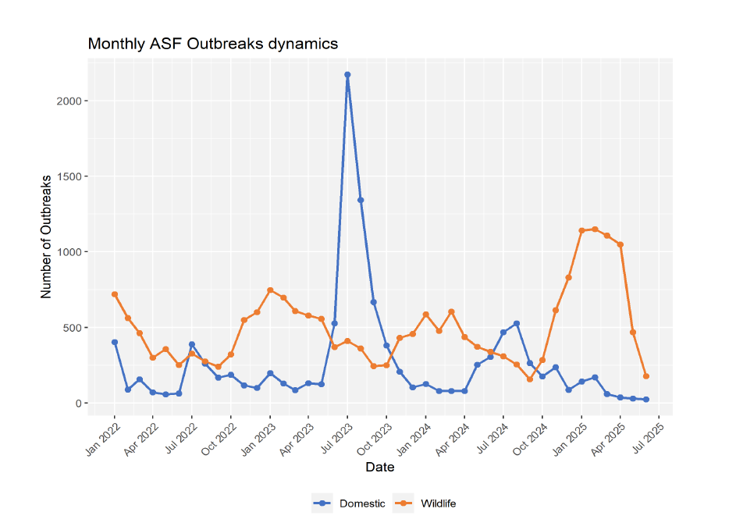
African Swine Fever Trends
Wild boar cases in Europe had surged over the winter and started to decline in the springtime
African swine fever - WOAH - World Organization for Animal Health
Notes:
This chart represents countries where disease is not considered endemic (Europe and some Asian countries)
The Q3 surge of ASF in domestic swine that we saw last year has not occurred this year, domestic cases have stayed lower, but wild boar cases have increased beyond expected levels this last fall into this winter.
Since January 2022, more than 970,000 cases in pigs and more than 35,000 cases in wild boars have been reported, with around 2,080,000 animal losses in domestic pigs.

Slide 3
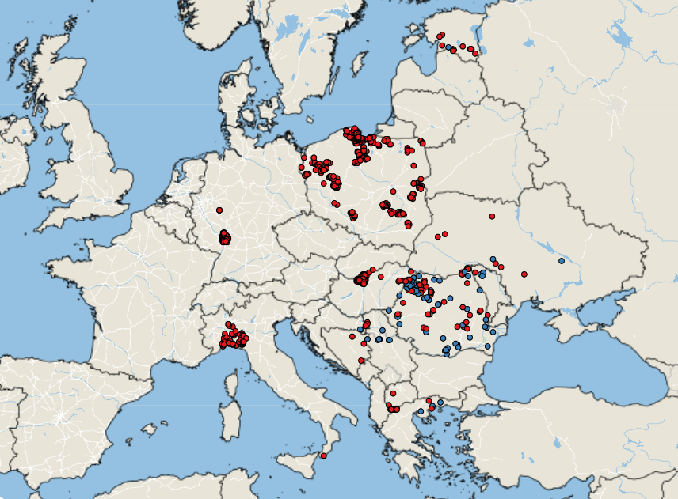
ASF Cases - Europe
No great changes in distribution from last report
  1,927 cases in Europe in Q2
  505 cases so far in Q3
Germany reported new cases in wild boar >100 km from previous reports, with genotyping indicating a new introduction from Italy
Recent domestic cases reported in Estonia, Lithuania, and Latvia
No new declarations of freedom
ASF cases in Europe Q2
https://empres-i.apps.fao.org/general
Wild Boar
Domestic Swine
Notes:
Note- removed Bosnia bullet point as its not the first cases of ASF (was reported previously – just a new WOAH report due to integrated with another system)
Estonia - As of August 13, seven ASF outbreaks have been confirmed, affecting nearly 26,000 pigs across different regions of the country (~10% of its pig population). spread is driven both by wild boars contact and occasional jumps linked to contaminated equipment, vehicles, or materials.
Latvia- reported a fourth outbreak of ASF in domestic pigs in Talsi municipality
Lithuania reported 2 outbreaks in domestic swine

Slide 4
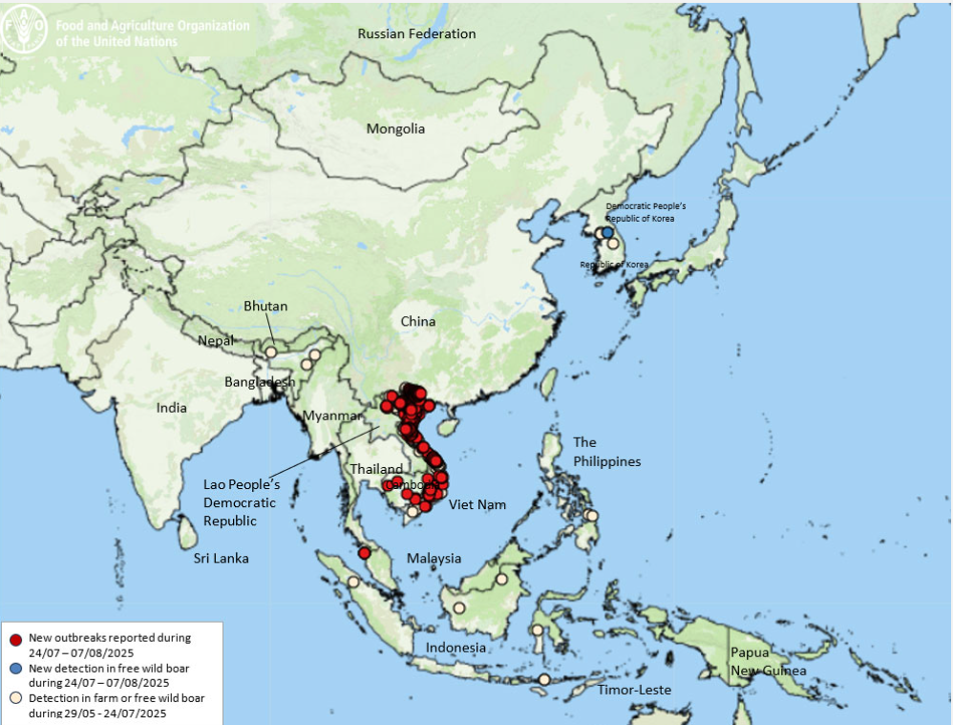
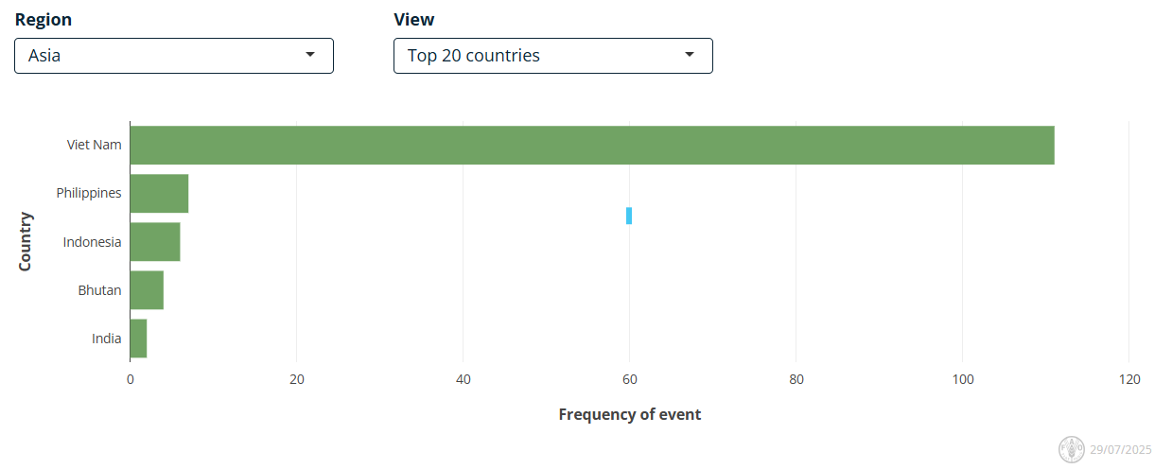
ASF Cases – Asia (Q2)
ASF situation in Asia & Pacific update
Ongoing high level of infection with hotspots in
  Vietnam
  Philippines
  Indonesia
  Bhutan
  India
Vietnam is having a surge in cases (only ~30% of pigs in the country have been vaccinated)
https://empres-i.apps.fao.org/epidemiology
Notes:
New ASF sit update should be available after Aug 21st – but it isn’t ☹
Vietnam has also been dealing we a lot of illegal transportation and selling of ASF infected pigs.
See SHIC report - Vietnam | July 10: Police dissolve a ring selling ASF-affected pork to Hanoi markets and restaurants. On July 11, illegal dumping of pigs in another province was resulting in severe pollution of waterways; this illegal dumping follows several outbreaks of ASF in the province

Slide 5
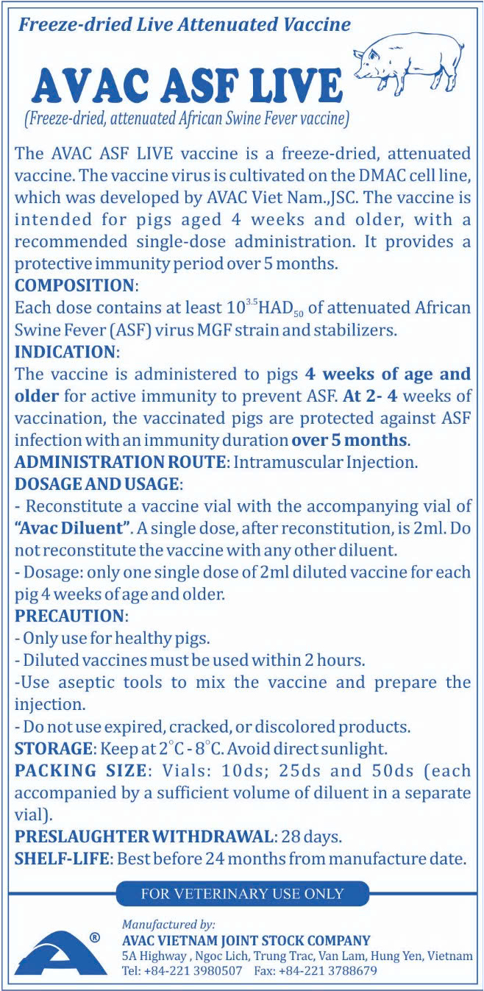
Vietnam exports first African swine fever vaccine batch to Indonesia | The Star
Vietnam sales of 120,000 doses of vaccine to Indonesia
Nearly 500,000 doses have already been exported to the Philippines and Nigeria
3 million doses used in Vietnam
Company is pursuing regulatory approval in India, Malaysia, Nepal and Myanmar
AVAC ASF LIVE

Slide 6
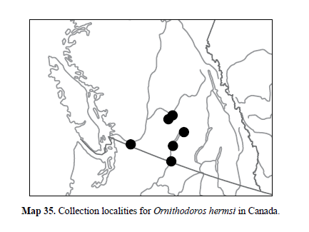
Texas scientists map DNA of tick threatening human and swine health
Soft ticks Ornithodoros are hosts and vectors for African Swine Fever
  Nidicolous tick
    Live in nests, burrows and other sheltered locations
  Live > than five years without a blood meal
  Female ticks can transfer pathogens to their offspring
  Can become a reservoir of ASF
Study looked at genetics of soft tick in US, Ornithodoros turicata
10 species of Ornithodoros are vectors of ASF
Experimental transmission of African swine fever virus by Ornithodoros lahorensis (Acari: Argasidae) | bioRxiv
Knowledge gaps about Ornithodoros in Canada
One known species in BC
Distribution, vector competence
Won’t be detected with usual tick surveillance methods
Handbook of the Ticks of Canada
Notes:
Known competent vectors for ASF include: O. turicata, O. phacochoerus, O. porcinus, O. erraticus, O. moubata, O. waterbergensis, O. compactus, O. papillipes and O. verrucosus and now with the recent Chinese Study include O. lahorensis

Slide 7
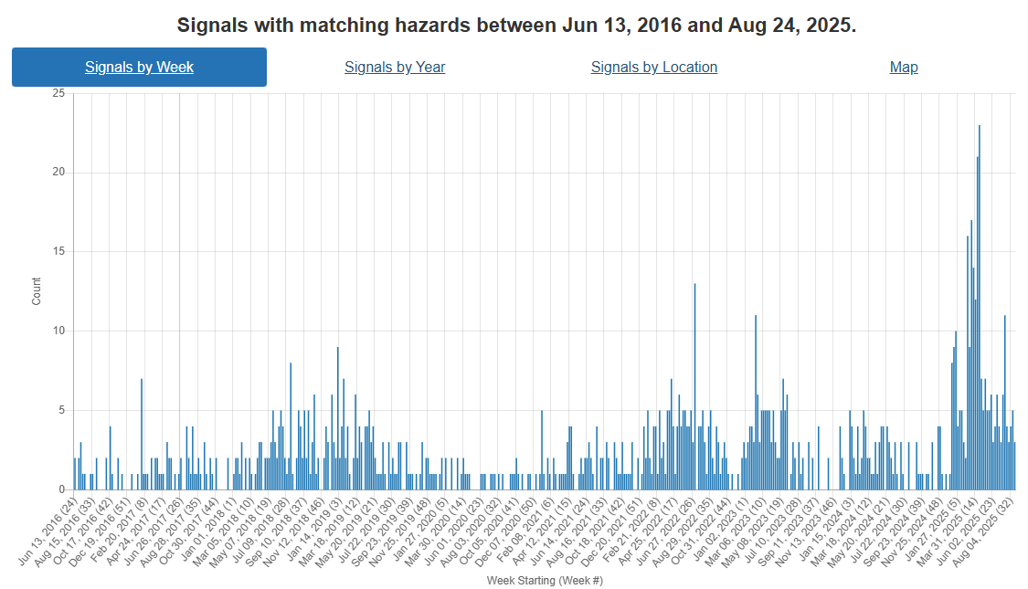
Foot and Mouth Disease – Hazard Trend
Slovakia
COVID
Indonesia
SAT-2
Middle East
Hungary
Germany
SAT-1
Middle East
& Turikye
Notes:
FMD trends over the last ~9 years. Can see increasing activity in recent years starting with its spread to Indonesia, than emergence of SAT-2 in the Middle East. This year Europe reporting cases in Germany, then Hungary and Slovakia. In addition there has been emergence of serotype SAT-1 in the middle East and Türkiye as well.

Slide 8
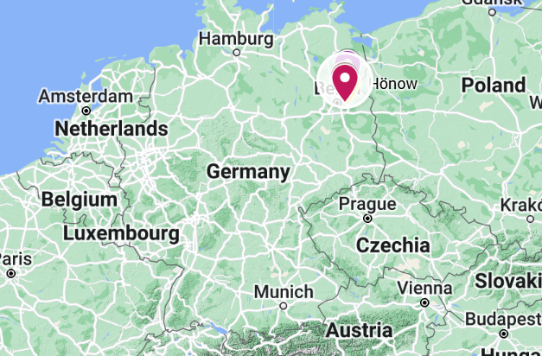
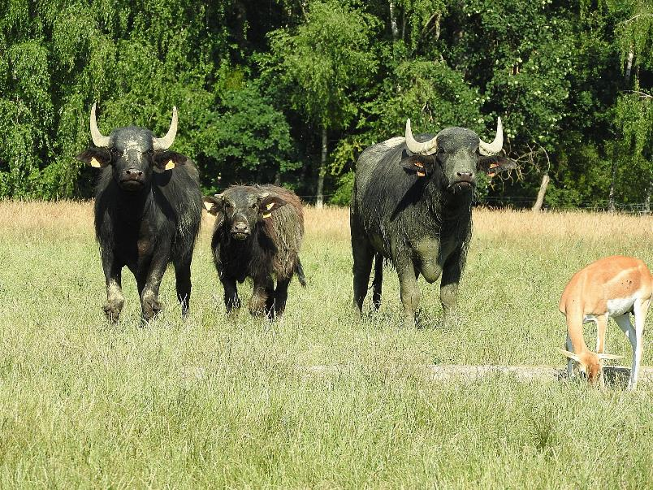
Foot and Mouth Disease in Germany
Germany has regained freedom from FMD without vaccination May 14th
Only had a single case in water buffalo

Slide 9
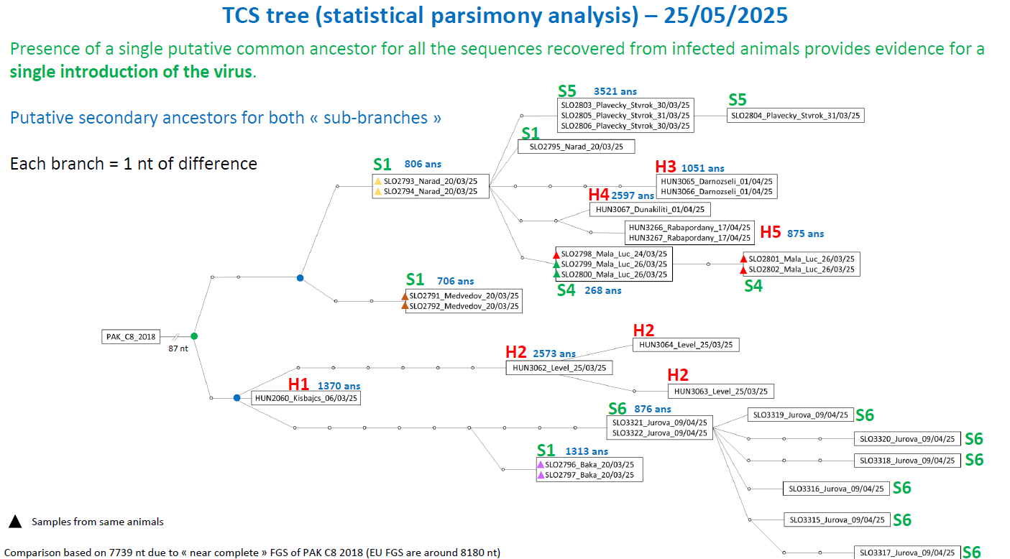
Foot and Mouth Disease – Hungary and Slovakia
No new cases confirmed in Hungary or Slovakia
  Genotyping confirms the cases are all related to a single introduction
Hungary
  Protection and Surveillance Zones lifted June 2
  Further restricted zones lifted June 5
Slovakia
  Last surveillance zone lifted June 5th
  Final cleansing and disinfection expected August 31st
Presentations - European Commission

Slide 10
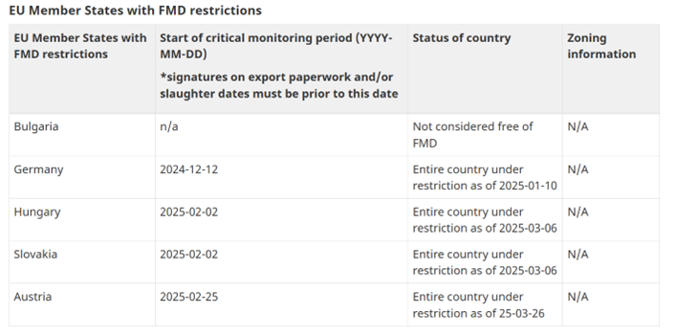
Foot and Mouth Disease – Europe
Canada still has import restrictions in place
Disease Freedom from FMD

Slide 11
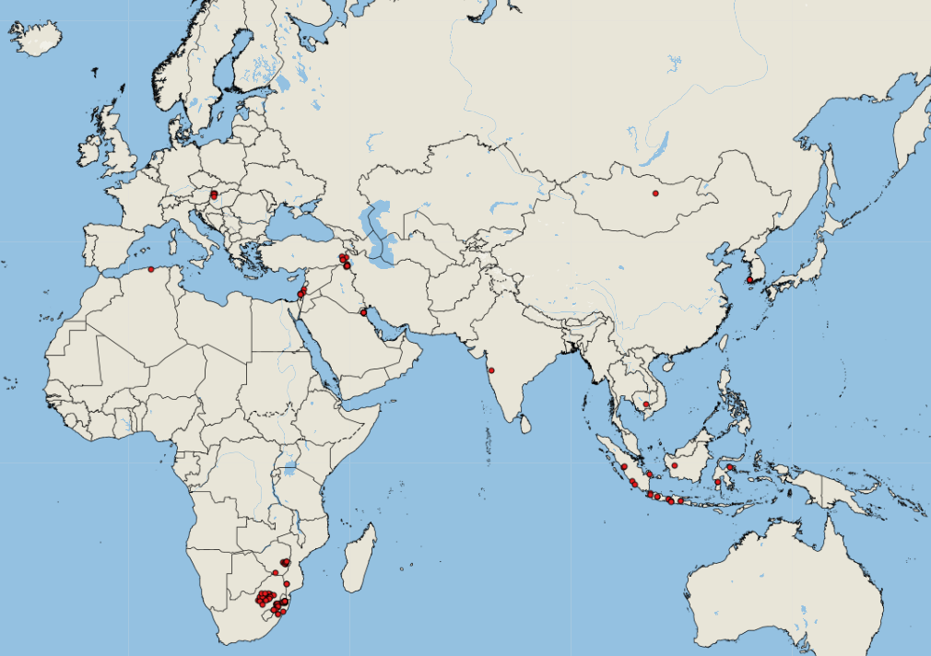
FMD SAT-1 incursion to Middle East
Egypt recently reported its first cases of SAT-1 to WOAH - from mid-July
Türkiye closes all animal markets nationwide due to foot-and-mouth disease risk - Türkiye Today
  Thrace on high alert, vaccination underway but still seeing lesions in animals
  Türkiye has 4 known different serotypes circulating: A, O, SAT-1, and SAT-2 (as well as some untyped outbreaks)
Turkey produces 4.5 million vaccines to curb SAT-1 FMD outbreak
FAO/WOAH FMD Ref Lab Report – Q2
FMD All strains April 1 - August 21, 2025
https://empres-i.apps.fao.org/diseases

Slide 12
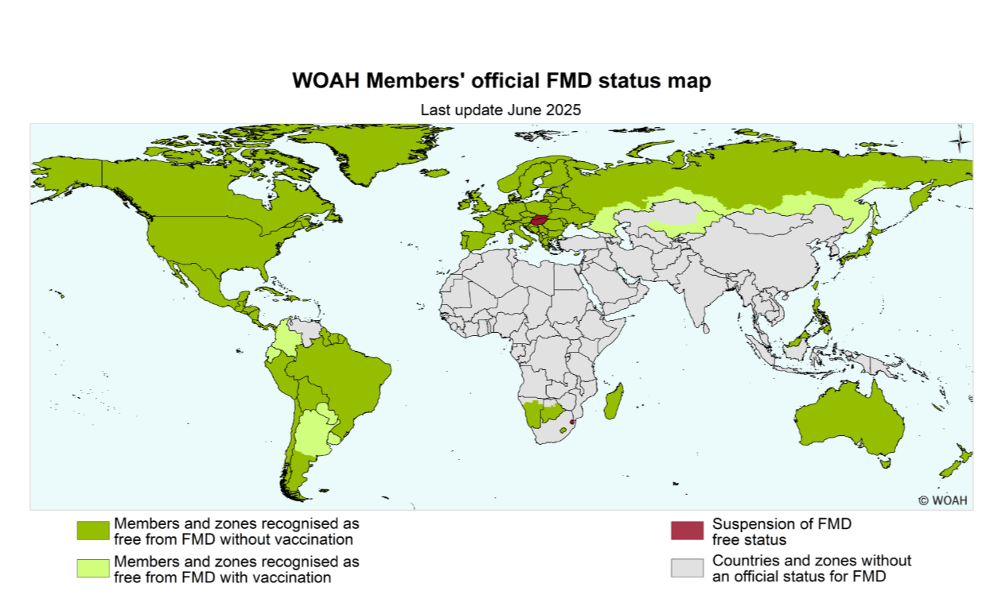
Brazil and Bolivia Free of FMD without vaccination
Brazil
First cases reported in 1895
Eradication efforts began in 1960
Strategy to move to freedom without vaccination started in 2017
Bolivia
1st cases reported in 1910
20-year strategy to achieve freedom without vaccination

Slide 13
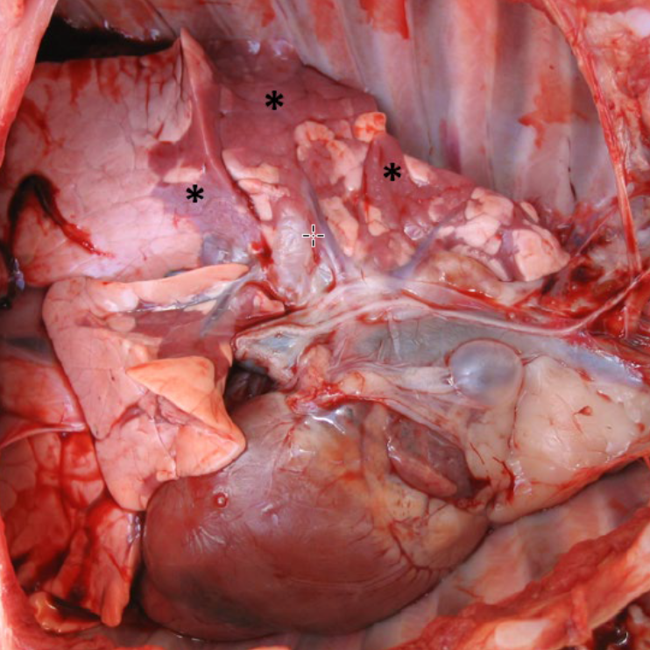
SHIC-Funded Study First to Confirm Porcine Astrovirus 4 as a Primary Cause of Tracheitis and Bronchitis in Piglets – Swine Health Information Center
Objective: determine if PoAstV4 is a primary pathogen
CDCD piglets (17 challenged, 11 negative controls)
Intratracheal challenge with positive tissue homogenate
Monitored via nasal swabs q2days
Necropsy at 5 + 8 days post challenge
https://www.uoguelph.ca/ahl/first-detection-porcine-astrovirus-4-suckling-pigs-ontario
Notes:
Porcine astrovirus 4 (PoAstV4) has previously been detected in piglets with respiratory disease. However, it was unclear if the virus was the cause of disease or merely a bystander. The objective of this study was to infect piglets with PoAstV4 and evaluate if respiratory disease was reproduced. Caesarean-derived colostrum-deprived (CDCD) piglets were infected (17 – challenged and 11 negative controls) with PoAstV4 and were found to be shedding the virus in nasal secretions as early as 2 days post challenge (DPC) with all pigs testing negative by 14 DPC. Both tracheitis and bronchitis were diagnosed in infected pigs necropsied at 5 and 8 DPC with viral detection in these tissues at the same time. There was a productive immune response to infection with detection of anti-PoAstV4 antibodies in the blood and the characterization of immune cells within infected tissues. Results from this study show that PoAstV4 can cause microscopic lesions of an epitheliotropic viral infection in the respiratory tract, very similar to influenza A virus.

Slide 14
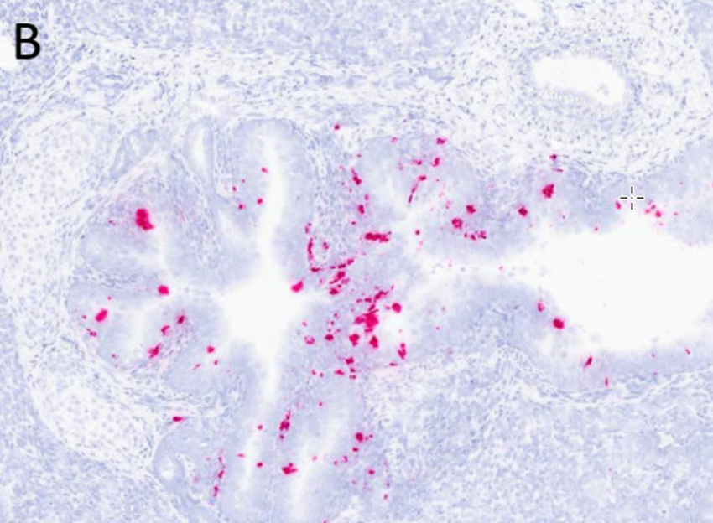
SHIC-Funded Study First to Confirm Porcine Astrovirus 4 as a Primary Cause of Tracheitis and Bronchitis in Piglets – Swine Health Information Center
In situ hybridization to identify virus in tissues
Serology (IgM and IgG)
Quantifying infiltrating lymphocytes (T and B cells) within lesioned airways using immuno-histochemistry and digital image analysis software
Virus in nasal secretions within 2dpi, gone by day 14
Shedding virus in feces
Tracheitis and bronchitis present
https://www.uoguelph.ca/ahl/first-detection-porcine-astrovirus-4-suckling-pigs-ontario
Notes:
Porcine astrovirus 4 (PoAstV4) has previously been detected in piglets with respiratory disease. However, it was unclear if the virus was the cause of disease or merely a bystander. The objective of this study was to infect piglets with PoAstV4 and evaluate if respiratory disease was reproduced. Caesarean-derived colostrum-deprived (CDCD) piglets were infected (17 – challenged and 11 negative controls) with PoAstV4 and were found to be shedding the virus in nasal secretions as early as 2 days post challenge (DPC) with all pigs testing negative by 14 DPC. Both tracheitis and bronchitis were diagnosed in infected pigs necropsied at 5 and 8 DPC with viral detection in these tissues at the same time. There was a productive immune response to infection with detection of anti-PoAstV4 antibodies in the blood and the characterization of immune cells within infected tissues. Results from this study show that PoAstV4 can cause microscopic lesions of an epitheliotropic viral infection in the respiratory tract, very similar to influenza A virus.

Slide 15
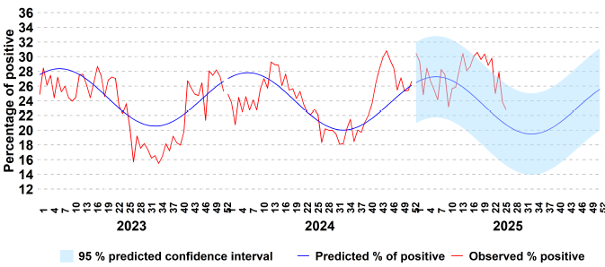
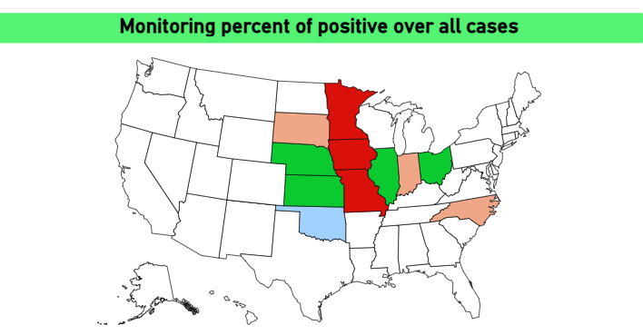
PRRS in US
https://www.swinehealth.org/disease-monitoring-reports/
Spike in PRRS cases in the US in Q2
Signal > 3 standard deviations above baseline for several states
Several cases (to finishing sites) attributed to biosecurity breaches
  Transport
  Feed Delivery
  Manure hauling
SDRS Dashboards – Field Epidemiology

Slide 16
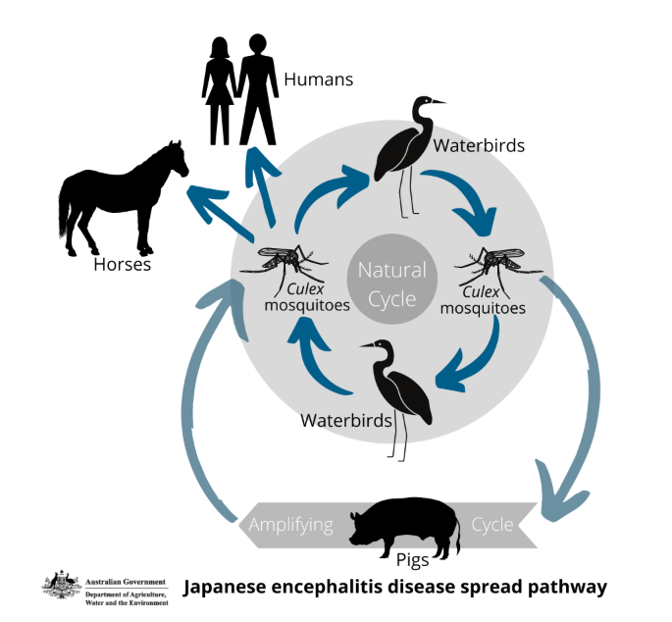
Sheep serve as amplifying hosts of Japanese Encephalitis
JEV is normally thought of as a disease spread between wild birds and pigs; humans and horses are dead-end hosts
Clinically affected Sheep on a farm in China
  Neurological signs
  Circling and ataxia
JEV only virus isolated from brain tissue

Slide 17
Sheep serve as amplifying hosts of Japanese Encephalitis
Researchers infected naïve sheep with virus (SC or IV)
Animals developed mild, non-specific clinical signs
  Anorexia, conjunctival redness, moaning, restlessness, impatience
Viremia resulted
Sufficient virus present to infect mosquitos
Virus shed in nasal and anal secretions
Sero-survey in 31 Provinces with 19 positive
Authors conclude that sheep may serve as amplifying hosts of JEV
JEV is not present in Canada
Vectors are possible route of introduction
Revisiting the risk of introduction of Japanese encephalitis virus (JEV) into the United States – An updated semi-quantitative risk assessment - ScienceDirect
Mosquito vector competence for Japanese encephalitis virus: a systematic review and meta-analysis update

Slide 18
Scientific Findings
Monitoring for classical swine fever virus persistence and seropositivity in vaccinated pig farms using on-farm sentinel pigs during the pre-elimination phase toward a CSF-free status – ScienceDirect
Susceptibility of Ferret and Cat to Porcine Deltacoronavirus: Evidence of Infection in Ferrets But Not Cats - Meng - 2025 - Transboundary and Emerging Diseases - Wiley Online Library
Senecavirus A Incidence in U.S. Breeding Herds: A Decade of Surveillance Data
Isolation and Characterization of Seneca Valley Virus From Pig Transboundary Spread to the Mink Infection
Quantifying the zoonotic risk profile of European influenza A viruses in swine from 2010 to 2020 inclusive | Journal of Virology
Evaluation of pandemic potential of the genotype 4 (G4) swine influenza virus using ex vivo and in vitro cultures of the human respiratory tract
Emerging threats of HPAI H5N1 clade 2.3.4.4b in swine: knowledge gaps and the imperative for a One Health approach
Spatiotemporal Dynamics of Emerging Foot-and-Mouth Disease, Bluetongue, and Peste Des Petits Ruminants in Algeria
Predicted foot and mouth disease virus and African swine fever virus inactivation within carcases undergoing field decomposition in three Australian climate zones

Slide 19
Scientific Findings
Emergence of Microvariants of African Swine Fever Virus Genotype II in the Asia–Pacific - O’Dwyer - 2025 - Transboundary and Emerging Diseases - Wiley Online Library
Development of a risk-based zoning strategy for African swine fever control in South Korea: Integrating spatial analysis and biosecurity assessment
Anti-pA137R antibodies exacerbate the pathogenicity of African swine fever virus in pigs | Journal of Virology
Revisiting the early event of African swine fever virus DNA replication | Journal of Virology
African swine fever virus infection enhances CD14-dependent phagocytosis of porcine alveolar macrophages to promote bacterial uptake and apoptotic body-mediated viral transmission | Journal of Virology
The African swine fever virus p22 inhibits the JAK-STAT signaling pathway by promoting the TAX1BP1-mediated degradation of the type I interferon receptor | PLOS Pathogens
Targeted Whole Genome Sequencing of African Swine Fever Virus and Classical Swine Fever Virus on the MinION Portable Sequencing Platform | bioRxiv
A synthetic genomics-based African swine fever virus engineering platform | Science Advances
Advances in African swine fever virus molecular biology and host interactions contributing to new tools for control | Journal of Virology

