Slide 1

Community for Emerging and Zoonotic Diseases
Q3 Signals of Interest for CSHIN
18 November 2025
www.cezd.ca

Slide 2
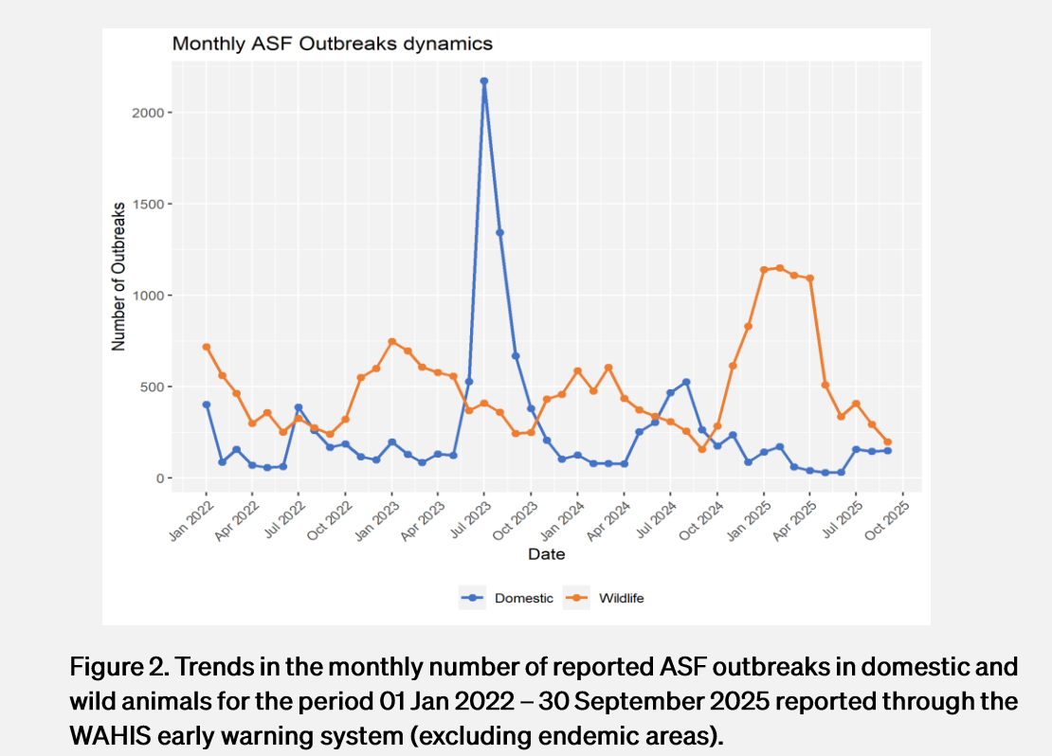
African Swine Fever Trends
Wild boar cases in Europe had surged over the winter and started to decline in the springtime
Decline continued into the fall
WOAH - asf-report-69.pdf
Notes:
This chart represents countries where disease is not considered endemic (Europe and some Asian countries)
The Q3 surge of ASF in domestic swine that we saw last year has not occurred this year, domestic cases have stayed lower, but wild boar cases have increased beyond expected levels this last fall into this winter.
Since January 2022, more than 35,000 cases in wild boars have been reported, with around 2,080,000 animal losses in domestic pigs.

Slide 3
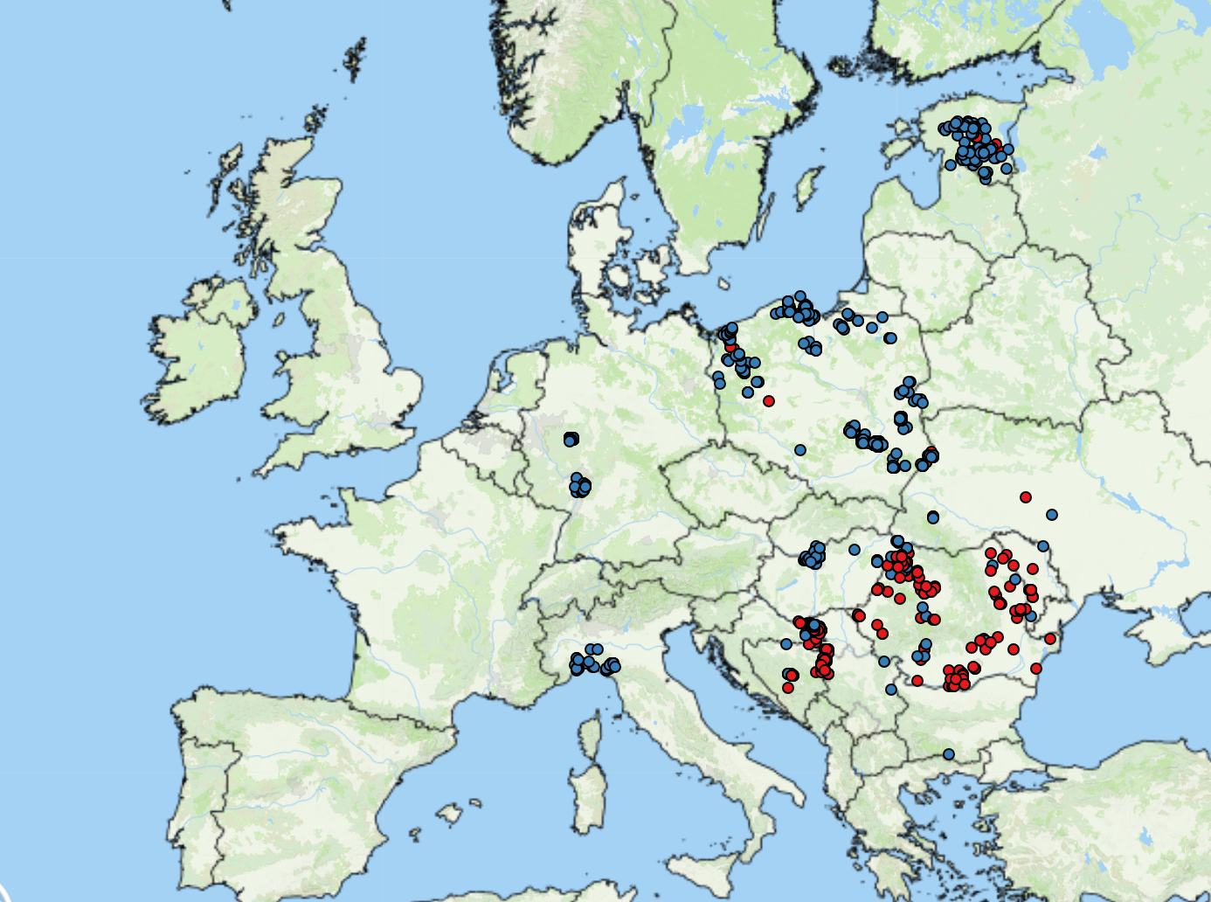
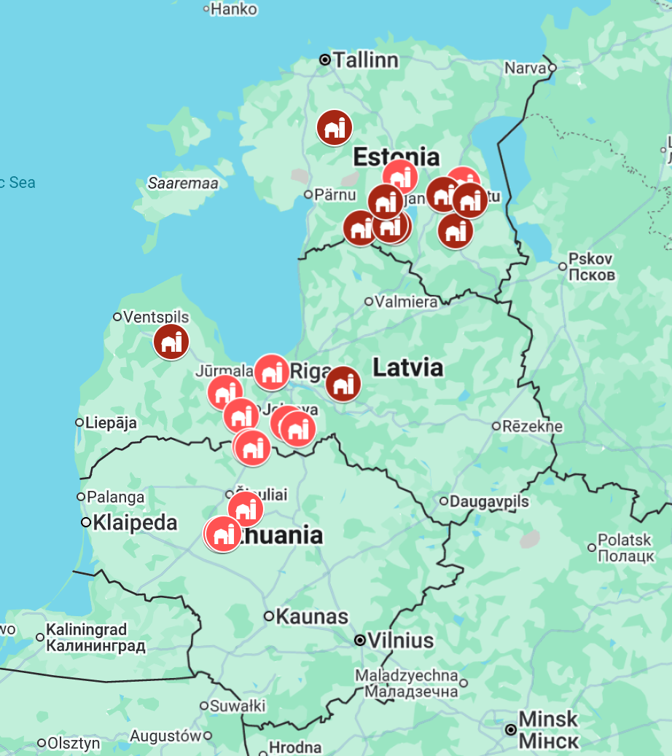
ASF Cases - Europe
No great changes in distribution from last report
  1,299 cases in Europe in Q3
  212 cases so far in Q4
No new declarations of freedom
Baltic State Outbreaks on Domestic Farms
Eight Years of African Swine Fever in the Baltic States: Epidemiological Reflections
ASF cases in Europe Q3
https://empres-i.apps.fao.org/general
Map Credit: Vincent ter Beek
Domestic Swine
Wild Boar
Notes:
Estonia – For Q3 there have been 6 farm detections and 106 wild boar cases, Q4 18 cases all in wild boar so far (annual total 11 domestic, 176 wild boar)
Latvia- 11 outbreaks in domestic pigs, 1022 in wild boar
Lithuania 8 outbreaks in domestic pigs, 600 in wild boar
Why such big increases in wild boar detections, populations that had previously declined due to the virus have recovered, and the young replacements are naïve to ASF. Summertime sees a spike in carcass detection and retrieval.

Slide 4
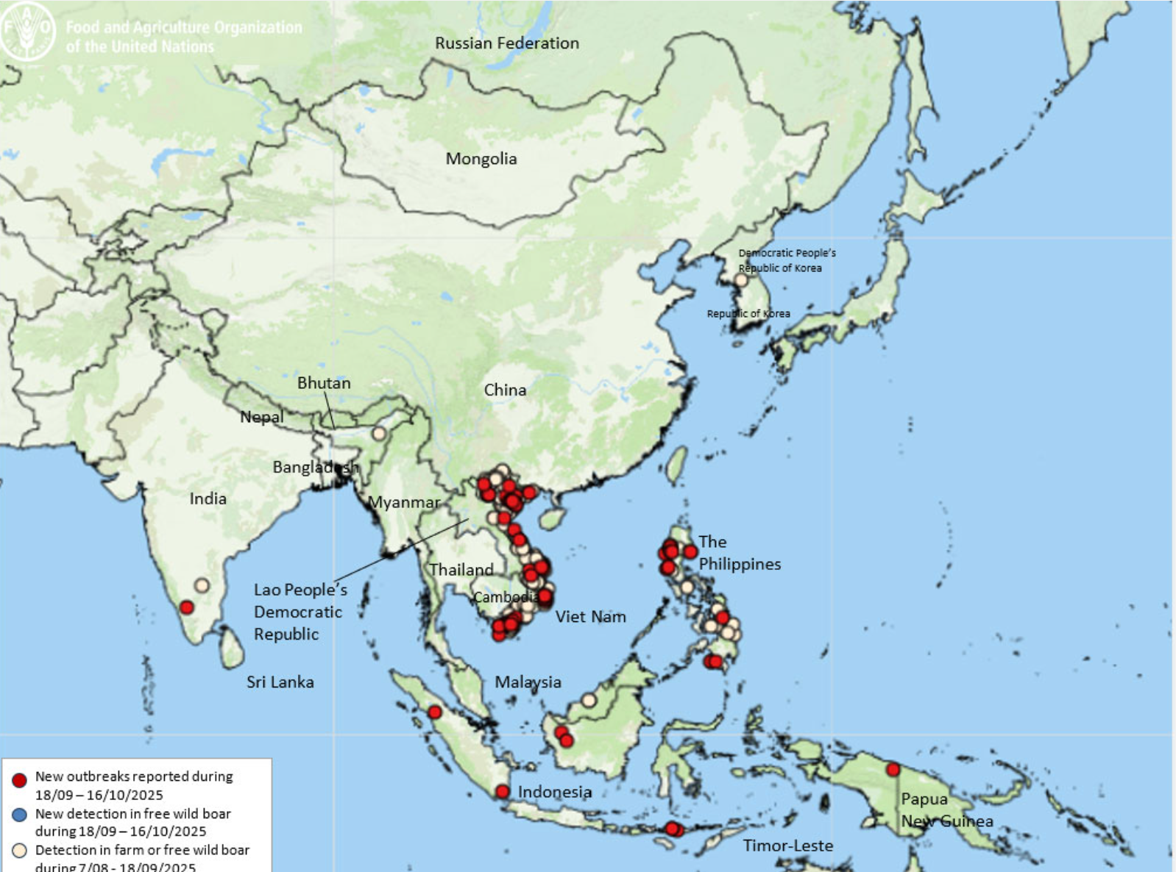
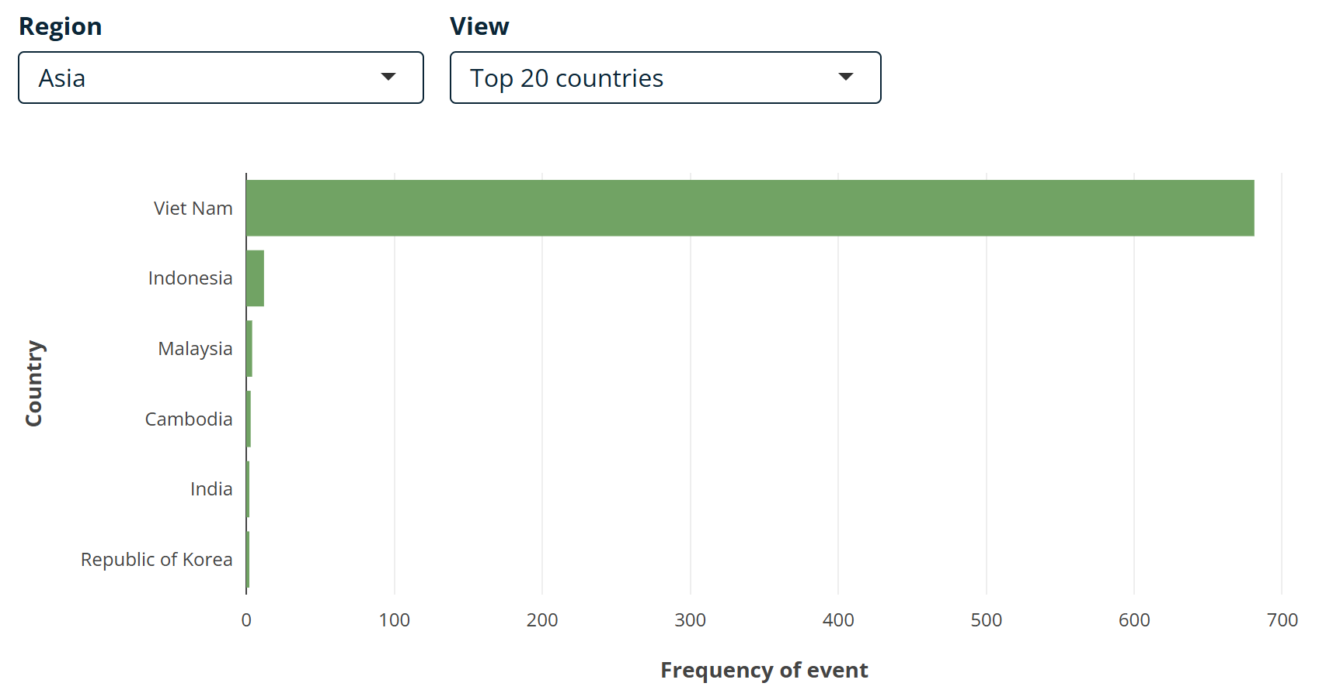
ASF Cases – Asia (Q3)
ASF situation in Asia & Pacific update
Ongoing high level of infection across Asia with the most cases reported by Vietnam
In Q4 the outbreak in Taiwan is most notable
  Taiwan had declared freedom from ASF
  Recent case genetically most similar to strains from China and Vietnam
  Improperly processed kitchen waste is likely source
  Taiwan Confirms ASF Case Genetically Linked to China and Vietnam What It Means for Global Pork Biosecurity | Farms.com
https://empres-i.apps.fao.org/epidemiology
Notes:
Kitchen waste fed to the pigs was incompletely steamed, those fed the kitchen waste had a mortality rate of ~39% compared to 2.5% for those fed regular feed. Another farm which fed the same kitchen waste, but the waste was completely cooked, has had multiple negative tests for ASF.
That is why it’s illegal to feed meat to pigs in Canada!

Slide 5
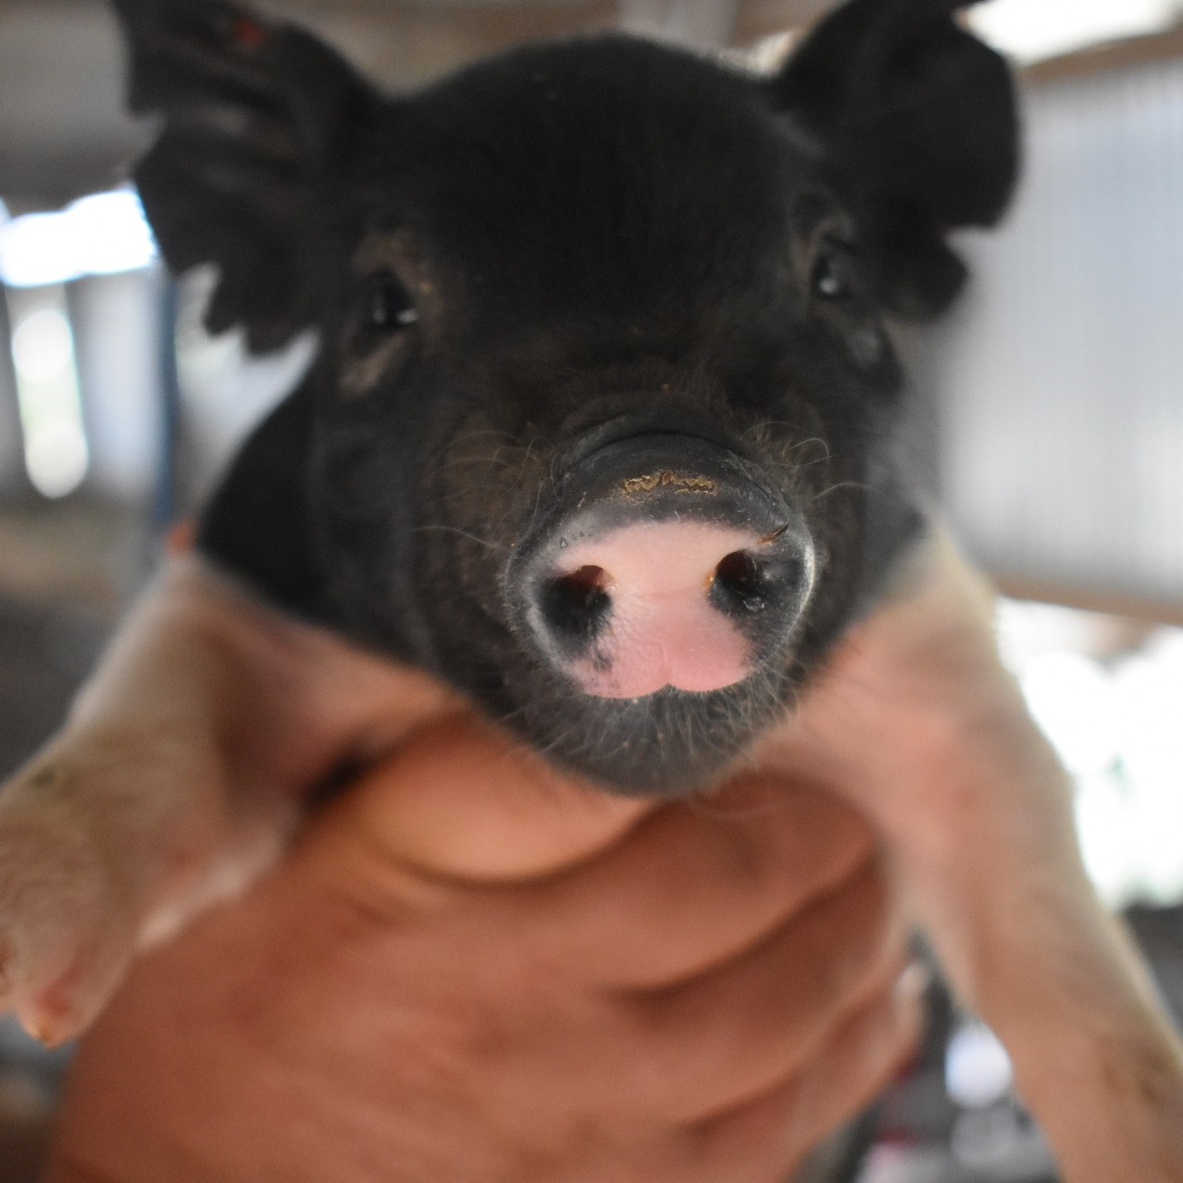
Full article: Pathogenicity and pathobiological characterization of a recombinant genotype I/II African swine fever virus in pigs
Lab challenge study
Shows that the recombinant genotype I/II is more virulent
  Shorter incubation period
  Earlier onset of high fever
  Rapid progression to death
  Higher level of virus in organs
  More severe hemorrhagic lesions (esp. lung and kidney)
  Jaundice
Small sample size
  10 - 7-week-old female pigs
Comparisons with Genotype II challenge studies not done concurrently

Slide 6
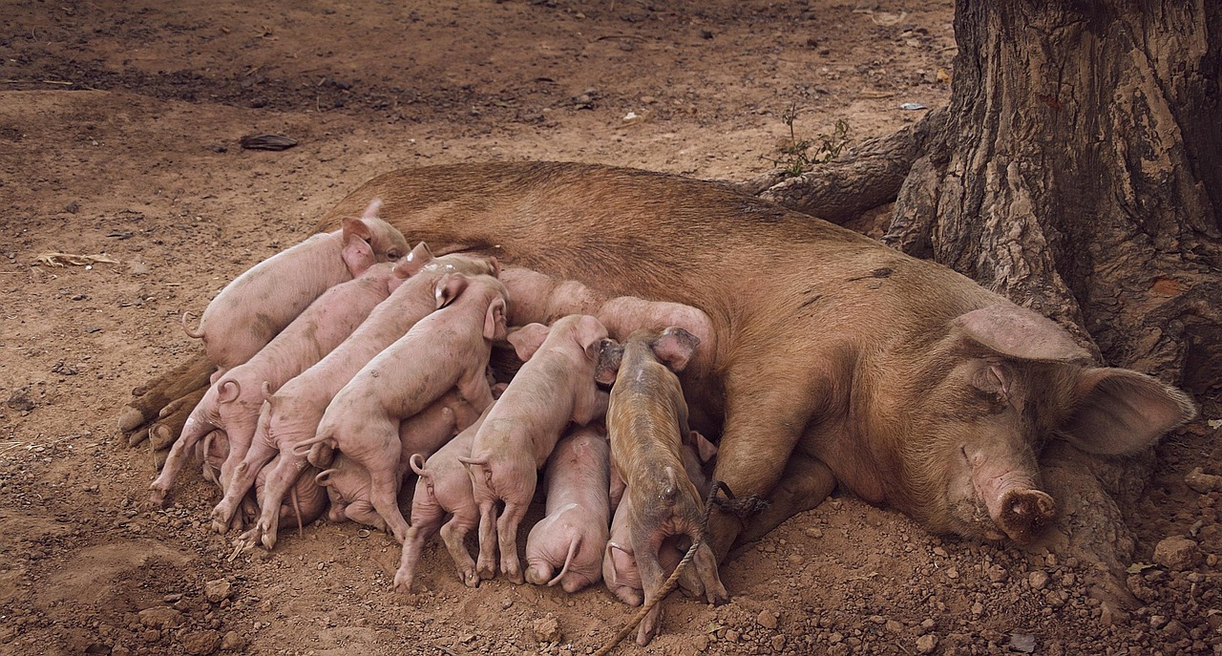
Back after 26 years: Brucella suis emerges in Danish pigs
First re-emergence since 1999
Free range farm 3850 pigs
Required to use double fencing
Investigation triggered due to reproductive losses
5 contact herds identified as positive
Source of infection unknown
Biovar 2 is found in hares and endemic in wild boar in Europe
Few if any wild boar in Denmark due to eradication policy and fencing at German border
Previously were able to export live animals due to freedom from B. suis
Significant impact on export certificates for Denmark
Notes:
After 25 years without cases, Denmark confirmed an outbreak of Brucella suis biovar 2 in a free-range pig herd in Herning on August 22, 2025, following confirmation by the French Agency for Food Safety and the Environment (ANSES) reference laboratory. The affected herd includes approximately 3,850 pigs, with no fatalities reported, though reproductive losses triggered suspicion earlier in August. The outbreak poses potential economic risks and raises concerns about zoonotic transmission, despite no human cases being identified to date.
5 contact herds identified as positive on iELISA
Control measures, including movement restrictions and traceability, have been implemented, but the source of infection remains unknown. Brucellosis had not been detected in Danish pig herds since 1999, making this re-emergence significant. Brucella suis biovars 1–3 mainly affect domestic pigs, feral pigs, wild boar (Sus scrofa), and other Suidae. Biovar 2 is also found in wild European hares (Lepus europaeus) and is endemic in wild boar across Europe, serving as a potential source of infection for domestic pigs. Outbreaks are often linked to farming practices and weak biosecurity, especially in areas with intensive pig production.
In Denmark, outdoor pig farms are required to use double fencing to prevent public access and contain the pigs. While Denmark has no free-ranging wild boar, stray animals from neighboring countries have occasionally been detected and are culled under the current policy. The recent confirmation has had a significant impact on animal certification and trade. A total of 89 export certificates have been flagged, and the standard certification basis for pig movements within the EU can no longer be applied. Currently, pigs can only be moved to other EU countries if they originate from farms that maintain animals under controlled housing conditions and adhere to proven biosecurity and risk mitigation measures to prevent the spread of brucellosis. Farms keeping pigs outdoors or receiving animals from outdoor systems are excluded, as they cannot meet the required standards. Previously, Denmark benefited from an exemption allowing exports under the assumption of freedom from brucellosis for five years. With the August 2025 outbreak, this exemption is no longer valid, and movements for production to other EU countries are suspended. The Danish Veterinary and Food Administration is currently developing a pre-movement monitoring program to support future certification and restore export possibilities.

Slide 7
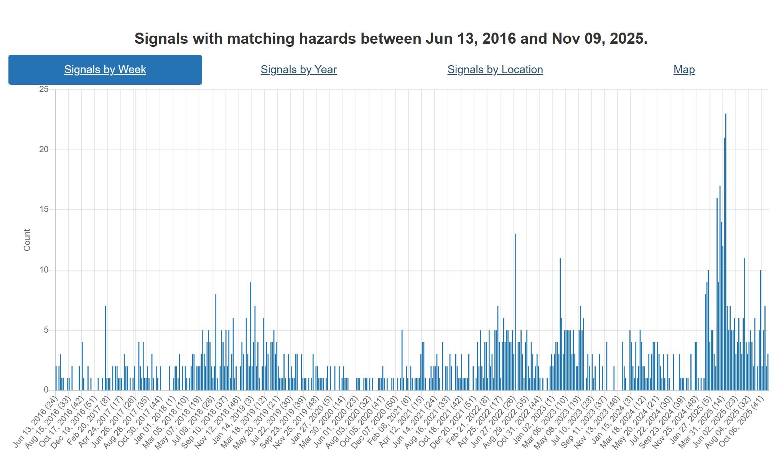
Foot and Mouth Disease – Hazard Trend
Slovakia
COVID
SAT-2
Middle East
Hungary
Indonesia
Germany
SAT-1
Middle East
& Turikye
October Report 2025_fv
Notes:
The trend line doesn’t look different from the last meeting, however, there are concerning changes in the distribution of SAT-1.

Slide 8
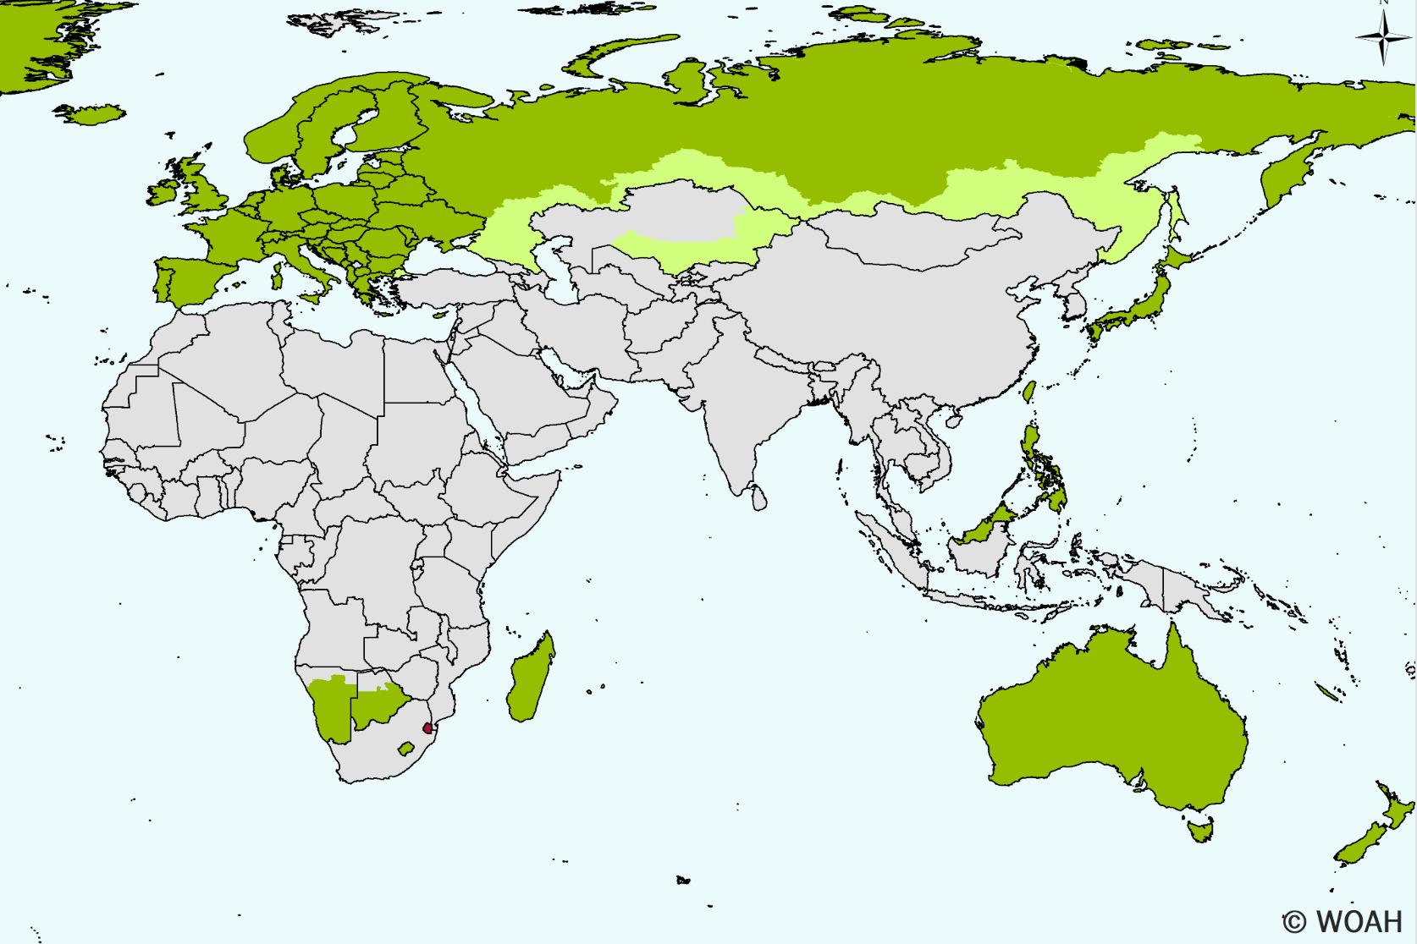
FMD SAT-1 Spread
FMD SAT-1 had been spreading in the Middle East and North Africa (Iraq, Bahrain, Egypt, Kuwait)
Türkiye has an ongoing high number of cases 78 last month ADIS outbreaks-weekly-report
Cases also now reported in Azerbaijan and Iran
  Insufficient vaccine to manage the outbreaks
Country Reports: 2025 | World Reference Laboratory for Foot-and-Mouth Disease
Buffer zone of vaccinated animals in Russia may protect Europe if SAT-1 is included in the vaccine used. Vaccine strains used in the buffer zone are uncertain.
https://www.egyptwindow.net/article/4892689

Slide 9
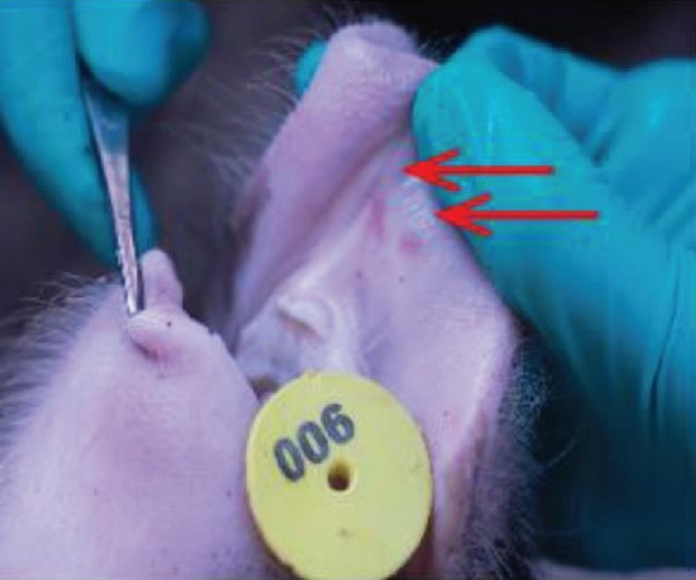
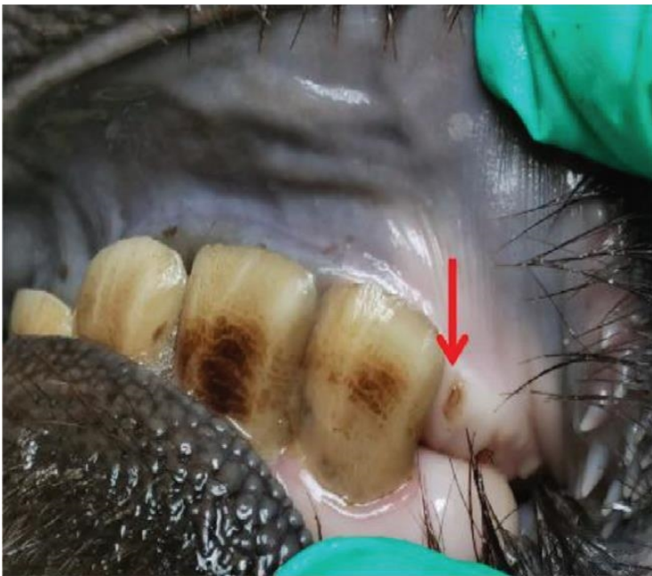
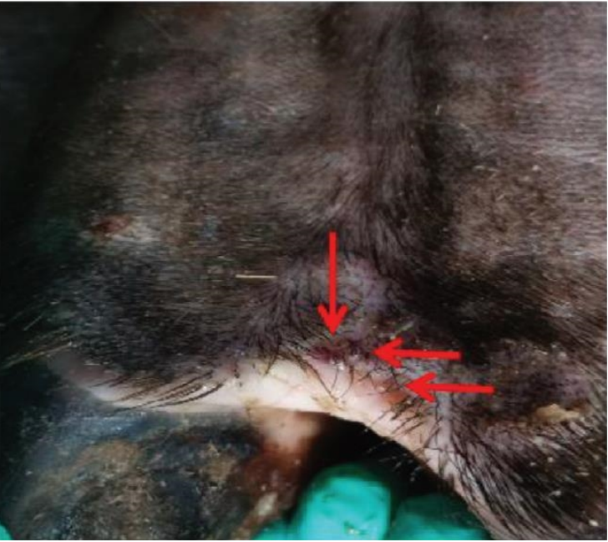
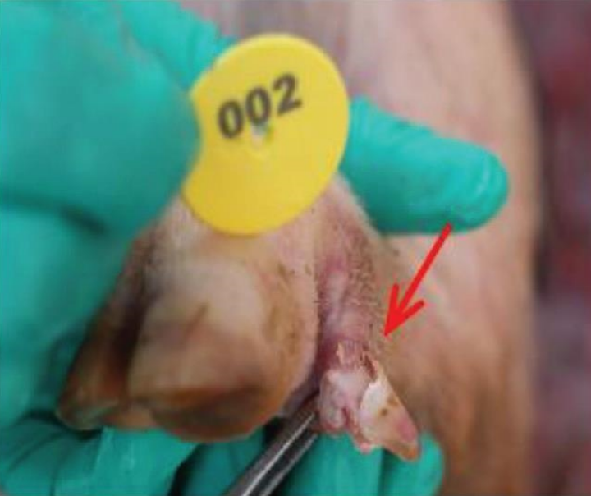
Pathogenicity of the First Buffalo‐origin Senecavirus A in Conventional Piglets and Buffaloes - Zhou - 2025 - Transboundary and Emerging Diseases - Wiley Online Library
2018 SVA identified in a Buffalo in Guangdong Province
Animal had mouth ulcers
Virus had 99% genetic similarity with a wild boar origin strain
Challenge study shows that the strain is pathogenic to buffalo and piglets
  Vesicular lesions and systemic infection
Notes:
SVA is traditionally associated with vesicular disease in swine. However, neutralizing antibodies have been detected in small populations of cattle and wild mice in the United States, suggesting possible exposure without overt clinical signs.
In 2018, SVA was identified in a buffalo in Guangdong Province, China — the first confirmed detection in this species. The buffalo-origin strain, SVA/GD/China/2018, was isolated from an animal with mouth ulcers and shares over 99% genetic similarity with a wild boar-origin strain. A recent study has shown this strain to be pathogenic in both buffalo and piglets, causing vesicular lesions and systemic infection. Viral antigens were found in lung tissue, nasolabial regions, and blister lesions, with severe symptoms observed at high viral doses.
These findings raise important questions about cross-species transmission and biosecurity in mixed-species operations.

Slide 10
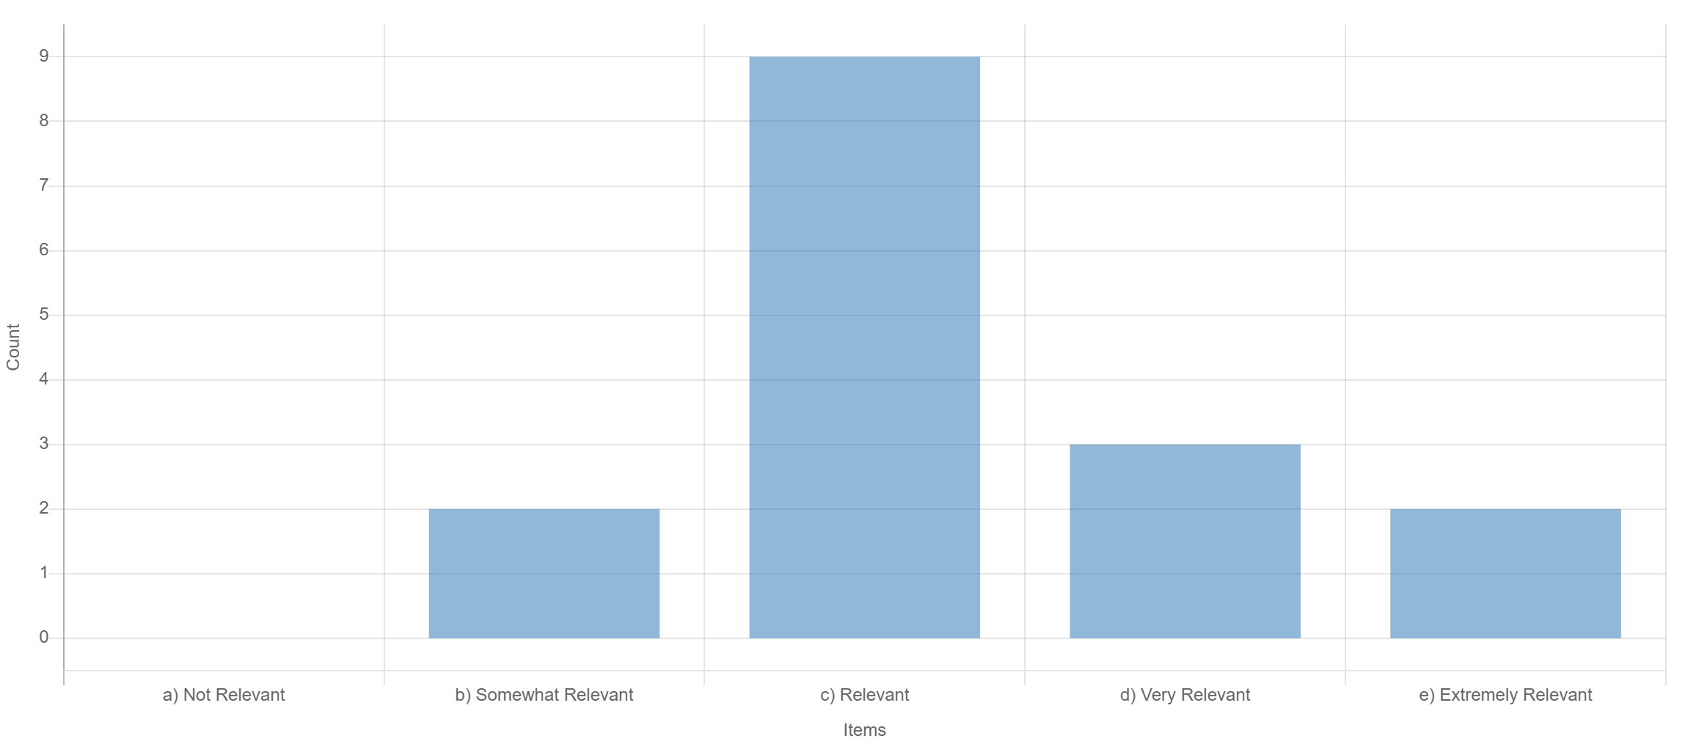
Pathogenicity of the First Buffalo‐origin Senecavirus A in Conventional Piglets and Buffaloes - Zhou - 2025 - Transboundary and Emerging Diseases - Wiley Online Library
Community Feedback:
Significant trade implications
Need to differentiate SVA from FMD
Extremely relevant if other livestock species can be affected

Slide 11
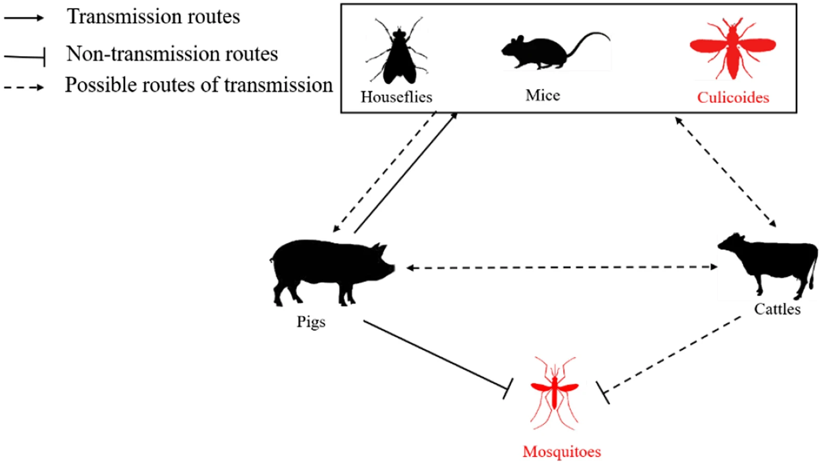




SVA Transmission Pathways Found (quick search)
Detection of the Emerging Picornavirus Senecavirus A in Pigs, Mice, and Houseflies | Journal of Clinical Microbiology
Detection of SVA in mice and housefly samples and recovery of viable virus from mouse feces and small intestine suggest that these pests may play a role on the epidemiology of SVA
Prolonged Viability of SenecaVirus A in exposed houseflies (Musca domestica)
Evidence of vertical transmission of Senecavirus A in naturally infected sows - ScienceDirect
Direct
Indirect
Pathogenicity of Seneca Valley virus in pigs and detection in Culicoides from an infected pig farm
Stability of Senecavirus A in animal feed ingredients and infection following consumption of contaminated feed
Seneca Valley virus RNA detection in pig feed and feed ingredients in Brazil - Leme - 2019 - Transboundary and Emerging Diseases - Wiley Online Library
Are any pathways missing?

Slide 12
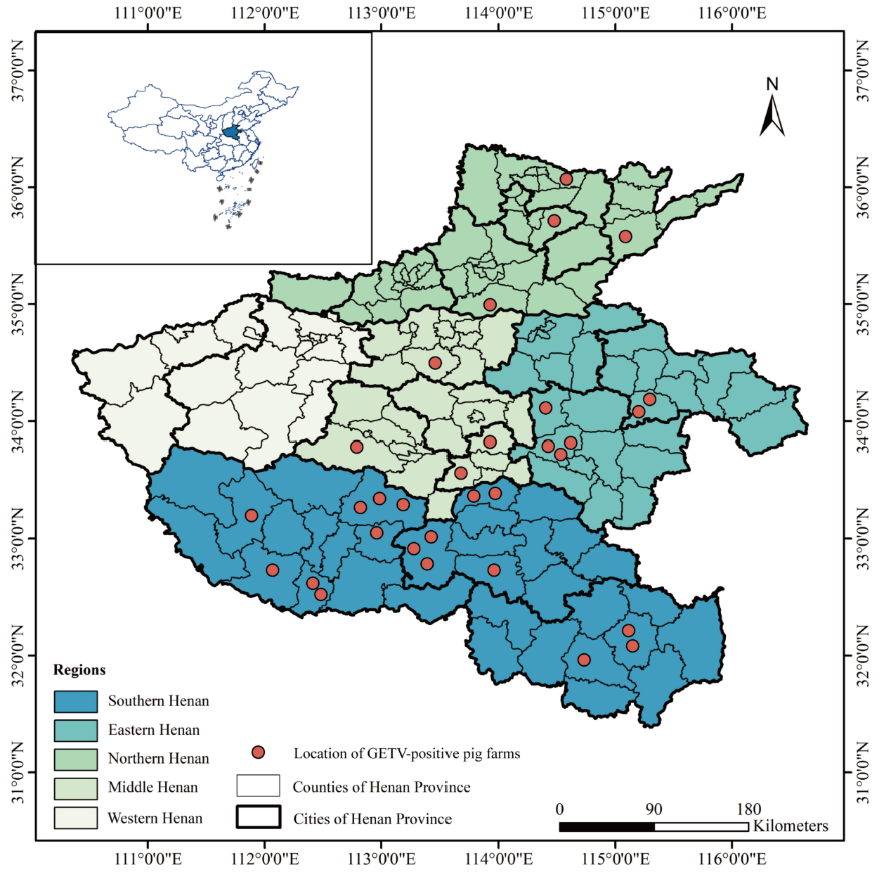
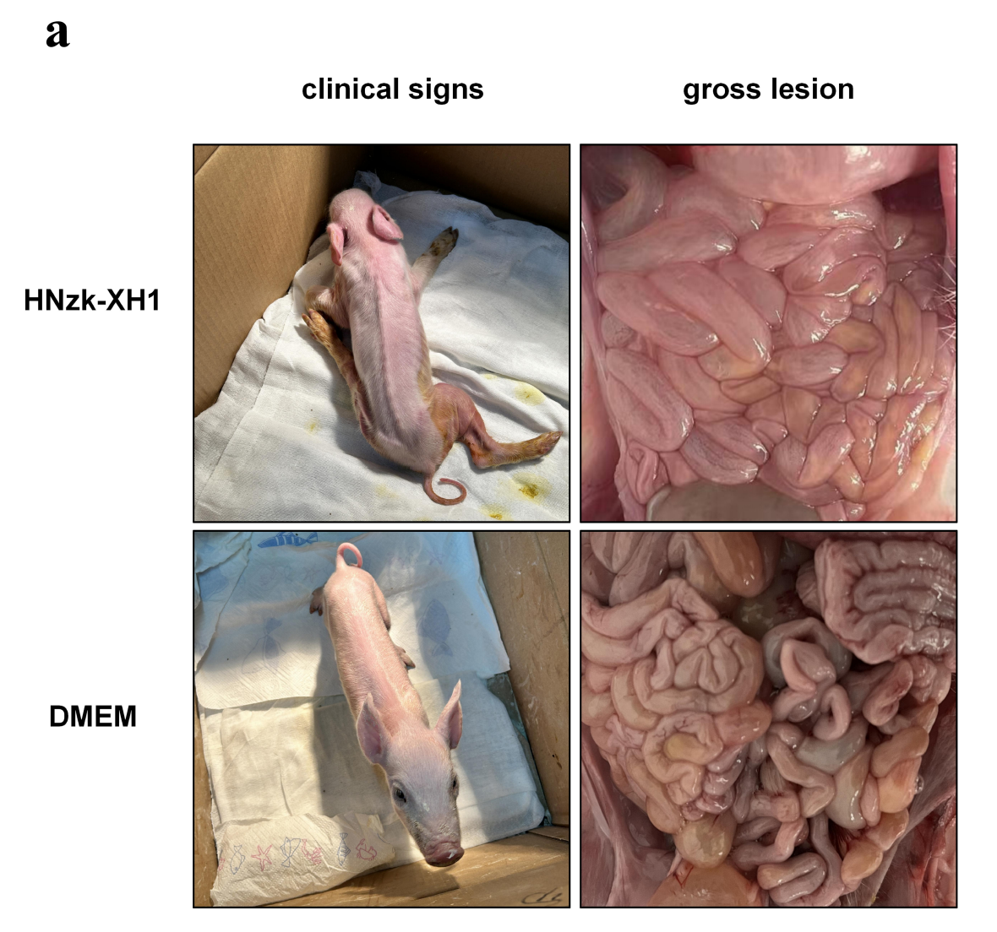
Full article: Outbreak and epidemic of Getah virus infection in swine by virulence-enhanced GIII variant in Henan, central China in 2024
Paper Published on Getah virus variant in Henan Province, China
Showed a more virulent strain of Getah virus and identified key mutations in the virus
Paper published July 2025

Slide 13
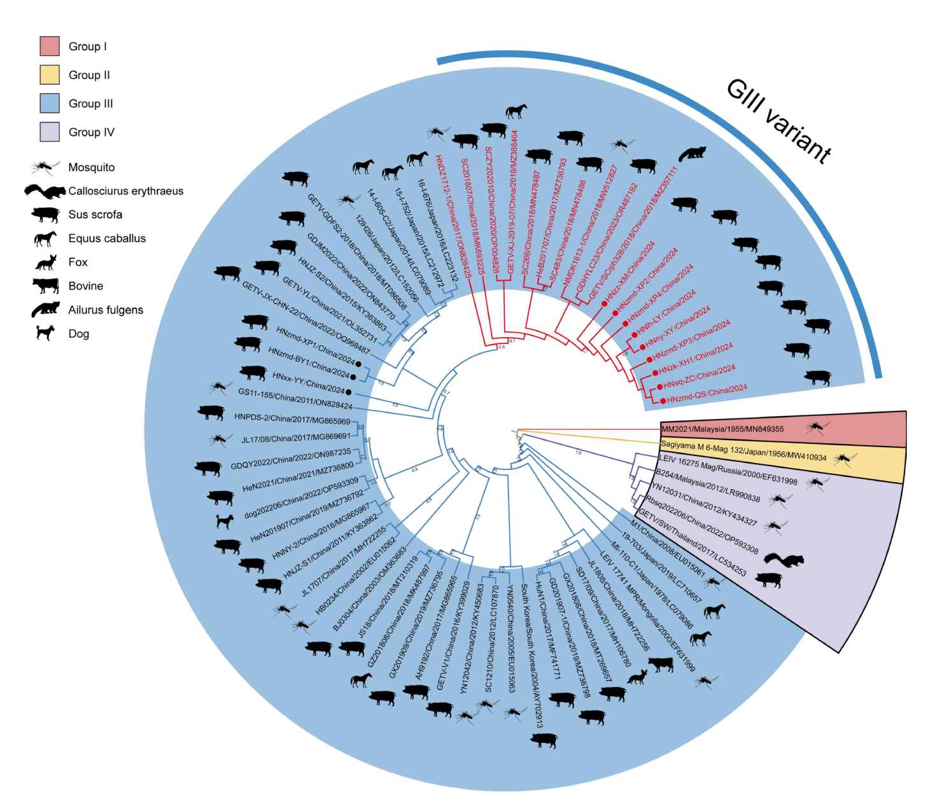
Full article: Outbreak and epidemic of Getah virus infection in swine by virulence-enhanced GIII variant in Henan, central China in 2024
Virus shows multiple mutations from previous strains and is more pathogenic
Variant has been found in pigs, horses, mosquitos and Pallas’ tree squirrel
September 2025
The outbreak of pig gaita virus in Henan and other provinces has a very high mortality rate and is spreading across the country (group photo) - Pig farm - Piglet - Blogger - Social Situation - -See China.com - (Mobile version)
High mortality rate across multiple Provinces
States 95% positive piglets with 100% mortality
Getah virus in the Canadian Context

Slide 14
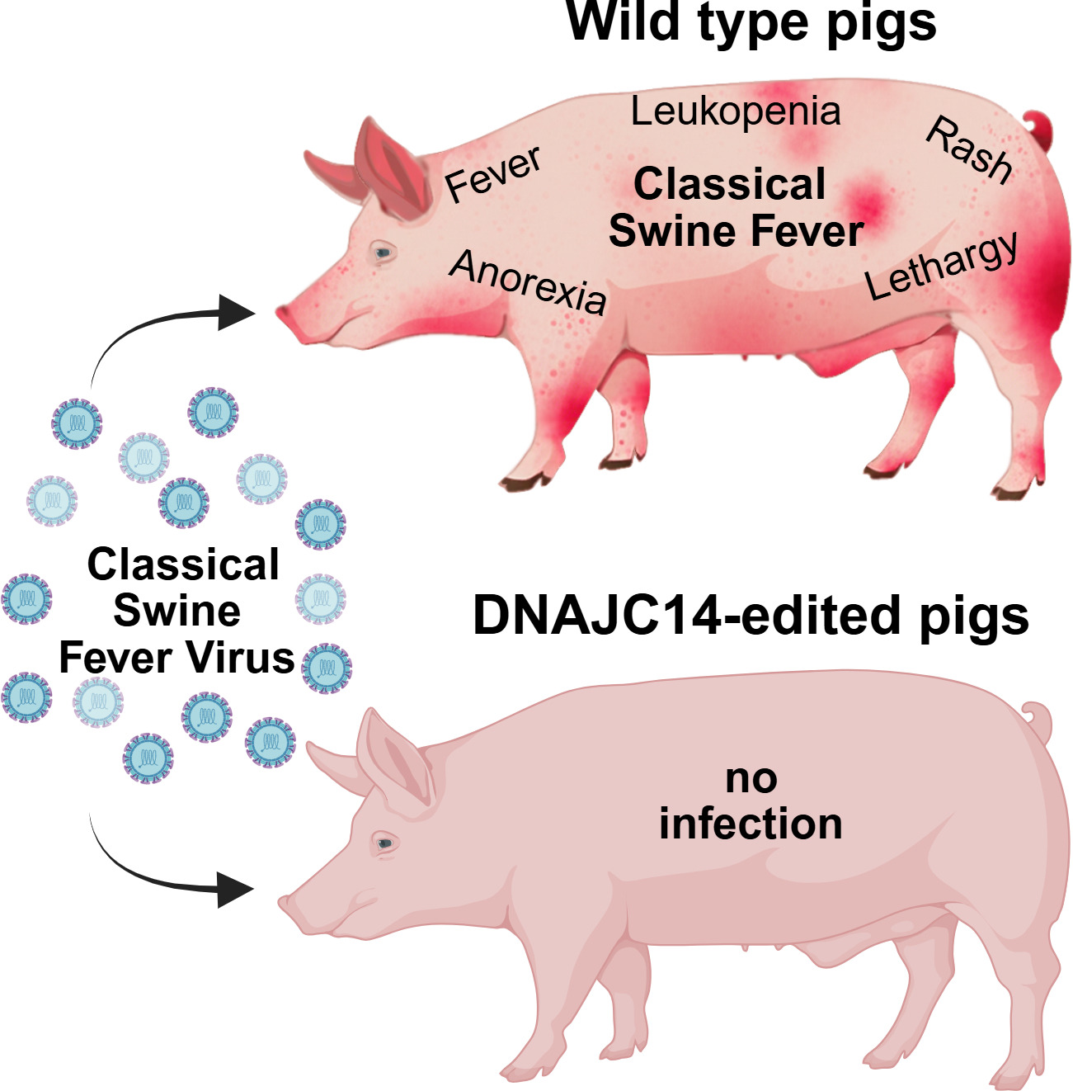
DNAJC14 gene-edited pigs are resistant to classical pestiviruses - ScienceDirect
CRISPR/Cas9 gene editing
Pigs produced with altered DNAJC14 genes
In vitro – cells did not support viral replication of CSFV or BVDV
In vivo – complete resistance to infection
Small sample size, only a single virus used in challenge, uncertain impacts on animal health and welfare

Slide 15
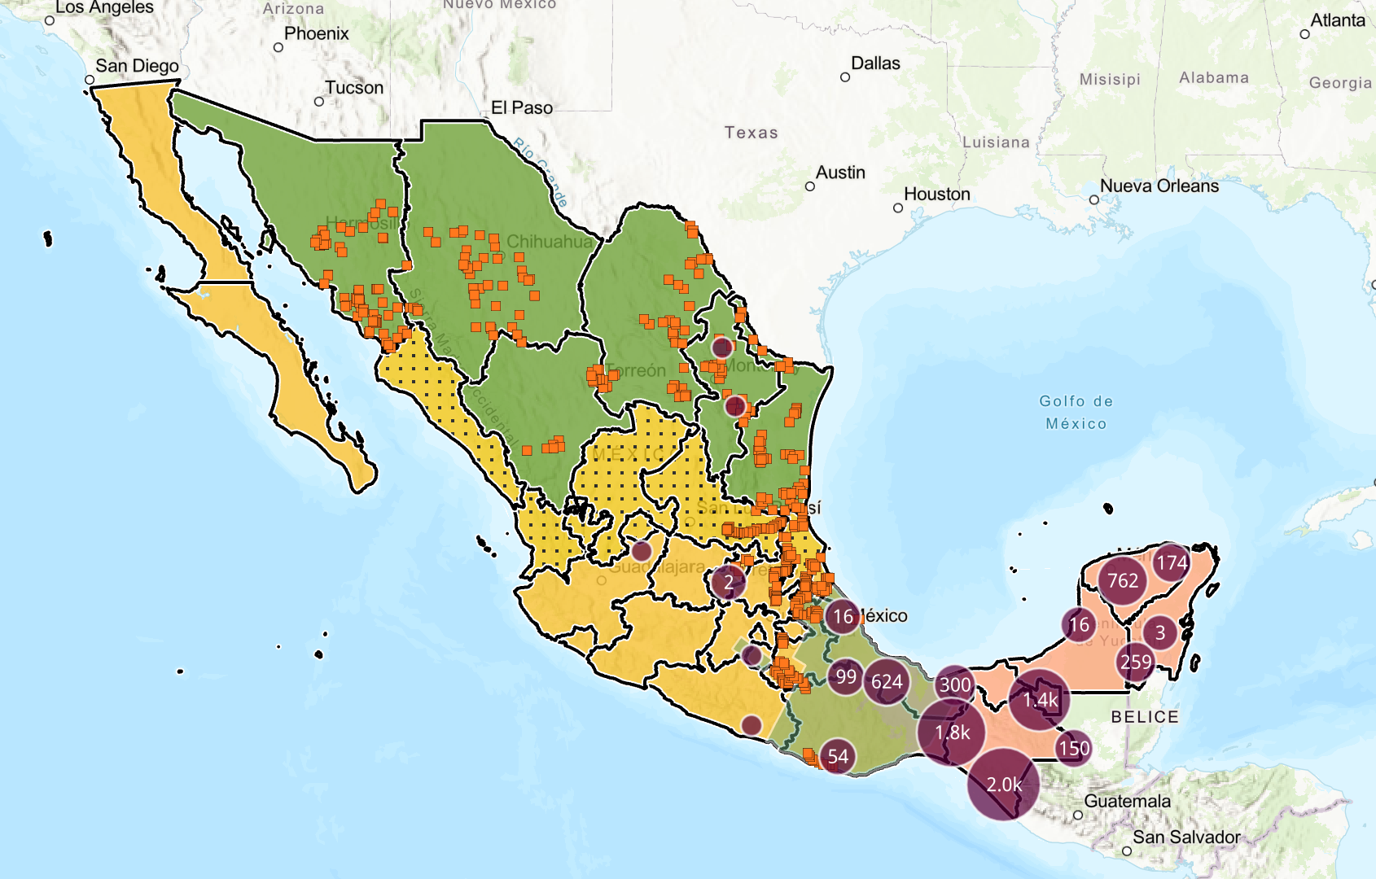








New World Screwworm
Species Affected
All warm-blooded vertebrates
Current Geographic Distribution
Accumulated detections
Notes:
The New World Screwworm is an immediately notifiable disease in Canada, it affects all warm-blooded vertebrates including humans.
The parasitic fly has been migrating steadily northwards from the Darien gap in Panama since 2023, it has now been detected as close as ~110 km from the US border in Nuevo Leon in September 2025. A control program is currently underway in Mexico, areas considered positive are shown in pink, all cases are identified with the burgundy circles, the sterile fly release zone is the most southern green band on this map, the yellow areas are buffer zone with the yellow stippled area having inspection of animals moving north. Green area is considered free, with the orange squares indicating locations of fly traps.
The fly cannot establish in Canada due to our winter conditions, however, introductions during the spring or summer could see several generations of flies develop prior to their destruction in colder months.

Slide 16
Survival in Canada if Introduced
Winter (Nov – March)
Summer (April – October)
Nowhere in Canada exceed the thresholds defined for NWS overwintering in the southern United States (9.4 °C for December–February)
Average soil temperatures above 8 °C for 60 consecutive days, which would be necessary for pupal survival.
NWS cannot overwinter in Canada under current climatic conditions
Life cycle is extended as temperature lowers
  18 days at 29 °C
  44 days at 15 °C
In Southern Canada, environmental conditions may support the emergence of adults two to four times over the course of the summer, indicating a limited but plausible possibility of seasonal establishment.
  Development of pupae into adult fly: April to September
  Ovarian maturation of adult flies can occur from May to September

Slide 17
Scientific Findings
Porcine Deltacoronavirus-Related Viruses in House Sparrows
A multi-disciplinary approach to identify spillover interfaces of bat coronaviruses to pig farms in Italy | PLOS One
Emergence of African swine fever in Bangladesh: key findings from an outbreak investigation | BMC Veterinary Research | Full Text
Influenza D Virus Circulation Among Bovines, Swine, Equines, and Wild Boars in Italy: A Sero-Epidemiological Study
Sources and sinks of influenza A virus genomic diversity in swine from 2009 to 2022 in the United States | Journal of Virology
Identification of H1N2 influenza viruses in turkeys after spillover from swine and in vitro characterization – ScienceDirect
Whole‐Genomic Characterization of Two Different PRRSV‐1 Strains Isolated From a Single Pig - Gong - 2025 - Transboundary and Emerging Diseases - Wiley Online Library
ASF outbreaks in Vietnam (2019–2024): insights and lessons learned | Veterinary Research Communications
Detection of African Swine Fever Virus Genotype II in West Africa (2020) and Its Co‐Circulation With Endemic Genotype I: Implications for Pig Production - Meki - 2025 - Transboundary and Emerging Diseases - Wiley Online Library

Slide 18
Scientific Findings
Pathogenicity of the First Buffalo‐origin Senecavirus A in Conventional Piglets and Buffaloes - Zhou - 2025 - Transboundary and Emerging Diseases - Wiley Online Library
Fecal and Environmental Shedding of Influenza A Virus in Brazilian Swine: Genomic Evidence of Recent Human-to-Swine Transmission
Epidemiological and molecular retrospective analysis of porcine circovirus 3 in the US grower-finisher herd – ScienceDirect
Evaluation of Cross-Protection of African Swine Fever Vaccine ASFV-G-ΔI177L Between ASFV Biotypes
Active surveillance for influenza A virus in swine reveals within-farm reassortment and cocirculation of distinct subtypes and genetic clades – ScienceDirect
Emerging threats of HPAI H5N1 clade 2.3.4.4b in swine: knowledge gaps and the imperative for a One Health approach
The first detection of swine orthopneumovirus at a pig farm in Sweden: A case report
Disruption of influenza A virus transmission in gene-edited pigs

