Slide 1
Community for Emerging and Zoonotic Diseases
Identifying emerging risks through collective intelligence
CEZD – CAHSS Vector Network Update
2 June 2025
www.cezd.ca

Slide 2
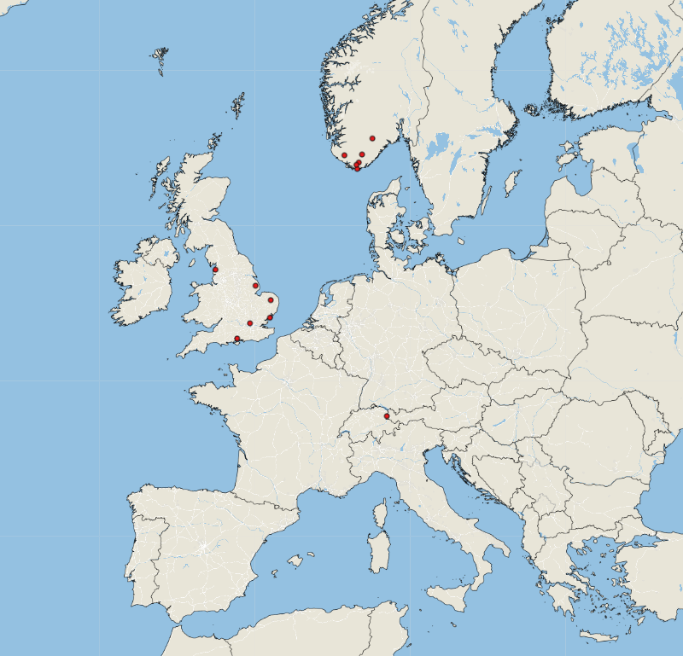
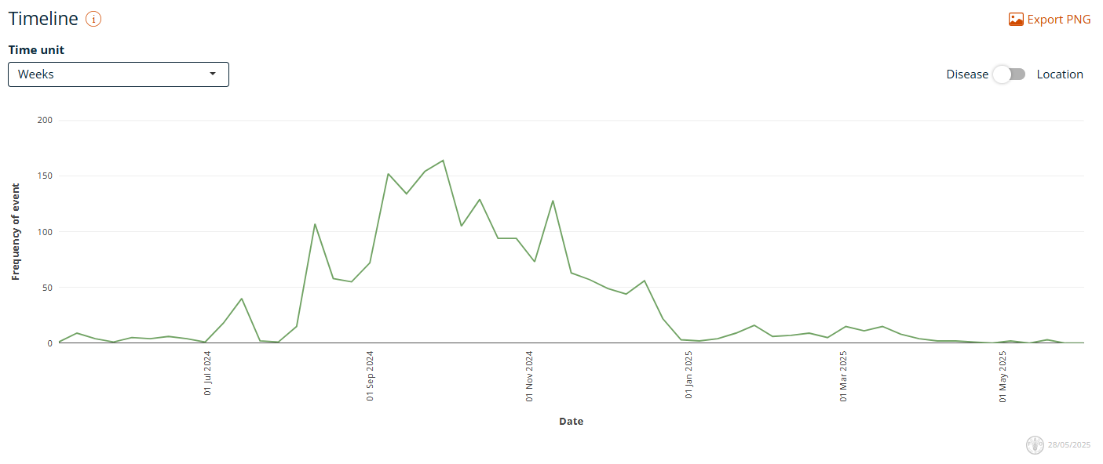
Bluetongue virus (BTV-3) in Europe
First reported Sept 5, 2023 in the Netherlands
Source of infection has never been identified
Few sporadic reports from Norway & UK
BTV-3 March 24, 2025 – May 28, 2025
Investigation of the global transportation of Culicoides biting midges, vectors of livestock and equid arboviruses, from flower-packing plants in Kenya
Are Culicoides present within flower packaging plants in Africa?
Present in small numbers outside and within greenhouses, but declined with each stage of production
Risk of exporting Culicoides with packaged cut flowers is likely very small
Empres-Plus
Notes:
Very few reports over the last ~2 months. We’ve had 13 events of BTV reported in EMPRES-I (all BTV-3), 6 events from Norway, 6 from the UK, and then 1 from Africa (Botswana).
However, report tend to increase in late July.
Netherlands has not updated their case counts since April 10: Bluetongue positive per municipality 2024 | Map | NVWA

Slide 3
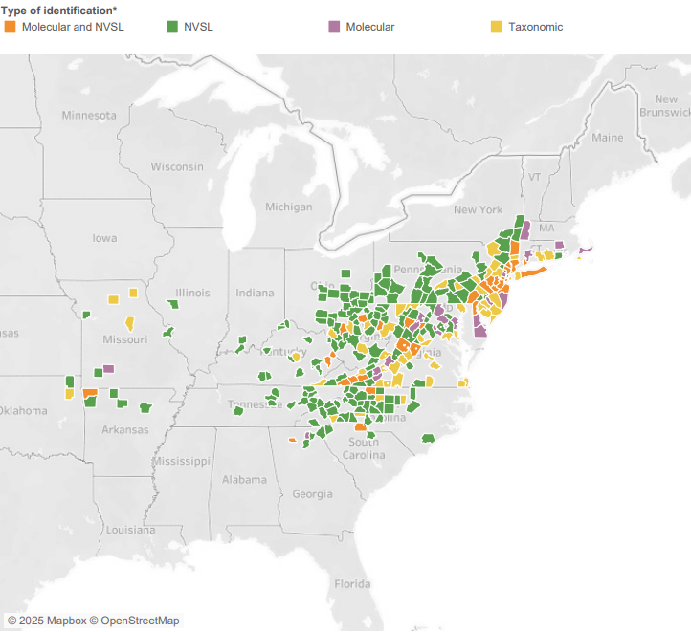
Longhorn Tick and Theileriosis in the USA
Lack of resources, competing priorities, June call is cancelled
State – reduced surveillance activities (resources, weather)
~59% of affected counties are established
Majority of recent findings are nymphs
Reports of nymphs waking up after being in -20 degrees for two weeks
Evidence of pathogens overwintering in ticks (from Japan, 1985): The presence of Theileria sergenti in Haemaphysalis longicornis overwintering in pasture in Japan
USDA Haemaphysalis longicornis (Asian longhorned tick) Situation Report – May 2025
https://scwds.shinyapps.io/haemaphysalis/
Notes:
Not too much has changed here, no new states, a few new counties in already affected state reported. ~59% of affected counties are classified as established.
Established definition: at least six individual ticks, or 2 of 3 life stages collected in single collection period (one year)

Slide 4
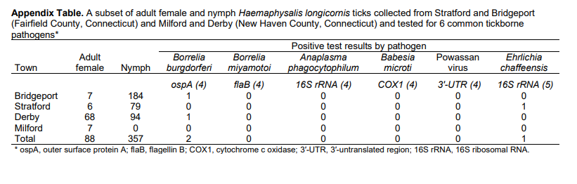
Ehrlichia chaffeensis DNA in Haemaphysalis longicornis Ticks, Connecticut, USA
Screened ticks collected in Connecticut 2021-2023 to assess potential human pathogens
3 nymphs positive for pathogens:
  1 for Ehrlichia chaffeensis (from feeding on white tail deer?)
  2 for Borrelia burgdorferi
Notes:
Ehrlichia chaffeensis is the most common causative agent of human monocytic ehrlichiosis (HME) and is transmitted primarily by the lone star tick.
Collected 8,700 H. longicornis larvae (n = 8,120), nymphs (n = 412), and adult female ticks (n = 168) we collected from 4 towns in southwestern Connecticut during 2021–2023
Tested 88 females and 357 nymphs for evidence of infection. Of those ticks, 2 (0.6%) nymphs tested positive for B. burgdorferi, and 1 (0.8%) nymph collected in May 2021 from Stratford (41.1526°N, 73.1471°W) tested positive for E. chaffeensis
The Stratford site where the E. chaffeensis–positive specimen was collected is frequented by white-tailed deer, and repeated surveys have revealed that the area is heavily infested with H. longicornis and A. americanum. White-tailed deer are known reservoir hosts for E. chaffeensis
Due to the fact that the ALHT does ocassiaonaly bite humans and it has been reported to partially feed in host-seeking may lead to human pathogen transmission as the tick could try to complete a blood meal after partially feeding on an infected host.

Slide 5
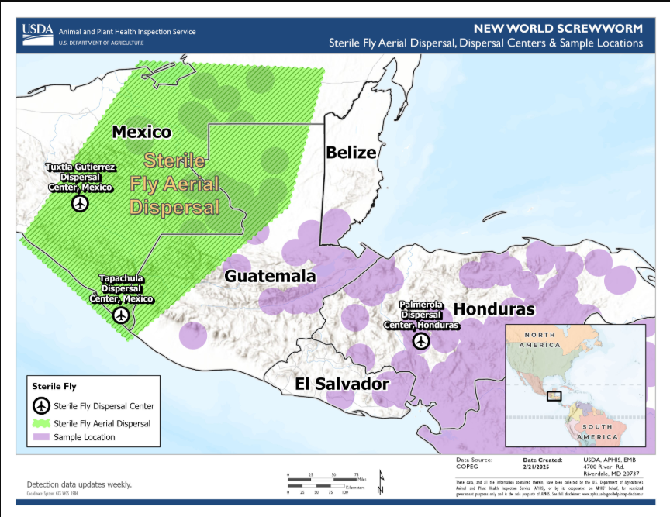
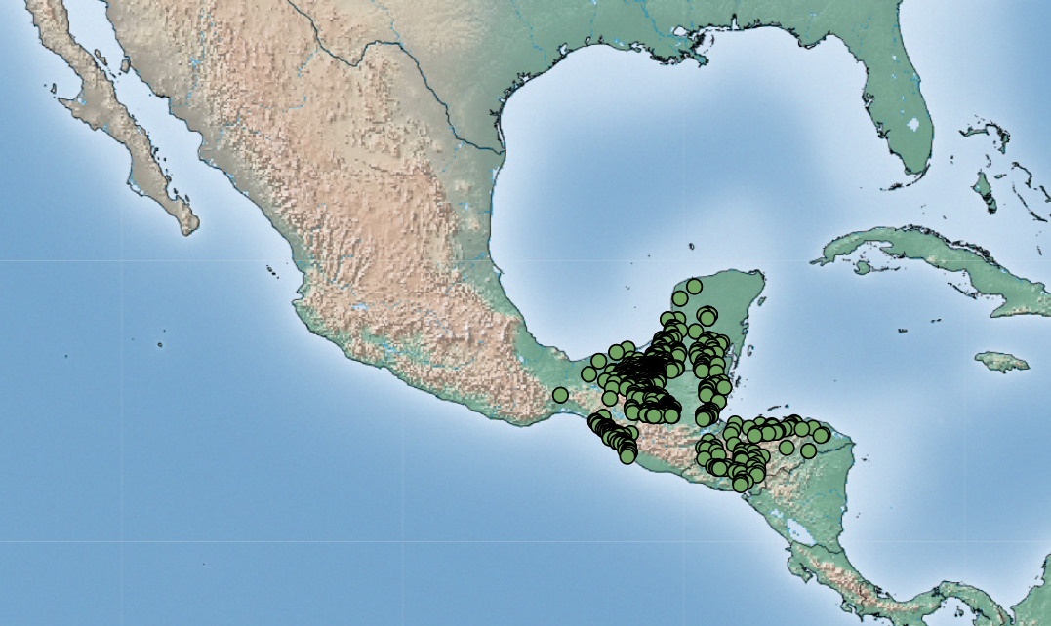
New World Screwworm in Central America and Mexico
NWS has now been found as far north as the Yucatan peninsula, Oaxaca and Veracruz (942 cases since Jan 1, 2025)
Sterile fly release moved to Mexico to try and prevent further northward movement
But flies surpassed that location recently
USDA states that the eradication of NWS in Central America with re-establishment of controls at the Darian gap are the aim of the program
11 May – USDA closed border to imports of animals from Mexico
Additional human cases reported from Mexico, Honduras, Costa Rica
January 1 – May 9 2025
COPEG
Notes:
The fly can travel four kilometers a day flying and if it is mobilized in animals transported in trucks it can be transported up to 400 kilometers
Some modelling predictions indicate that the screwworm could arrive in Sonora in September, but could also be earlier

Slide 6
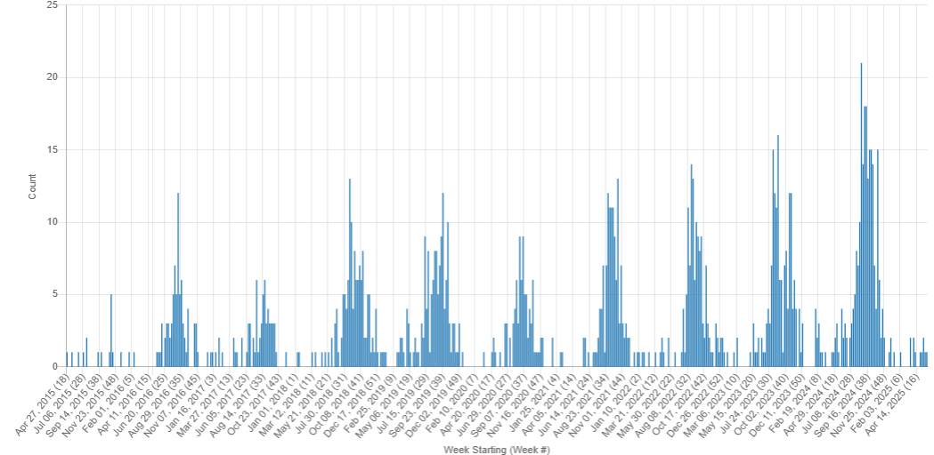
West Nile Virus
Starting to see signals from the US in the last two weeks: Illinois (mosquitos), California (mosquito), Alabama (human)
UK reported its first finding of WNV genetic fragments in mosquitos (Aedes vexans) in Nottinghamshire collected in July 2023
Italy and Romania have also reported human cases in 2025
WNV Signals: April 2015 – May 2025

Slide 7
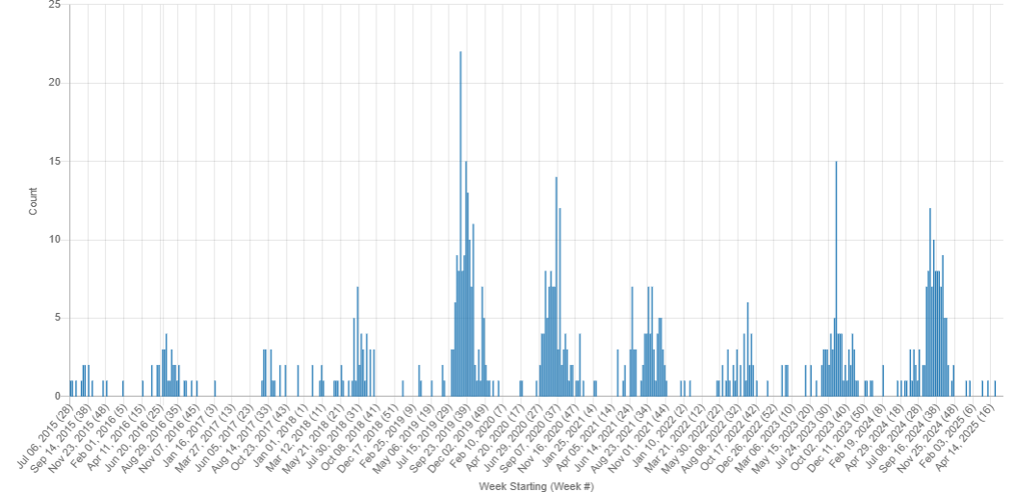
Eastern Equine Encephalitis
EEE in a Florida donkey (mid-April)
EEE in Pennsylvania wild turkey (late 2024)
EEE Signals: July 2015 – May 2025
Notes:
Only two EEE signals over the lasy ~2.5 months
On April 17, a yearling donkey in Lake County, Florida, tested positive for Eastern equine encephalitis (EEE) after developing clinical signs on April 3. The donkey is now deceased. Last year we started seeing EEE signals mid April.
The case of the turkey in Luzerne County originated when the Pennsylvania Game Commission was contacted after the bird was spotted acting erratically and walking in circles. George said the virus is transmitted mainly among birds. Aside from wild turkeys, Lau said the disease can impact pheasants, quail and deer. Because it’s spread by mosquitoes, wildlife cases tend to merge in late summer
Luzerne county had previously reported a case in a horse and wild deer

Slide 8
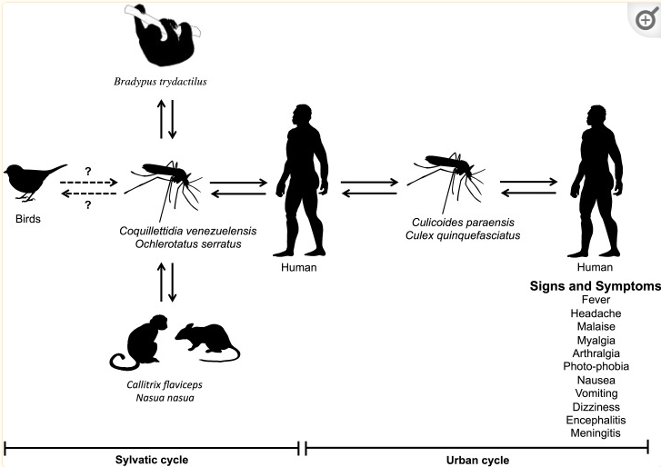
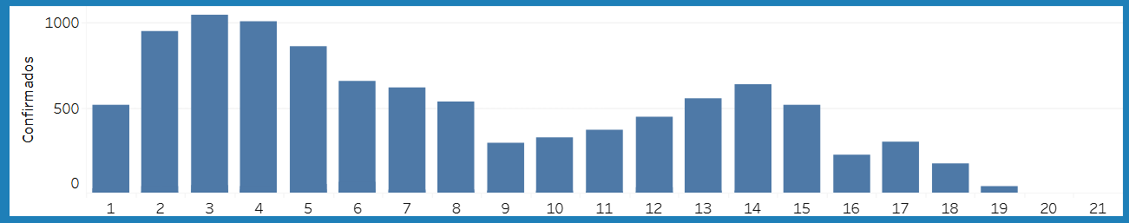
Oropouche virus
PAHO reported OROV case across 9 countries:
  Brazil – 10,076 confirmed
  Cuba – 2,452 suspected (16 confirmed)
  Panama – 287 confirmed
  Peru – 233 confirmed
Investigations into vertical transmission in Brazil
PAHO OROV research agenda
Re-emergence of Oropouche
virus as a novel global threat
Oropouche Virus: Clinical, Epidemiological, and Molecular Aspects of a Neglected Orthobunyavirus
PAHO Oropouche ARBOportal – weekly OROV cases for 2025
Notes:
In 2025, between epidemiological week (EW) 1 and EW 19, there were 10,639 confirmed Oropouche cases reported the Americas Region. Confirmed cases were reported in nine countries in the Americas Region: Brazil (n= 10,076 cases), Canada and US ( each had 1 imported case), Cuba (n= 16 confirmed cases 2452 suspect), Guyana (n= 1 case), Panama2 (n= 287 cases), and Peru (n= 233 cases), Venezuela 5 cases, Colombia had 21 cases
For Brazil, this is a 56% increase in cases compared to the same period last year (6440). Have not seen much more information on the situation in Cuba.
2024 in Brazil, there were five confirmed cases of vertical transmission (four fetal deaths and one case of congenital anomaly) and further investigation of fetal deaths, f miscarriages, and congenital abnormalities
PAHO recently released and OROV research agenda: Focusing on five critical areas – vertical transmission, vectors and reservoirs, epidemiology and surveillance, laboratory advancements, and clinical aspects – highlighting urgent gaps and strategic actions.

Slide 9
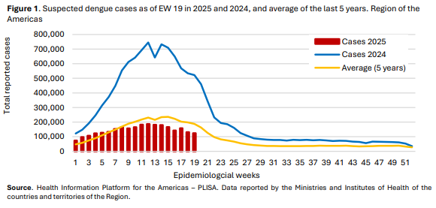
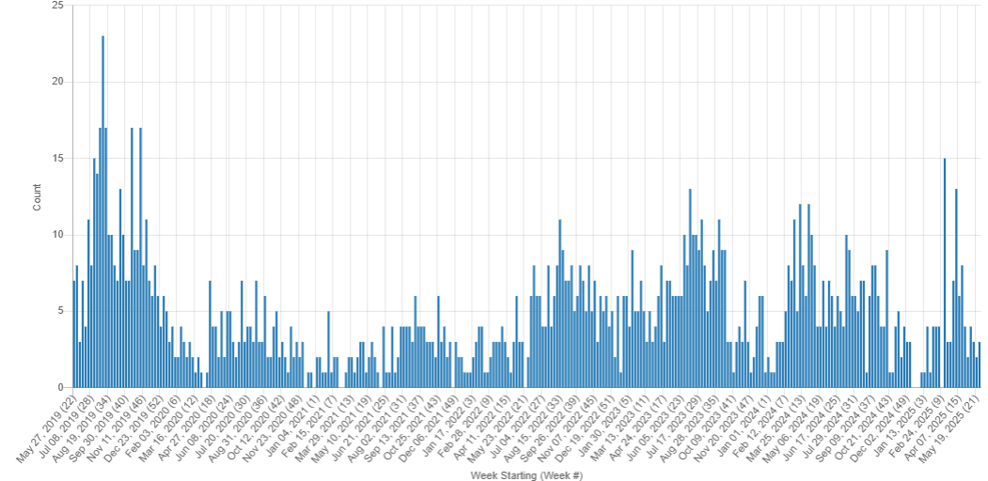
Dengue
PAHO Dengue: analysis by country
PAHO released an epidemiological update on Dengue in the Americas on May 29, 2025
Australia has reported a locally acquired case in Queensland
Bangladesh total cases 4492
Philippines report increased cases
Singapore reports reduced cases
WHO Dengue Dashboard – Data up to April 2025
Recent traveller case in Quebec – from Martinique
Dengue Signals: May 2019 – May 2025
Notes:
For the first 19 weeks of 2025, a total of 2,755,110 suspected cases of dengue were reported. 1,096,668 (40%) were laboratory-confirmed, and 3,490 (0.1%) were classified as severe dengue. A total of 1,160 fatalities have been recorded (CFR 0.042%). This represents a decrease of 71% compared to the same period in 2024 and 13% compared to the average of the last 5 years. Figure 1 shows these trends
While the trends, cases are a lot lower than last year, Cases in Mexico have been increasing in last 4 weeks
Cairns (in north Queensland) has recorded its first locally-transmitted case of the mosquito-borne illness in seven years (2018).
it used to have yearly outbreaks of dengue fever, including one in 2008-09 which infected nearly 1,000 people.
Then in 2011 they started releasing large numbers of dengue-resistant mosquitoes in the city which stopped them spreading the virus to humans.
Bangladesh - the total number of dengue cases reported this year has reached 4,492. So far, 23 people have died from the mosquito-borne disease in 2025.
In the Philippines cases have surged: The Negros Occidental Provincial Health Office reported 1,897 dengue cases with seven deaths from Jan. 1 to May 10, 2025, compared to 449 cases during the same period last year.
Singapore - The number of dengue cases for January to May 2025 has dropped about 74 per cent from the same period in 2024, with almost 2,000 cases recorded for the year to date, according to figures from the National Environment Agency (NEA).
This is also “significantly lower” than the number of cases during the same period in 2023, when more than 3,000 cases were reported for the first half of the year. About 10,000 dengue cases were recorded in the first half of 2024.

Slide 10
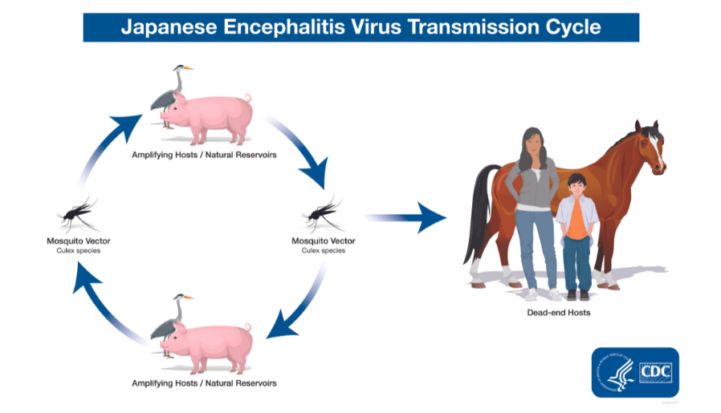
Japanese Encephalitis in Australia
Flavivirus
Spread by Culex species mosquitos
Pigs (& sheep) can act as amplifying hosts
Emerged in Australia in 2022 affecting humans and pigs
Australia 2025: Two human deaths in NSW, one in Queensland
2025 – Two piggeries in Queensland, feral swine
India cases rising in urban areas
SHIC JE Factsheet – June 2024
Sheep serve as amplifying hosts of Japanese encephalitis virus, increasing the risk of human infection
Sheep develop high levels of viremia, display mild non-specific clinical signs
High levels of JEV in nasal and anal secretions
Mosquitos (Ae. Albopictus, Cx. pipiens pallens, and Cx. pipiens quinquefasciatus) fed viremic blood meal with positive infection rates 40-50% (14 dpi)
Viral loads in mosquito salivary glands 39-60% (14 dpi)
Notes:
Japanese encephalitis virus (JEV) is a flavivirus that causes encephalitis in humans mainly in Asia and the western Pacific. The virus also produces neurological disease in pigs and horses and reproductive failure in pigs.
JE virus is transmitted to humans through the bites of infected Culex species mosquitoes, particularly Culex tritaeniorhynchus.
In areas of Asia, JE virus transmission is seasonal. Human disease usually peaks in the summer and fall.
JEV emergence in the United States (and other areas outside of Asia) is a concern due to the presence of competent mosquito vectors and susceptible hosts.
First cases in pigs since 2022.. And some report of JE in feral pigs and fears that they may further amplify and spread the virus.
Recent study from china examined the role of sheep in JEV transmission:
Sheep infected with SH2201 developed high levels of viremia, and most display mild, nonspecific clinical signs (e.g., fever, reduced appetite, and decreased activity), similar to the signs present in experimentally infected pigs
Brain samples also showed JEV-induced encephalitis lesions
Analysis of virus shedding in nasal and anal secretions of SH2201-infected sheep revealed high levels of JEV shedding in both sample types, suggesting that sheep can shed the virus into their surroundings, potentially acting as an important source of JEV transmission.

Slide 11
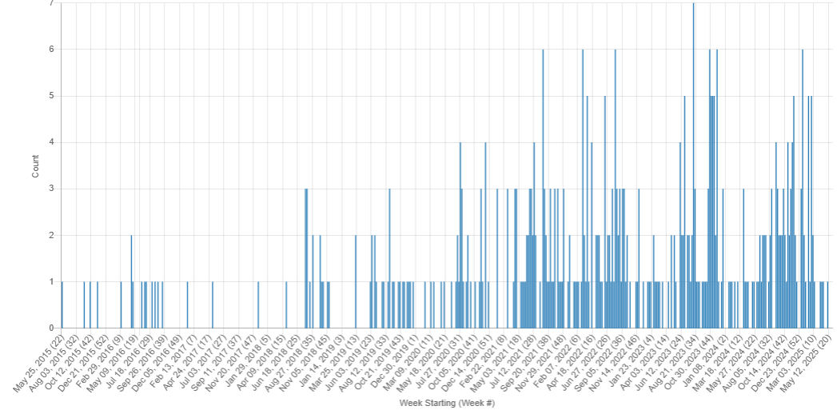
Lumpy Skin Disease
Very few reports in the last two months
  Cases reported in Pakistan and India, Tunisia
LSD Signals: May 2015 – May 2025

Slide 12
Scientific Findings
Mathematical modeling and dynamic analysis of dengue fever: examining economic and psychological impacts and forecasting disease trends through 2030—a case study of Nepal
Risk factors for dengue mortality: a 7-year retrospective cohort in Honduras
Clinical and epidemiological characteristics of the dengue outbreak of 2024: a multicenter observation from Bangladesh
Natural fatal infection of Tembusu virus in bottlenose dolphins in Thailand
Estimation the reinvasion of New World Screwworm (Cochliomyia hominivorax) in Central America: The role of animal movement in disease dispersal and control measures
(Re)Emerging Arboviruses of Public Health Significance in the Brazilian Amazon
First report on identification and genetic characterization of Getah virus in wild boar in China
A climate and population dependent diffusion model forecasts the spread of Aedes Albopictus mosquitoes in Europe
Molecular basis for shifted receptor recognition by an encephalitic arbovirus
Mayaro virus in Latin America and the Caribbean
Prevalence and molecular epidemiology of the novel equine parasite Theileria haneyi in China
Haemaphysalis longicornis ticks are unable to transstadially transmit Theileria haneyi to horses
Multiple Introductions of the Asian Longhorned Tick (Haemaphysalis longicornis) to the United States Revealed Using Mitogenomics

Slide 13
Scientific Findings
A new spotted fever group Rickettsia genotype in Haemaphysalis leporispalustris from Maine, USA
The spatiotemporal ecology of Oropouche virus across Latin America: a multidisciplinary, laboratory-based, modelling study
Impact of BTV-3 Circulation in Belgium in 2024 and Current Knowledge Gaps Hindering an Evidence-Based Control Program
Unraveling the relationships between midge abundance and incidence, microbial communities, and soil and water properties in a protected natural tallgrass prairie
Pre-print: Investigation of the global transportation of Culicoides biting midges, vectors of livestock and equid arboviruses, from flower-packing plants in Kenya
Environmental risk and Alpha-gal Syndrome (AGS) in the Mid-Atlantic United States
Emerging babesiosis in the mid-Atlantic: autochthonous human babesiosis cases and Babesia microti in Ixodes scapularis and Ixodes keiransi ticks from Delaware, Maryland, Virginia, West Virginia, and the District of Columbia, 2009 to 2024
Pre-print: Re-emergence of Yellow Fever Virus in Brazil: Evidence from Forest and peri-urban Settings
Crimean-Congo Haemorrhagic Fever Virus in Eastern Portugal; Evidence from Cattle and Red Deer
Assessing Schmallenberg Virus Disease in Sardinia (Italy) After the First Epidemic Episode in 2012
Contact between soft tick vectors of African swine fever virus and invasive wild pigs in the southeastern USA

