Slide 1
Community for Emerging and Zoonotic Diseases
Identifying emerging risks through collective intelligence
CEZD – CAHSS Vector Network Update
6 October 2025
www.cezd.ca

Slide 2
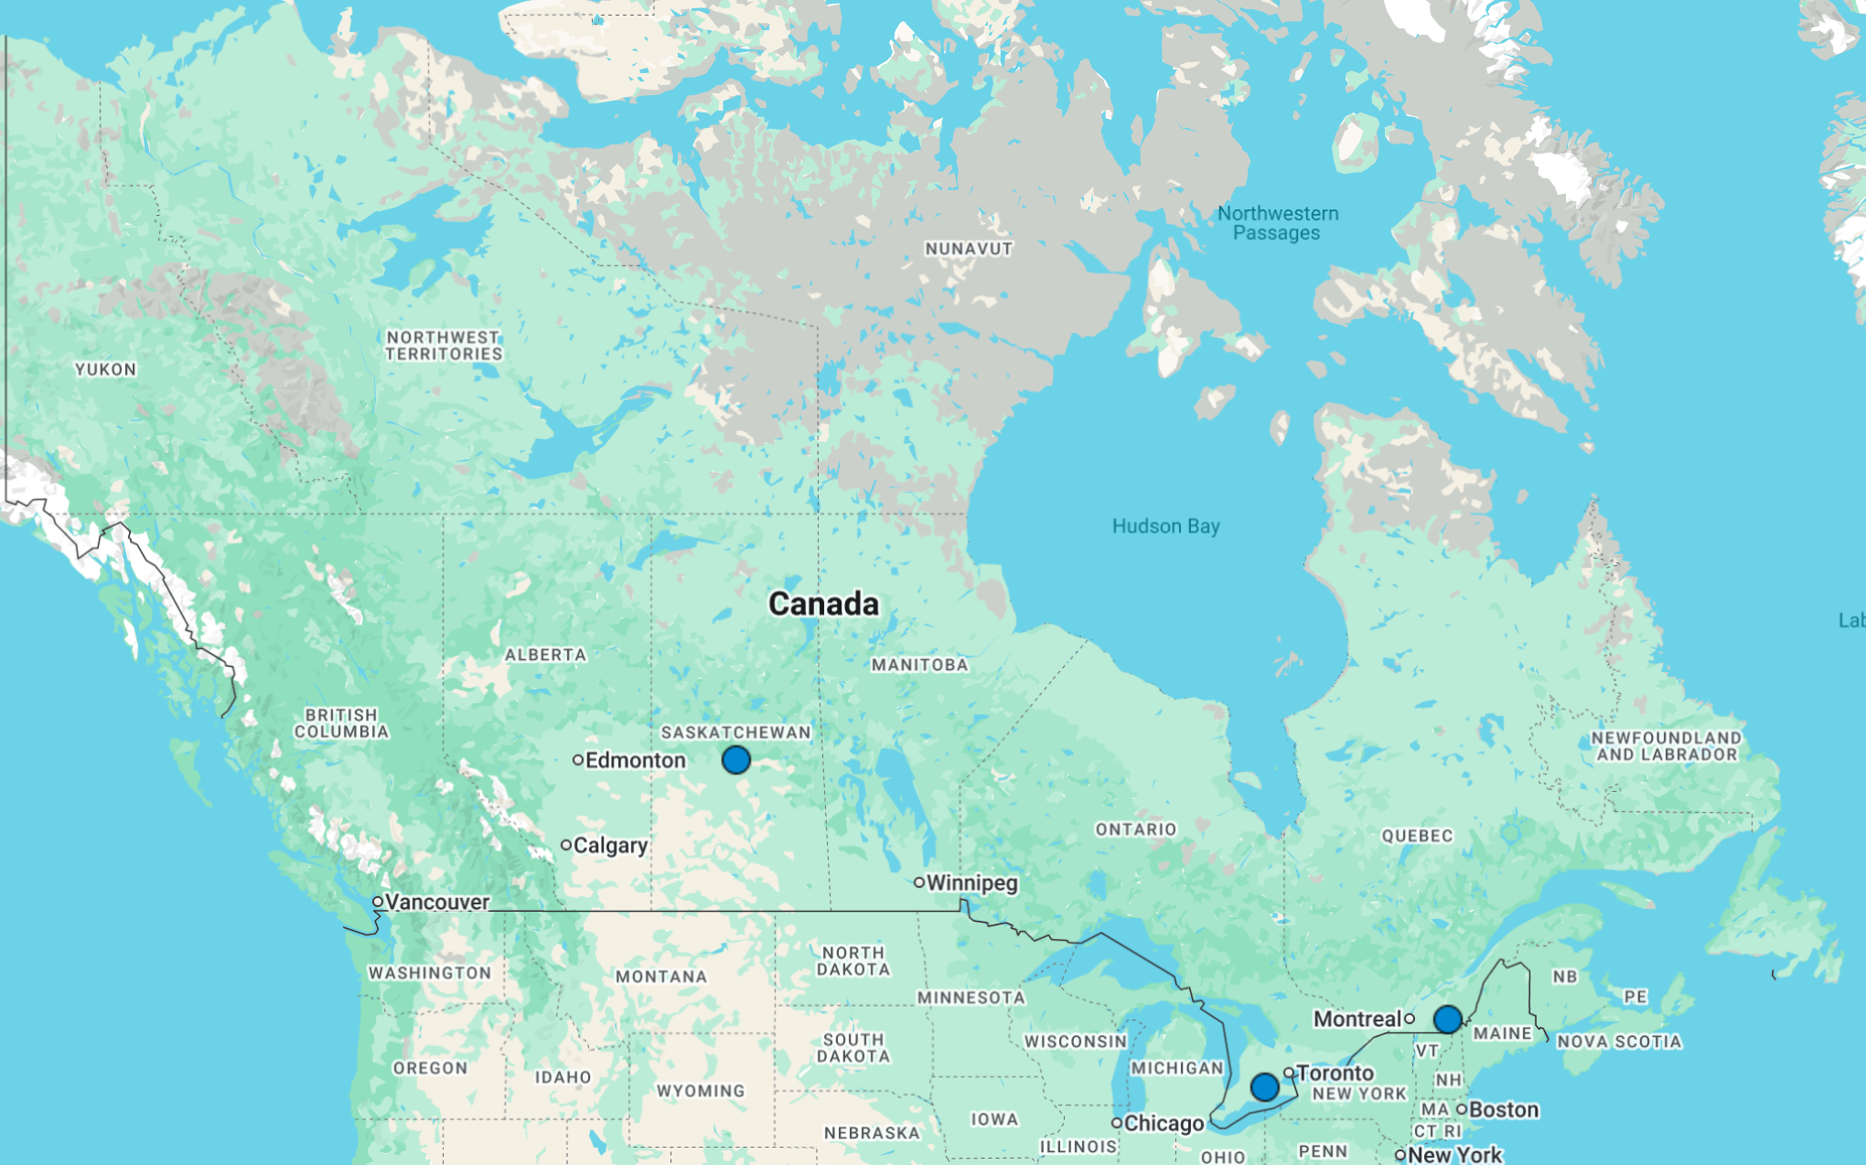
Rocky Mountain Spotted Fever in Canada
RMSF is an illness caused by the bacteria Rickettsia rickettsii
Spread through tick bites
  American dog tick (Dermacentor variabilis)
  Brown dog tick (Rhipicephalus sanguineus)
  Rocky Mountain wood tick (Dermacentor Anderson
In late June/early July 2025, there were reports of RMSF cases in dogs in Ontario, some of which had a history of being in Long Point
Mid-August 2025, a human case of RMSF was reported for the first time in a resident of Eastern Townships, Quebec
Early-September 2025, a man from Prince Albert, Saskatchewan tested positive for RMSF
Mid-September 2025, two human cases of RMSF were confirmed in individuals who reported visiting Long Point, Ontario
  Local tick surveillance in the Long Point area has identified R. rickettsii in American dog ticks
Notes:
RMSF is an illness caused by the bacteria rickettsia rickettii, it is spread through tick bites – It is endemic in Mexico and parts of the USA, and in the USA, primarily by the American dog tick, but also the rocky mountain wood tick and brown dog tick.
The American dog tick is also well-established across Canada, from eastern Alberta to Nova Scotia, with high prevalence in Manitoba, Ontario, and Nova Scotia during late spring and early summer. Its range has expanded northward and westward over time, likely due to climate change, land use changes, and host migration.
This summer cases started cropping up in Ontario, followed by Quebec, and Saskatchewan. In Canada, RMSF is not currently nationally reportable or notifiable to PHAC, it is monitored as an emerging pathogen,
In late June 2025, there were reports of RMSF cases in dogs in Ontario. One initally case tested positive for Rickettsia rickettsii on PCR and displayed matching clinical signs. There are additional unverified reports of other cases in the same area. Shortly after, four additional cases were reported, brining the total number of cases to 5, four of which had a history of being in Long Point, an area that is well-known for an abundance of ticks and tickborne diseases.
The fifth dog’s history is less clear, it may have also been in the area
In mid- august, Quebec confirmed its first case of RMSF in a resident of Eastern Townships (we’ll come back to this in a minute)
In early September – a man from Prince Albert, Saskatchewan has tested positive for RMSF; he believes he contracted the disease from a tick at Emma Lake
In mid-September, Ontario confirmed two human cases of RMSF in individuals who reported visiting Long Point (the same region where cases in dogs were reported early this summer). However, one of the sources mentioned that one of these individuals was the same individual who was reported positive in Quebec.
Local tick surveillance in the Long Point area has identified R. rickettsii in American dog ticks.
So all together there have been 5 confirmed cases in dogs, and 3 (or 4) cases reported in humans over the course of this past summer.

Slide 3
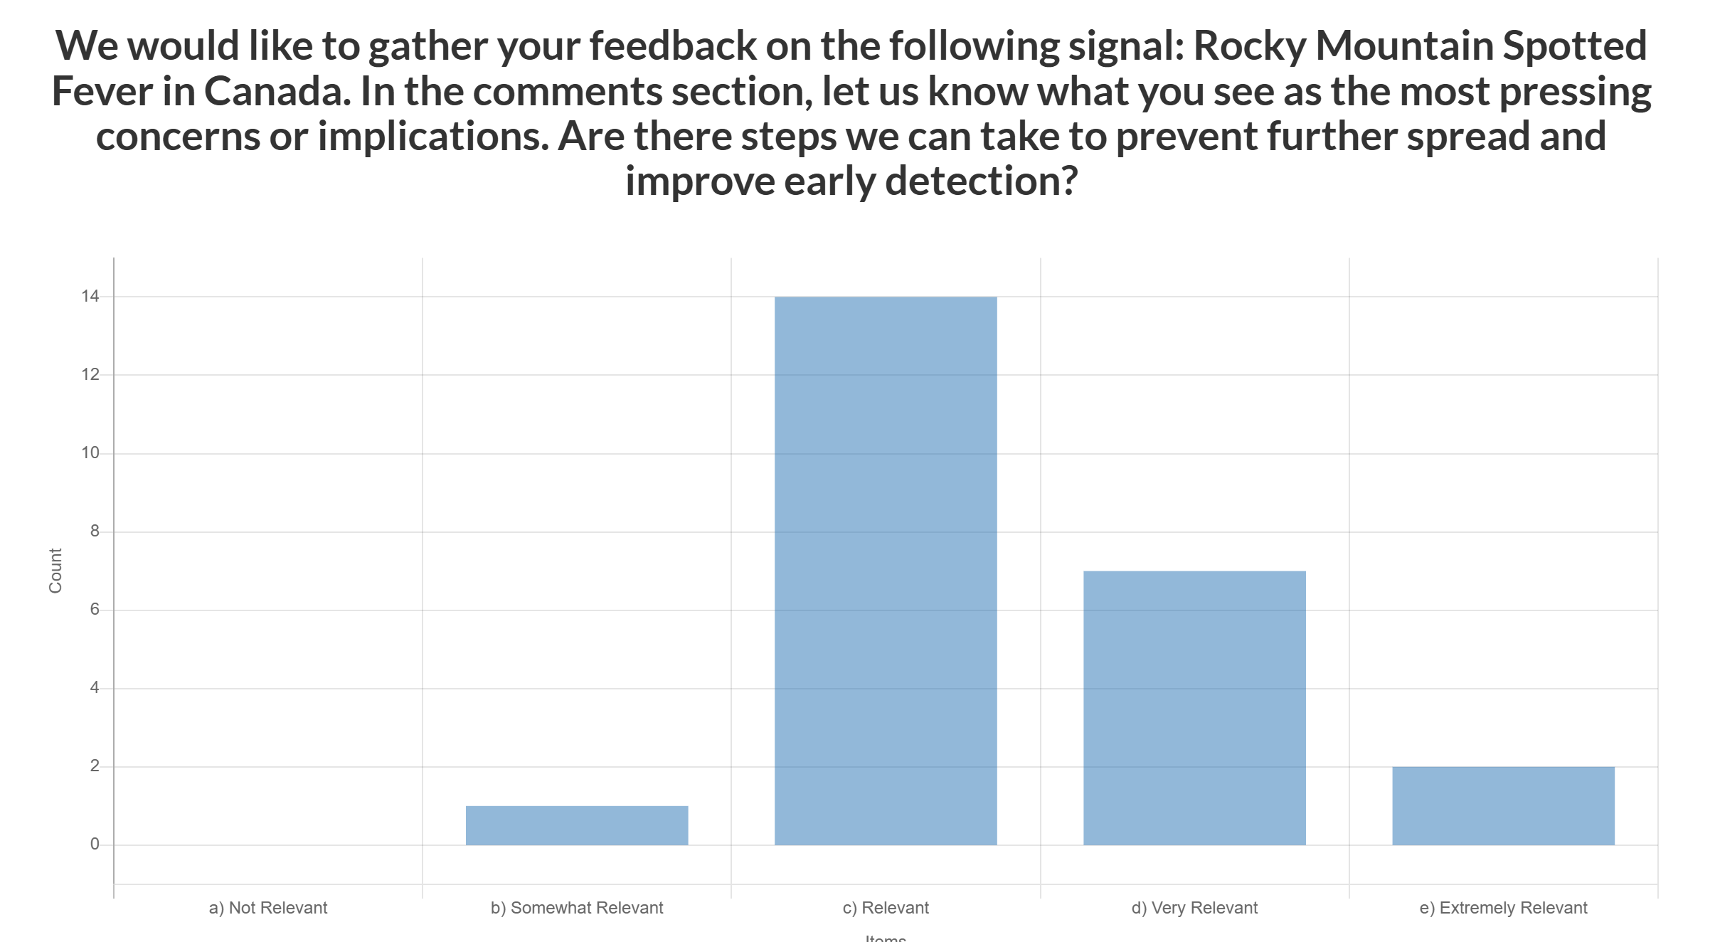
Ping - Rocky Mountain Spotted Fever in Canada
Ping sent on September 4, 2025
N = 25
Average rating = 3.28 (relevant to very relevant)
Comments touched on a few different themes, including: surveillance and reporting, prevention, climate change, diagnostics, research and gaps
Encourage PHAC to make RMSF a reportable disease in humans if validated diagnostics are available
Expand Lyme disease surveillance infrastructure to include RMSF – establish baseline prevalence
Address under-detection and emerging areas of risk (e.g. SK vs ON)
Raise awareness – both general public and doctors/vets - train healthcare providers to recognize and treat RMSF and other tick-borne infections
Notes:
Due to the increasing reports, we decided to send a ping to the community to gather feedback on the relevance to Canada, most pressing concerns or implications, and if there are any steps we can take to prevent further spread and improve early detection?

Slide 4


Asian Longhorn Tick and Theileriosis in the USA
ALHT calls have been taken over by the University of Tennessee
Since the last CAHSS call – three additional states have reported first detections
24 states + Washing D.C. now affected
Mid-June, Michigan reported ALHT nymphs were found in Berrin County, found by routine tick surveillance
Mid-June, Iowa confirmed case of Theileria orientalis Ikeda, and the presence of the ALHT, in cattle in Van Buren County
  As of mid-July, Iowa has reported additional cases (4 confirmed, 1 suspected) of Theileriosis in cattle in the southeast corner of the state, along with findings of the ALHT
Mid-August, Maine confirmed its first finding of the ALHT in Cumberland County
Asian Longhorned Tick Situation Report - The Tick App

Slide 5
Malaria in the USA
Locally Acquired (Autochthonous) Mosquito-Transmitted Plasmodium vivax Malaria — Saline County, Arkansas, September 2023
  In 2023, 10 cases of locally acquired malaria were reported in the USA
  Florida (7), Texas (1), Arkansas (1), and Maryland* (1)
  These were the first locally acquired cases in 20 years
In August 2025, two suspected locally acquired cases have been reported
  Washington - a woman from East Pierce County, who had not recently travelled, was diagnosed with malaria
  New Jersey - a case of malaria was reported in a resident of Morris County with no international travel history
Officials believe these local cases are due to specific circumstances where a person infected with malaria (from previous travel) gets bitten by a local Anopheles mosquito, that then picks up the parasite and bites someone else, passing it on
Notes:
The U.S. does not currently have the conditions for a major outbreak, but they are becoming more favorable for malaria transmission. Warmer winters are giving the Anopheles mosquitoes an opportunity to start reproducing earlier—allowing for greater populations growth and as a result a higher probability of biting an infected person who has been to a malaria-endemic area, and then passing it on locally.

Slide 6


New World Screwworm in Central America and Mexico
USA - Mexico border remains closed (cattle, bison, horses)
Recent detection in Nuevo León (~125 km from border)
Mexico has reported 52 human cases (mostly in Chiapas), including 3 deaths linked to underlying conditions
Situation in other Central American countries: Honduras (64+ human cases, >2,496 animal cases), Nicaragua (124 human cases), Guatemala (16 human cases), El Salvador (5 human cases), Belize (2 human cases), and Costa Rica (56 human cases in 2025, triple the 2024 count)
The USDA is investing $29.5 million in sterile fly production and dispersal facilities in Mexico and Texas
Mexico has launched an interactive dashboard for tracking NWS in animals
The USA is deploying Swormlure-5, a synthetic bait with insecticide, and has authorized emergency use of animal drugs for NWS control
July 2025
COPEG
Notes:
The positive New World Screwworm (NWS) case in Nuevo León, Mexico, was confirmed in Sabinas Hidalgo on September 21, 2025. The affected animal was an 8-month-old cow that had recently been moved to a certified feedlot in Nuevo León from a region in southern Mexico known to have active NWS cases.
Food and Drug Administration conditionally approved Dectomax-CA1 (doramectin injection) injectable solution for the prevention and treatment of New World screwworm larval infestations, and prevention of NWS reinfestation for 21 days. Dectomax-CA1 is conditionally approved for use only in cattle.

Slide 7
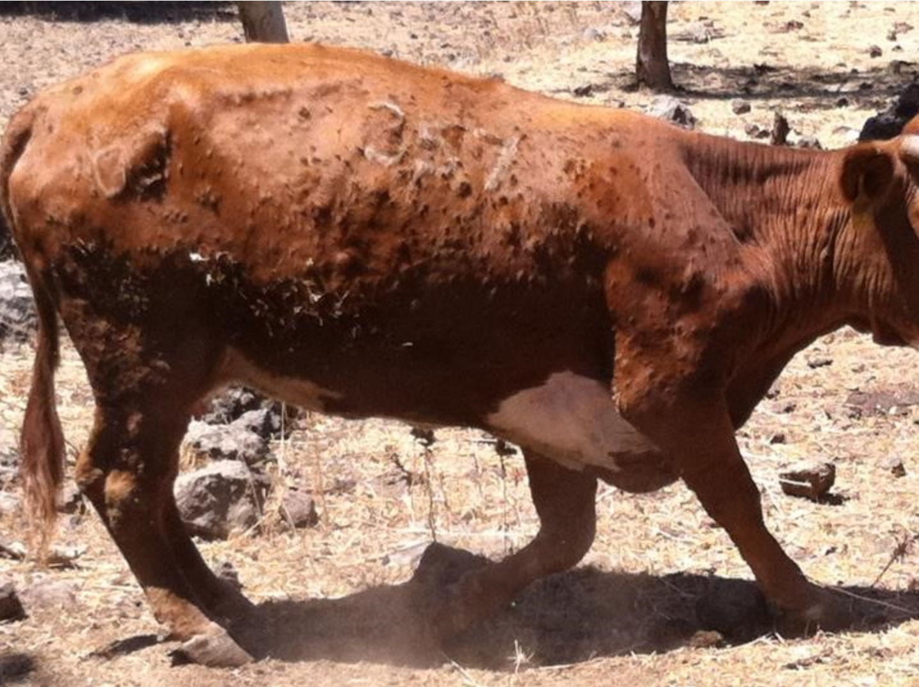
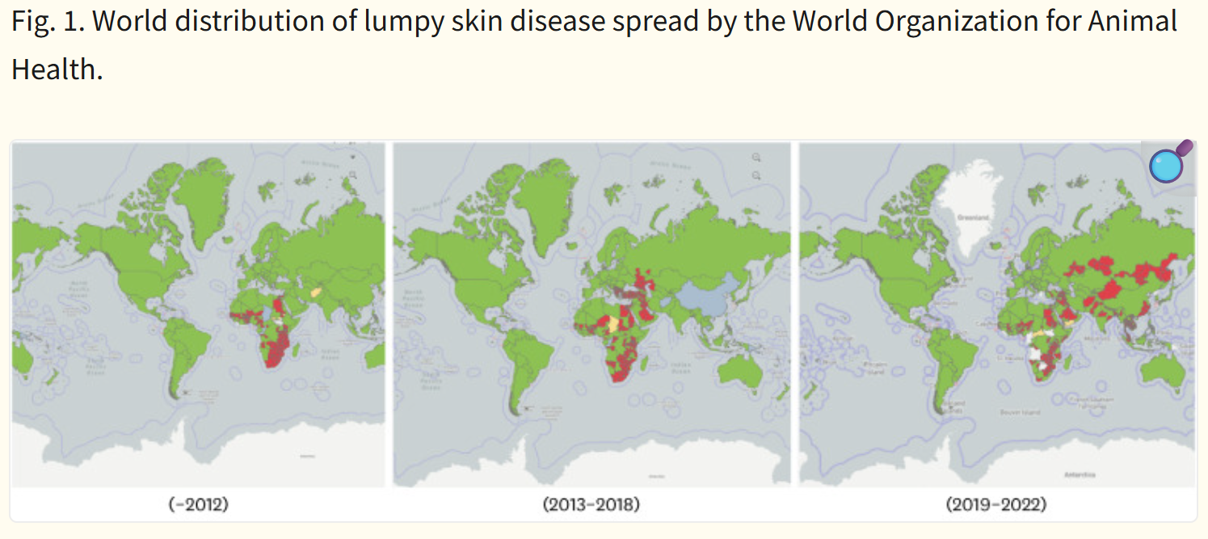
Lumpy Skin Disease
Lumpy Skin Disease | Department of Natural Resources and Environment Tasmania
Lumpy skin disease is highly contagious viral disease that affects cattle
Spread by flies and mosquitos
Clinical signs: fever, skin nodules, nasal/eye discharge, lameness and reduced milk production
Closely related to sheep and goat pox, from which it cannot be distinguished by routine diagnostic tests
Economic losses – decreased milk yield, culling, trade restrictions, damage to hides, and reproductive issues
LSD is endemic in most African countries - since 2013, it has spread rapidly through the Middle East, some parts of Europe and throughout Asia
Lumpy skin disease as an emerging infectious disease - PMC
Notes:
LSD in a viral disease that affects cattle and water buffalo, its spread by flies and mosquitos.
Clinical signs include fever, skin nodules, nasal/eye discharge, lameness, and reduced milk production.
It was first identified in Zambia in 1929 and is found throughout Africa.
It is closely related to SGP
. LSD causes significant economic losses due to:
Decreased milk yield (up to 30%)
Trade restrictions
Culling of infected animals
Damage to hides and reproductive issues

Slide 8
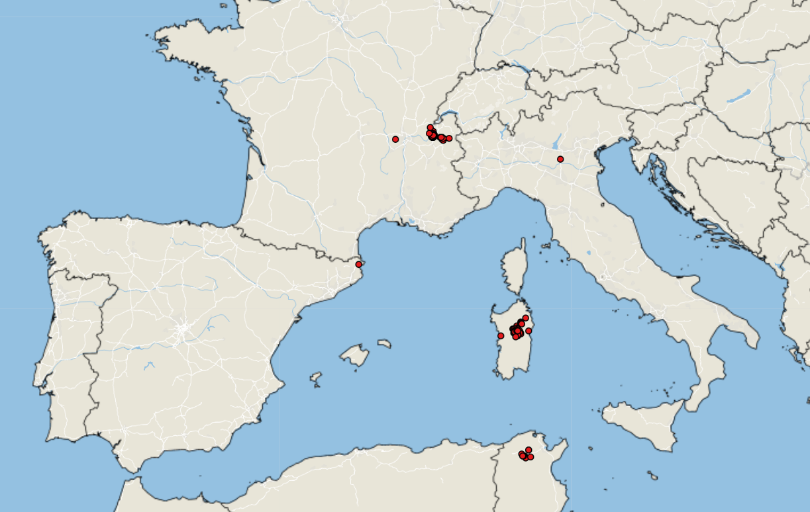
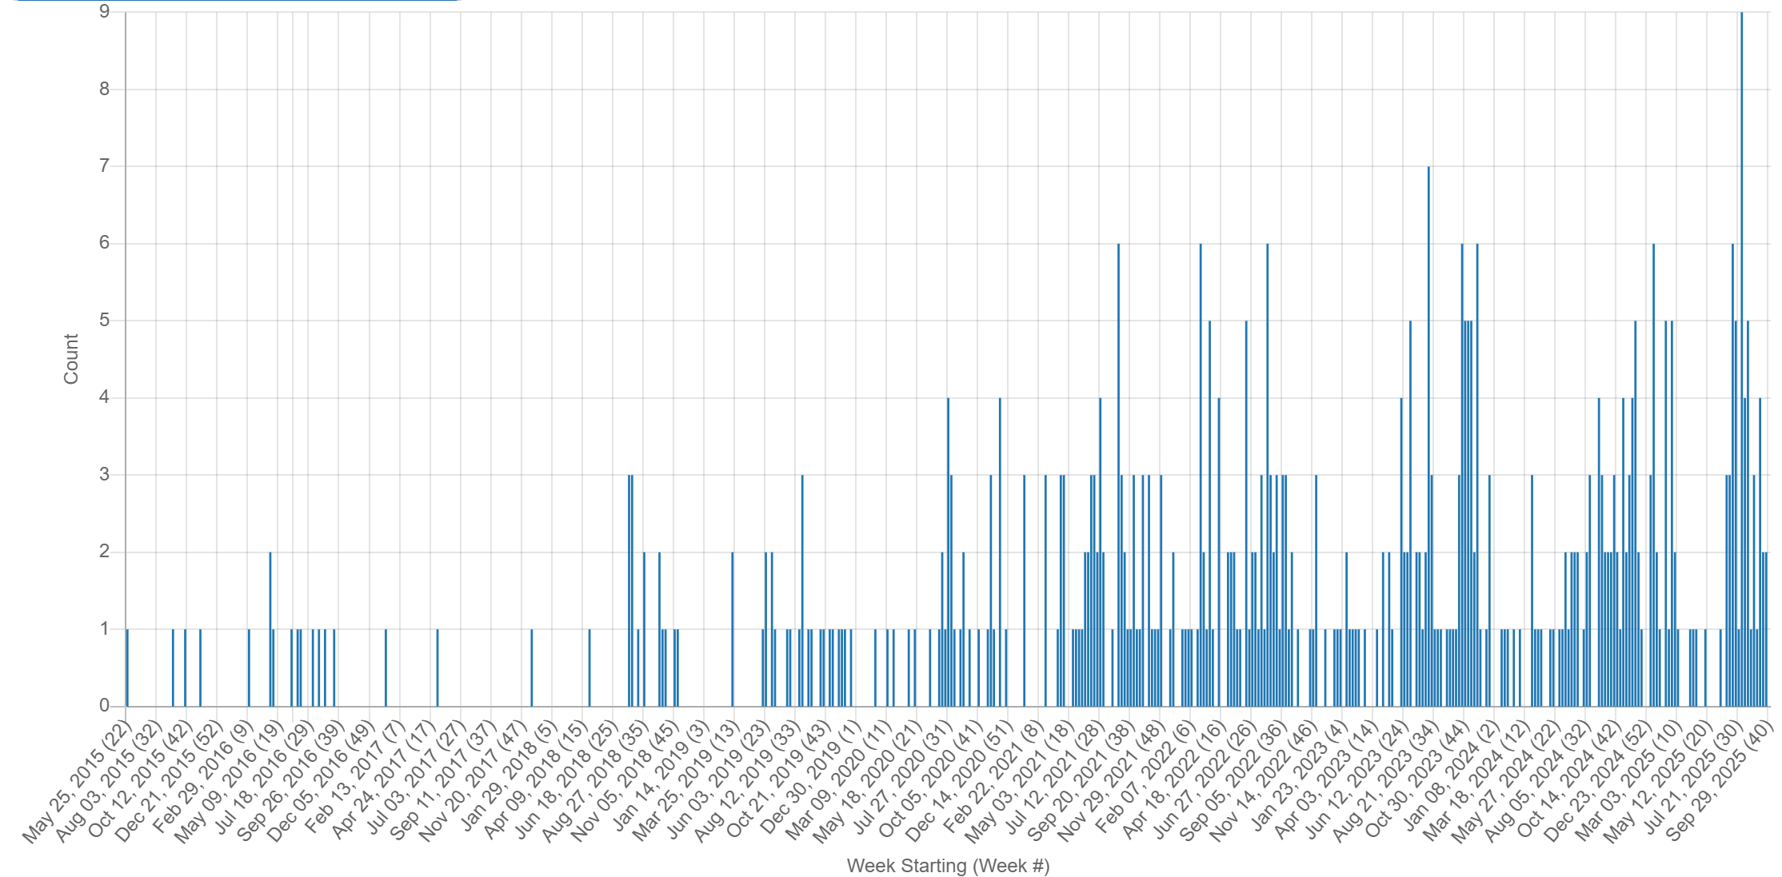
Lumpy Skin Disease in Europe
Empres-i +
LSD Case: June 2025 – October 2025
Italy reported its first cases of LSD in Sardinia
  Potential source of the outbreak listed as vector movement from northern Africa
  Genotyping showed that the virus circulating in Italy is closely related to cluster 1.2, which includes strains isolated in Nigeria and South Africa
France reported its first cases of LSD in Savoie, close to its borders with Switzerland and Italy
France: 79 outbreaks, mainly in Savoie(32), Haute-Savoie(44), Ain(2), and Rhône(1)
Italy: 68 outbreaks, concentrated in Sardinia, with one cases in Lombardy (linked to animal movement from Sardinia
Protection zone established, depopulation, and emergency vaccinations campaigns
October 4th - Spain reported 3 cases in Girona, close to French border
LSD Signals: May 2015 – October 2025
Notes:
In late June 2025 the First outbreaks of LSD in Europe were reported in Italy and then France.
Italy reported its first cases of LSD in Sardinia. Seven cases of LSD were reported in domestic cattle in Orani. The WAHIS report identifies the potential source of the outbreak as vector movement from northern Africa, where LSD has recently been reported (Tunisia and Algeria).
Recent genotyping showed that the virus circulating in Italy is closely related to cluster 1.2, which includes strains isolated in Nigeria and South Africa
Shortly thereafter, France has reported its first cases of LSD in Savoie (southeastern France), close to its borders with Switzerland and Italy; fifteen cases were initially reported.
As of early October 2025, France: 79 outbreaks, mainly in Savoie, Haute-Savoie, and Ain, with a recent spread to Rhône.
Italy: 68 outbreaks, concentrated in Sardinia, with isolated cases in Lombardy (linked to animal movement from Sardinia)
Protection zones (20 km radius) and surveillance zones (50 km radius) have been established around outbreak sites. Animal movement restrictions are in place within and between affected regions. Depopulation (culling) of infected herds is being used to contain spread.
Emergency vaccination campaigns are underway in both countries.

Slide 9
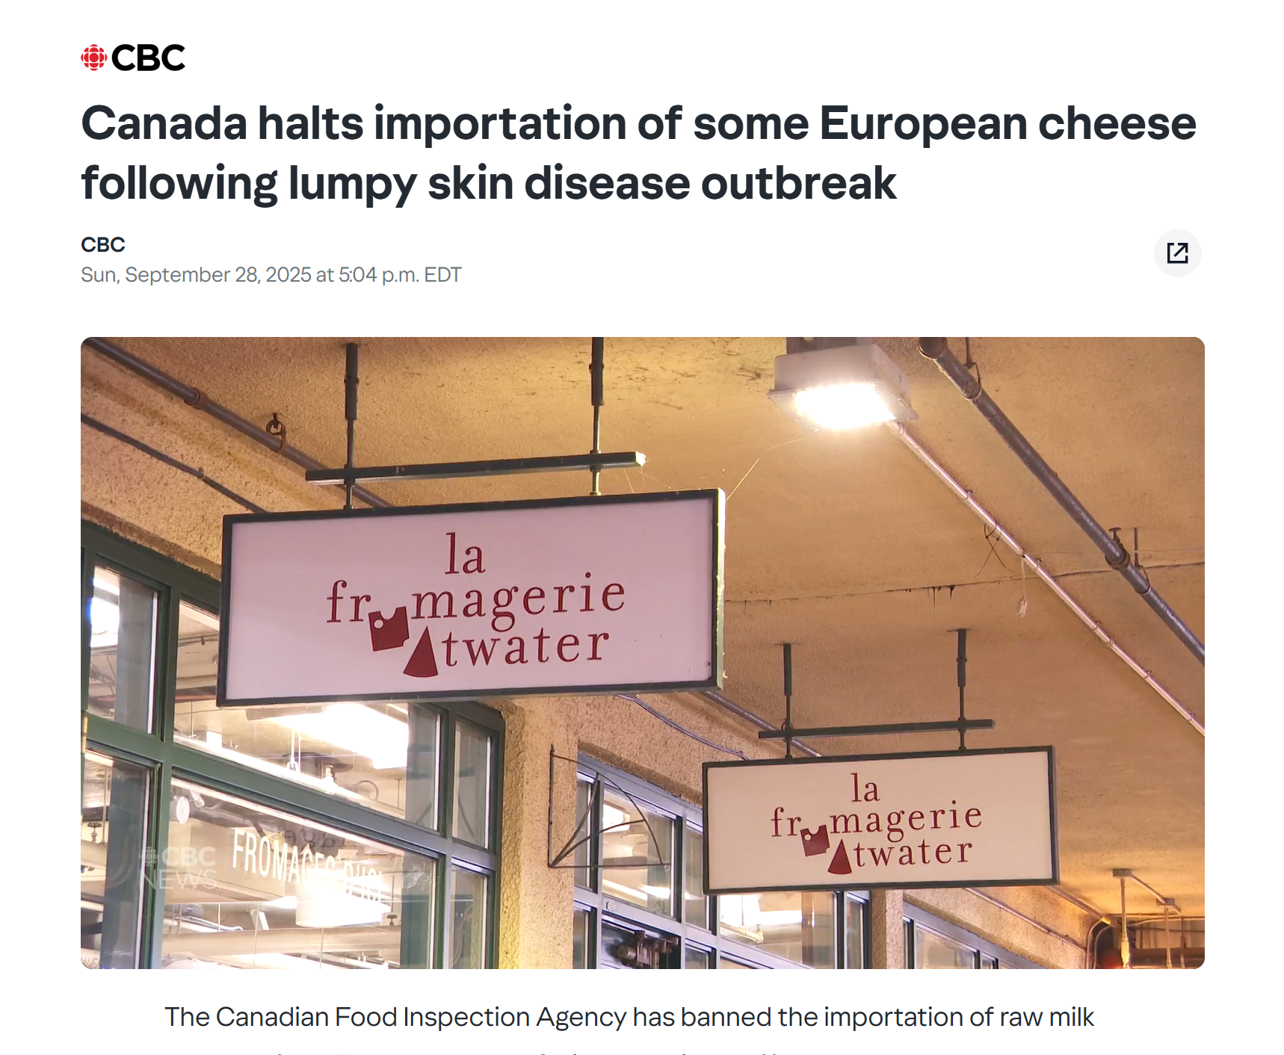
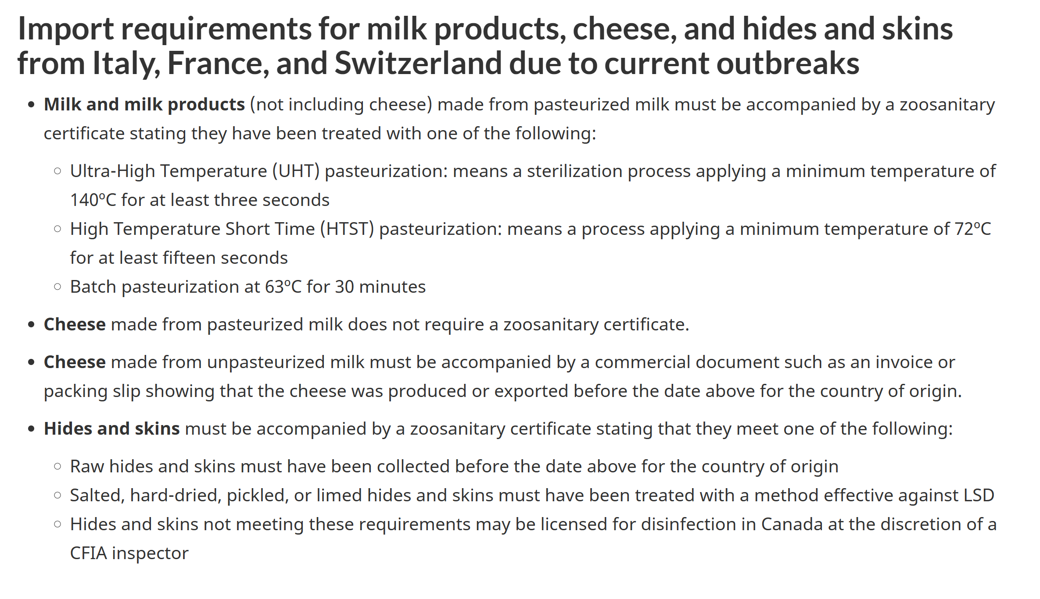
Lumpy Skin Disease in Europe
CFIA import requirements
Canada halts importation of some European cheese following lumpy skin disease outbreak
Lumpy skin disease - Countries that Canada recognizes as being free from the disease - inspection.canada.ca
Notes:
Canada has suspended imports of certain bovine products (e.g., raw milk cheeses and hides/skins) from France, Italy, and Switzerland.

Slide 10
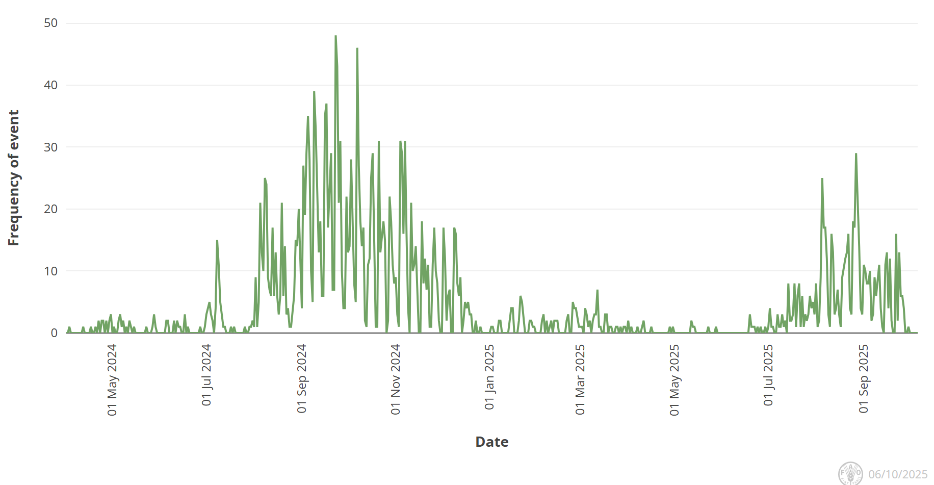
Bluetongue virus in Europe
Europe still reporting cases of BTV (serotypes 3, 8, and recently 5), but less than the previous year
BTV-3 Cases
  UK, Poland, Norway, Czech Republic, Romania (1st report), Hungary (1st since 2015)
  In Africa, Morocco recently reported its first cases of BTV-3
BTV-8 Cases
  UK, Slovenia, Italy, Greece, North Macedonia, Croatia, Serbia, Bosnia
BTV-5
  Italy
Unspecified BTV Serotype
  Kosovo
Empres-Plus
Notes:
The total number of BTV-3 cases in Great Britain for the 2025 to 2026 vector season (since July 2025) is 91. There have been: 87 cases in England 4 cases in Wales The total number of BTV-8 cases in Great Britain for the 2025 to 2026 vector season (since July 2025) is one. This case was in England.
Italy recently reported BTV-5 in sheep in Sardinia

Slide 11
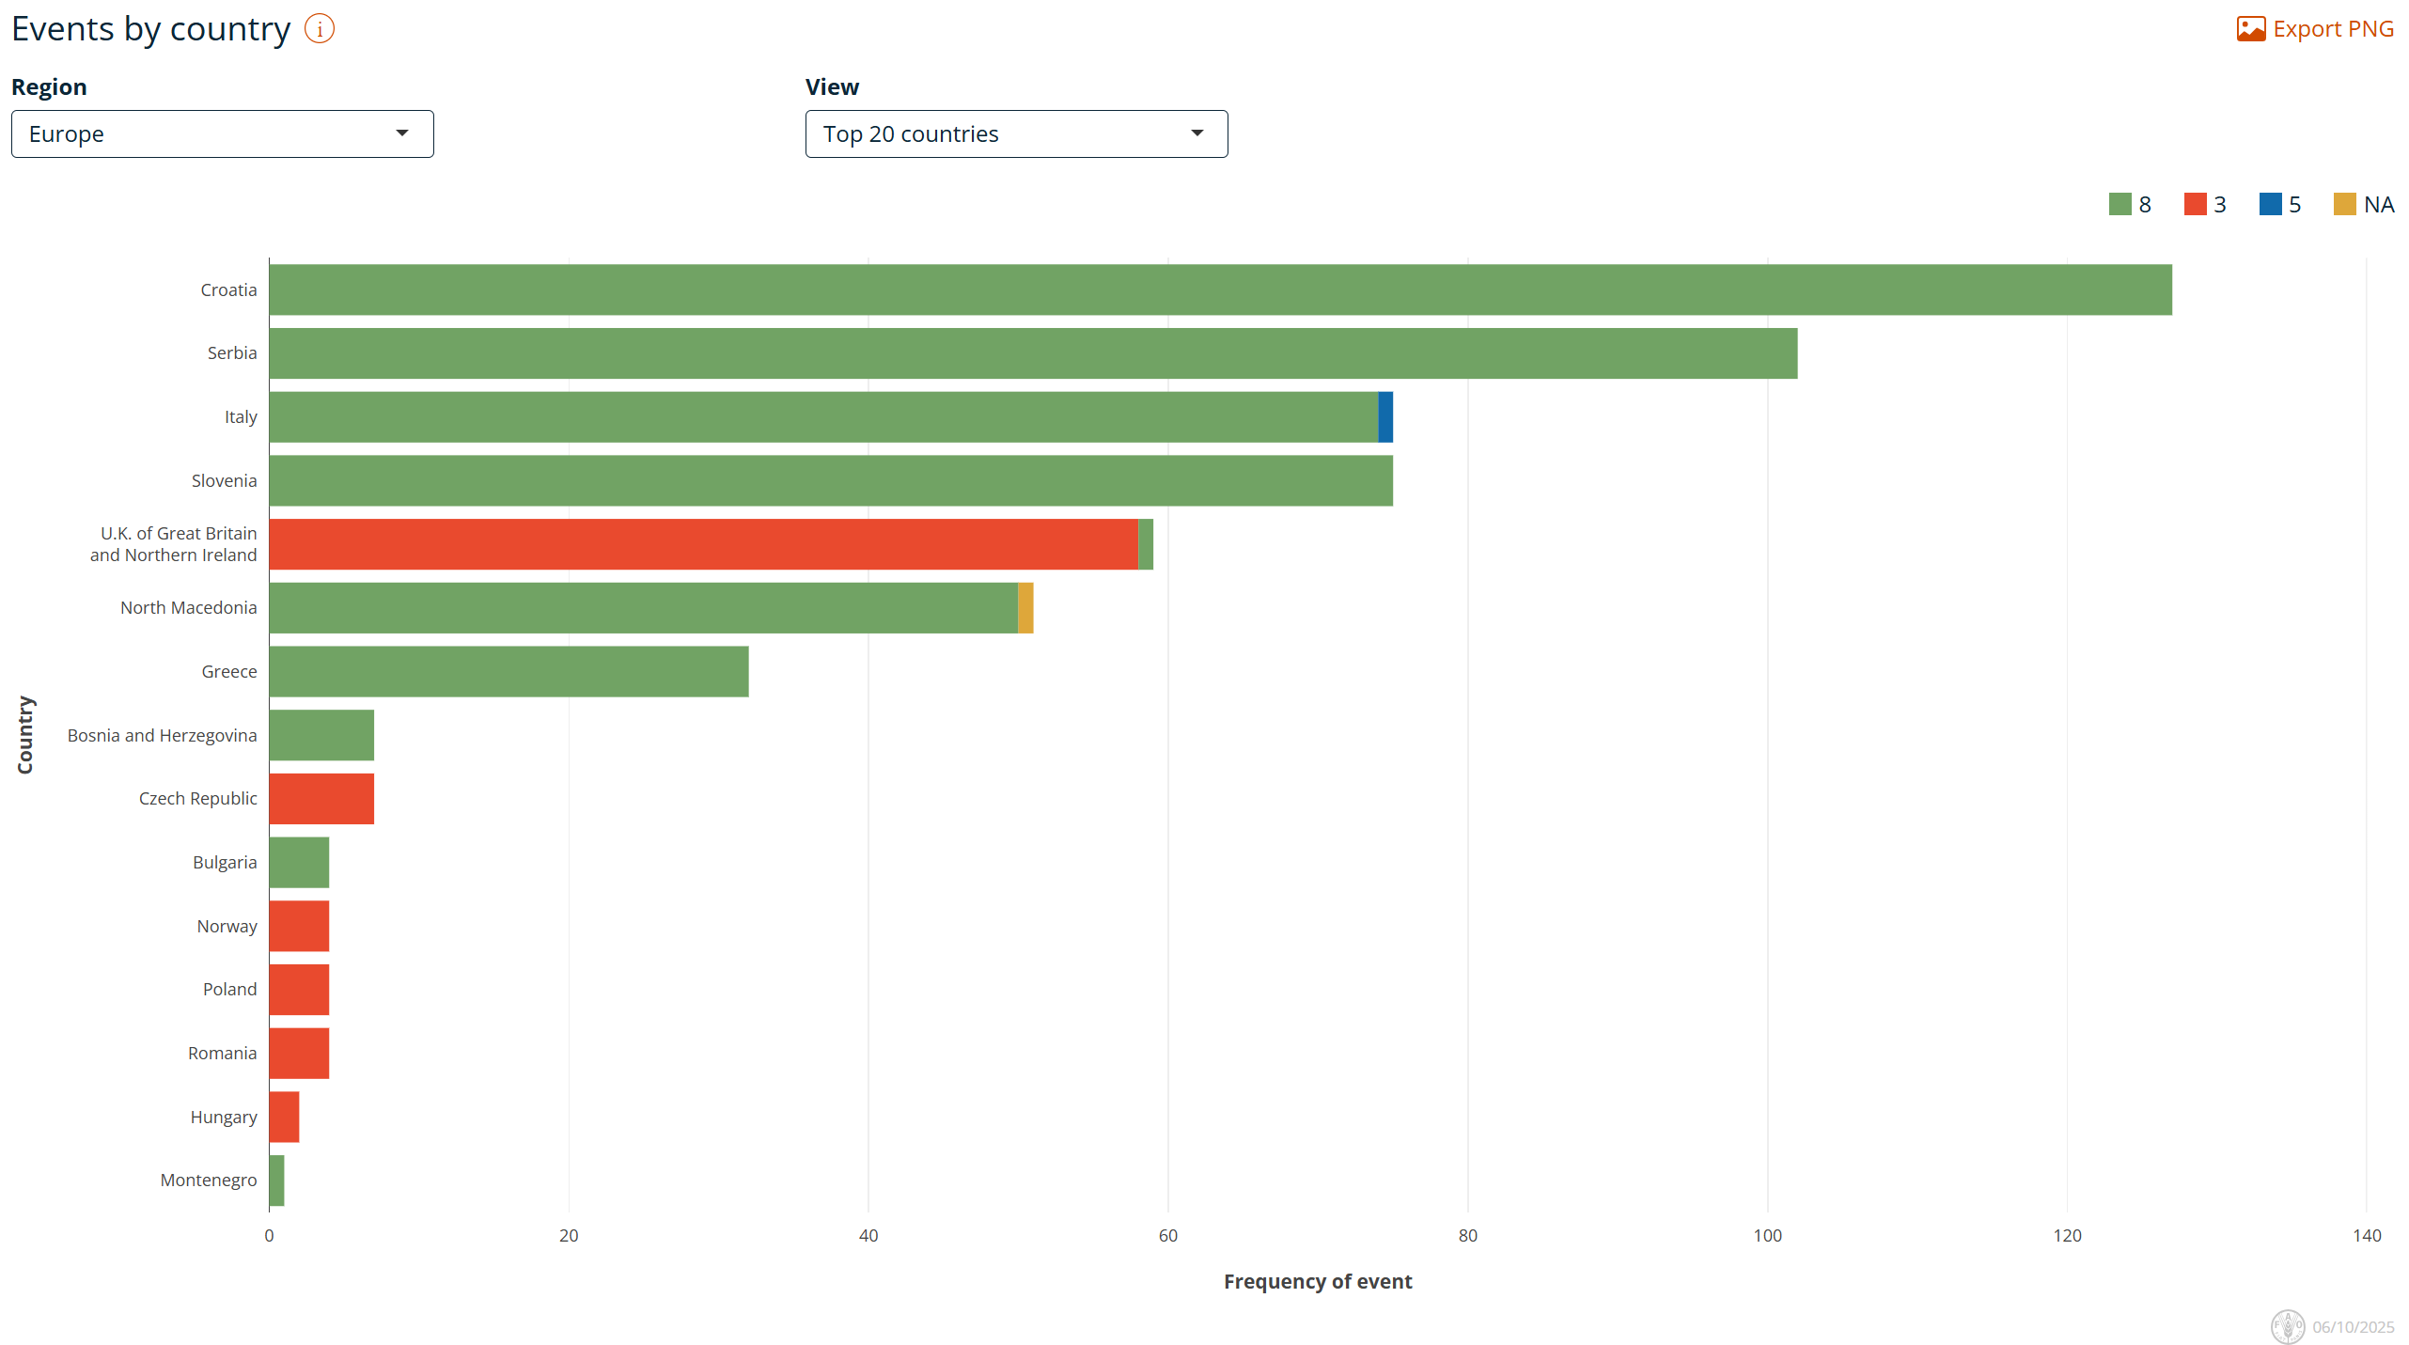
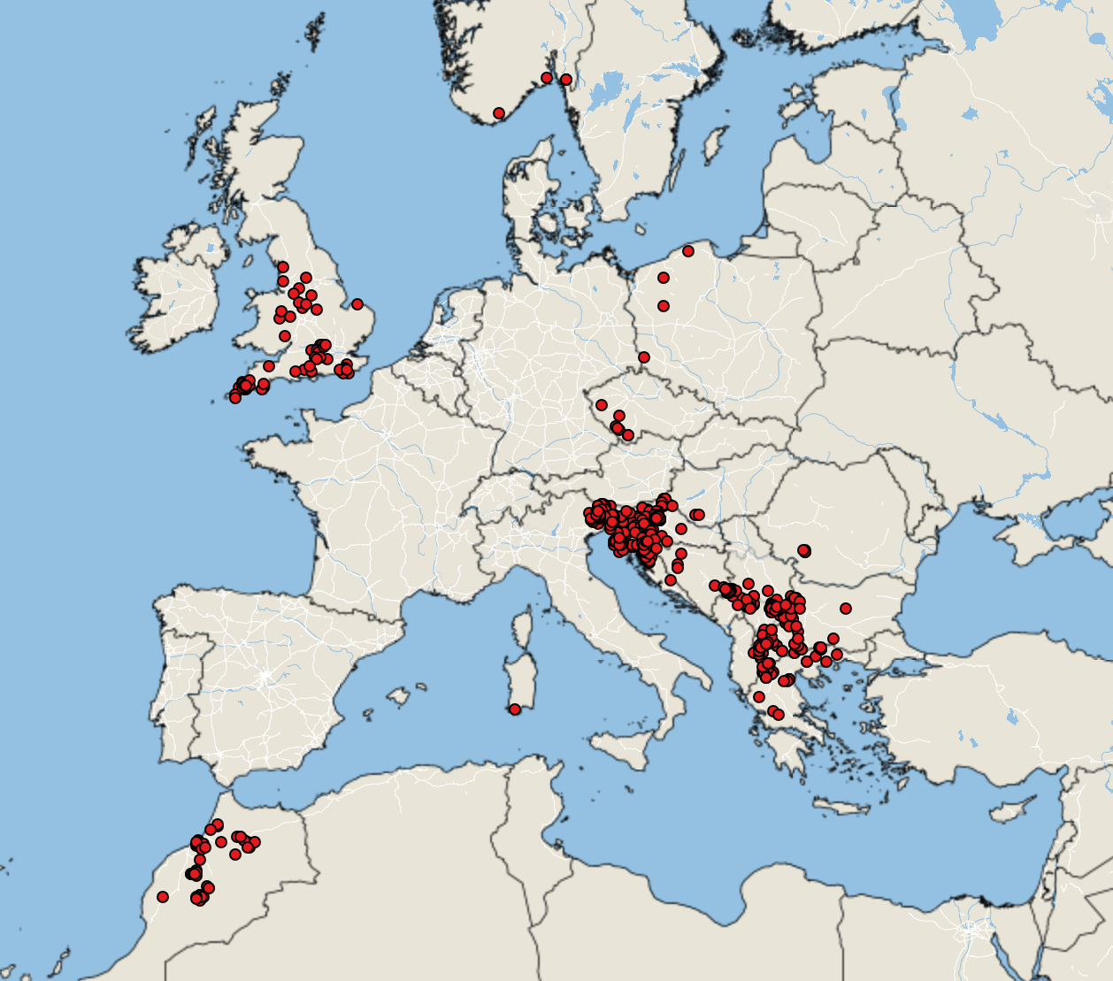
Bluetongue virus in Europe
Empres-Plus
BTV cases June 1, 2025 – October 5, 2025

Slide 12
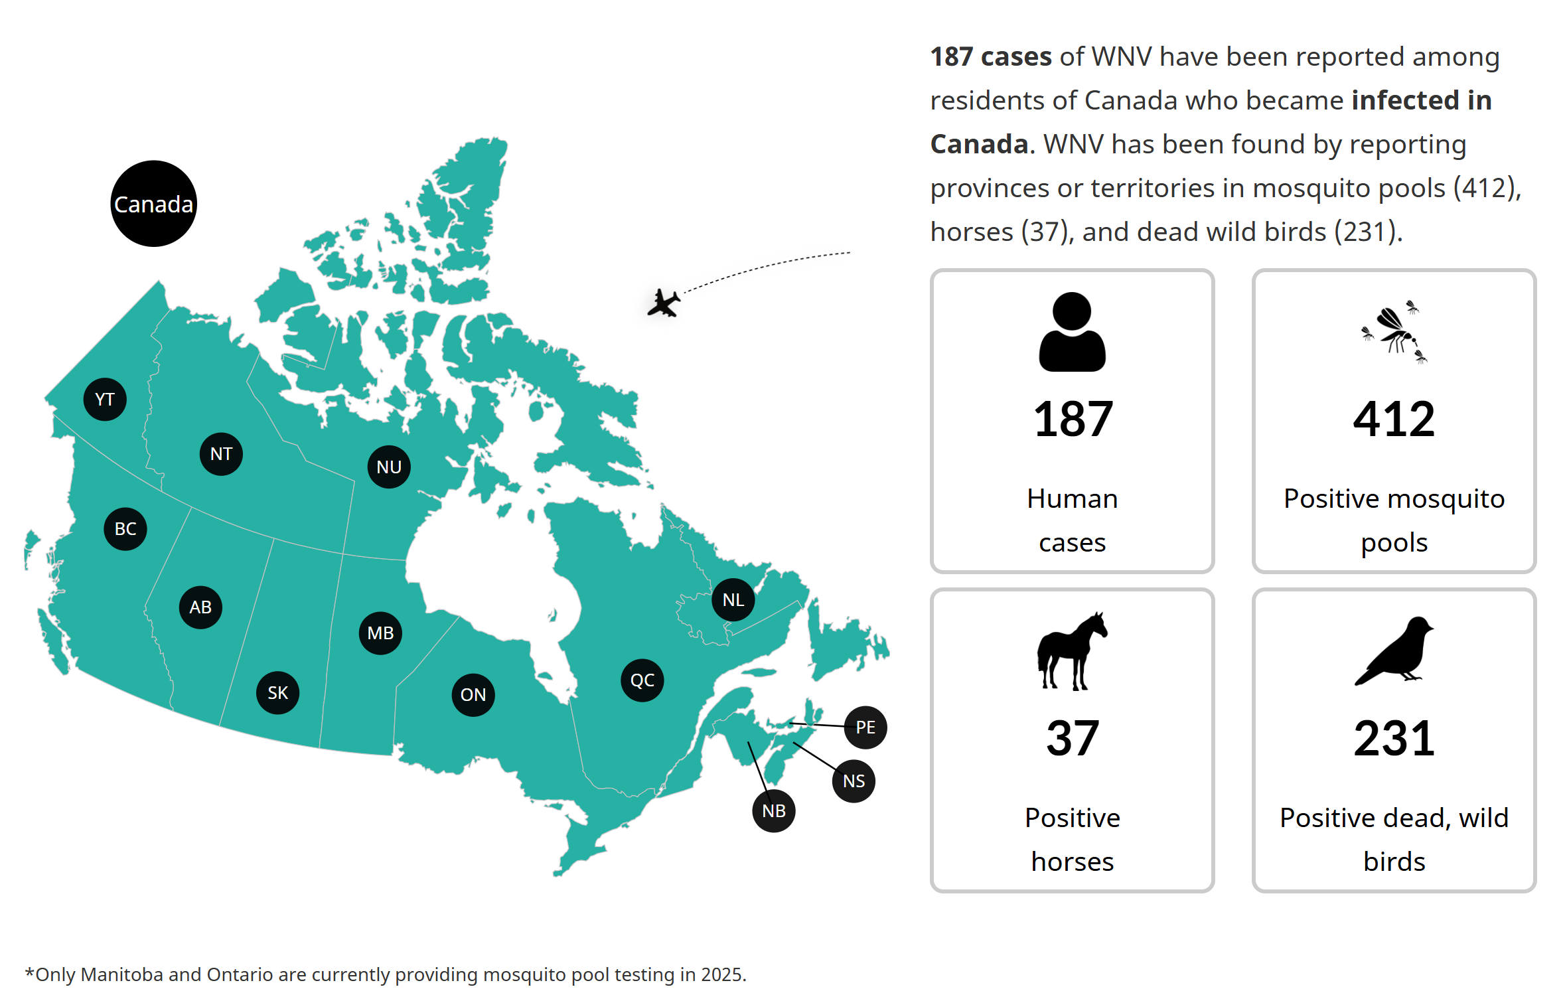
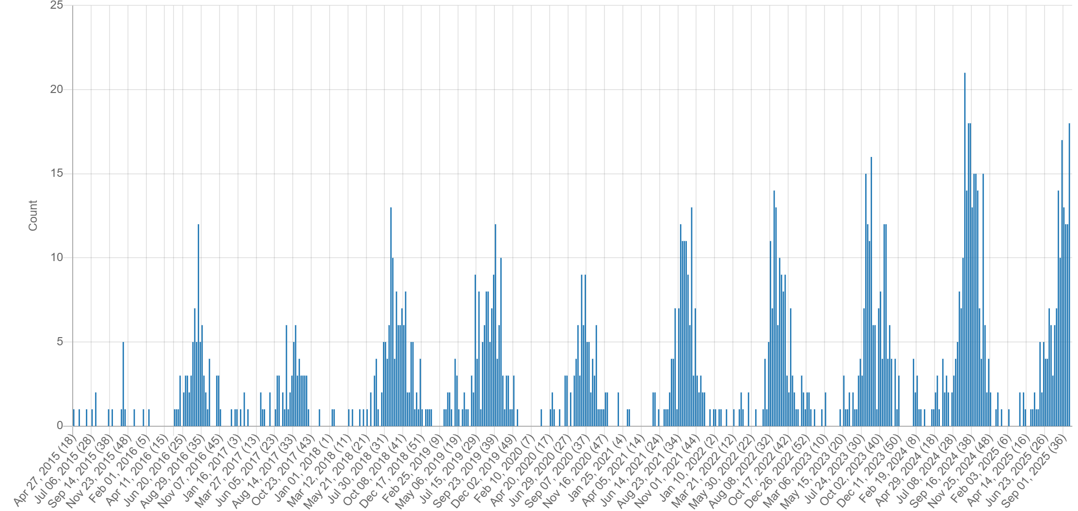
West Nile Virus
Seasonal update: Mosquito-borne disease surveillance in Canada — Canada.ca
Ontario has reported the greatest WNV activity so far this year, followed by Quebec
Lots of activity being reported from the USA
In Europe, Italy has reported the 430 cases
  Greece, Romania, Bulgaria, Germany, France also reporting cases
WNV Signals: April 2015 – October 2025
Notes:
As of September 20, 2025- PHAC data (epi week 38) – there have been 187 human cases of WNV reported across Canada, with 4 deaths, 37 cases in horses, 231 dead wild bird detections and 412 positive mosquito pools (ON and MB).
WNV cases are surging across Europe, with climate change expanding mosquito habitats, particularly those of the Culex genus. [Italy is the most affected country, accounting for over 80% of all confirmed infections in the EU
Cannot include every signal so this chart is also an under-representation

Slide 13
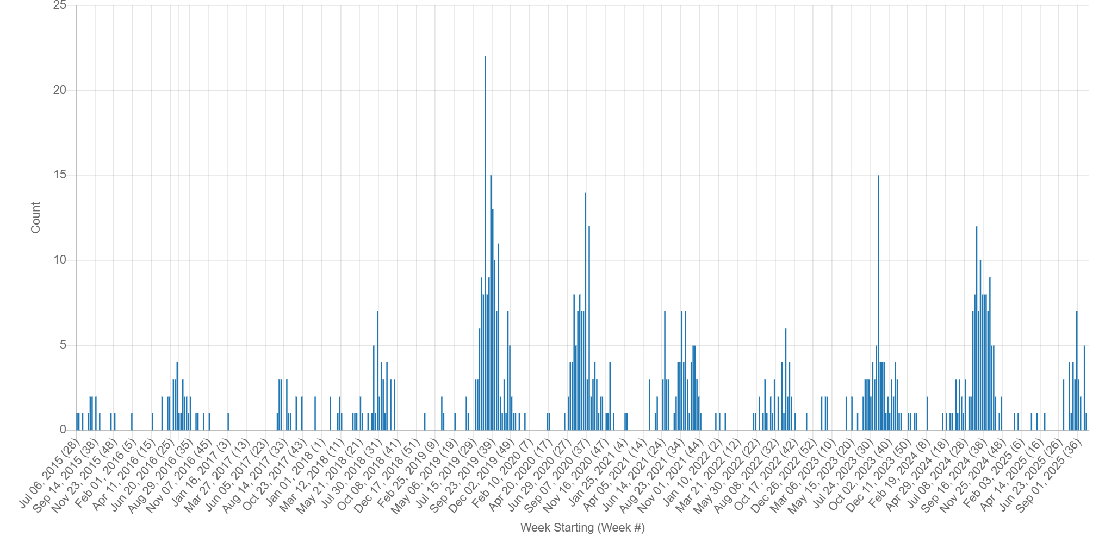
Eastern Equine Encephalitis
Number of signals is less than the previous year
Canada - Three human cases and eight cases in horses
USA also reporting cases in horses across various states, and in humans in New York, Maine, and South Carolina
EEE Signals: July 2015 – October 2025
Notes:
Canada – 1 human case was from Hamilton Ontario,

Slide 14
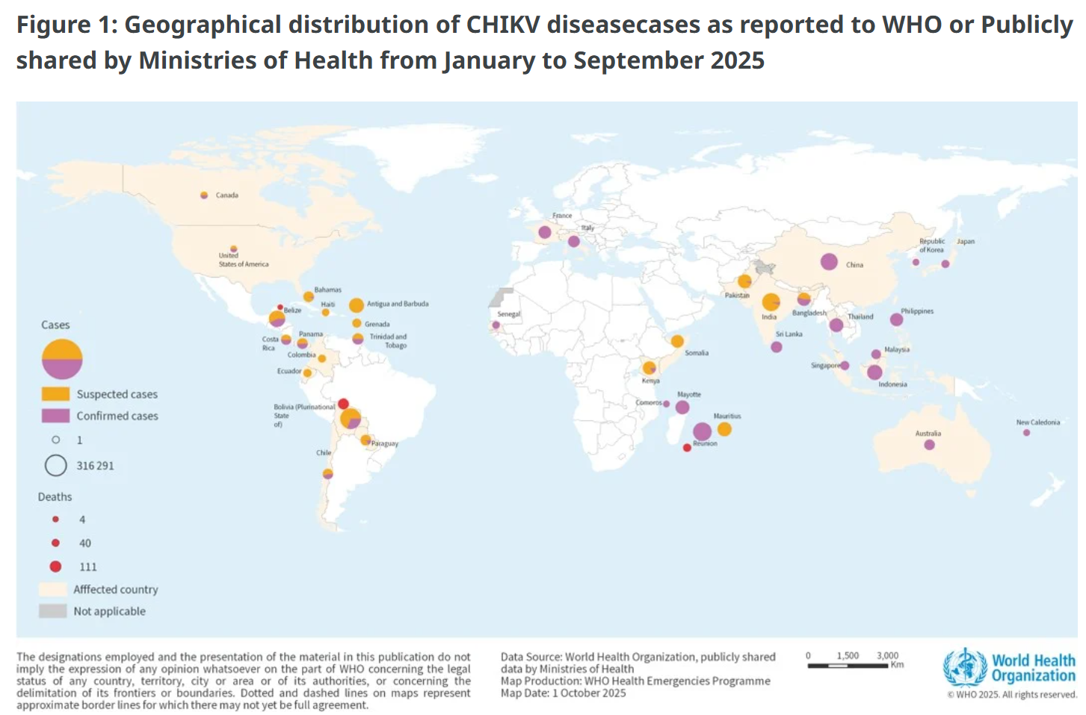
Chikungunya Worldwide
Between January 1 and September 30, 2025, a total of 445 271 suspected and confirmed CHIKV cases and 155 deaths were reported globally from 40 countries
South America and the French Overseas Territories (Reunion) have reported the highest case numbers
China has reported >16,000 local cases of CHIKV in Guangdong, with Foshan having the highest concentration of cases
Europe – France(479) and Italy(205) have reported local cases of CHIKV
Cuba has recently reported an outbreak of CHIKV – US travel advisory
Chikungunya virus disease- Global situation
Notes:
Chikungunya is a mosquito-borne viral disease caused by the CHIKV and is transmitted by Aedes aegypti and Aedes albopictus, which can also transmit dengue and Zika viruses.
data from January to September 2025, 263 592 suspected and 181 679 confirmed CHIKV disease cases and 155 CHIKV disease-related deaths have been reported globally. While certain WHO Regions are reporting lower case numbers compared to 2024, others are experiencing marked increases.
CHIKV disease can be introduced into new areas by infected travelers and local transmission may be established if there is the presence of Aedes mosquito and a susceptible population.
In China, as of 27 September 2025, a total of 16 452 locally transmitted cases has been reported in Guangdong Province. All cases were laboratory-confirmed. This represents the largest documented chikungunya outbreak to date in China. The cases have been reported in 21 cities, mainly in Foshan City (10032), Jiangmen City (5209), Guangzhou City (590), Shenzhen City (128), Zhanjiang City (112), Zhuhai City (60), and Zhongshan City (54). Additionally, during 1-21 September, Guangxi Zhuang Autonomous Region reported 297 local and associated cases; Fujian Province reported 124 local and associated cases; and some other provinces (such as Hunan, Sichuan, and Hainan provinces) al
In 2025, two European countries—France and Italy—have reported locally acquired cases of CHIKV disease. France has recorded 479 cases distributed across 54 clusters, with 40 clusters currently active. Italy has reported 205 locally acquired cases distributed across four clusters of which

Slide 15
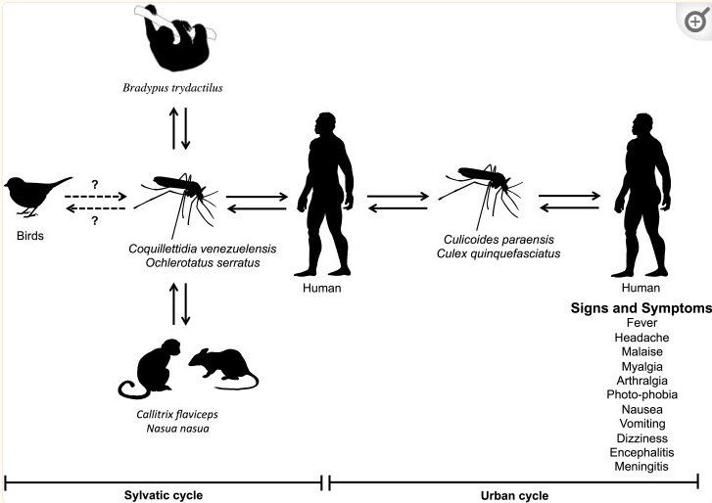
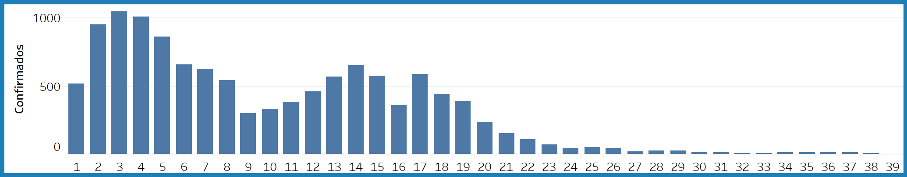
Oropouche virus
Epidemiological Alert Chikungunya and Oropouche in the Americas Region - 28 August 2025
PAHO reported 12,786 cases across 11 countries:
  Brazil – 11,888 confirmed
  Peru, Panama, Uruguay, Venezuela, Guyana, Cuba, Chile, Colombia, USA + Canada (1 imported case each)
Oropouche Virus: Clinical, Epidemiological, and Molecular Aspects of a Neglected Orthobunyavirus
PAHO Oropouche ARBOportal – weekly OROV cases for 2025
Notes:
In 2025, between EW 1 and EW 30, 12,786 confirmed cases of Oropouche were reported in the Americas Region. Confirmed cases were reported in 11 countries: Brazil (n= 11,888 cases including five deaths), Canada (n= 1 imported case), Chile (n= 2 imported cases), Colombia (n= 26 cases), Cuba (n= 28 cases), the United States of America (n= 1 imported case), Guyana (n= 1 case), Panama (n= 501 cases including one death), Peru (n= 330 cases), Uruguay (n= 3 imported cases), and Venezuela (Bolivarian Republic of) (n= 5 cases) (Figure 5) (33)

Slide 16
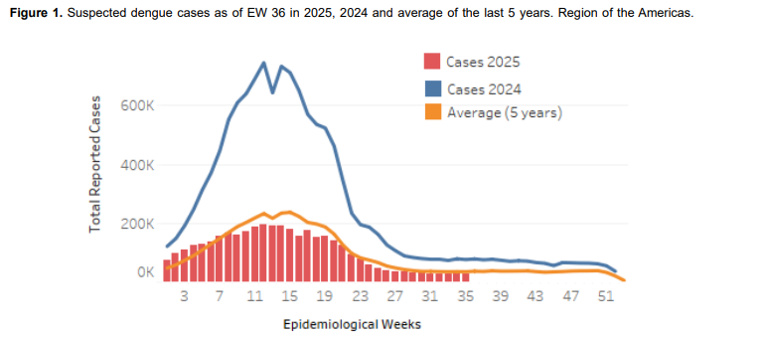
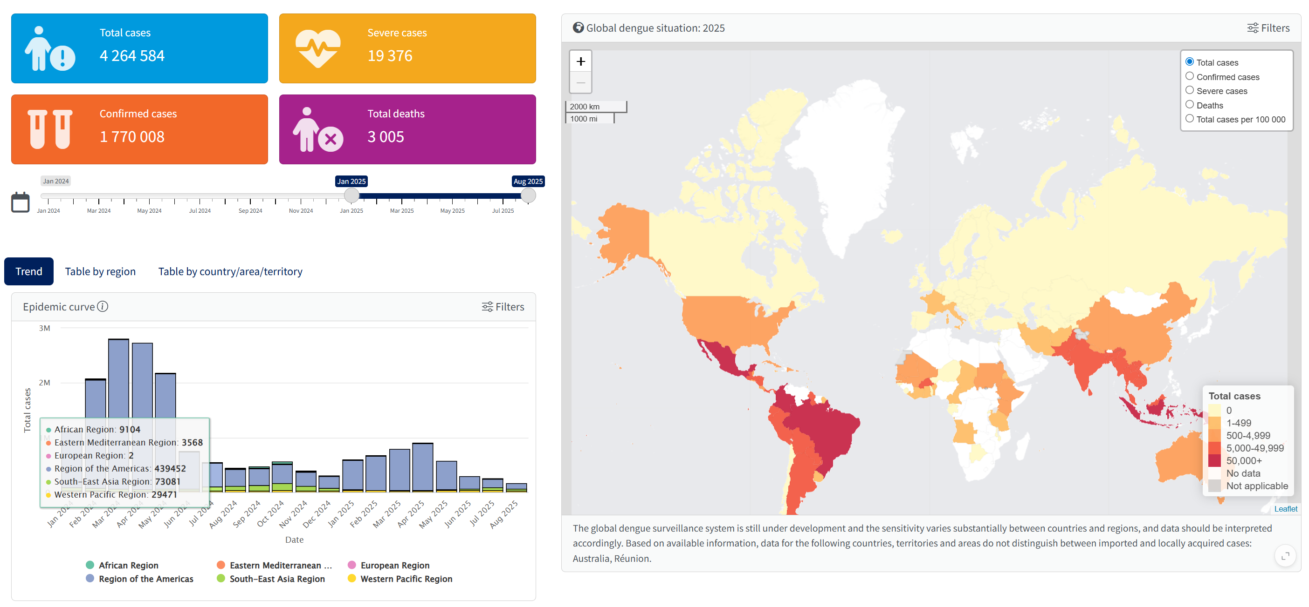
Dengue
PAHO Dengue: analysis by country
PAHO released an epidemiological update on Dengue in the Americas on September 26, 2025
Asia is reporting a rise in cases in certain countries (Bangladesh, India, China, Afghanistan)
Europe – locally acquired cases reported in Italy and France
WHO Dengue Dashboard – Data up to August 2025
Notes:
As of epidemiological week 36 of 2025, a total of 3,814,835 million suspected cases of dengue were reported, 1,527,118 cases (40%) were laboratory-confirmed, and 6,198 (0.2%) were classified as severe dengue. A total of 1,936 fatalities have been recorded, resulting in a case fatality rate (CFR) of 0.051%
However, the total case counts represent a decrease of 68% compared to the same period in 2024 and 10% compared to the average of the last 5 years.
The country reporting the highest number of cases was Brazil, followed by Colombia, Mexico, and Guyana
Bangladesh: Rising cases, >50,000 case mark for the year (50,689) along with 215 deaths.
India: Increasing cases in Kerala (566 cases) and Karnataka (183 cases).
Afghanistan: Suspected cases have risen since mid-April (595 cases).
China: 563 confirmed cases, higher than in June 2024.

Slide 17
Scientific Findings
Field evidence of Trypanosoma cruzi infection, diverse host use and invasion of human dwellings by the Chagas disease vector in Florida, USA
Chagas Disease, an Endemic Disease in the United States
Detection of Novel Orthobunyavirus Reassortants in Fatal Neurologic Case in Horse and Culicoides Biting Midges, South Africa
First isolation and identification of tembusu virus from naturally infected quails highlighting its cross-species transmission risk
Pre-print: Quantitative evaluation of dogs as sentinels for Rift Valley fever virus circulation in Madagascar
Pre-print: Venezuelan Equine Encephalitis Virus, Amazonas, Brazil, 2025
Bluetongue’s New Frontier—Are Dogs at Risk?
Cross-continental hitchhiking of exotic ticks on human travelers and ensuing public health challenges in the USA
High prevalence of vector-borne pathogens in the blood of clinically healthy dogs in Hong Kong
Notes from the Field: Early-Season Human Plague Transmitted from an Infected Cat — Oregon, January 2024
Characterization of post-acute multi-organ sequelae following dengue infection
Notes:
Recent publications highlight emerging risks and novel findings:
Chagas disease endemicity in the US
Novel orthobunyaviruses in South Africa
Imported exotic ticks and vector-borne pathogens in dogs
Vertical transmission of Usutu virus
Crimean-Congo hemorrhagic fever in Europe and Africa
Surveillance updates on dengue, WNV, and other arboviruses

Slide 18
Scientific Findings
Mosquito vector competence for Japanese encephalitis virus: a systematic review and meta-analysis update
Outbreak of autochthonous West Nile virus infection in Lazio region, Italy, July to August 2025: preliminary investigation
Oropouche virus efficiently replicates and is immunostimulatory in vivo in nonhuman primate species
Canine Spotted Fever Group Rickettsial Seroprevalence as an Indicator for Human Rocky Mountain Spotted Fever Case Rates in Arizona, USA
Babesia microti (Babesiidae, Piroplasmida) infection in a Chinese traveler returning from the United States of America
Mathematical modeling of lumpy skin disease: New perspectives and insights
Replication and Virulence in Cattle of the First Lumpy Skin Disease Virus Isolated in Xinjiang, China (2019)
Pediatric Case Report and Overview of Autochthonous Tick-Borne Encephalitis, Belgium
Epidemiological Alert Chikungunya and Oropouche in the Americas Region - 28 August 2025
Importation of the exotic tick Amblyomma geoemydae into Sweden via illegally introduced turtles (Geoemyda spengleri) from Thailand
Risk assessment and perspectives of local transmission of chikungunya and dengue in Italy, a European forerunner
Surveillance of West Nile virus infections in humans and animals in Europe, monthly report
Estimation of Incubation Period for Oropouche Virus Disease among Travel-Associated Cases, 2024–2025

Slide 19
Scientific Findings
Current status of severe fever with thrombocytopenia syndrome in China (Review)
Severe Fever with Thrombocytopenia Syndrome Acquired through Dog Bite, South Korea
Vertical transmission in field-caught mosquitoes identifies a mechanism for the establishment of Usutu virus in a temperate country
Experimental Usutu virus infection in Eurasian blackbirds (Turdus merula)
First detection of Sindbis virus in wild birds in Nigeria
Evidence of Crimean-Congo hemorrhagic fever virus in livestock and wildlife in Northeastern Portugal
First report of Crimean-Congo hemorrhagic fever virus exposure in human and livestock populations, Center Region, Cameroon
A review on the role of birds as disseminators of ticks, with special emphasis on Hyalomma species and Crimean-Congo haemorrhagic fever virus
Monitoring of Schmallenberg virus, bluetongue virus and epizootic haemorrhagic disease virus in biting midges in Germany 2019-2023
Targeted next-generation sequencing reveals hemotropic mycoplasmas, Bartonella spp., and Babesia in shelter dogs from Texas, USA
Identification of Co-Circulating Dengue and South America–Origin Zika Viruses, Pakistan, 2021–2022
New World Screwworm Infestation in Wild Mountain Tapirs, Central Andes Mountains, Colombia

