Slide 1
Community for Emerging and Zoonotic Diseases
Identifying emerging risks through collective intelligence
CEZD – CAHSS Vector Network Update
5 January 2026
www.cezd.ca
1
Notes:
1

Slide 2

Bovine Theileriosis in Canada
Bovine theileriosis is caused by Theileria protozoa
Infects cattle, sheep, water buffalo, yak, and other bovids
Several types of T. orientalis are found in the USA, but only T. orientalis Ikeda has been shown to cause severe illness
T. orientalis is transmitted by ticks, primarily the ALHT, but may also occur through re-use of needles, or during transfusions
The CFIA confirmed Canada’s first case of T. orientalis Ikeda in Kawartha Lakes, Ontario in October
    The cow was imported from the USA on July 15, 2025
    No control measures are undertaken to control the disease
2
Notes:
On October 8, 2025, the CFIA was notified of a suspicion of Theileriosis in a dairy cow with regenerative anemia located in Kawartha Lakes, Ontario. The cow was imported from the USA on July 15, 2025. The NCFAD then confirmed the sample to be positive for Theileria orientalis Ikeda through metagenomic sequencing and genotype identification. This is the first detection of Theileriosis in Canada. No control measures are undertaken to control the disease.
Bovine theileriosis is caused by a blood parasite (protozoa) from the Theileria genus that infects red and white blood cells. It is primarily spread by ticks, especially the Asian longhorned tick, but can also spread via contaminated needles or blood transfusions. However, other insects such as flies, mosquitoes and lice may also spread the disease but their role is not yet clear.
Susceptible species include cattle, sheep, water buffalo and other bovids.
There are several types of Thelieria orientallis in the USA (including Chitose, buffeli and Ikeda) but only Ikeda has been shown to cause severe illness.
Clinical signs in infected cattle often appear as:
fever
swollen lymph nodes (lymphadenopathy)
loss of appetite and weight loss
nasal discharge
diarrhea
decreased milk production
anaemia, jaundice, and bloody urine
How sick the animal gets depends on the type of theileria parasite and the susceptibility of the animal host. In some cases, animals may get sick or die, especially if they've never had the disease before.
2

Slide 3


Asian Longhorn Tick and Theileriosis in the USA
Since the last CAHSS call – Kansas has reported its first detection in October 2025
  Found on a dog in Franklin County
25 states + Washing D.C. now affected
Kansas has also recently report theileriosis in cattle that were brought into the state (unclear from where)
Theileria is tick-borne, but flies, mosquitos, and lice may also play a role
Asian Longhorned Tick Situation Report - The Tick App
Notes:
Primarily tick borne - secondary vectors and poor hygiene during routine herd management procedures can increase risk significantly
3

Slide 4
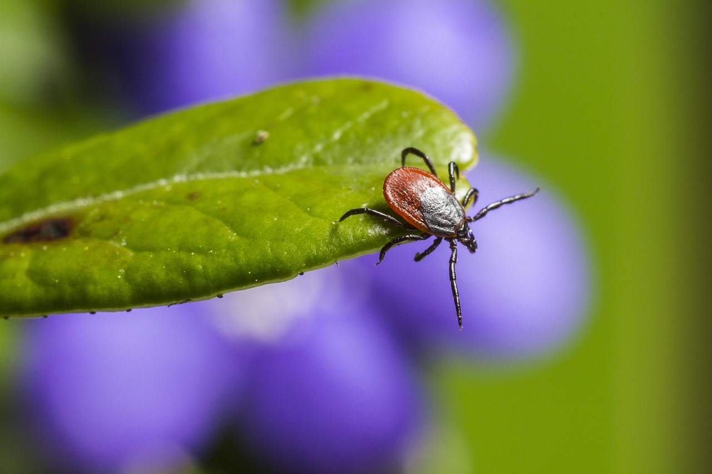
Tick Borne Encephalitis
70 year old man from Calgary
Travelled to Czechia and Georgia (August to October 2025)
There was no known tick bite – can spread through consumption of unpasteurized milk
Patient had fever, confusion and night sweats
PCR from Blood and subsequent seroconversion
Positive European Lyme Immunoblot
GeoSentinel report – Tick-borne encephalitis in a traveler returning to Canada from Czechia; considerations for diagnostic testing and pre-travel counseling – BEACON
4
Notes:
In Calgary, Alberta, a 70-year-old man was diagnosed with TBE after returning from travelling to the Czech Republic and Georgia. The infection was confirmed by PCR from blood with subsequent seroconversion, and a positive European Lyme immunoblot. There was no reported/known tick bite. TBE is endemic throughout the Czech Republic, and the country reports some of the highest TBE incidence rates in Europe.
4

Slide 5
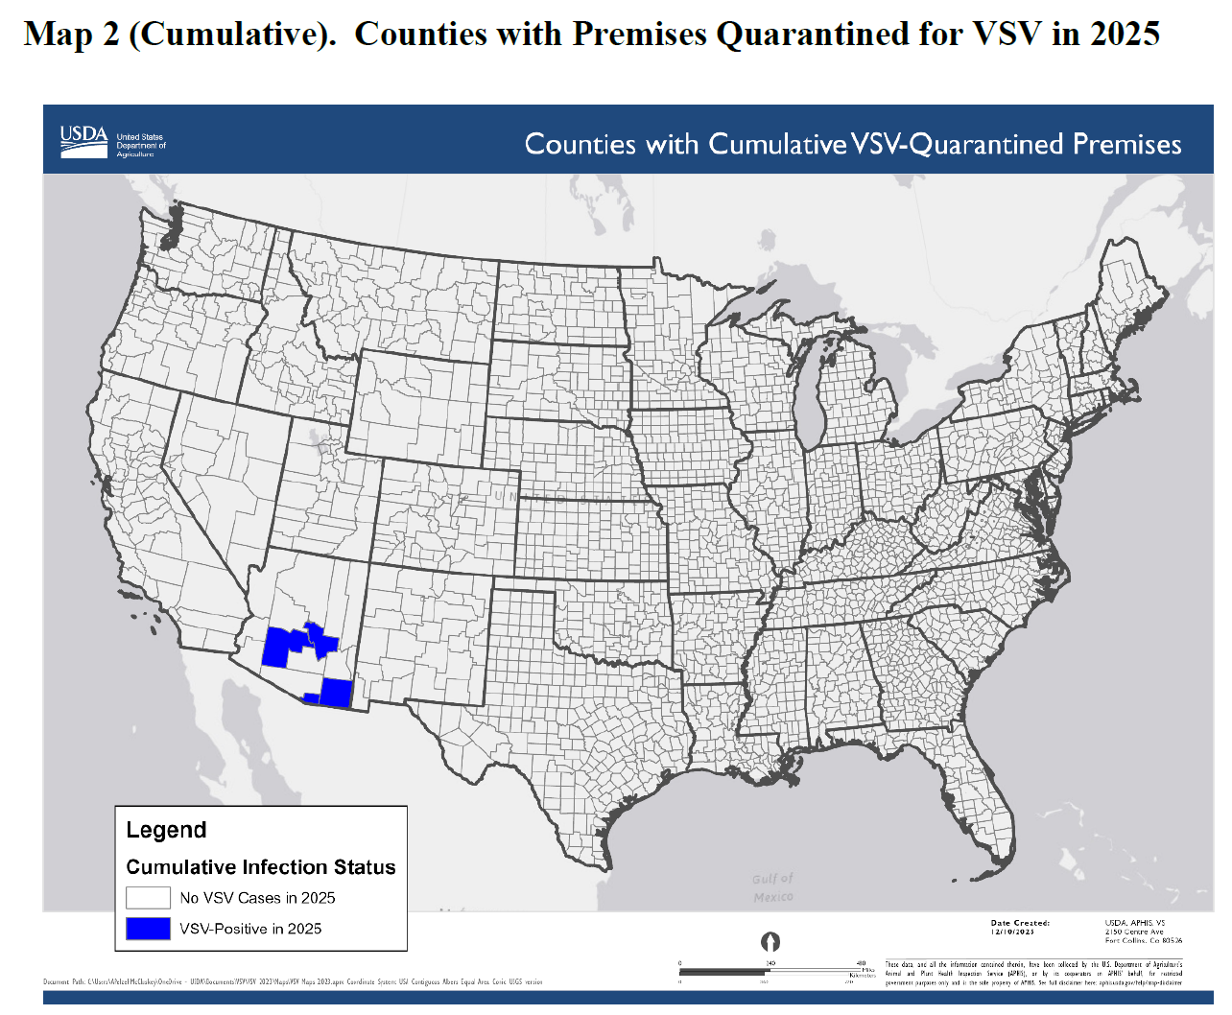
Vesicular Stomatitis in Arizona
USDA VSV Situation Report
Most recent incursion is in Arizona (October 2025)
New Jersey Strain virus
5 premises affected in 4 counties
  Cochise County (2 initial cases - released)
  Gila County (1 case – released)
  Santa Cruz County (1 case – quarantine)
  Maricopa County (1 case, wild horse – quarantine)
No recent livestock movements onto the index premises
Suspect that vector movements across the border are the source of the outbreaks
The 2023/24 outbreaks in California, Nevada and Texas are also thought to have originated from vector movements across the border with Mexico
5
Notes:
Vesicular stomatitis primarily affects horses but can also affect other farm animals such as cows, sheep, and goats, as well as humans.
It circulates annually in livestock and insect vectors in southern Mexico and results in occasional incursions in the U.S. when climate and ecological factors support northward movement.
Most recent incursion to the southern US is in Arizona with the New Jersey Strain virus.
On October 31, 2025, the USA confirmed two cases of vesicular stomatitis New Jersey virus (VSNJV) in horses on two separate premises in Cochise County, Arizona.
There had been no recent livestock movements related to the index case, so, it is suspected that vector movements across the border are the source of the outbreaks.
As of the end of December there have been 5 affected premises reported across 4 counties, with 2 currently still in quarantine.
5

Slide 6
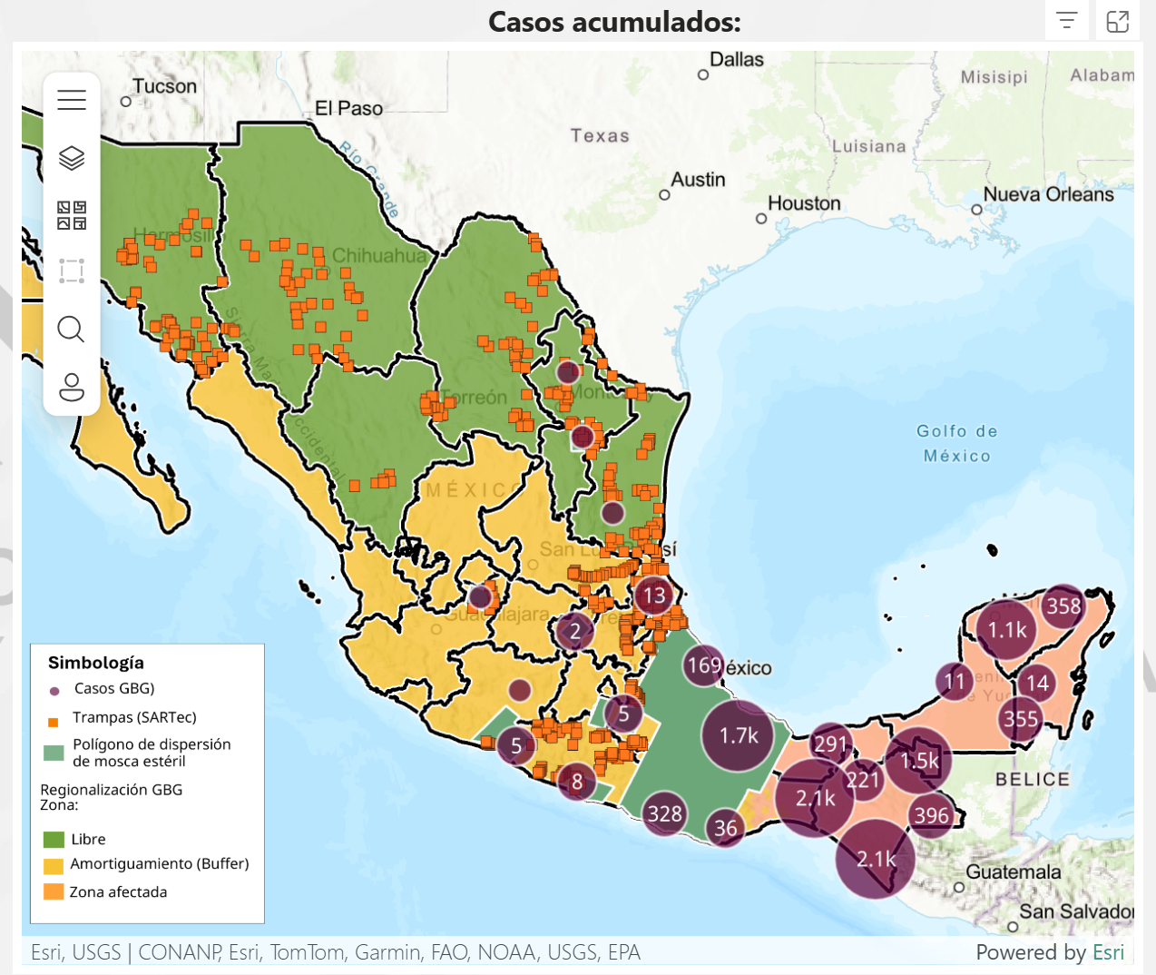
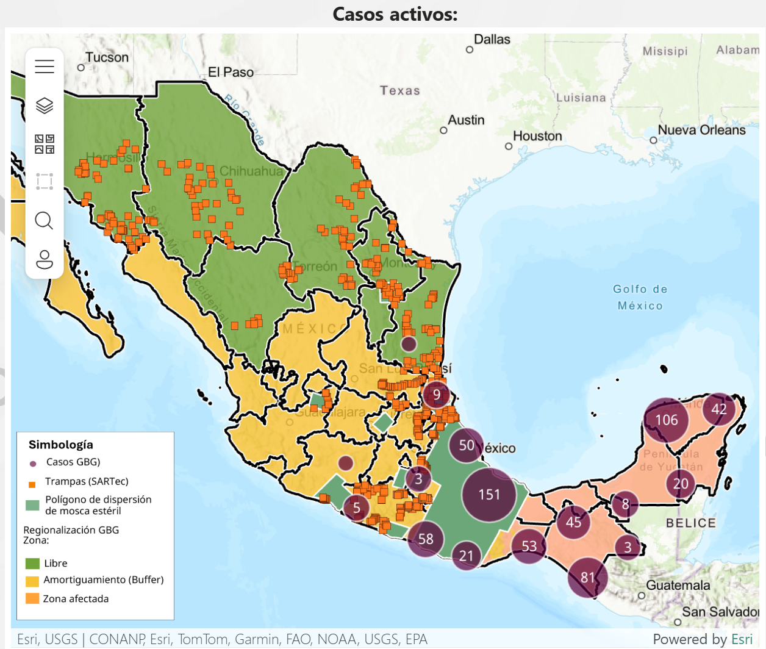
New World Screwworm
Mexico has reported its first case of NWS in Tamaulipas (317km from Texas border) - same region where the new sterile fly dispersal facility was opened
Mexico has reported a 3rd case of NWS in Nuevo Leon in a bovine imported from Veracruz
Continued increase in cases in animals and humans
Mexico’s interactive dashboard displays 671 active cases of NWS in animals (13,106 cumulative)
Mexico – 1602 (~12.2%) cases in dogs, 32 cases in cats
Alternate management strategy being piloted in Yucatan to decrease total fly numbers before release of sterile flies
“For sterile flies to be effective, there must be 10 of them for each fertile fly”
6
Notes:
Mexico has reported its first case of NWS in Tamaulipas - in a 6 day old calf (no reports of it being imported from another region) - Today they also reported a case in Altimira in a horse – which could mean the fly has reached the region.
This is also the same region where the new sterile fly dispersal facility was opened (Tampico, Mexico); which aims to increase the range and number of sterile flies being released and allow for a greater ability to push the pest south.
Mexico has reported a third case of NWS infestation in Nuevo Leon, again in a bovine imported from a southern affected region (Veracruz)
Mexico's dashboard shows 671 active cases with 13,106 cumulative cases in animals. A recent report also mentioned the impact of pets, with ~1602 cases reported in dogs and 32 cases in cats
Mexico has also reported additional human cases of NWS infestation, bringing the total number to 106 as of Dec 13 (Chiapas = 86, Campeche = 4, Tabasco = 2, Yucatan = 8, Oaxaca = 2, and QuintanaRoo = 4)
6

Slide 7


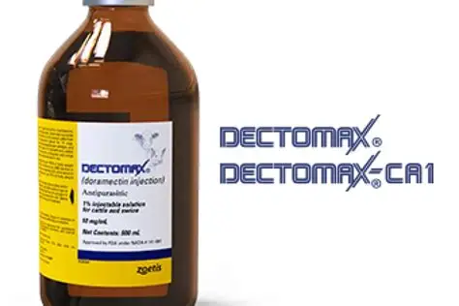
New World Screwworm
Emergency Use Authorizations
  Credelio Cat
  Credelio Dog
Efficacy of lotilaner against myiasis caused by Cochliomyia hominivorax (Diptera: Calliphoridae) in naturally infested dogs | Parasites & Vectors
US FDA Conditionally Approved Treatments
  Credelio Quattro-CA1 (Elanco) chewable tablets for dogs
  Exzolt Cattle-CA1 (Merck) fluralaner topical solution for beef cattle (>2 months of age) and replacement dairy heifers (<20 months of age)
  Dectomax-CA1 (Zoetis) injectable for cattle, 35 day withdrawal for cattle, not for use in dairy >20 months of age
7
Notes:
Washington, D.C., December 17, 2025—Today, the U.S. Food and Drug Administration conditionally approved Credelio Quattro-CA1 (lotilaner, moxidectin, praziquantel, pyrantel) chewable tablets for the treatment of infestations caused by New World screwworm (NWS) larvae (myiasis) in dogs and puppies at least eight weeks of age and weighing at least 3.3 pounds.
Washington, D.C., December 4, 2025—Today, the U.S. Food and Drug Administration conditionally approved Exzolt Cattle-CA1 (fluralaner) topical solution for the prevention and treatment of New World screwworm (NWS) larval infestations, and the treatment and control of cattle fever tick in beef cattle 2 months of age and older and replacement dairy heifers less than 20 months of age.
7

Slide 8
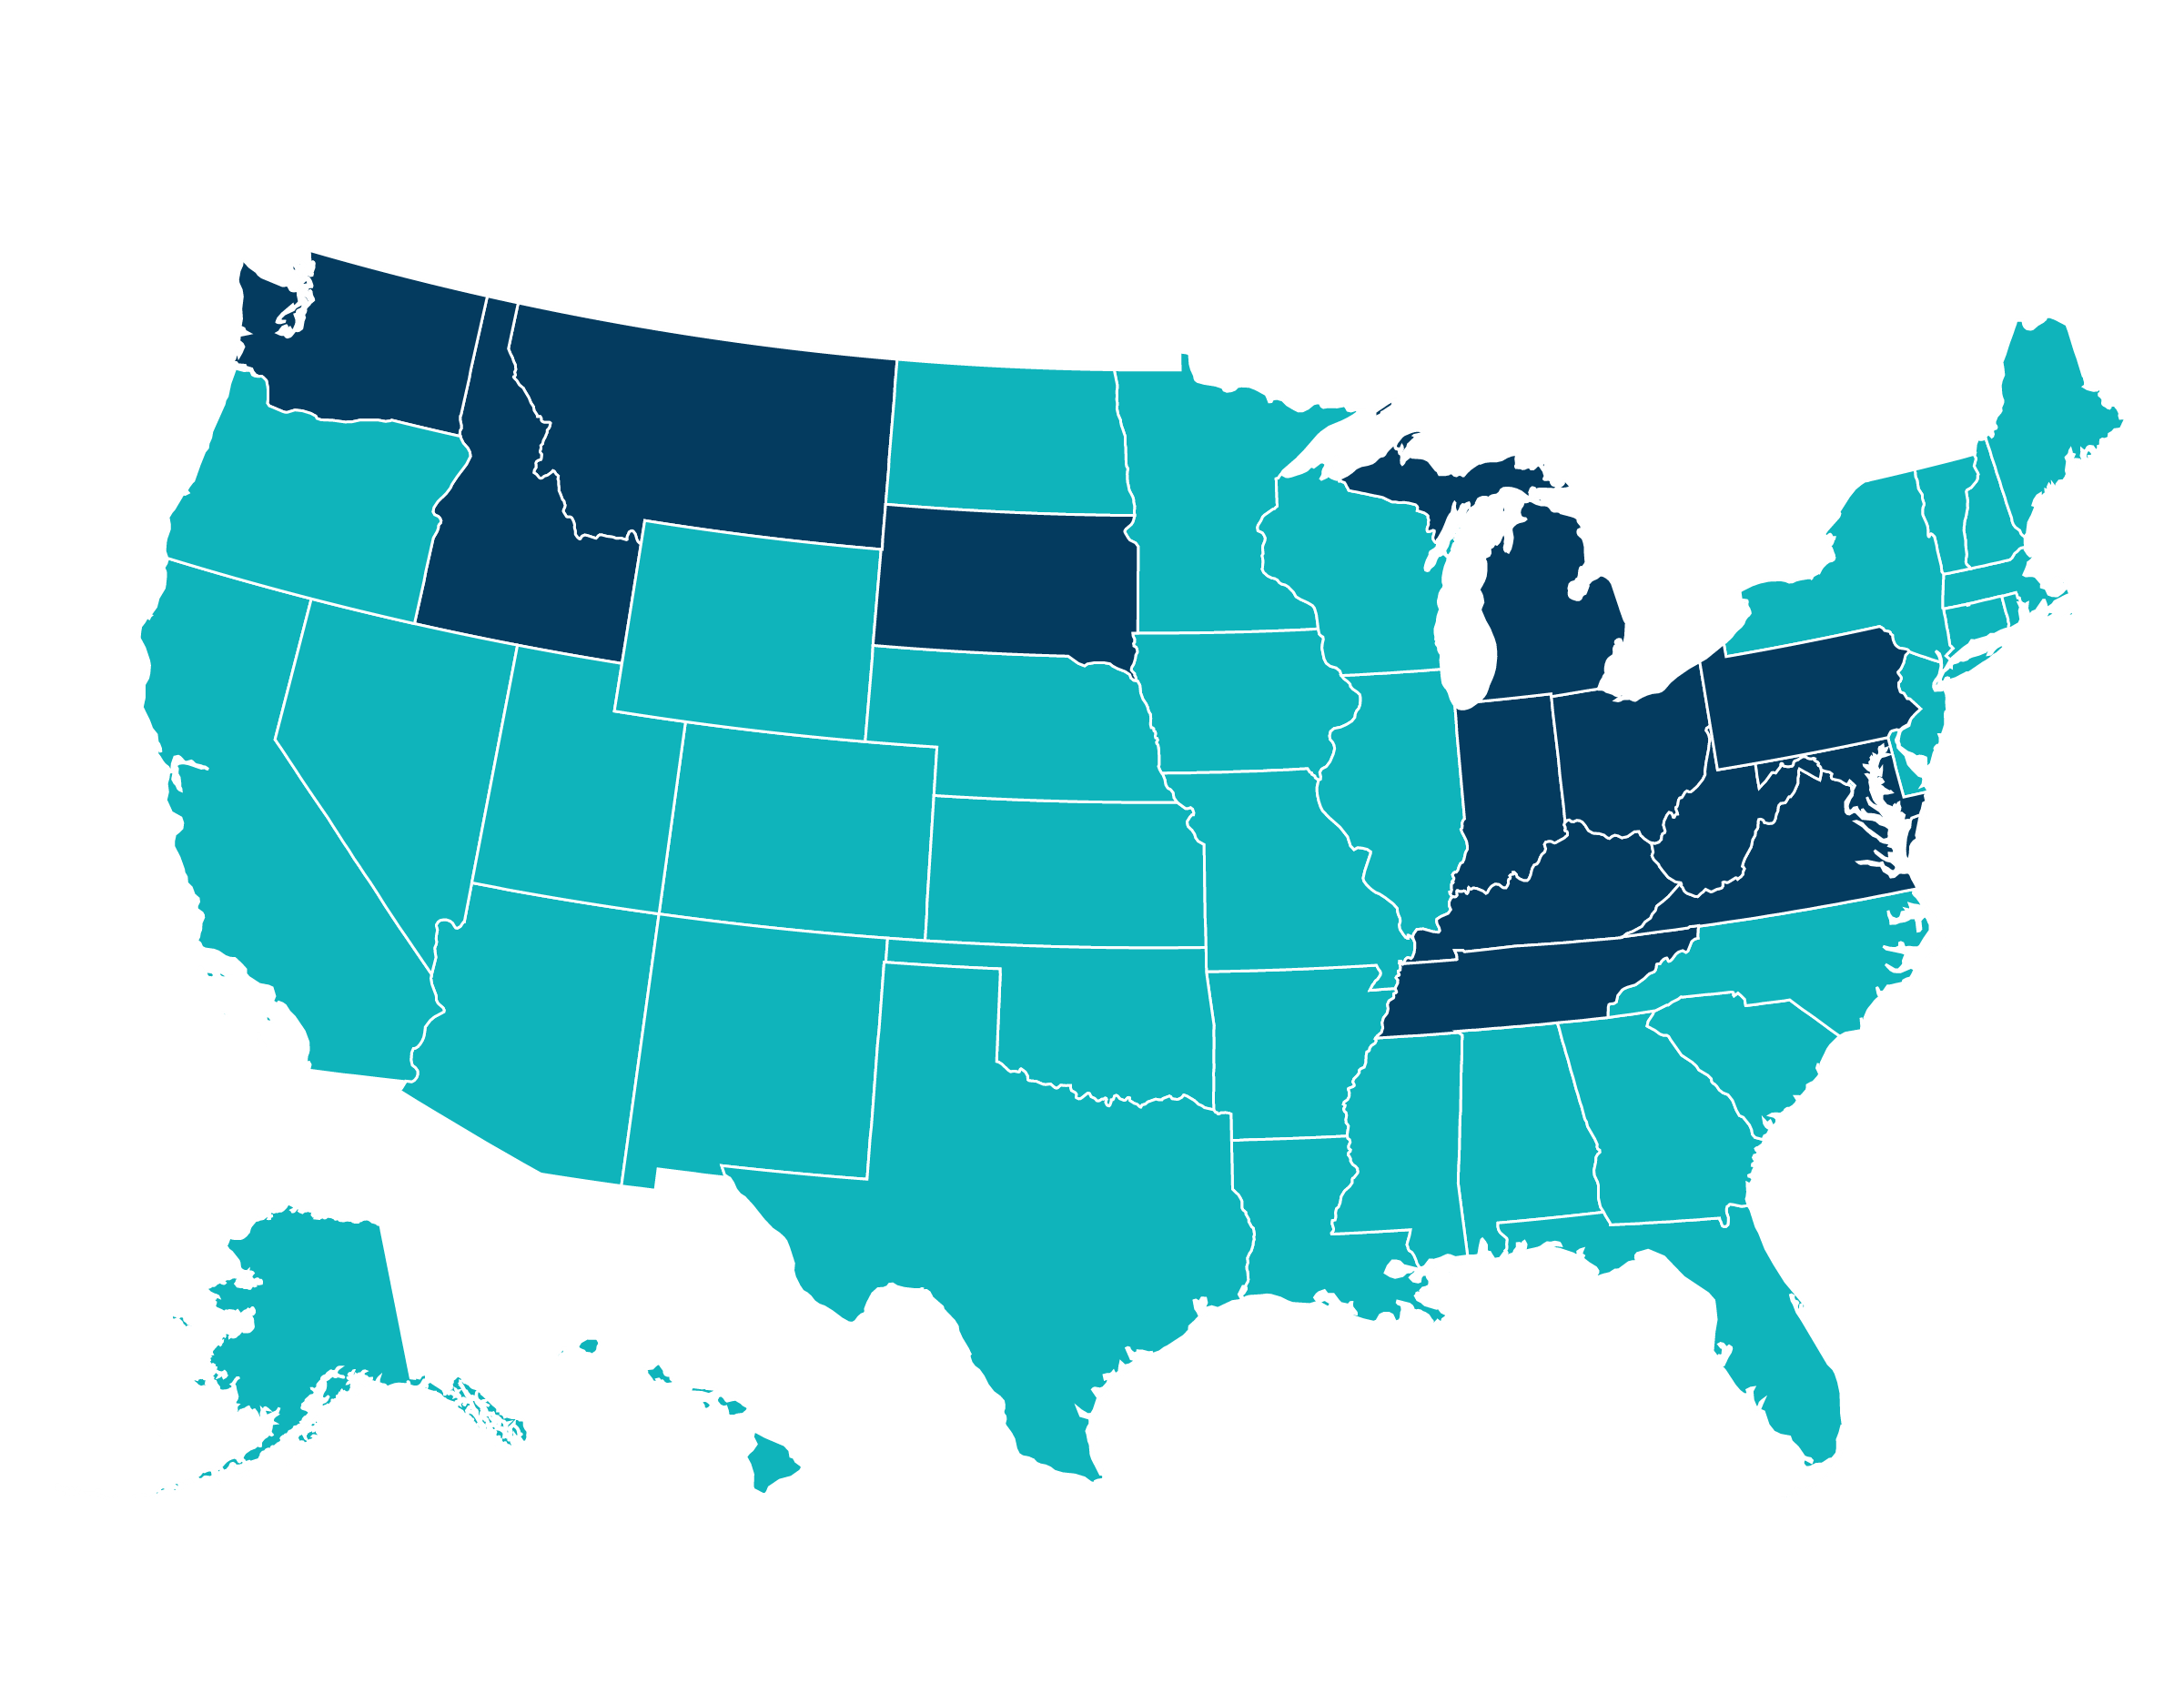
Epizootic Hemorrhagic Disease in the United States
Epizootic Hemorrhagic Disease in the United States has been severe in 2025
Reports of hundreds to thousands of white-tailed deer impacted across at least 13 states in 2025
Maryland
Virginia
West Virginia
Pennsylvania
Ohio
Indiana
Kentucky
Michigan
Washington
Idaho
Montana
South Dakota
Nearly 100 deer found dead in Grand Forks, B.C. as epizootic hemorrhagic disease confirmed | CBC News
Tennessee
Notes:
The United States has had a severe outbreak of epizootic hemorrhagic disease in the late summer and fall of 2025 with hundreds to thousands of cases occurring in white tailed deer across at least 13 states.
Canada periodically has cases of epizootic hemorrhagic disease when the midge vectors are blown across the border, this occurred in the fall of 2025 in Grand Forks British Columbia with hundreds of white-tailed deer killed by the virus.
Montana is reporting an increase in deer deaths, thought to be due to EHD, in Mission Valley, as well as a possible increase in bear activity as they feed on the carcasses
8

Slide 9
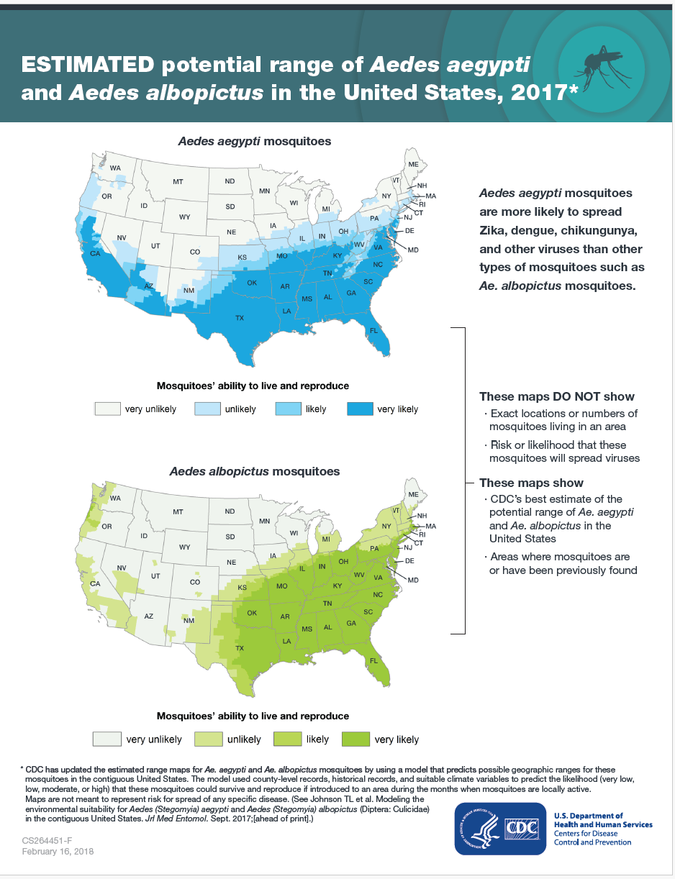
Chikungunya in the USA
New York State Department of Health Confirms First Locally Acquired Case of Chikungunya in New York State
October 2025 - first autochthonous case in New York State and first in the United States in 6 years
2017 maps from CDC indicate Aedes aegypti are unlikely to live and reproduce in New York whereas Aedes albopictus, unlikely in North, likely in South
Current and Projected Distributions of Aedes aegypti and Ae. albopictus in Canada and the U.S. - Federal Open Science Repository of Canada – 2020
9
Notes:
A locally acquired case of chikungunya has been reported in the USA, in Nassau County on Long Island New York in October 2025. This is the first locally acquired case in New York and the first in the USA since 2019. The source of exposure remains unknown but can be spread when a local Ades albopictus mosquito bites an infected traveller and then bites another person.
CDC maps from 2017 indicate estimates of range for A. aegypti and albopictus, showing that A. aegypti are very unlikely and albopictus as unlikely to live and reproduce in New York, with both species very likely in the southeast.
9

Slide 10
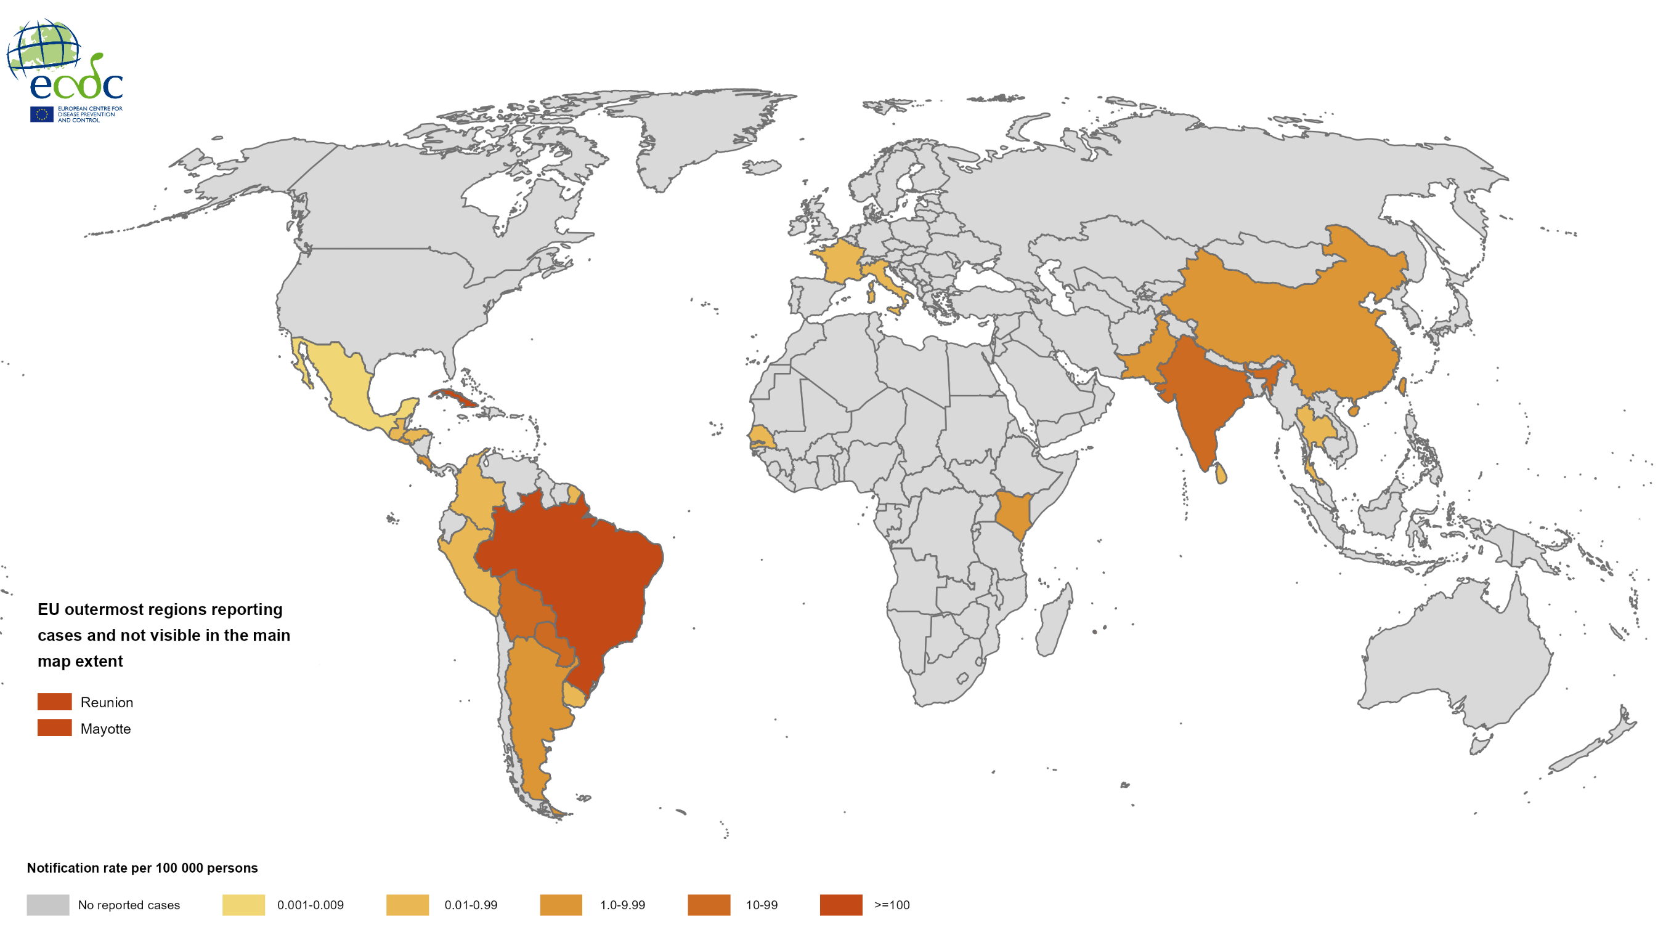
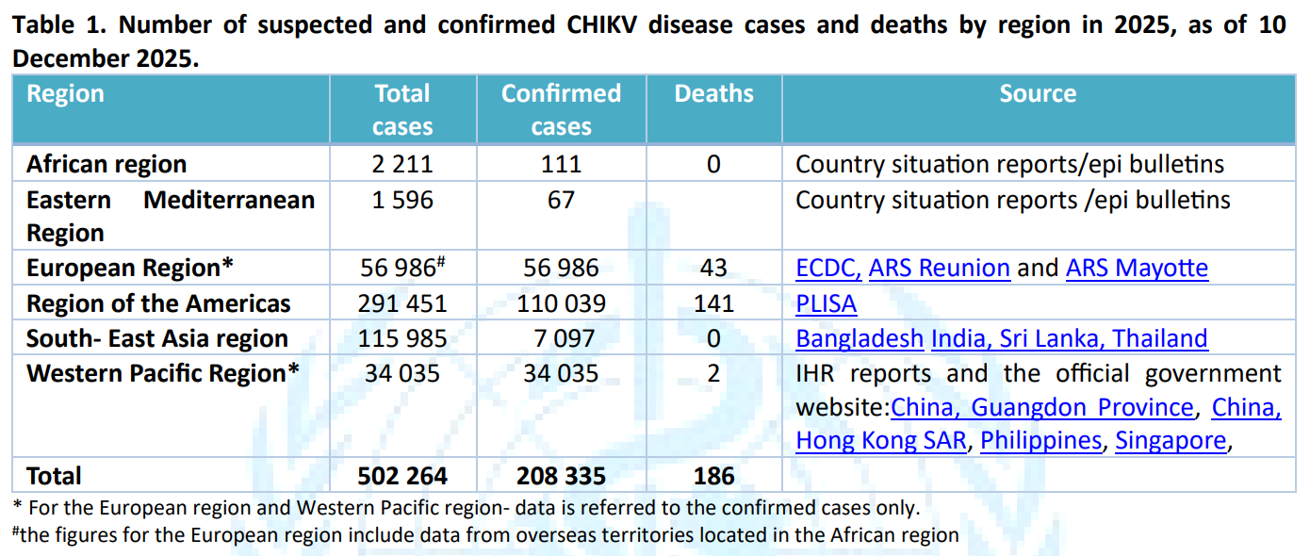
Chikungunya Worldwide
Chikungunya virus disease worldwide overview
Between January 1 and December 10, 2025, a total of 502 264 suspected and 208 335 confirmed CHIKV cases and 186 deaths were reported globally from 41 countries
CDC has travel notices for CHIKV for: Bangladesh, Cuba, China (Guangdong Province), and Sri Lanka
WHO Rapid Risk Assessment on CHIKV Global Spread
  Global public health risk is assessed as moderate
10
Notes:
With regards to the worldwide picture. From January to December 10 2025, there have been 502 264 suspected and 208 335 confirmed CHIKV disease cases and 186 CHIKV disease-related deaths have been reported globally from 41 countries. Similar to previous reports, certain regions are reporting lower case numbers compared to 2024, others are experiencing marked increases.
The CDC currently has travel notices for CHIKV for Bangladesh, China (Guangdong), Sri Lanka, and Cuba (with Cuba also reported outbreaks of dengue and oropouche).
A recent WHO rapid risk assessment has assessed the global public health risk as moderate.
10

Slide 11
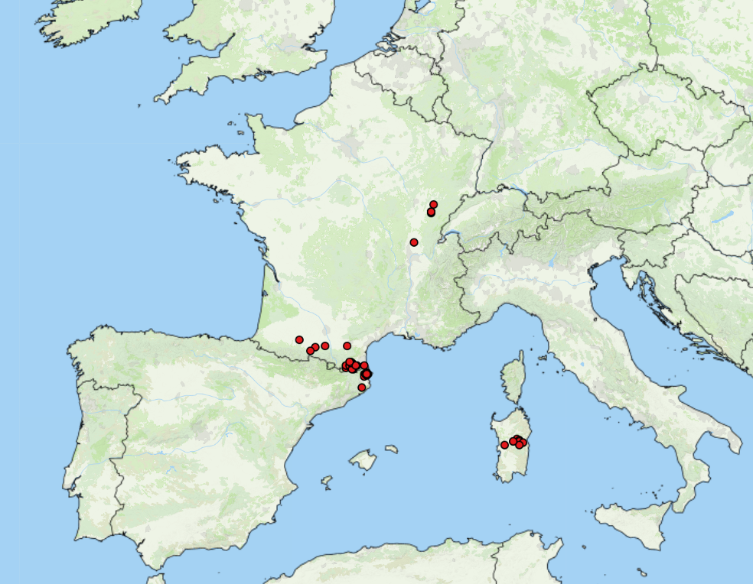
Lumpy Skin Disease in Europe
LSD Cases: October 2025 – December 2025
Empress +
France: 115 outbreaks, Savoie (32), Haute-Savoie (44), Ain (3), Rhône (1), Jura (7), Pyrénées-Orientales (22), Doubs (1), Ariège (1) and Hautes-Pyrénées (1), Haute-Garonne (2), Aude (1)
Italy: 80 outbreaks, concentrated in Sardinia, with one cases in Lombardy (linked to animal movement from Sardinia), no new outbreaks reported since early November 2025
Spain: cases in Girona, close to French border, as of October 27 has reported 17 outbreaks
DEFRA LSD Outbreak Assessment: Phylogenetic analysis indicates that the outbreaks in France and Italy are clade 1.2 strain - same clade that circulating in Europe in 2015 - 2017
French farmers have been protesting the culling measures used to control LSD
11
Notes:
In late June 2025 the First outbreaks of LSD in Europe were reported in Italy, followed shortly by France and then Spain.
As of December 29, 2025
France has experienced 115 outbreaks, Savoie (32), Haute-Savoie (44), Ain (3), Rhône (1), Jura (7), Pyrénées-Orientales (22), Doubs (1), Ariège (1) and Hautes-Pyrénées (1), Haute-Garonne (2), Aude (1) - still reporting new outbreaks, with french farmers protesting the culling measures used in an effort to control the disease.
Italy up to 80 outbreaks, still concentrated on Sardinia, no new outbreaks since early Nov 2025
Spain has reported 17 outbreaks all still within Girona (close to the french border) with the last one on October 27, 2025
Info included in a recent DEFRA outbreak assessment indicates from phylogenetic analysis that the LSD outbreaks in France and Italy and clase 1.2, the same one that circulated in Europe in 2015-2017.
11

Slide 12
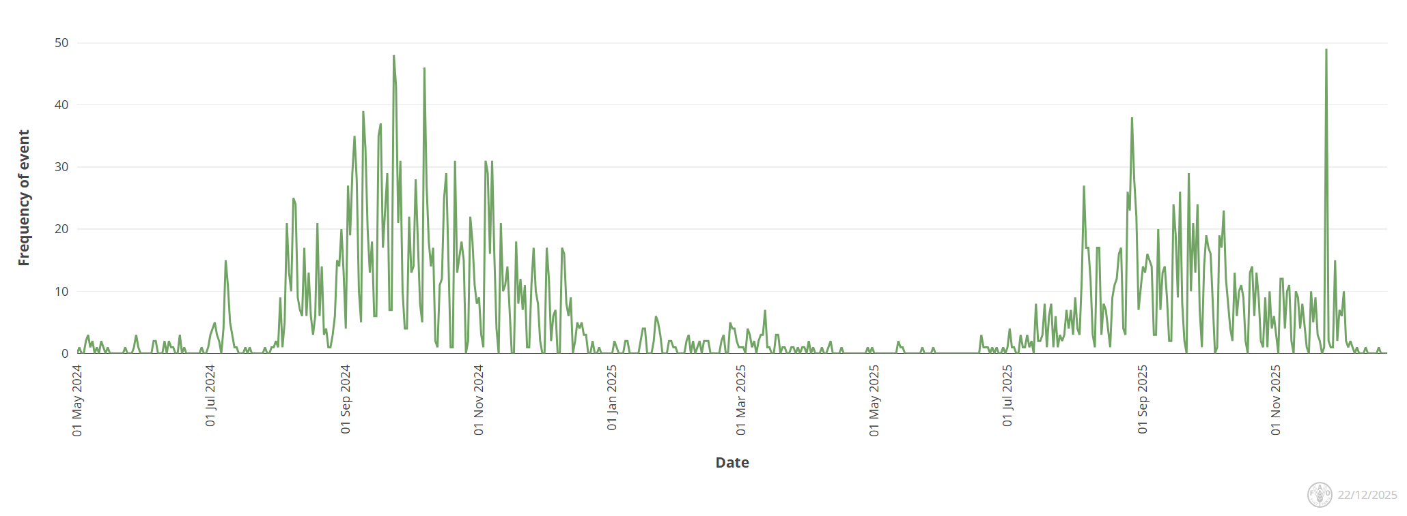
Bluetongue virus in Europe
Europe still reporting cases of BTV (serotypes 3, 8, 5, and 4)
BTV – 3
  The UK (including Northern Ireland now), Romania, Serbia, Greece, Poland, Hungary, Bulgaria, Lithuania, Croatia
BTV – 8
  Germany (re-emergence), Greece, Serbia, Bosnia, Slovenia, Hungary, Bulgaria
BTV - 4
  Bulgaria, Romania, Italy, Greece
BTV – 5
  Italy
Empres-Plus
Notes:
With regards to Bluetongue we are still seeing cases across Europe with a recent peak, with cases of BTV-3 being reported from Northern Ireland now as well.. Most cases/activity has been related to BTV-3, followed by BTV-8 (which has just recently been reported again in Germany and a re-emergence). BTV-4 has been reported in a few countries (Bulgaria, romania, Italy and a little in Greece) and then BTV-5 reported in Italy.
12

Slide 13
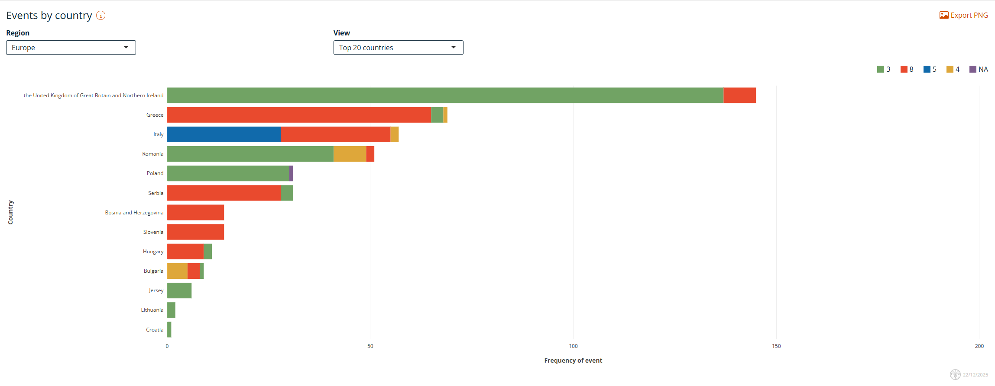
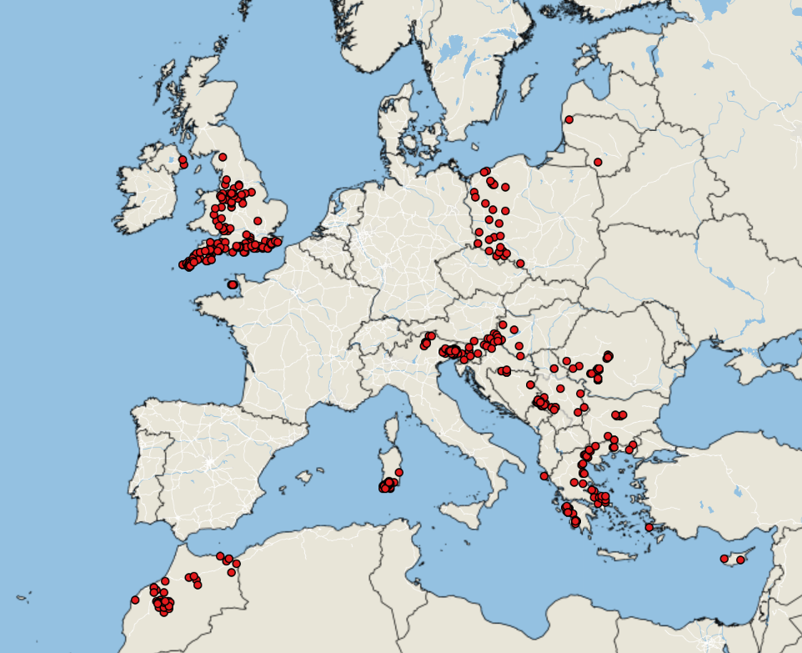
Bluetongue virus in Europe
Empres-Plus
BTV cases October 1, 2025 – December 22, 2025
Notes:
This is that same information in chart form, and you can see all of the cases reported across Europe from the beginning of October until Dec 22nd.
13

Slide 14
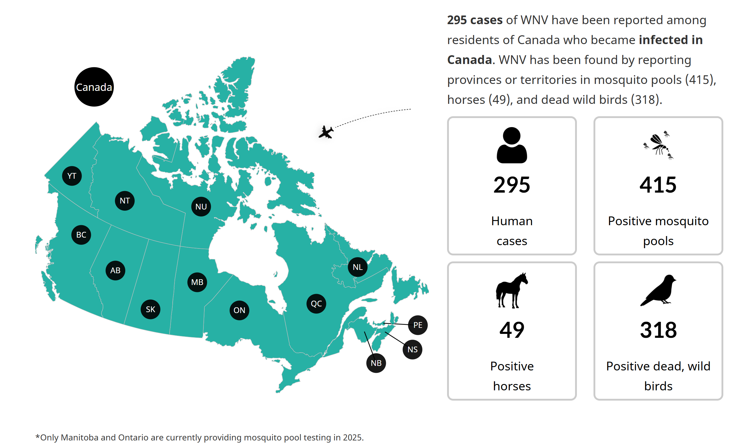
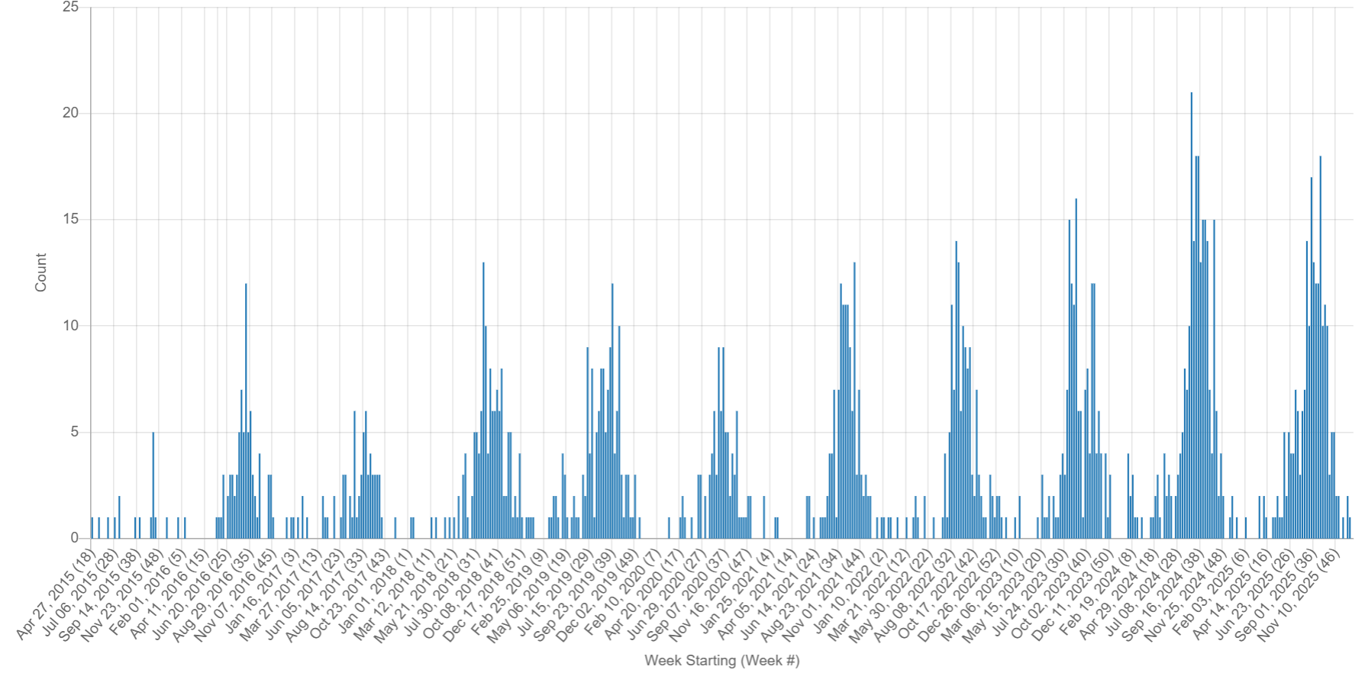
West Nile Virus
Seasonal update: Mosquito-borne disease surveillance in Canada — Canada.ca
Ontario and Quebec greatest WNV activity in 2025
Lots of activity being reported from the USA
  Colorado - 275% increase in WNV in 2025
In Europe, 1,112 locally acquired cases and 97 deaths
  Italy (779), Greece (96, 1 with unknown place of infection), France (62), Serbia (62), Romania (49), Spain (36), Hungary (14), Croatia (4), Albania (3), Germany (2), North Macedonia (2), Bulgaria (1), Kosovo (1) and Türkiye (1)
WNV Signals: April 2015 – December 2025
14
Notes:
As of November 1, 2025- PHAC data (epi week 38) – there have been 295 human cases of WNV reported across Canada, with 9 deaths, 49 cases in horses, 318 dead wild bird detections and 415 positive mosquito pools (ON and MB).
December 2025, 14 countries in Europe reported 1 112 locally acquired¹ human cases of WNV infection. The earliest and latest date of onset were on 19 May 2025 and 27 October 2025, respectively. Locally acquired cases have been reported by Italy (779), Greece (96, of which 1 with unknown place of infection), France (62), Serbia (62), Romania (49), Spain (36), Hungary (14), Croatia (4), Albania (3), Germany (2), North Macedonia (2), Bulgaria (1), Kosovo* (1) and Türkiye (1). In Europe, 97 deaths were reported.
Cannot include every signal so this chart is also an under-representation

Slide 15
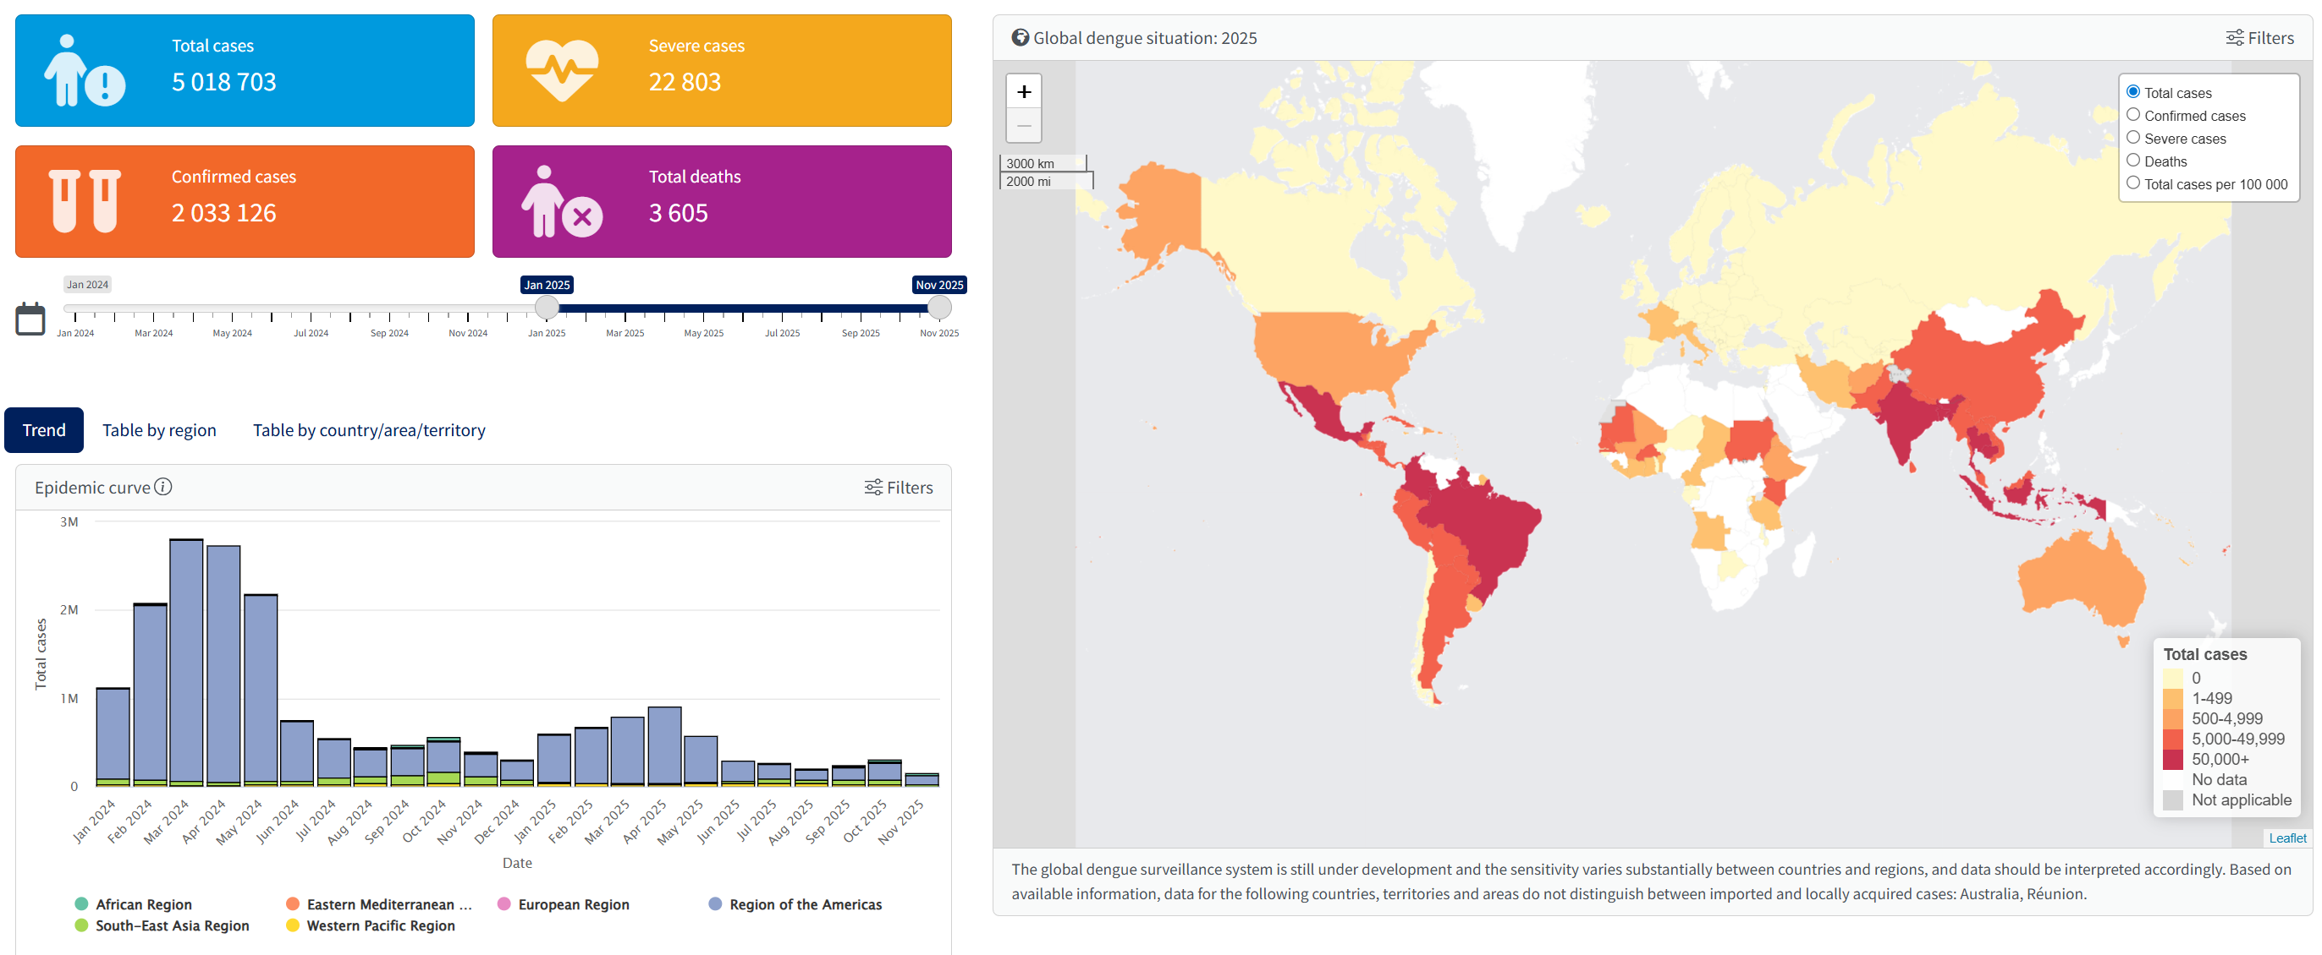
Dengue
PAHO Dengue: analysis by country
PAHO released an epidemiological update on Dengue in the Americas on December 22, 2025
Most Asian countries reporting declining total cases, except Bhutan which has stayed elevated
Europe – locally acquired cases reported in Italy and France
WHO Dengue Dashboard – Data up to December 9 2025
15
Notes:
In the epidemiological week (EW) 48 of 2025, a total of 4,294,752 suspected cases of dengue were reported, with 1,637,384 confirmed cases. This represents a decrease of 67% compared to the same period in 2024 and 9% compared to the average of the last 5 years. Figure 1 shows the trend of suspected dengue cases as of EW 48.
2150 deaths were reported - with the case fatality rate (CFR) in 2025 to date is 0.050%.
The country reporting the highest number of cases was Brazil, followed by Mexico, Colombia, and Guatemala.
WHO dashboard – 5 million total cases, 2 million confirmed, with 3605 deaths worldwide for 2025
15

Slide 16
Scientific Findings
Various small mammal hosts are involved in the transmission cycle of zoonotic Anaplasma phagocytophilum in Southeastern Canada
Isolation and Characterization of Rickettsia finnyi, Novel Pathogenic Spotted Fever Group Rickettsia in Dogs, United States
First finding of Rickettsia rickettsii in Haemaphysalis longicornis (Acari: Ixodidae) in North America
Metagenomic surveillance of emerging viruses in mosquito populations from high-risk regions of Iran
Spillover infections by rustrela virus, borna disease virus 1 and tick-borne encephalitis virus revealed by retrospective screening of mammalian encephalitis of unknown origin
Improving the sex-specificity of a conditional female lethal system for genetic biocontrol of the New World screwworm, Cochliomyia hominivorax
Factors associated with infection and hospitalization of Zika cases during the 2016–2018 outbreak in Mexico
Pathogens spread by high-flying wind-borne mosquitoes
Global invasion patterns and dynamics of disease vector mosquitoes
Engineered Metarhizium fungi produce longifolene to attract and kill mosquitoes
Virome analysis and detection of ticks and tick-borne viruses in Shanghai, China
Investigation of avian louse flies as potential vectors of protozoan and bacterial pathogens of veterinary importance
16
Notes:
16

Slide 17
Scientific Findings
First detection of Crimean Congo Hemorrhagic Fever antibodies in cattle and wildlife of southern continental France: Investigation of explanatory factors
Blood donor West Nile virus screening identifies three autochthonous Usutu virus infections in Spain
Human infection with Candidatus Rickettsia jingxinensis: First identification and clinical characteristics
Two Autochthonous Cases of Anaplasmosis, Washington, USA, 2022–2023
Bluetongue virus in carnivores: expanding the host range and implications for disease ecology
Entomological surveillance for bluetongue virus in Poland: late-season activity and abundance of Culicoides vectors in 2024
Nationwide surveillance detects yellow fever and chikungunya viruses in multiple Aedes mosquito species in Nigeria
Exploring the challenge of diagnosing and tracking Oropouche virus during Brazil’s largest recorded dengue epidemic in 2024
Transmission Routes of Oropouche Virus: Potential Role of European Biting Midges and First Oral Infection Attempt in Wild-Caught Culicoides (Subgenus Avaritia)
Potential vectors associated to Oropouche virus transmission in Cuba, 2024
WHO World Malaria Report 2025
Public Health Response to the First Locally Acquired Malaria Outbreaks in the US in 20 Years
17
Notes:
17

Slide 18
Scientific Findings
Invasive mosquito surveillance in the United Kingdom 2020 to 2024: First detection of Aedes aegypti eggs in the UK and further detection of Aedes albopictus
Isolation and genomic characterization of Chikungunya virus during the 2025 outbreak in Foshan, China
Spatio-temporal dataset (2009–2012) of Culicoides spp., vectors of livestock viruses, in France
Gagosa Mountain virus, a novel arbovirus identified in Ornithodoros lahorensis ticks from the Shigatse region of the Tibetan Plateau
Preparation for a potential outbreak of bluetongue virus in Ireland: surveillance design to estimate local prevalence after an initial case detection
Molecular Epidemiology and Seroepidemiology of Oz Virus Infection in Ticks and Wild Boars in Ibaraki Prefecture, Japan
Under the scales: Identification of ticks in rehabilitated African pangolins and confiscated scales
A one-health approach to surveillance of tick-borne pathogens across different host groups
Fatal Tick-Borne Encephalitis in Unvaccinated Traveler from the United States to Switzerland, 2022
Tick-borne encephalitis in a traveler returning to Canada from Czechia
Comparative metagenomic profiling of microbial pathogen diversity in Haemaphysalis longicornis and Hyalomma dromedarii ticks
Safety, tolerability, and immunogenicity of the ChAdOx1 RVF vaccine against Rift Valley fever among healthy adults in Uganda: a single-centre, single-blind, randomised, placebo-controlled, dose-escalation, phase 1 trial
18
Notes:
18

