Slide 1
Community for Emerging and Zoonotic Diseases
Identifying emerging risks through collective intelligence
CEZD – CAHSS Poultry Update
23 October 2025
www.cezd.ca

Slide 2
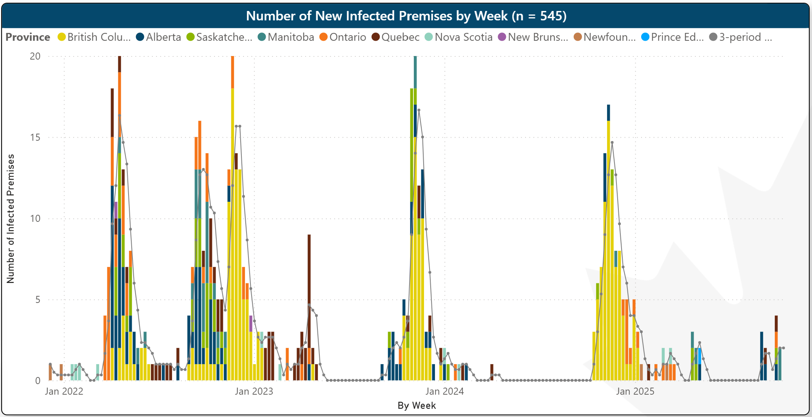
HPAI in Domestic Birds in Canada
D1.1
2021
2022
246 IPs
2023
122 IPs
2024
76 IPs
2025
33 IPs
D1.1
Microsoft Power BI
Last updated October 14, 2025
Notes:
This is our epidemic curve for HPAI on poultry farms in Canada, and you can clearly see that it has been a very busy time over the last few years. But our total number of infected premises has actually been declining year over year, in every Province except BC which has remained steady with a high number of cases in the fall.

Slide 3
Species on Affected Farms (Sept – Oct 14, 2025)
Notes:
When you look at the species affected on farms in the last couple of months you see is that while some of the farms are single species with turkeys ducks or chickens, many of the farms house multiple species.

Slide 4
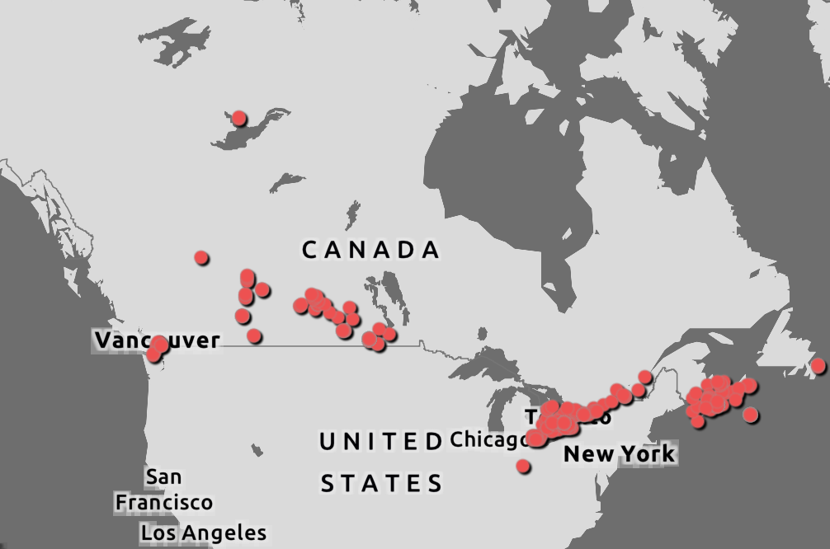
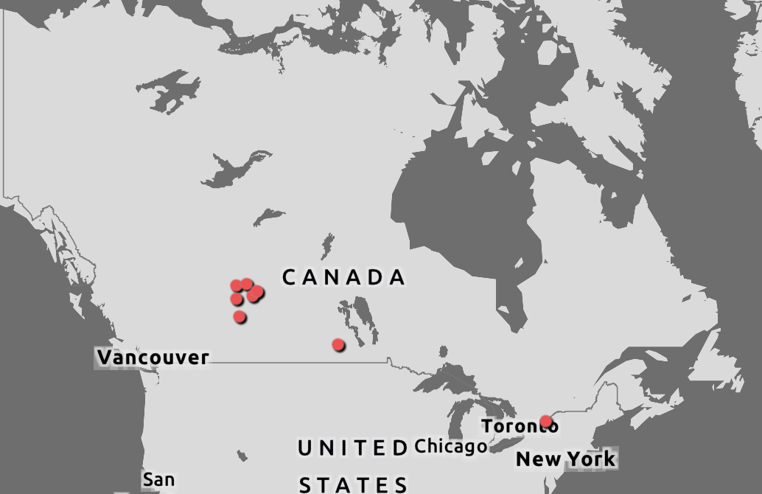
Wildlife HPAI
All of 2025 – 353 HPAI positive wild birds and mammals
Since last meeting, 9 new cases reported positive
CWHC
Wild Bird Dashboard

Slide 5
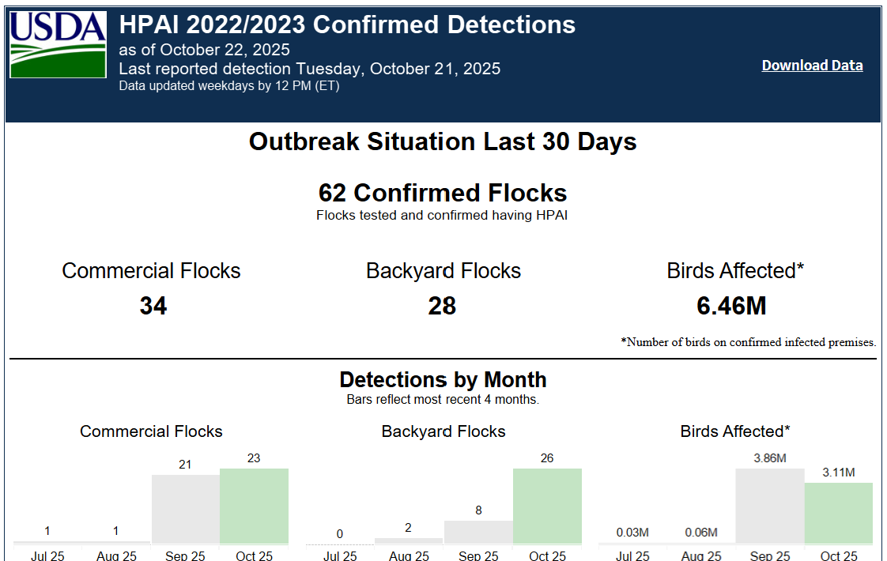
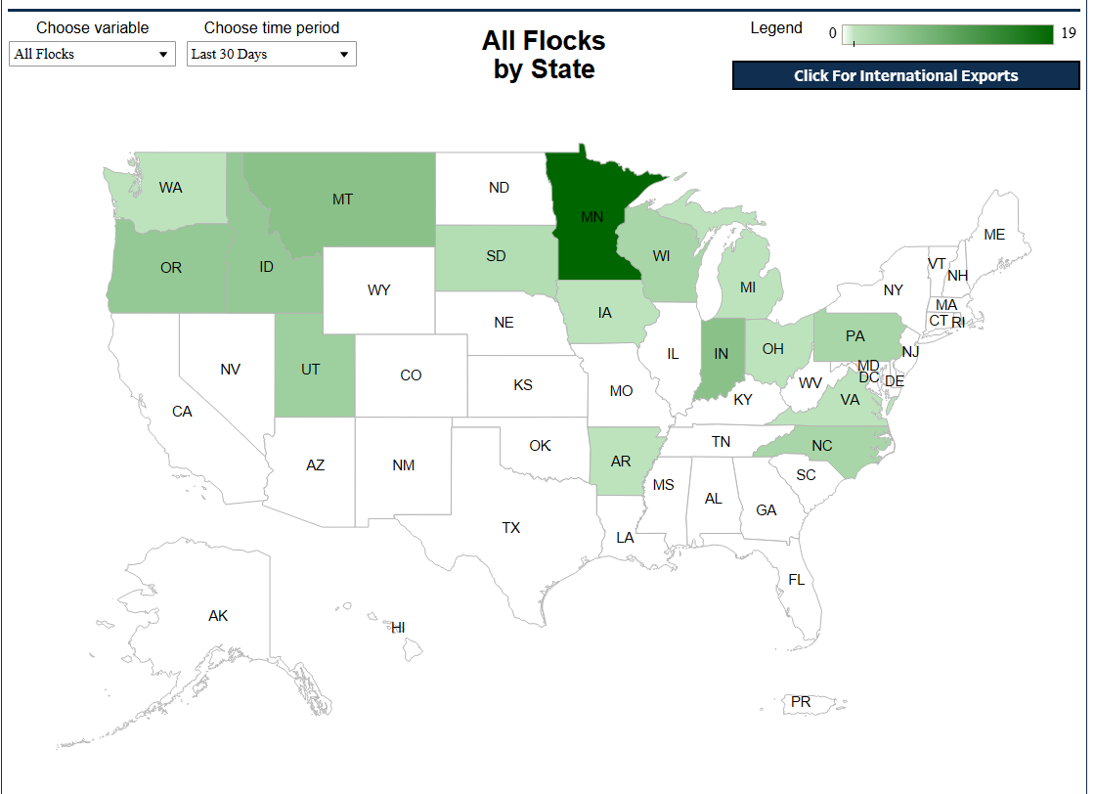
United States – HPAI Domestic Bird Detections Last 30 days
34 Commercial
28 Backyard Flocks
6.46 million birds
Confirmations of Highly Pathogenic Avian Influenza in Commercial and Backyard Flocks | Animal and Plant Health Inspection Service (usda.gov)

Slide 6
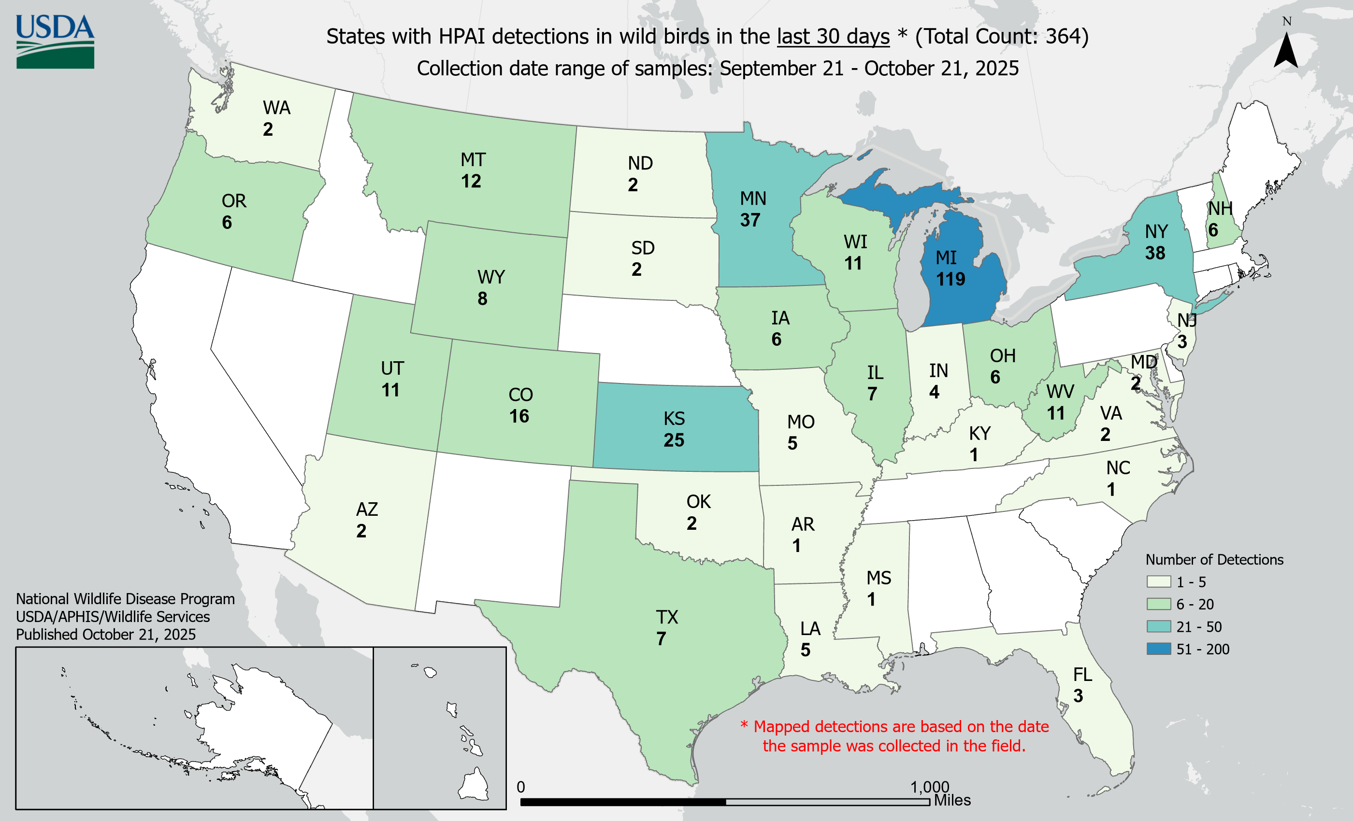
US Wild Bird HPAI Detections, Sept 21 – Oct 21, 2025
364 wild bird detections of HPAI in the last 30 days
Uncertain genotyping and unknown number of birds tested
HPAI Detections in Wild Birds (usda.gov)

Slide 7
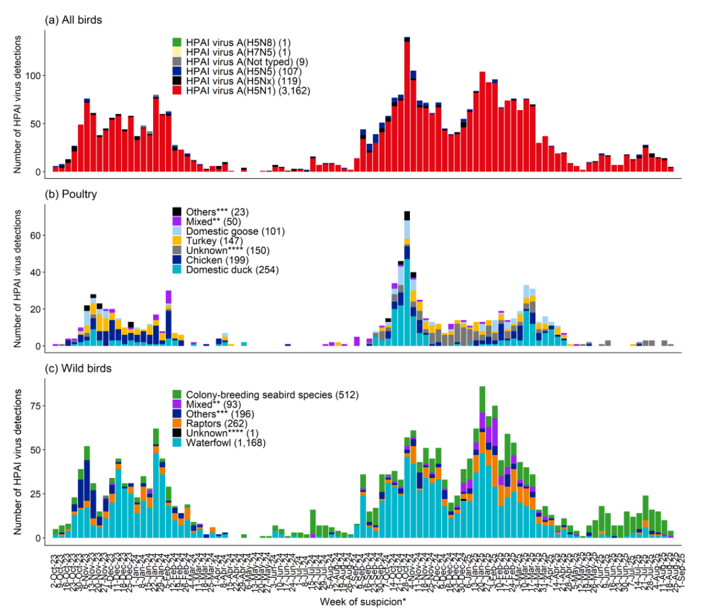
European Union
2023
2024
2025
2024-25 worse than 2023-24
90% of poultry cases are genotype EA-2024-DI.x (not the same as our D1.x)
Less genetic diversity that the previous year
Decline in cases in the spring and summer, increases have been seen now in fall
Colony breeding seabird numbers are increased
Notes:
Like Canada, Europe has had a much worse season in 2024-25 than 2023-24
In the previous season 2023-24 , there was much greater genetic diversity in the viral strains circulating in Europe, whereas in 2024-25, 90% of the poultry cases are genotype DI.x.
Right now the cases are starting to increase in Europe, and what we need to watch is that on the wild bird side the colony breeding seabird numbers in green on the bottom right chart, have increased, and it is these populations where the H5N1 spillover to North America in 2021 is though to have originated.

Slide 8

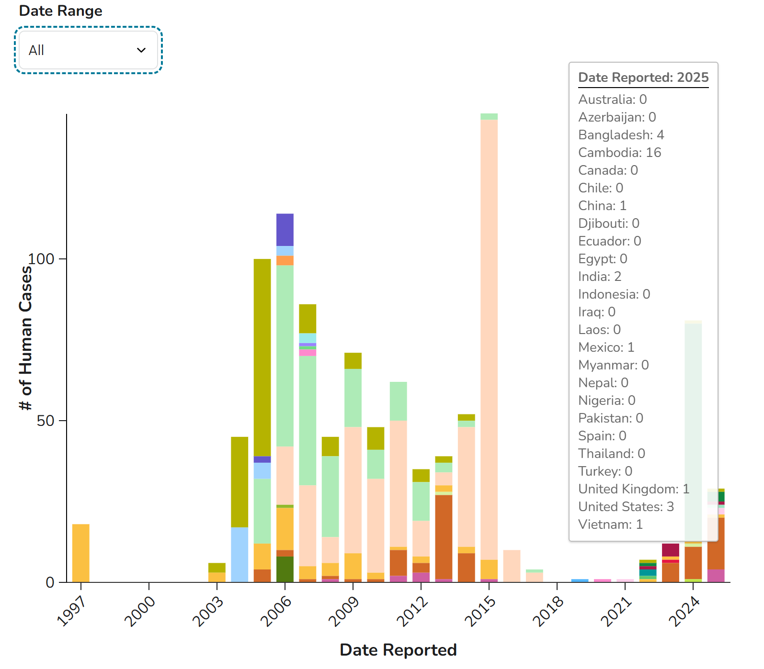
Recent International HPAI Cases in Humans
10 countries reporting human cases of H5N1 in 2025
2.3.2.1e in Asia more severe cases than 2.3.4.4b in North America
Most recent cases
  23F in Mexico with no history of contact with poultry
    Dog, poultry bird, pigeons also positive for H5
  3 year old in Cambodia contact with sick birds
Notes:
Jumping to human infections with H5N1
We can expect sporadic severe cases in Humans and these international cases are tragic but not surprizing.
There have been around 1000 cases of H5N1 in humans reported since 1997, with 471 deaths since 2003.

Slide 9
Netherlands Vaccine Trial
Objective:
  Determine whether vaccination under field circumstances protects against HPAI infection long term and decreases intra-flock transmission
Birds vaccinated once with a Turkey Marek’s virus strain modified to carry the H5 antigen
Laying hens vaccinated against HPAI as day old chicks
  2399 vaccinates
  4665 non-vaccinated
Housed in normal growing conditions until transferred to the lab for challenge
Longitudinal study – 4 phases over time, 1st 2 complete
Notes:
Netherlands has implemented a vaccination study in four phases, first two phases are complete.
The objective of their trial is to determine whether vaccination of laying hens, under field circumstances, protects against HPAI infection for the long term, and if it decreases transmission within a flock.
The birds in the trial were vaccinated once with a Turkey Marek’s virus strain modified to carry the H5 antigen, this was in addition to the normal routine vaccines that are administered in commercial production. Control birds received only their routine vaccines.
Laying hens were vaccinated once as day old chicks, including almost 2400 vaccinates, and 4600 control birds that only received their routine vaccines.
The birds were housed under normal growing conditions until transferred to the lab for challenge.

Slide 10


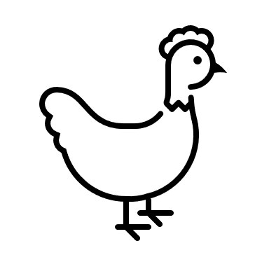
Day old chicks HPAI Vaccinated
+
Control
7 weeks transported to lab
Blood samples + swabs collected
8 weeks 2 vaccinated and 2 control groups exposed to virus
Routine sampling for 21 days
Unvaccinated pullets added to exposed birds 24 hours post exposure
A – HPAI
vaccinate
Swabs for virus
Blood samples for immunology
HPAI
Vaccinate
Control
B – HPAI
vaccinate
Phase 1: Challenge at 8 weeks post vaccination
A – Control
B – Control
Notes:
In the first phase of the study, vaccinated and control birds were transported to the laboratory after 7 weeks in normal commercial growth conditions.
They were allowed to acclimate for one week, and were tested for both virus and immune response prior to the viral challenge.
At 8 weeks of age, HPAI vaccinated birds and control birds were exposed to the virus and 24 hours later, naïve birds were cohoused with the exposed birds.
The animals were subject to routine sampling for 21 days to monitor disease progression and immune response.

Slide 11
Results – 8 weeks
Results
Virus Challenged Birds
In Contact Birds
No infection of vaccinates, no transmission from inoculated to in contact naïve birds
2 birds in Group A did shed virus for 2-4 days via the choana (no systemic infection), no shedding via cloaca
A – HPAI
Vaccinated
0/5 infected
0/5 infected
B – HPAI
Vaccinated
0/5 infected
0/5 infected
4/5 infected
2/5 infected
Infection and transmission to contact birds R>1
Viral shedding via choana and cloaca
A – Control
B – Control
5/5 infected
5/5 infected
Phase 1 – at 8 weeks post vaccination, the vaccine protects against clinical signs and transmission
Notes:
With a virus challenge at 8-weeks-old, none of the HPAI vaccinated birds became infected systemically after exposure to the virus and none of the birds cohoused with them became infected. Two of the HPAI vaccinated birds did shed virus for 2-4 days via their upper respiratory system, but there was no shedding via the cloaca, and no immune response.
For the control birds, 90% of the exposed birds and 70% of the cohoused birds became infected with virus and shed virus via the respiratory and intestinal route.
So for the trial at 8 weeks of age, the authors concluded that the vaccine protected against clinical signs and transmission within flock.

Slide 12

Day old chicks HPAI Vaccinated
Control
23 weeks transported to lab
Blood samples + swabs collected
24 weeks 2 vaccinated and 2 control groups exposed to virus
Routine sampling for 21 days
Unvaccinated pullets added to exposed birds 24 hours post exposure
19 weeks half of the birds transported to layer production facility
A – HPAI
Vaccinate
Swabs for virus
Blood samples for serology
HPAI
Vaccinate
Control
B – HPAI
Vaccinate
A – Control
Phase 2: Challenge at 24 weeks post vaccination
B – Control
Notes:
In phase 2 a similar process was undertaken, except the birds were moved to the lab at 23 weeks of age and the challenge study was initiated at 24 weeks. This age was chosen because it’s around the time when laying hens should be entering peak production, and their immune response can be altered by that physiological stress.

Slide 13
Results – 24 weeks post vaccination
Virus Challenged Birds
In Contact Birds
Results
10% mortality
Antibodies produced in response to challenge
T cells activated
R>1 R=1 (0.5-2.1) and R=1.9 (0.5-5.2)
A – HPAI
Vaccinated
4/5 infected
3/5 infected
B – HPAI
Vaccinated
4/5 infected
5/5 infected
5/5 infected
100% mortality
All birds shedding virus via choana and cloaca
R value = 15.4 (6-33)
A – Control
5/5 infected
B – Control
5/5 infected
5/5 infected
Phase 2 – at 24 weeks post vaccination, the vaccine protects against clinical signs and death, vaccinated chickens shed significantly less virus than unvaccinated
Notes:
When challenged with virus at 24 weeks post vaccination, 80% of the HPAI vaccinated birds became infected after exposure to virus as did 80% of the birds cohoused with them. 10% mortality was observed in the vaccinated birds, they produced antibodies in response to challenge, and their T cells were activated.
100 % of the control birds, and 100% of the birds co-housed with them became infected and 100% died. All birds were shedding virus via respiratory and intestinal routes.
The vaccinated birds shed significantly less virus than the unvaccinated so the intra flock transmission was significantly reduced.
The authors conclude that at 24 weeks, a single HPAI vaccine decreases mortality and clinical signs and significantly lowers intra-flock transmission rates.

Slide 14
The Efficacy of Inactivated Vaccine Against H5 Clade 2.3.4.4b Highly Pathogenic Avian Influenza Virus in Turkeys
USDA study
Objective: evaluate efficacy of a single dose of inactivated vaccine, administered at different ages against challenge with H5N1 2.3.4.4.b, in 10-week-old broad breasted white turkey hens
Vaccine was inactivated H5N9
The N9 portion should allow the differentiation of vaccinated vs birds infected with H5N1
Notes:
For Turkeys, a trial conducted by the USDA shows promise for protection of turkeys against HPAI.
The study objective was to evaluate the efficacy of a single dose of inactivated vaccine, administered at different ages, against challenge with H5N1 2.3.4.4.b, in 10-week-old broad breasted white turkey hens
The vaccine used was an inactivated H5N9 virus, with the N9 portion being used to determine if vaccinated birds can be differentiated from infected birds.

Slide 15
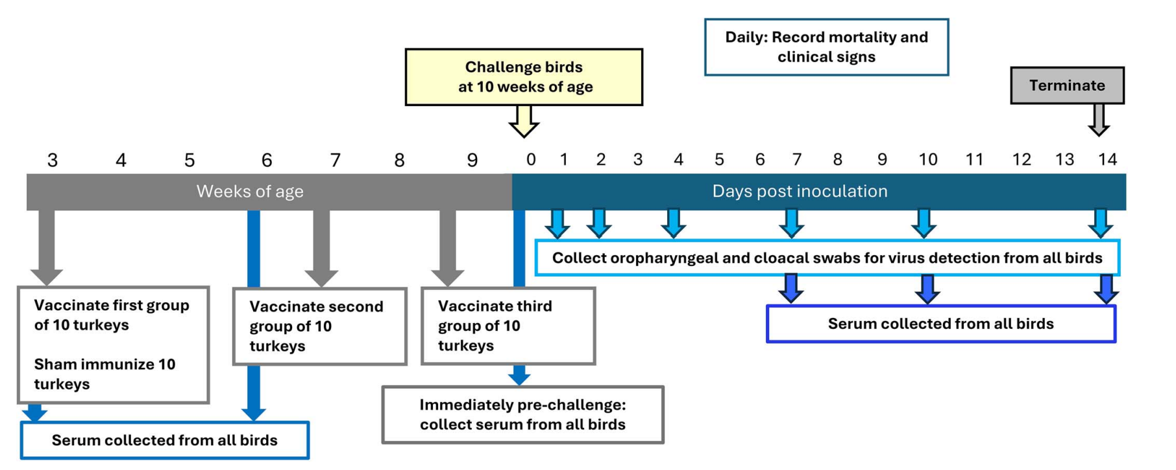
Notes:
Test animals were acquired at hatch and did not receive any routine vaccinations from the hatchery
At 3 weeks of age, they were divided into 4 groups of 10 birds
One group of 10 received a sham vaccine at 3 weeks of age
A second group of 10 received the hpai vaccine at 3 weeks of age
The third group was vaccinated aginast hpai at 7 weeks and the final group was vaccinated at 9 weeks.
All vaccinated birds received 0.5 ml of vaccine subcutaneously at the nape of the neck
Serum was collected to assess immune response prior to vaccination, and prior to challenge.
Birds were challenged with virus at 10 weeks of age and the monitored for clinical signs, viral shedding, and immune response for the next 14 days.

Slide 16






Results – Clinical Signs and Mortality
Sham
Vaccinated
3 weeks
Vaccinated
7 weeks
Vaccinated
9 weeks
Challenge
10 weeks
100% mortality
Clinical signs of HPAI
Swelling around eye
100% survival
100% survival
100% survival
Lethargy
Notes:
100% of the sham vaccinated birds died from HPAI, and showed clinical signs of the disease
100% of the vaccinated birds survived, and only two birds in the group vaccinated at 9 weeks of age showed clinical signs. One with mild swelling around the eyes and the second with lethargy.
The authors conclude that the vaccine provides protection against morbidity and mortality when birds were vaccinated at 3 and 7 weeks but only protects against mortality when vaccinated at 9 weeks. The one-week interval between vaccination and challenge does not allow a sufficient immune response to develop.

Slide 17
Results – Viral Shedding
Sham
Vaccinated
3 weeks
Vaccinated
7 weeks
Vaccinated
9 weeks
100% shed virus
Oropharyngeal + Cloacal
Oropharyngeal – 80%
Cloacal – 10%
Oropharyngeal – 100%
Cloacal – 50%
Oropharyngeal – 100%
Cloacal – 60%
Shed significantly more
virus than vaccinates
Vaccinated birds shed significantly less virus post challenge compared to sham
Shed significantly more virus on 7 DPC
Compared to 3 week vaccinated birds
Notes:
All turkeys shed virus at some point in time during the study.
In the Sham vaccinated group, 100% shed virus via the oropharyngeal and cloacal routes and shed a significantly greater quantity of virus than the vaccinated groups.
For all vaccinated birds, virus was shed via the oropharyngeal and cloacal routes, but a smaller number of birds shed virus when they had had sufficient time to mount an immune response prior to challenge.
The amount of virus shed was significantly greater in the birds that had not had enough time to mount an immune response.

Slide 18




Results – Antibody Response
Study Group | Pre-vaccination (3 weeks) all test methods | Pre-challenge Antibody (HA) | Pre-challenge Antibody (N)
Sham | 0% | 0% | 0%
3 Week | 0% | 100% | 100%
7 week | 0% | 30% | 100%
9 week | 0% | 0% | 0%
Notes:
None of the turkeys had antibodies against influenza prior to the vaccination.
Serology from 10 weeks of age (after vaccination but before challenge with virus) shows the best response in Turkeys vaccinated at 3 weeks with 100% seropositive against HA and N.
The turkeys vaccinated at 7 weeks of age showed only 30% seroconversion against Hemagglutinin and 100% seroconversion against neuraminidase.
Whereas those vaccinated at 9 weeks of age showed no evidence of seroconversion.

Slide 19
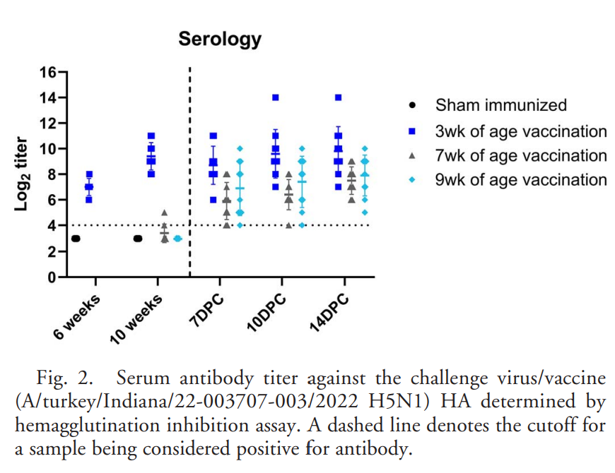
Antibody Titres to HA post challenge
No change in titre for birds vaccinated at 3 weeks
Significant increases in HA titre at 7 days post challenge for the birds vaccinated at 7 and 9 weeks
Notes:
Over the duration of the trial, there was no change in antibody titre against haemagglutinin for birds vaccinated at 3 weeks, but significant increases in titres occurred for those birds vaccinated at 7 and 9 weeks.

Slide 20
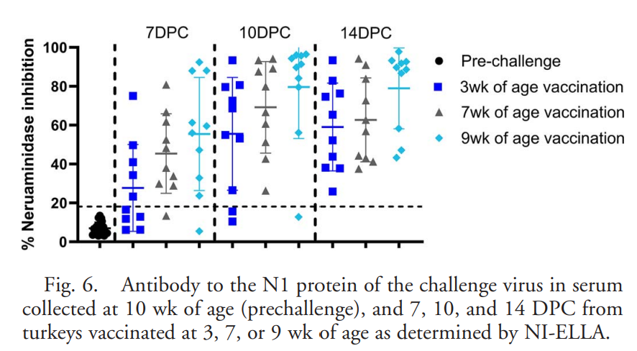
Antibody Titres to N post challenge
By end of study (14 days post challenge) all vaccinated birds were seropositive for N9
At 7 days post challenge the seroconversion was greatest in the group vaccinated at 9 weeks>7 weeks>3 weeks
Notes:
By the end of the study, all of the vaccinated birds showed positive titres for the neuraminidase portion of the virus.
Midway through the challenge, the results were counter intuitive with the birds vaccinated at 7 and 9 weeks having greater responses than those vaccinated at 3 weeks.

Slide 21
RESEARCH NOTE: Exploring the Competence of Various Poultry Species for Cache Valley virus Infection - ScienceDirect
Cache valley virus causes disease in small ruminants
Virus has been found in mosquitos that feed on birds
Explore in-vivo susceptibility of poultry to CVV
  3-day old chickens
  3-day old ducklings
  14-day old quail
In vitro in cell lines of chickens, quails and ducks
Virus replicated very efficiently in vitro
In live animals
  No clinical signs of disease
  No viremia
  No seroconversion

Slide 22
Scientific Findings
Strengths, challenges, and variations - insights into biosecurity practices in Swedish poultry production following HPAI outbreaks - ScienceDirect
Vaccination and surveillance for high pathogenicity avian influenza in poultry—current situation and perspectives – ScienceDirect
Intensive transmission in wild, migratory birds drove rapid geographic dissemination and repeated spillovers of H5N1 into agriculture in North America | bioRxiv
Landscape changes elevate the risk of avian influenza virus diversification and emergence in the East Asian–Australasian Flyway | PNAS
WOAH HPAI Situation Report September 2025
Full article: Strict Biosecurity and Epidemiological Segmentation Enable Partial Culling During a Highly Pathogenic Avian Influenza Outbreak
Epidemiological Update Avian Influenza A(H5N1) in the Americas Region 15 October 2025

Slide 23
Scientific Findings
Risk factors for highly pathogenic avian influenza outbreaks in Japan during 2022–2023 season identified by additive Bayesian network modeling | Scientific Reports
Surveillance on California dairy farms reveals multiple sources of H5N1 transmission | bioRxiv
Potential impacts of 2.3.4.4b highly pathogenic H5N1 avian influenza virus infection on Snow Goose (Anser caerulescens) movement ecology | PLOS One
fao-woah-who-joint-h5-assessment-july-2025.pdf
A Review of Avian Influenza Virus Exposure Patterns and Risks Among Occupational Populations
Vaccination of poultry against highly pathogenic avian influenza (HPAI): joint industry and cross-government vaccination taskforce - GOV.UK
Quantifying H5N1 outbreak potential and control effectiveness in high-risk agricultural populations | medRxiv

Slide 24
Scientific Findings
Companion animals and H5N1 highly pathogenic avian influenza: cause for concern? in: Journal of the American Veterinary Medical Association Volume 263 Issue 11 (2025)
Frontiers | Emerging threats of H5N1 clade 2.3.4.4b: cross-species transmission, pathogenesis, and pandemic risk
Decoding non-human mammalian adaptive signatures of 2.3.4.4b H5N1 to assess its human adaptive potential | Microbiology Spectrum
Genetic reassortment and diversification of host specificity have driven evolutionary trajectories of lineages of panzootic H5N1 influenza | bioRxiv
H5N1 highly pathogenic avian influenza vaccination: Seroresponse of mexican poultry in the 2022–2024 – ScienceDirect
Poultry farm density and proximity drive highly pathogenic avian influenza spread – PMC
Investigating factors driving shifts in subtype dominance within H5Nx clade 2.3.4.4b high pathogenicity avian influenza viruses | Microbiology Society
Identification of H1N2 influenza viruses in turkeys after spillover from swine and in vitro characterization - ScienceDirect

Slide 25
Scientific Findings
Highly pathogenic avian influenza A (H5N1) virus outbreaks in South America in 2022–2024: a comprehensive review of an ongoing panzootic – ScienceDirect
Viral expansion after transfer is a primary driver of influenza A virus transmission bottlenecks | PLOS Biology
Infection of ratites with clade 2.3.4.4b HPAIV H5N1: Potential implications for zoonotic risk | bioRxiv
Update on H5N1 Panzootic: Infected Mammal Species Increase by Almost 50% in Just Over a Year - Plaza - 2025 - Influenza and Other Respiratory Viruses - Wiley Online Library
Avian influenza spillover into poultry: environmental influences and biosecurity protections – ScienceDirect
ECDC Avian influenza overview June–September 2025
PB2 and NP of North American H5N1 virus drive immune cell replication and systemic infections | Science Advances
Vaccination of poultry against highly pathogenic avian influenza (HPAI): joint industry and cross-government vaccination taskforce - GOV.UK

