Slide 1
Community for Emerging and Zoonotic Diseases
Identifying emerging risks through collective intelligence
CEZD – CAHSS Poultry Update
22 January 2026
www.cezd.ca

Slide 2
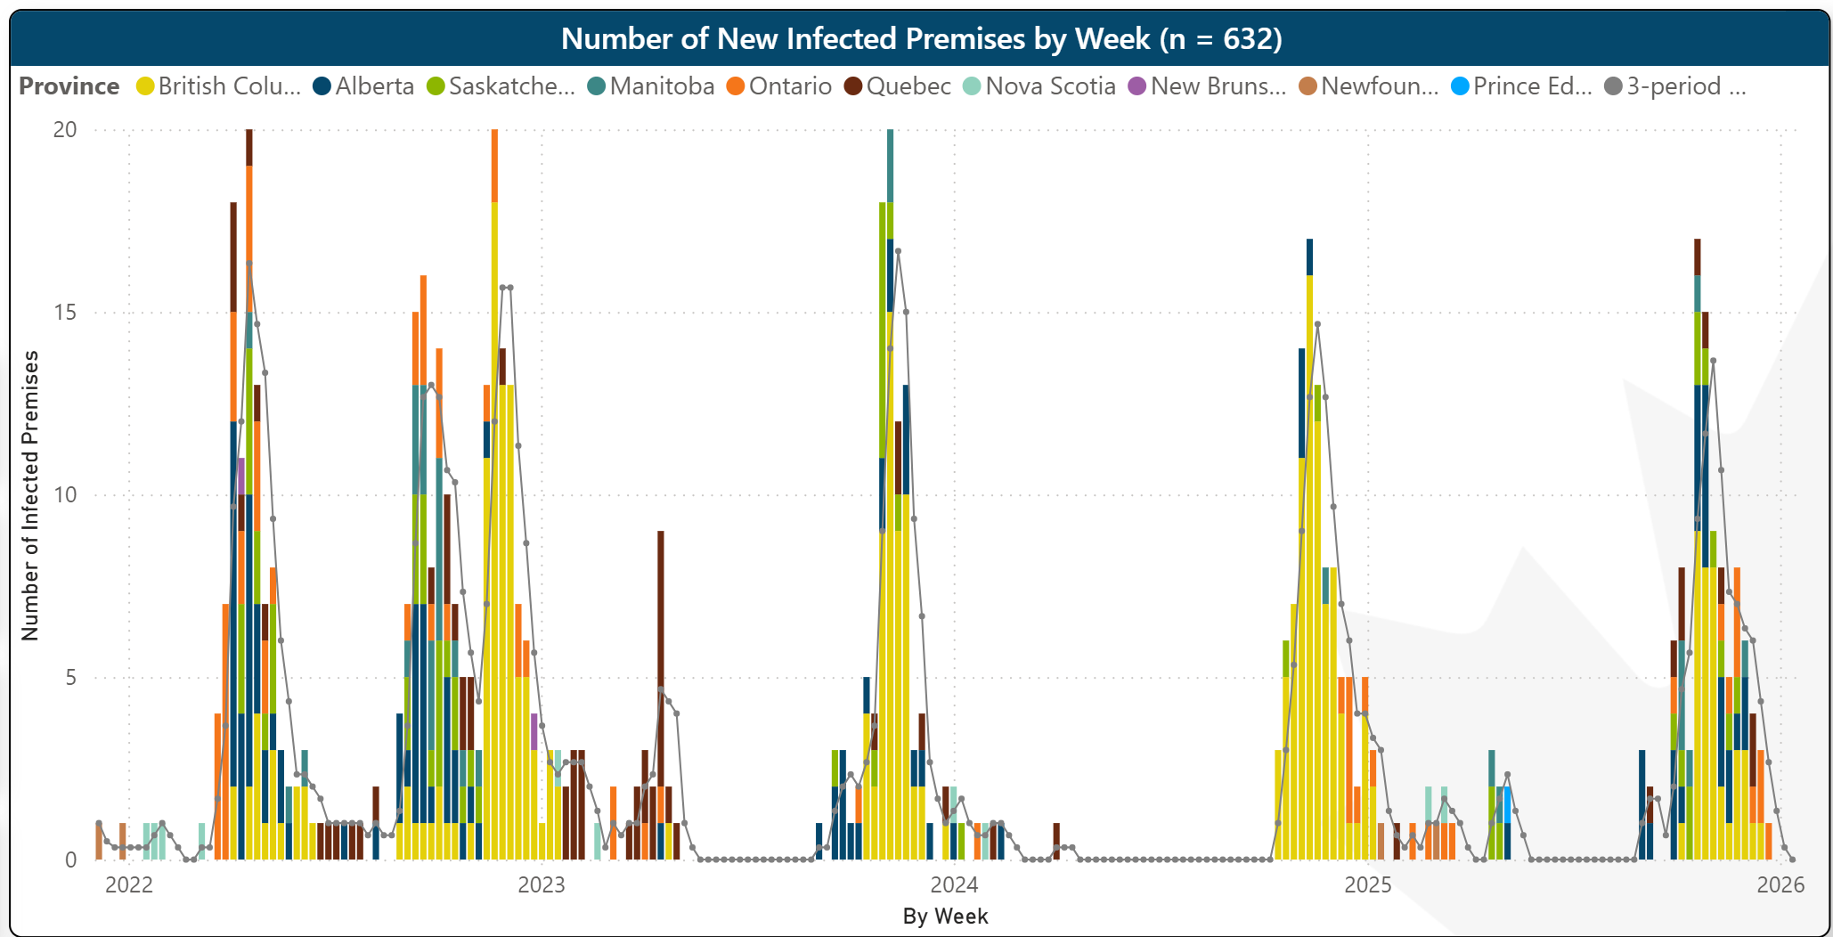
HPAI in Domestic Birds in Canada
2021
2022
246 IPs
2023
122 IPs
2024
76 IPs
2025
120 IPs
D1.1
D1.1
Microsoft Power BI
Last updated January 12, 2026
Notes:
This is our epidemic curve for HPAI on poultry farms in Canada, and you can clearly see that it has been a very busy time over the last few years. The continued decline we had hoped to see this fall did not materialize, and we’re back up to the numbers seen in 2023. Provinces impacted are more diverse this season, with BC seeing fewer cases than last year and Alberta and Saskatchewan seeing more.
Question: What has BC done differently this season to have a decreased case count in a severe year.
96-62-77-41

Slide 3
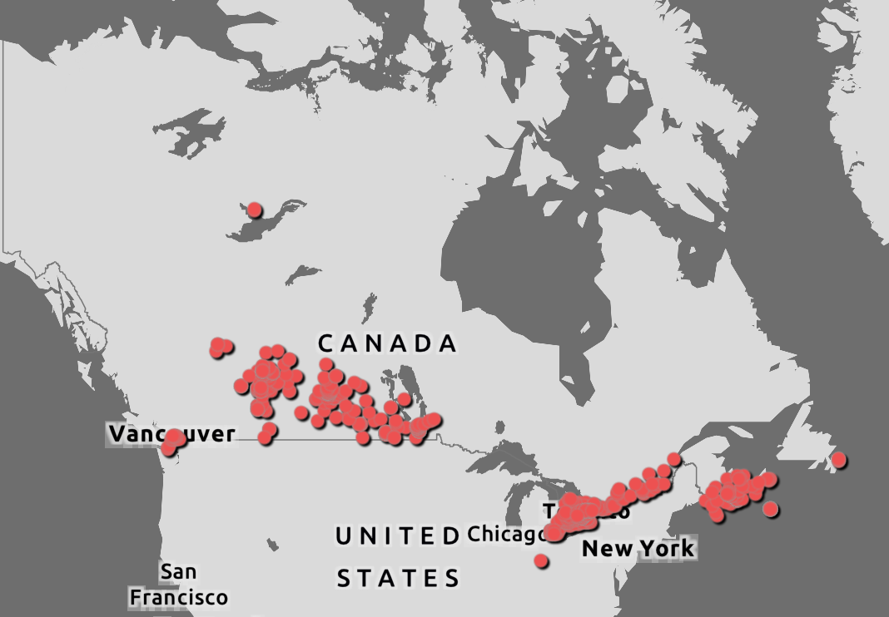
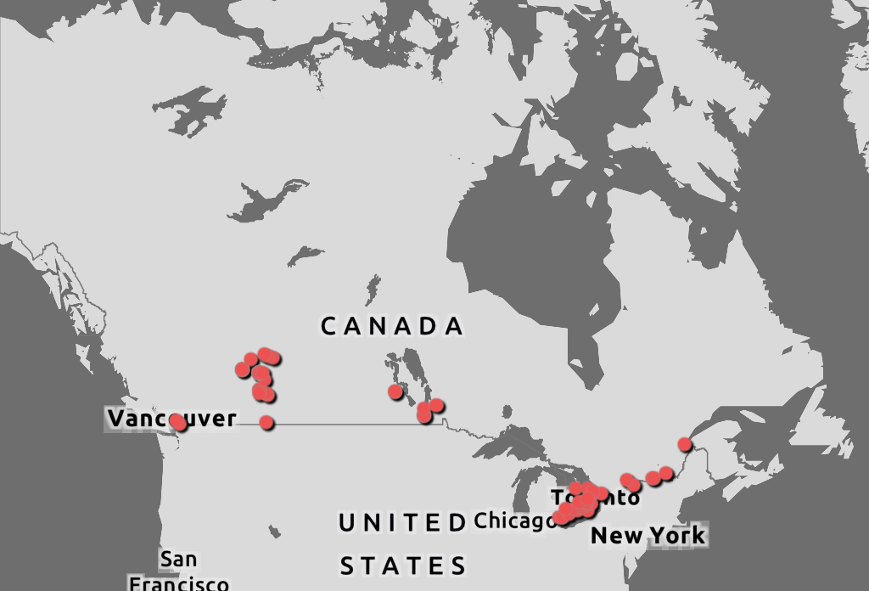
Wildlife HPAI
All of 2025 – 608 HPAI positive wild birds and mammals
Since last meeting, 68 new
CWHC
Wild Bird Dashboard

Slide 4
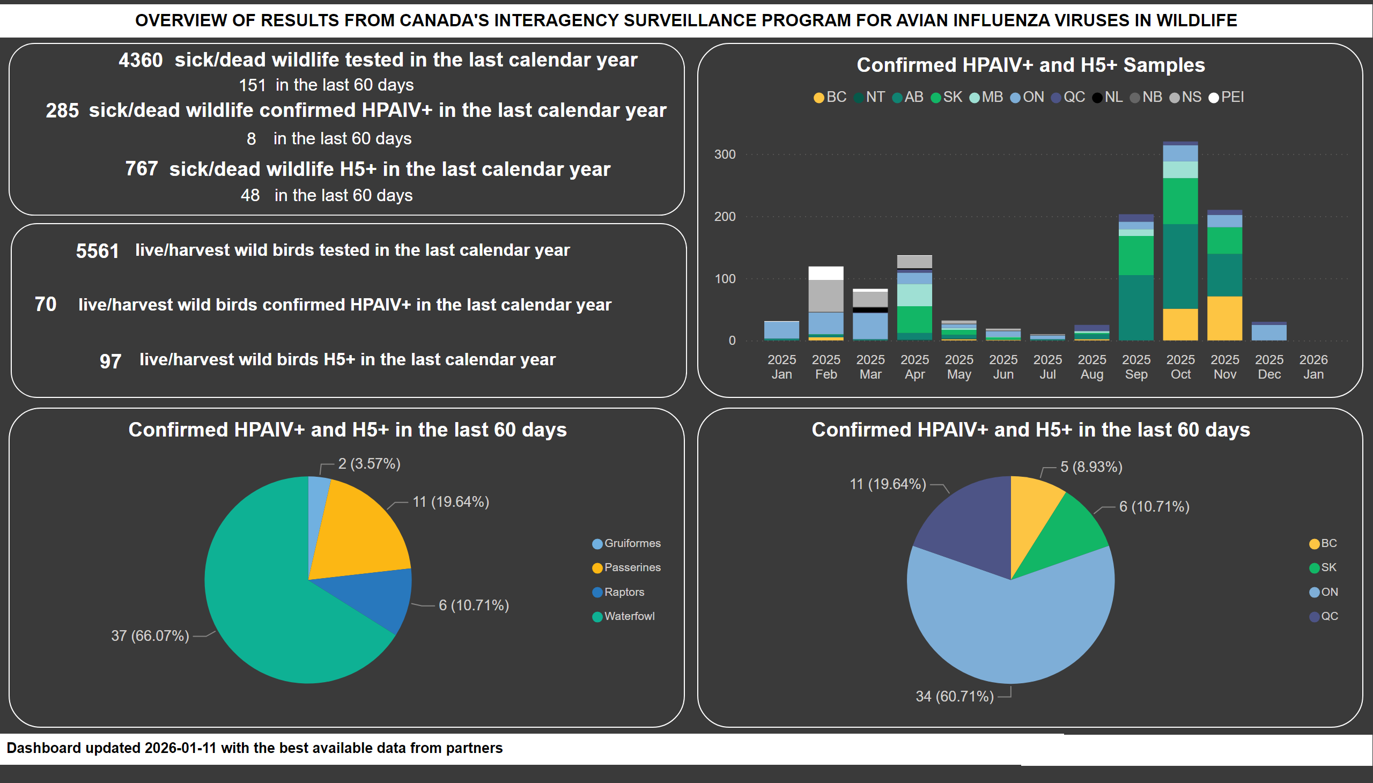
Overview
Notes:
Confirmed HPAIV+ and H5+ in the last 60 days
No alt text provided
textbox
No alt text provided
textbox
No alt text provided
image
No alt text provided
card
No alt text provided
card
No alt text provided
card
No alt text provided
textbox
No alt text provided
textbox
No alt text provided
textbox
No alt text provided
shape
No alt text provided
card
No alt text provided
card
No alt text provided
textbox
No alt text provided
textbox
No alt text provided
card
No alt text provided
textbox
No alt text provided
card
No alt text provided
textbox
No alt text provided
textbox
No alt text provided
shape
No alt text provided
textbox
No alt text provided
card
No alt text provided
textbox
No alt text provided
card
No alt text provided
Confirmed HPAIV+ and H5+ Samples
No alt text provided
Confirmed HPAIV+ and H5+ in the last 60 days
No alt text provided

Slide 5
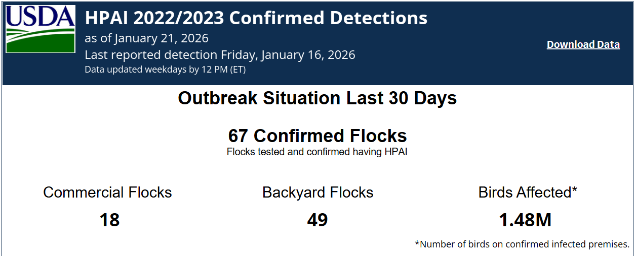
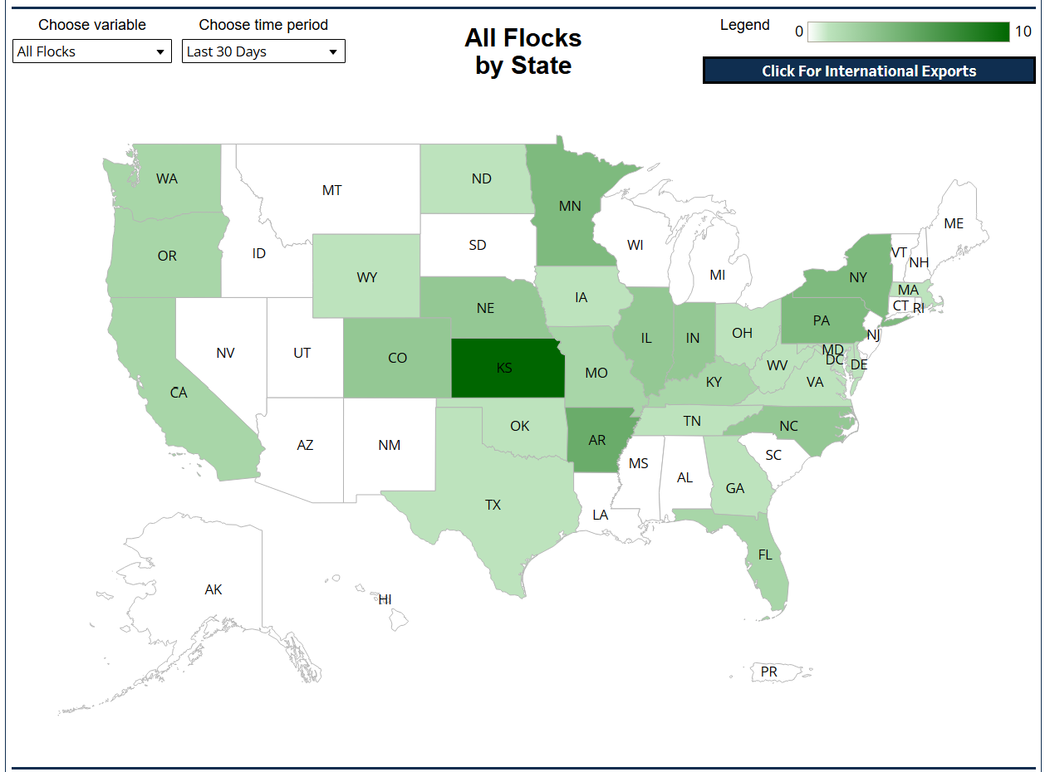
United States – HPAI Domestic Bird Detections Last 30 days
18 Commercial
49 Backyard Flocks
1.48 million birds
Confirmations of Highly Pathogenic Avian Influenza in Commercial and Backyard Flocks | Animal and Plant Health Inspection Service (usda.gov)

Slide 6
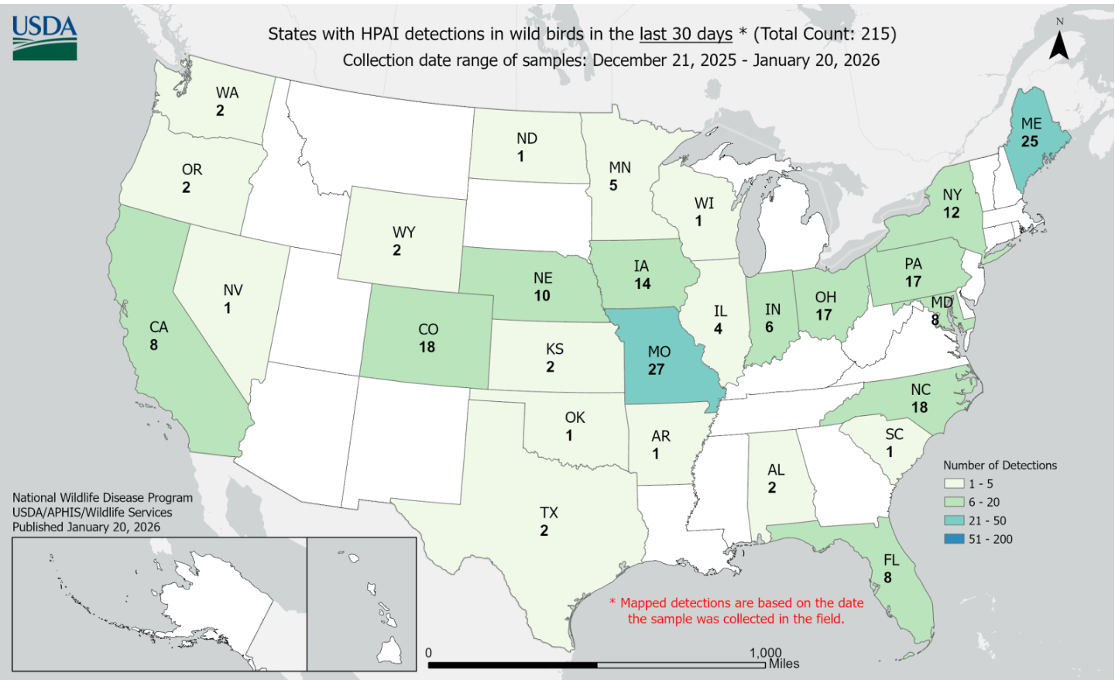
US Wild Bird HPAI Detections
December 21, 2025 – January 20, 2026
215 detections of HPAI in wild birds in the last 30 days
Uncertain genotyping and unknown number of birds tested
Declining number of cases
HPAI Detections in Wild Birds (usda.gov)

Slide 7
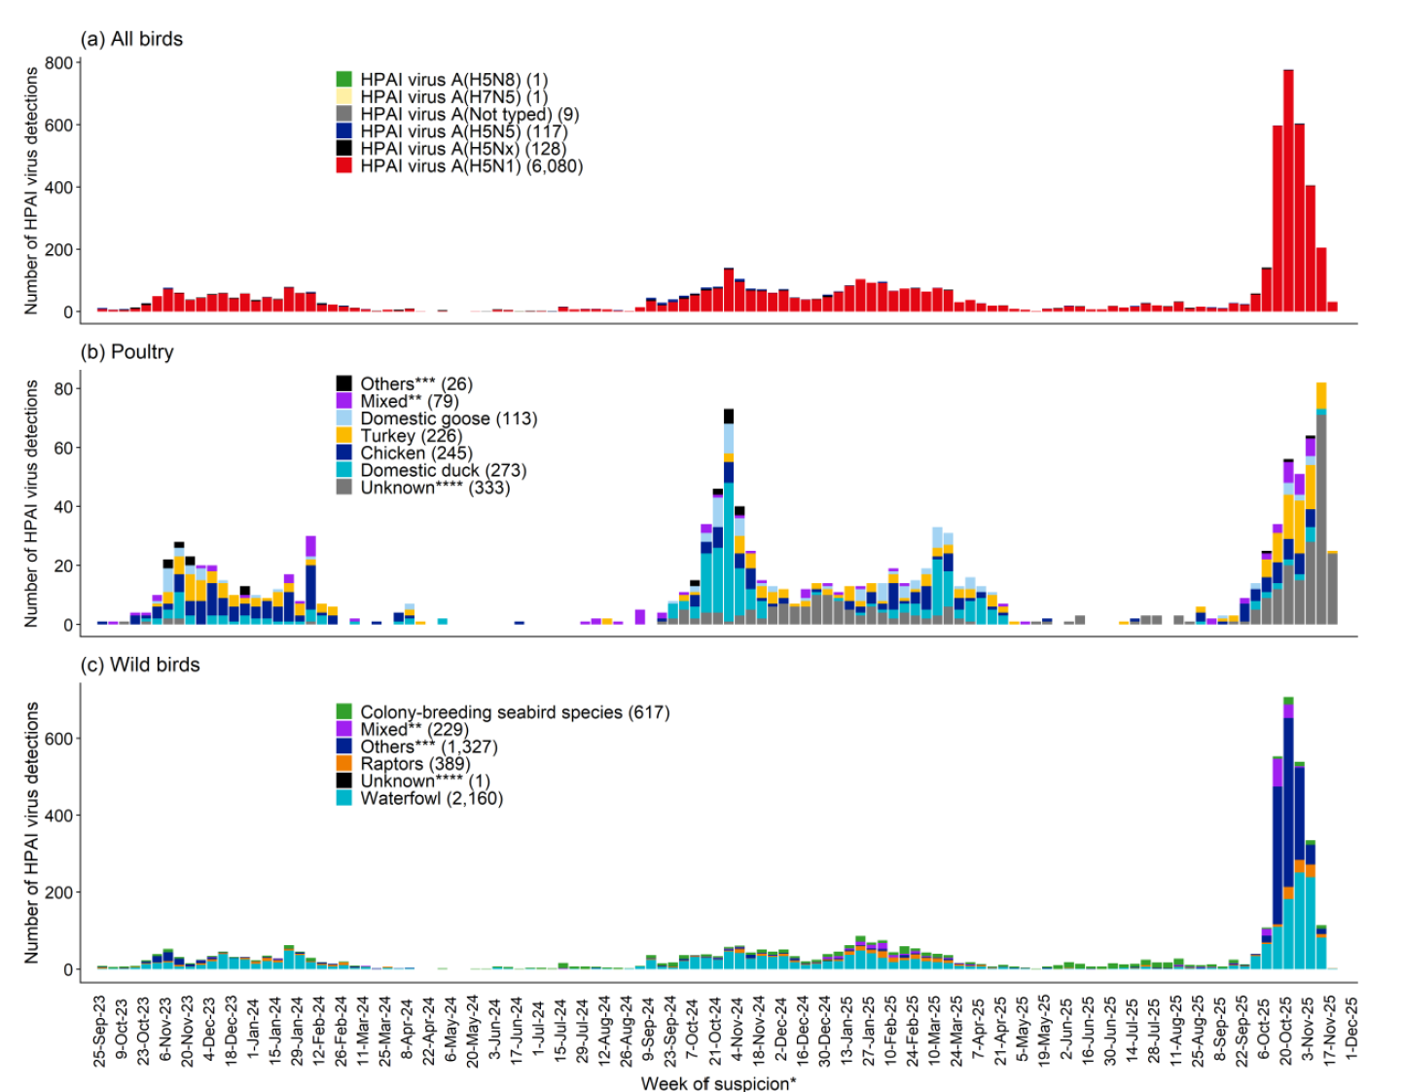
European Union
2023
2024
2025
Steep increase in detections in wild birds in Europe in the fall
Massive numbers of wild cranes and waterfowl impacted
Sub-clinically infected mallards at greater prevalence than seen previously in the Netherlands
Spillover to domestic birds
Most common genotype is H5N1 2.3.4.4b DI.2.1 = new reassortant
Avian influenza overview September–November 2025
Notes:
Like Canada, Europe has had a very difficult fall with high numbers of HPAI cases, and much like us, cases are continuing to be reported during the winter.

Slide 8
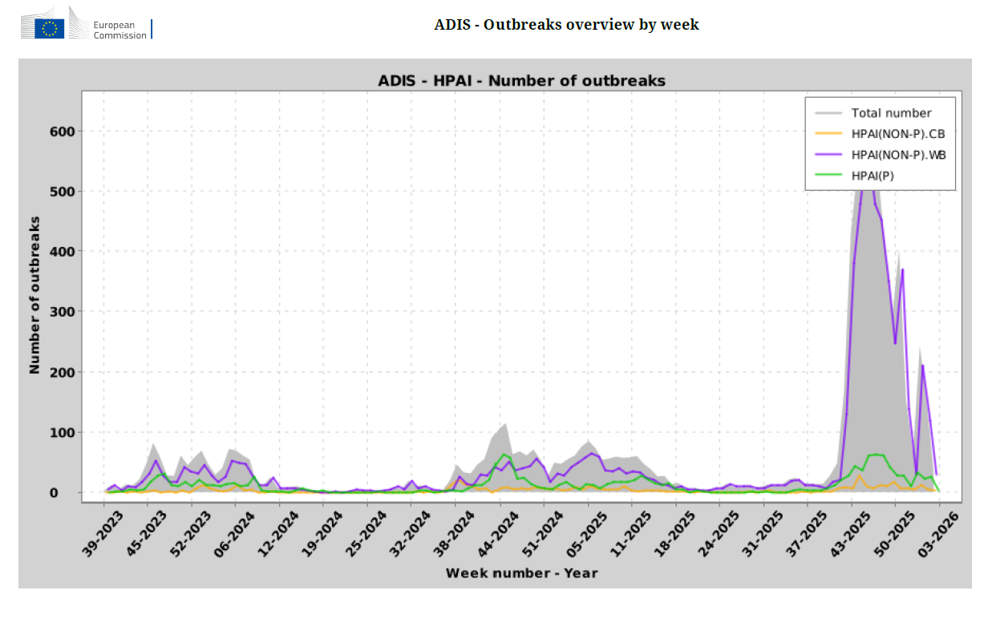
HPAI in Europe
Europe – Genotype DI N.Am Genotype D1
Share no gene segments
Even the HA segment which is 2.3.4.4b are now different sub-lineages
outbreaks-weekly-report-by-disease
Avian influenza overview September–November 2025
Notes:
Europe is having a very bad HPAI season this fall, particularly in wild birds, and that is leading to more domestic cases.
The map shows cumulative cases in Europe between October 1st and November 19,
The graph from ADIS shows spike in wild bird cases this fall that is 4 times greater than anything previously seen.
In Europe genotype DI is dominant and in North America Genotype D1 is dominant
These two viral groups share no gene segments. Even the HA segment which is 2.3.4.4b are now part of different sub-lineages (pers comm Tony Signore)

Slide 9
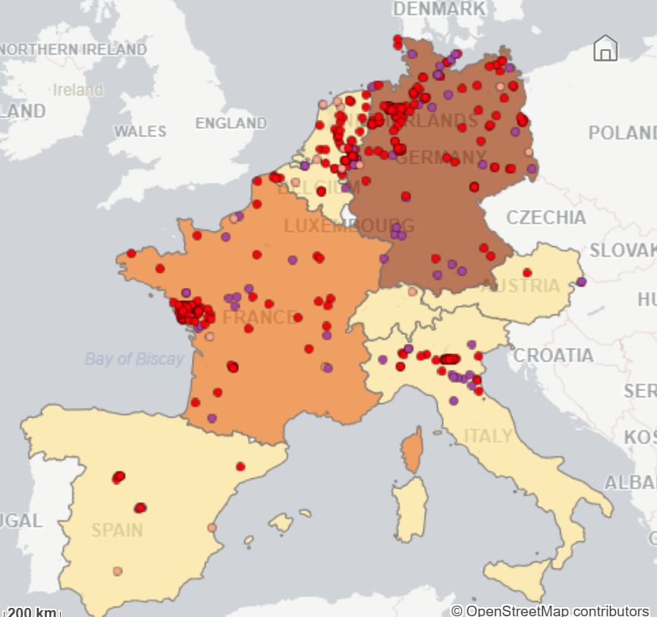
HPAI in Domestic Birds in South-Western Europe
Overlap with wild bird detections 6 September to 28 November
  Germany (138)
  France (68)
    31 in vaccinated ducks
  Netherlands (19)
  Spain (9)
  Belgium (9)
EURL Avian Flu Data Portal

Slide 10

To what extent may the duck population be protected after vaccination against highly pathogenic avian influenza? Contributions from a modelling approach and French field data - ScienceDirect
Approach
Vaccine – Volvac B.E.S.T
Theoretical modelling scenario
  expected level of protection if vaccination done according to recommendations
Field data informed scenario
  real world data to describe the level of protection under field conditions
Assessing immunity at whole flock level
Not covering within flock immune response
1st 6 months of vaccination in 2023-24
Bivalent subunit inactivated vaccine
  H5 from H5N1 2.3.2 A/Duck/China/E319-2/2003
  Inactivated avian orthoavulavirus type 1

Slide 11
Vaccine Protocols
 | First Dose | Second Dose | Third Dose
Meat Ducks Muscovy Ducks | 10 days of age (max 21 days) | 28 days of age (max 23 days after first dose) | not mandatory
Pekin Ducks | 1 day of age | 28 days of age | not mandatory
Fattening ducks | 10 days of age (max 21 days) | 28 days of age (max 23 days after first dose) | mandatory in high-risk areas, unless slaughtered before 56 days of age, 56-61 days of age
To what extent may the duck population be protected after vaccination against highly pathogenic avian influenza? Contributions from a modelling approach and French field data - ScienceDirect

Slide 12
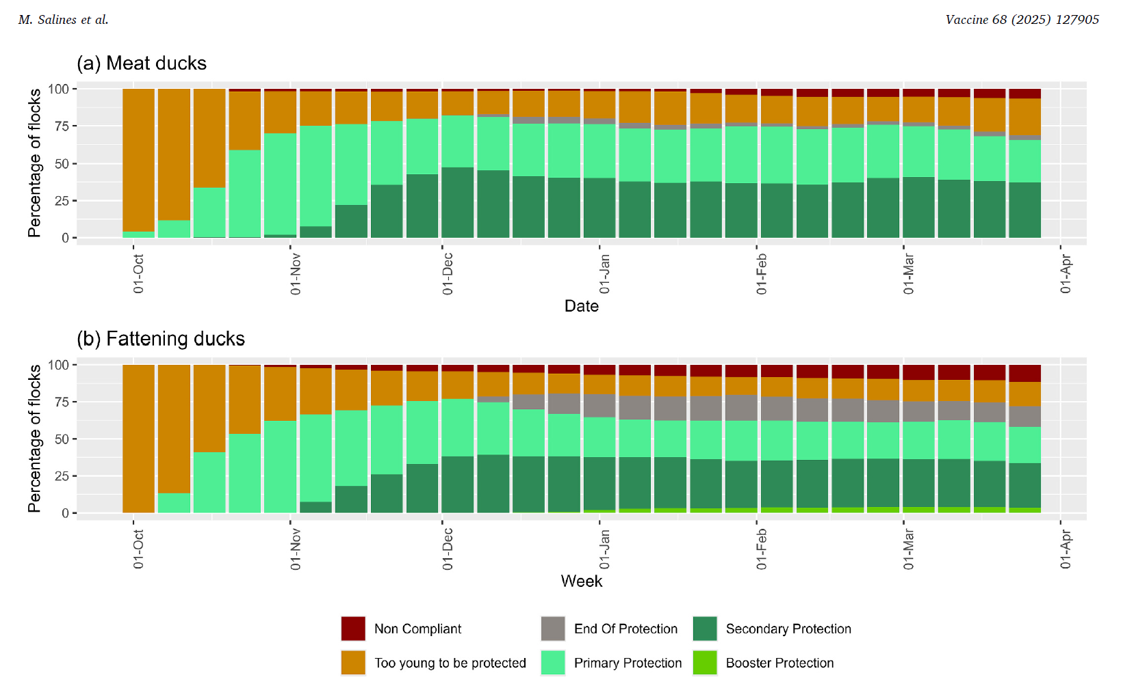
Results
51 million doses of vaccine administered
  51% meat ducks
  49% fattening ducks
>95% compliance with vaccination requirement
40-50% of flocks fully protected during the 6-month period (second or third dose)
40% with primary protection of first dose
To what extent may the duck population be protected after vaccination against highly pathogenic avian influenza? Contributions from a modelling approach and French field data - ScienceDirect

Slide 13

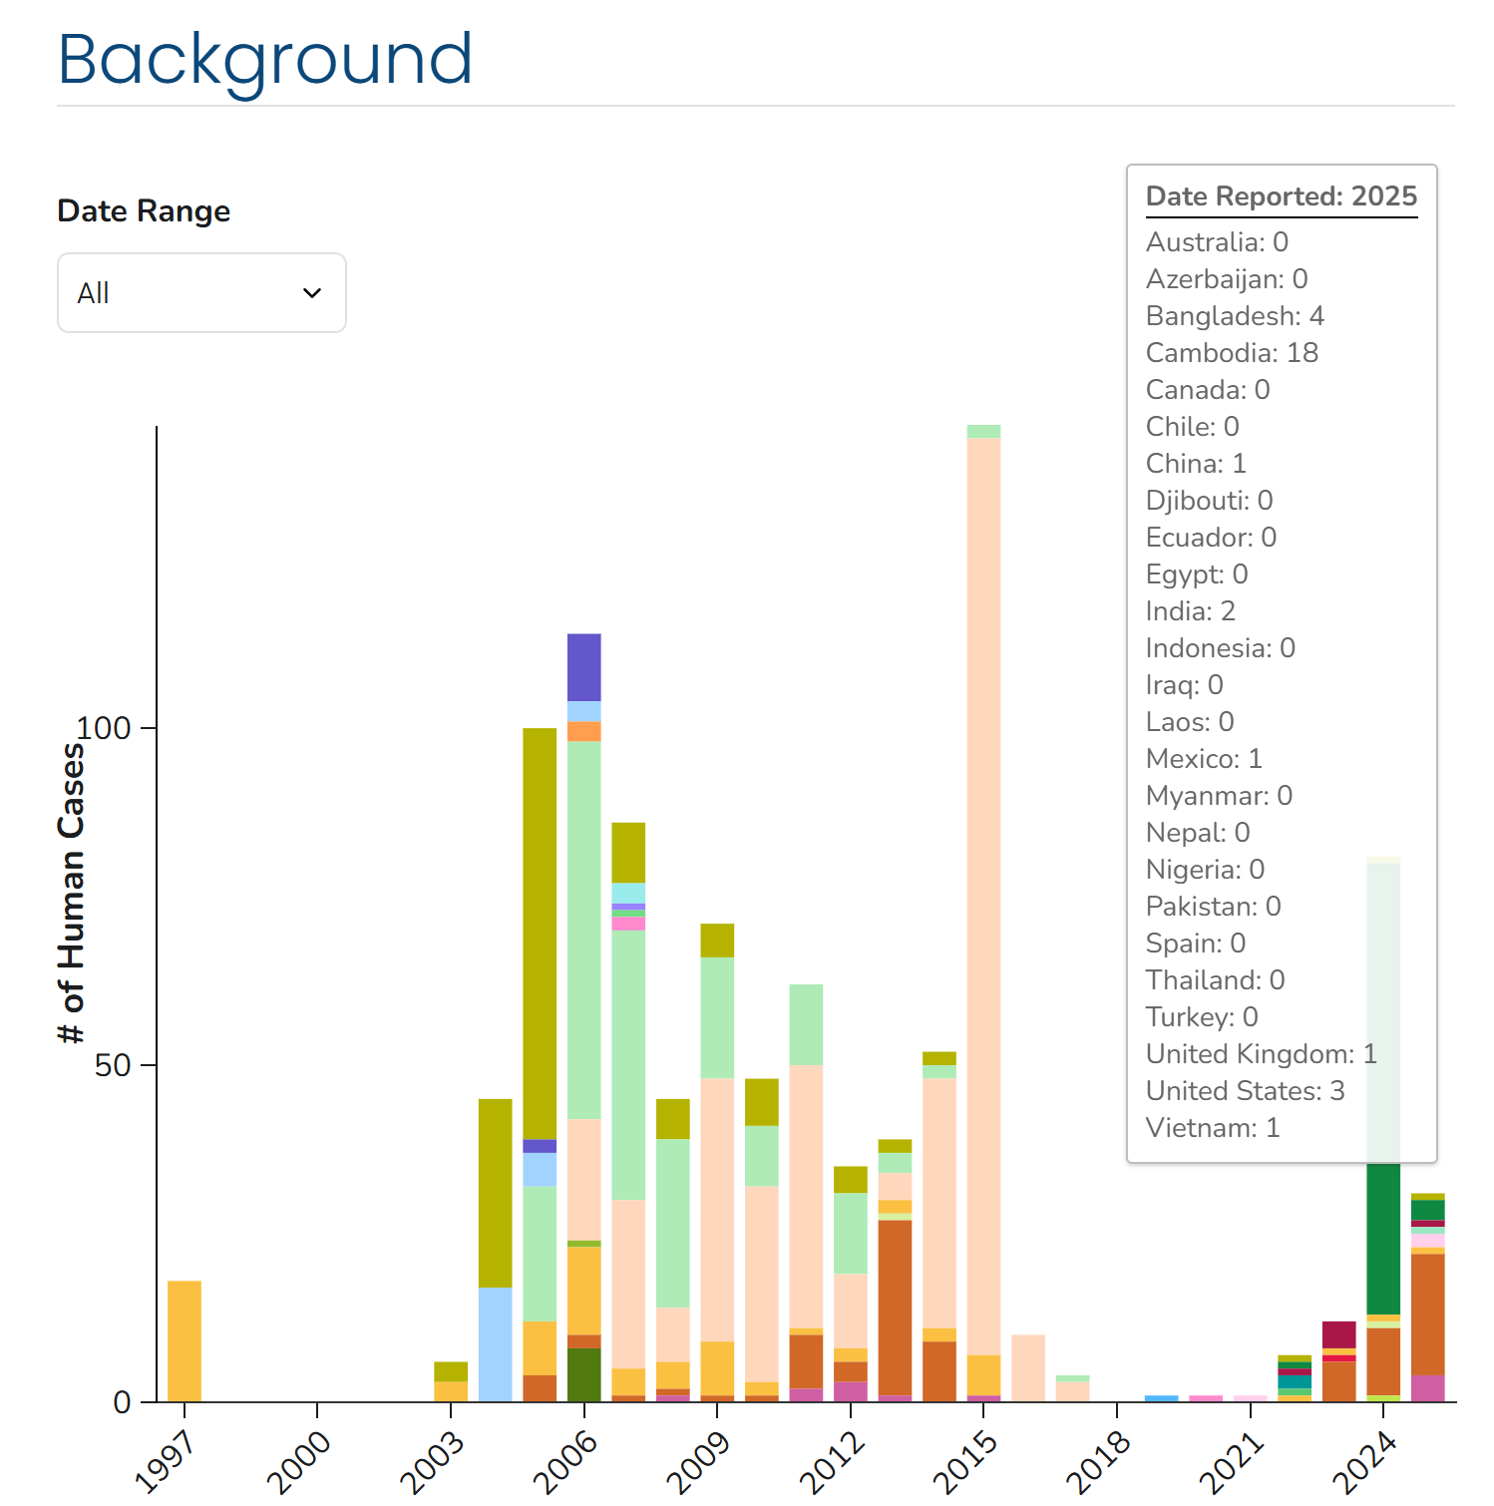
Recent International H5N1 Cases in Humans
Decline in total cases from 2024 due to low number reported from the US associated with dairy farm infections
Notable cases in 2025
Cambodia (18) clade 2.3.2.1e (9 fatal)
  All had contact with domestic birds
H5N5 mortality in Washington State
  Backyard poultry
No human-to-human transmission seen
Influenza at the human-animal interface summary and assessment, 19 December 2025
Global Human Cases with Influenza A(H5N1), 1997-2025 | Bird Flu | CDC

Slide 14
Lack of Avian Metapneumovirus Detection of Subtypes A and B in Eggs from Virus-Positive Commercial Turkey Breeders Supports the Premise That Vertical Transmission Does Not Contribute to Virus Spread | Avian Diseases
Clinical signs
8-week-old turkey hens from South Carolina
  Clinical signs and PCR positive for aMPV-B
Nasal turbinates and lung were only tissues PCR positive for aMPV-B
Differs from other studies that found virus in the reproductive tract of mature hens
Egg testing (20 day old embryonated eggs)
Flocks 1-3, 34-38 weeks old North Carolina aMPV-B
Flock 4, 36 weeks, Illinois positive for aMPV-A and B
Flock 5 – 53 weeks, Illinois aMPV-A
Flock 6 + 7, 35 and 37 weeks, Missouri aMPV-A
All egg samples negative on tissues and eggshells
Study does not support vertical transmission of aMPV
Notes:
Study limitations, we don’t know time of infection of these flocks, no control groups used.
Contributes to evidence that indicates that aMPV is not vertically transmitted.

Slide 15
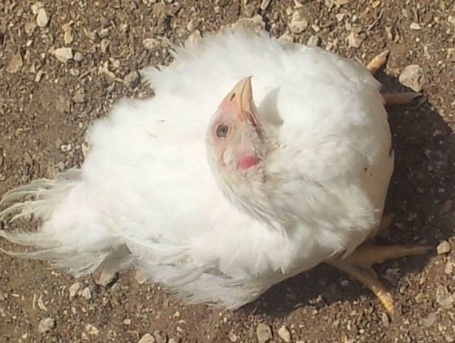
Newcastle Disease
Poland
  >7 million birds culled in 2025
  Vaccination appears to have been ineffective
  Ongoing outbreaks
Recent Cases in Europe
Spain (5) ongoing
Slovakia (1) resolved
Bulgaria (1) resolved
North Macedonia (1) resolved
Hendrix Genetics

Slide 16
Scientific Findings
Unexpected Detection of Highly Pathogenic Avian Influenza (HPAI) H5N1 virus in bovine Semen | bioRxiv
Official Statement on High Pathogenicity Avian Influenza (HPAI) in Cattle
Resurgence of Zoonotic Highly Pathogenic Avian Influenza A(H5N1) Virus in Cambodia | New England Journal of Medicine
Asymptomatic Human Infections With Avian Influenza A(H5N1) Virus Confirmed by Molecular and Serologic Testing: A Scoping Review | Infectious Diseases | JAMA Network Open | JAMA Network
Epidemiological and Genetic Characterization of Three H9N2 Viruses Causing Human Infections — Changsha City, Hunan Province, China, April 2025
Genetic and Serological Analysis of H7N3 Avian Influenza Viruses in Mexico for Pandemic Risk Assessment - PubMed

Slide 17
Scientific Findings
Framework for early warning of animal health threats
Assessment of biosecurity practices and risk factors for avian influenza outbreaks in commercial poultry farms in Bangladesh | Scientific Reports
H5N5 Avian influenza confirmed in Grays Harbor County resident | Washington State Department of Health
Serological Evidence of Highly Pathogenic Avian Influenza (H5N1) in Invasive Wild Pigs in Western Canada - Ley Garcia - 2025 - Transboundary and Emerging Diseases - Wiley Online Library
Highly Pathogenic Avian Influenza Viruses (HPAIV) Associated with Major Southern Elephant Seal Decline at South Georgia | Communications Biology
Ecology and spread of the North American H5N1 epizootic | Nature
Biosecurity uptake and perceived risk of avian influenza among people in contact with birds | medRxiv
A Systematic Review of New, Enhanced Surveillance Systems and Methodologies for Zoonotic Influenza Viruses in Animals and Human–Animal Interface - Badra - 2025 - Influenza and Other Respiratory Viruses - Wiley Online Library
Unprecedented high level of highly pathogenic avian influenza in wild birds in Europe during the 2025 autumn migration

Slide 18
Scientific Findings
Detection of H5N1 highly pathogenic avian influenza virus RNA in filth flies collected from California farms in 2024 | Scientific Reports
Detection and isolation of H5N1 clade 2.3.4.4b high pathogenicity avian influenza virus from ticks (Ornithodoros maritimus) recovered from a naturally infected slender-billed gull (Chroicocephalus genei) | bioRxiv
Emergence of a novel reassorted high pathogenicity avian influenza A(H5N2) virus associated with severe pneumonia in a young adult | medRxiv
Avian-origin influenza A viruses tolerate elevated pyrexic temperatures in mammals | Science
Endemic avian influenza landscape in Asia: sustained zoonotic risks | Infection | Springer Nature Link
Genomic diversity and reassortment of highly pathogenic avian influenza A/H5N1 virus (clade 2.3.4.4b) in Brazil: Evidence of multiple introductions and intra-epidemic reassortment in 2025 – ScienceDirect
Isolation and characterization of a novel reassortant H3N8 avian influenza virus from chickens in Eastern China | Virus Genes | Springer Nature Link
Natural infections of highly pathogenic avian influenza virus H5N1 in wild birds between 2020 and 2023 in the UK: a retrospective study with focus on microscopic lesions, viral distribution and neurotropism – PMC
Scenarios for pre-pandemic zoonotic influenza preparedness and response

Slide 19
Scientific Findings
Avian influenza overview September–November 2025
Immunogenicity and efficacy of commercial poultry avian influenza vaccines against HPAI A(H5N1) clade 2.3.4.4b viruses in Mexico – ScienceDirect
Avian Influenza A(H5N5)- United States of America
Investigation of avian louse flies as potential vectors of protozoan and bacterial pathogens of veterinary importance | Scientific Reports
Novel Highly Pathogenic Avian Influenza A(H5N1) Virus, Argentina, 2025 - Volume 31, Number 12—December 2025 - Emerging Infectious Diseases journal – CDC
A taxonomically harmonized global dataset of wild bird hosts for avian influenza virus surveillance | Scientific Data
Statement on the impact of HPAI on wildlife worldwide - WOAH - World Organisation for Animal Health
Highly pathogenic avian influenza: a One Health perspective on risks, surveillance, and resilience | ImmunoHorizons | Oxford Academic
Development of a portable avian influenza virus characterisation system: bringing the inside-out | Scientific Reports
Emergence of D1.1 reassortant H5N1 avian influenza viruses in North America | bioRxiv
Highly pathogenic avian influenza (HPAI H5N1, clade 2.3.4.4b, genotype C2.1) in commercial ring-necked pheasants during the 2022 outbreak in the United States

Slide 20
Scientific Findings
Highly Pathogenic Avian Influenza A(H5N1) Clade 2.3.4.4b Virus Infection in Poultry Farm Workers, Washington, USA, 2024 - Volume 31, Number 12—December 2025 - Emerging Infectious Diseases journal – CDC
journals.plos.org/globa
A modelling assessment of the impact of control measures on highly pathogenic avian influenza transmission in poultry in Great Britain | PLOS Computational Biologylpublichealth/article?id=10.1371/journal.pgph.0005463
Converging threats: The intersection of seasonal influenza surges and zoonotic highly pathogenic avian influenza
The expanding H5N1 avian influenza panzootic causes high mortality of skuas in Antarctica | Scientific Reports
Evolution of H5N1 Cross‐Species Transmission: Adaptive Mutations Driving Avian‐to‐Human Infection - Man - 2026 - Advanced Genetics - Wiley Online Library
Environmental metagenomics enhances detection of circulating viruses from live poultry markets in Cambodia | Nature Communications
Full article: First identification of concurrent infections with novel emerging duck astrovirus and duck hepatitis A virus type 3 (DHAV-3) in ducklings in Egypt using metagenomic next-generation sequencing (m-NGS)

