Slide 1
Community for Emerging and Zoonotic Diseases
Identifying emerging risks through collective intelligence
CEZD – CAHSS Poultry Update
23 April 2026
www.cezd.ca

Slide 2
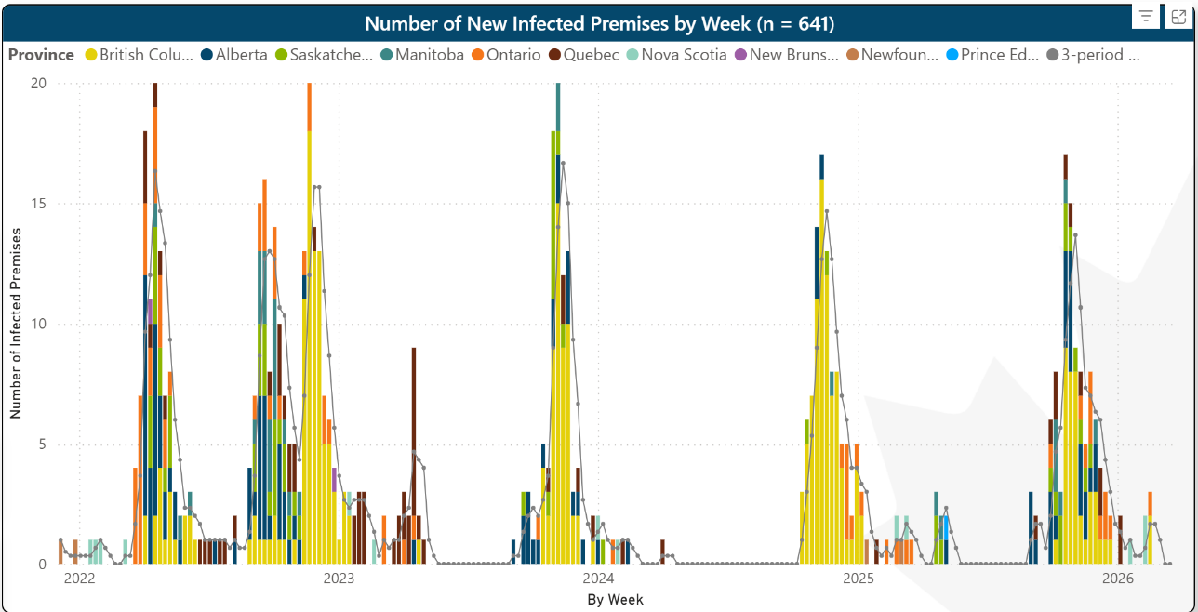
HPAI in Domestic Birds in Canada
2021
2022
246 IPs
2023
122 IPs
2024
76 IPs
2025
121 IPs
2026
12 IPs
D1.1
Last updated April 09, 2026
Microsoft Power BI
Notes:
For us after a catastrophic year in 2022, we had been on an annual decline in cases overall, but the fall of 2025 saw an increase once again in the total number of cases and over a greater geographic distribution than the previous wave.

Slide 3
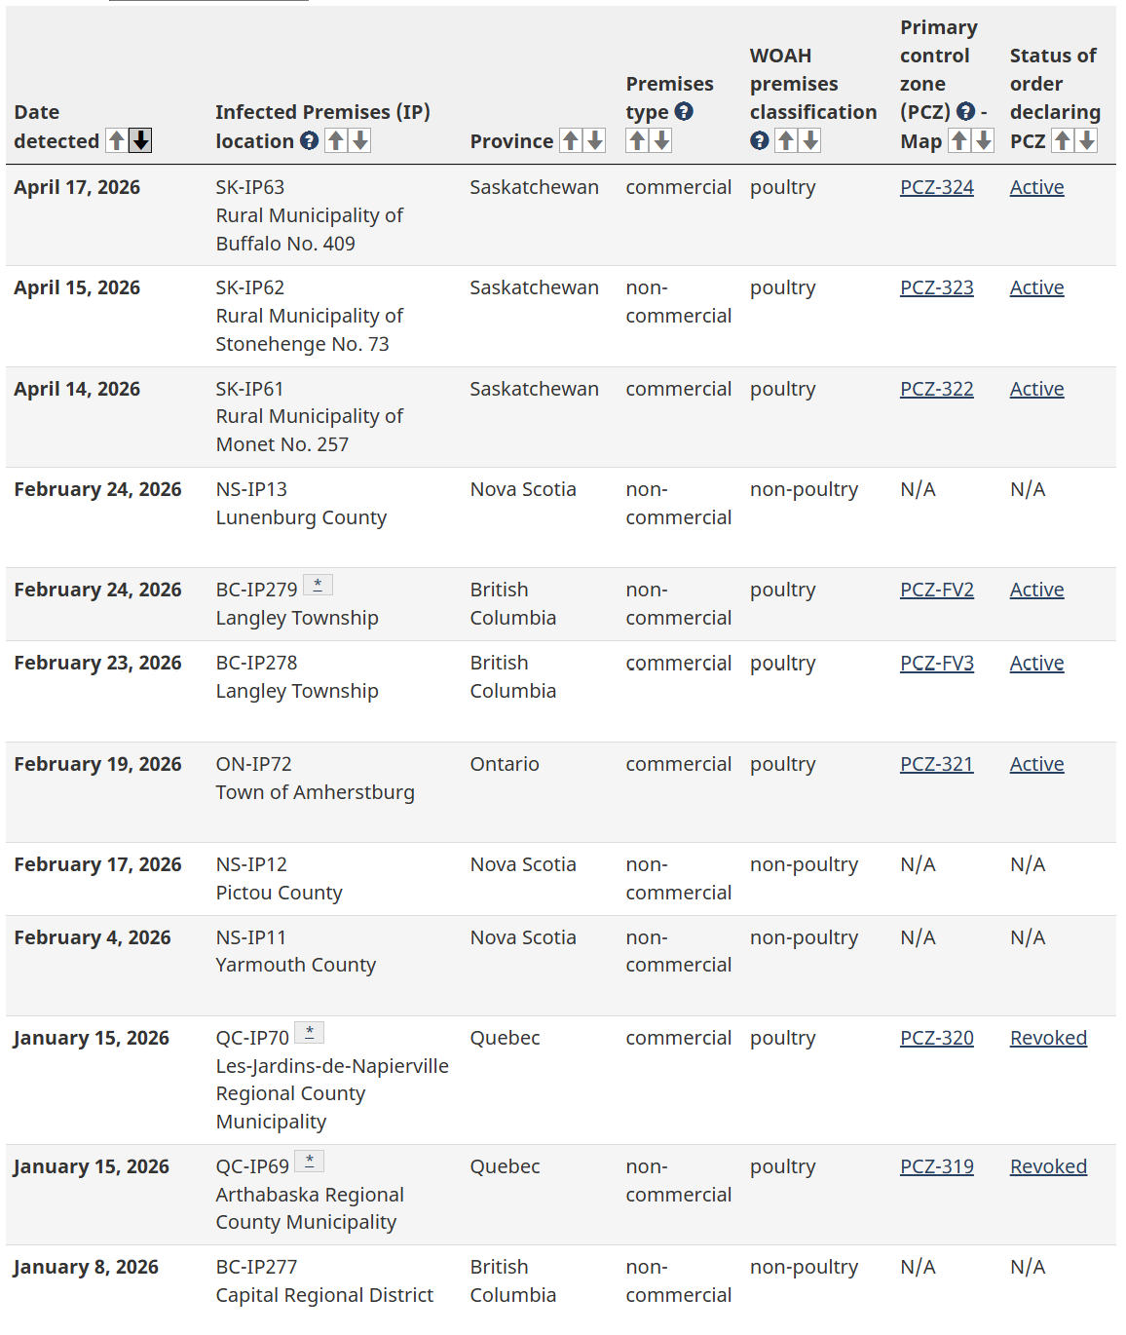
Domestic Cases
12 cases since January 1st
Most recent cases in April in Saskatchewan
Investigations and orders of avian influenza in domestic birds by province - inspection.canada.ca

Slide 4
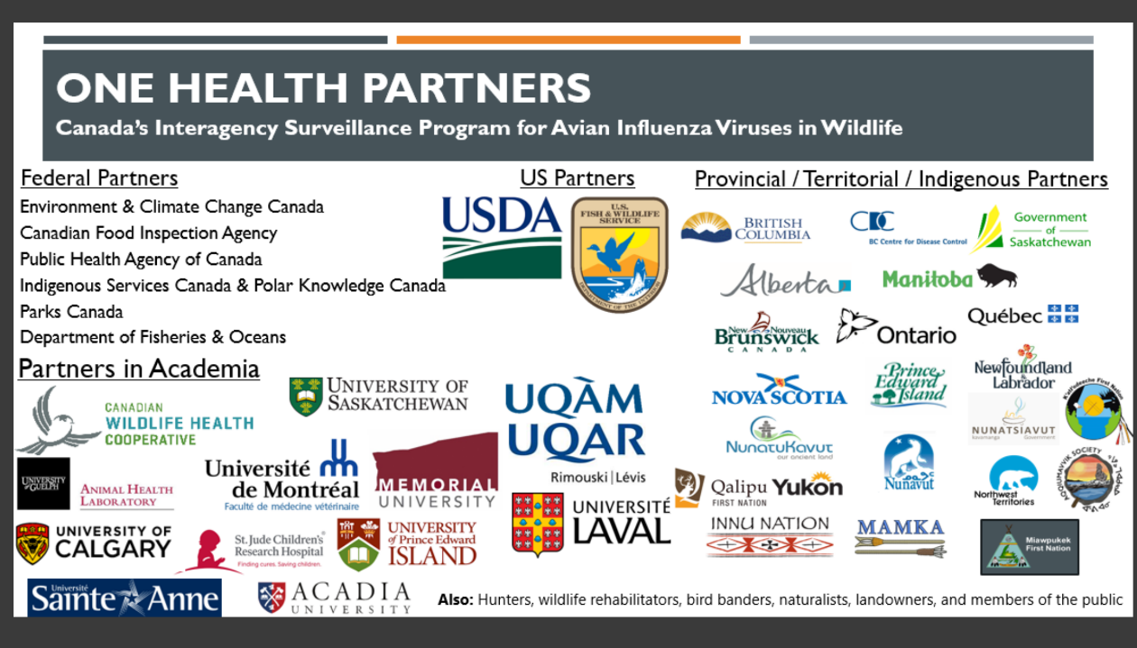
Surveillance Partners
Notes:
These next couple of slides originate directly from data collected by the partners in Canada’s Interagency Surveillance program for Avian Influenza Viruses in Wildlife.

Slide 5
HPAI in Wild Birds in Canada
CWHC Wild Bird Dashboard
Notes:
Our wild bird detections in Canada were increased over the previous year in the face of a lower number of birds sampled, and at the end of this curve we are missing some data points as samples may not have been tested yet.

Slide 6
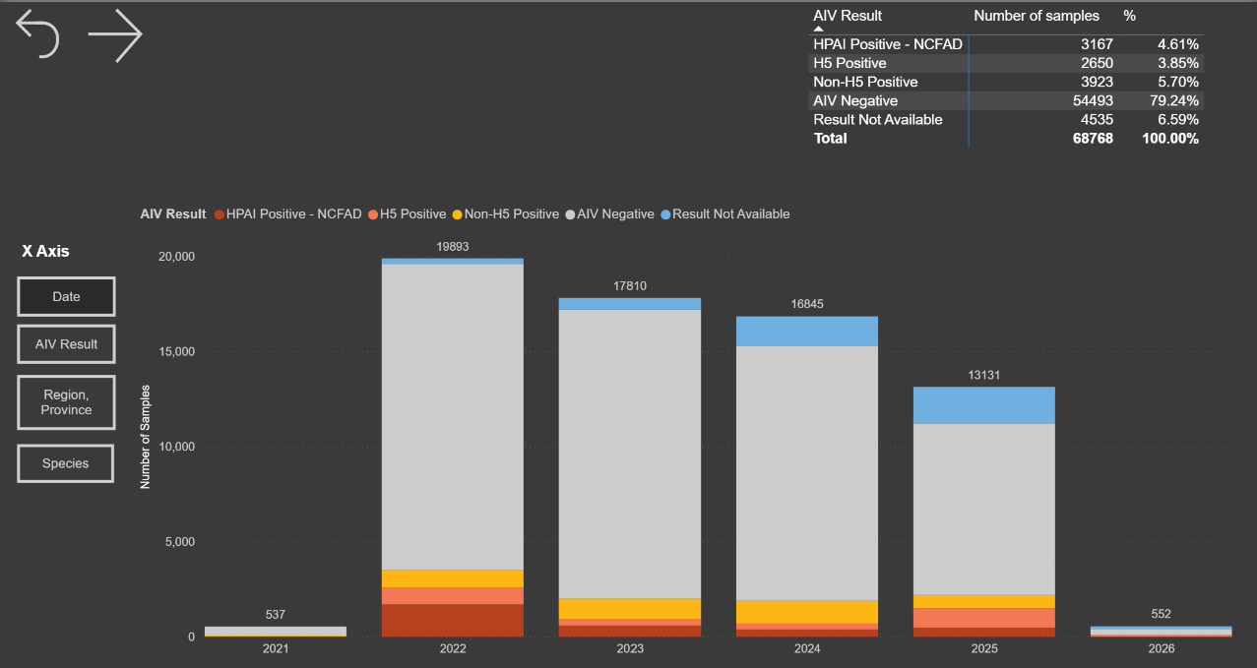
Virus Surveillance: Summary Tables/Figures
Notes:
This is a chart of the number of samples taken, and number of positive HPAI detections using PCR testing for viral genomic material.
Two things to note here,
The first is that overall number of samples have gone down year over year, The second is that almost 80 percent of the samples taken are negative for HPAI genetic material. This has not been changing year over year.

Slide 7
HPAI in Canadian Wild Birds
CWHC Wild Bird Dashboard
Notes:
When you look at which wild bird species are positive for virus, the proportions of each population affected continue to remain pretty much the same year over year, but in 2025 the increased number of positive waterfowl is very clearly visible.
Waterfowl are the most affected species year over year consistently, followed by Raptors. The diversity of species infected with H5N1 has been massive, Waterfowl remain the top concern, though the viral host range in wild birds has expanded substantially meaning there are more opportunities for infection.

Slide 8
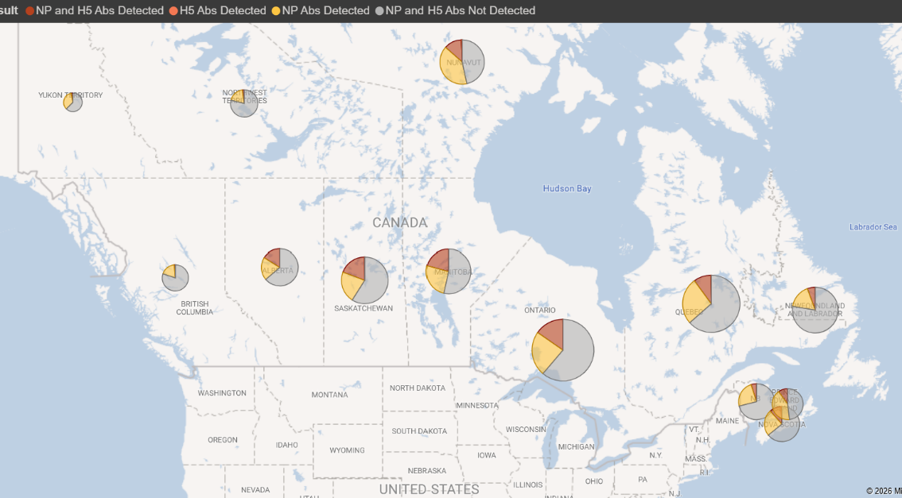
Wild Bird Serology
Notes:
When we look at antibody levels, instead of looking for virus, we find a similar picture.
Antibody levels in wild birds are variable with each population but the proportions affected overall stay similar.
~65% (the largest grey portion of the pie) have no antibodies to influenza at all, 24% (the yellow portion) have antibodies to Nucleoprotein (which is a general indication of exposure to influenza) and about 11% show H5 antibodies.
All this tells us is that there is some level of immunity present in wild bird populations.
Any time there is a susceptible population and virus present there will be infected wild birds.

Slide 9
United States

Slide 10
US Domestic Poultry Cases
Notes:
The United States has not had a decline in cases over the last couple of years, with 2024/25 being elevated due to HPAI in Dairy Cattle spilling back to poultry, and 2025/26 continuing to increase largely due to the D1.1 strain of the virus.

Slide 11
Major Species Groups - US
Notes:
What is visible though is a change in the species affected in the fall of 2025 and winter of 2026.
This graph rolls up the various categories of birds into a higher level just based on the species being reared. An increase in cases in Commercial Ducks is clearly visible in this graph, with a decrease in cases in commercial chickens. If we knew the genotypes of all of these outbreaks, it would b interesting to know if the large numbers of commercial chickens affected in 2024/25 were increased due to genotype B3.13.
The WOAH poultry and Non-poultry designations here largely refer to mixed backyard birds.

Slide 12
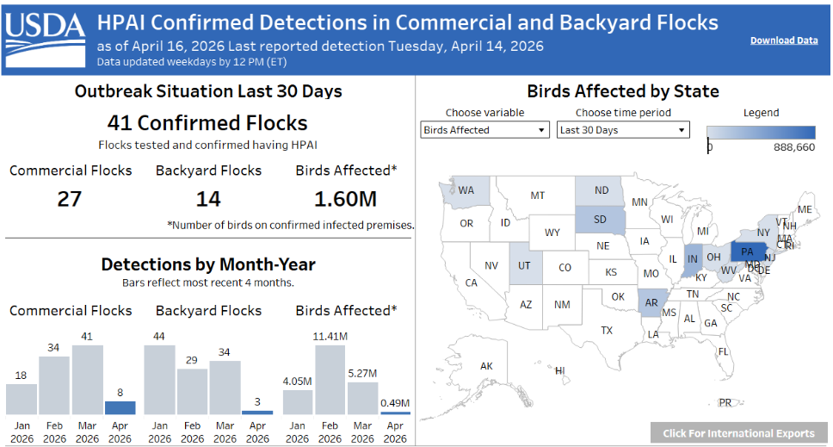
United States – HPAI Domestic Bird Detections Last 30 days
(updated April 16)
Confirmations of Highly Pathogenic Avian Influenza in Commercial and Backyard Flocks | Animal and Plant Health Inspection Service (usda.gov)
Notes:
The United States has had a truly awful time in 2025, with more cases of HPAI than any other single country,
In the first quarter of 2026, the numbers have only had a slight dip and are now on the upswing with the spring migration.
Infected domestic premises are found in every flyway.

Slide 13
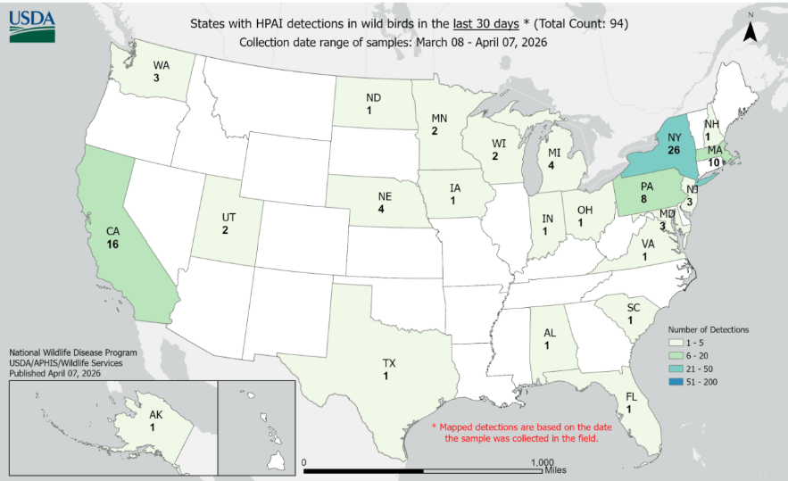
US Wild Bird HPAI Detections
94 wild bird detections of HPAI March 8 – April 7, 2026
Ongoing wild bird mortality events being reported (undiagnosed)
  Hundreds of geese dying around picturesque Hamptons pond -- fueling bird-flu outbreak worries
  Why so many dead geese in New Jersey? Over 4,000 lifeless birds found in just a month
  101 vultures found dead at Blue Spring State Park, likely from bird flu
Diagnosed Highly Pathogenic Avian Influenza Continues to Affect Wild Birds Across All Four U.S. Flyways | U.S. Geological Survey
HPAI Detections in Wild Birds (usda.gov)
Notes:
Ongoing cases in wild birds in the United States, along with the relatively high number of farmed cases in Q1 2026 do not bode well for Canada during the spring migration.
There have been ongoing detections of HPAI in wild birds in the US throughout the winter with multiple mass mortality events in wild birds being reported.

Slide 14
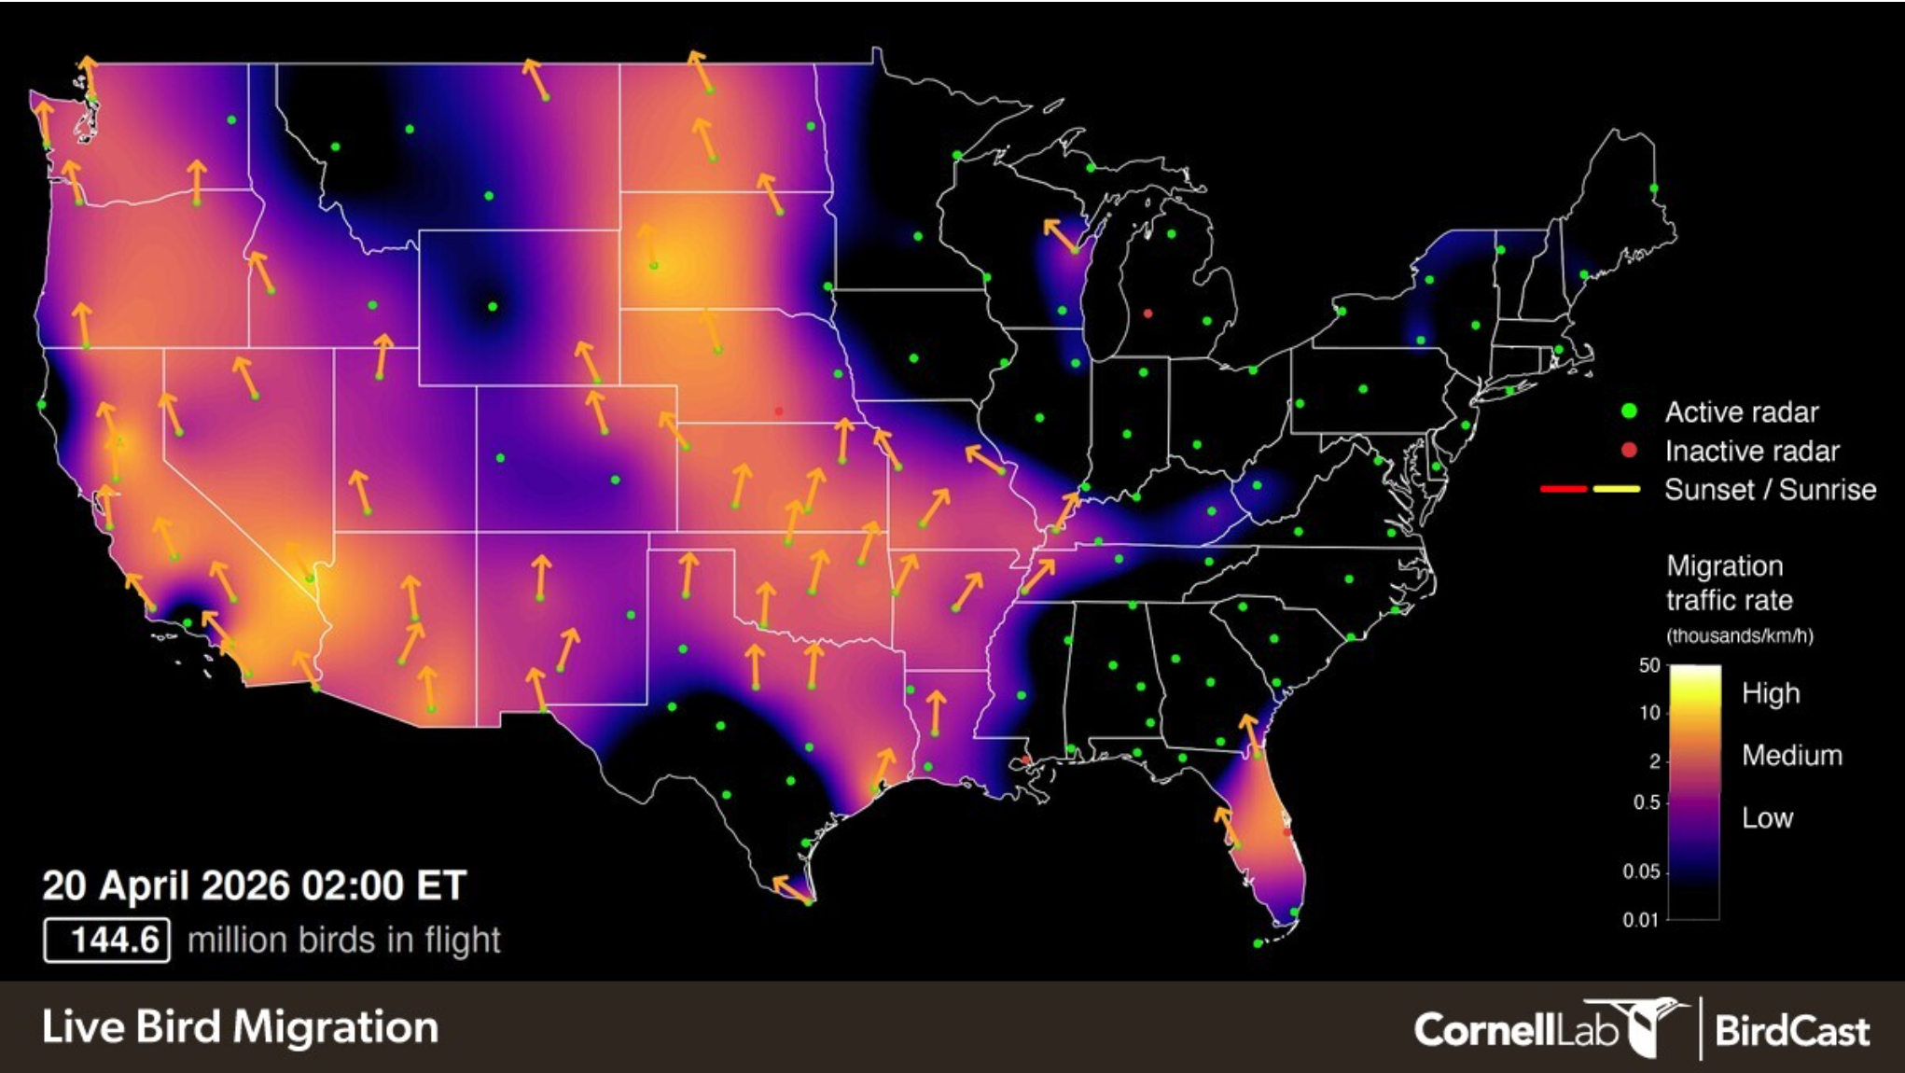
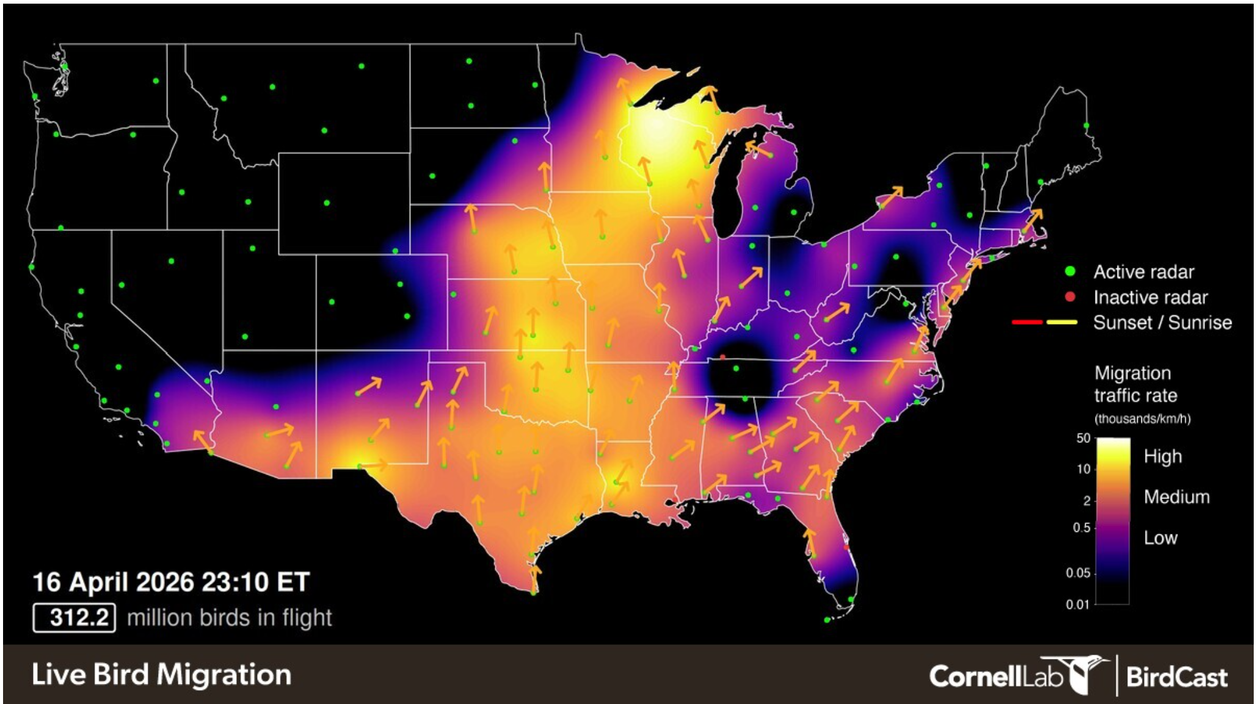
Wild bird spring migration is well underway in all flyways in North America
Expect D1.1 to still be dominant based on strains present in US
BirdCast

Slide 15
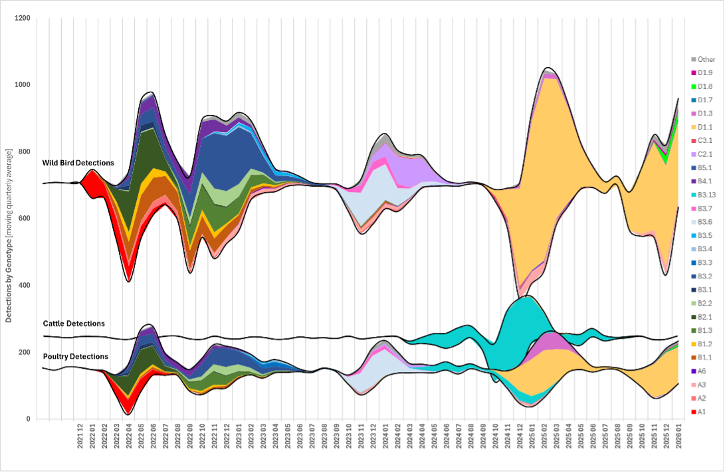
US Genotypes
GenoFLU/docs/wild_bird_detections.png at main · USDA-VS/GenoFLU · GitHub
D1.1 dominant
Greater Diversity
Notes:
The dominant genotype in the US in both wild and farmed birds is D1.1 in yellow with a few other minor variants. The diversity of viral genotypes seen in the first couple of years post introduction has really declined with a single genotype becoming dominant since it’s emergence in the fall of 2024. It is still undergoing a lot of mutation, but less reassortment has been detected since D1.1 emerged.

Slide 16
Europe

Slide 17
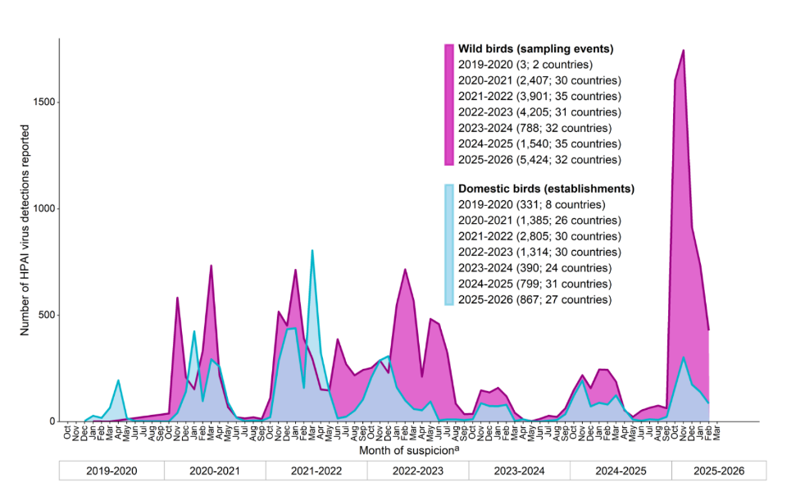
Avian influenza | EFSA
Notes:
The fall of 2025 was the worst for wild birds in European history.

Slide 18
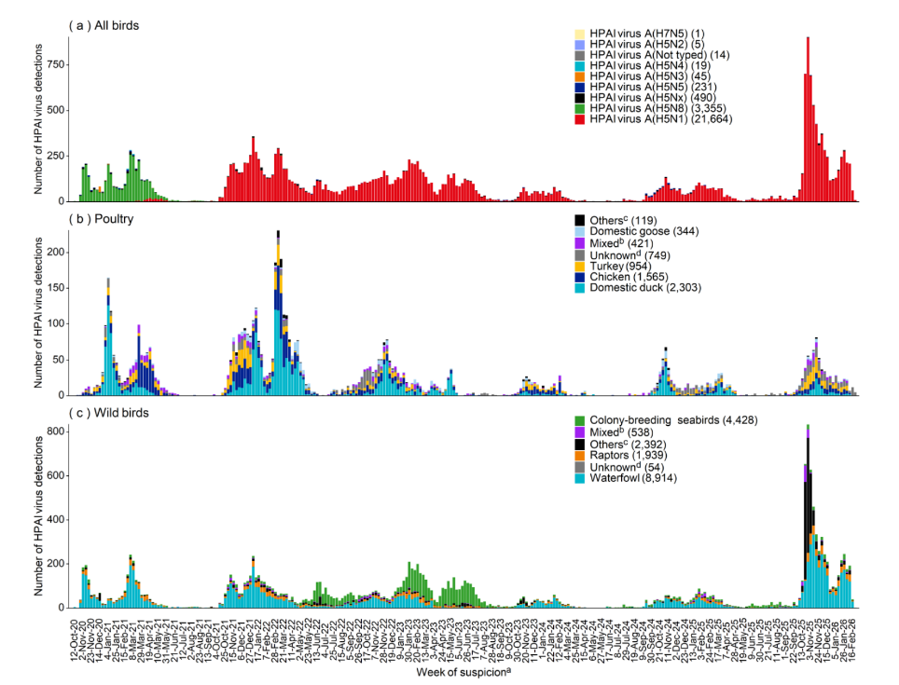
European
Union
2020
2021
2022
2023
2024
2025
2026
https://www.efsa.europa.eu/en/efsajournal/pub/10015
Notes:
Fall of 2025 and into the winter of 2026 has been awful in Europe.
The dominant genotype is DI.2.1, and it has impacted waterfowl and cranes at a very high level. Given the intense infection pressure, the number of domestic cases in Europe is not as bad as it could have been. 90% of the cases in domestic poultry are due to primary introductions rather than farm to farm spread.

Slide 19
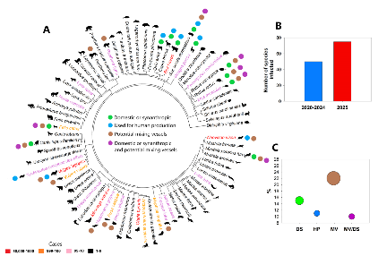
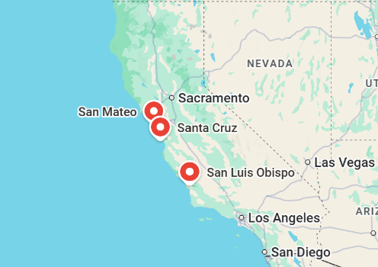
Mammals
H5 Influenza A Outbreak in Marine Mammals | Institute for Pandemic Insights
Update on H5N1 Panzootic: Infected Mammal Species Increase by Almost 50% in Just Over a Year - Plaza - 2025 - Influenza and Other Respiratory Viruses - Wiley Online Library
San Mateo
  Northern Elephant Seal
  California Sea Lion
  Southern Sea Otter
Santa Cruz
  Northern Elephant Seal
San Luis Obispo
  California Sea Lion

Slide 20

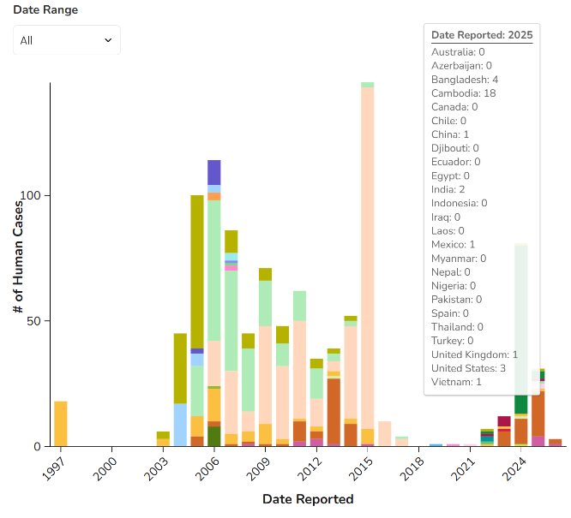
H5N1 cases in Humans
In 2025 Cambodia had the most cases of H5N1 2.3.2.1e in humans (18)
Other countries reporting infection
  Bangladesh (4)
  China (1)
  India (2)
  UK (1)
  US (3)
  Vietnam (1)
Global Human Cases with Influenza A(H5N1), 1997-2026 | Bird Flu | CDC
Notes:
Jumping to human infections with H5N1
We can expect sporadic severe cases in Humans and these international cases are tragic but not surprizing.
To date cases in 2026 have been in Bangladesh (1) and Cambodia (2)
No indication of human to human transmission in any cases so far.

Slide 21
Other Recent Avian Influenza Cases in Humans
H9N2 - LPAI
H5N5 2.3.4.4b - HPAI
18 cases in 2025 (China)
  Sporadic poultry associated infections
  Mostly children with mild symptoms
9 so far in 2026 (8 China, 1 Italy, travel associated)
  Mild/moderate illnesses
195 cases worldwide since 1998, 2 deaths
1 case in the United States November 2025
Exposure to infected poultry
Underlying medical conditions
Passed away November 21st
1st case reported globally of human illness from H5N5

Slide 22
Innovative Paths Forward in HPAI management
Protecting the nation's poultry supply | K-State Today | Kansas State University
  Research to get a vaccine against HPAI into mealworms
Studying HPAI in the air
  Non-thermal plasma for inactivating HPAI
  Study how long the virus remains infectious in the air and whether non-thermal plasma technology can reduce its infectivity
Multimodal sensing technologies for HPAI biosurveillance in poultry production systems | npj Biosensing
  Look at molecular, physiological and biological signals for earlier detection of HPAI
    Detection of viral RNA or antigens
    Thermal imaging for fever
    Acoustic surveillance for respiratory anomalies and changes in vocalization

Slide 23
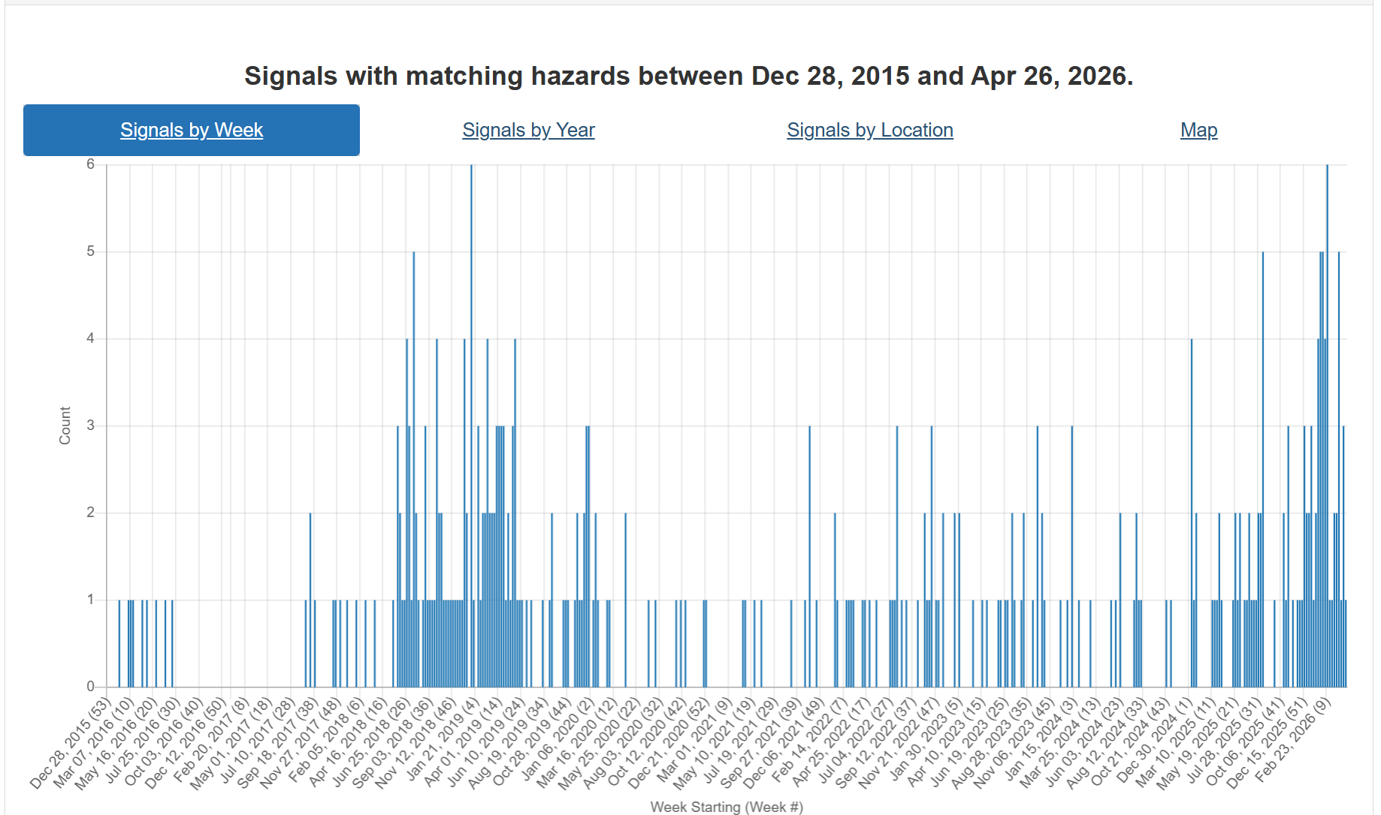
Newcastle Disease
Ongoing cases in Europe
Since January
  Poland
  Germany
  Spain
  Lithuania
In 2025
  Poland
  Spain
  Slovenia
  Slovakia
  Malta
  Bulgaria
  North Macedonia
Notes:
CEZD Ping Summary – Newcastle Disease
Situation description: Over the past year, ND activity has risen sharply in Europe. Poland continues to report the greatest number of outbreaks across commercial and non-commercial flocks. Additional detections occurred throughout 2025 in Spain, Slovakia, Bulgaria, and North Macedonia, particularly in small or backyard flocks. Most recently, in February 2026, both Lithuania and Germany reported new outbreaks. Lithuania confirmed its first ND outbreak in geese on a small farm near Vilnius, while Germany reported two outbreaks - one in turkeys in Brandenburg near the Polish border and another in laying hens in Bayern. Sequencing of the Brandenburg virus identified genotype VII.1.1, closely related to strains circulating in Poland. Several other outbreaks have involved vaccinated flocks, raising concerns about biosecurity lapses, vaccine mismatch or failure, or the emergence of more transmissible strains.
Question: Given the recent rise in ND reports across Europe and the re-emergence of virulent ND in Canada last year, how relevant is this trend to Canada?
In the comments sections, let us know your thoughts as to what factors might be driving the increase (e.g., wild bird movements, biosecurity breaches, viral evolution, vaccine performance, or enhanced detection due to HPAI related surveillance)?
Distributed: March 2, 2026
Results:
Number of responses = 24 Average Rating: 2.96 = 3.0
Overall sentiment clustered towards ‘Relevant’. However, the respondents generally viewed the signal as important for situational awareness rather than an indication of immediate risk to Canada.
Key Themes from Responses
Increasing outbreaks in vaccinated and commercial flocks were a major concern.
Outbreaks in countries with strict vaccination programs (e.g., Germany) raised questions about vaccine performance, biosecurity implementation, and the possible emergence of more virulent or transmissible NDV strains.
Biosecurity gaps were identified as a key driver of risk.
Most respondents emphasized that detections in vaccinated flocks likely reflect lapses in biosecurity or human-mediated spread rather than true vaccine mismatch in most cases.
Wildlife, pigeons, and backyard flocks were seen as persistent reservoirs.
Pigeons and cormorants were frequently identified as bridge species, with backyard, fancy, and squab pigeon flocks representing higher-risk settings due to limited surveillance and inconsistent vaccination practices.
Surveillance effects versus true increase were debated.
Some respondents suggested the apparent rise in ND reflects enhanced surveillance during the HPAI era, while others noted that involvement of farmed flocks suggests a real increase beyond detection bias.
Interaction with HPAI and system capacity pressures was highlighted.
ND’s ability to mimic HPAI clinically and diagnostically was viewed as a complicating factor, particularly given ongoing strain on animal health resources responding to multiple concurrent disease events.
Overall Interpretation
While the European ND outbreaks are unlikely to spread directly to Canada, respondents broadly viewed the signal as a meaningful warning. The consensus emphasized continued vigilance, strong biosecurity at key interfaces, targeted monitoring of high-risk populations, and readiness to differentiate ND from other avian diseases such as HPAI.

Slide 24
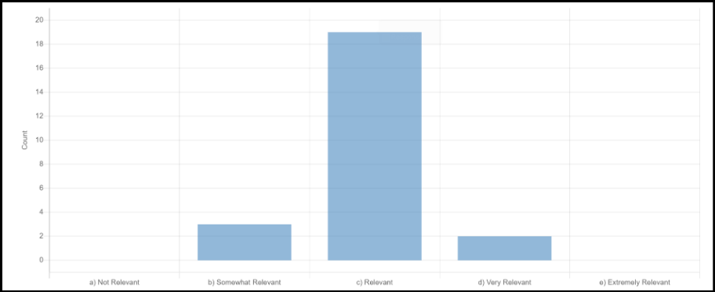
Newcastle Disease Ping
Ping
Increased outbreaks in vaccinated and commercial flocks
Concerns with:
  vaccine performance
  biosecurity implementation
  emergence of more virulent strains
Persistent reservoirs in pigeons and cormorants
Potential detection bias due to increased testing due to HPAI
System capacity pressures due to concurrent outbreaks
24 responses, average rating 2.96
Respondents generally viewed the signal as important for situational awareness rather than an indication of immediate risk to Canada.
Notes:
CEZD Ping Summary – Newcastle Disease
Situation description: Over the past year, ND activity has risen sharply in Europe. Poland continues to report the greatest number of outbreaks across commercial and non-commercial flocks. Additional detections occurred throughout 2025 in Spain, Slovakia, Bulgaria, and North Macedonia, particularly in small or backyard flocks. Most recently, in February 2026, both Lithuania and Germany reported new outbreaks. Lithuania confirmed its first ND outbreak in geese on a small farm near Vilnius, while Germany reported two outbreaks - one in turkeys in Brandenburg near the Polish border and another in laying hens in Bayern. Sequencing of the Brandenburg virus identified genotype VII.1.1, closely related to strains circulating in Poland. Several other outbreaks have involved vaccinated flocks, raising concerns about biosecurity lapses, vaccine mismatch or failure, or the emergence of more transmissible strains.
Question: Given the recent rise in ND reports across Europe and the re-emergence of virulent ND in Canada last year, how relevant is this trend to Canada?
In the comments sections, let us know your thoughts as to what factors might be driving the increase (e.g., wild bird movements, biosecurity breaches, viral evolution, vaccine performance, or enhanced detection due to HPAI related surveillance)?
Distributed: March 2, 2026
Results:
Number of responses = 24 Average Rating: 2.96 = 3.0
Overall sentiment clustered towards ‘Relevant’. However, the respondents generally viewed the signal as important for situational awareness rather than an indication of immediate risk to Canada.
Key Themes from Responses
Increasing outbreaks in vaccinated and commercial flocks were a major concern.
Outbreaks in countries with strict vaccination programs (e.g., Germany) raised questions about vaccine performance, biosecurity implementation, and the possible emergence of more virulent or transmissible NDV strains.
Biosecurity gaps were identified as a key driver of risk.
Most respondents emphasized that detections in vaccinated flocks likely reflect lapses in biosecurity or human-mediated spread rather than true vaccine mismatch in most cases.
Wildlife, pigeons, and backyard flocks were seen as persistent reservoirs.
Pigeons and cormorants were frequently identified as bridge species, with backyard, fancy, and squab pigeon flocks representing higher-risk settings due to limited surveillance and inconsistent vaccination practices.
Surveillance effects versus true increase were debated.
Some respondents suggested the apparent rise in ND reflects enhanced surveillance during the HPAI era, while others noted that involvement of farmed flocks suggests a real increase beyond detection bias.
Interaction with HPAI and system capacity pressures was highlighted.
ND’s ability to mimic HPAI clinically and diagnostically was viewed as a complicating factor, particularly given ongoing strain on animal health resources responding to multiple concurrent disease events.
Overall Interpretation
While the European ND outbreaks are unlikely to spread directly to Canada, respondents broadly viewed the signal as a meaningful warning. The consensus emphasized continued vigilance, strong biosecurity at key interfaces, targeted monitoring of high-risk populations, and readiness to differentiate ND from other avian diseases such as HPAI.

Slide 25
Scientific Findings
Management of critical illness in an adolescent caused by highly pathogenic avian influenza A(H5N1) virus infection in British Columbia, Canada – ScienceDirect
H4N6 avian influenza virus in Iran: first isolation and molecular insights | Virus Genes | Springer Nature Link
Viral protein mutations enabling mammalian adaptation in Avian Influenza A viruses: Strategies for zoonotic risk mitigation and future perspectives – ScienceDirect
Assessing HPAI-H5 transmission risk across wild bird migratory flyways in the United States | Nature Communications
Vaccination against H5 HP avian influenza virus leads to persistent immune response in wild king penguins | Nature Communications
Frontiers | Early detection and genetic characterization of clade 2.3.4.4b H5N1 and H5N9 highly pathogenic avian influenza viruses at the onset of fall migration in wild birds during october 2025 in South Korea

Slide 26
Scientific Findings
Multiple Introductions of Highly Pathogenic Avian Influenza Viruses into the High Arctic: Svalbard and Jan Mayen, 2022–2025 | bioRxiv
Current Status of Clade 2.3.4.4b H5N1 Highly Pathogenic Avian Influenza Virus Transmission in Mammals
Multimodal sensing technologies for HPAI biosurveillance in poultry production systems | npj Biosensing
Emergence and Genetic Characteristics of H5N1, H5N6, and H5N3 Clade 2.3.4.4b High Pathogenicity Avian Influenza Viruses in South Korea During the 2023–2024 and 2024–2025 Winter Seasons – PMC
Fly larvae as an alternative sample for the detection of highly pathogenic avian influenza A(H5N1) virus – PubMed
Evolution and spread of H8Nx avian influenza viruses from wild birds in East Asia, 2019-2024 | Archives of Virology | Springer Nature Link
Mapping global avian influenza risk patterns through waterbird activity entropy | Nature Communications

Slide 27
Scientific Findings
Farm-level transmission dynamics and risk assessment of H5 Avian Influenza – ScienceDirect
Global overview of the spread and impact of H5 clade 2.3.4.4b HPAI virus in wildlife, 2020-2024 – offlu
Newcastle disease in Europe - GOV.UK
Epidemiological Update - Avian Influenza A(H5N1) in the Americas Region - 11 March 2026 - PAHO/WHO | Pan American Health Organization
A newly emergent N1 neuraminidase associated with clade 2.3.4.4b highly pathogenic avian influenza A(H5) viruses in North America | medRxiv
Novel Reassortant H5N2 Highly Pathogenic Avian Influenza Viruses from Backyard Poultry in Mexico | MDPI
Risk communication on avian flu biosecurity: social research, audience segmentation, and communication strategy for an EU awareness‐raising campaign - - 2026 - EFSA Supporting Publications - Wiley Online Library
Beyond poultry: Rethinking monitoring and control of HPAI H5Nx anticipating spillover risks for mammals – offlu
Containment scenarios for post-spillover transmission chains of avian influenza H5N1 from poultry to humans | Nature Health
To what extent may the duck population be protected after vaccination against highly pathogenic avian influenza? Contributions from a modelling approach and French field data – ScienceDirect
Introduction and inter-species transmission dynamics of high pathogenicity avian influenza H5N1 viruses in Japan 2021–25 | Virus Evolution | Oxford Academic

