Slide 1
Community for Emerging and Zoonotic Diseases
Identifying emerging risks through collective intelligence
Monthly Community Meeting
March 23, 2023
www.cezd.ca

Slide 2
Agenda
Roll call / Additions to Agenda
Updates
  Getah Virus
  Discipline specific reports posted to website
  Annual Survey
Emerging Agents discussion
  Plasticosis + Small Hive Beetle
Transmission of pathogens over long distances
  Example of M. bovis in New Zealand

Slide 3
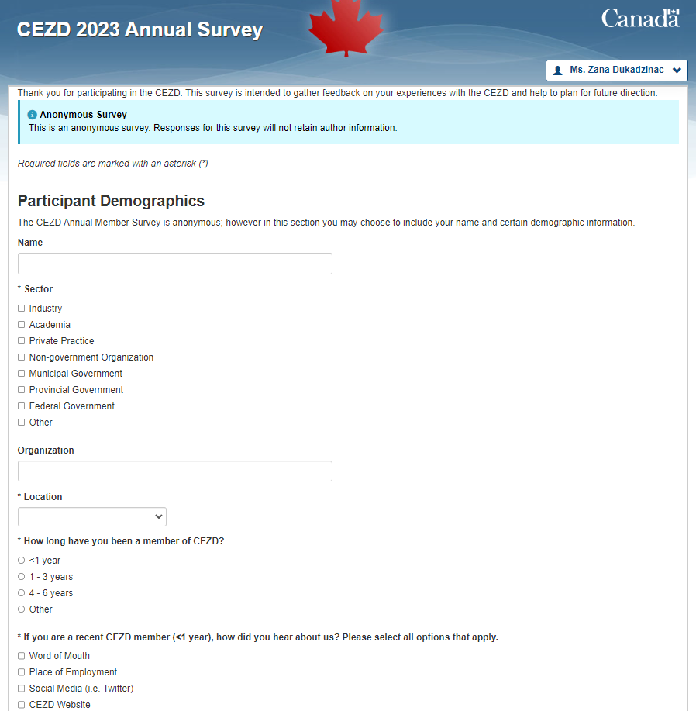
Annual Survey
Expires March 31st
As of March 22 N = 41
Great feedback on CEZD value, focus, and priorities
Priorities:
  Collaboration
  Reporting
  Presentation/Webinars
Notes:
All respondents indicated CEZD provided them with information that assisted them in their current position.
Areas of assistance – awareness, but we are seeing growth with respect to preparedness and response
Priorities question got a lot of great feedback, grouped it into a few categories (collaboration, reporting, presentations/webinars and a few others).
Collaboration- continued One health partnerships, different sector groups, GPHIN, link with researchers/activities outside of Canada, provincial municipal emergency management programs
Reporting- decrease time lag in reporting events (potential daily reporting), include summary of disease trends
Presentations/webinars – more online sessions with quest speakers, share info on continuing education events, more blog posts or conference presentations to reach other sectors
A few interesting ideas:
Develop priority list of emerging diseases for Canada
Provide updates on world research on ED, best practices in prevention/control
Connecting media with appropriate experts from community on relevant issues to increase knowledge translation to public
So lots of great feedback so far and if you’d like to give us your ideas on what to focus on going forward and you haven’t completed it yet, please do so within the next week.

Slide 4
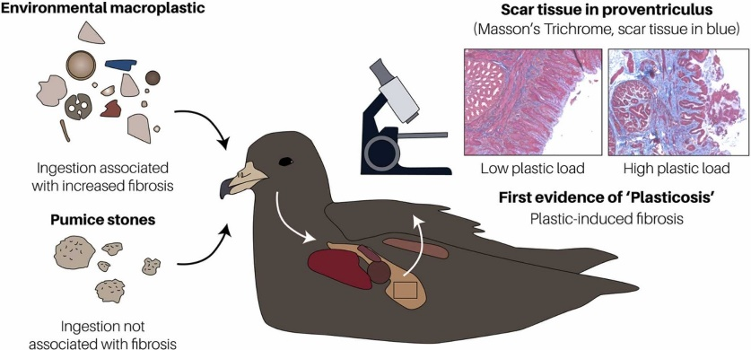
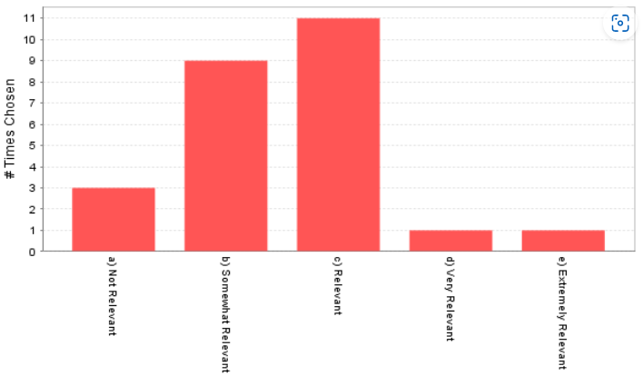
Emerging Agents – Plasticosis Ping
Notes:
Huge range of responses, in fact, the most diverse ping response we’ve ever seen.

Slide 5

Emerging Agents
Can we consider ‘plasticosis’ or plastic pollution to be an “emerging agent”?
Does the community want to see signals like this?
  Hazards that are physical, chemical or radioactive
  e.g. Imidacloprid/Fipronil used in agriculture and on companion animals can kill insects (ecosystem impacts)

Slide 6
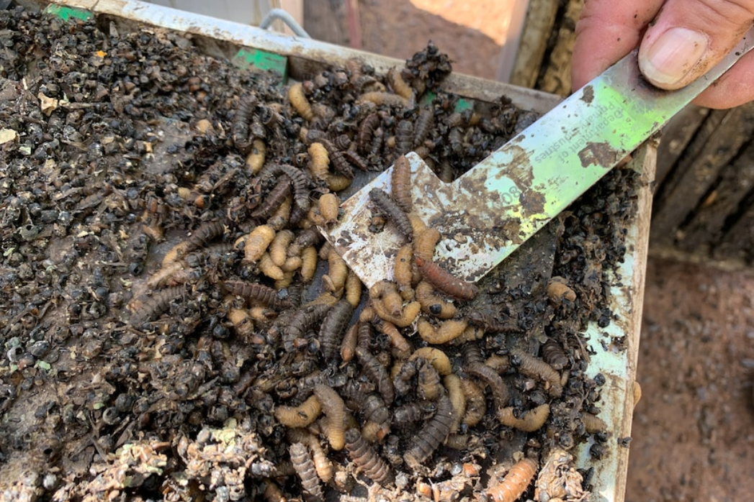
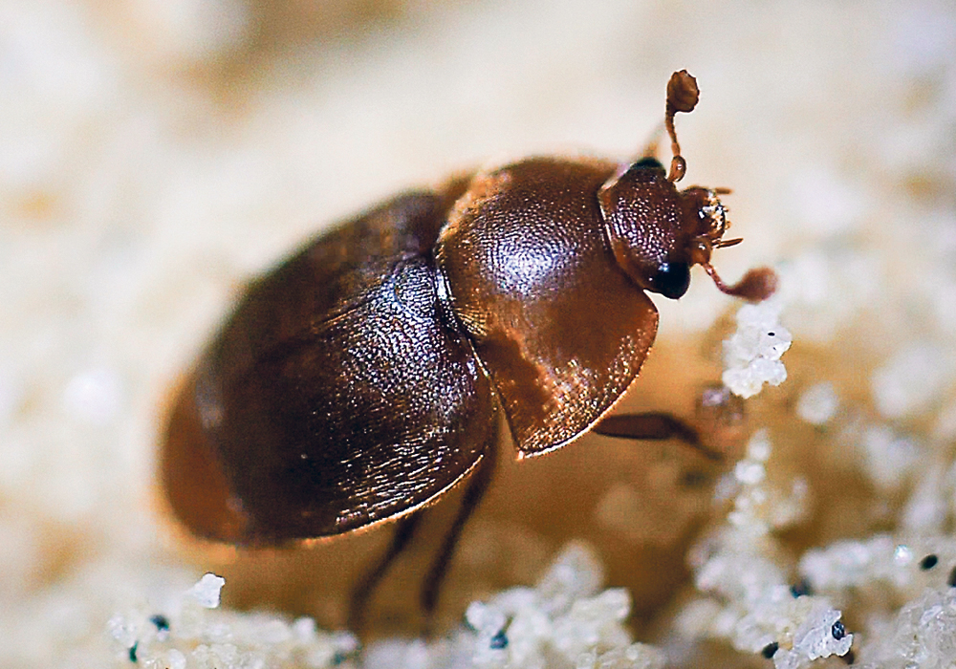
Small hive beetle detected in Devonport beehive threatens $12.8m Tasmanian honey industry - ABC News
We haven’t engaged with pests and diseases of bees in any significant way
A few key diseases in the HC dictionary
  Acarapisosis of honey bees
  American foulbrood
  European foulbrood
  Nosemosis
  Small Hive Beetle
  Tropilaelaps infestation
  Varroosis of honey bees
We’ll need to look into the best sources for information if community wants more of these signals
Notes:
In its larvae stage, the small hive beetle burrows into beehives and consumes brood, pollen and honey, which can significantly damage the hive's population and affect honey production.
"It puts a yeast right through the hive and all the maggots grow, and they slime it all out," he said.

Slide 7
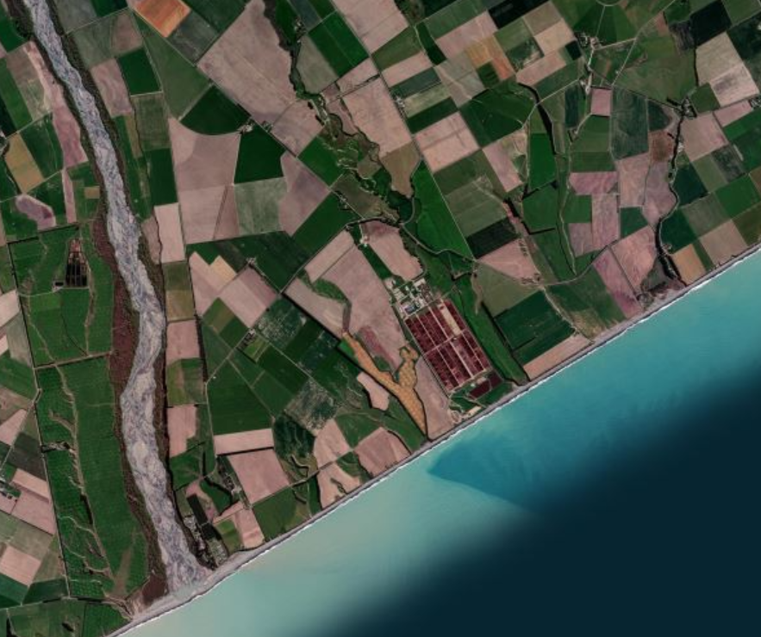
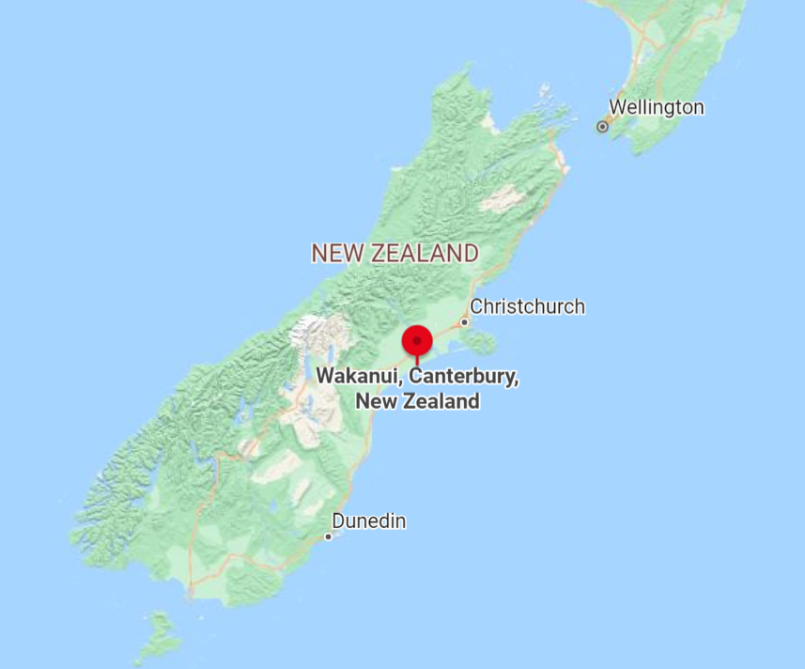
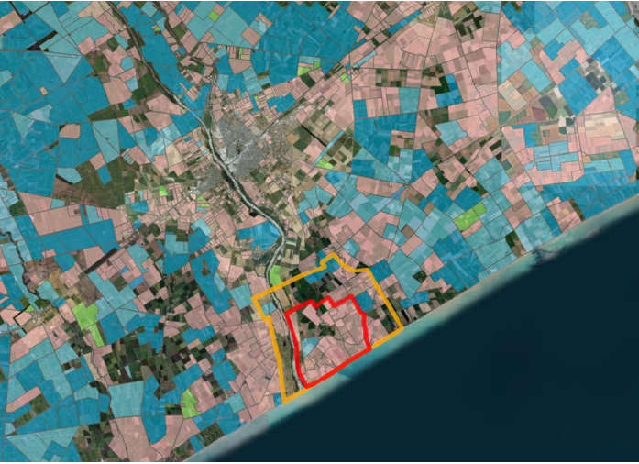
Pathogen Transmission over long distances
What do we know?
Mycoplasma bovis in New Zealand
Independent review conducted when it appeared disease transmission occurred with control measures in place
Vast majority of M. bovis cases were due to close contact between infectious and susceptible cattle
The study describes an anomaly in normal disease spread pattern
News items say up to 5km spread via airborne route

Slide 8
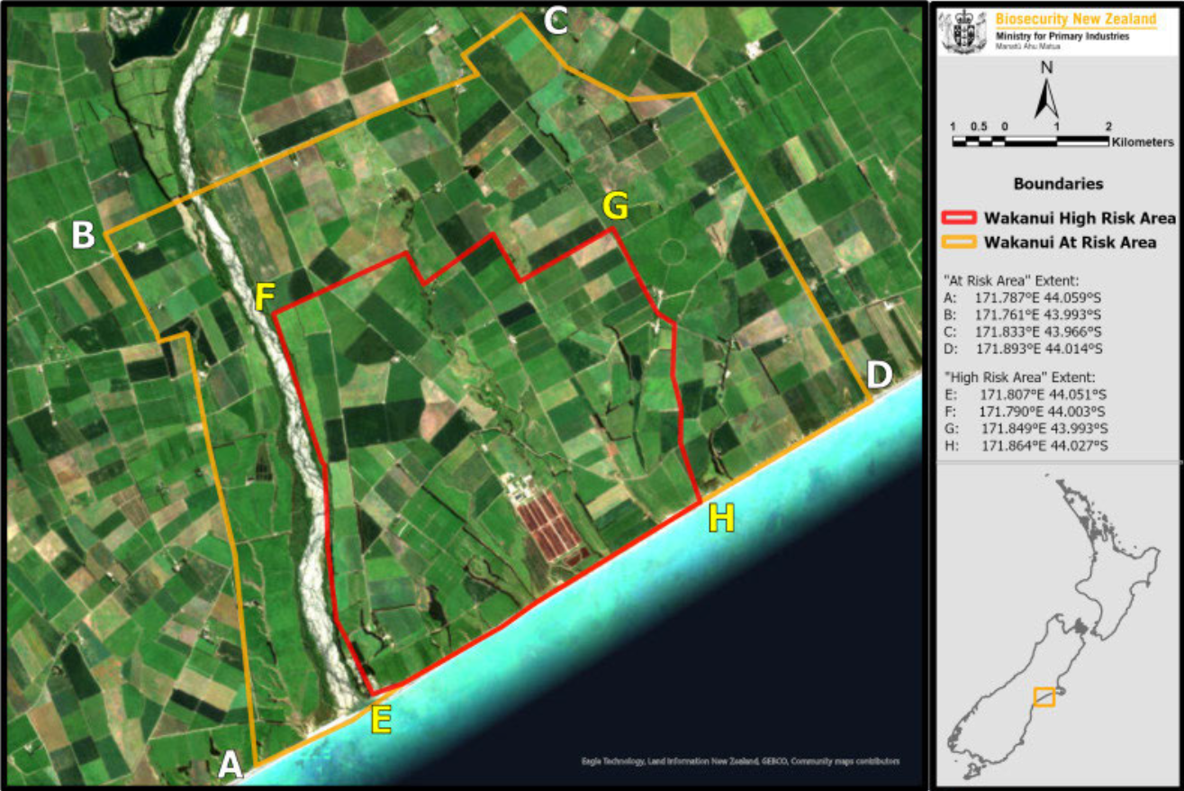
Mid 2022 Feedlot was the last premises with M. bovis when other properties in the area started to test positive
Since Sept 2022
100% of the cases in the CAN have an unknown source of infection
68% in the larger Canterbury area are unknown source
Controlled Area Notice (CAN) implemented October 2022 – removed March 17 2023
Notes:
Controlled Area October 2022
Red = ‘high risk’ 8 infected properties – grazed within 1.5 km of the feedlot
Yellow = ‘at risk’ 2 infected properties
Cluster cannot be explained by the distribution of the susceptible species

Slide 9
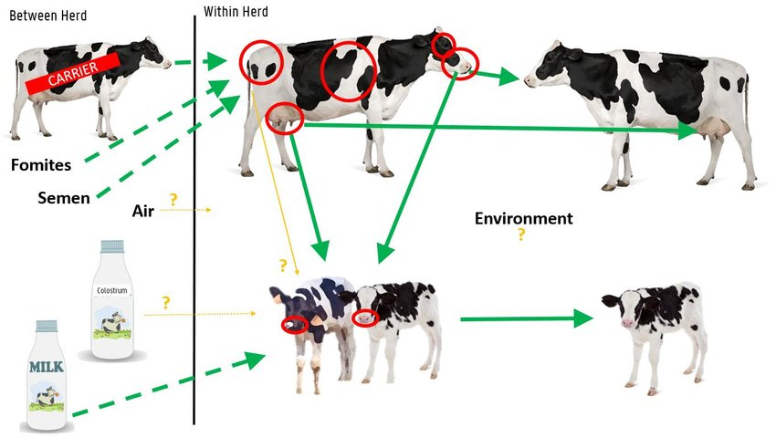
Exposure pathways examined
1. Close contact (cattle-to-cattle)
2. Ingestion of infected milk or colostrum
3. Artificial insemination and embryo transfer
4. Airborne transmission
5. Fomites (trucks, equipment, etc.)
6. Birds, insects and feral animal vectors
7. Sheep and deer
8. Manure or effluent
9. Groundwater contamination
PhD thesis Dr Linde Gille – Ghent University
Routes of transmission of Mycoplasma bovis

Slide 10
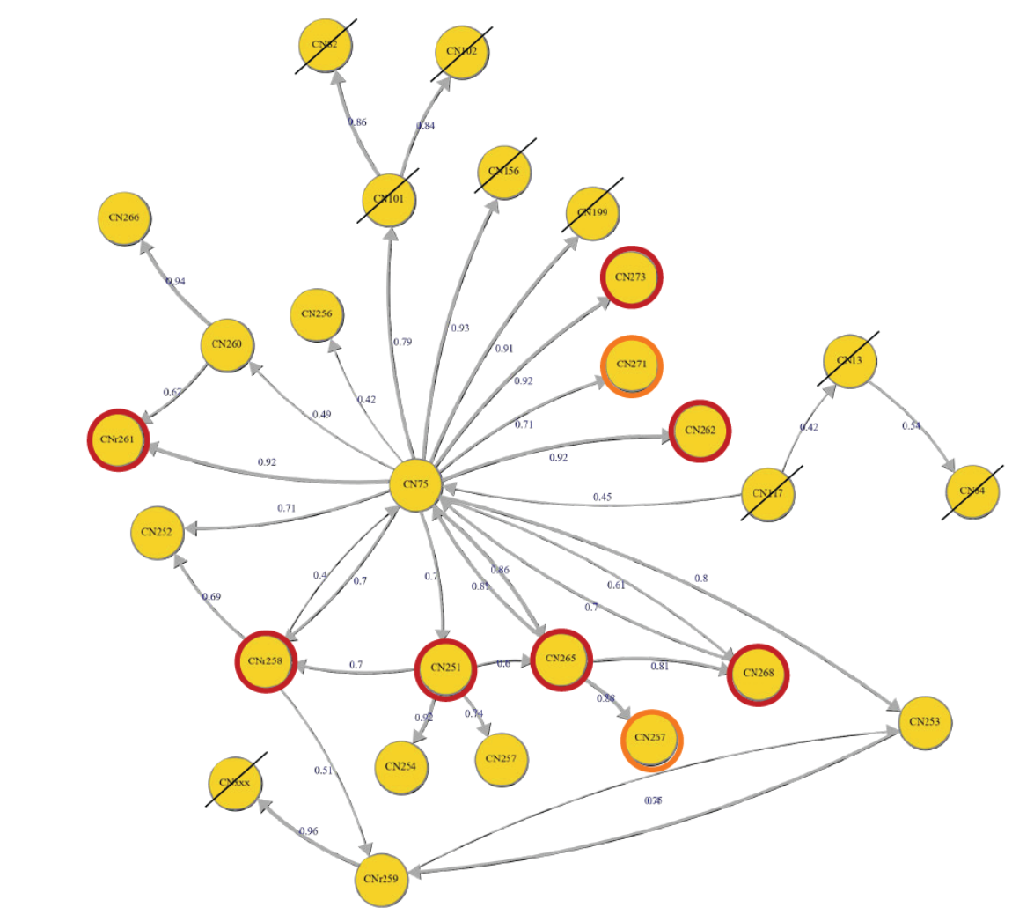
Molecular epidemiology
Data incomplete, WGS on 18 samples
Feedlot appears be source of infection for 3 farms in high risk area, and 1 in the at risk area
4 farms in high risk area have multiple sources of infection
Connections between farms within the high risk area and outside are evident

Slide 11
Conclusions
“The review has not determined the transmission routes occurring in Wakanui with any certainty, and it is possible we may never be able to categorically say what the transmission route is”
Hypothesis – the sustained high level of infection among cattle at the feedlot has created an unusually high level of shedding of M. bovis and resulted in airborne transmission to other farms
Despite:
No published reports on airborne transmission of M. bovis
Pathogen is fragile in the environment
Molecular epi demonstrates probable linkages between properties
Questions
In Canada, have we seen evidence of airborne transmission of M. bovis?
What about other agents? Situations?
How to incorporate into prevention/preparedness
Notes:
•it includes a large, concentrated and dynamic population of infected animals (the feedlot)
there is a spatial cluster of Confirmed Properties within a 5 km radius from the feedlot, most of
which have paddocks within 1.5 km of the feedlot.

Slide 12
Airborne transmission may have played a role in the spread of 2015 highly pathogenic avian influenza outbreaks in the United States | Scientific Reports (nature.com)
Abnormal bird mortality started near air intake vents
Majority of the positive cases in Iowa might have received airborne virus, carried by fine particulate matter
The modeled airborne virus concentrations never exceeded the minimal infective doses for poultry
The continuous exposure might have increased airborne infection risks.
Virus not expected to survive more than 1 day
In 2015 farms in US farms were not immediately depopulated

Slide 13
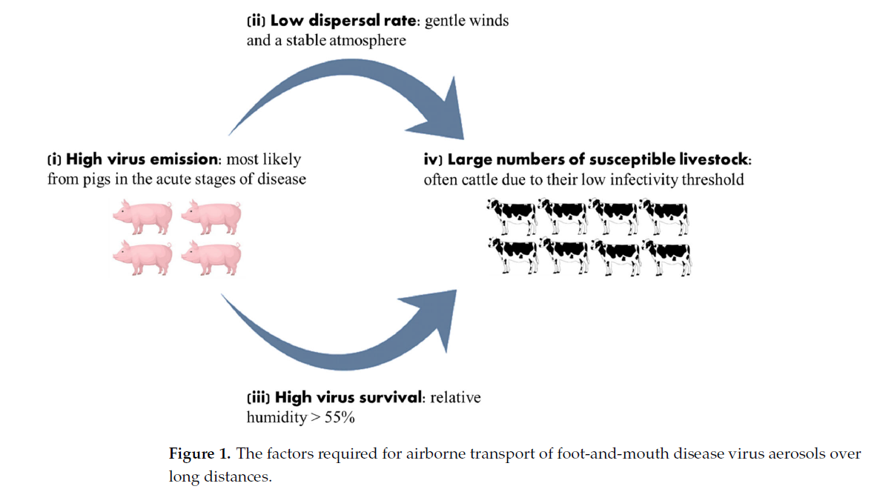
Viruses | Free Full-Text | Airborne Transmission of Foot-and-Mouth Disease Virus: A Review of Past and Present Perspectives (mdpi.com)
Notes:
In the case of FMDV, it has been calculated that at a relative humidity of 60% and a wind velocity of 10 m/s, the virus could travel over 100 km.

Slide 14
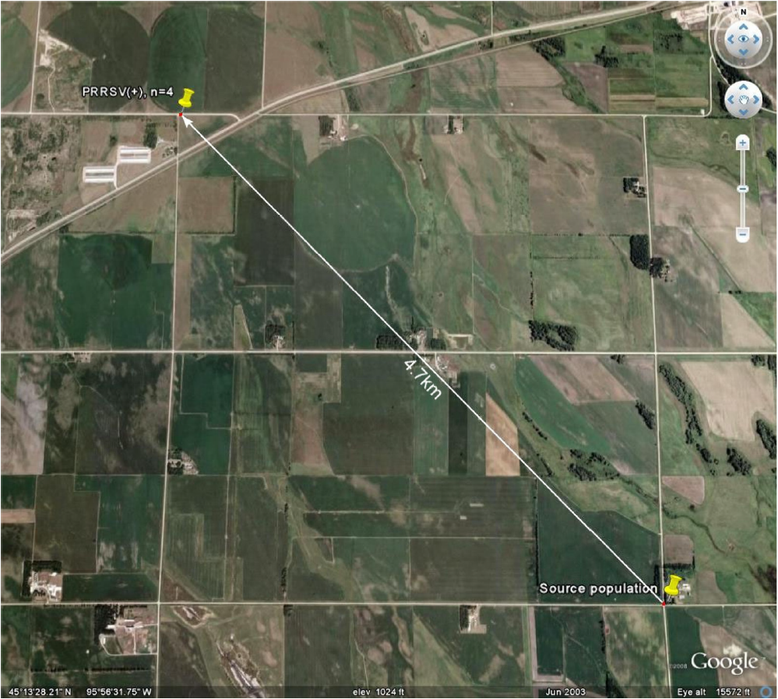
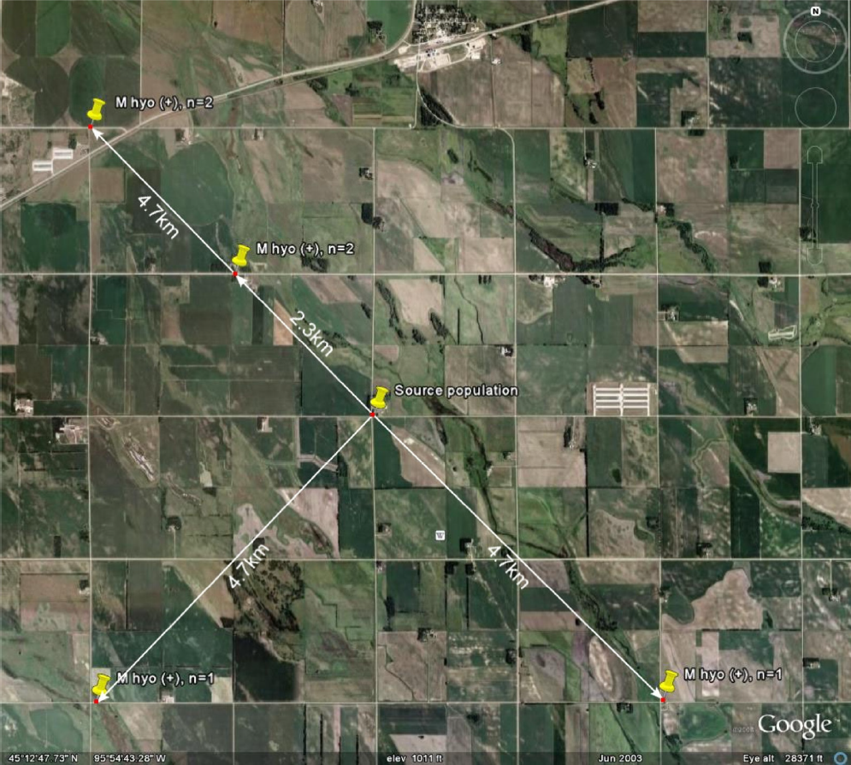
Evidence of long distance airborne transport of porcine reproductive and respiratory syndrome virus and Mycoplasma hyopneumoniae | Veterinary Research, a journal on Animal Infection (vetres.org)
PRRS Virus
Mycoplasma hyopneumonia
N.B. Viable organism recovery, not animal infection

