Slide 1

Community for Emerging and Zoonotic Diseases
Monthly Community Meeting
23 January 2025
www.cezd.ca

Slide 2
Agenda
Welcome and Updates (2 mins)
H5N1 in US Dairy Update – Dr Murray Gillies (~20+ minutes)
Development of programming to mitigate HPAI hotspot spillover risks in Lower Middle-Income Countries (Dr Brian Bedard) (~10-15 minutes)
Signals of Interest
  FMD in Germany
4. To Ping or Not to Ping

Slide 3
Updates
African swine fever | Contagious equine metritis
Anaplasma marginale | Equine infectious anaemia
Anaplasma phagocytophilum | Foot and mouth disease
Anthrax | Glanders
Aujesky's disease | Highly pathogenic avian influenza
Baylisascariasis | Lumpy skin disease
Bluetongue | Peste des petits ruminants
Bovine Cysticercosis | Porcine cysticercosis
Bovine spongiform encephalopathy | Rabbit Hemorrhagic Disease Virus
Bovine tuberculosis | Rabies
Brucella abortus | Schmallenberg virus
Brucella melitensis | Seneca Valley Virus
Brucella suis | Swine Influenza
Chronic wasting disease | Trichinosis
Classical swine fever | Vesicular stomatitis viruses
Contagious bovine pleuropneumonia | White nose syndrome
One Health Prioritization rankings ongoing slowly
  32 are ranked

Slide 4
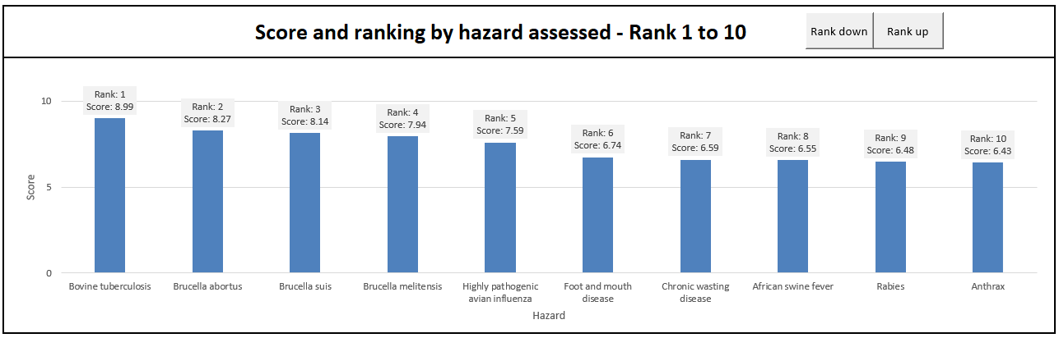
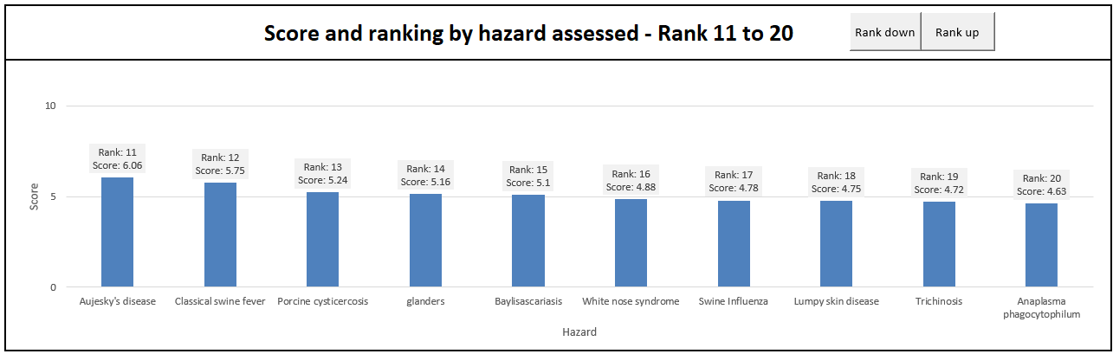

Slide 5



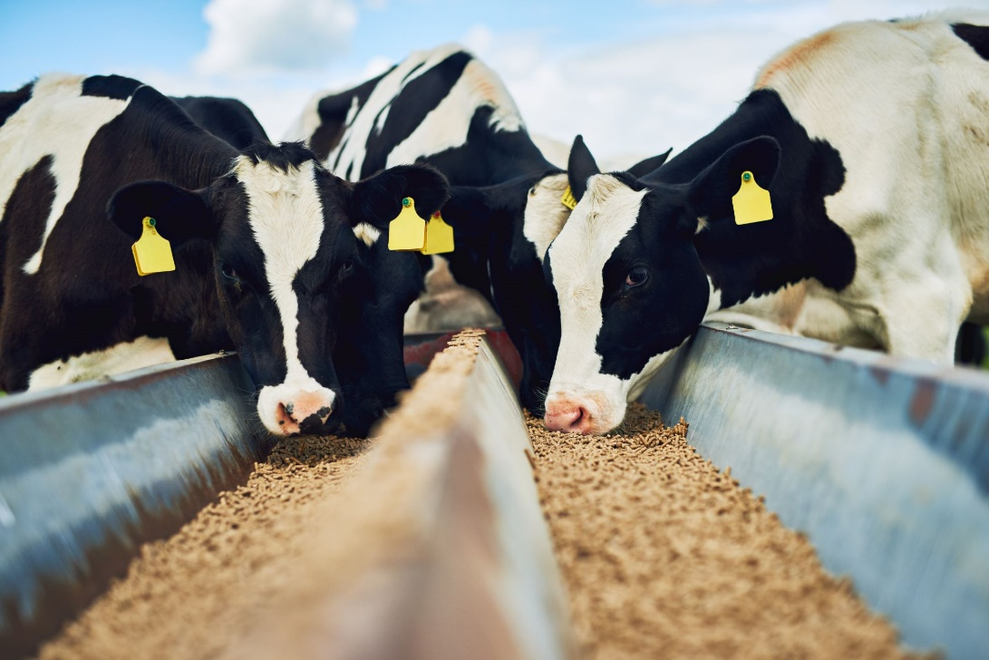
High Path Avian Influenza - Bovine update
January 23, 2025
Dr. Murray Gillies
Coordinator
Canadian Animal Health Surveillance System (CAHSS)
AABP District 12 Director

Slide 6
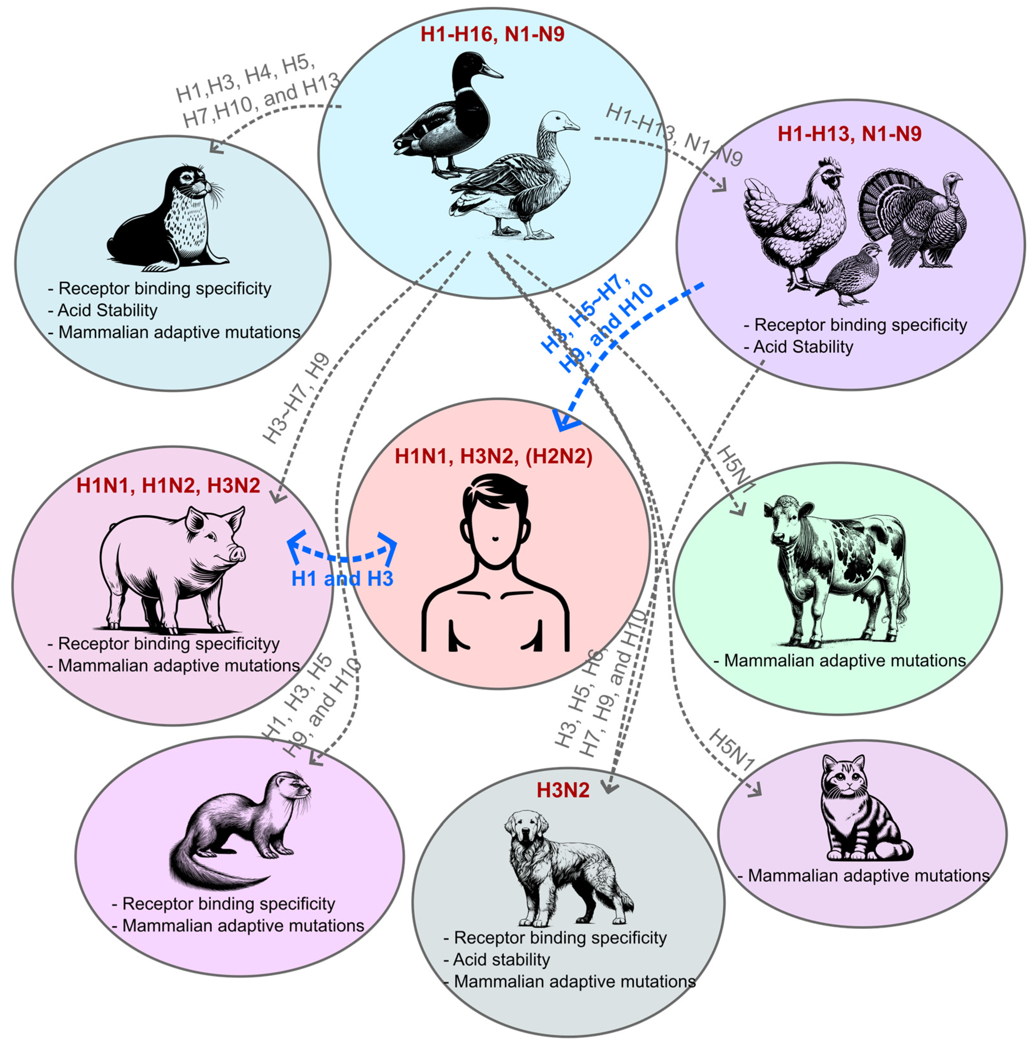
HPAI spillover hotspots in LMIC
Dr Brian Bedard
Exploring Potential Intermediates in the Cross-Species Transmission of Influenza A Virus to Humans

Slide 7

Signals of Interest

Slide 8
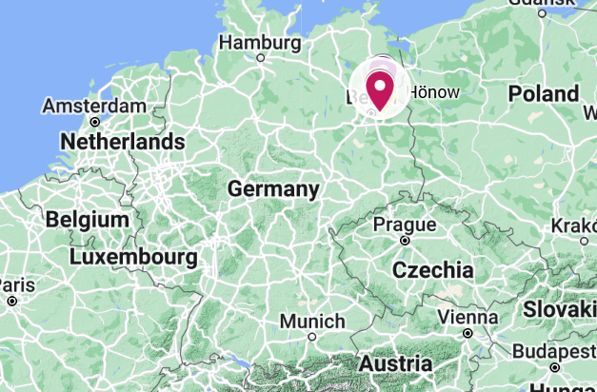
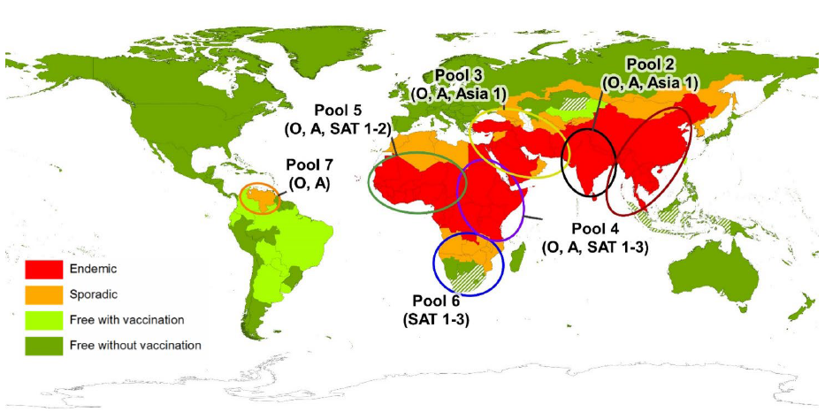
Foot and Mouth Disease in Germany
Germany has reported a case of FMD in water buffalo in Brandenburg (Jan 10)
  First occurrence since 1988
  Three buffalo have died and the rest of the herd (11) have been culled
  Identified as serotype O – vaccines available in German FMD antigen bank
  Vaccine will be made, uncertain if used
  Source of infection is still unknown
  Backyard farm “organic”, feed hay from own fields
  No trade within epidemiologically significant period
  Foot-and-mouth disease - European Commission
Global Distribution of FMD – Merck Veterinary Manual
Notes:
Germany reported an outbreak of FMD in water buffalo in Honow, outskirts of Berlin, on Friday (Jan 10th).
This is the first report of FMD in the country since 1988 (which occurred in lower saxony). And the last outbreak in Europe was reported in Bulgaria in 2011. FMD remains endemic in Turkey, the Middle East, Africa, parts of Asia and South America.
In this event - three water buffalo in Honow have died and the entire herd (remaining 11 buffalo) were culled as a precautionary measure. You can see on the map on the top right where this is in Germany.
The serotype has been identified as O – which is closely related FMD viruses are found in the Middle East and Asia, - You can see from the bottom right image the different pools for FMD worldwide and serotype O is present in all of them except for pool 6 which is in southern Africa. But the closest in proximity to Europe would be those circulating in the middle east (pool 3)
The sequence is closest to strains from Turkiye in December 2024 https://food.ec.europa.eu/animals/animal-diseases/diseases-and-control-measures/foot-and-mouth-disease_en but has also been found in India, Nepal and Iran
The exact origin and route of entry is still unknown, and it is interesting that it was detected in water buffalo and its listed as a backyard farm
But it also shows that the risk of introduction of this virus into a susceptible population can happen anytime.

Slide 9
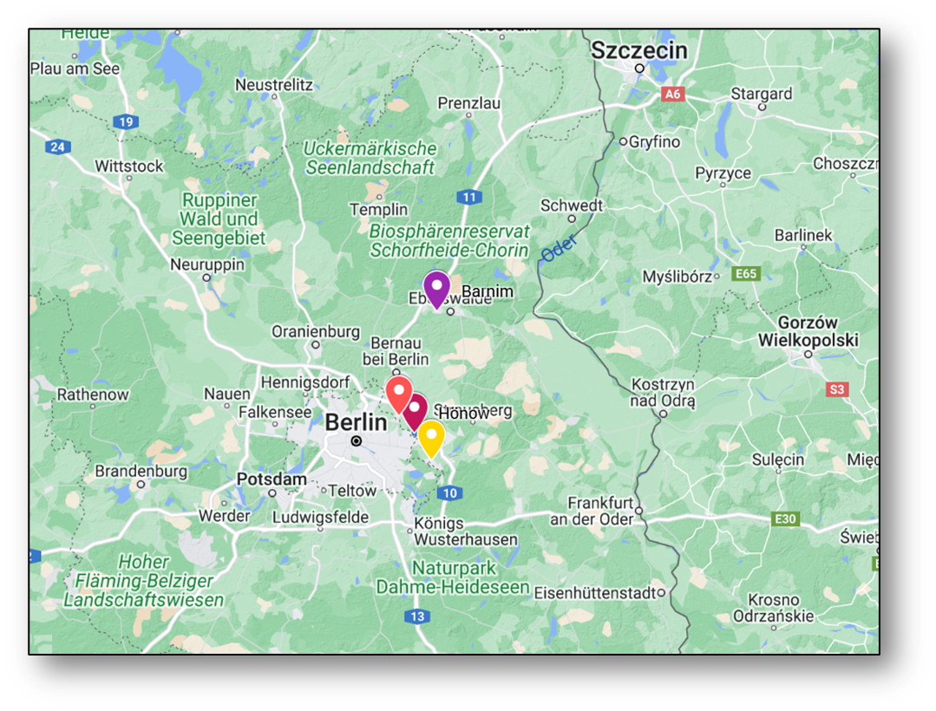
Response to date
  Immediate transportation ban (5 days)
  All susceptible livestock within a 1km radius culled
      ~200 pigs in Ahrensfelde culled, all tested negative
  3km protection zone
  10km surveillance zone
  Sampling of all establishments within the 10 km Zone is ongoing, so far results have been negative
    All clinically normal
DEFRA FMD Outbreak Assessment
Notes:
Immediate transportation ban (5 days) in Brandenburg
- all susceptible livestock within a 1km radius would be culled as a precaution and this includes a pigs farm with ~ 200 pigs in Ahrensfelde, near where the outbreak was detected.
- Additionally, 55 sheep and goats and 3 cattle from a farm in OderSpree are to be slaughtered on 13 January as the farm had obtained hay from the farm in Hönow where the outbreak occurred but none of the animals have shown signs of infection. The sampling of all establishments within the 10km Restriction Zone (RZ) is ongoing, but so far results have been negative. There is also a hunting ban in place in the restriction zone and berlins two zoo’s have closed.
- Netherlands have implemented a national ban on the movement of veal calves (unless they are going to slaughter) and a ban on visitors to veal farms because there have been more than 3,600 calves transported from Brandenburg to the Netherlands since 1 December. These calves are located on more than 125 veal calf farms spread across the Netherlands.
Re-testing of samples which tested negative for bluetongue for FMD as bluetongue can be a differential diagnosis for FMD
Protection Zone: means a zone where specific biosecurity and sanitary measures are implemented to prevent the entry of a pathogenic agent into a free country or zone from a neighbouring country or zone of a different animal health status.

Slide 10
Response to date
  55 sheep and goats and 3 cattle from a farm outside the 10 km radius slaughtered as they had purchased hay from the index site
      all clinically normal and tested negative
Goats (Barnim) with clinical signs tested negative on PCR and serology
    Foot and Mouth Disease | Friedrich-Loeffler-Institut
WAHIS
  DEFRA FMD Outbreak Assessment
Notes:
55 sheep and goats and 3 cattle from a farm in OderSpree (Yellow marker) were slaughtered on 13 January as the farm had obtained hay from the farm in Hönow where the outbreak occurred but none of the animals have shown signs of infection and have since tested negative.
- Goats in Barnim (the purple marker on the map) had clinical signs but were PCR and antibody negative

Slide 11
Response to date
  Hunting ban put in place in the 10 km zone
  Berlins zoos closed
    Tested susceptible species
  Netherlands ban on veal calves from Brandenburg
  >3,600 imported from Brandenburg since December 1) to ~120 farms – all tested
  Netherlands retesting samples tested for bluetongue, to date all negative
DEFRA FMD Outbreak Assessment – Risk to UK considered Medium
Notes:
There is also a hunting ban in place in the restriction zone and berlins two zoo’s have closed.
- Netherlands have implemented a national ban on the movement of veal calves (unless they are going to slaughter) and a ban on visitors to veal farms because there have been more than 3,600 calves transported from Brandenburg to the Netherlands since 1 December. These calves are located on more than 125 veal calf farms spread across the Netherlands.
Re-testing of samples which tested negative for bluetongue for FMD as bluetongue can be a differential diagnosis for FMD

Slide 12
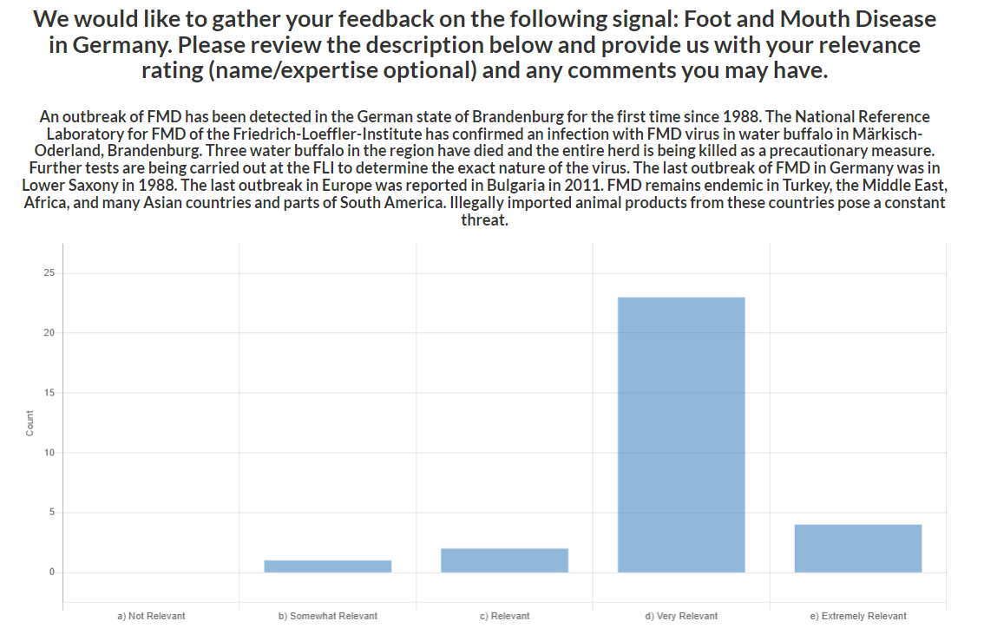
Foot and Mouth Disease in Germany
CEZD Ping Results
CFIA has issued import restrictions for commodities/products from Germany (required to maintain our free status)
Canada – FMD last reported in 1951 in Saskatchewan
  Introduction thought to have been by an immigrant through his clothes as well as by sausage
  The epidemic of foot-and-mouth disease in Saskatchewan, Canada, 1951-1952 - PMC
Notes:
Sent out a ping to the CEZD community early Friday morning and to date we’ve had 32 responses. With an average rating of very relevant.

Slide 13
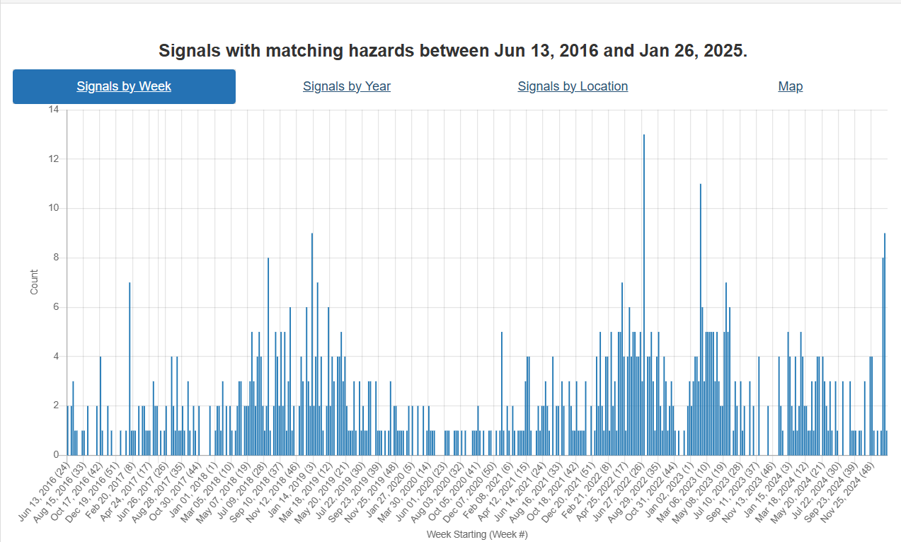
Indonesia
COVID
SAT-2
Middle East
Germany

Slide 14
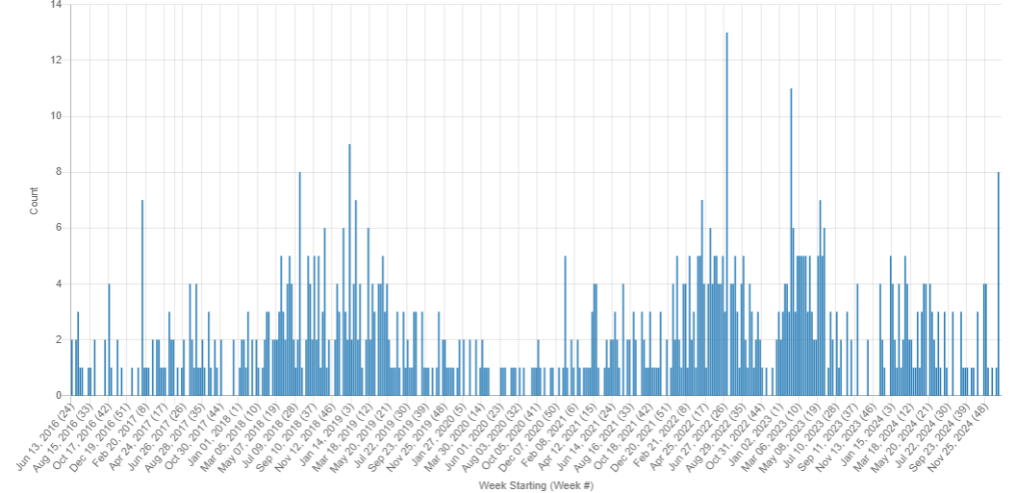
Foot and Mouth Disease
Other countries reporting FMD outbreaks: Palestine(O), Israel, Algeria (SAT-2), Libya(O), China(O), Indonesia, South Africa (SAT – 2)
FMD Indonesia
SAT – 2 Middle East
COVID
KIWI FMD Signals June 2016 - January 2025
Notes:
A few other countries have reported outbreaks of FMD over the past few months: Palestine, Israel, Algeria, Libya, China, Indonesia South Africa

Slide 15
Foot-and-mouth disease: ban on animal transport extended by 48 hours | rbb24
Transportation ban
All animals in 1 km radius culled (negative)
All animals in 10 km radius sampled (negative)
Animals outside the 10km radius, at a farm that had obtained hay from the farm with water buffalo, were culled and sampled (negative)
Berlin Zoo and petting farms temporarily closed
Employees from affected areas were “released”
All deliveries from affected areas stopped
Susceptible species in the zoo tested
Transport of Bison to Caucasus for release stopped

Slide 16
To Ping or not to Ping?
Pings have declined and Group Notifications increased
Trigger for a ping was variable ratings (doesn’t happen much now)
Items core team need community feedback on
What is community preference? To ping or not to ping?

